Slide 1

Unit I
JAYAWANTRAO SAWANT COLLEGE OF ENGINEERING, HADAPSAR, PUNE
Topic: Introduction To Machine Learning

Slide 2
What is Machine Learning
JAYAWANTRAO SAWANT COLLEGE OF ENGINEERING, HADAPSAR, PUNE
In the real world, we are surrounded by humans who can learn everything from their experiences with their learning capability.
we have computers or machines which work on our instructions. But can a machine also learn from experiences or past data like a human does?

Slide 3
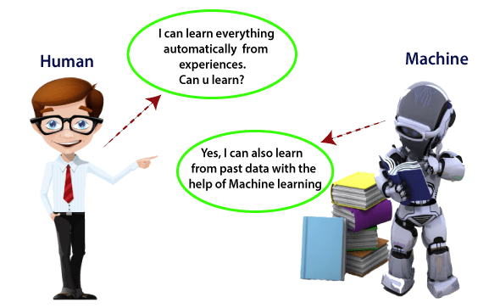
What is Machine Learning
JAYAWANTRAO SAWANT COLLEGE OF ENGINEERING, HADAPSAR, PUNE

Slide 4
Machine learning
JAYAWANTRAO SAWANT COLLEGE OF ENGINEERING, HADAPSAR, PUNE
Machine learning enables a machine to automatically learn from data, improve performance from experiences, and predict things without being explicitly programmed.
Primary aim of ML is to allow the computers to learn automatically without human interaction.
eg. Face recognition, and friend suggestion by Facebook, self-driving cars, cyber fraud detection

Slide 5
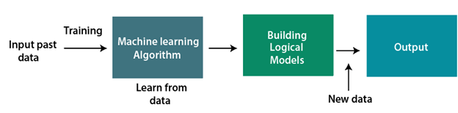
JAYAWANTRAO SAWANT COLLEGE OF ENGINEERING, HADAPSAR, PUNE
How does Machine Learning work
A Machine Learning system learns from historical data, builds the prediction models, and whenever it receives new data, predicts the output for it.
The accuracy of predicted output depends upon the amount of data.

Slide 6
JAYAWANTRAO SAWANT COLLEGE OF ENGINEERING, HADAPSAR, PUNE
Features of Machine Learning
Machine learning uses data to detect various patterns in a given dataset.
It can learn from past data and improve automatically.
Machine learning is much similar to data mining as it also deals with the huge amount of the data

Slide 7
JAYAWANTRAO SAWANT COLLEGE OF ENGINEERING, HADAPSAR, PUNE
Need for Machine Learning
The need for machine learning is increasing day by day. The reason behind the need for machine learning is that it is capable of doing tasks that are too complex for a person to implement directly.
As a human, we have some limitations as we cannot access the huge amount of data manually, so for this, we need some computer systems and here comes the machine learning to make things easy for us.
Prof .Mohini Thorat

Slide 8
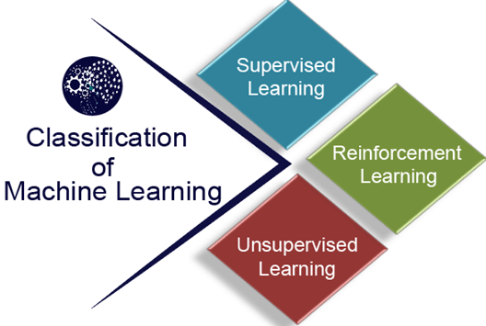
JAYAWANTRAO SAWANT COLLEGE OF ENGINEERING, HADAPSAR, PUNE
Classification of Machine Learning
At a broad level, machine learning
can be classified into three types:
Supervised learning
Unsupervised learning
Reinforcement learning

Slide 9
JAYAWANTRAO SAWANT COLLEGE OF ENGINEERING, HADAPSAR, PUNE
Supervised Learning
Supervised learning is a type of machine learning method in which we provide sample labeled data to the machine learning system in order to train it, and on that basis, it predicts the output.
The system creates a model using labeled data to understand the datasets and learn about each data, once the training and processing are done then we test the model by providing a sample data to check whether it is predicting the exact output or not.

Slide 10
JAYAWANTRAO SAWANT COLLEGE OF ENGINEERING, HADAPSAR, PUNE
Unsupervised Learning
Unsupervised learning is a learning method in which a machine learns without any supervision.
The training is provided to the machine with the set of data that has not been labeled, classified, or categorized, and the algorithm needs to act on that data without any supervision.
In unsupervised learning, we don't have a predetermined result. The machine tries to find useful insights from the huge amount of data. It can be further classifieds into two categories of algorithms:
Clustering
Association

Slide 11
JAYAWANTRAO SAWANT COLLEGE OF ENGINEERING, HADAPSAR, PUNE
Reinforcement Learning
Reinforcement learning is a feedback-based learning method, in which a learning agent gets a reward for each right action and gets a penalty for each wrong action.
The agent learns automatically with these feedbacks and improves its performance. In reinforcement learning, the agent interacts with the environment and explores it.
The robotic dog, which automatically learns the movement of his arms, is an example of Reinforcement learning.
Prof .Mohini Thorat

Slide 12
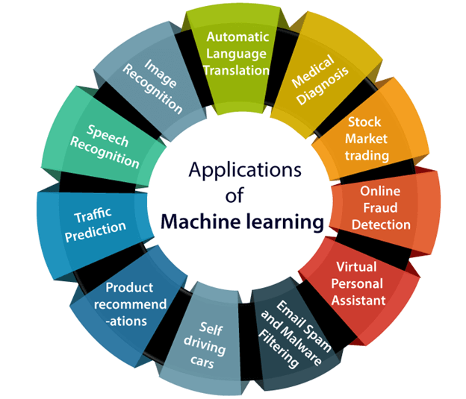
JAYAWANTRAO SAWANT COLLEGE OF ENGINEERING, HADAPSAR, PUNE
Applications of Machine learning
Union

Slide 13
JAYAWANTRAO SAWANT COLLEGE OF ENGINEERING, HADAPSAR, PUNE
Parametric model
It summarizes data with a set of parameters of fixed size, so it doesn’t matter how data is being considered for parametric model.
Examples of parametric Machine Learning Algorithm-
Logistic Regression
Linear Discriminant Analysis
Perception
Naïve Bayes
Simple neural networks.
interface
Prof .Mohini Thorat

Slide 14
JAYAWANTRAO SAWANT COLLEGE OF ENGINEERING, HADAPSAR, PUNE
Non –parametric Learning
This types of Algorithms do not make strong assumptions for mapping functions.
As these are no assumptions ,any functional form can be learnt from the training data.
This type of non-parametric learning is applicable when there is a lot of data and no prior knowledge is available.
A very common Non-parametric family is called Instance – Based learning and makes real time predictions based on hypothesis determined only by the training samples.

Slide 15
JAYAWANTRAO SAWANT COLLEGE OF ENGINEERING, HADAPSAR, PUNE
Learnability
The parametric model can be divided into two parts:
1. Static structure of parameters –
It is determined by the choice of specific algorithm and mostly immutable unless model provides some re-modelling functionalities.
2. Dynamic set of parameters-
It is the objective of optimization ,which considers n unbounded parameters ,which generates n-dimensional space.

