Slide 1

Unit V
JAYAWANTRAO SAWANT COLLEGE OF ENGINEERING, HADAPSAR, PUNE
Multithreading in Java

Slide 2
Thread
JAYAWANTRAO SAWANT COLLEGE OF ENGINEERING, HADAPSAR, PUNE
Thread is tiny Program running continuously. It is sometimes called as light weight process.

Slide 3
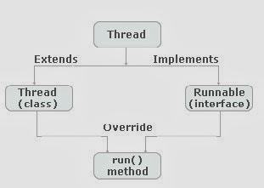
Creating Thread
JAYAWANTRAO SAWANT COLLEGE OF ENGINEERING, HADAPSAR, PUNE

Slide 4
Thread Methods
JAYAWANTRAO SAWANT COLLEGE OF ENGINEERING, HADAPSAR, PUNE
Method | Description
setName() | To change the name of the current thread.
getName() | To retrieve the name of the thread
setPriority() | To set the priority of a thread.
getPriority() | To retrieve the priority of a thread.
Thread.currentThread() | Returns the reference to the currently executing thread object
Thread.sleep() | Causes the currently executing thread to pause for a specified time in milliseconds
isAlive() | Returns a Boolean value, true if thread is alive, else false.
join() | Holds the execution of currently running thread until the specified thread has finished execution or terminated.
getState() | Returns the state of the thread.

Slide 5
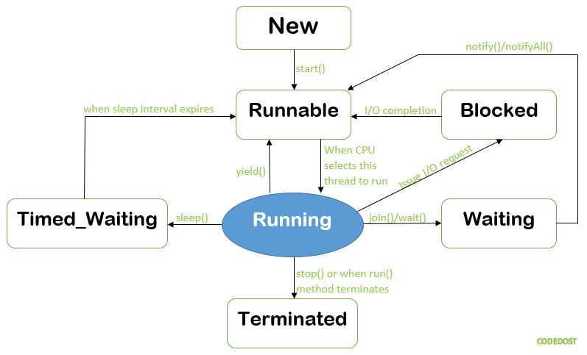
JAYAWANTRAO SAWANT COLLEGE OF ENGINEERING, HADAPSAR, PUNE
Thread Model

Slide 6
JAYAWANTRAO SAWANT COLLEGE OF ENGINEERING, HADAPSAR, PUNE
Thread Priorities
SetPriority
getPriority

Slide 7
JAYAWANTRAO SAWANT COLLEGE OF ENGINEERING, HADAPSAR, PUNE
Synchronization Messaging
Synchronization: The Process of ensuring one access at a time by one thread is called synchronization.
There are two way achieve the synchronization:
1. Using Synchronization Method
2. Using Synchronization Blocks

Slide 8
JAYAWANTRAO SAWANT COLLEGE OF ENGINEERING, HADAPSAR, PUNE
Creating Multiple Thread Methods
isAlive(): It tests if this thread is alive. A thread is alive if it has been started and has not yet died. There is a transitional period from when a thread is running to when a thread is not running. After the run() method returns, there is a short period of time before the thread stops. If we want to know if the start method of the thread has been called or if thread has been terminated, we must use isAlive() method. This method is used to find out if a thread has actually been started and has yet not terminated.

Slide 9
JAYAWANTRAO SAWANT COLLEGE OF ENGINEERING, HADAPSAR, PUNE
Sample Program isAlive()
// Java program to illustrate
// isAlive()
public class oneThread extends Thread {
public void run()
{
System.out.println("geeks ");
try {
Thread.sleep(300);
}
catch (InterruptedException ie) {
}
System.out.println("forgeeks ");
}
public static void main(String[] args)
{
oneThread c1 = new oneThread();
oneThread c2 = new oneThread();
c1.start();
c2.start();
System.out.println(c1.isAlive());
System.out.println(c2.isAlive());
}
}
Output
geeks
true
True
geeks
forgeeks
forgeeks

Slide 10
JAYAWANTRAO SAWANT COLLEGE OF ENGINEERING, HADAPSAR, PUNE
Join():When the join() method is called, the current thread will simply wait until the thread it is joining with is no longer alive. Or we can say the method that you will more commonly use to wait for a thread to finish is called join( ). This method waits until the thread on which it is called terminates. Its name comes from the concept of the calling thread waiting until the specified thread joins it. Additional forms of join( ) allow you to specify a maximum amount of time that you want to wait for the specified thread to terminate.

Slide 11
JAYAWANTRAO SAWANT COLLEGE OF ENGINEERING, HADAPSAR, PUNE
Sample Program of join()
// Java program to illustrate
public class oneThread extends Thread {
public void run()
{
System.out.println("geeks ");
try {
Thread.sleep(300);
}
catch (InterruptedException ie) {
}
System.out.println("forgeeks ");
}
public static void main(String[] args)
{
oneThread c1 = new oneThread();
oneThread c2 = new oneThread();
c1.start();
try {
c1.join(); // Waiting for c1 to finish
}
catch (InterruptedException ie) {
}
c2.start();
}
}
Output
Geeks
forgeeks
geeks
forgeeks

Slide 12
JAYAWANTRAO SAWANT COLLEGE OF ENGINEERING, HADAPSAR, PUNE
Web Application in java –
Features of JavaScript
Browser Support
Structure Programming Syntax
Dynamic Typing
Run time Evaluation
Support for object
Regular Expression
Function Programming
Union

Slide 13
JAYAWANTRAO SAWANT COLLEGE OF ENGINEERING, HADAPSAR, PUNE
JavaScript in html
The JavaScript can be directly embedded within HTML document or it can be stored as external file.
Syntax:
<script type=“text/javascript”>
--------------
-------------
</script>
D
interface

Slide 14
JAYAWANTRAO SAWANT COLLEGE OF ENGINEERING, HADAPSAR, PUNE
Example in javaScript
<!DOCTYPE html >
<html>
<head>
<title> page title</title>
<script>
document.write("Welcome to Javatpoint");
</script>
</head>
<body>
<p>Inthis example we saw how to add JavaScript in the head section </p>
</body>
</html>

Slide 15
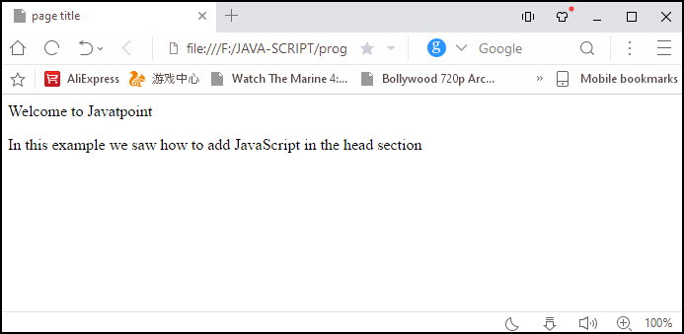
JAYAWANTRAO SAWANT COLLEGE OF ENGINEERING, HADAPSAR, PUNE
Output

Slide 16
JAYAWANTRAO SAWANT COLLEGE OF ENGINEERING, HADAPSAR, PUNE
Pop-Up-Box
One of the important features of JavaScript is its interactivity with the user.
JavaScript has three kind of popup boxes: Alert box, Confirm box, and Prompt box.
Alert Box: An alert box is often used if you want to make sure information comes through to the user.
When an alert box pops up, the user will have to click "OK" to proceed.
Syntax
window.alert("sometext");

Slide 17
JAYAWANTRAO SAWANT COLLEGE OF ENGINEERING, HADAPSAR, PUNE
Example for Alert Box
<!DOCTYPE html>
<html>
<body>
<h2>JavaScript Alert</h2>
<button onclick="myFunction()">Try it</button>
<script>
function myFunction() {
alert("I am an alert box!");
}
</script>
</body>
</html>

Slide 18
JAYAWANTRAO SAWANT COLLEGE OF ENGINEERING, HADAPSAR, PUNE
Confirm Box
A confirm box is often used if you want the user to verify or accept something.
When a confirm box pops up, the user will have to click either "OK" or "Cancel" to proceed.
If the user clicks "OK", the box returns true. If the user clicks "Cancel", the box returns false.
Syntax
window. Confirm("sometext");

Slide 19
JAYAWANTRAO SAWANT COLLEGE OF ENGINEERING, HADAPSAR, PUNE
Example for Confirm Box
<!DOCTYPE html>
<html>
<body>
<h2>JavaScript Confirm Box</h2>
<button onclick="myFunction()">Try it</button>
<p id="demo"></p>
<script>
function myFunction() {
var txt;
if (confirm("Press a button!")) {
txt = "You pressed OK!";
} else {
txt = "You pressed Cancel!";
}
document.getElementById("demo").innerHTML = txt;
}
</script>
</body>
</html>

Slide 20
JAYAWANTRAO SAWANT COLLEGE OF ENGINEERING, HADAPSAR, PUNE
Prompt Box
A prompt box is often used if you want the user to input a value before entering a page.
When a prompt box pops up, the user will have to click either "OK" or "Cancel" to proceed after entering an input value.
If the user clicks "OK" the box returns the input value. If the user clicks "Cancel" the box returns null.
Syntax
window.prompt("sometext","defaultText");

Slide 21
JAYAWANTRAO SAWANT COLLEGE OF ENGINEERING, HADAPSAR, PUNE
Example for Prompt Box
<!DOCTYPE html>
<html>
<body>
<h2>JavaScript Prompt</h2>
<button onclick="myFunction()">Try it</button>
<p id="demo"></p>
<script>
function myFunction() {
var txt;
var person = prompt("Please enter your name:", "Harry Potter");
if (person == null || person == "") {
txt = "User cancelled the prompt.";
} else {
txt = "Hello " + person + "! How are you today?";
}
document.getElementById("demo").innerHTML = txt;
}
</script>
</body>
</html>

Slide 22
JAYAWANTRAO SAWANT COLLEGE OF ENGINEERING, HADAPSAR, PUNE
Form design
Form design is atypical layout on the web page by which a user can interact with the web page.
Typical component of forms are text area, checkboxes, radio buttons and push buttons.
These components of from are called as form controls or controls.

Slide 23
JAYAWANTRAO SAWANT COLLEGE OF ENGINEERING, HADAPSAR, PUNE
Checkbox
The <input type="checkbox"> defines a checkbox.
Checkboxes let a user select ZERO or MORE options of a limited number of choices.

Slide 24
JAYAWANTRAO SAWANT COLLEGE OF ENGINEERING, HADAPSAR, PUNE
Example for checkbox
<!DOCTYPE html>
<html>
<body>
<h2>Checkboxes</h2>
<p>The <strong>input type="checkbox"</strong> defines a checkbox:</p>
<form action="/action_page.php">
<input type="checkbox" id="vehicle1" name="vehicle1" value="Bike">
<label for="vehicle1"> I have a bike</label><br>
<input type="checkbox" id="vehicle2" name="vehicle2" value="Car">
<label for="vehicle2"> I have a car</label><br>
<input type="checkbox" id="vehicle3" name="vehicle3" value="Boat">
<label for="vehicle3"> I have a boat</label><br><br>
<input type="submit" value="Submit">
</form>
</body>
</html>

Slide 25
JAYAWANTRAO SAWANT COLLEGE OF ENGINEERING, HADAPSAR, PUNE
Radio Buttons
The <input type="radio"> defines a radio button.
Radio buttons let a user select ONE of a limited number of choices.

Slide 26
JAYAWANTRAO SAWANT COLLEGE OF ENGINEERING, HADAPSAR, PUNE
Example for radio button
<!DOCTYPE html>
<html>
<body>
<h2>Radio Buttons</h2>
<form>
<input type="radio" id="male" name="gender" value="male">
<label for="male">Male</label><br>
<input type="radio" id="female" name="gender" value="female">
<label for="female">Female</label><br>
<input type="radio" id="other" name="gender" value="other">
<label for="other">Other</label>
</form>
</body>
</html>

Slide 27
JAYAWANTRAO SAWANT COLLEGE OF ENGINEERING, HADAPSAR, PUNE
Select Element
The <select> element defines a drop-down list.
Example for Select Element
<!DOCTYPE html>
<html>
<body>
<h2>The select Element</h2>
<p>The select element defines a drop-down list:</p>
<form action="/action_page.php">
<label for="cars">Choose a car:</label>
<select id="cars" name="cars">
<option value="volvo">Volvo</option>
<option value="saab">Saab</option>
<option value="fiat">Fiat</option>
<option value="audi">Audi</option>
</select>
<input type="submit">
</form>
</body>
</html>

Slide 28
JAYAWANTRAO SAWANT COLLEGE OF ENGINEERING, HADAPSAR, PUNE
Write a form to make login and password
<!DOCTYPE html>
<html>
<head>
<meta name="viewport" content="width=device-width, initial-scale=1">
<title> Login Page </title>
<style>
</style>
</head>
<body>
<center> <h1> Student Login Form </h1> </center>
<form>
<div class="container">
<label>Username : </label>
<input type="text" placeholder="Enter Username" name="username" required>
<label>Password : </label>
<input type="password" placeholder="Enter Password" name="password" required>
<button type="submit">Login</button>
<input type="checkbox" checked="checked"> Remember me
<button type="button" class="cancelbtn"> Cancel</button>
Forgot <a href="#"> password? </a>
</div>
</form>
</body>
</html>

Slide 29
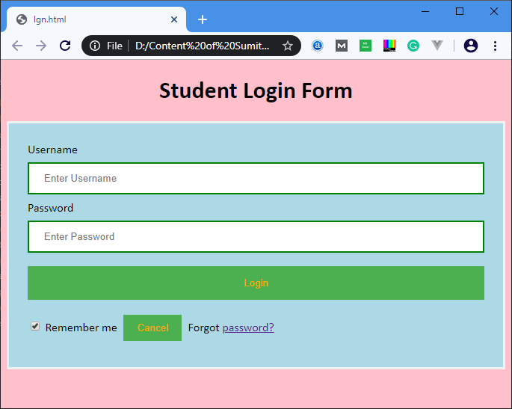
JAYAWANTRAO SAWANT COLLEGE OF ENGINEERING, HADAPSAR, PUNE
Output

Slide 30
JAYAWANTRAO SAWANT COLLEGE OF ENGINEERING, HADAPSAR, PUNE
Introduction to JavaScript Framework
AngularJS
Angular JS is a powerful javaScript framework.
It is an open source front-end enabled web application framework.
It is licensed under apache license version 2.0
It extends HTML DOM with additional attributes. It is more responsive to user actions.

Slide 31
JAYAWANTRAO SAWANT COLLEGE OF ENGINEERING, HADAPSAR, PUNE
Advantages
Built by Google Engineers
MVC Support
Intuitive
Comprehensive
Rich Features
Unit testing
Reusable code
Less code

Slide 32
JAYAWANTRAO SAWANT COLLEGE OF ENGINEERING, HADAPSAR, PUNE
Disadvantages
As Angular JS is based on JavaScript framework, it is not secure.
There are multiple ways to do the same thing with Angular JS. Sometimes, it can be hard for novices to say which way is better for a task.

Slide 33
JAYAWANTRAO SAWANT COLLEGE OF ENGINEERING, HADAPSAR, PUNE
Features
Data Binding
Scope
Controller
Directives
Filters
Routing
Services
Dependency Injection

Slide 34
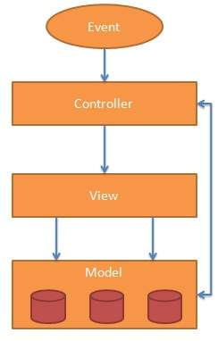
JAYAWANTRAO SAWANT COLLEGE OF ENGINEERING, HADAPSAR, PUNE
MVC Architecture

Slide 35
JAYAWANTRAO SAWANT COLLEGE OF ENGINEERING, HADAPSAR, PUNE
Directives
ng-app
ng-model
ng-bind

Slide 36
JAYAWANTRAO SAWANT COLLEGE OF ENGINEERING, HADAPSAR, PUNE
ReactJS
React.js is a Open Sourrce Javascript Library developed by Facebook. React.js is a front end (UI) library that facilitate the creation of rich internet applications (RIA). React.js gives way to create interactive, stateful & reusable UI components.

Slide 37
JAYAWANTRAO SAWANT COLLEGE OF ENGINEERING, HADAPSAR, PUNE
Features of ReactJS
Virtual DOM
Components
JSX
One way Data Binding

Slide 38
JAYAWANTRAO SAWANT COLLEGE OF ENGINEERING, HADAPSAR, PUNE
VeuJS
VueJS is a progressive JavaScript framework used to develop interactive web interfaces. Focus is more on the view part, which is the front end. It is very easy to integrate with other projects and libraries. The installation of VueJS is fairly simple, and beginners can easily understand and start building their own user interfaces. The content is divided into various chapters that contain related topics with simple and useful examples.

Slide 39
JAYAWANTRAO SAWANT COLLEGE OF ENGINEERING, HADAPSAR, PUNE
Features of VeuJS
Components
Event handling
Data binding
Animation
Computed Properties
Light weight and efficient

