Slide 1

Unit IV
JAYAWANTRAO SAWANT COLLEGE OF ENGINEERING, HADAPSAR, PUNE
Inheritance, Package and Exception Handling using Java

Slide 2

Inheritance
JAYAWANTRAO SAWANT COLLEGE OF ENGINEERING, HADAPSAR, PUNE

Slide 3
Inheritance
JAYAWANTRAO SAWANT COLLEGE OF ENGINEERING, HADAPSAR, PUNE
one class acquires the properties (methods and fields) of another. With the use of inheritance the information is made manageable in a hierarchical order.
The class which inherits the properties of other is known as subclass (derived class, child class) and the class whose properties are inherited is known as superclass (base class, parent class)

Slide 4
extends keyword
JAYAWANTRAO SAWANT COLLEGE OF ENGINEERING, HADAPSAR, PUNE
extends is the keyword used to inherit the properties of a class.
Following is the syntax of extends keyword.
class B extends A
{
}

Slide 5
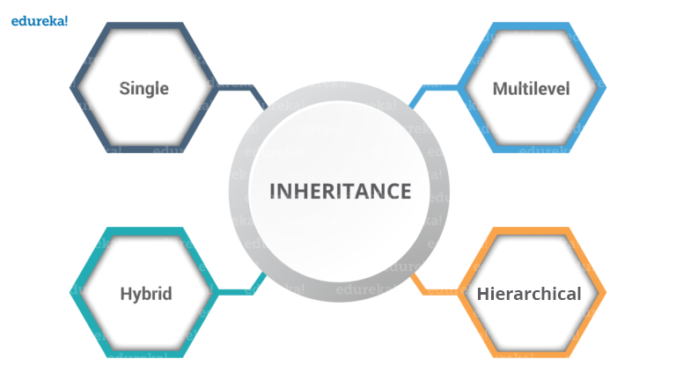
JAYAWANTRAO SAWANT COLLEGE OF ENGINEERING, HADAPSAR, PUNE
TyPes of Inheritance

Slide 6
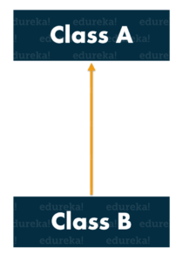
JAYAWANTRAO SAWANT COLLEGE OF ENGINEERING, HADAPSAR, PUNE
single inheritance....
single inheritance, one class inherits the properties of another.
It enables a derived class to inherit the properties and behavior from a single parent class. this will, in turn, enable code reusability as well as add new features to the existing code.

Slide 7
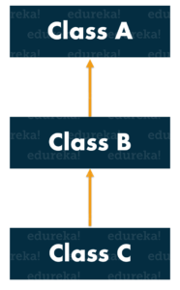
JAYAWANTRAO SAWANT COLLEGE OF ENGINEERING, HADAPSAR, PUNE
Multilevel Inheritance...
A class is derived from a class which is also derived from another class, i.e. a class having more than one parent class but at different levels, such type of inheritance is called Multilevel Inheritance.
In this case class C implicitly inherits the properties and methods of class A along with Class B. That’s what is multilevel inheritance.

Slide 8
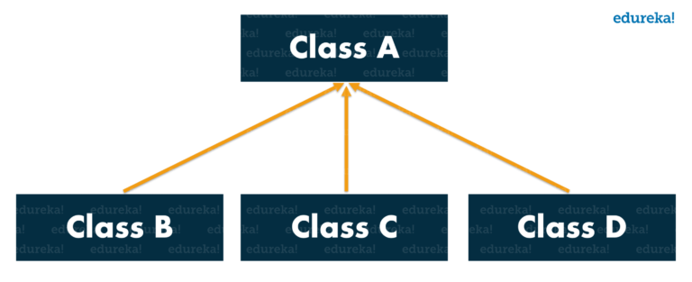
JAYAWANTRAO SAWANT COLLEGE OF ENGINEERING, HADAPSAR, PUNE
Hierarchical Inheritance
When a class has more than one child classes (subclasses) or in other words, more than one child classes have the same parent class, then such kind of inheritance is known as Hierarchical Inheritance .
Here class A has three child classes are sharing all properties of A. moreover Class B,C,D. has it own Property as well

Slide 9
JAYAWANTRAO SAWANT COLLEGE OF ENGINEERING, HADAPSAR, PUNE
Super Keyword in Java
The super keyword in Java is a reference variable which is used to refer immediate parent class object.
Whenever you create the instance of subclass, an instance of parent class is created implicitly which is referred by super reference variable.

Slide 10
JAYAWANTRAO SAWANT COLLEGE OF ENGINEERING, HADAPSAR, PUNE
super can be used to refer immediate parent class instance variable.
super can be used to invoke immediate parent class method.
super() can be used to invoke immediate parent class constructor.

Slide 11
JAYAWANTRAO SAWANT COLLEGE OF ENGINEERING, HADAPSAR, PUNE
super can be used to refer immediate parent class instance variable:
class Animal
{
String color="white";
}
class Dog extends Animal
{
String color="black";
void printColor()
{
System.out.println(color);//prints color of Dog class
System.out.println(super.color);//prints color of Animal class
}
}
class TestSuper1
{
public static void main(String args[])
{
Dog d=new Dog();
d.printColor(); }
}

Slide 12
JAYAWANTRAO SAWANT COLLEGE OF ENGINEERING, HADAPSAR, PUNE
Method Overriding
In a class hierarchy, when a method in a subclass has the same name and type signature as a method in its superclass, then the method in the subclass is said to override the method in the superclass
Union

Slide 13
JAYAWANTRAO SAWANT COLLEGE OF ENGINEERING, HADAPSAR, PUNE
Method Overriding
If subclass (child class) has the same method as declared in the parent class, it is known as method overriding.
In other words, If subclass provides the specific implementation of the method that has been provided by one of its parent class, it is known as Method Overriding.
D
interface

Slide 14
JAYAWANTRAO SAWANT COLLEGE OF ENGINEERING, HADAPSAR, PUNE
Method Overriding
Advantage of Java Method Overriding
provide specific implementation of a method that is already provided by its super class.
Rules for Method Overriding
method must have same name as in the parent class
method must have same parameter as in the parent class.
must be IS-A relationship (inheritance).

Slide 15
JAYAWANTRAO SAWANT COLLEGE OF ENGINEERING, HADAPSAR, PUNE
Example of method overriding
class Vehicle
{
void run()
{
System.out.println("Vehicle is running");
}
}
class Bike extends Vehicle
{
void run()
{
System.out.println("Bike is running safely");
}
public static void main(String args[])
{
Bike obj = new Bike();
obj.run();
}
}

Slide 16
JAYAWANTRAO SAWANT COLLEGE OF ENGINEERING, HADAPSAR, PUNE
Method Overloading | Method Overriding
1) Method overloading is used to increase the readability of the program. | Method overriding is used to provide the specific implementation of the method that is already provided by its super class.
2) method overloading is performed within a class. | Method overriding occurs in two classes that have IS-A relationship.
3) In case of method overloading parameter must be different. | In case of method overriding parameter must be same.

Slide 17
JAYAWANTRAO SAWANT COLLEGE OF ENGINEERING, HADAPSAR, PUNE
Dynamic method dispatch
Dynamic method dispatch allows Java to support overriding of a method, which is central for run-time polymorphism.
It allows a class to specify methods that will be common to all of its derivatives while allowing subclasses to define the specific implementation of some or all of those methods.
It also allows subclasses to add its specific methods subclasses to define the specific implementation of some.

Slide 18
JAYAWANTRAO SAWANT COLLEGE OF ENGINEERING, HADAPSAR, PUNE
Abstract class in Java
A class which is declared as abstract is known as an abstract class. It can have abstract and non-abstract methods. It needs to be extended and its method implemented. It cannot be instantiated.
A Java abstract class is a class which cannot be instantiated, meaning you cannot create new instances of an abstract class. The purpose of an abstract class is to function as a base for subclasses.

Slide 19
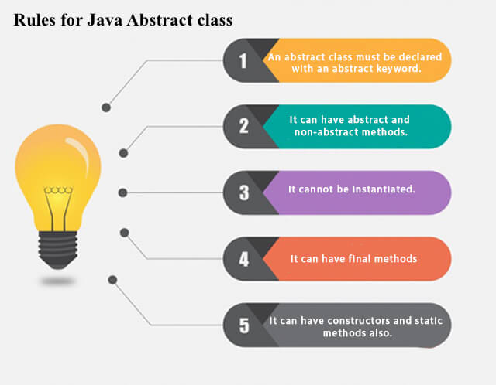
JAYAWANTRAO SAWANT COLLEGE OF ENGINEERING, HADAPSAR, PUNE
abstract class
An abstract class must be declared with an abstract keyword.
It can have abstract and non-abstract methods.
It cannot be instantiated.
It can have constructors and static methods also.
It can have final methods which will force the subclass not to change the body of the method.

Slide 20
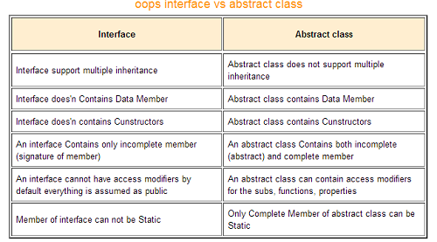
JAYAWANTRAO SAWANT COLLEGE OF ENGINEERING, HADAPSAR, PUNE

Slide 21
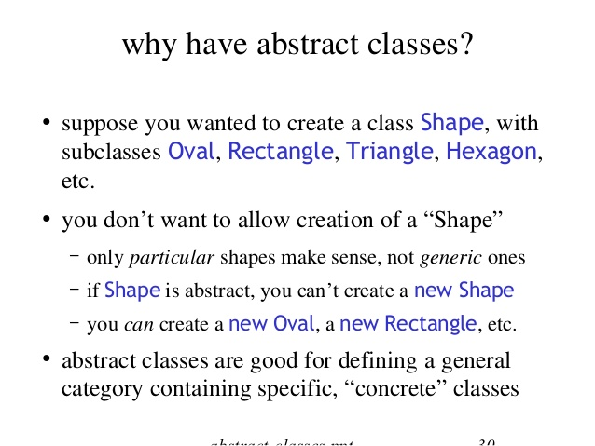
JAYAWANTRAO SAWANT COLLEGE OF ENGINEERING, HADAPSAR, PUNE

Slide 22
JAYAWANTRAO SAWANT COLLEGE OF ENGINEERING, HADAPSAR, PUNE
Object class in Java
The Object class is the parent class of all the classes in java by default. In other words, it is the topmost class of java.
The Object class is beneficial if you want to refer any object whose type you don't know. Notice that parent class reference variable can refer the child class object, know as upcasting.
Let's take an example, there is getObject() method that returns an object but it can be of any type like Employee,Student etc, we can use Object class reference to refer that object. For example:

Slide 23
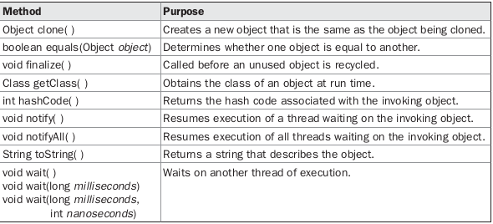
JAYAWANTRAO SAWANT COLLEGE OF ENGINEERING, HADAPSAR, PUNE

Slide 24
JAYAWANTRAO SAWANT COLLEGE OF ENGINEERING, HADAPSAR, PUNE
Package
A java package is a group of similar types of classes, interfaces and sub-packages.
Some of the existing packages in Java are
java.io − classes for input , output functions are bundled in this package
−java.lang − bundles the fundamental classes

Slide 25
JAYAWANTRAO SAWANT COLLEGE OF ENGINEERING, HADAPSAR, PUNE
Advantage of Java Package
Java package is used to categorize the classes and interfaces so that they can be easily maintained.
Java package provides access protection.
Java package removes naming collision.
package MyPackage; (syntax)

Slide 26
JAYAWANTRAO SAWANT COLLEGE OF ENGINEERING, HADAPSAR, PUNE
Interface in Java
An interface in Java is a blueprint of a class. It has static constants and abstract methods.
The interface in Java is a mechanism to achieve abstraction. There can be only abstract methods in the Java interface, not method body. It is used to achieve abstraction and multiple inheritance in Java.
In other words, you can say that interfaces can have abstract methods and variables. It cannot have a method body.

Slide 27
JAYAWANTRAO SAWANT COLLEGE OF ENGINEERING, HADAPSAR, PUNE
Why use Java interface?
There are mainly three reasons to use interface. They are given below.
It is used to achieve abstraction.
By interface, we can support the functionality of multiple inheritance.
It can be used to achieve loose coupling.

Slide 28
JAYAWANTRAO SAWANT COLLEGE OF ENGINEERING, HADAPSAR, PUNE
interface printable{
void print();
}
class A6 implements printable{
public void print(){System.out.println("Hello");}
public static void main(String args[]){
A6 obj = new A6();
obj.print();
}
}

Slide 29
JAYAWANTRAO SAWANT COLLEGE OF ENGINEERING, HADAPSAR, PUNE
Multiple inheritance in Java by interface
interface Printable{
void print();
}
interface Showable{
void show();
}
class A7 implements Printable,Showable{
public void print(){System.out.println("Hello");}
public void show(){System.out.println("Welcome");}
public static void main(String args[]){
A7 obj = new A7();
obj.print();
obj.show();
}
}

Slide 30
JAYAWANTRAO SAWANT COLLEGE OF ENGINEERING, HADAPSAR, PUNE
Nesting Applying
An interface, i.e., declared within another interface or class, is known as a nested interface. The nested interfaces are used to group related interfaces so that they can be easy to maintain. The nested interface must be referred to by the outer interface or class. It can't be accessed directly.
Points to remember for nested interfaces:
There are given some points that should be remembered by the java programmer.
The nested interface must be public if it is declared inside the interface, but it can have any access modifier if declared within the class.
Nested interfaces are declared static

Slide 31
JAYAWANTRAO SAWANT COLLEGE OF ENGINEERING, HADAPSAR, PUNE
Nesting Applying
Syntax of nested interface which is declared within the interface:
interface interface_name{
...
interface nested_interface_name{
...
}
}
Syntax of nested interface which is declared within the class:
class class_name{
...
interface nested_interface_name{
...
}
}

Slide 32
JAYAWANTRAO SAWANT COLLEGE OF ENGINEERING, HADAPSAR, PUNE
Nesting Applying
interface Showable{
void show();
interface Message{
void msg();
}
}
class TestNestedInterface1 implements Showable.Message{
public void msg(){System.out.println("Hello nested interface");}
public static void main(String args[]){
Showable.Message message=new TestNestedInterface1();//upcasting here
message.msg();
}
}

Slide 33
JAYAWANTRAO SAWANT COLLEGE OF ENGINEERING, HADAPSAR, PUNE
variable in an interface
The variable in an interface is public, static, and final by default.
If any variable in an interface is defined without public, static, and final keywords then, the compiler automatically adds the same.
No access modifier is allowed except the public for interface variables.
Every variable of an interface must be initialized in the interface itself.
The class that implements an interface can not modify the interface variable, but it may use as it defined in the interface.

Slide 34
JAYAWANTRAO SAWANT COLLEGE OF ENGINEERING, HADAPSAR, PUNE
variable in an interface
Template :
interface interfaceName{ // Any number of final, static variables
datatype variableName = value; // Any number of abstract method declarations
returntype methodName(list of parameters or no parameters); }

Slide 35
JAYAWANTRAO SAWANT COLLEGE OF ENGINEERING, HADAPSAR, PUNE
extend Interfaces
When one interface inherits from another interface, that sub-interface inherits all the methods and constants that its super interface declared.
In addition, it can also declare new abstract methods and constants.
To extend an interface, you use the extends keyword just as you do in the class definition. Unlike a subclass which can directly extend only one subclass, an interface can directly extend multiple interfaces.
This can be done using the following syntax
[public] interface InterfaceName
extends interfacel[, interface2, , interfaceN]
{//interface body}

Slide 36
JAYAWANTRAO SAWANT COLLEGE OF ENGINEERING, HADAPSAR, PUNE
extend Interfaces
S.No. | Extends | Implements
1. | By using “extends” keyword a class can inherit another class, or an interface can inherit other interfaces | By using “implements” keyword a class can implement an interface
2. | It is not compulsory that subclass that extends a superclass override all the methods in a superclass. | It is compulsory that class implementing an interface has to implement all the methods of that interface.
3. | Only one superclass can be extended by a class. | A class can implement any number of an interface at a time
4. | Any number of interfaces can be extended by interface. | An interface can never implement any other interface

Slide 37
JAYAWANTRAO SAWANT COLLEGE OF ENGINEERING, HADAPSAR, PUNE
instanceof operator
The java instanceof operator is used to test whether the object is an instance of the specified type (class or subclass or interface).
The instanceof in java is also known as type comparison operator because it compares the instance with type. It returns either true or false. If we apply the instanceof operator with any variable that has null value, it returns false.
class Simple1{
public static void main(String args[]){
Simple1 s=new Simple1();
System.out.println(s instanceof Simple1);//true
}
}
Output:true

Slide 38
JAYAWANTRAO SAWANT COLLEGE OF ENGINEERING, HADAPSAR, PUNE
Difference Between Class and Interface
S. No. | Class | Interface
1. | In class, you can instantiate variables and create an object. | In an interface, you can’t instantiate variables and create an object.
2. | Class can contain concrete(with implementation) methods | The interface cannot contain concrete(with implementation) methods
3. | The access specifiers used with classes are private, protected, and public. | In Interface only one specifier is used- Public.

Slide 39
JAYAWANTRAO SAWANT COLLEGE OF ENGINEERING, HADAPSAR, PUNE
Exceptions Handling
An Exception is a condition that is caused by a run – time error in the program.
When JAVA interpreter encounters an error, it creates an Exception object and throws it.
if the exception object is not caught and handled properly, the interpreter will display an error message and will terminate the program.
if the programmer want the program to continue with execution of the remaining code, then the programmer should try to catch the exception object thrown by the error condition and then display an appropriate message for taking corrective actions. This task is known as Exception Handling.

Slide 40
JAYAWANTRAO SAWANT COLLEGE OF ENGINEERING, HADAPSAR, PUNE
Exception Handling
The purpose of Exception Handling mechanism is to provide a means to detect and report an “Exception Circumstance” so that appropriate action can be taken. Exception Handling performs the following tasks
Find the problem (HIT the exception).
Inform that an error has occurred (THROW the exception).
Receive the error information (CATCH the exception).
Take corrective actions (HANDLE the exception).
The exception handling code basically consists of two segments. One to detect error and to throw exceptions and the other to catch exception and to take appropriate actions.

Slide 41
JAYAWANTRAO SAWANT COLLEGE OF ENGINEERING, HADAPSAR, PUNE
Exception Handling
An exception can occur for many different reasons. Following are some scenarios where an exception occurs.
A user has entered an invalid data.
A file that needs to be opened cannot be found.
A network connection has been lost in the middle of communications or the JVM has run out of memory.

Slide 42
JAYAWANTRAO SAWANT COLLEGE OF ENGINEERING, HADAPSAR, PUNE
Exception Handling
All exception types are subclasses of the built-in class Throwable
The java.lang.Throwable class is the root class of Java Exception hierarchy which is inherited by two subclasses: Exception and Error. A hierarchy of Java Exception classes are given below:

Slide 43
JAYAWANTRAO SAWANT COLLEGE OF ENGINEERING, HADAPSAR, PUNE
Exception types
Exceptions can be categorized into two ways:
Built-in Exceptions
Checked Exception
Unchecked Exception
User-Defined Exceptions

Slide 44
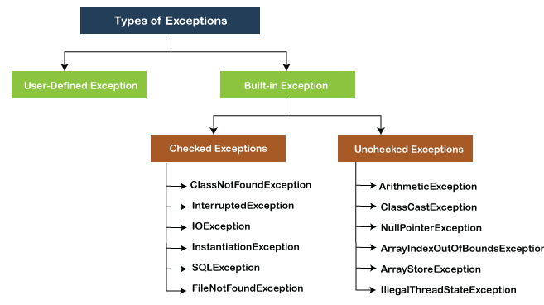
JAYAWANTRAO SAWANT COLLEGE OF ENGINEERING, HADAPSAR, PUNE
Exception types

Slide 45
JAYAWANTRAO SAWANT COLLEGE OF ENGINEERING, HADAPSAR, PUNE
Exception types
Checked exceptions:
Checked exceptions are called compile-time exceptions because these exceptions are checked at compile-time by the compiler. The compiler ensures whether the programmer handles the exception or not. The programmer should have to handle the exception; otherwise, the system has shown a compilation error.
List of common checked exceptions in Java

Slide 46
JAYAWANTRAO SAWANT COLLEGE OF ENGINEERING, HADAPSAR, PUNE
List of common checked exceptions in Java
Exception class | Description
IOException | This exception is raised when an input/output operation fails
SQLException | This exception is raised when a database operation fails
ClassNotFoundException | This exception is raised when a class cannot be found.
InstantiationException | This exception is raised when an object cannot be instantiated.
NoSuchMethodException | This exception is raised when a method cannot be found.

Slide 47
JAYAWANTRAO SAWANT COLLEGE OF ENGINEERING, HADAPSAR, PUNE
Unchecked exceptions in Java
The unchecked exceptions are just opposite to the checked exceptions.
The compiler will not check these exceptions at compile time.
In simple words, if a program throws an unchecked exception, and even if we didn't handle or declare it, the program would not give a compilation error.
Usually, it occurs when the user provides bad data during the interaction with the program.

Slide 48
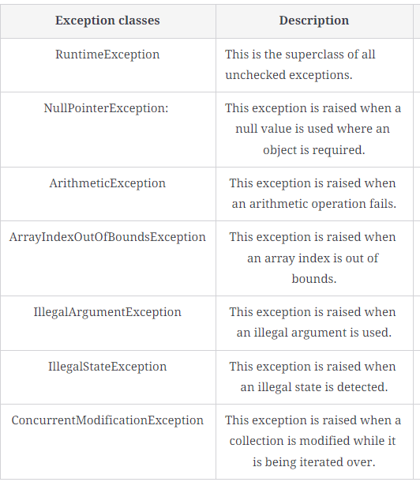
JAYAWANTRAO SAWANT COLLEGE OF ENGINEERING, HADAPSAR, PUNE
Unchecked exceptions in Java
List of common unchecked exceptions in Java
Prof. Shubhangi Gaikwad

Slide 49
JAYAWANTRAO SAWANT COLLEGE OF ENGINEERING, HADAPSAR, PUNE
Difference between Checked Exception and Unchecked Exception
S.No | Checked Exception | Unchecked Exception
1. | These exceptions are checked at compile time. These exceptions are handled at compile time too. | These exceptions are just opposite to the checked exceptions. These exceptions are not checked and handled at compile time.
2. | These exceptions are direct subclasses of exception but not extended from RuntimeException class. | They are the direct subclasses of the RuntimeException class.
3. | The code gives a compilation error in the case when a method throws a checked exception. The compiler is not able to handle the exception on its own. | The code compiles without any error because the exceptions escape the notice of the compiler. These exceptions are the results of user-created errors in programming logic.
4. | These exceptions mostly occur when the probability of failure is too high. | These exceptions occur mostly due to programming mistakes.
5. | Common checked exceptions include IOException, DataAccessException, InterruptedException, etc. | Common unchecked exceptions include ArithmeticException, InvalidClassException, NullPointerException, etc.
6. | These exceptions are propagated using the throws keyword. | These are automatically propagated.
7. | It is required to provide the try-catch and try-finally block to handle the checked exception. | In the case of unchecked exception it is not mandatory.
Prof. Shubhangi Gaikwad

Slide 50
JAYAWANTRAO SAWANT COLLEGE OF ENGINEERING, HADAPSAR, PUNE
user-defined exception:
In java we can create our own exception class and throw that exception using throw keyword. These exceptions are known as user-defined or custom exceptions. In this tutorial we will see how to create your own custom exception and throw it on a particular condition.
In java we have already defined, exception classes such as ArithmeticException, NullPointerException etc. These exceptions are already set to trigger on pre-defined conditions such as when you divide a number by zero it triggers ArithmeticException, In the last tutorial we learnt how to throw these exceptions explicitly based on your conditions using throw keyword.

Slide 51
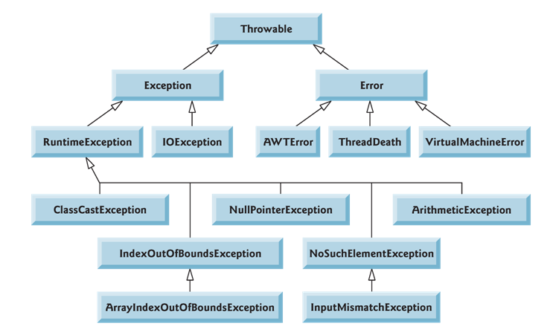
JAYAWANTRAO SAWANT COLLEGE OF ENGINEERING, HADAPSAR, PUNE
Java Exception Hierarchy

Slide 52
JAYAWANTRAO SAWANT COLLEGE OF ENGINEERING, HADAPSAR, PUNE
keywords in Exceptions
try The "try" keyword is used to specify a block where we should place exception code. The try block must be followed by either catch or finally. It means, we can't use try block alone.
catch The "catch" block is used to handle the exception. It must be preceded by try block which means we can't use catch block alone. It can be followed by finally block later.
finally The "finally" block is used to execute the important code of the program. It is executed whether an exception is handled or not.
throw The "throw" keyword is used to throw an exception.
throws The "throws" keyword is used to declare exceptions. It doesn't throw an exception. It specifies that there may occur an exception in the method. It is always used with method signature.

Slide 53
JAYAWANTRAO SAWANT COLLEGE OF ENGINEERING, HADAPSAR, PUNE
throw
The Java throw keyword is used to throw an exception explicitly.
We specify the exception object which is to be thrown. The Exception has some message with it that provides the error description. These exceptions may be related to user inputs, server, etc.
The throw keyword is used to create a custom error.
The throw statement is used together with an exception type. There are many exception types available in Java: ArithmeticException, ClassNotFoundException, ArrayIndexOutOfBoundsException, SecurityException, etc.
The exception type is often used together with a custom method, like in the example above.

Slide 54
JAYAWANTRAO SAWANT COLLEGE OF ENGINEERING, HADAPSAR, PUNE
throws
The throws keyword in Java is used to declare exceptions that can occur during the execution of a program. For any method that can throw exceptions, it is mandatory to use the throws keyword to list the exceptions that can be thrown. The throws keyword provides information about the exceptions to the programmer as well as to the caller of the method that throws the exceptions.
The throws keyword allows exceptions to be propagated in the call stack. When a method declares that it throws an exception, it is not required to handle the exception. The caller of a method that throws exceptions is required to handle the exceptions (or throw them to its caller and so on) so that the flow of the program can be maintained.

Slide 55
JAYAWANTRAO SAWANT COLLEGE OF ENGINEERING, HADAPSAR, PUNE
Difference between throw and throws in Java
Sr. no. | Basis of Differences | throw | throws
1. | Definition | Java throw keyword is used throw an exception explicitly in the code, inside the function or the block of code. | Java throws keyword is used in the method signature to declare an exception which might be thrown by the function while the execution of the code.
2. | Type of exception Using throw keyword, we can only propagate unchecked exception i.e., the checked exception cannot be propagated using throw only. | Using throws keyword, we can declare both checked and unchecked exceptions. However, the throws keyword can be used to propagate checked exceptions only.
3. | Syntax | The throw keyword is followed by an instance of Exception to be thrown. | The throws keyword is followed by class names of Exceptions to be thrown.
4. | Declaration | throw is used within the method. | throws is used with the method signature.
5. | Internal implementation | We are allowed to throw only one exception at a time i.e. we cannot throw multiple exceptions. | We can declare multiple exceptions using throws keyword that can be thrown by the method. For example, main() throws IOException, SQLException.

Slide 56
JAYAWANTRAO SAWANT COLLEGE OF ENGINEERING, HADAPSAR, PUNE
finally block
Java finally block is a block used to execute important code such as closing the connection, etc.
Java finally block is always executed whether an exception is handled or not. Therefore, it contains all the necessary statements that need to be printed regardless of the exception occurs or not.
A finally block contains all the crucial codes such as closing connections, stream, etc that is always executed whether an exception occurs within a try block or not.
When finally block is attached with a try-catch block, it is always executed whether the catch block has handled the exception thrown by try block or not.

Slide 57
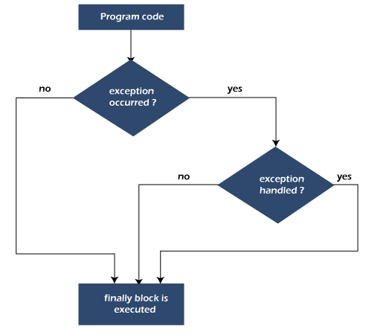
JAYAWANTRAO SAWANT COLLEGE OF ENGINEERING, HADAPSAR, PUNE
Flowchart of finally block

Slide 58
JAYAWANTRAO SAWANT COLLEGE OF ENGINEERING, HADAPSAR, PUNE
class Example
{ public static void main(String args[]) {
try{
int num=121/0;
System.out.println(num);
}
catch(ArithmeticException e){
System.out.println("Number should not be divided by zero");
}
/* Finally block will always execute even if there is no exception in try block
*/
finally{
System.out.println("This is finally block");
}
System.out.println("Out of try-catch-finally");
}
}

Slide 59
JAYAWANTRAO SAWANT COLLEGE OF ENGINEERING, HADAPSAR, PUNE
final, finally and finalize in Java
The final keyword can be used with class method and variable. A final class cannot be inherited, a final method cannot be overridden and a final variable cannot be reassigned.
The finally keyword is used to create a block of code that follows a try block. A finally block of code always executes, whether or not an exception has occurred. Using a finally block allows you to run any cleanup-type statements that you just wish to execute, despite what happens within the protected code.
The finalize() method is used just before object is destroyed and can be called just prior to object creation.

Slide 60
JAYAWANTRAO SAWANT COLLEGE OF ENGINEERING, HADAPSAR, PUNE
Multiple Catch Block
In Java, a single try block can have multiple catch blocks. When statements in a single try block generate multiple exceptions, we require multiple catch blocks to handle different types of exceptions. This mechanism is called multi-catch block in java.
Each catch block is capable of catching a different exception. That is each catch block must contain a different exception handler.
Syntax:
try
{ statements; }
catch(ExceptionType1 e1)
{ statements; }
catch(ExceptionType2 e2)
{ statements; }

Slide 61
JAYAWANTRAO SAWANT COLLEGE OF ENGINEERING, HADAPSAR, PUNE
public class MultipleCatchBlock1 {
public static void main(String[] args) {
try{
int a[]=new int[5];
a[5]=30/0;
}
catch(ArithmeticException e)
{
System.out.println("Arithmetic Exception occurs");
}
catch(ArrayIndexOutOfBoundsException e)
{
System.out.println("ArrayIndexOutOfBounds Exception occurs");
}
catch(Exception e)
{
System.out.println("Parent Exception occurs");
}
System.out.println("rest of the code");
}
}

Slide 62
JAYAWANTRAO SAWANT COLLEGE OF ENGINEERING, HADAPSAR, PUNE
Nested Try
In Java, using a try block inside another try block is permitted. It is called as nested try block. Every statement that we enter a statement in try block, context of that exception is pushed onto the stack.
For example, the inner try block can be used to handle ArrayIndexOutOfBoundsException while the outer try block can handle the ArithemeticException (division by zero).

Slide 63
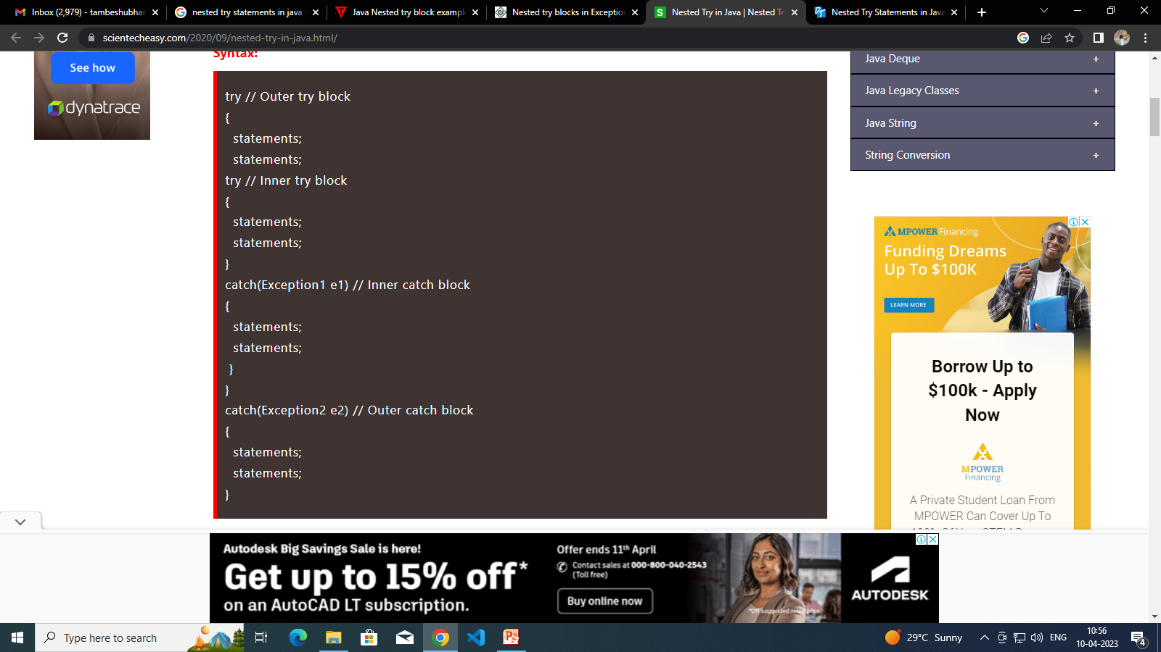
JAYAWANTRAO SAWANT COLLEGE OF ENGINEERING, HADAPSAR, PUNE
Nested Try Syntax:

Slide 64
JAYAWANTRAO SAWANT COLLEGE OF ENGINEERING, HADAPSAR, PUNE
Nested Try
try
{
statement 1;
statement 2;
try
{
statement 1;
statement 2;
}
catch(Exception e)
{
}
}
catch(Exception e)
{
}
....

Slide 65
JAYAWANTRAO SAWANT COLLEGE OF ENGINEERING, HADAPSAR, PUNE
class Exception{
public static void main(String args[]){
try{
try{
System.out.println("going to divide");
int b=59/0;
}catch(ArithmeticException e){System.out.println(e);}
try{
int a[]=new int[5];
a[5]=4;
}
catch(ArrayIndexOutOfBoundsException e) {System.out.println(e);}
System.out.println("other statement);
}catch(Exception e)
{System.out.println("Exception handeled");}
System.out.println("casual flow");
}
}

Slide 66
JAYAWANTRAO SAWANT COLLEGE OF ENGINEERING, HADAPSAR, PUNE
Multiple catch blocks
public class SampleMultipleCatchBlock{
public static void main(String args[]){
try{
int a[]=new int[5];
a[5]=30/0;
}
catch(ArithmeticException e)
{System.out.println("task1 is completed");}
catch(ArrayIndexOutOfBoundsException e)
{System.out.println("task 2 completed");}
catch(Exception e)
{System.out.println("task 3 completed");}
System.out.println("remaining code");
}
}

Slide 67
JAYAWANTRAO SAWANT COLLEGE OF ENGINEERING, HADAPSAR, PUNE
built-in exception
Exceptions that are already available in Java libraries are referred to as built-in exception.
These exceptions are able to define the error situation so that we can understand the reason of getting this error.
It can be categorized into two broad categories, i.e., checked exceptions and unchecked exception.

Slide 68
JAYAWANTRAO SAWANT COLLEGE OF ENGINEERING, HADAPSAR, PUNE
built-in exception
Following is the list of Java UnChecked Exceptions Defined in java.lang.
Sr.No. | Exception & Description
1 | ArithmeticException Arithmetic error, such as divide-by-zero.
2 | ArrayIndexOutOfBoundsException Array index is out-of-bounds.
3 | ArrayStoreException Assignment to an array element of an incompatible type.
4 | ClassCastException Invalid cast.
5 | IllegalArgumentException Illegal argument used to invoke a method.
6 | IllegalMonitorStateException

Slide 69
JAYAWANTRAO SAWANT COLLEGE OF ENGINEERING, HADAPSAR, PUNE
built-in exception
Following is the list of Java Checked Exceptions Defined in java.lang.
Sr.No. | Exception & Description
1 | ClassNotFoundException Class not found.
2 | CloneNotSupportedException Attempt to clone an object that does not implement the Cloneable interface.
3 | IllegalAccessException Access to a class is denied.
4 | InstantiationException Attempt to create an object of an abstract class or interface.
5 | InterruptedException One thread has been interrupted by another thread.

Slide 70
JAYAWANTRAO SAWANT COLLEGE OF ENGINEERING, HADAPSAR, PUNE
Steps to Create a Custom Exception in Java
Create your own Exception Class named InvalidInputException that extends Exception Class from java.lang.
Create a Constructor Method with String statement as an argument. String as an argument allows us to custom message each time we throw an exception.
Call super(statement) i.e. Constructor method of a superclass with a statement as input. This will print our custom message with the exception.

Slide 71
JAYAWANTRAO SAWANT COLLEGE OF ENGINEERING, HADAPSAR, PUNE
Managing I/O
The java.io package contains nearly every class you might ever need to perform input and output (I/O) in Java.
All these streams represent an input source and an output destination. The stream in the java.io package supports many data such as primitives, object, localized characters, etc.
Java I/O stream is the flow of data that you can either read from, or you can write to. It is used to perform read and write operations in file permanently. Java uses streams to perform these tasks. Java I/O stream is also called File Handling, or File I/O. It is available in java.io package.

Slide 72
JAYAWANTRAO SAWANT COLLEGE OF ENGINEERING, HADAPSAR, PUNE
Stream
In java, the IO operations are performed using the concept of streams. Generally, a stream means a continuous flow of data. In java, a stream is a logical container of data that allows us to read from and write to it.
A stream can be linked to a data source, or data destination, like a console, file or network connection by java IO system. The stream-based IO operations are faster than normal IO operations.
The Stream is defined in the java.io package.

Slide 73
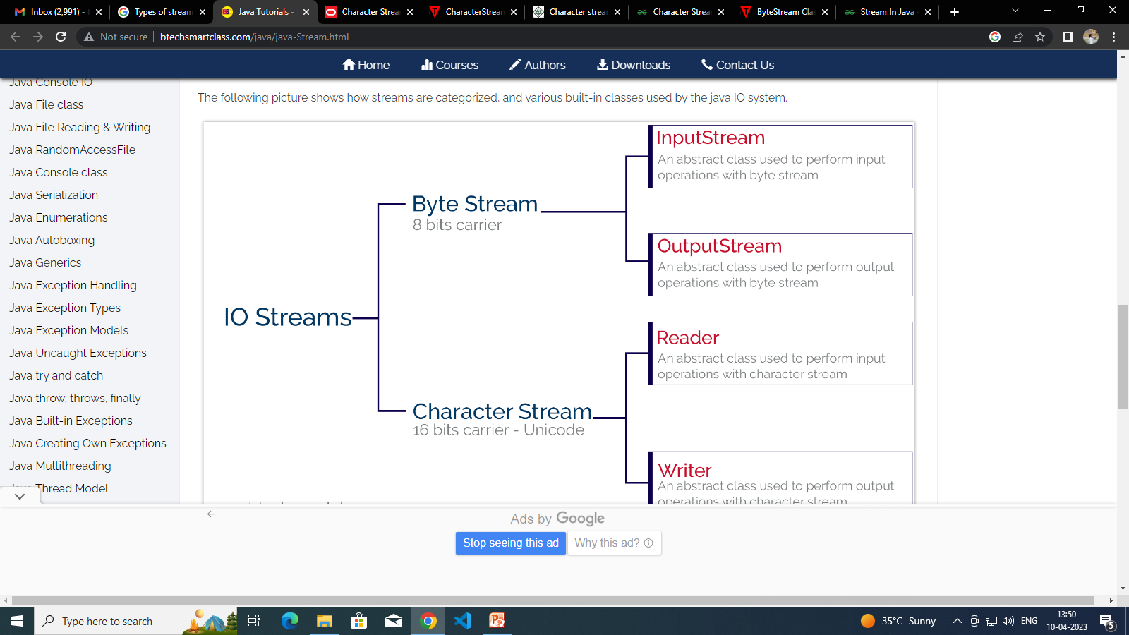
JAYAWANTRAO SAWANT COLLEGE OF ENGINEERING, HADAPSAR, PUNE

Slide 74
JAYAWANTRAO SAWANT COLLEGE OF ENGINEERING, HADAPSAR, PUNE
ByteStream
ByteStream classes are used to read bytes from the input stream and write bytes to the output stream. In other words, we can say that ByteStream classes read/write the data of 8-bits. We can store video, audio, characters, etc., by using ByteStream classes. These classes are part of the java.io package.
The ByteStream classes are divided into two types of classes, i.e., InputStream and OutputStream. These classes are abstract and the super classes of all the Input/Output stream classes.

Slide 75
JAYAWANTRAO SAWANT COLLEGE OF ENGINEERING, HADAPSAR, PUNE
ByteStream
Byte Streams − These handle data in bytes (8 bits) i.e., the byte stream classes read/write data of 8 bits. Using these you can store characters, videos, audios, images etc.
Character Streams − These handle data in 16 bit Unicode. Using these you can read and write text data only.

Slide 76
JAYAWANTRAO SAWANT COLLEGE OF ENGINEERING, HADAPSAR, PUNE
CharacterStream
The java.io package provides CharacterStream classes to overcome the limitations of ByteStream classes, which can only handle the 8-bit bytes and is not compatible to work directly with the Unicode characters. CharacterStream classes are used to work with 16-bit Unicode characters. They can perform operations on characters, char arrays and Strings.
However, the CharacterStream classes are mainly used to read characters from the source and write them to the destination. For this purpose, the CharacterStream classes are divided into two types of classes, I.e., Reader class and Writer class.

Slide 77
JAYAWANTRAO SAWANT COLLEGE OF ENGINEERING, HADAPSAR, PUNE
CharacterStream
Reader Class:
Reader class is used to read the 16-bit characters from the input stream.
However, it is an abstract class and can't be instantiated, but there are various subclasses that inherit the Reader class and override the methods of the Reader class.
All methods of the Reader class throw an IOException.
Writer Class:
Writer class is used to write 16-bit Unicode characters to the output stream.
The methods of the Writer class generate IOException.
Like Reader class, Writer class is also an abstract class that cannot be instantiated; therefore, the subclasses of the Writer class are used to write the characters onto the output stream.

Slide 78
JAYAWANTRAO SAWANT COLLEGE OF ENGINEERING, HADAPSAR, PUNE
Java Predefined Streams
Every language has some predefined streams for its users and Java is one of these languages. Three Java Predefined streams or standard streams are available in the java.lang.System class. These are as follows:
System.in | This is the standard stream for input. This stream is used for reading data for the program from the keyboard by default.
System.out | This is the standard stream for output. This stream is used for writing data from the program to an output device such as a monitor / console by default or to some specified file.
System.err | This is a standard stream for error. This is used to show an error message on the screen i.e. console by default for the users.

Slide 79
JAYAWANTRAO SAWANT COLLEGE OF ENGINEERING, HADAPSAR, PUNE
Reading console I/P:
By default, to read from system console, we can use the Console class. This class provides methods to access the character-based console, if any, associated with the current Java process. To get access to Console, call the method System.console().
Console gives three ways to read the input:
String readLine() – reads a single line of text from the console.
char[] readPassword() – reads a password or encrypted text from the console with echoing disabled
Reader reader() – retrieves the Reader object associated with this console. This reader is supposed to be used by sophisticated applications. For example, Scanner object which utilizes the rich parsing/scanning functionality on top of the underlying Reader.

Slide 80
JAYAWANTRAO SAWANT COLLEGE OF ENGINEERING, HADAPSAR, PUNE
Writing console O/P:
The easiest way to write the output data to console is System.out.println() statements. Still, we can use printf() methods to write formatted text to console.
Writing with System.out.println
System.out.println("Hello, world!");
Writing with printf()
The printf(String format, Object... args) method takes an output string and multiple parameters which are substituted in the given string to produce the formatted output content. This formatted output is written in the console.

Slide 81
JAYAWANTRAO SAWANT COLLEGE OF ENGINEERING, HADAPSAR, PUNE
Print Writer class:
Java PrintWriter class is the implementation of Writer class. It is used to print the formatted representation of objects to the text-output stream.
“PrintWriter is a class used to write any form of data e.g. int, float, double, String or Object in the form of text either on the console or in a file in Java.”
The most common practice to print data on the console is by using the System.out.print method

