Slide 1
Unit 2
Principles of Programming Languages
1
STRUCTURING THE DATA, COMPUTATIONS AND PROGRAM

Slide 2
Content of Syllabus: Unit-2
2
Elementary Data Types :Primitive data Types, Character String types, User Defined Ordinal Types, Array types, Associative Arrays, Record Types, Union Types, Pointer and reference Type. Expression and Assignment Statements: Arithmetic expression, Overloaded Operators, Type conversions, Relational and Boolean Expressions, Short Circuit Evaluation, Assignment Statements, Mixed mode Assignment. Statement level Control Statements: Selection Statements, Iterative Statements, Unconditional Branching. Subprograms: Fundamentals of Sub Programs, Design Issues for Subprograms, Local referencing Environments, Parameter passing methods. Abstract Data Types and Encapsulation Construct: Design issues for Abstraction, Parameterized
Abstract Data types, Encapsulation Constructs, Naming Encapsulations.

Slide 3
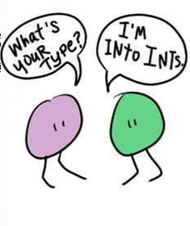
Data Types
3
A data type is a class of data objects with a set of operations for creating and manipulating them.
Examples of elementary data types: integer, real, character, Boolean, enumeration, pointer.
Data type: A data type defines a collection of data values and a set of predefined operations on those values

Slide 4
Data Types
6
Types are used as a way to classify data according to different categories.
And Different need of programming to store different type of data.
Classification of data types as follow.

Slide 5
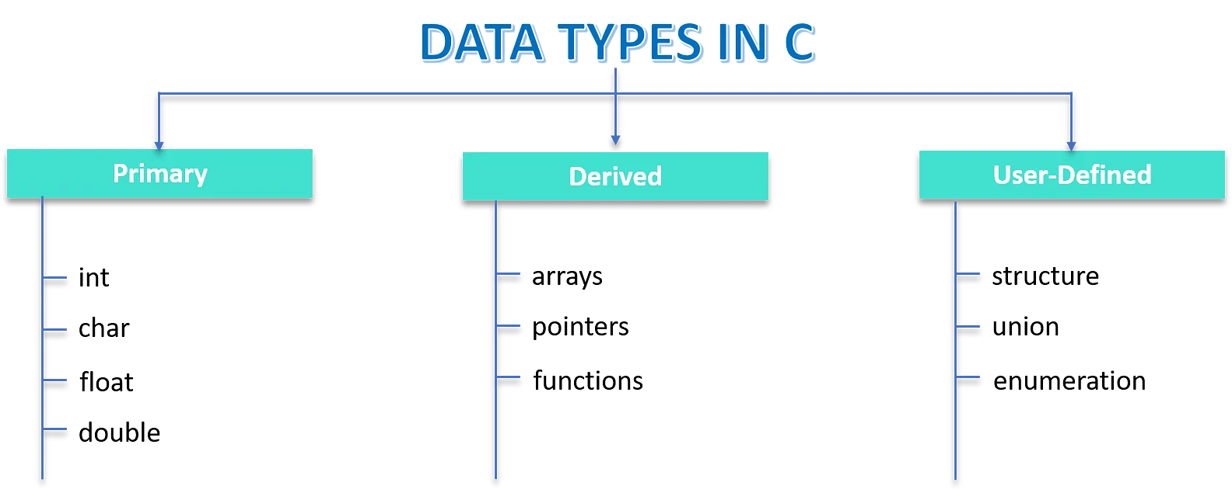
Data Types
7

Slide 6
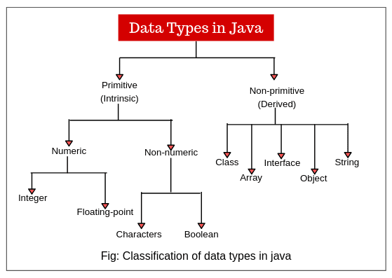
Data Types
8

Slide 7
Data Types
9
Built in Data types/Primitive Data Types
These data types are built-in or predefined data types and can be used
directly by the user to declare variables.
Primitive data types are those that are not defined in terms of other data types
Primitive data types available in C++ are:

Slide 8
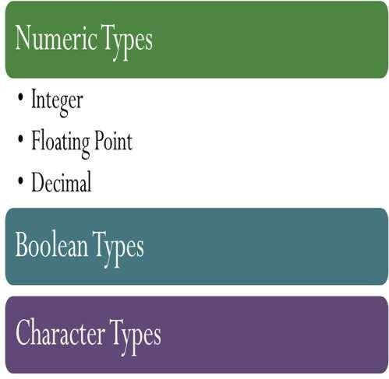
Data Types
10

Slide 9
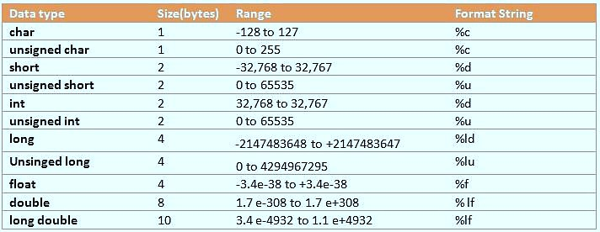
Data Types
11

Slide 10
Data Types (Used Defined data type)
12
A user-defined data type (UDT) is a data type that derived from an existing data type. You can use UDTs to extend the built-in types already available and create your own customized data types.
A data type created by programmer to fulfill the programing requirement is called user-defined data type.
Example: Reference, pointers, Function, Class, interface, enum, structure, union, etc

Slide 11
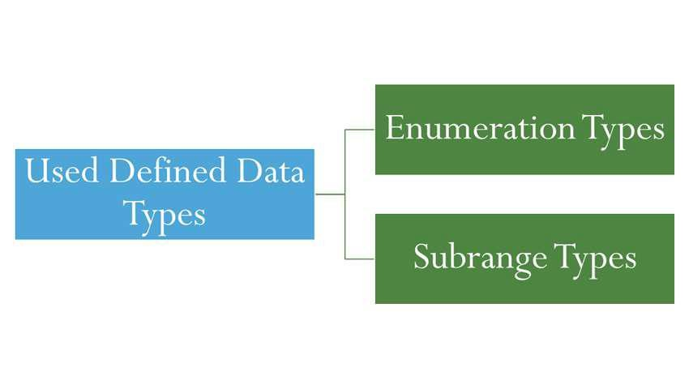
Data Types (Used Defined an ordinal type)
13
An ordinal type is one in which the range of possible values can be easily associated with the set of positive integers

Slide 12
Data Types (Used Defined an ordinal type)
14
Enumeration: This types provide a way of defining and grouping collections of named constants, which are called enumeration constants.
For example in C# we can define the enum data type as follows –
enum days (mon, tue, wed, thu, fri, sat, sun};
The enumeration constants are typically implicitly assigned the integer values, 0, 1, . but can explicitly assigned any integer literal in the type's definition.
enum days{
Mon=1, Tue=2, wed=3…….}

Slide 13
Data Types (Used Defined an ordinal type)
15
Design Issues for Enumeration Types
Following are design issues for enumeration types-
Is an enumeration constant allowed to appear in more than one type
definition?
If enumeration constants appear in more than one type definition, then
how the type of an occurrence of that constant is checked?
Are enumeration values bullied to integer ?

Slide 14
Data Types (Used Defined an ordinal type)
16
2. Subrange
Subrange data types are used in Pascal and ADA.
It is basically a continuous sequence of an ordinal types.
For defining a subset of values the subrange.
For example –
type Color is(RED, ORANGE, YELLOW, GREEN, BLUE, INDIGO, VIOLET)
subtype myfavcolor is Color range ORANGE...BLUE;

Slide 15
Data Types (Derived data types)
17
Derived data types
1. Data types that are derived from the built-in data types are known as
derived data types.
Examples are : array, stack, queue, etc

Slide 16
Data Types (Derived data types)
18
Function: A function is a block of code that is defined to perform a specific well- defined task.
Array: An array is a collection of items stored at continuous memory locations.
The idea of array is to represent many instances in one variable.
Pointers: Pointers are symbolic representation of addresses. They enable programs to simulate call-by-reference as well as to create and manipulate dynamic data structures.
Reference: When a variable is declared as reference, it becomes an alternative name for an existing variable. A variable can be declared as reference by putting ‘&’ in the declaration.

Slide 17
Array Types
19
Array is collection similar data type elements.
It is homogeneous aggregate of data elements in which an individual element is identified by its position in the aggregate, relative to the first elements.
For example - In C, C++ array can be declared as int a[50];

Slide 18
Array Types
20
Subscript Binding for Arrays .
The binding of subscript type to an array variable is usually static but
Subscript value ranges are sometimes dynamically bound.
In C, C++ the lower bound of all index ranges is fixed at 0; In Fortron 95 is default to 1.

Slide 19
Array Types
21
Array Categories based on Subscripts: There are basically four
categories –Binding
Static Array: It is one in which the subscript ranges are storage allocation is static that means it is done before type of arrays - Its working is efficient as there is no need to allocate and deallocate memory.
Fixed Stack Dynamic Array: A fixed stack-dynamic array subscript ranges are statically bound, but the allocation is done during execution. The
advantage of this type is space efficient
Fixed Heap Dynamic Array: It is similar to fixed stack dynamic, binding is dynamic but fixed after allocation (i.e., binding and storage is allocated from heap, not stack).

Slide 20
Array Types
22
Heap Dynamic Array: In this type, binding of subscript range and storage allocation is dynamic and can change any number of time. The advantage of this type of array is it is very flexible.

Slide 21
Array Types
23
Array Initialization: Array initialization is a process in which a list of values that are put in the array in the order in which the array elements are stored in memory
. Some language allow initialization at the time of storage allocation. .
For example-Following is an array initialization in C
Int a[] ={10,20,30} .
char c[] =“Aditya” .
Character Strings in C & C++ are implemented as arrays of char.
Java the array of string can be initialized as follows-
String [] name ={ “Aditya”, "Aakash", "Amit"}

Slide 22
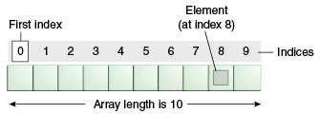
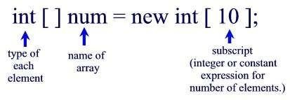
Array Types
24
Array Initialization:

Slide 23
Array Types
25
Array Operations.
The common array operations are assignment, catenation, comparison for
equality and inequality, and slices.
Ex. a[i]==key will compare the key element with element in array at ith
location.
Slice Operation: slice() method returns a new array containing a portion of the array on which it is implemented. The original remains unchanged.
var arr = [23,56,87,32,75,13];
// Extracted array
var new_arr = arr.slice(2,4);

Slide 24
Array Types
26
Array Operations.
Slice Operation: slice() method returns a new array containing a portion of the array on which it is implemented. The original remains unchanged.
Syntax: arr.slice(begin, end)
Arr [] = [23,56,87,32,75,13];
new_arr = arr.slice(2,4);
Output: [87,32]

Slide 25
Array Types
27
Heterogeneous Array: Heterogeneous array is a type of array in which the elements need not be of the same data type. Heterogeneous arrays are supported by the programming languages such as PERL, JavaScript, Python and Ruby.
In Perl, the heterogeneous array consists of numbers, strings and refer In
Python and Ruby array elements are references to the objects of any type

Slide 26
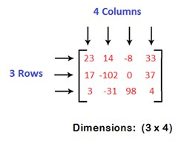
Array Types (Rectangular Array)
28
Rectangular Array: A rectangular array is a multidimensional array in which the rows have the same number of elements, and all of the columns have the same numbers of elements.
Where n!=m
For example-
rect_array[3][4]
Supported by C#, java, python.

Slide 27
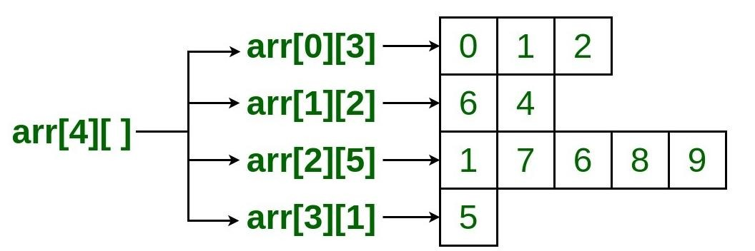
Array Types
30

Slide 28
Array Types
31
Slices: Slice of an array is nothing but the substructure of that array. The “:” Operator used within the square bracket to indicate that it is a list slice and not the index of the list.
For example
>>> a=[10,20,30,40,50,60]
>>> a[1:4] = [20, 30, 40]
>>> a[:5] = [10, 20, 30, 40, 50]

Slide 29
Array Types (Associative Array )
32
An associative array is an unordered collection of data elements that are indexed by an equal number of values called keys.
Each element of an associative array is a pair of a key and a value.
Associative arrays are supported by the standard class libraries of Java,
C++, C#, and F#, Perl.
For Example: In Perl, associative arrays are often called hashes. Names
begin with %; literals are delimited by parentheses.
as shown below-
%ages=("AAA"=>25, "BBB" =>10, "CCC" =>55)

Slide 30
Array Types (Associative Array )
34
An associative array is an unordered collection of data elements that are indexed by an equal number of values called keys
Also known asHash tables
Index by key (part of data) rather than value
Store both key and value (take more space)
Best when access is by data rather than index

Slide 31
Data Types
35
Specifications of a Data Types
Attributes: Different Properties of data types.
Values: The information stored in data types.
Operations: Set of operation performed on data types.

Slide 32


Data Types (Records)
36
What is record?

Slide 33
Data Types (Records)
37
Record Types: is a data structure which is collection of components of
different data types is termed as record.
Specification: The attributes of record are
The number of components
The data type of each component
In C, C++ the syntax for record declaration is denoted by struct. struct student
{ int rol_no;
char name[20];
}

Slide 34
Data Types (Union)
41
A union is a type whose variables are allowed to store different type values at different times during execution.
➢
Accessing Union Fields S.roll_no=20; S.name=“ABC”;

Slide 35
Data Types (Union)
42
Types of Union: Unions are classified as
A Discriminated Union
Free Union

Slide 36
Data Types (Union)
43
A discriminated union type is also called “tagged union types” or “algebraic data types”. It is a type that represents a value that can be one of several different types, with a tag indicating the type of the value.
For example, you might define a discriminated union-type Shape that can hold either a ‘Circle’ or a ‘Rectangle’, like this:
type Shape = Circle | Rectangle
interface Circle { kind: "circle"; radius: number; }
interface Rectangle { kind: "rectangle"; width: number; height: number; }
let s1: Shape = { kind: "circle", radius: 10 };
let s2: Shape = { kind: "rectangle", width: 5, height: 10 };

Slide 37
Data Types (Pointer)
46
Pointer: A pointer is a variable that stores a memory address, for the purpose acting as an alias to what is stored at that address.
A pointer can be used to access a location in the area where storage is
dynamically.
A pointer is a variable that stores the memory address of another variable as its value. A pointer variable points to a data type (like int ) of the same type, and is created with the * operator.

Slide 38
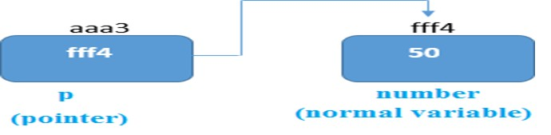
Data Types (Pointer)
47

Slide 39
Data Types (Pointer)
48
Pointer Example in C:
int var = 20; /* actual variable declaration */ int *ip; /* pointer variable declaration */
ip = &var; /* store address of var in pointer variable*/ printf("Address of var variable: %x\n", &var ); printf("Address stored in ip variable: %x\n", ip); printf("Value of *ip variable: %d\n", *ip );

Slide 40
Data Types (Pointer)
49
Output of above pointer example in C:
Address of var variable: bffd8b3c Address stored in ip variable: bffd8b3c Value of *ip variable: 20

Slide 41
Data Types (Pointer)
50
Uses of Pointers:
Provide the power of indirect addressing.
Provide a way to manage dynamic memory. A pointer can be used to access a location in the area where storage is dynamically created usually called a heap.

Slide 42
Data Types (Pointer)
51
Design Issues : The primary design issues are
Should a language support a pointer type or reference type or both?
What are the scope and lifetime of a pointer variable?
Are pointers used for dynamic storage management, indirect addressing
or both?
Are pointers restricted as to type of value to which they can point?
What is a the life time of dynamic variable?

Slide 43
Data Types (Pointer)
52
Following are implementation problems when pointers are used
Management of heap storage area : Due to creation of objects of different sizes during execution time requires management of general heap storage area.
The garbage problem: Sometimes the contents of the pointers are destroyed and object still exists which is actually not at all accessible.
Dangling references: The object is destroyed however the pointer still
contains the address of the used location, and can be wrongly used by the program.

Slide 44
Data Types (Pointer)
53
Example of Dangling Pointer:
int *ptr=(int *)malloc(sizeof(int));
int a=56; ptr=&a; free(a);
//ptr is now a dangling pointer.

Slide 45

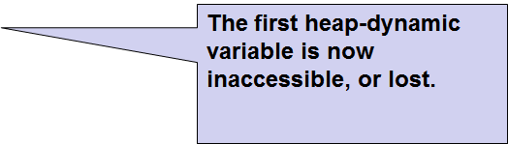
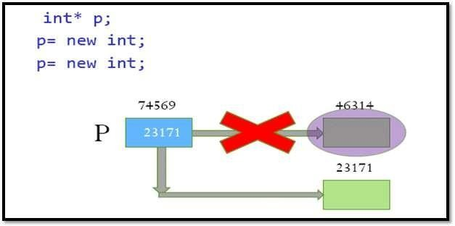
Data Types (Pointer)
54
Lost Heap dynamic Variable

Slide 46
Data Types (Reference)
55
Reference: A reference is a variable that refers to something else and can be used as an alias for that something.
A pointer is a reference, but a reference is not necessarily a pointer.
A reference is a variable that is referred to as another name for an already existing variable. The reference of a variable is created by storing the address of another variable.

Slide 47
Data Types (Reference)
56
int i=8; // variable initialization
int &a=i; // creating a reference variable cout<<"The value of 'i' variable is :"<<a;
Output: The value of 'i' variable is :8

Slide 48
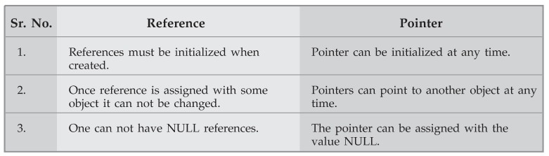
Data Types (Reference)
57

Slide 49
Expressions & Operators
58
Expressions are the fundamental means of specifying computations in a programming language.
To understand expression evaluation, need to be familiar with the orders of operator , operand evaluation and various types of operators.

Slide 50
Expressions & Operators
59
Arithmetic evaluation was one of the motivations for the development of the first programming languages
Arithmetic expressions consist of operators, operands, parentheses, and function
calls
Operators can be
A unary operator has one operand
A binary operator has two operands
A ternary operator has three operands

Slide 51
Expressions & Operators
60
Unary operators: are operators that act upon a single operand to produce a new value.
Types of unary operators:
unary minus(-)
increment(++)
decrement(- -)
NOT(!)
Addressof operator(&)
Unary Assign (=)

Slide 52
Expressions & Operators
61
Unary operators:
Example1:
int a = 10;
int b = -a; // b = -10
Example2:
int a = 1;
int b = ++a; // b = 2

Slide 53
Expressions & Operators
62
Unary operators:
Example3:
int main()
{
int a = 10; int b = 5; if (!(a > b))
cout << "b is greater than a" << endl;
else
cout << "a is greater than b" << endl;
return 0;
}

Slide 54
Expressions & Operators
63
Binary operators: are operators that act upon a two operand to produce a new value.
Types of unary operators:
Arithmetic Operators
Comparative Operators
Logical Operators

Slide 55
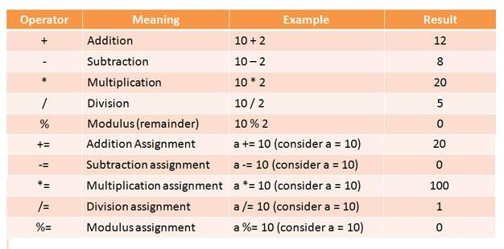
Expressions & Operators
64
Binary operators: (Arithmetic Operators)

Slide 56
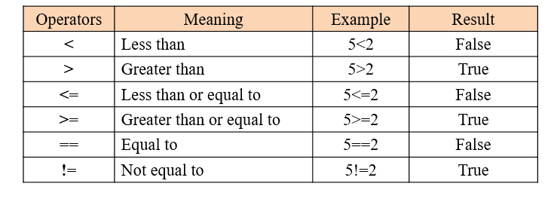
Expressions & Operators
65
Binary operators: (Comparative Operators)

Slide 57
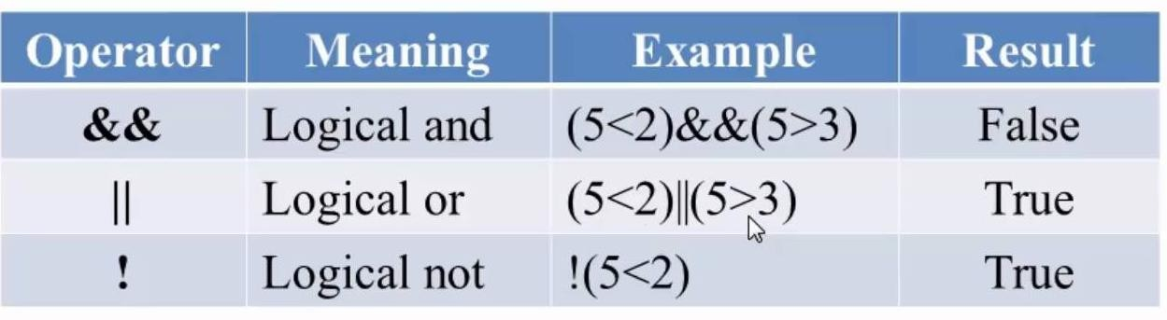
Expressions & Operators
66
Binary operators: (Logical Operators)

Slide 58
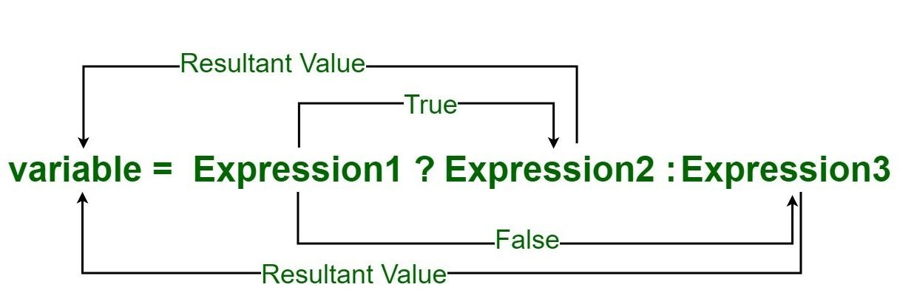
Expressions & Operators
67
A ternary operator: These operators works on has three operands. The conditional operator is kind of similar to the if-else statement as it does follow the same algorithm as of if-else statement but the conditional operator takes less space and helps to write the if-else statements in the shortest way possible.

Slide 59
Expressions & Operators
68
void main()
{
int m = 5, n = 4;
(m > n) ? printf("m is greater than n that is %d > %d" m, n)
: printf("n is greater than m that is %d > %d", n, m);
}

Slide 60
Expressions & Operators
69
average = (count==0 )? 0 : sum/count
Here if value of count is 0 then average will be 0 otherwise it will be computed as sum/count

Slide 61
Expressions & Operators
70
Operator precedence and associativity rules
The operator precedence rules for expression evaluation define the order in which
“adjacent” operators of different precedence levels are evaluated.
Typical precedence levels:
parentheses.
unary operators.
** (the exponential operator, if the language supports it).
*, /, %
5. +, -

Slide 62
Expressions & Operators
71
The associative property is a math rule that says that the way in which factors are
grouped in a multiplication problem does not change the product.
Typical associativity rules:
1. +, - ,*, /, Left to right
2. ^, **, is right to left

Slide 63
Expressions & Operators
72
Language allows you to specify more than one definition for a function name or an operator in the same scope, which is called function overloading and operator overloading respectively.
Operator that cannot be overloaded are as follows:
Arithmetic addition (+) Arithmetic subtraction (-)
Operator that cannot be overloaded are as follows:
Scope operator (::) member selector(.) member pointer selector(*) ternary operator(?:)
C++ FORTRAN 95 and Ada allow user defined overloaded operators where as Java does not permit operator overloading

Slide 64
Expressions & Operators
73
class Test
{
private: int num;
public: Test()
{ num=8;
}
void operator ++() num = num+2;
}
void Print() {
{
cout<<"The Count is: "<<num;
}
};

Slide 65
Expressions & Operators
74
Function Overloading is defined as the process of having two or more function with the same name, but different in parameters is known as function overloading in C++. In function overloading, the function is redefined by using
either different types of arguments or a different number of arguments.

Slide 66
Expressions & Operators
75
using namespace std;
void fun(int); void fun(int,int); void fun(int i)
{
cout << "Value of i is : " <<i;
}
void fun(int a,int b)
{
cout << "Value of a is : " <<a; cout << "Value of b is : " <<b;
}
int main()
{
fun(12);
return 0;
}

Slide 67
Expressions & Operators
76
Type conversion: is the process that converts the predefined data type of one variable into an appropriate data type. The main idea behind type conversion is to convert two different data type variables into a single data type to solve mathematical and logical expressions easily without any data loss.
Type conversion is of two types
A Narrowing conversion or Explicate conversion A widening or Implicate conversion

Slide 68
Expressions & Operators
77
When we are assigning a larger type to a smaller type, Explicit Casting is required.
A narrowing conversion is one that converts an object to a type that cannot include all of the values of the original type e g float to int
this type of conversion is generally may lose data

Slide 69
Expressions & Operators
78
public class ExplicitCastingExample
{ public static void main(String args[]) {
double d = 30.0;
float f = (float) d;
long l = (long) f;
int i = (int) l;
short s = (short) i;
// Explicit casting is needed for below conversion
System.out.println("double value : "+d);
System.out.println("float value : "+f);
System.out.println("long value : "+l);
System.out.println("int value : "+i);
} }

Slide 70
Expressions & Operators
79
A widening conversion or Implicate conversion is one in which an object is converted to a type that can include at least approximations to all of the values of the original type e g int to float
Widening Type Conversion can happen if both types are compatible and the
target type is larger than source type. Widening Casting takes place when two
types are compatible and the target type is larger than the source type. this type of conversion is generally considered as safe

Slide 71
Expressions & Operators
80
public class ImplicitCastingExample
{ public static void main(String args[]) {
byte i = 40; short j = i; int k = j; long l = k;
// No casting needed for below conversion
System.out.println("byte value : "+i); System.out.println("short value : "+j); System.out.println("int value : "+k); System.out.println("long value : "+l);
} }

Slide 72
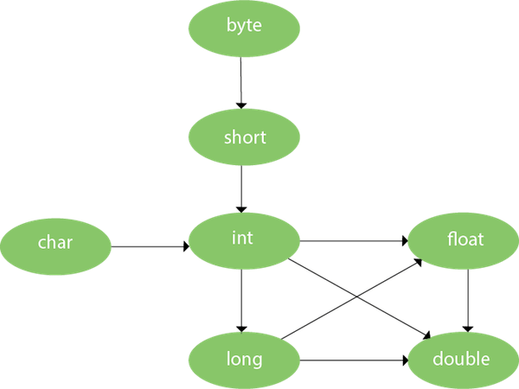
Expressions & Operators
81
Let us See the flow of data type in java that
can be converted to another type Implicitly.

Slide 73
Loop Controlled Mechanism
82
Different types of Loop
If Loops
Switch case
For Loops
While Loops
Do While loops

Slide 74
Loop Controlled Mechanism
83
For Loop: for loop in C programming is a repetition control structure that allows programmers to write a loop that will be executed a specific number of times. for loop enables programmers to perform n number of steps together in a single line.
Syntax:
for (initialize expression; test expression; update expression)
{
// // body of for loop //
}

Slide 75
Loop Controlled Mechanism
84
Example:
for(int i = 0; i < n; ++i)
{
printf("Body of for loop which will execute till n");
}

Slide 76
Loop Controlled Mechanism
85
While Loop:
While loop does not depend upon the number of iterations. In for loop the number of iterations was previously known to us but in the While loop, the execution is terminated on the basis of the test condition. If the test condition will become false then it will break from the while loop else body will be executed.
Syntax: initialization_expression; while (test_expression)
{
// body of the while loop update_expression;
}

Slide 77
Loop Controlled Mechanism
86
Example:
// Initialization expression int i = 2;
while(i < 10)
{
// loop body
printf( "Hello World\n");
i++; // update expression
}

Slide 78
Loop Controlled Mechanism
87
Do While Loop:
The do-while loop is similar to a while loop but the only difference lies in the do-while loop test condition which is tested at the end of the body. In the do-while loop, the loop body will execute at least once irrespective of the test condition.Syntax: initialization_expression;
do
{
// body of the do while loop update_expression;
} while (test_expression);

Slide 79
Loop Controlled Mechanism
88
Example:
// Initialization expression int i = 2;
do
{
// loop body
printf( "Hello World\n");
i++; // update expression
} while(i < 10);

Slide 80
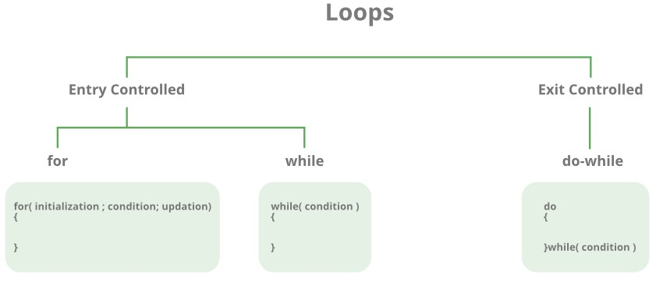
Loop Controlled Mechanism
89

Slide 81
Loop Controlled Mechanism
90
If Else Loop (Two Selection)
The if-else statement in C is used to perform the operations based on some specific condition. The operations specified in if block are executed if and only if the given condition is true.
There are the following variants of if statement in C language.
If statement
If-else statement If else-if ladder Nested if

Slide 82
Loop Controlled Mechanism
91
IF Example:
void main(){
int number=0;
printf("Enter a number:"); scanf("%d",&number); if(number%2==0){
printf("%d is even number",number);
}
}

Slide 83
Loop Controlled Mechanism
92
IF Else Example:
void main(){
int number=0; printf("enter a number:");
scanf("%d",&number); if(number%2==0){
printf("%d is even number",number);
}
else{
printf("%d is odd number",number);
}
}

Slide 84
Loop Controlled Mechanism
93
IF Else ladder Example:
Void main(){
int number=0; printf("enter a number:"); scanf("%d",&number);
if(number==10){
printf("number is equals to 10"); } else if(number==50){ printf("number is equal to 50"); } else if(number==100){ printf("number is equal to 100"); } else{
printf("number is not equal to 10, 50 or 100"); }
}

Slide 85
Loop Controlled Mechanism
94
IF Else ladder Example:
Void main(){
int number=0; printf("enter a number:"); scanf("%d",&number);
if(number==10){
printf("number is equals to 10"); } else if(number==50){ printf("number is equal to 50"); } else if(number==100){ printf("number is equal to 100"); } else{
printf("number is not equal to 10, 50 or 100"); }
}

Slide 86
Loop Controlled Mechanism
95
Switch Statement (Multiway Selection)
The switch statement is an alternate to if-else-if ladder statement which allows us to execute multiple operations for the different possible values of a single variable called switch variable. Here, We can define various statements in the multiple cases for the different values of a single variable.

Slide 87
Loop Controlled Mechanism
96
Switch Statement (Multiway Selection)
void main()
{
scanf(“%d”,&ch); switch(ch)
{
case 1: printf("hi"); break; case 0:
printf("bye"); break; default:
printf(" Hello bye ");
}
}

Slide 88
Subprograms
97
Subprograms can be viewed as abstract operations on a predefined data set.
A subprogram definition describes the interface to and the actions of the subprogram abstraction.
A subprogram call is an explicit request that the subprogram be executed.
A subprogram is defined as a set of statements that can be reused at multiple places in a program when convenient.
This reuse results in multiple types of savings, from memory space to coding time.

Slide 89
Subprograms
98
Features of Subprograms
A subprogram has a single entry point.
The caller is suspended during the implementation of the called subprogram.
Control repeatedly returns to the caller when the called subprogram’s execution eliminates.
The calling program is suspended during execution of the called subprogram.
Control always returns to the caller when the called subprogram's execution
The subprogram call is an explicit request that subprogram be executed.
The subprogram header is first part of the definition, including the name, the kind.
The signature is also called as parameter profile which is nothing but the number, order and types of its parameters.

Slide 90
Subprograms
99
There are two categories of sub-program-
Procedures
Functions

Slide 91
Subprograms (Procedures)
100
Procedures − A procedure is defined as a subprogram
that defines
parameterized computations.
These computations are executed by an individual call statement.
Procedures represent new statements.
For example, because Pascal does not have a sort statement, a user can develop a procedure to sort arrays of records and use a call to that procedure in place of the unavailable sort statement.

Slide 92
Subprograms (Procedures)
101
Syntax of Procedures −
PROCEDURE Name of Procedure (formal parameter list);
BEGIN
{instruction sequence} END; {end of procedure}

Slide 93
Subprograms (Procedures)
102
Example of Procedures − (* Finds the minimum of the 2 values *)
procedure findMin(x, y : integer; var m: integer);
begin
If x < y then m := x
Else
m := y;
end; { end of procedure findMin }

Slide 94
Subprograms (Functions)
103
Functions:
A function is a subprogram that evaluates a value. Functions and procedures are
structured identical, except that
Functions are semantically modeled on mathematical functions.
Functions have a RETURN clause.
Functions produce no side effects i.e., it changes neither its parameters nor any variables defined outside the function.

Slide 95
Subprograms (Functions)
104
Functions:
A function is a subprogram that evaluates a value. Functions and procedures are
structured identical, except that
Functions are semantically modeled on mathematical functions.
Functions have a RETURN clause.
Functions produce no side effects i.e., it changes neither its parameters nor any variables defined outside the function.

Slide 96
Subprograms (Functions)
105
Functions Syntax:
RETURN TYPE Name of Function (formal parameter list)
{
local declaration section
……………….
………………. instruction sequence
}

Slide 97
Subprograms (Functions)
106
Functions Example: int findMin(int x, int y)
{
int m; If x<y m=x else m=y
return m;
}

Slide 98
Subprograms
107
Difference between procedure and function
Procedure | Function
Procedure may or may not return a value. | Function return a value.
Procedure is set of commands executed in order. | Function is set of instructions for used for some computation.
Procedures can not be called from function. | Function can be called from procedure.
Example - Pascal, ADA are some programming languages that make use of procedures. | Example-C, C++, Java are some programming languages that make use of functions.

Slide 99
Subprograms
108
Design Issues for Subprograms:
What parameter passing methods are provided?
Are parameter types checked?
Are local variables static or dynamic?
Can subprogram definitions appear in other subprogram definitions?
Can subprograms be overloaded?
Can subprogram be generic?

Slide 100
Local Variables
109
Variables that are declared within or inside a function block are known as Local variables.
These variables can only be accessed within the function in which they are declared.
The lifetime of the local variable is within its function only, which means the variable exists till the function executes. Once function execution is completed, local variables are destroyed and no longer exist outside the function.
The reason for the limited scope of local variables is that local variables are stored in the stack, which is dynamic in nature and automatically cleans up the data stored within it.

Slide 101
Local Variables
110
Variables that are declared within or inside a function block are known as Local variables.
These variables can only be accessed within the function in which they are declared.
The lifetime of the local variable is within its function only, which means the variable exists till the function executes. Once function execution is completed, local variables are destroyed and no longer exist outside the function.
The reason for the limited scope of local variables is that local variables are stored in the stack, which is dynamic in nature and automatically cleans up the data stored within it.

Slide 102
Local Variables
111
Example:
#include <stdio.h> void main(){
int a; int b; int sum;
}

Slide 103
Local Variables
112
Types of local Variables
Static Local Variables
Stack Dynamic Variables

Slide 104
Local Variables
113
1. Static Local Variables:
A local static variable is a variable, whose lifetime doesn’t stop with a function call
where it is declared. It extends until the lifetime of a complete program.

Slide 105
Local Variables
114
Advantages of Static Local Variables:
The static local variables are efficient than stack-dynamic local variables as they
require no run time overhead for allocation and deallocation.
It allows direct accessing.
Disadvantages of Static Local Variables:
They do not support for recursion.
The storage for locals cannot be shared among some programs.

Slide 106
Local Variables
115
Stack dynamic variable:
The stack dynamic local variables are kind of local variables which are bound to storage when the subprogram begins execution and are unbound from storage when the execution terminates.
Stack-dynamic variables are allocated from the run-time stack.

Slide 107
Local Variables
116
Advantages of Stack dynamic variable:
The stack dynamic local variables support for recursion.
The storage for locals is shared among some subprograms.
Disadvantages of Stack dynamic variable:
The cost is required to allocate, initialize, and deallocate the variables for each call to subprogram.
Accesses to stack dynamic local variables must be indirect.

Slide 108
Global Variables
117
Global variables are those variables which are declared outside of all the functions or block and can be accessed globally in a program.
It can be accessed by any function present in the program.
Once we declare a global variable, its value can be varied as used with different functions.
The lifetime of the global variable exists till the program executes. These variables are stored in fixed memory locations given by the compiler and do not automatically clean up.
Global variables are mostly used in programming and useful for cases where all the functions need to access the same data.

Slide 109
Global Variables
118
Example:
#include<stdio.h>
int a=50, b=40;
void main()
{
printf("a = %d and b=%d",a,b);
}

Slide 110
Parameter Passing Methods
119
Different Parameter passing methods are:
Call by value:
Call by Reference:
Call by Name:
Call by value result:

Slide 111
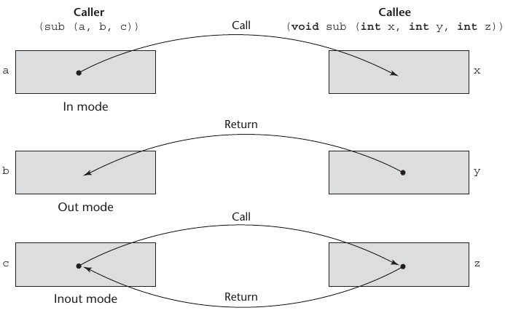
Parameter Passing Methods
120

Slide 112
Parameter Passing Methods
121
Call by value:
This is the simplest method of parameter passing.
The actual parameters are evaluated and their r-values are passed to called
procedure.
The operations on formal parameters do not changes the values of actual Parameter.
Example C & C++.

Slide 113
Parameter Passing Methods
122
Call by value Example:
void func(int a, int b) //Formal Parameters
{
a += b;
printf("In func, a = %d b = %d\n", a, b);
}
void main()
{
int x = 5, y = 7;
// Passing parameters
func(x, y); // Actual Parameters
printf("In main, x = %d y = %d\n", x, y);
}

Slide 114
Parameter Passing Methods
123
Call by reference:
This method is also called as call by address or call by location.
The L-value, the address of actual parameter is passed to the called routines
activation record.
The values of actual parameters can be changed.
The actual parameters should have an L-value.
Example: C, C++, PASCAL

Slide 115
Parameter Passing Methods
124
Call by reference Example:
void swapnum(int* i, int* j)
{
int temp = *i;
*i = *j;
*j = temp;
}
Void main()
{
int a = 10, b = 20;
swapnum(&a, &b); // passing parameters
printf("a is %d and b is %d\n", a, b);
}

Slide 116
Parameter Passing Methods
125
Copy restore or values result:
This method is a hybrid between call by value and call by reference.
This method is also known as copy-in-copy-out or values result.
The calling procedure calculates the value of actual parameter and it is then copied to activation record for the called procedure.
During execution of called procedure, the actual parameters value is not affected.
If the actual parameter has L-value then at return the value of formal parameter is copied to actual parameter.
Example: In Ada this parameter passing method is used.

Slide 117
Parameter Passing Methods
126
Copy restore or values result:
Void summer(out int x, out int y)
➢{
int z=x+y; Summer(out x, out y)
➢}
……………..
Summer(out a, out b)

Slide 118
Parameter Passing Methods
127
Call by name:
This is less popular method of parameter passing.
Procedure is treated like macro.
The procedure body is substituted for call in caller with actual parameters substituted for formals.
The actual parameters can be surrounded by parenthesis to preserve the integrity.
The locals names of called procedure and names of calling procedure distinct.
Example: ALGOL uses call by name method.

Slide 119
Parameter Passing Methods
128
Call by name:
Void add(int x, int y)
{
Int z=x+y;
}
…..
…..
Add(a,b)

Slide 120
Parameter Passing Methods
129
Call by Result:
This method uses out-mode semantics.
Just before control is transferred back to the caller, the value of the formal
parameter is transmitted back to the actual parameter.
This method is sometimes called call by result.
In general, pass by result technique is implemented by copy.

Slide 121
Parameter Passing Methods
130
Call by Result Example:
Void summer(out int x, out int y)
{
int z=x+y; Summer(out x, out y)
}

Slide 122
The Concept of Abstraction
131
An abstraction is a view or representation of an entity that includes only the most significant attributes
The concept of abstraction is fundamental in programming (and computer
science)
Nearly all programming languages support process abstraction with subprograms
Nearly all programming languages designed since 1980 support data abstraction

Slide 123
The Concept of Abstraction
132
An abstract data type is an enclosure that includes only the
data representation of one specific data type and
the subprograms that provide the operations for that type
No need to include other various things.
An instance of an abstract data type is called an object

Slide 124
The Concept of Abstraction
133
Let us understand with example:
I’m a coffee addict. So, when I wake up in the morning, I go into my kitchen, switch on the coffee machine and make coffee. Sounds familiar?
Making coffee with a coffee machine is a good example of abstraction. You need to know how to use your coffee machine to make coffee. You need to provide water and coffee beans, switch it on and select the kind of coffee you want to get.
The thing you don’t need to know is how the coffee machine is working internally to brew a fresh cup of delicious coffee. You don’t need to know the ideal temperature of the water or the amount of ground coffee you need to use

Slide 125
User Defined Abstract Data Types
134
A data type created by programmer to fulfill the programing requirement is called
user-defined data type.
The abstract datatype is special kind of datatype, whose behavior is defined by a set of values and set of operations.
The keyword “Abstract” is used as we can use these datatypes, we can perform
different operations.
Some examples of ADT are Stack, Queue, List etc.
Let us see some operations of those mentioned ADT −
Stack −
isFull(), This is used to check whether stack is full or not
isEmpry(), This is used to check whether stack is empty or not ….etc

Slide 126
Encapsulation Constructs
135
Encapsulation is one of the core concepts
in object-oriented
programming and describes the bundling of data and methods operating on this data into one unit. You can use it to implement an information-hiding mechanism.

Slide 127
Encapsulation Constructs
136
Large programs have two special needs:
Some means of organization , other than simply division into subprograms
Some means of partial compilation (compilation units that are
smaller than the whole program)
Obvious solution: a grouping of subprograms that are logically related into a unit that can be separately compiled (compilation units) Such collections are called encapsulation

Slide 128
Encapsulation Constructs :Encapsulation in C
137
Files containing one or more subprograms can be independently compiled
The interface is placed in a header file
Problem: the linker does not check types between a header and
associated implementation
#include preprocessor specification used to include header files in
applications

Slide 129
Encapsulation Constructs :Encapsulation in C++
138
Can define header and code files, similar to those of C
Or, classes can be used for encapsulation
The class is used as the interface (Prototype)
The member definitions are defined in a separate file
Friends provide a way to grant access to private members of a class

Slide 130
Encapsulation Constructs :Encapsulation in Ada
139
Ada specification packages can include any number of data and subprogram declarations.
Ada packages can be compiled separately.
A package’s specification and body parts can be compiled separately

Slide 131
Encapsulation Constructs :Encapsulation in Java
140
Packages can contain more than one class definition; classes in a package are partial friends
Clients of a package can use fully qualified name or use the import declaration

