Slide 1
AI-Powered Startup Blueprint Generator using IBM Granite-3-3-8B
CAPSTONE PROJECT
Presented By:
Tanishka Pundhir-Jaipur Engineering College,Kukas
Department- Artificial Intelligence

Slide 2
OUTLINE
Problem Statement
Proposed System/Solution
System Development Approach
Algorithm & Deployment
Result
Conclusion
Future Scope
References

Slide 3
Problem Statement
Problem: Most aspiring entrepreneurs lack a clear framework or mentorship to convert an idea into a structured startup plan. Building business blueprints manually takes time, research, and expertise — making it inaccessible to early-stage innovators.

Slide 4
Proposed Solution
The proposed solution is an AI-powered Startup Blueprint Generator Agent designed to help aspiring entrepreneurs transform raw startup ideas into actionable business plans.
It uses a Large Language Model (Granite-3-3-8bInstruct) to understand user inputs like domain, audience, budget, and timeline, and generates a complete startup plan that includes:
Problem definition
Solution outline
MVP features
Revenue model
Target market strategy
Go-to-market plan
Suggested tech stack and more
The user-friendly interface is built using Gradio and allows users to enter their idea in simple text fields and instantly receive a structured startup blueprint.

Slide 5
System Approach
Technology Stack:
Workflow:
User provides 4–5 basic inputs
These inputs are inserted into a prompt template
The prompt is passed to IBM Granite-7B
The model returns a detailed, formatted startup blueprint
Component | Tool/Platform
💡 LLM Model | IBM Granite-7B (via InstructLab)
📄 Data Format | Prompt-based generation
🧠 AI Method | Prompt Engineering
🧪 Environment | Jupyter Notebook / CLI
📝 Output | Text-based startup blueprint
Workflow:
User provides 4–5 basic inputs
These inputs are inserted into a prompt template
The prompt is passed to IBM Granite model
The model returns a detailed, formatted startup blueprint

Slide 6
Algorithm & Deployment
Algorithm Used:
Language Model: IBM Granite-7B (via InstructLab) or Falcon-7B-Instruct (as open alternative)
Prompt Engineering: Carefully structured prompts are passed to the LLM to guide it in generating business-relevant blueprints.
No training/fine-tuning was done; model works using prompt-based inference.
🔹 Input Features:
Domain of startup (e.g., EdTech)
Target audience
Estimated budget
Country of operation
MVP timeline
🔹 Model Output:
A comprehensive business plan based on the user’s inputs.
🔹 Deployment:
The application is deployed as a Gradio Web App.
It is hosted on Hugging Face Spaces using gradio deploy for free and permanent access.
Interface built using Gradio allows real-time interaction.
Optional GPU hardware is activated via Hugging Face for faster response generation.

Slide 7
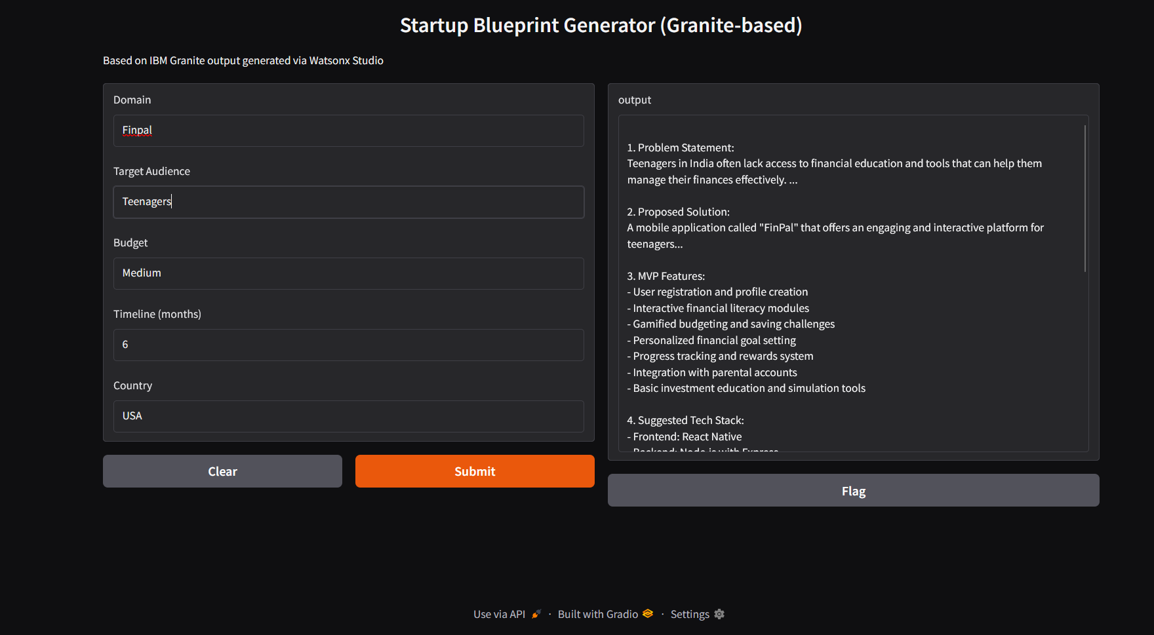
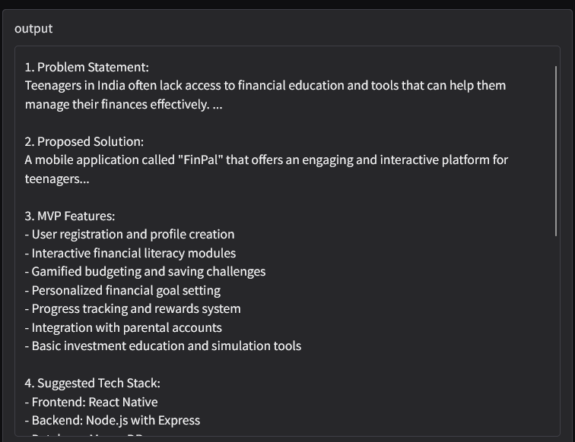
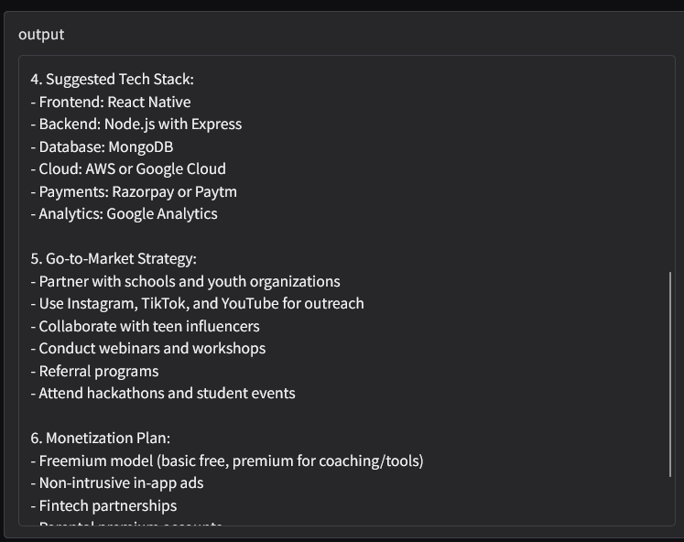
Result

Slide 8
Conclusion
This project demonstrates how IBM’s Granite-7B model can serve as a business strategist, generating high-quality startup blueprints using well-crafted prompts. Prompt engineering was central to guiding the LLM toward structured, relevant, and domain-specific outputs.

Slide 9
Future scope
Add a frontend UI to collect inputs via forms
Connect to real startup/investor databases
Export the blueprint as a downloadable PDF
Add voice-based input and multi-language support
Use Retrieval-Augmented Generation (RAG) for grounded results
Integrate it with Watson Assistant or allow PDF export of business plan

Slide 10
References
IBM Granite (InstructLab): https://github.com/IBM/instructlab
IBM Granite Model Card
Prompt Engineering Guide – OpenAI
IBM Granite Model- ibm/granite-3-3-8b-instruct

Slide 11
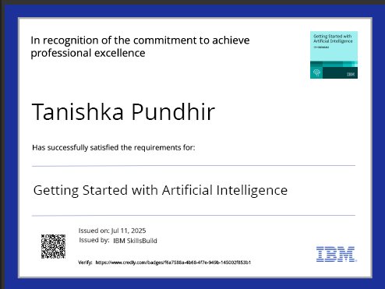
IBM Certifications

Slide 12

IBM Certifications

Slide 13
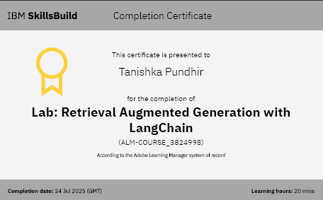
IBM Certifications

Slide 14
THANK YOU “Empowering entrepreneurs with AI — one prompt at a time.”

