Slide 1
AI-Powered Startup Blueprint Generator using IBM Granite-3-3-8B
CAPSTONE PROJECT
Presented By:
Tanishka Pundhir-Jaipur Engineering College,Kukas
Department- Artificial Intelligence

Slide 2
OUTLINE
Problem Statement
Proposed System/Solution
System Development Approach
Algorithm & Deployment
Result
Conclusion
Future Scope
References

Slide 3
Problem Statement
Problem: Most aspiring entrepreneurs lack a clear framework or mentorship to convert an idea into a structured startup plan. Building business blueprints manually takes time, research, and expertise — making it inaccessible to early-stage innovators.

Slide 4
Proposed Solution
The proposed solution is an AI-powered Startup Blueprint Generator Agent designed to help aspiring entrepreneurs transform raw startup ideas into actionable business plans.
It uses a Large Language Model (Granite-3-3-8bInstruct) to understand user inputs like domain, audience, budget, and timeline, and generates a complete startup plan that includes:
Problem definition
Solution outline
MVP features
Revenue model
Target market strategy
Go-to-market plan
Suggested tech stack and more
The user-friendly interface is built using Gradio and allows users to enter their idea in simple text fields and instantly receive a structured startup blueprint.

Slide 5
System Approach
Technology Stack:
Workflow:
User provides 4–5 basic inputs
These inputs are inserted into a prompt template
The prompt is passed to IBM Granite-7B
The model returns a detailed, formatted startup blueprint
Component | Tool/Platform
💡 LLM Model | IBM Granite-3-3-8B (via InstructLab)
📄 Data Format | Prompt-based generation
🧠 AI Method | Prompt Engineering
🧪 Environment | Watsonx.ai Notebook / CLI
📝 Output | Text-based startup blueprint
Workflow:
User provides 4–5 basic inputs
These inputs are inserted into a prompt template
The prompt is passed to IBM Granite model
The model returns a detailed, formatted startup blueprint

Slide 6
Algorithm & Deployment
Algorithm Used:
Language Model: IBM Granite-3-3-8B (via Instruct)
Prompt Engineering: Carefully structured prompts are passed to the LLM to guide it in generating business-relevant blueprints.
No training/fine-tuning was done; model works using prompt-based inference.
🔹 Input Features:
Domain of startup (e.g., EdTech)
Target audience
Estimated budget
Country of operation
MVP timeline
🔹 Model Output:
A comprehensive business plan based on the user’s inputs.
🔹 Deployment:
The application is deployed as a Gradio Web App.
It is hosted on Hugging Face Spaces using gradio deploy for free and permanent access.
Interface built using Gradio allows real-time interaction.
Optional GPU hardware is activated via Hugging Face for faster response generation.

Slide 7
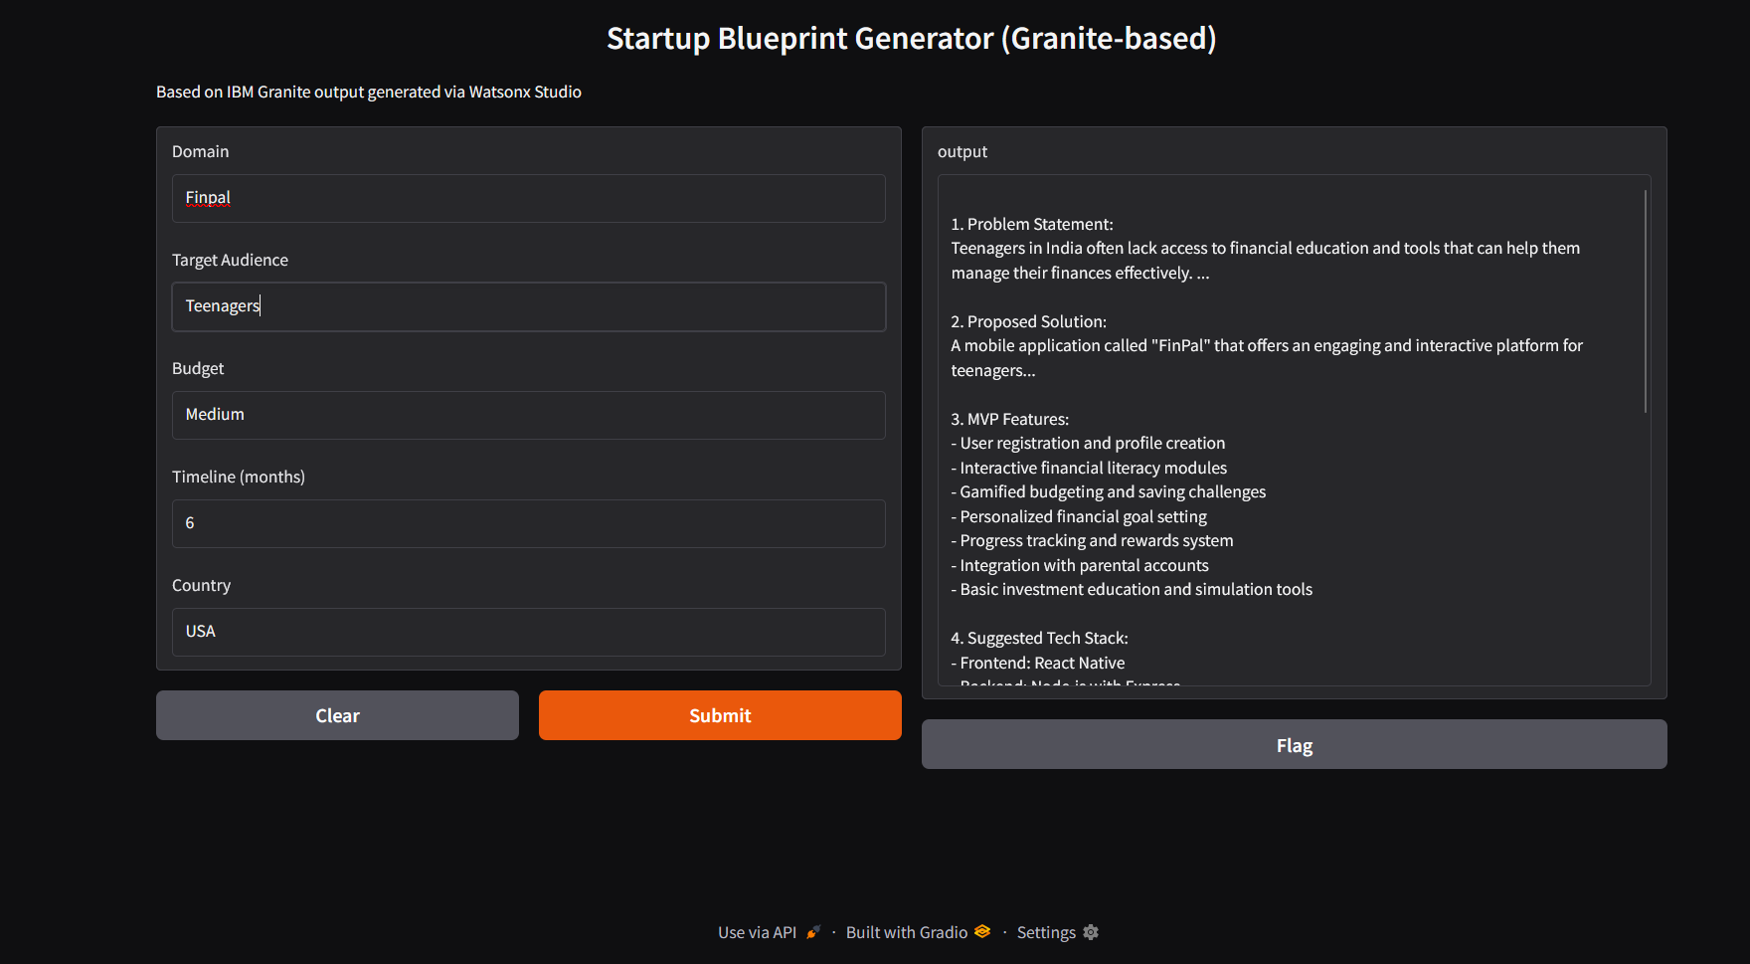
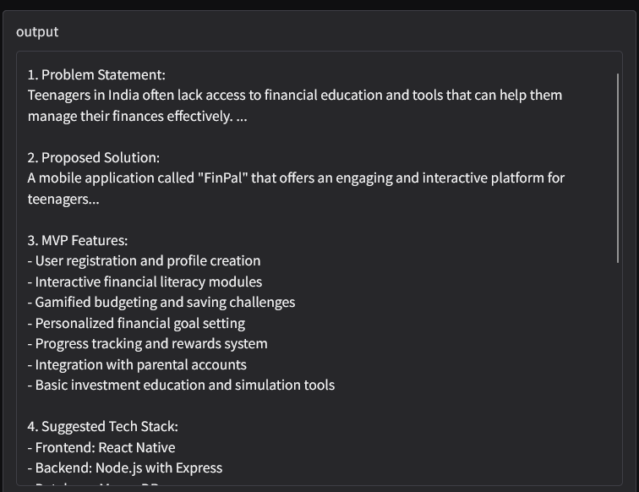
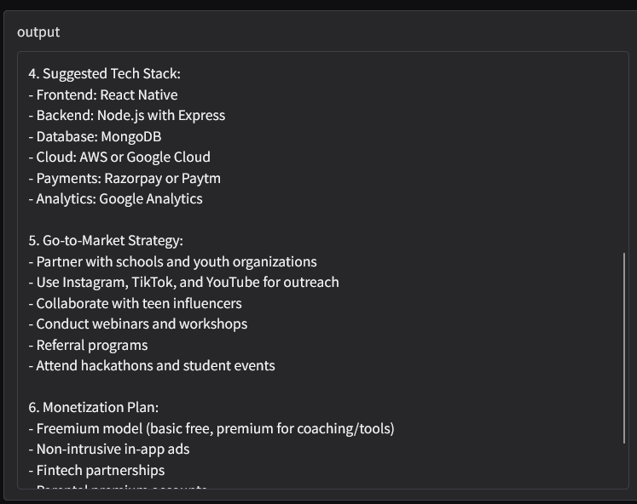
Result
#- Due to limitations in the IBM Cloud Lite tier, direct deployment of Granite via API was not possible. The model was used inside Watsonx Studio Notebook, and the Gradio UI was built on top of the actual output for presentation and demonstration purposes.

Slide 8
Conclusion
This project demonstrates how IBM’s Granite-3-3-8B model can serve as a business strategist, generating high-quality startup blueprints using well-crafted prompts. Prompt engineering was central to guiding the LLM toward structured, relevant, and domain-specific outputs.

Slide 9
Future scope
Add a frontend UI to collect inputs via forms
Connect to real startup/investor databases
Export the blueprint as a downloadable PDF
Add voice-based input and multi-language support
Use Retrieval-Augmented Generation (RAG) for grounded results
Integrate it with Watson Assistant or allow PDF export of business plan

Slide 10
References
IBM Granite (InstructLab): https://github.com/IBM/instructlab
IBM Granite Model Card
Prompt Engineering Guide – OpenAI
IBM Granite Model- ibm/granite-3-3-8b-instruct

Slide 11
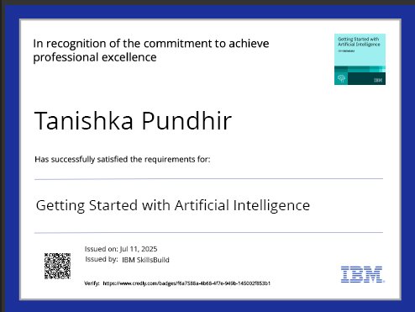
IBM Certifications

Slide 12

IBM Certifications

Slide 13
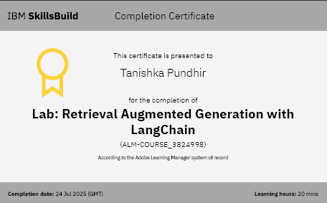
IBM Certifications

Slide 14
THANK YOU “Empowering entrepreneurs with AI — one prompt at a time.”

