Slide 1
Using Consumer Sentiment to Enhance Service Quality in Fast Food Restaurants

Slide 2
Background/Introduction
The fast food industry is extremely competitive, and customer satisfaction is critical for business success.
Online reviews have grown in importance as a source of client feedback for businesses.
Sentiment analysis is a machine learning approach that may give insights into consumer experiences and opinions by categorizing evaluations as positive, negative, or neutral.

Slide 3
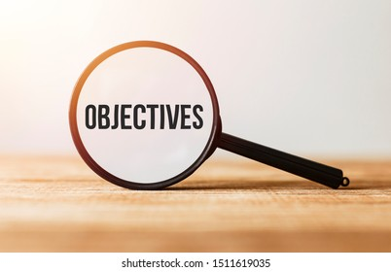
Objectives
Improve service quality at fast food businesses, particularly McDonald's, by using sentiment analysis.
In McDonald's reviews, identify common issues and opportunities for improvement.
Make recommendations for increasing service quality at fast food businesses that fit to McDonald's customers' specific needs and interests.

Slide 4

Data Collection
McDonald's reviews dataset available on data.world.com
Dataset includes over a thousand reviews from customers of McDonald's restaurants located in different cities
Each review includes the name of the city, a list of broken regulations, and a confidence rating in each of the policies violated
Reviews provide information about the quality of food, speed of service, and employee conduct
Reviews were collected in February 2015

Slide 5
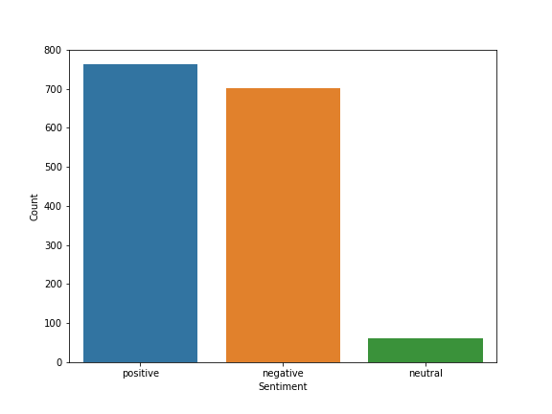
Data Visualization
Figure 1: Bar chart showing the distribution of the sentiment
Figure 1 displays the distribution of sentiment in customer reviews
Positive reviews slightly outweigh negative reviews, with both being close in count
The number of neutral reviews is significantly lower than positive and negative reviews
These insights can be used to develop strategies for improving the customer experience and addressing any negative feedback

Slide 6
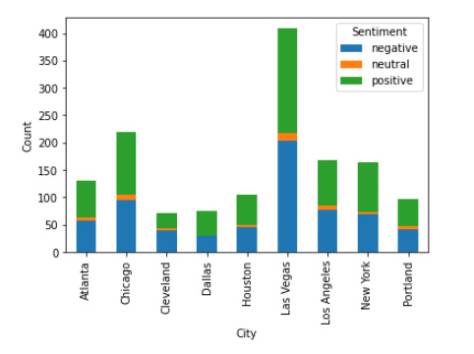
Data Visualization
Figure 2: Stacked bar chart
Figure 2 show that Las Vegas has the highest positive sentiment, while Chicago has the highest negative sentiment.
The cities with the highest to lowest negative sentiment are: Chicago, Los Angeles, Atlanta, New York, Houston, Portland, Cleveland, and Dallas.
Understanding the sentiment distribution by city can help McDonald's identify areas where they need to improve their service to increase customer satisfaction.

Slide 7
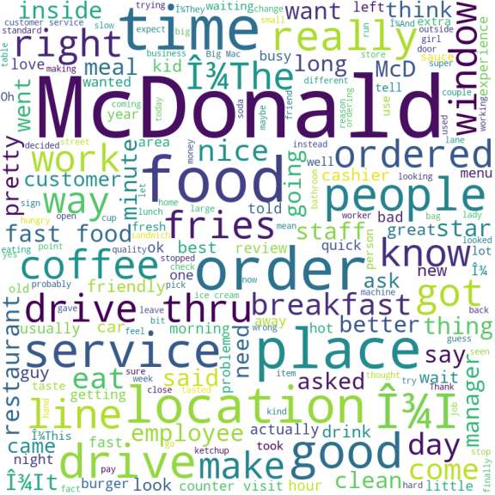
Data Visualization
Figure 3: Word cloud
Long wait times, incorrect orders, and issues with the drive-thru window are the main issues associated with the words "time," "want," "right," and "window.“
Dissatisfaction with food and coffee quality is also a significant concern based on the use of those words.
Customers have reported problems with the restaurant's service, ordering process, and location, as indicated by the words "service," "order," and "place.“ Addressing these issues could improve customer satisfaction

Slide 8
Data Analysis
Table 1: The frequency of negative words
The term "McDonald" indicates that customers associate their negative experiences with the McDonald restaurant.
The second and third most frequently used terms, "order" and "food", suggest issues with the ordering process and quality of meals.
Complaints about "drive" and "time" indicate problems with the drive-thru and long wait time.
Negative words like "service" and "place" indicate that customers may have issues with the restaurant's service and convenience of location.
mcdonald | 72.764727
order | 68.956075
food | 55.452807
drive | 51.050202
time | 48.005738
servic | 45.550878
place | 40.461686
locat | 36.962073
wait | 33.097516
fri | 29.859012
good | 29.260674

Slide 9
Data Analysis
Table 2: The performance of the models
Table 2 shows that Random Forest: Highest Accuracy Score of 0.7410
Logistic Regression: Second Highest Accuracy Score of 69.84%
SVM: Accuracy Score of 69.18%
Decision Tree: Accuracy Score of 64.59%
Random Forest is the best method for the McDonald's reviews dataset.
Accuracy of these models is not outstanding, improvement suggestions will be provided at the conclusion of the study.
Model | Accuracy
Random Forest | 74.10%
Logistic Regression | 69.84%
Support Vector Machine | 69.18%
Decision Tree | 64.59%

Slide 10
Conclusion
Positive reviews outweigh negative ones, but there are still areas of improvement.
Positive reviews are more common in Las Vegas, while negative reviews are more common in Chicago.
Customers face issues with wait times, food, and service.
McDonald's has several options to tackle these problems, including improving order accuracy and meal quality, reducing drive-thru lines, enhancing customer service, and strengthening management processes.
These efforts can improve customer retention and loyalty.
Random Forest model outperformed other models, with an accuracy rate of 74.10%.
There is an opportunity for improvement in model accuracy.

Slide 11
Recommendation
Analysis has shown that McDonald's can elevate its service quality and satisfy customers through the following recommendations:
Order precision
Food quality
Quality Service
Location management
To improve the model accuracy we have to conduct the following techniques:
Increase dataset size
Enhance data quality
Fine-tune models.

Slide 12
Thank You!

