Slide 1

DATA EXPLORATION AND VISUALIZATION ANALYSIS
TANISHQ CHERUKURI

Slide 2
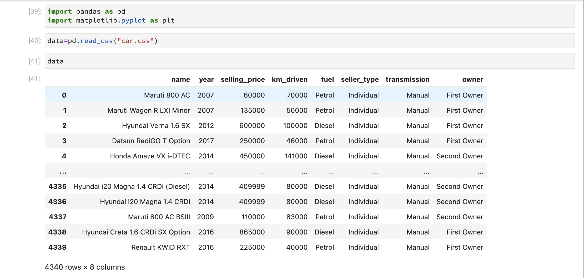
DATA DESCRIPTION
This data is about Car Details Data Set, this data was taken from ’CAR DEKHO’ app related to used car details.
The data has 4340 Rows and 8 Columns.
Data link: https://www.kaggle.com/datasets/akshaydattatraykhare/car-details-dataset

Slide 3
COLUMN INFROMATION
Following details of cars are included in the dataset.
Car Name
Year
Selling Price
Kms Driven
Fuel
Seller Type
Transmission
Owner
Car Name:
This Column defines the car manufacturing company name.
Year:
This Column defines the car manufacturing year.
Selling Price:
This Column defines car resale value price.
Kms Driven:
This Column defines car kms driven.

Slide 4
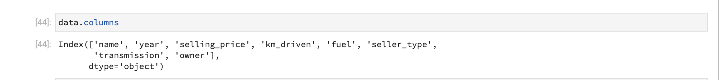
Fuel:
This Column defines the fuel type of the car.
Seller Type:
This Column defines the seller type.
Transmission:
This Column defines the transmission type of the car.
Owner:
This Column defines the car owner.

Slide 5
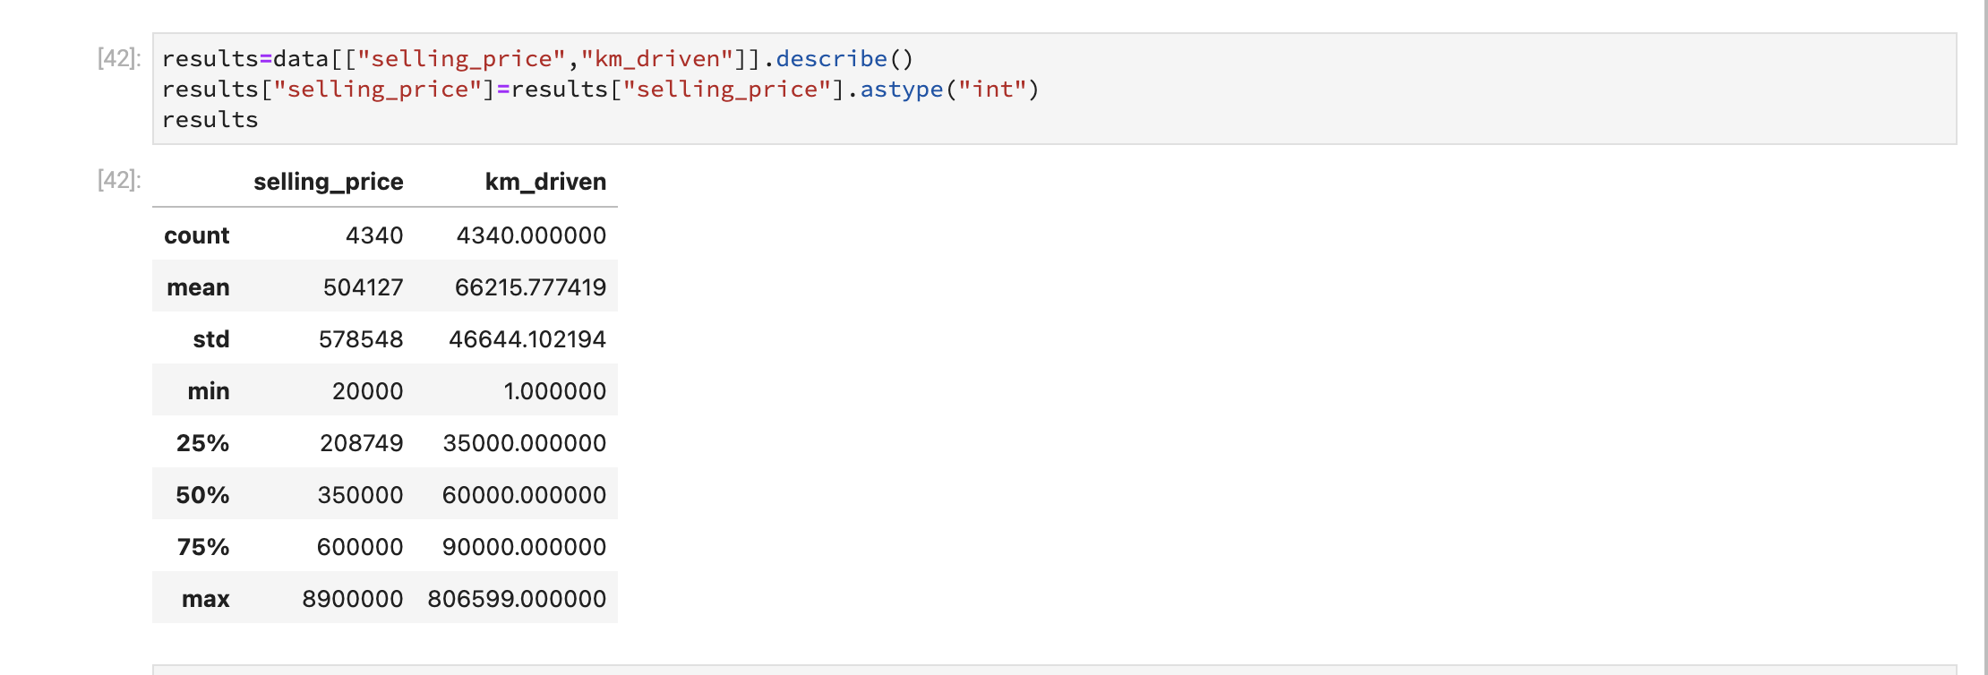
Shows Selling Price and Kms Driven

Slide 6
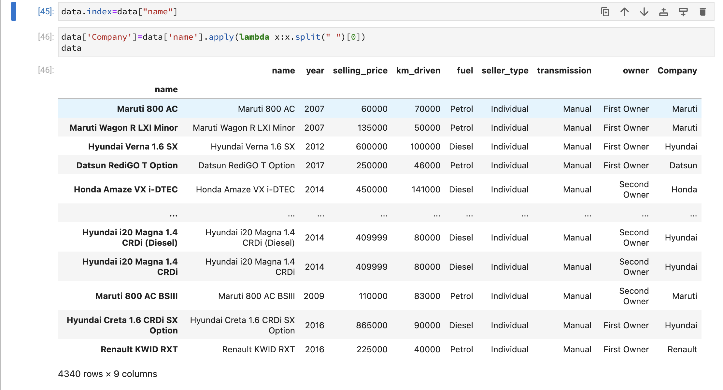

Slide 7
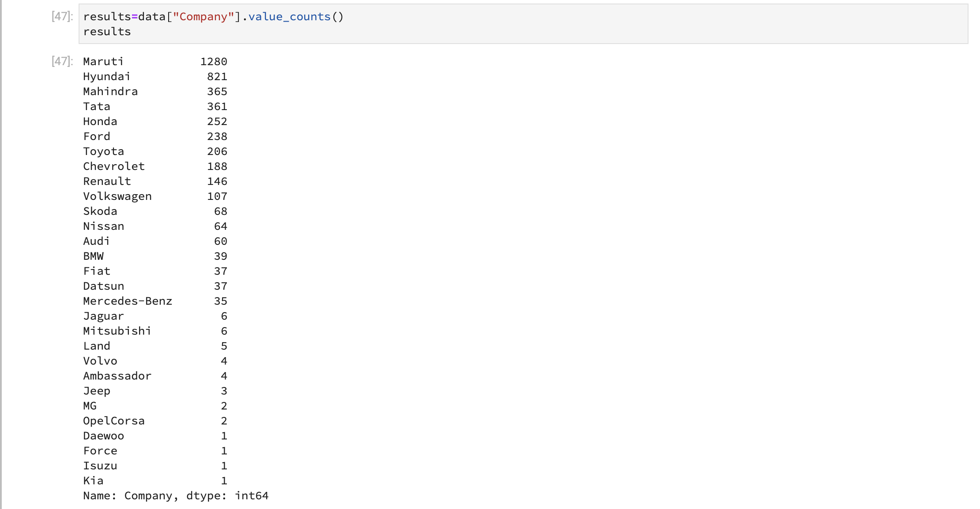
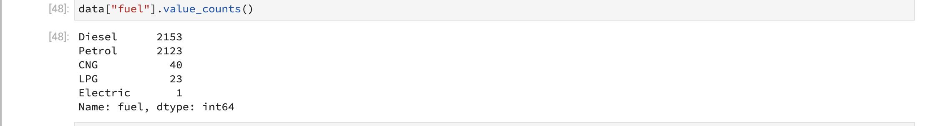
Number of cars sold by each company:
Number of cars sold by fuel type:

Slide 8
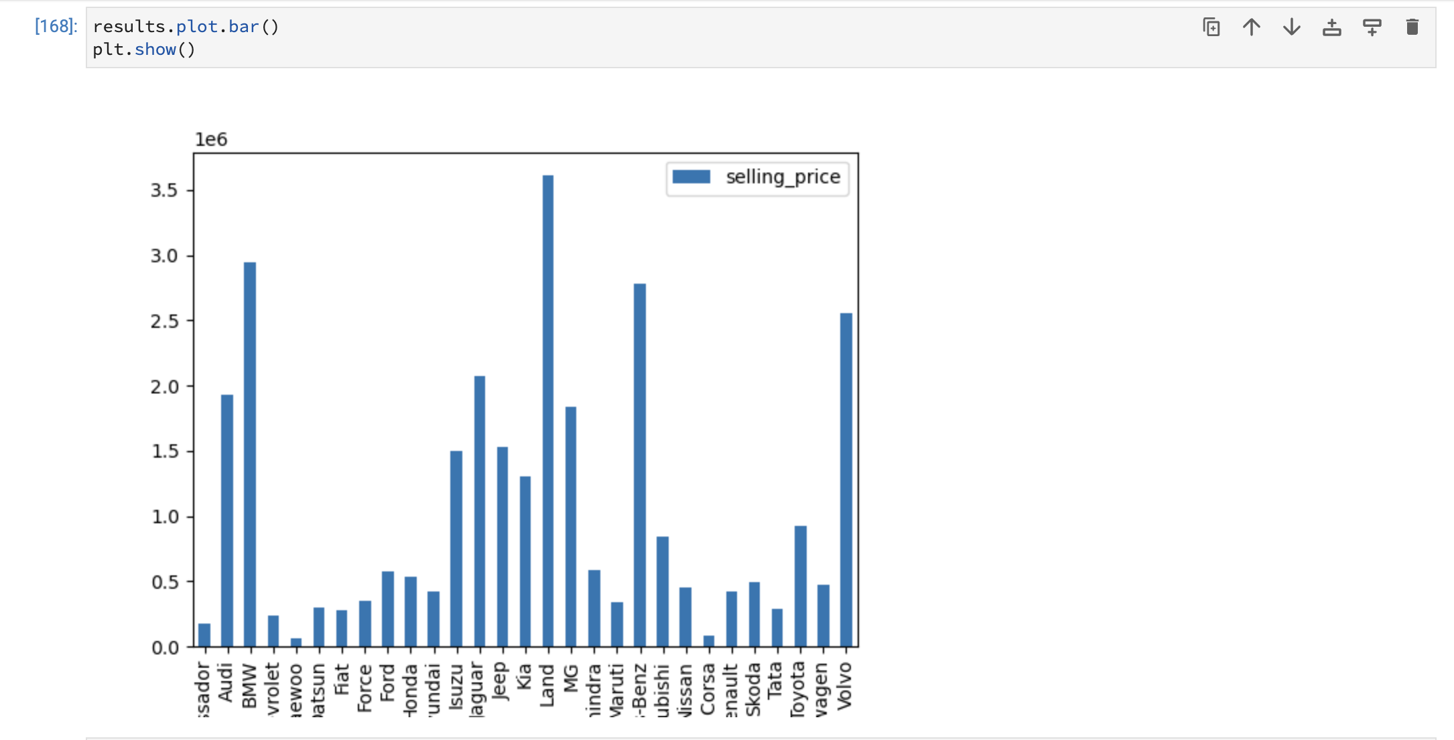
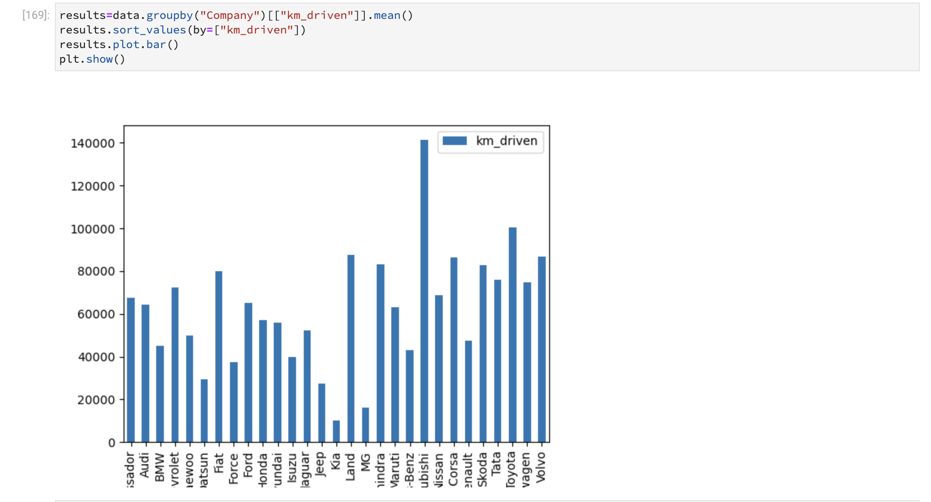
VISUALIZATION ANALYSIS:

Slide 9
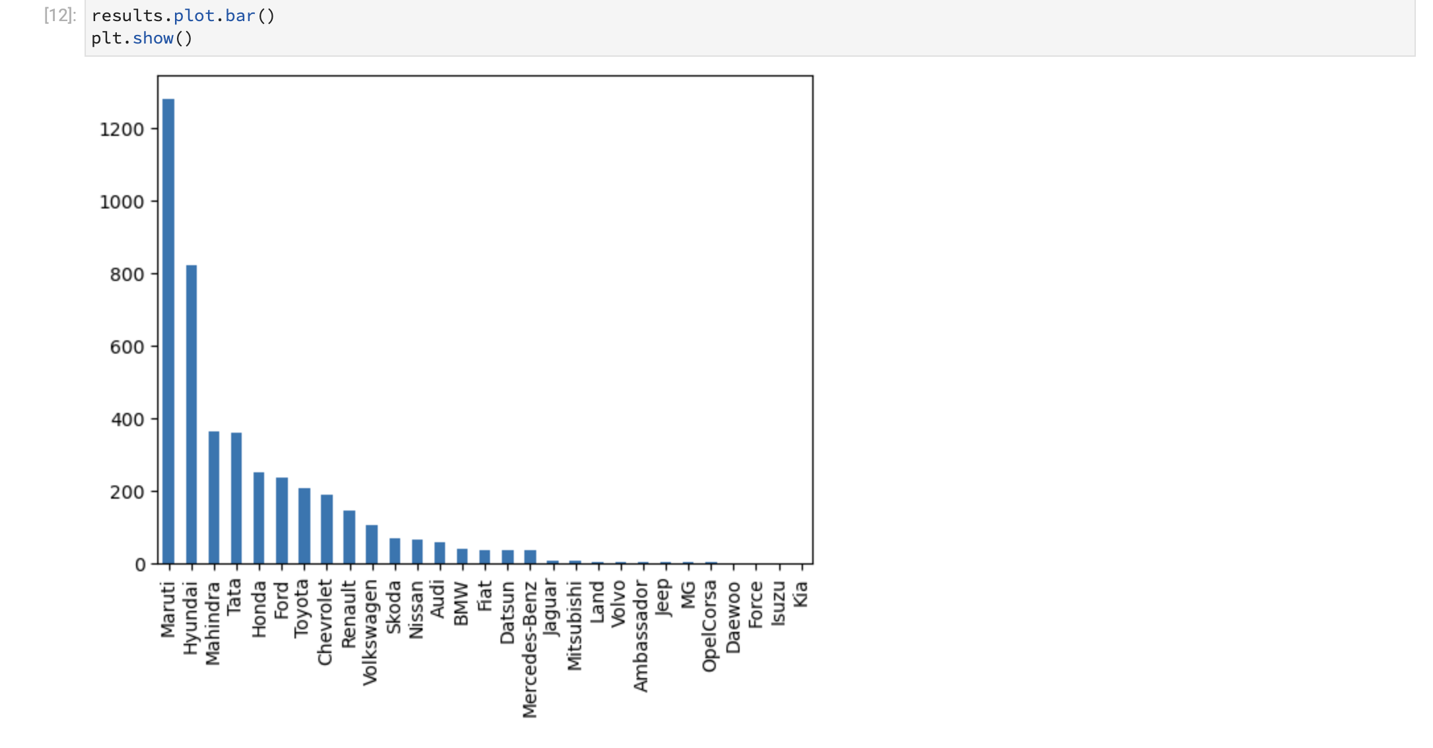

Slide 10
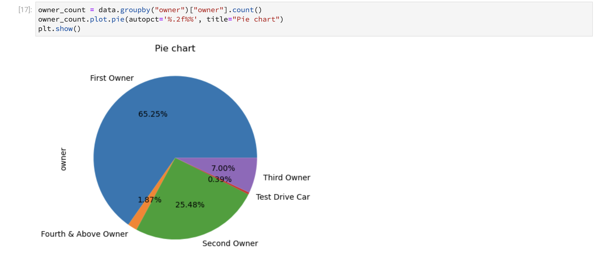
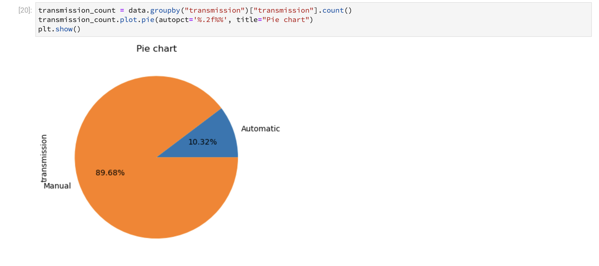
VISUALIZATION ANALYSIS:

Slide 11
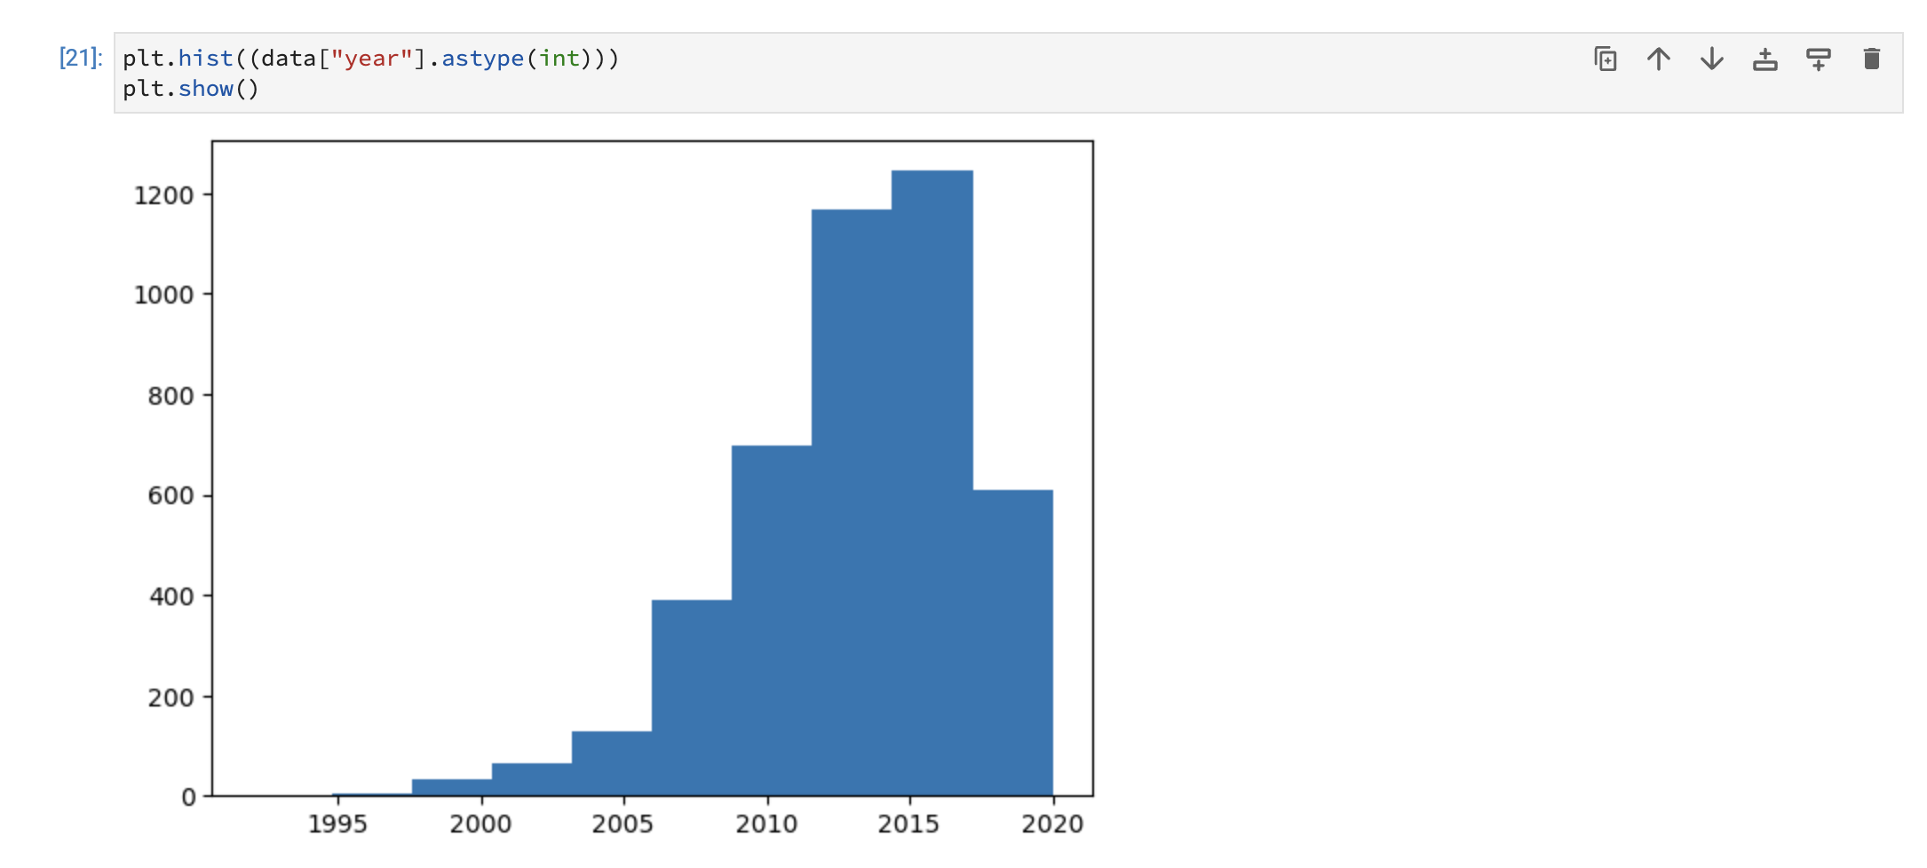

Slide 12
CONCLUSION:
MARUTI SUZUKI has high margin compare to all cars.
Diesel and Petrol cars are almost sold equally and the least is electric cars.
First owner cars are sold highest by 65.25% and test drive cars are sold least by 0.39%
Manual transmission cars are sold highest by 89.68% and automatic by 10.32%
KIA,FORCE ISUZU cars are list sold.

