Slide 1
Predicting Employee Attrition in the Workplace Using Predictive Models
By
TANISHQ CHERUKURI

Slide 2
Background of the Study
Employee attrition poses a significant challenge, impacting organizations financially, and operationally (Hasan, 2017).
Attracting and retaining top talent is crucial for modern businesses, emphasizing the need for proactive management strategies (Erkkilä, 2020).
Data analytics and employee behavior insights enable a shift from reactive to proactive management of attrition hence anticipating issues before they serious.
This research aims to identify patterns, trends, and indicators of employee attrition through the analysis of historical data, surveys, and external factors (Emerald Insight, 2019).
The adoption of predictive analytics helps in retaining valuable employees by identifying warning indicators and facilitating strategic workforce planning.
Some of the factors that cause attrition are imbalance workplace, career advancement opportunities, unhealthy relationships with managers, etc
Recent studies highlight the impact of attrition on company culture and reputation, emphasizing the need for strategic decision-making guided by predictive models (Holtom et al., 2008).

Slide 3
Business Problem/Issue
Employee attrition is a major issue for firms, damaging their bottom line and overall operational efficiency. The expenditures of recruiting, onboarding, and training new staff are significant (Chhavi, 2022). Aside from the financial implications, attrition damages team relationships, resulting in lower morale and productivity among surviving employees.
When senior staff leave, businesses risk losing institutional knowledge and expertise. To address this issue, a proactive approach beyond reactive measures is required to predict attrition tendencies and apply targeted retention efforts (Grotto et al., 2017).

Slide 4

Objective of the Project
This project aims to create a prediction model for staff attrition to help companies avoid losing employees. It also seeks to discover significant attrition traits and patterns for a clear understanding and retention program creation.

Slide 5
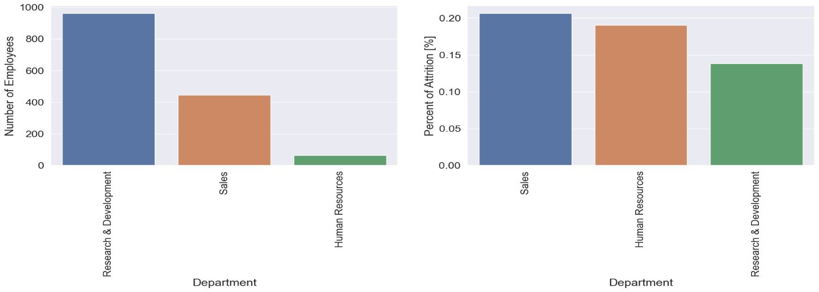
Data Analysis Results
The figure above shows that sales and human resources employees have a higher likelihood of leaving the company than research and development employees. This could be due to a variety of factors such as high-pressure environments, demanding targets, which could lead to increased stress and potential dissatisfaction.

Slide 6
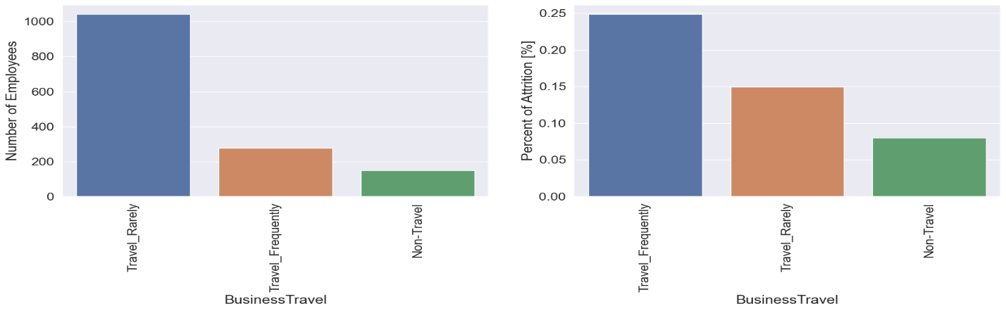
Data Analysis Results
The figure above shows that frequent travelers’ employees are more likely to leave the company. Frequent business travel can cause work-life imbalance and dissatisfaction due to extended time away from home.

Slide 7
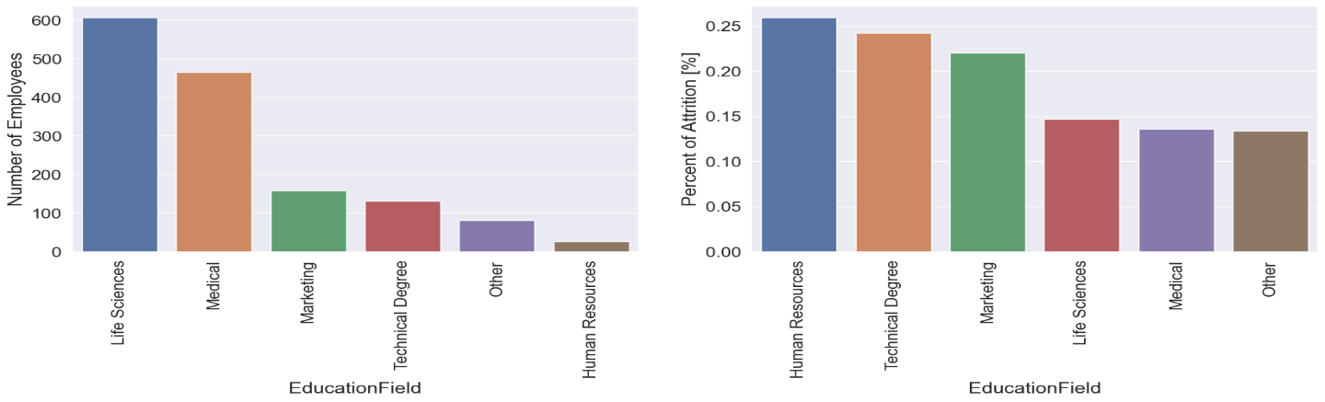
Data Analysis Results
The figure above shows that employees with a background in human resources show a higher likelihood of leaving the company as compared to those who studied medical and other professions. This could be due to a variety of challenges such as dealing with employee’s relations, workplace conflicts and other demanding tasks related to HR.

Slide 8
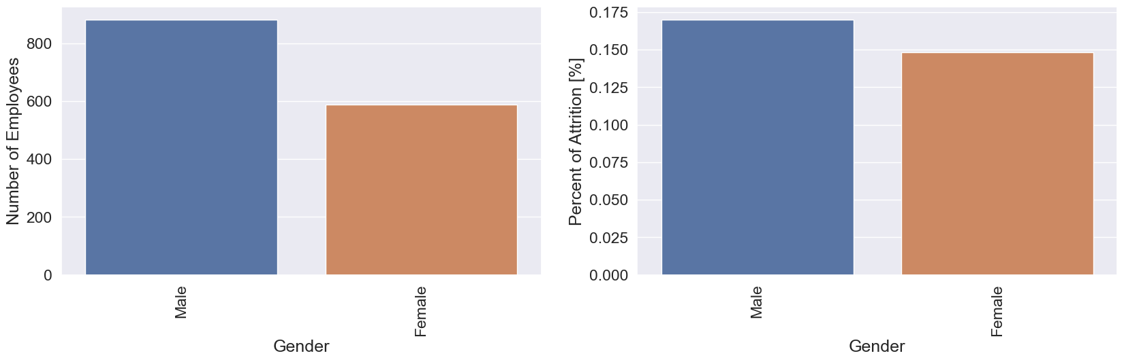
Data Analysis Results
The figure above shows that male employees show a higher likelihood of leaving the company than female employees. Some of the factors are imbalance work-life, job dissatisfaction, and career advancement opportunities.

Slide 9
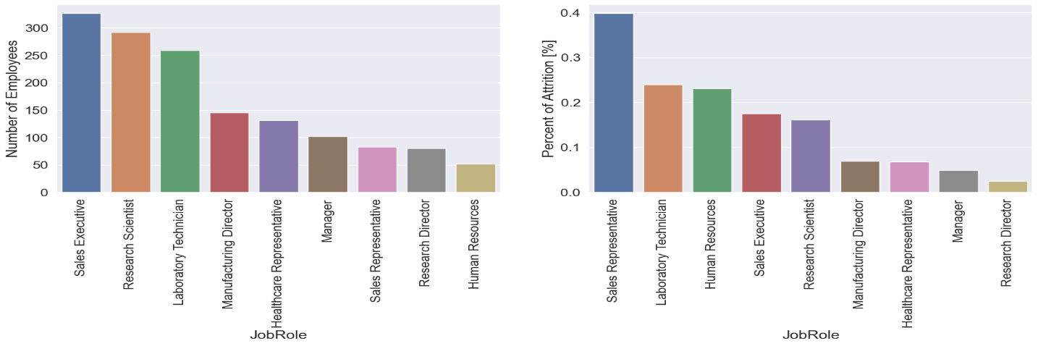
Data Analysis Results
The figure above shows that sales representatives are more likely to leave the company than managers and research directors. High-pressure targets, intense competition, and frequent client interactions may cause this. Sales positions are stressful and dissatisfying which may increase attrition compared to managers and research directors.

Slide 10
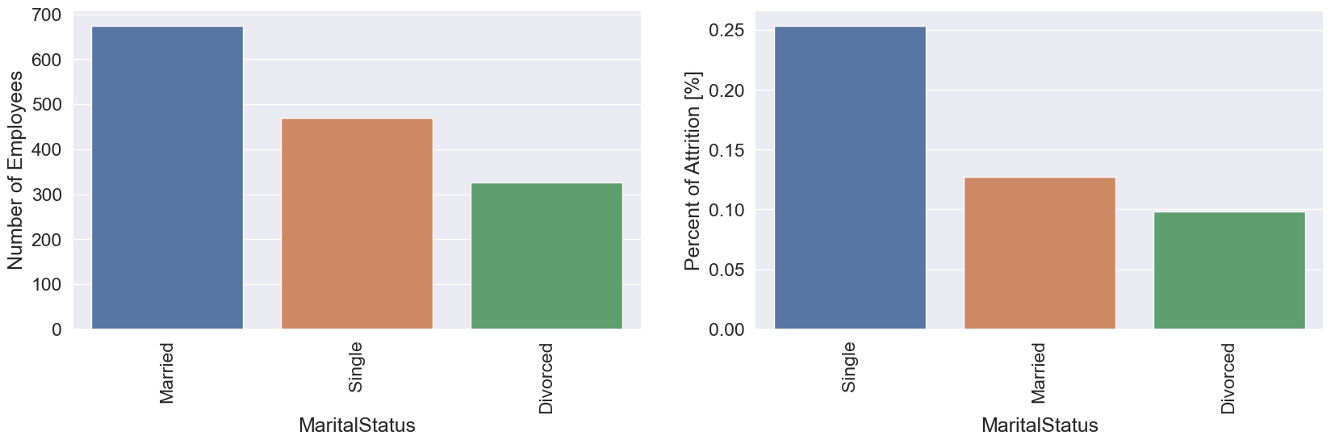
Data Analysis Results
The figure above shows that single employees are more likely to leave the company than married or divorced employees. This could be due to a variety of factors such as different priorities and responsibilities. Single employees have more freedom in their personal lives, which leads to job changes.

Slide 11
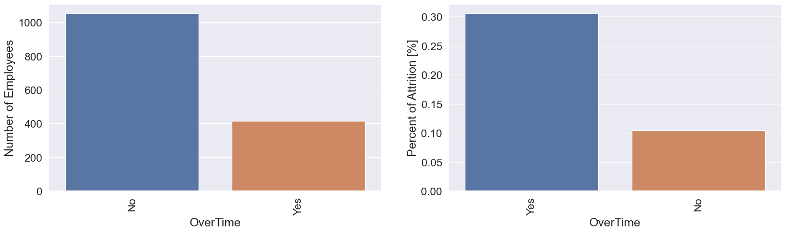
Data Analysis Results
The figure above shows that single employees are more likely to leave the company than married and divorced employees. This could be due to several factors such as differing priorities and responsibilities. Single employees have more personal freedom, which leads to job changes.

Slide 12
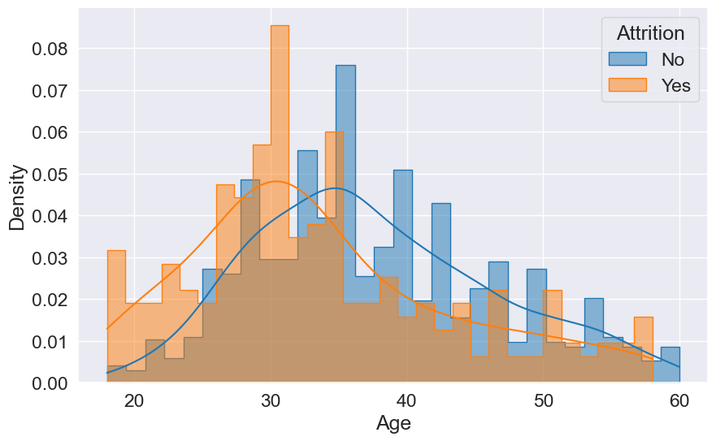
Data Analysis Results
The figure above shows that the age range of around 25 to 35 years old stands out with the most remarkable attrition rate as compared to 40 years and older. Some of the reasons can be career development and advancement opportunities.

Slide 13
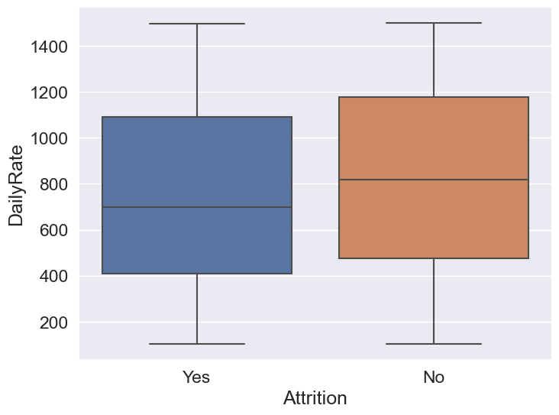
Data Analysis Results
The figure above shows that employees who are paid less per day are more likely to leave the firm than those who are paid more per day. Employees who believe they are underpaid for their skills, responsibilities, or market standards may be more likely to seek employment elsewhere.

Slide 14
Modelling Results - Performance
The table above shows that Logistic Regression predicts employee attrition very well as compared to other models. In contrast, Naive Bayes’ high ROC score shows great predicting ability for identifying leaving employees. The Naïve Bayes model is appropriate for identifying employees who are likely to leave and those who are likely to stay since it has a ROC of 73.41%. Naïve Bayes effectively reduces false negatives hence making it ideal for predicting employee leaves. Random Forest models are good in capturing complex relationships and managing multicollinearity hence can be best option since our data had multicollinearity.
Model Name | Accuracy | ROC
Logistic Regression | 89.12% | 65.49%
SVC | 88.78% | 57.69%
Gradient Boosting | 88.10% | 61.64%
Random Forest | 87.42% | 54.74%
Naive Bayes | 84.01% | 73.41%

Slide 15
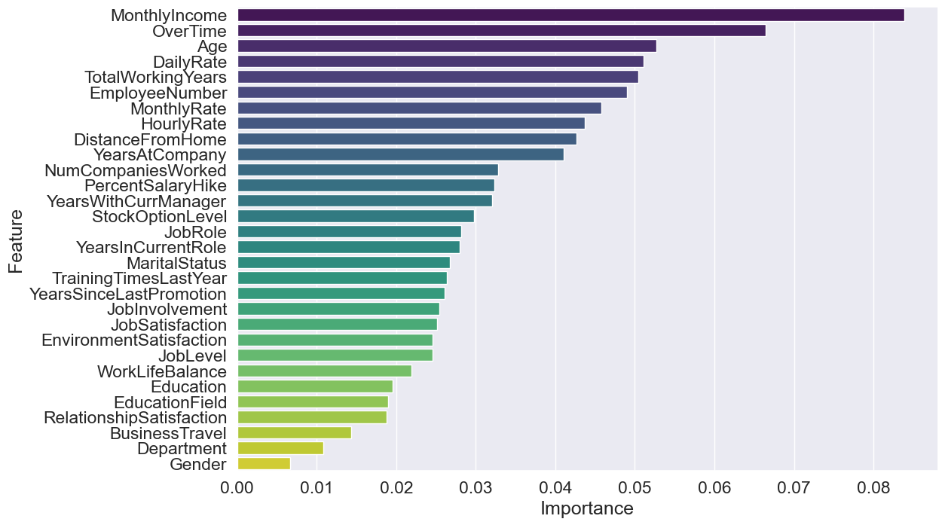
Data Analysis Results
The figure above shows that monthly income, overtime, age, daily rate, total working years, number of employees, monthly rate, hourly rate, distance from home are top 11 features which influence the likelihood of leaving the company. The least importance features are gender, department, and business travel.

Slide 16
Recommendation Actions
Focus on Compensation and Benefits: MonthlyIncome, Overtime, and HourlyRate are crucial. Consider competitive salary packages and manage overtime work effectively to reduce attrition.
To pay attention to the age factor: Younger employees may be more prone to leave, so strategies targeting this age group could be beneficial.
Work-Life Balance and Satisfaction: TotalWorkingYears, JobSatisfaction, and WorkLifeBalance play roles. Ensure a healthy work-life balance, job satisfaction, and overall employee well-being.
Individual Employee Engagement: EmployeeNumber and MonthlyRate suggest individual variations. Understand the needs and concerns of specific employees.
Consider Retention Strategies: BusinessTravel, Department, and Gender are less impactful, they should not be ignored. Evaluate the impact on a case-by-case basis and implement targeted retention strategies where needed.
Best Machine Learning Model: The Random Forest model demonstrated good performance in predicting employee attrition. The Random Forest models are less prone to overfitting, ability to handle complex relationship, and manage multicollinearity since our data set had multicollinearity. Deploy this model as a key tool for retention strategy.

Slide 17
Conclusion
In conclusion, our project successfully addressed the challenge of employee attrition by developing predictive models and identifying key factors influencing attrition. The Logistic Regression model demonstrated high accuracy hence making it reliable for overall predictions. However, Naive Bayes outperformed in terms of ROC score hence it can minimize false negatives thus making it a suitable choice for identifying employees likely to leave. The feature importance analysis shown importance factors such as monthly income, overtime, age, and work-related aspects.
My recommendations focus on compensation, considering age-related strategies, promoting work-life balance, and tailoring retention efforts based on individual engagement. Additionally, the Random Forest model emerged as the best machine learning tool because of its performance in handling complex relationships and multicollinearity. By implementing these findings, organizations can proactively address attrition challenges and encourage a more stable and productive workplace hence reducing financial losses.

Slide 18
References
Chhavi, K. (2022). EBSCO Publishing Service Selection Page. Web.p.ebscohost.com. https://web.p.ebscohost.com/
Emerald Insight. (2019). Discover Journals, Books & Case Studies | Emerald Insight. Emerald.com. https://www.emerald.com/insight/
Erkkilä, S. (2020). Managing voluntary employee turnover with HR analytics. Lutpub.lut.fi, 31(211). https://lutpub.lut.fi/handle/10024/161686
Grotto, A. R., Hyland, P. K., Caputo, A. W., & Semedo, C. (2017). Employee Turnover and Strategies for Retention. The Wiley Blackwell Handbook of the Psychology of Recruitment, Selection and Employee Retention, 3212(443), 443–472. https://doi.org/10.1002/9781118972472.ch21
Hasan, Md. N. (2017). Factors affecting employee turnover and sound retention strategies in business organization: a conceptual view. Problems and Perspectives in Management, 15(1), 63–71. https://www.ceeol.com/search/article-detail?id=620104

Slide 19
Thank You

