Slide 1
SECURE DATA HIDING IN IMAGES USING STEGANOGRAPHY
SECURE THE DATA TO PREVENT HACKERS
Presented By:
Student Name : Tanishq Kandari
College Name & Department : Graphic Era University (BTECH CSE)

Slide 2
OUTLINE
Problem Statement
Technology used
Wow factor
End users
Result
Conclusion
Git-hub Link
Future scope

Slide 3
Problem Statement
Developing a secure method for hiding sensitive data within images is crucial to ensure confidentiality and prevent unauthorized access. Traditional encryption techniques may attract attention, whereas steganography conceals data within media files, making it less detectable. This project focuses on implementing a steganographic technique in JavaScript to embed and extract hidden text within images. Additionally, the solution ensures data integrity by verifying the extracted text against the original message.

Slide 4
Technology used
cv2 (OpenCV): Used for image processing and manipulation.
os: Helps with file handling and system operations.
string: Provides string manipulation utilities.
tkinter: Enables GUI-based user interaction.
filedialog, simpledialog: Allow file selection and user input via dialogs.
PIL (Image, ImageTk): Used for handling and displaying images in Tkinter.
messagebox: Displays alert and confirmation messages to the user.

Slide 5
Wow factors
This project stands out with its user-friendly GUI, making it accessible even to users without prior technical knowledge. A passcode feature adds an extra layer of security, ensuring only authorized access to hidden data. Each component, including image insertion and message entry, is uniquely identified for seamless interaction. Implemented in Jupyter Notebook, the project provides an interactive and intuitive experience. The combination of steganography, security, and accessibility makes it a unique and practical solution.

Slide 6
End users
Journalists & Activists: Securely hide sensitive information in images to avoid detection.
Cybersecurity Professionals: Use for secure data transmission and forensic analysis.
General Users: Protect personal data without needing prior technical knowledge.
Law Enforcement & Intelligence Agencies: Conceal and retrieve confidential information safely.
Researchers & Educators: Demonstrate steganography concepts in an interactive way.

Slide 7
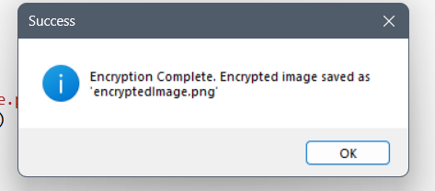
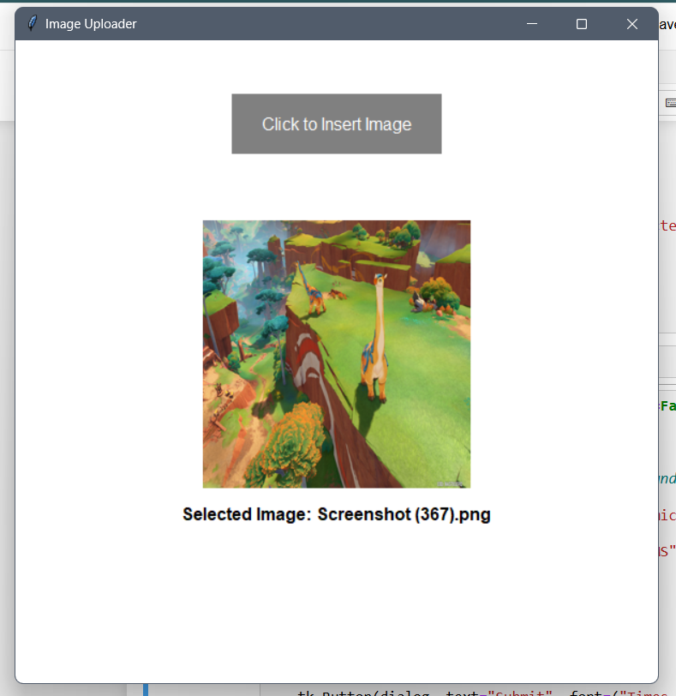
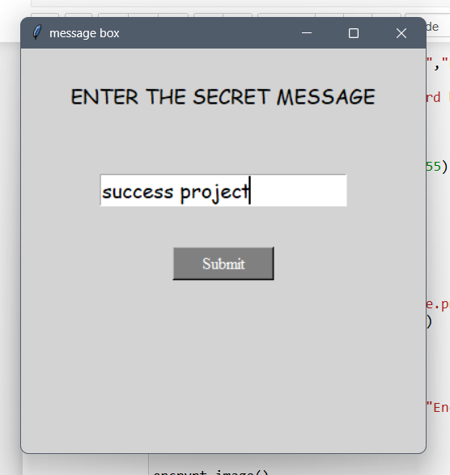
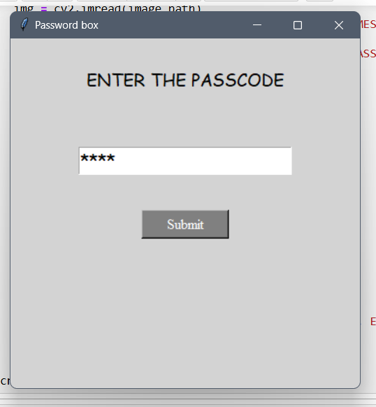
Results - encryption

Slide 8
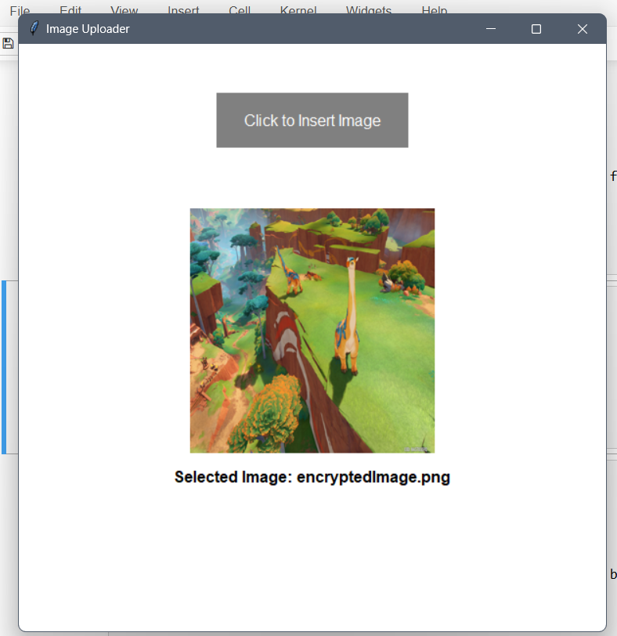
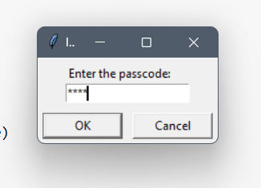
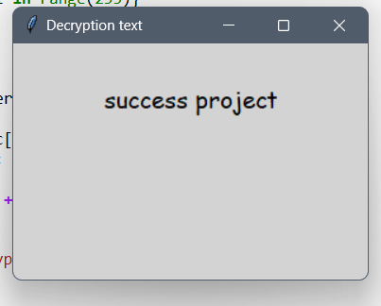
Results - decryption

Slide 9
Conclusion
This project provides a secure and user-friendly approach to hiding sensitive data in images using steganography. By integrating a passcode feature and an intuitive GUI, it ensures accessibility for all users, even those without technical expertise. The use of Jupyter Notebook enhances interactivity, making it easy to experiment with and understand. However, a key concern is that steganographic methods can still be vulnerable to advanced detection techniques and modifications to the image. Ensuring robust encryption alongside steganography can further enhance security. Overall, this project offers a practical and effective solution for confidential data hiding while addressing usability challenges.

Slide 10
GitHub Link
https://github.com/Tanishq-Kandari/AICTE-Internship.git

Slide 11
THANK YOU

