Slide 1
In-depth Lip Interpretation Technology
Submitted in the partial fulfillment for the award of the degree of
BACHELOR OF ENGINEERING
IN
ARTIFICIAL INTELLIGENCE AND MACHINE LEARNING
Submitted by:
TANISHQ ARORA 21BCS11285
SANSKAR SHARMA 21BCS6601
PRAGYA SINGH 21BCS8786
KAVYA ARORA 21BCS11602
Under the Supervision of:
MR. JASWINDER SINGH
Department of AIT-CSE
DISCOVER . LEARN . EMPOWER

Slide 2
Outline
Introduction to Project
Problem Formulation
Objectives of the work
Methodology
Result and Output
Conclusion
Future Scope
References

Slide 3
Introduction to Project
The problem definition of "In-depth lip interpretation technology," involves identifying and addressing challenges related to understanding and interpreting lip movements comprehensively. Here's a brief outline of the problem definition:
1. Limited Communication Accessibility: Many individuals, such as those with speech disabilities or hearing impairments, rely on lip reading as a means of communication. However, traditional lip reading methods have limitations in accurately capturing nuanced lip movements.
2. Ambiguity and Context: Lip movements can be ambiguous and context-dependent. Different words and phrases may appear similar on the lips, making it challenging for individuals to accurately interpret speech solely through lip reading.

Slide 4
3. Variability Across Speakers: People have different lip shapes, sizes, and movements, leading to variability in lip patterns. This variability presents a significant challenge for developing accurate and reliable lip interpretation technologies.
4. Real-time Interpretation: Real-time interpretation of lip movements is crucial for effective communication in various settings, such as during conversations, presentations, or in noisy environments. However, existing technologies may struggle to provide timely and accurate interpretations.
5. Integration with Assistive Technologies: Lip interpretation technology needs to integrate seamlessly with existing assistive technologies, such as speech-to-text systems or hearing aids, to enhance communication accessibility for individuals with diverse needs.
Addressing these challenges requires advanced machine learning algorithms, computer vision techniques, and interdisciplinary research collaborations to develop robust and reliable lip interpretation technologies that can accurately decipher lip movements in various contexts and environments

Slide 5
Problem Formulation
For in-depth lip interpretation technology projects, the focus lies in tackling challenges such as accurately detecting and segmenting lip movements from visual data, developing robust methods for feature extraction capturing lip shape and motion dynamics, analyzing variations in lip gestures across languages, integrating lip interpretation with speech recognition for improved accuracy, mitigating the impact of noise and environmental factors on interpretation, optimizing real-time processing efficiency, and ensuring accessibility for diverse user populations, including those with hearing impairments or speech disabilities.
1. Identification of Lip Movements
2. Feature Extraction and Representation
3. Lip Movement Analysis
4. Speech and Emotion Recognition
5. Noise and Environmental Variability
6. Real-Time Processing and Efficiency
7. Accessibility and Inclusivity

Slide 6
Objectives of the Work
The primary goal of an extensive project on lip interpretation is to establish a sophisticated system proficient in analyzing and comprehending lip movements and patterns with exceptional precision and dependability. This initiative is geared towards crafting advanced algorithms and models tailored to deciphering lip movements, gestures, and expressions, with the intention of application in speech recognition, emotion detection, and communication assistance. By harnessing cutting-edge technology, the system aims to elevate human-computer interaction, foster improved comprehension of spoken language among individuals with hearing impairments, and bolster the efficacy of speech recognition systems, particularly in environments characterized by high levels of noise.
The overarching objective of this endeavor is to develop a robust infrastructure capable of interpreting lip cues with utmost accuracy and reliability, thereby unlocking a myriad of potential applications across various domains. Through the integration of innovative methodologies and computational techniques, the system endeavors to bridge gaps in communication barriers, empower individuals with hearing impairments, and optimize the performance of speech recognition technologies under adverse conditions. Ultimately, the project seeks to revolutionize the landscape of human-machine interaction by leveraging the intricate nuances of lip movements to enhance communication and accessibility for diverse populations.

Slide 7
Methodology
1.Data Collection and Annotation: Gather a diverse dataset of lip movement videos across different speakers, languages, and contexts. Annotate the data with corresponding transcripts or phonetic information to facilitate supervised learning algorithms.
2.Machine Learning Algorithms: Employ machine learning techniques, such as deep learning models (e.g., convolutional neural networks - CNNs, recurrent neural networks - RNNs), to train the system to recognize and interpret lip movements. Transfer learning approaches can be utilized to leverage pre-trained models and adapt them to lip reading tasks.
3.Feature Extraction and Representation: Extract relevant features from lip movement videos, such as shape, texture, and motion characteristics. Explore different feature representation methods, including handcrafted features and learned representations, to capture the unique aspects of lip movements.
4.Temporal Modeling: Since lip movements unfold over time, employ temporal modeling techniques, such as Long Short-Term Memory (LSTM) networks or Temporal Convolutional Networks (TCNs), to capture temporal dependencies and dynamics in lip sequences.

Slide 8
5.Integration of Context and Language Models: Incorporate contextual information and language models to enhance the accuracy and robustness of lip interpretation. Language models can provide additional context and constraints to improve the recognition of ambiguous or context-dependent lip movements.
6.Evaluation Metrics: Define appropriate evaluation metrics, such as word error rate (WER) or phoneme error rate (PER), to assess the performance of the lip interpretation system. Conduct thorough evaluations using held-out validation sets and benchmark datasets to measure accuracy, robustness, and generalization capabilities.
7.User-Centered Design and Evaluation: Involve end-users, including individuals with speech disabilities or hearing impairments, throughout the development process. Solicit feedback, conduct usability studies, and iteratively refine the system based on user input to ensure it meets their needs and preferences.
8.Privacy and Ethical Considerations: Implement privacy-preserving measures, such as data anonymization and encryption, to protect the confidentiality of user data and ensure compliance with relevant privacy regulations. Adhere to ethical guidelines and obtain informed consent from participants involved in data collection and evaluation studies.
9.Interdisciplinary Collaboration: Foster collaboration between researchers, engineers, clinicians, linguists, and end-users to leverage diverse expertise and perspectives in the development of lip interpretation technology. Engage in knowledge sharing and interdisciplinary dialogue to address complex challenges and optimize system performance.

Slide 9
Result and Outputs
Metrics:
Accuracy:
This fundamental metric assesses the model's performance on new, unseen data by comparing correct predictions to actual labels.
Balanced Accuracy:
Similar to accuracy but considers variations in data distribution, particularly valuable for unbalanced datasets, though in this project, the dataset is mostly balanced.
Precision:
Indicates the confidence level of the model by measuring the ratio of True Positives to the sum of False Positives and True Positives.
.

Slide 10
Recall:
Evaluates the ratio of True Positives to the sum of False Negatives and True Positives.
F1 Score:
A weighted average of precision and recall, serving as a compromise between the two metrics, with a higher score indicating a better model performance.
Model Training:
The 3D CNN was trained for 20 epochs, with a final training accuracy of 97.4% and testing accuracy of 99.2%, crucial for assessing performance on unseen data.

Slide 11
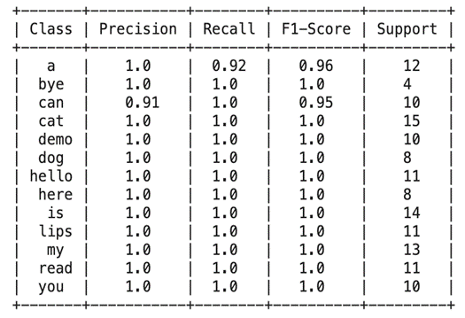

Slide 12
Confusion Matrix Analysis:
Examining the confusion matrix reveals instances where the model confuses visually similar words, such as "a" with "cat," indicating challenges in distinguishing certain lip movements.
Model Performance Metrics:
Precision, recall, and F1 score of 1.0 for most classes demonstrate exceptional accuracy in identifying positive samples. The balanced accuracy of 99.3% further attests to the model's robustness.
ROC AUC Curve:
The ROC curve illustrates consistently high AUC values, indicating strong discriminatory ability. The curve's steep ascent towards the top-left corner signifies high true positive rates at low false positive rates, indicative of the model's effectiveness

Slide 13
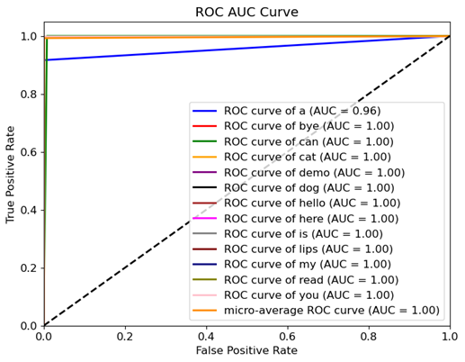

Slide 14
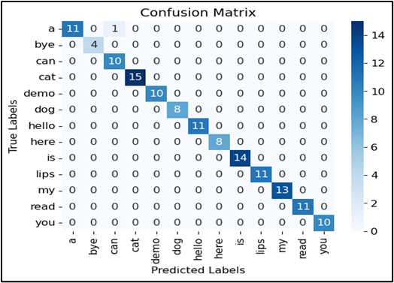

Slide 15
Conclusion
Lip interpretation technology has evolved significantly, showcasing human innovation and technological advancement.
Integration of computer vision enables accurate lip tracking and real-time analysis of lip movements.
Machine learning enhances lip interpretation by learning complex patterns from large datasets.
Applications include real-time subtitles for the deaf, surveillance, and natural human-computer interaction.
Challenges include variability in lip movement, context importance, and privacy concerns.
Ethical adoption and continued research are crucial for addressing challenges and maximizing technology benefits.

Slide 16
Future Work
Enhance lip reading systems by incorporating additional modalities like facial expressions and contextual information.
Improve model focus and handling of distractions with attention mechanisms.
Boost performance through transfer learning and domain adaptation techniques.
Tackle variability in lip movements using data augmentation and regularization techniques.
Design user-friendly interfaces based on user-centric studies and real-time deployment for various lip reading applications.

Slide 17
References
[1] A. Garg, J. Noyola, S. Bagadia, “Lip reading using CNN and LSTM,” in Technical Report, 2016.
[2] Y. Li, Y. Takashima, T. Takiguchi, Y. Ariki, “Lip reading using a dynamic feature of lip images and convolutional neural networks,” in 2016 IEEE/ACIS 15th International Conference on Computer and Information Science (ICIS), pp. 1–6, June 2016.
[3] S. Petridis, Z. Li, M. Pantic, “End-to-end visual speech recognition with LSTMs,” CoRR, vol. abs/1701.05847, 2017.
[4] A. Rekik, A. Ben-Hamadou, W. Mahdi, “A new visual speech recognition approach for RGB-D cameras,” in Image Analysis and Recognition (A. Campilho and M. Kamel, eds.), (Cham), pp. 21–28, Springer International Publishing, 2014
[5]Takeshi Saitoh, Ryosuke Konishi ―A Study of Influence of Word Lip Reading by Change of Frame Rate‖. ISCA Archive on Audio-Visual Speech Processing :speech.org/ archiveHakone, Kanagawa, Japan”
[6]Takeshi Saitoh ―Development of Communication Support System Using Lip Reading‖ IEEJ Transactions On Electrical And Electronic Engineering, IEEJ Trans 2013; 8: 574–579 Published online in Wiley Online Library (wileyonlinelibrary.com). DOI:10.1002/tee.21898
[7] Cruz, Hans Miguel Puente, Jofet Kane T Santos, Christian, Vea Larry A., Rajendaran Vairavan ―Lip Reading Analysis of English Letters as Pronounced by Filipino Speakers Using Image Analysis‖ 1st International Conference on Green and Sustainable Computing (ICoGeS) 2017 IOP PublishingIOP Conf. Series: Journal of Physics: Conf. Series 12345678901019 (2018) 012041 doi :10.1088/1742-6596/1019/1/01204
[8] I. Anina, Z. Zhou, G. Zhao, M. Pietikainen, “Ouluvs2: A multi-view audiovisual database for non-rigid mouth motion analysis,” in 2015 11th IEEE International Conference and Workshops on Automatic Face and Gesture Recognition (FG), vol. 1, pp. 1–5, May 2015.

Slide 18
[9] E. K. Patterson, S. Gurbuz, Z. Tufekci, J. N. Gowdy, “Moving talker, speaker-independent feature study, and baseline results using the CUAVE multimodal speech corpus,” EURASIP J. Appl. Signal Process., vol. 2002, pp. 1189–1201, Jan. 2002.
[10] W. Dong, R. He, S. Zhang, “Digital recognition from lip texture analysis,” in 2016 IEEE International Conference on Digital Signal Processing (DSP), pp. 477–481, Oct 2016.
[11] T. Stafylakis, G. Tzimiropoulos, “Combining residual networks with LSTMs for lipreading,” CoRR, vol. abs/1703.04105, 2017.
[12] J. S. Chung, A. Zisserman, “Lip reading in the wild,” in Asian Conference on Computer Vision, pp. 87–103, Springer, 2016.
[13] Y. Takashima, R. Aihara, T. Takiguchi, Y. Ariki, N. Mitani, K. Omori, K. Nakazono, “Audio-visual speech recognition using bimodal trained bottleneck features for a person with severe hearing loss,” in INTERSPEECH, 2016.
[14]Sunil S. Morade Suprava Patnaik (2015), ―Comparison of classifiers for lip reading with CUAVE and TULIPS database‖. Optik - International Journal for Light and Electron Optics, 126(24), 5753–5761.
[15] M.H. Rahmani, F. Almasganj Lip-reading via a DNN-HMM hybrid system using combination of the image-based and model-based features
[16] T. Stafylakis, G. Tzimiropoulos, Combining Residual Networks with LSTMs for Lipreading, in: Proc Annu Conf Int Speech Commun Assoc INTERSPEECH 2017-August, 2017, 3652–3656.
[17] G. Sterpu, H. Naomi, Towards Lipreading Sentences with Active Appearance Models. AVSP, 2017, 70–75.
[18] K. Thangthai, R. Harvey, Improving computer lipreading via DNN sequence discriminative training techniques, in: Proc Annu Conf Int Speech Commun Assoc INTERSPEECH 2017-August, 2017, pp. 3657–3661. https://doi.org/10.21437/INTERSPEECH.2017-106.
[19] K. Xu, D. Li, N. Cassimatis, X. Wang LCANet: End-to-end lipreading with cascaded attention-CTC
[20] M. Wand, J. Schmidhuber, N.T. Vu, Investigations on End- to-End Audiovisual Fusion. ICASSP, IEEE Int Conf Acoust Speech Signal Process – Proc 2018-April
[21] S. Petridis, T. Stafylakis, P. Ma, et al., End-to-End Audiovisual Speech Recognition. ICASSP, IEEE Int Conf Acoust Speech Signal Process – Proc 2018-April, 2018

Slide 19
[22] T. Afouras, J.S. Chung, A. Zisserman, Deep Lip Reading: a comparison of models and an online application, in: Proc Annu Conf Int Speech Commun Assoc INTERSPEECH 2018-September, 2018, pp. 3514–3518.
[23] S. Petridis, Y. Wang, Z. Li, M. PanticEnd-to-End Audiovisual Fusion with LSTMsThe 14th International Conference on Auditory-Visual Speech Processing. International Speech Communication Association (2018), pp. 36-40
[24] T. Saitoh, Z. Zhou, G. Zhao, M. Pietikäinen, Concatenated Frame Image Based CNN for Visual Speech Recognition. Lect Notes Comput Sci (including Subser Lect Notes Artif Intell Lect Notes Bioinformatics) 10117 LNCS, 2016, pp. 277–289. https://doi.org/10.1007/978-3-319-54427-4_21.
[25] J.S. Chung, A. Zisserman, Lip Reading in the Wild. Lect Notes Comput Sci (including Subser Lect Notes Artif Intell Lect Notes Bioinformatics) 10112 LNCS, 2016, 87–103. https://doi.org/10.1007/978-3-319-54184-6_6.
[26] K. Thangthai, R.W. Harvey, S.J. Cox, B.J. Theobald, Improving lip-reading performance for robust audiovisual speech recognition using DNNs, in: AVSP, 2015, pp. 127–131
[27] M. Zimmermann, M. Mehdipour Ghazi, H.K. Ekenel, J.-P. Thiran, Visual Speech Recognition Using PCA Networks and LSTMs in a Tandem GMM-HMM System. Lect Notes Comput Sci (including Subser Lect Notes Artif Intell Lect Notes Bioinformatics) 10117 LNCS, 2016, 264–276. https://doi.org/10.1007/978-3-319-54427-4_20.
[28] Lee D, Lee J, Kim K-E (2016) Multi-view Automatic Lip-Reading Using Neural Network. Lect Notes Comput Sci (including Subser Lect Notes Artif Intell Lect Notes Bioinformatics) 10117 LNCS:290–302. https://doi.org/10.1007/978-3-319-54427-4_22.
[29] Koumparoulis A, Potamianos G (2019) Deep View2View Mapping for View-Invariant Lipreading. 2018 IEEE Spok Lang Technol Work SLT 2018 - Proc 588–594. https://doi.org/10.1109/SLT.2018.8639698.
[30] Han H, Kang S, Yoo CD (2018) Multi-view visual speech recognition based on multi task learning. Proc - Int Conf Image Process ICIP 2017-September:3983–3987. https://doi.org/10.1109/ICIP.2017.8297030.
[31] A. Bakry, A. Elgammal MKPLS: Manifold kernel partial least squares for lipreading and speaker identification Proc IEEE Comput Soc Conf Comput Vis Pattern Recognit, 684–691 (2013)

