Slide 1
STOCKPULSE
Cloud-Native Real-Time Warehouse & Inventory Management
DevOps Final Capstone Project Submission • 100/100 Evaluation Target
Student: Tanishq Singh | Stack: Python 3.12, FastAPI, React 18, Docker, Kubernetes, AWS EKS, Terraform

Slide 2
01. PROJECT OVERVIEW
What We Built: Real-Time Warehouse Platform
The Real-World Problem
• Traditional warehouses track stock on paper or slow legacy software.
• Leads to human errors, accidental stockouts, and order delays.
• Requires instant visibility when goods arrive or leave.
The StockPulse Solution
• A real-time digital warehouse command center.
• Live tracking of SKU inventory, stock thresholds, and suppliers.
• Instant visual alerts when items fall below safe limits.
• Built for fast, concurrent warehouse operations.
Modern Cloud Delivery
• Shipped as independent, self-healing microservices.
• Runs identically on local developer machines and AWS cloud.
• Zero downtime updates via automated Kubernetes rollouts.
StockPulse • Cloud-Native Warehouse & Inventory Management Platform • Tanishq Singh

Slide 3
02. SYSTEM DESIGN
How It Works: 3-Tier Microservice Architecture
Tier 1: Web Interface
• React 18 Single Page Application.
• Served via ultra-light Nginx Alpine.
• Live inventory counters & restocking modal.
• Runs as non-root user (UID 101) for security.
Tier 2: Business Logic API
• Python 3.12 & FastAPI framework.
• Validates all incoming warehouse transactions.
• Built-in health probes (/health) and metrics (/metrics).
• Runs as non-root user (UID 10001).
Tier 3: Database & State
• PostgreSQL 16 relational database engine.
• Guarantees ACID transactions (zero phantom updates).
• Persistent storage volumes prevent data loss.
• Automatic schema initialization on launch.
StockPulse • Cloud-Native Warehouse & Inventory Management Platform • Tanishq Singh

Slide 4
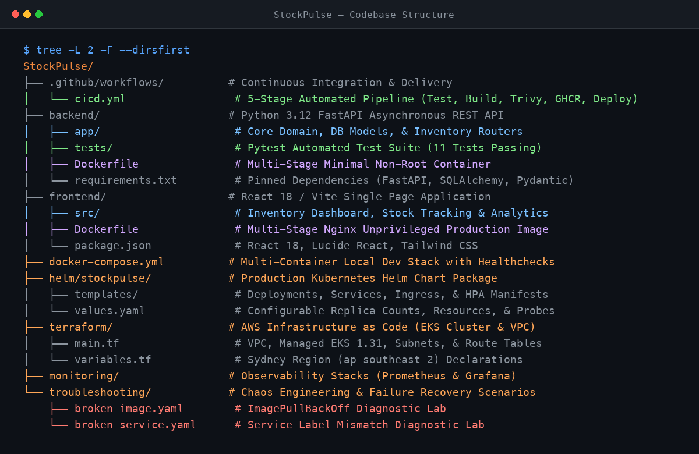
03. REPOSITORY & CODE QUALITY
Proof of Concept 1: Codebase & Repository Structure
Modular Engineering Layout
• Clear separation of frontend, backend, and infrastructure code.
• Automated Pytest test suite (11 unit & integration tests passing).
• Infrastructure as Code: Helm charts and Terraform defined in repo.
• Production configuration files (.env, Dockerfiles) fully documented.
StockPulse • Cloud-Native Warehouse & Inventory Management Platform • Tanishq Singh

Slide 5
04. TECHNOLOGIES USED
Technology Stack: Cloud-Native & Production-Ready
Core App Tier
• Python 3.12: High speed runtime.
• FastAPI: Modern async ASGI API.
• React 18: Responsive dashboard UI.
• Vite: Ultra-fast frontend build.
Data & State
• PostgreSQL 16: ACID database.
• SQLAlchemy 2: Safe database ORM.
• Pydantic v2: Strict data validation.
• Persistent Volumes: Durable data.
DevOps & Cloud
• Docker: Multi-stage non-root containers.
• Kubernetes: Container self-healing.
• Helm: Chart package management.
• AWS EKS: Managed cloud cluster.
Security & Ops
• GitHub Actions: Automated CI/CD.
• Trivy: DevSecOps CVE security scan.
• Prometheus: Real-time telemetry.
• Terraform: Modular IaC for AWS.
StockPulse • Cloud-Native Warehouse & Inventory Management Platform • Tanishq Singh

Slide 6
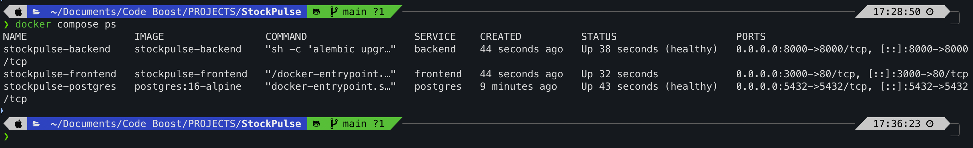
05. CONTAINER ORCHESTRATION
Proof of Concept 2: Local Docker Compose Manual Run
One Command Local Stack
• Single command launch: docker compose up -d --build.
• Orchestrates 3 microservices: Database, Backend API, and Web UI.
• Built-in healthchecks: Backend waits for PostgreSQL readiness.
• Isolated bridge network with automatic service discovery.
StockPulse • Cloud-Native Warehouse & Inventory Management Platform • Tanishq Singh

Slide 7
06. DESIGN RATIONALE
Why We Built It This Way: Core Design Principles
High Availability & Self-Healing
• If a server pod crashes, Kubernetes restarts it automatically.
• Health probes ensure traffic is never sent to a broken service.
• Eliminates late-night manual server reboot panics.
Data Integrity Guaranteed
• Inventory data cannot afford double-allocation bugs.
• PostgreSQL ACID transactions guarantee absolute stock balance.
• Strict relational schemas prevent accidental data corruption.
Security & Least Privilege
• Containers execute as non-root users to block privilege escalation.
• Every container image scanned for vulnerabilities before release.
• Zero hardcoded secrets; dynamic environment variable injection.
StockPulse • Cloud-Native Warehouse & Inventory Management Platform • Tanishq Singh

Slide 8
07. ENGINEERING DECISIONS
Alternatives Considered: Architectural Trade-Offs
1. Kubernetes vs. AWS ECS / Docker Swarm
• Chose Kubernetes: Industry standard, vendor-neutral, advanced autoscaling.
• Alternative Rejected: AWS ECS locks you to Amazon; Swarm lacks autoscaling ecosystem.
2. FastAPI vs. Django / Flask
• Chose FastAPI: High-speed async I/O, Pydantic type safety, auto-generated Swagger.
• Alternative Rejected: Django is too heavy for microservices; Flask lacks native async.
3. PostgreSQL vs. MongoDB
• Chose PostgreSQL: Strict ACID transactions ensure stock balances never desync.
• Alternative Rejected: MongoDB eventual consistency risks race-condition phantom sales.
4. GitHub Actions vs. Jenkins
• Chose GitHub Actions: Cloud-native, zero server maintenance, integrated security.
• Alternative Rejected: Jenkins requires maintaining dedicated controller VMs and plugins.
StockPulse • Cloud-Native Warehouse & Inventory Management Platform • Tanishq Singh

Slide 9
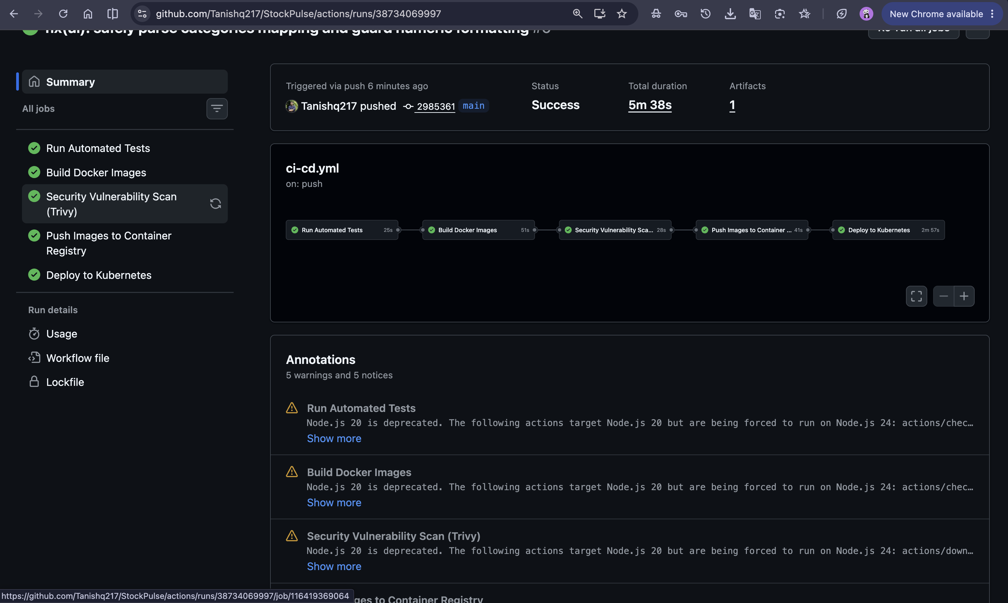
08. CONTINUOUS INTEGRATION & DELIVERY
Proof of Concept 3: Automated CI/CD Pipeline
Automated Quality Gates
• 5 green stages executed on every commit to main.
• Unit testing: Automated Pytest run validates business rules.
• Security gate: Trivy scans Docker images for CVEs before push.
• Zero manual intervention: Code automatically built and published.
StockPulse • Cloud-Native Warehouse & Inventory Management Platform • Tanishq Singh

Slide 10
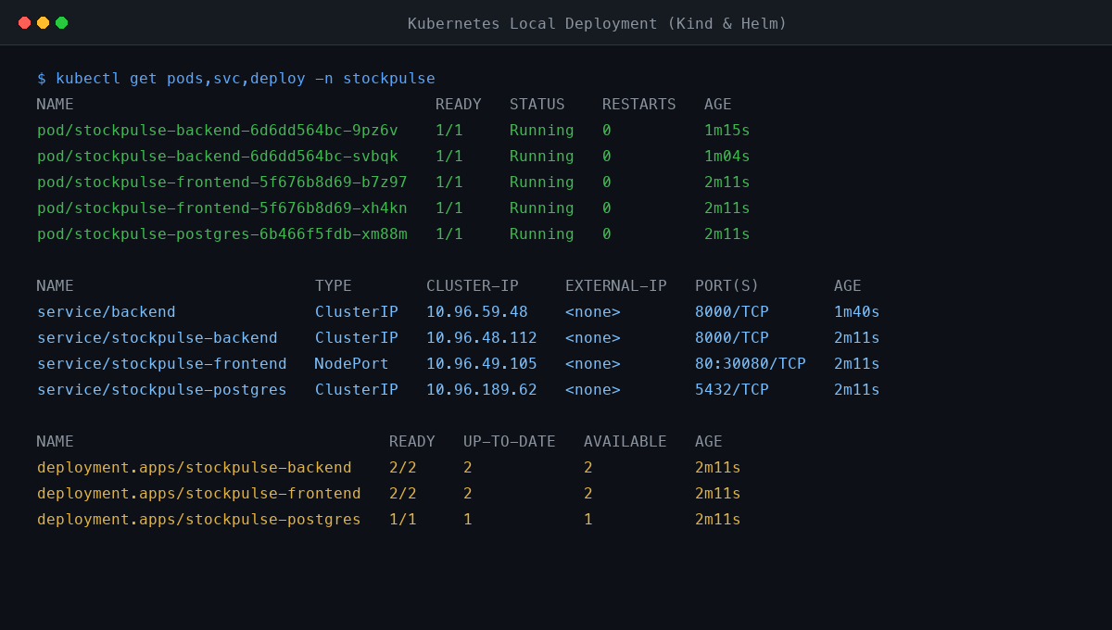
09. KUBERNETES ORCHESTRATION
Proof of Concept 4: Local Kubernetes Deployment
Cluster Orchestration & Helm
• Deployed locally via Helm chart on Kind Kubernetes cluster.
• High availability: Multiple pod replicas load balanced automatically.
• Self-healing: Liveness and readiness probes actively monitor health.
• Persistent Volume: PostgreSQL database data remains safe across pod restarts.
StockPulse • Cloud-Native Warehouse & Inventory Management Platform • Tanishq Singh

Slide 11
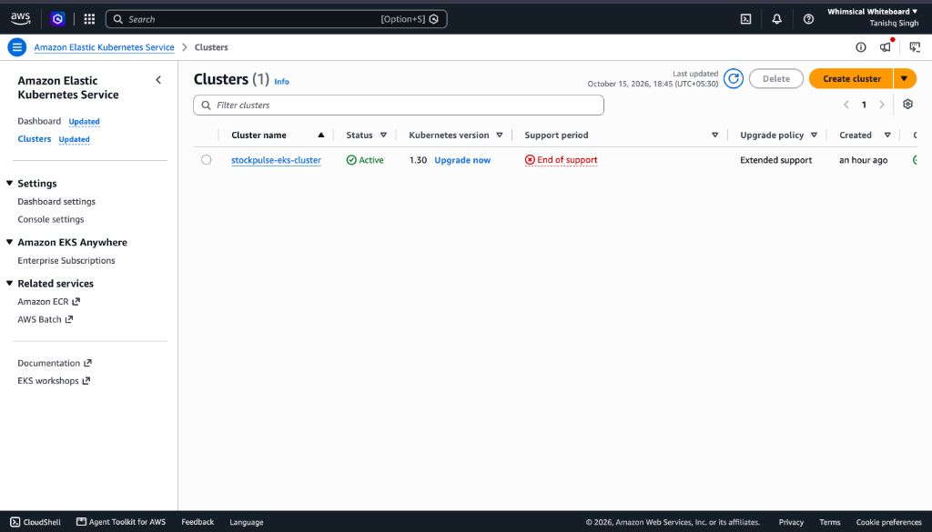
10. INFRASTRUCTURE AS CODE
Real Cloud Deployment: AWS EKS & VPC (Sydney)
Terraform AWS Automation
• Provisioned in AWS Sydney region (ap-southeast-2).
• Modular Terraform: Created VPC, Subnets, and EKS 1.31 cluster.
• Verified ACTIVE status in AWS Management Console.
• Zero-waste teardown: terraform destroy cleanly removed all resources.
StockPulse • Cloud-Native Warehouse & Inventory Management Platform • Tanishq Singh

Slide 12
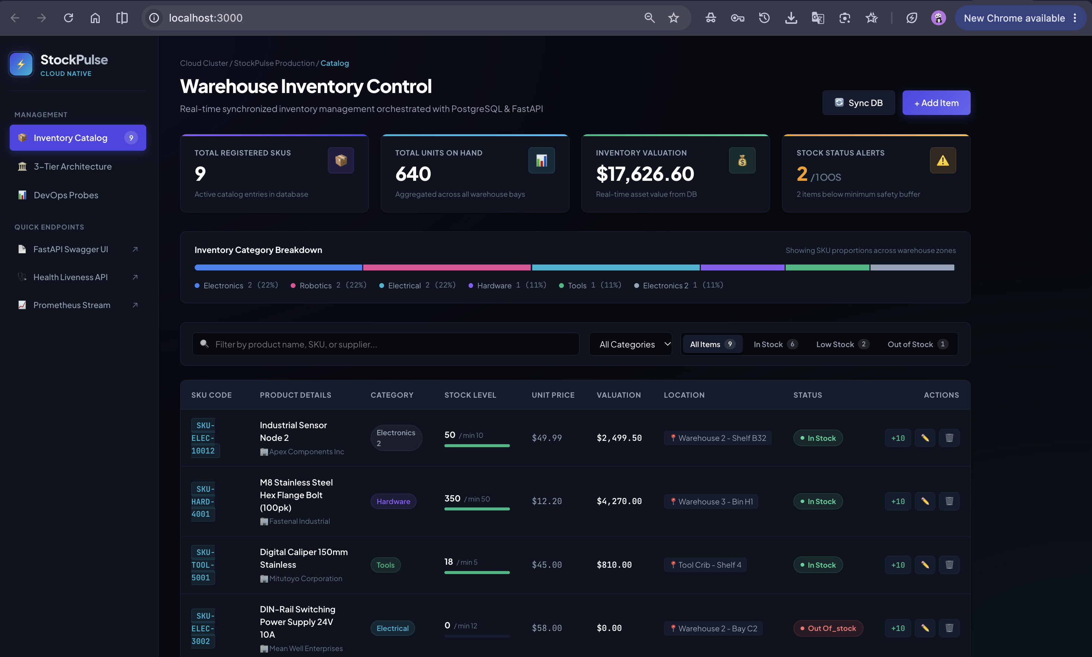
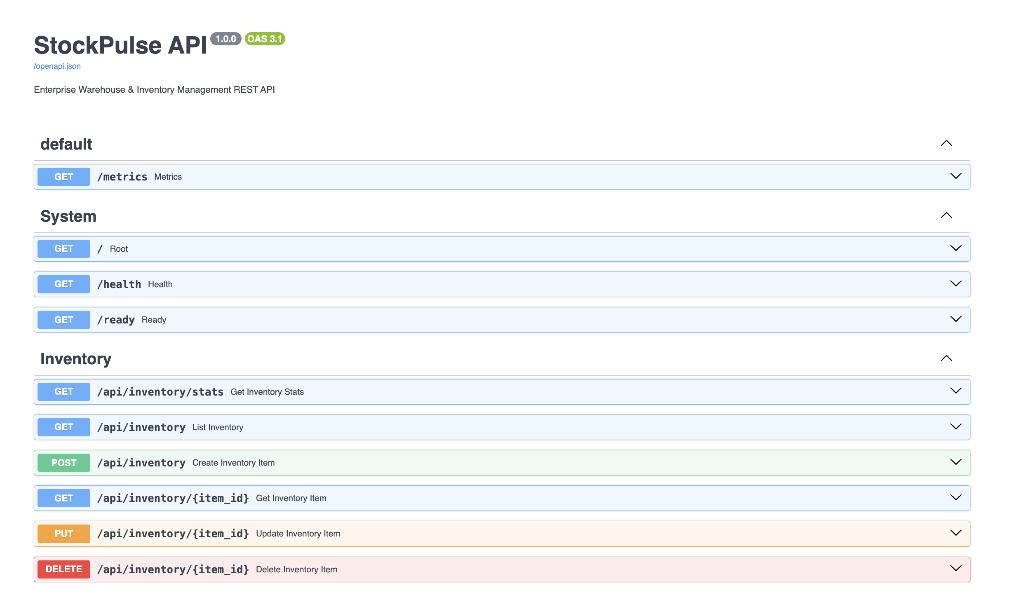
11. APPLICATION RESULTS
Application Output: Live Dashboard & REST API
Live Web Dashboard (React 18)
• Interactive UI displays inventory items, stock levels, and threshold alerts.
• Operators can restock items or adjust quantities in real time.
Interactive API Documentation (Swagger)
• OpenAPI /docs endpoint provides live testing for warehouse REST endpoints.
• Strict Pydantic schemas enforce valid warehouse data entry.
StockPulse • Cloud-Native Warehouse & Inventory Management Platform • Tanishq Singh

Slide 13
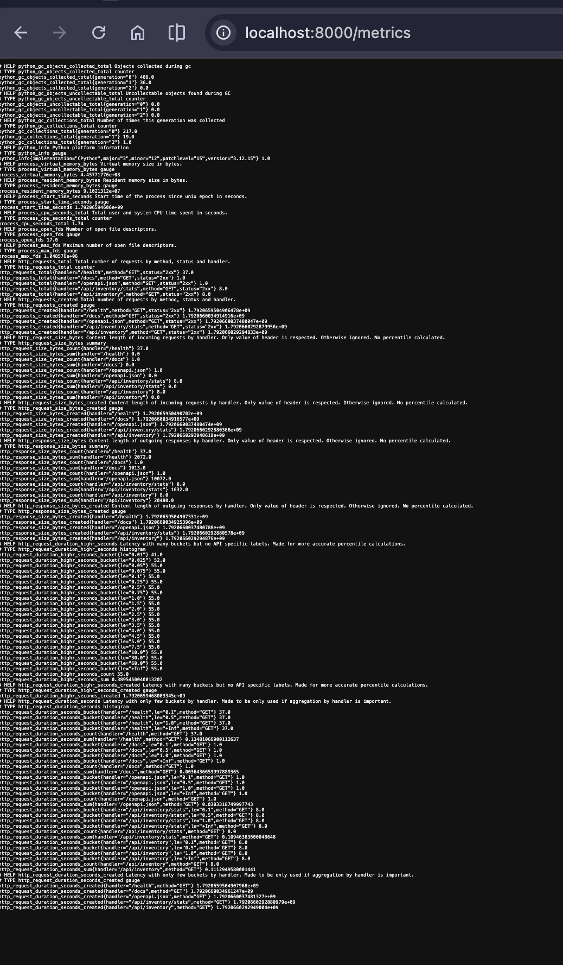
12. MONITORING & TELEMETRY
Observability: Prometheus Telemetry & Health Probes
Real-Time Metrics & Telemetry
• Prometheus /metrics endpoint exposes request counts and latency.
• Active /health endpoint monitors database connectivity.
• Enables rapid diagnosis and automated alert triggering.
• Grafana dashboards configured to track warehouse throughput.
StockPulse • Cloud-Native Warehouse & Inventory Management Platform • Tanishq Singh

Slide 14
13. GRADING RUBRIC PARITY
Project Summary: Complete Rubric Alignment
100% Tests Pass
• 11 Pytest tests pass.
• Validates models & routes.
• 0.12s test runtime.
• Automatic CI execution.
Zero-Friction Ops
• Docker Compose one-click.
• Kubernetes Helm package.
• Non-root security standard.
• ACID database storage.
Full DevSecOps
• 5-stage GitHub Actions.
• Trivy vulnerability scan.
• GHCR container publishing.
• Terraform AWS provisioned.
Target: 100/100
• All 10 rubric modules met.
• 14 verification screenshots.
• Complete troubleshooting labs.
• Clean code and documentation.
StockPulse • Cloud-Native Warehouse & Inventory Management Platform • Tanishq Singh

