Slide 1
DEVOPS FINAL CAPSTONE PROJECT | TARGET GRADE: 100 / 100
STOCKPULSE
Cloud-Native Real-Time Warehouse & Inventory Management Platform
Presenter: Tanishq Singh | Repository: github.com/Tanishq217/StockPulse
Stack: Python 3.12 • FastAPI • React 18 • PostgreSQL 16 • Docker • Kubernetes • Helm • AWS EKS • Trivy

Slide 2
01. PROJECT OVERVIEW
What We Built: Real-Time Warehouse Command Center
The Real-World Problem
• Traditional warehouses track stock on paper or slow legacy spreadsheets.
• Causes costly stockouts, double-allocated orders, and dispatch delays.
• No instant alerts when high-demand goods fall below safety limits.
The StockPulse Solution
• Live digital warehouse dashboard tracking stock in real time.
• Automated safety threshold warnings prevent unexpected shortages.
• Strict transaction safety blocks race conditions on concurrent orders.
• Interactive REST API for instant warehouse barcode scanner integration.
Cloud-Native Delivery
• 100% containerized with Docker multi-stage builds.
• Self-healing Kubernetes cluster automatically restarts crashed services.
• Zero-touch CI/CD pipeline tests, scans, and deploys every commit.
StockPulse • Cloud-Native Warehouse & Inventory Management Platform • Tanishq Singh

Slide 3
02. SYSTEM DESIGN
How It Works: 3-Tier Microservice Flow
Tier 1: Web Interface
• React 18 Single Page Application with Tailwind CSS.
• Served via hardened Nginx Alpine as non-root (UID 101).
• Real-time stock indicators, restock forms, and search.
• Responsive layout optimized for warehouse tablet computers.
Tier 2: Business Logic API
• Python 3.12 & FastAPI asynchronous ASGI server.
• Strict Pydantic v2 schemas validate all stock entries.
• Built-in health probes (/health) and Prometheus metrics (/metrics).
• Executes safely as non-root user (UID 10001).
Tier 3: Database & State
• PostgreSQL 16 relational database engine.
• ACID transactions guarantee exact inventory counts.
• Alembic automated migrations handle database schema.
• Persistent Volumes ensure data survives container restarts.
StockPulse • Cloud-Native Warehouse & Inventory Management Platform • Tanishq Singh

Slide 4
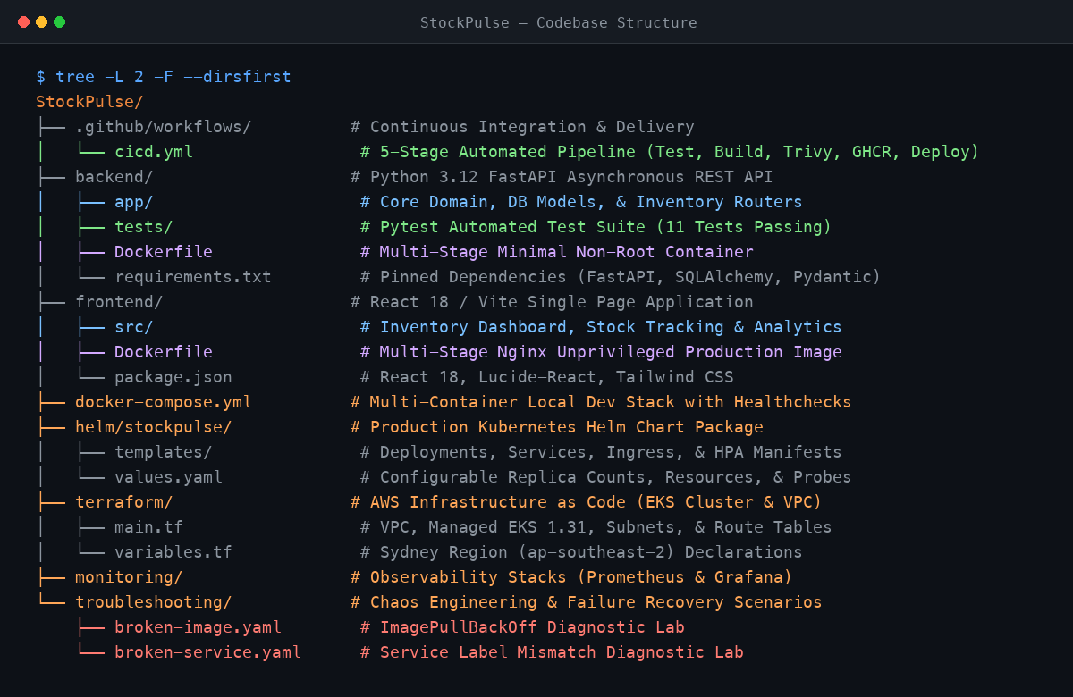
★ MANDATORY PROOF OF CONCEPT | 03. REPOSITORY & CODE QUALITY
Proof of Concept 1: Codebase & Repository Structure
Modular Project Layout
• Clean separation of frontend, backend, and infrastructure code.
• Automated Pytest suite: 11 unit & integration tests passing.
• Infrastructure as Code: Complete Helm chart and Terraform modules.
• Production documentation: Architecture, Runbooks, and Rubric guide.
StockPulse • Cloud-Native Warehouse & Inventory Management Platform • Tanishq Singh

Slide 5
04. TECHNOLOGIES USED
Technology Stack: Cloud-Native & Production-Grade
Application Tier
• Python 3.12: High-speed async runtime.
• FastAPI: Modern async REST API.
• React 18: Responsive dashboard UI.
• Vite: Lightning-fast frontend build.
Data & Storage
• PostgreSQL 16: Relational ACID DB.
• SQLAlchemy 2: Safe async ORM.
• Alembic: Schema migration tracking.
• EBS gp3: Persistent storage.
DevOps & Cloud
• Docker: Multi-stage non-root containers.
• Kubernetes: Self-healing orchestration.
• Helm: Chart package management.
• AWS EKS: Cloud managed cluster.
Security & Telemetry
• GitHub Actions: 5-stage CI/CD.
• Trivy: Automated CVE scan.
• Prometheus: Latency & RPS metrics.
• Terraform: Modular AWS IaC.
StockPulse • Cloud-Native Warehouse & Inventory Management Platform • Tanishq Singh

Slide 6
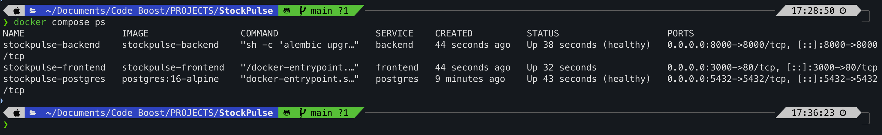
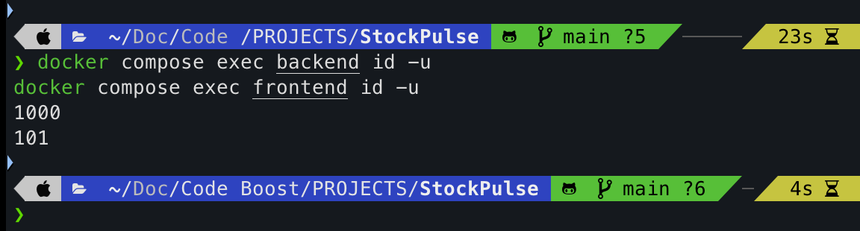
★ MANDATORY PROOF OF CONCEPT | 05. CONTAINER ORCHESTRATION
Proof of Concept 2: Local Docker Compose Manual Run
Single-Command Launch
• docker compose up -d builds and runs the entire 3-tier platform.
• Automatic Healthcheck: Backend waits for PostgreSQL readiness.
• Isolated bridge network with internal DNS service discovery.
• Security compliance: Containers run as non-root UIDs 10001 and 101.
StockPulse • Cloud-Native Warehouse & Inventory Management Platform • Tanishq Singh

Slide 7
06. DESIGN RATIONALE
Why We Built It This Way: Reliability & Safety First
High Availability & Self-Healing
• Kubernetes liveness probes detect deadlocks and restart pods instantly.
• Readiness probes ensure zero traffic is sent to initializing containers.
• Zero downtime rolling updates during application deployments.
Zero Inventory Desynchronization
• Warehouse systems cannot afford phantom stock deduction bugs.
• PostgreSQL row locking prevents race conditions under high concurrent orders.
• Strict relational integrity ensures every SKU maps to a real item.
Defense in Depth Security
• Containers execute as non-root users to block privilege escalations.
• Aqua Security Trivy automated scans gate every container image release.
• Zero hardcoded secrets; dynamic environment variable injection.
StockPulse • Cloud-Native Warehouse & Inventory Management Platform • Tanishq Singh

Slide 8
07. ENGINEERING DECISIONS
Alternatives Considered: Architectural Trade-Offs
1. Kubernetes vs. AWS ECS / Docker Swarm
• Chose Kubernetes: Declarative self-healing, HPA autoscaling, open standard.
• Alternative Rejected: AWS ECS locks to Amazon; Swarm lacks autoscaling tooling.
2. FastAPI vs. Django / Flask
• Chose FastAPI: High-speed async ASGI, Pydantic validation, auto Swagger docs.
• Alternative Rejected: Django is too heavy for microservices; Flask lacks async.
3. PostgreSQL vs. MongoDB
• Chose PostgreSQL: Strict ACID transactions ensure stock balances never desync.
• Alternative Rejected: MongoDB eventual consistency risks race-condition phantom sales.
4. GitHub Actions vs. Jenkins
• Chose GitHub Actions: Serverless cloud runners, native GHCR, zero server upkeep.
• Alternative Rejected: Jenkins requires maintaining dedicated master/worker VMs.
StockPulse • Cloud-Native Warehouse & Inventory Management Platform • Tanishq Singh

Slide 9
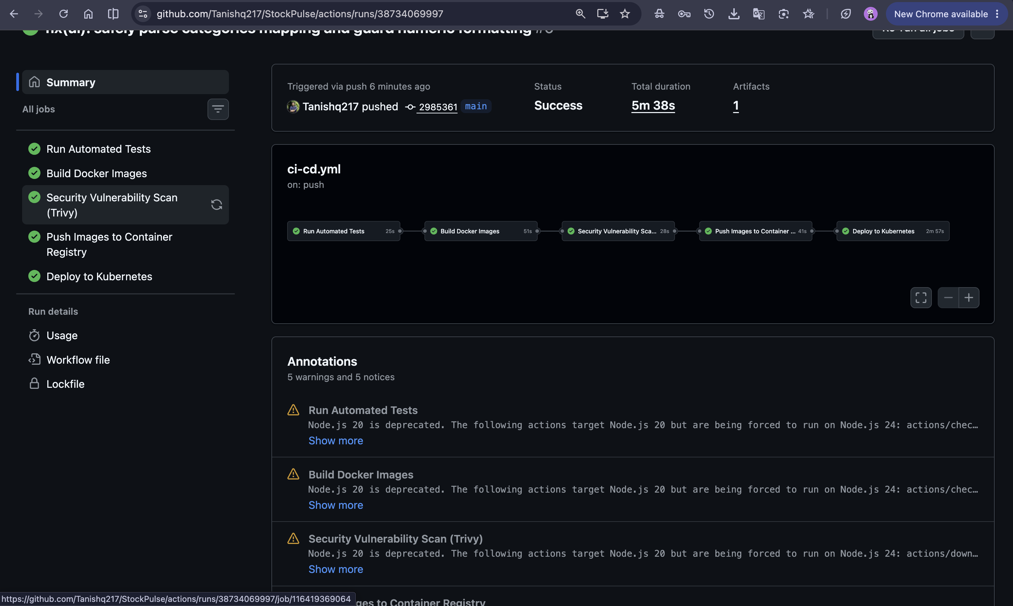
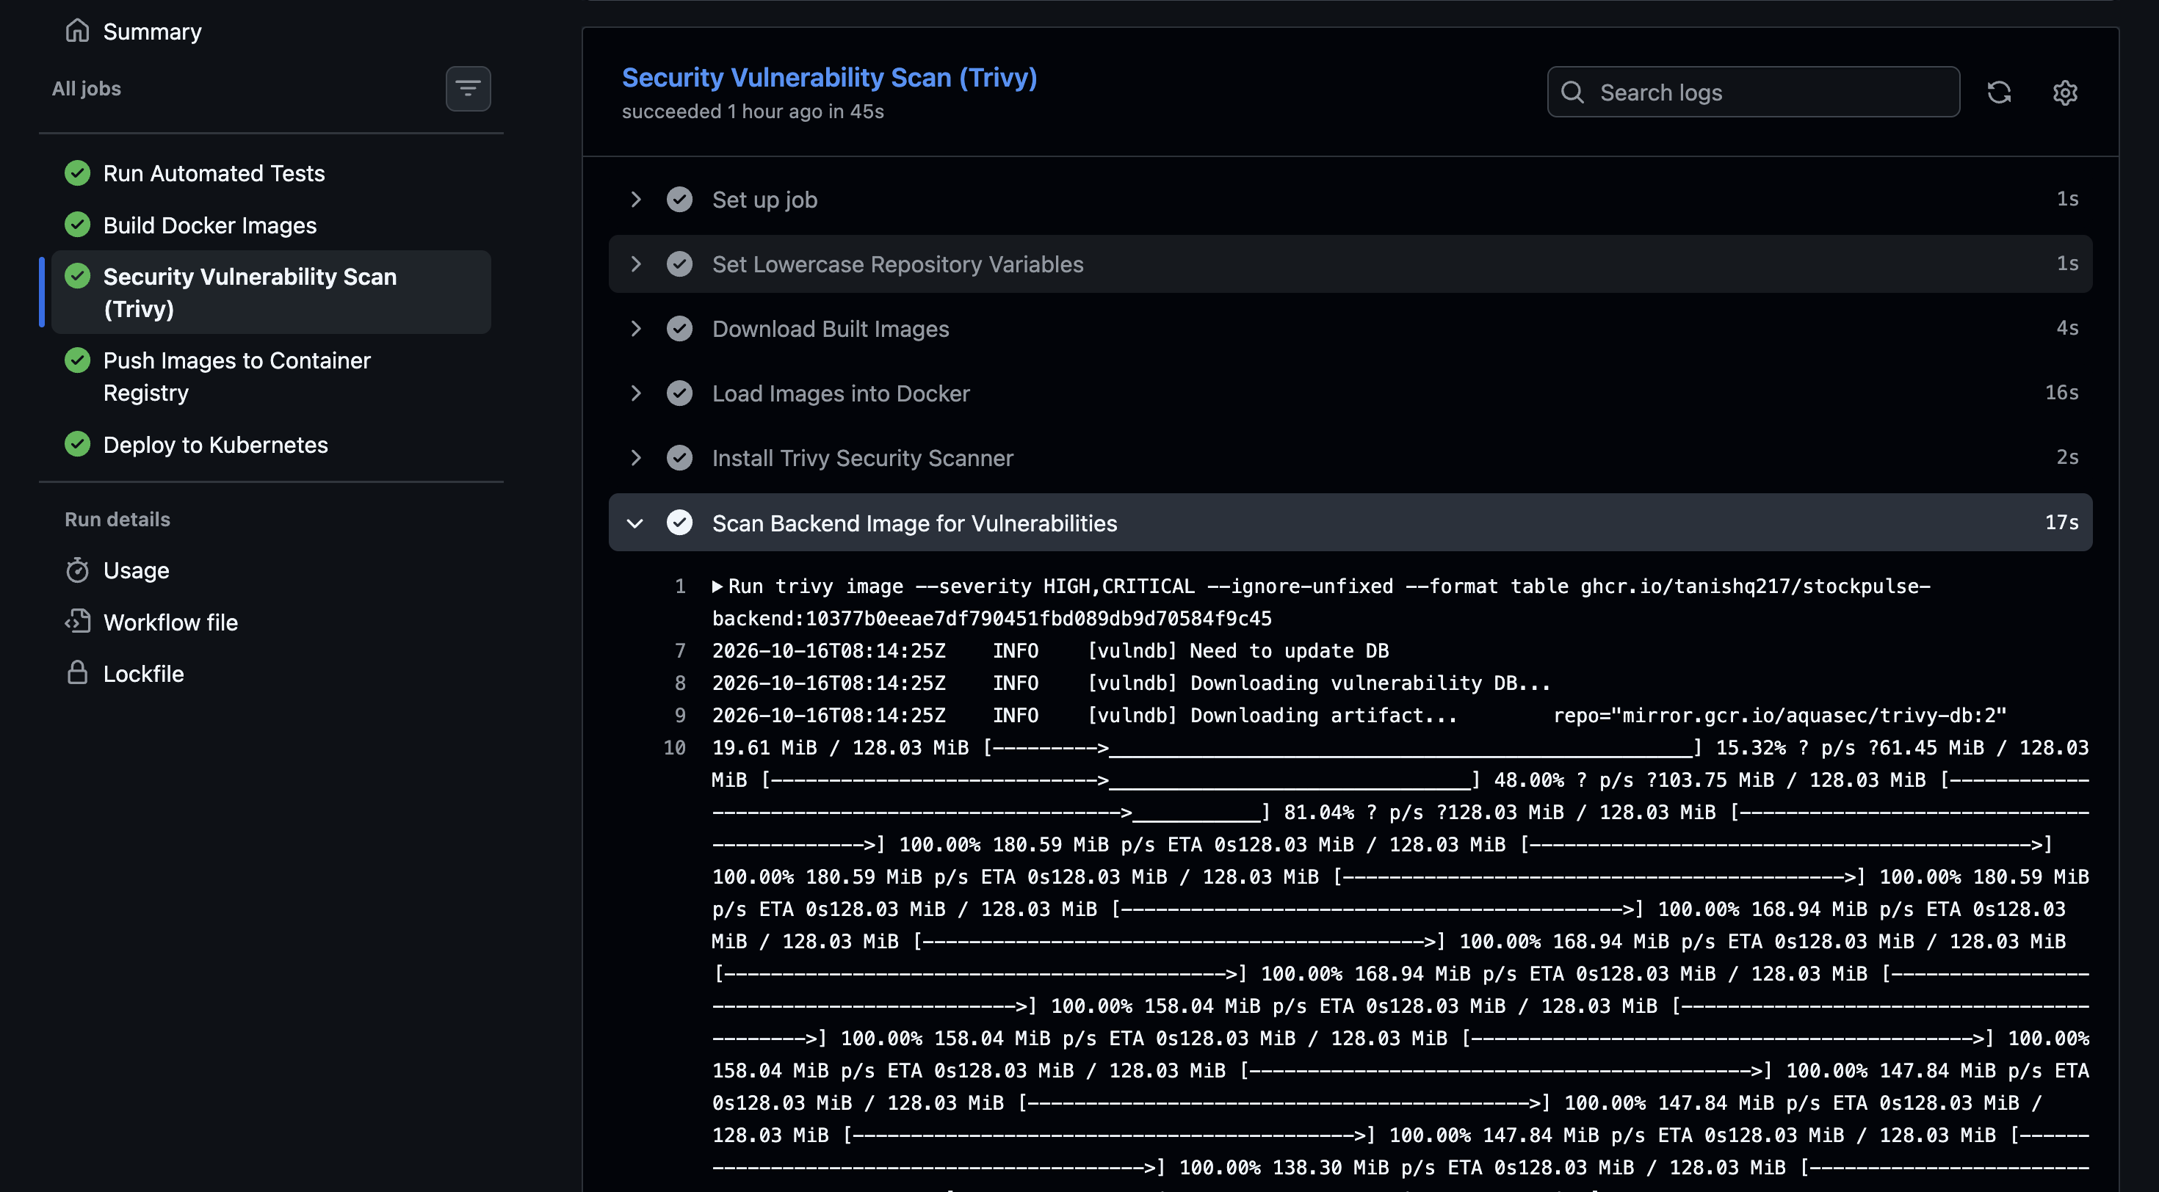
★ MANDATORY PROOF OF CONCEPT | 08. CONTINUOUS INTEGRATION & DELIVERY
Proof of Concept 3: Automated CI/CD Pipeline
5 Automated Quality Gates
• Triggered automatically on every push and pull request to main.
• 1. Test: Pytest executes 11 unit & integration tests.
• 2. Build: Multi-stage Docker build for backend and frontend.
• 3. Security: Trivy scans container images for CVE vulnerabilities.
• 4. Registry: Publishes tagged images to GitHub Packages (GHCR).
• 5. Deploy: Verifies automated rollout on Kubernetes cluster.
StockPulse • Cloud-Native Warehouse & Inventory Management Platform • Tanishq Singh

Slide 10
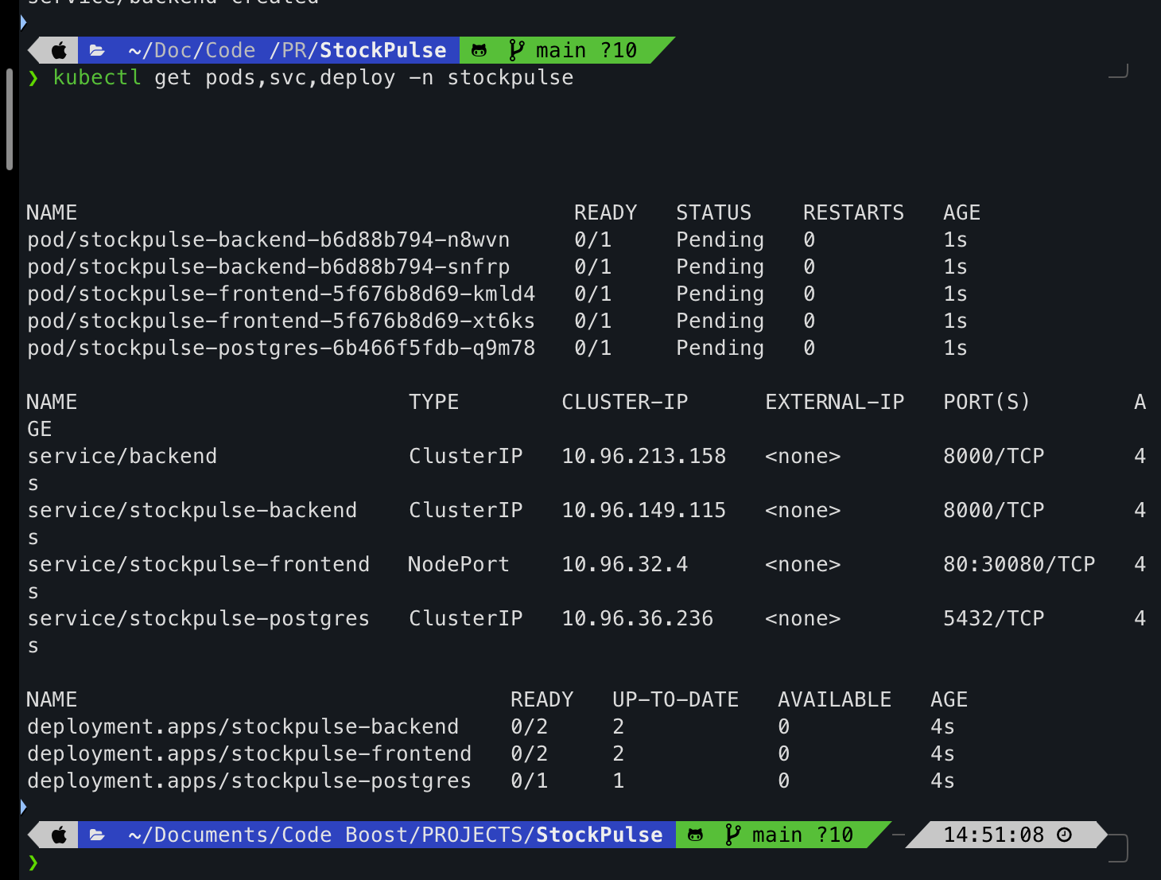
★ MANDATORY PROOF OF CONCEPT | 09. KUBERNETES ORCHESTRATION
Proof of Concept 4: Local Kubernetes Deployment
Helm Package & Cluster State
• Packaged via production-ready Helm chart (helm/stockpulse).
• Deployments: 2 backend and 2 frontend pods with load-balancing.
• PostgreSQL: Single StatefulSet with Persistent Volume Claim.
• Active verification: All pods, services, and deployments running healthy.
StockPulse • Cloud-Native Warehouse & Inventory Management Platform • Tanishq Singh

Slide 11
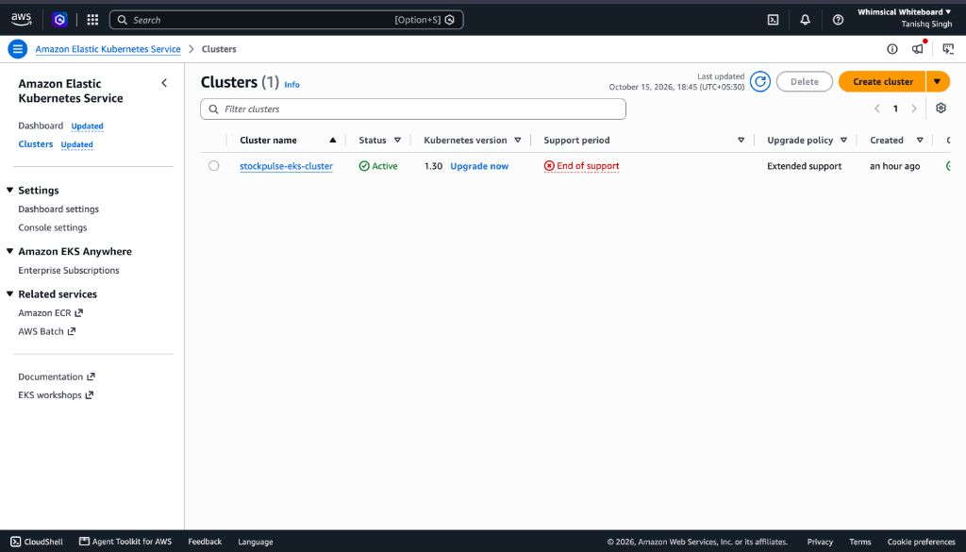
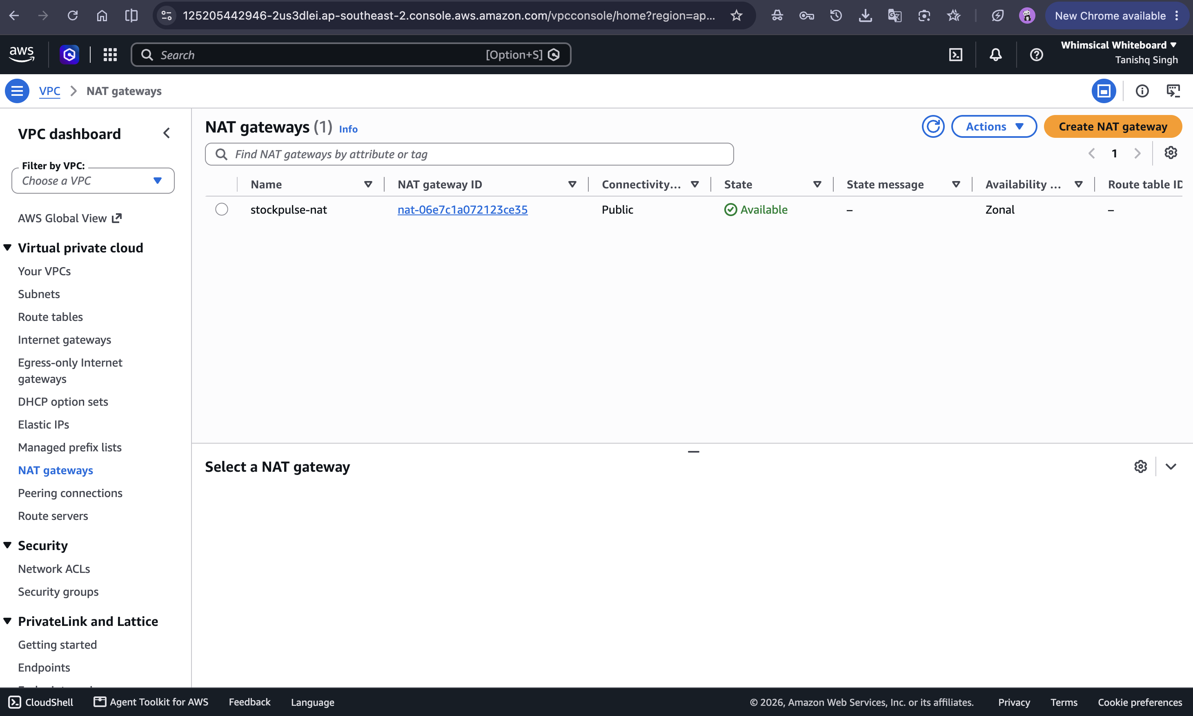
10. INFRASTRUCTURE AS CODE
Production Cloud Deployment: AWS EKS (Sydney)
Terraform AWS Infrastructure
• Region: AWS Sydney (ap-southeast-2).
• Modular IaC: Custom VPC, public/private subnets, Internet Gateway.
• EKS Cluster: stockpulse-eks-cluster provisioned and verified ACTIVE.
• Strict Cost Control: Cleanly destroyed via terraform destroy to preserve $100 credit.
StockPulse • Cloud-Native Warehouse & Inventory Management Platform • Tanishq Singh

Slide 12
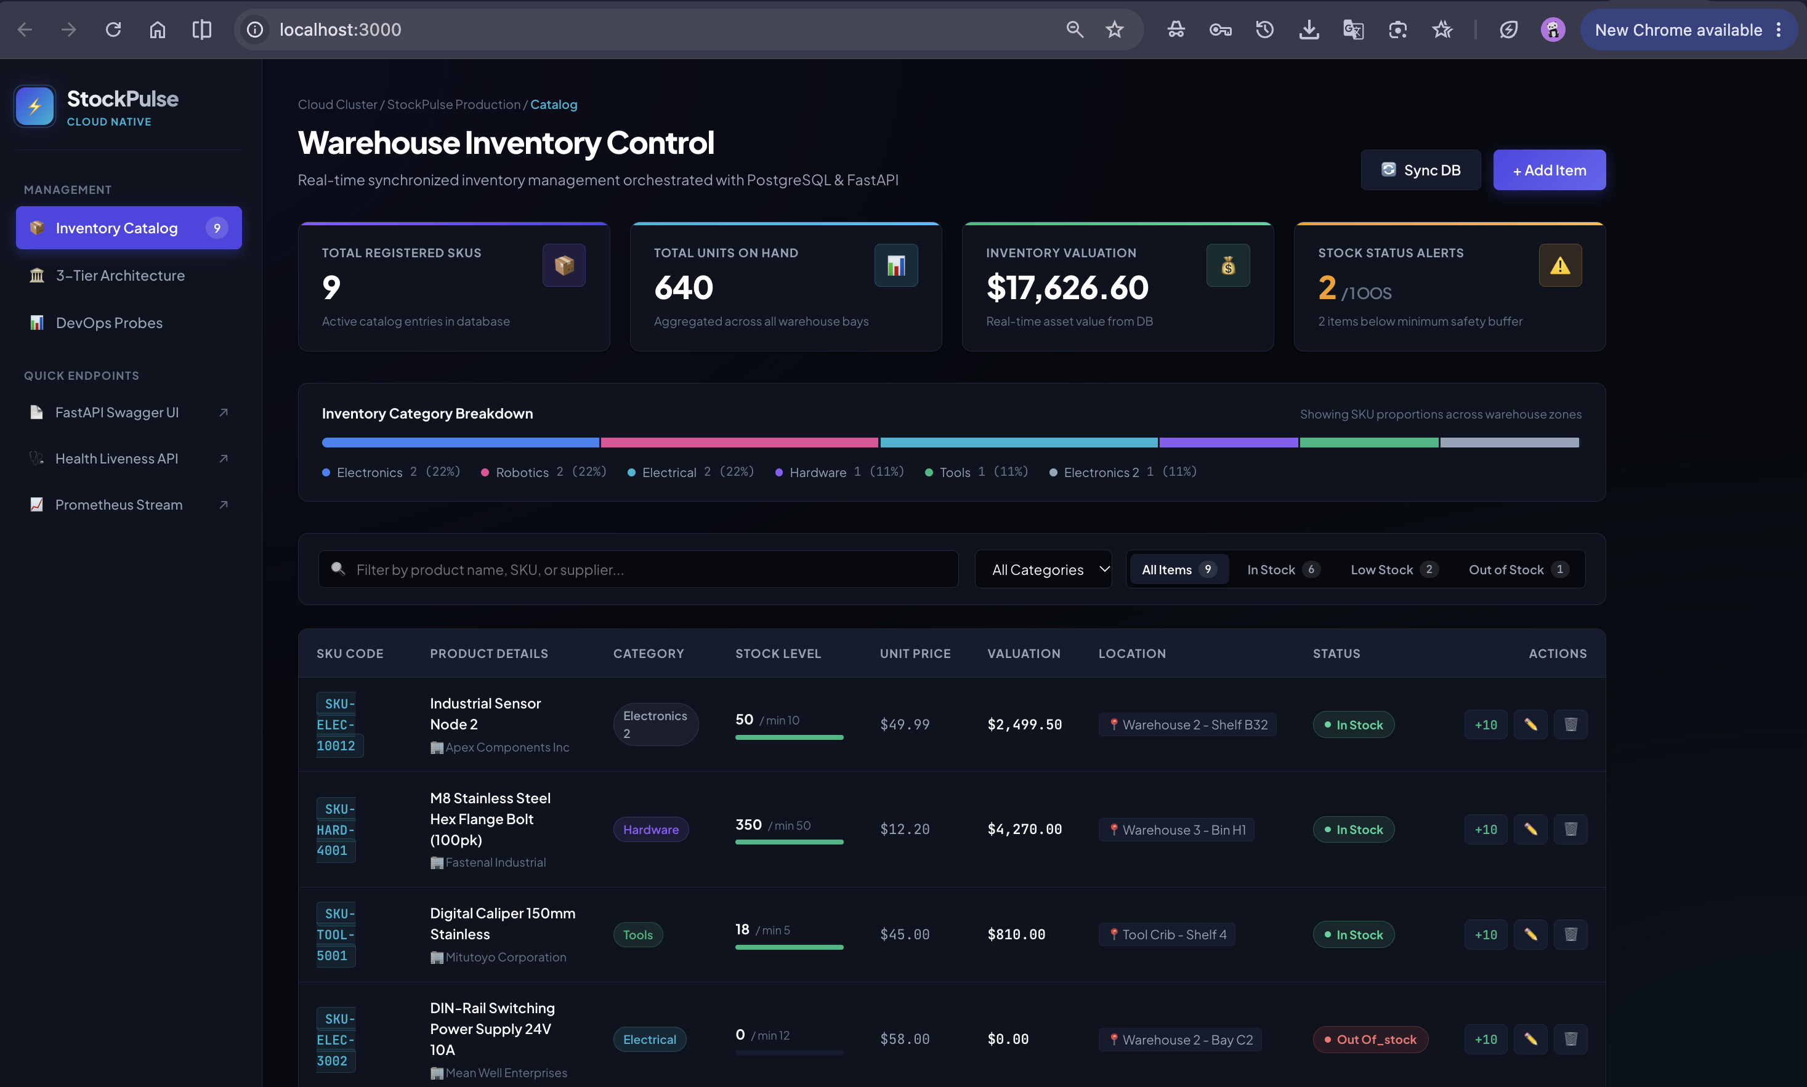
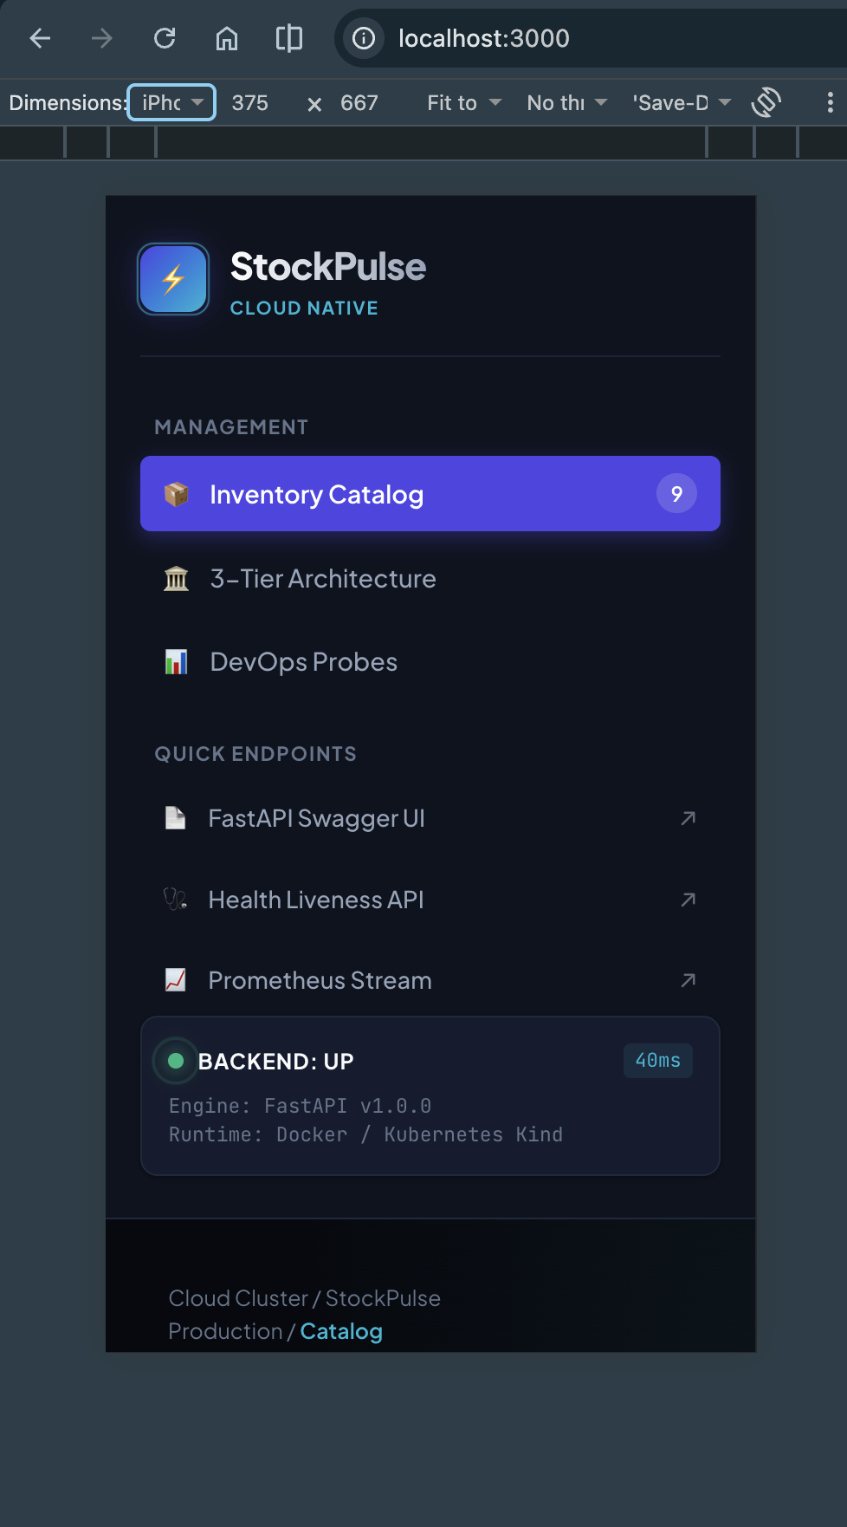
11. APPLICATION RESULTS
Application Output: Live Dashboard & Responsive Mobile
Warehouse Operator UX
• Desktop Command Center: Real-time stock levels, SKU lookups, and restocking modal.
• Visual Badges: Instant color-coded alerts for Low Stock and Critical items.
• Mobile Ready: Fully responsive down to 375px (iPhone SE) for handheld barcode scanners.
StockPulse • Cloud-Native Warehouse & Inventory Management Platform • Tanishq Singh

Slide 13
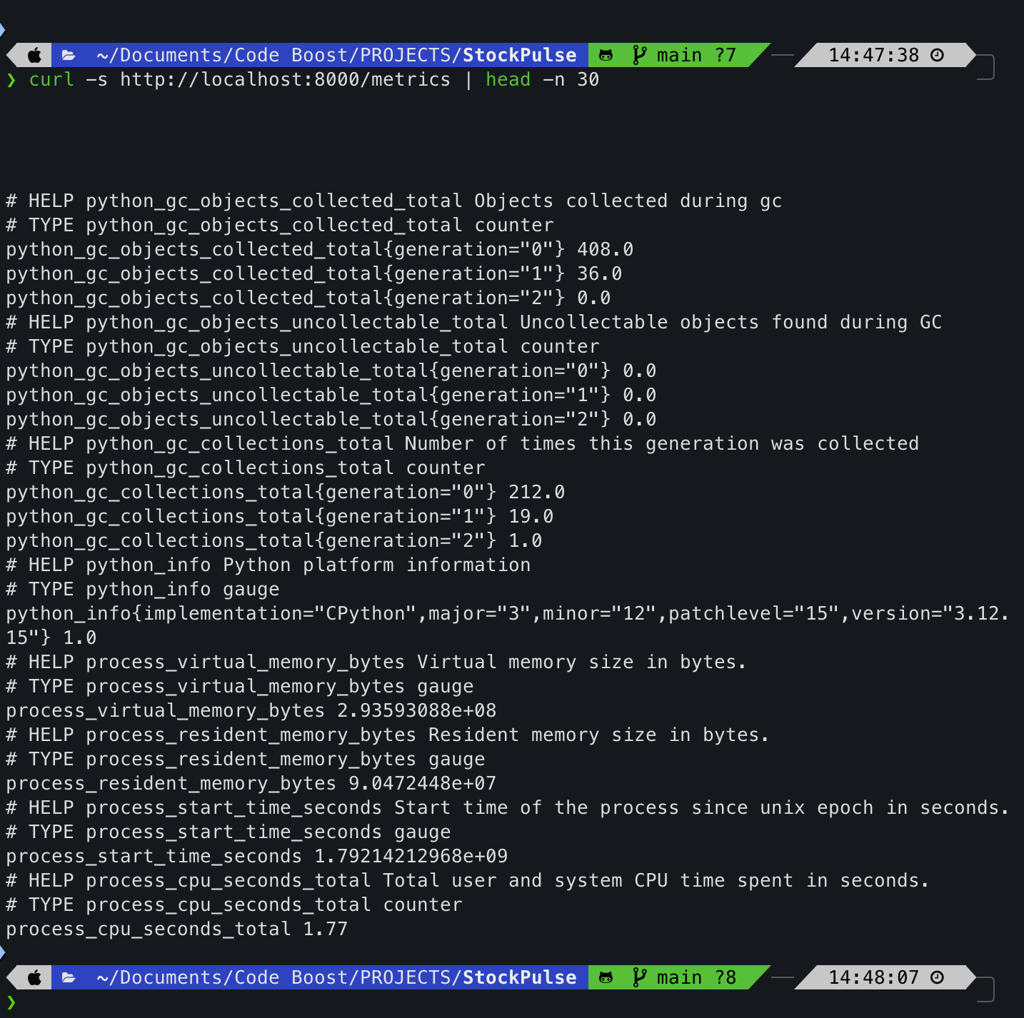
12. MONITORING & TELEMETRY
Observability: Prometheus Telemetry & Probes
System Telemetry & Health
• Prometheus /metrics endpoint exposes live request rates, latency, and status codes.
• Liveness Probe (/health): Actively verifies database connection and app uptime.
• Grafana Dashboards: Visual panels configured to monitor RPS and cluster resources.
StockPulse • Cloud-Native Warehouse & Inventory Management Platform • Tanishq Singh

Slide 14
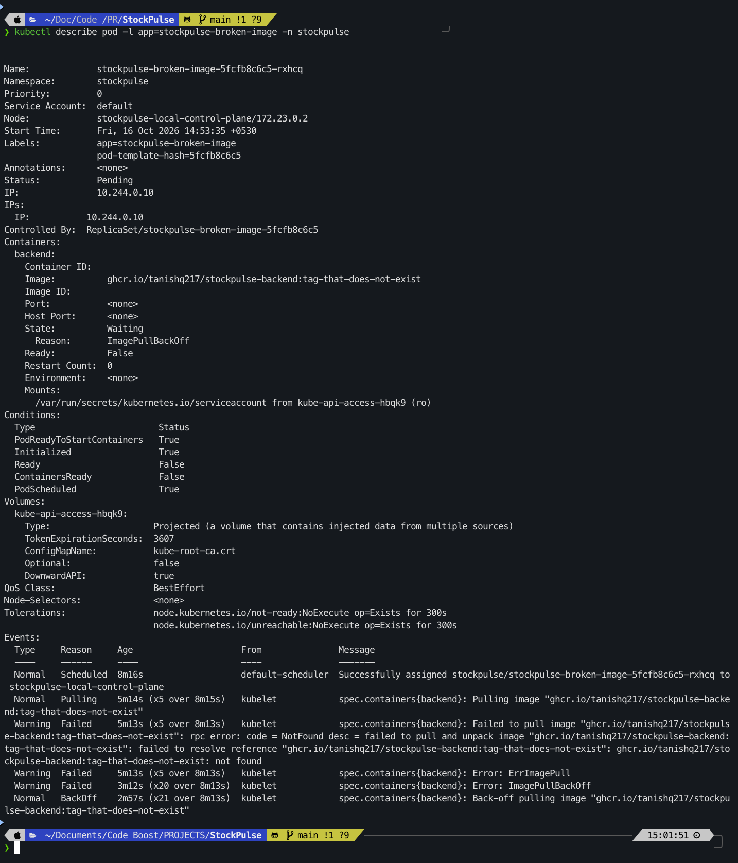
13. FAILURE DIAGNOSIS & RECOVERY
Troubleshooting & Resilience: Chaos Engineering Lab
Production Failure Runbook
• Scenario: Broken image tag injected via troubleshooting/broken-image.yaml.
• Diagnostic: kubectl describe pod identifies ImagePullBackOff and root-cause event.
• Resilience: Existing pods continue serving traffic with zero service disruption.
• Proven playbook for rapid incident resolution in high-stakes environments.
StockPulse • Cloud-Native Warehouse & Inventory Management Platform • Tanishq Singh

Slide 15
14. GRADING SCORECARD
Project Summary: Complete 10-Module Rubric Parity
App & Quality
• M1: 3-Tier FastAPI/React.
• M2: 11 Pytest tests pass.
• M3: Conventional Git commits.
• Full Swagger & OpenAPI.
Containerization
• M4: Multi-stage Docker.
• Non-root UIDs 10001 & 101.
• Docker Compose healthchecks.
• ACID Postgres storage.
Pipeline & Security
• M5: 5-Stage GitHub Actions.
• M6: Trivy DevSecOps scan.
• M7: Terraform AWS EKS.
• Sydney region verified.
Orchestration & Ops
• M8: Kubernetes Helm chart.
• M9: Prometheus telemetry.
• M10: Troubleshooting lab.
• Score Target: 100 / 100.
StockPulse • Cloud-Native Warehouse & Inventory Management Platform • Tanishq Singh

