Slide 1
Stealth Intrusion Detection:
TinyML sound classification on ESP32
B.Tech, CSE
5th Semester
Presented by:
Tanishq Yadav
CSE-1
24U020070
Supervisor:
Dr. Priyankar Choudhary,
Assistant Professor, CSE
Indian Institute of Information Technology Bhopal (M.P)

Slide 2
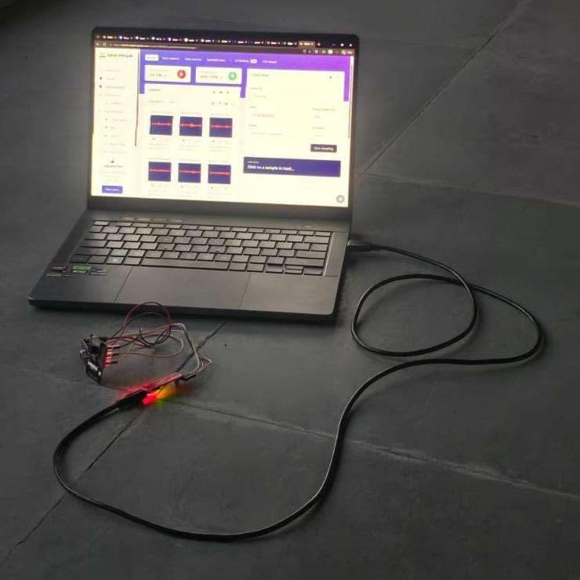
Introduction
PIR sensors and cameras detect motion, not how someone moves [1], [2].
Stealthy steps still make a distinct sound pattern.
A TinyML model on the ESP32 classifies this sound locally; no audio leaves the device.
The camera and Wi-Fi switch on only after an intrusion is confirmed.
Data-recording setup: ESP32 + MAX9814 + Edge Impulse Studio
2

Slide 3
Literature review and background
APPROACH
LIMITATIONS
PIR / ESP32-CAM [1], [2]
Motion trigger only; no acoustic confirmation
Seismic + acoustic fusion [3], [4]
Fewer false alarms, but needs specialised sensors
Footstep recognition [5], [6]
Identifies people, not stealth movement
TinyML audio [7], [8]
Speech and gestures, not walking sounds
Research gap: no low-cost indoor system classifies sound on-device and wakes the camera only after confirmation.
3

Slide 4
Problem statement and objectives
Problem
Motion sensors only detect movement; cameras waste power
Detect
Classify stealth movement from sound on the ESP32
Confirm
Alert only if score > 0.70 for 3 consecutive windows
Act
Capture one photo, upload it and push an alert
Evaluate
Test on unseen data; measure RAM, flash and speed
Scope
Phase-I: one microphone, indoors, two classes
4

Slide 5


Proposed methodology
1
Sample
MAX9814 on GPIO14,
ADC at 8 kHz
2
Clean
DC offset removed
(moving average)
3
Features
MFE spectrogram,
500 ms window
4
Classify
1D CNN, int8, 2 classes
5
Confirm
> 0.70, 3 hits, 60 s
cooldown
Trained in Edge Impulse [9] on about 8 minutes of recordings (4 people, 2 classes) and deployed on the ESP32 as a compiled C++ library.
≈
1D CNN
ADC sampling, 500 ms window
own + public clips, 4 people
int8 model, 2 classes
5

Slide 6
System diagram and flowchart
ALWAYS ON · LOCAL
FIRMWARE LOOP
Listen: 500 ms → MFE → CNN
MAX9814 mic
Sampling task
MFE + 1D CNN
Confirmation
GPIO14 · ADC
8 kHz · core 0
int8 · core 1
> 0.70 · 3 hits
Score > 0.70?
no
ONLY AFTER CONFIRMATION · EVENT PATH
yes
Flutter app
OneSignal
Cloudinary
Wi-Fi + camera
3 hits in a row?
no
alert + photo
REST push
HTTPS upload
ON · 1 JPEG
yes
Cooldown over?
no
Local decision first: no audio leaves the device. Only one photo and one alert are sent.
yes
Photo · upload · alert
6

Slide 7
Implementation
Layer
Details
Hardware
ESP32-WROVER + MAX9814 (GPIO14) + OV2640
Firmware
Core 0 samples audio; core 1 runs the model (≈ 1 ms)
Model
Edge Impulse [9]: MFE + 1D CNN, int8, own + public clips
Alerts
Cloudinary upload → OneSignal push → Flutter app
Fixes
40 dB gain (GAIN pin), mic on GPIO14, separate 5 V supply
7

Slide 8
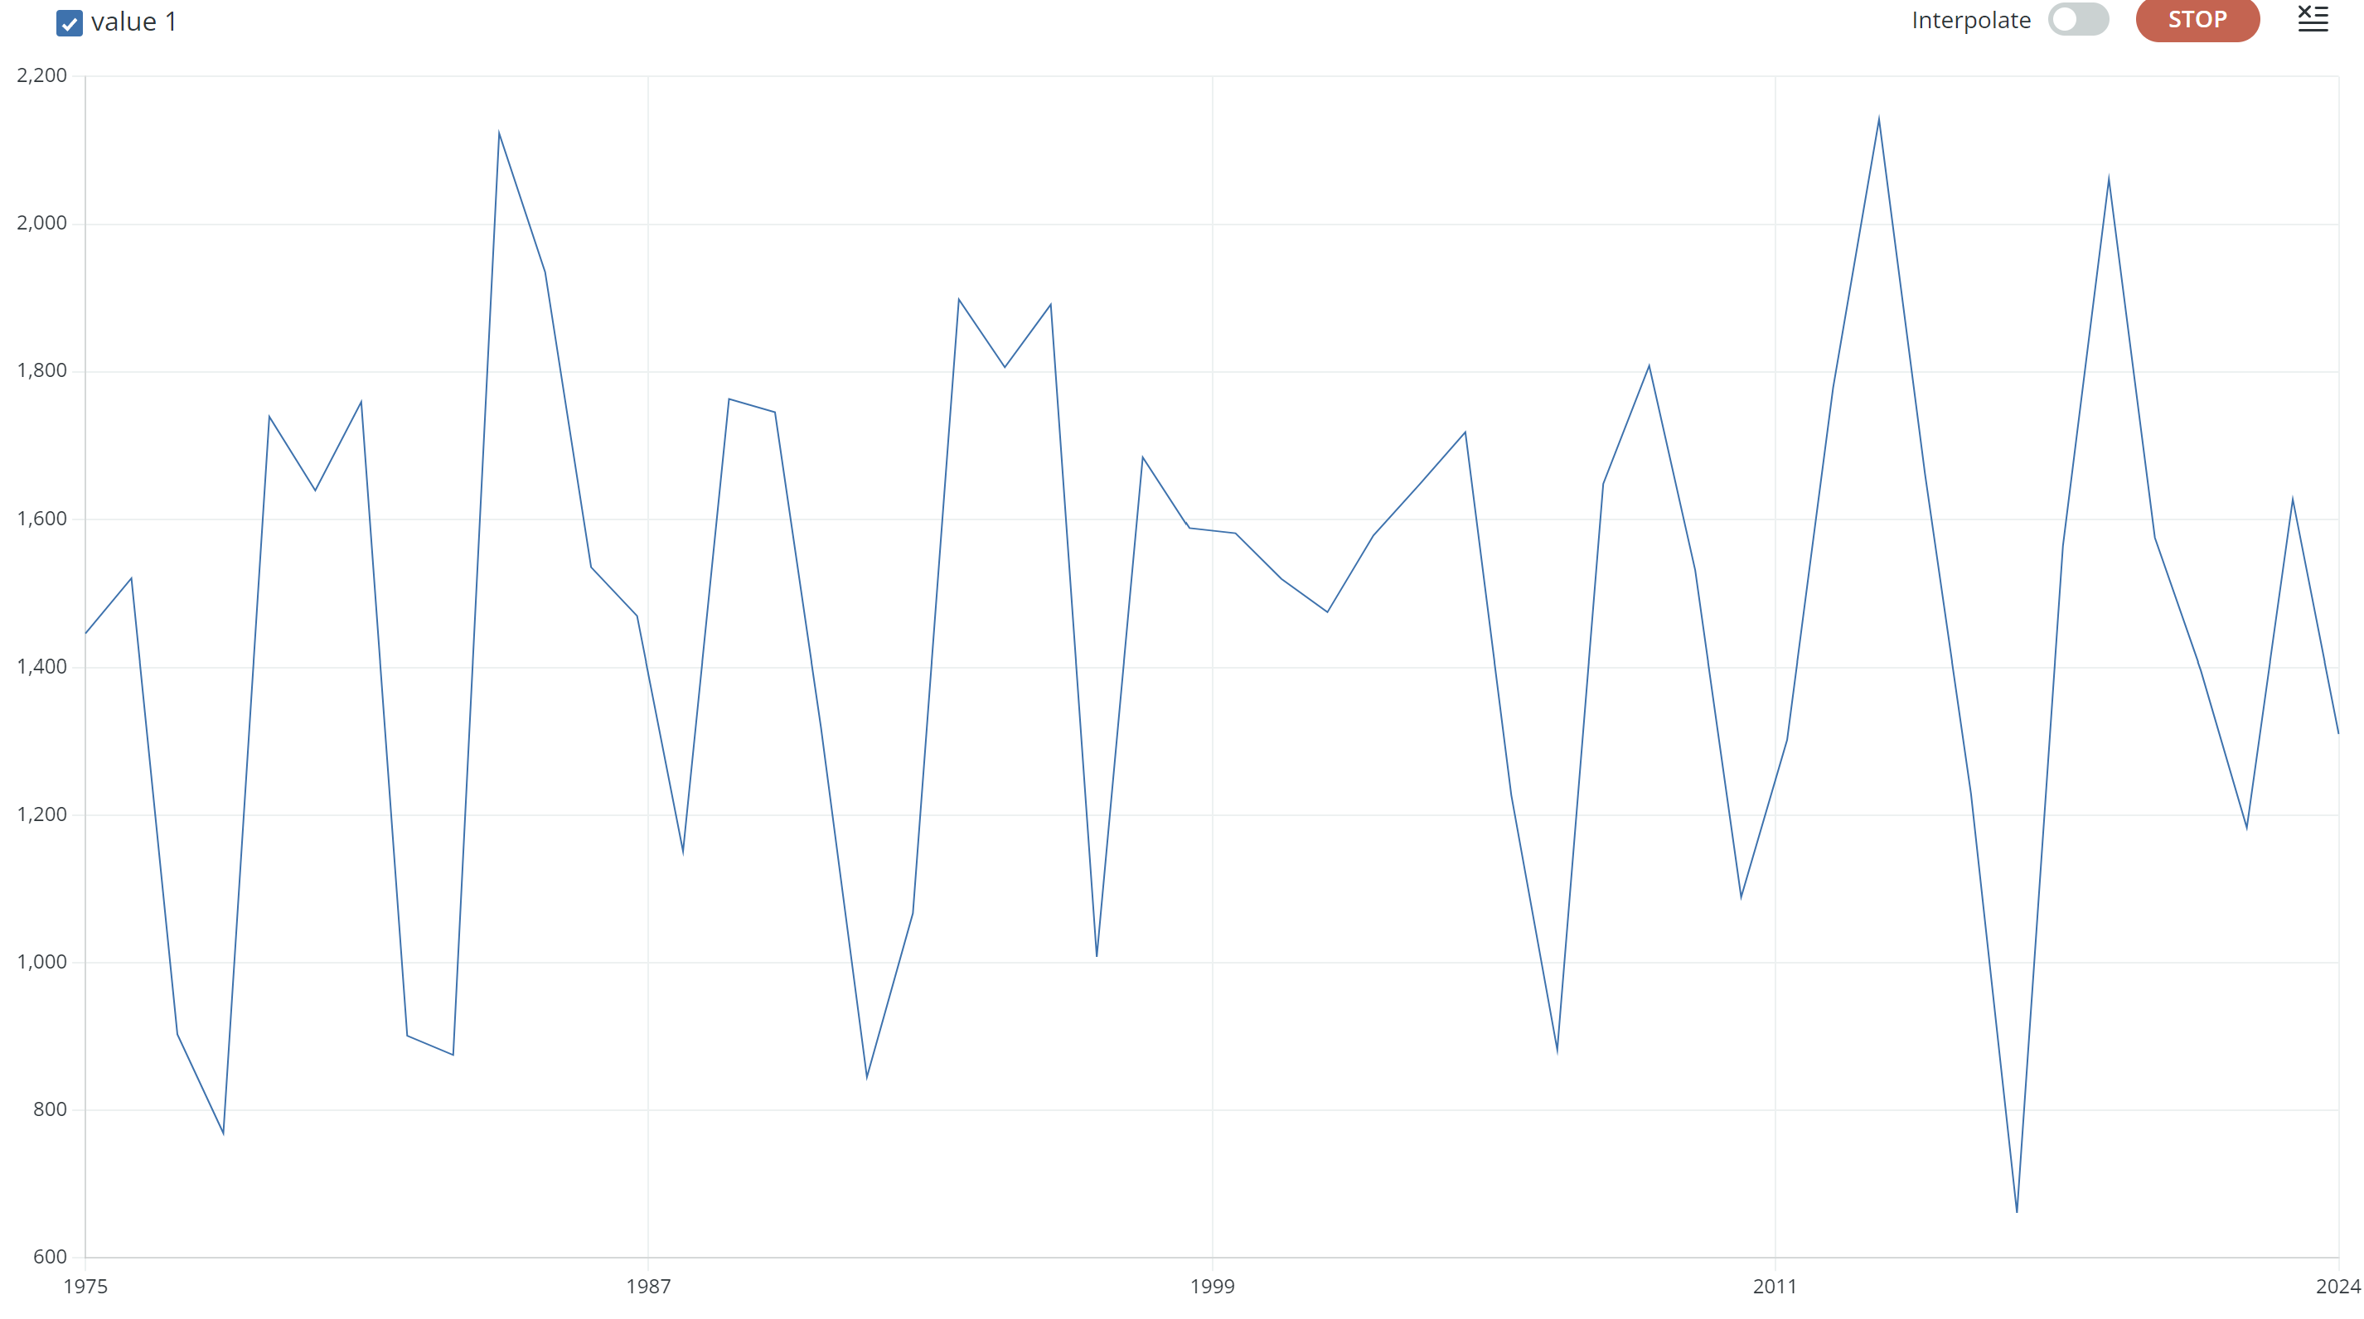
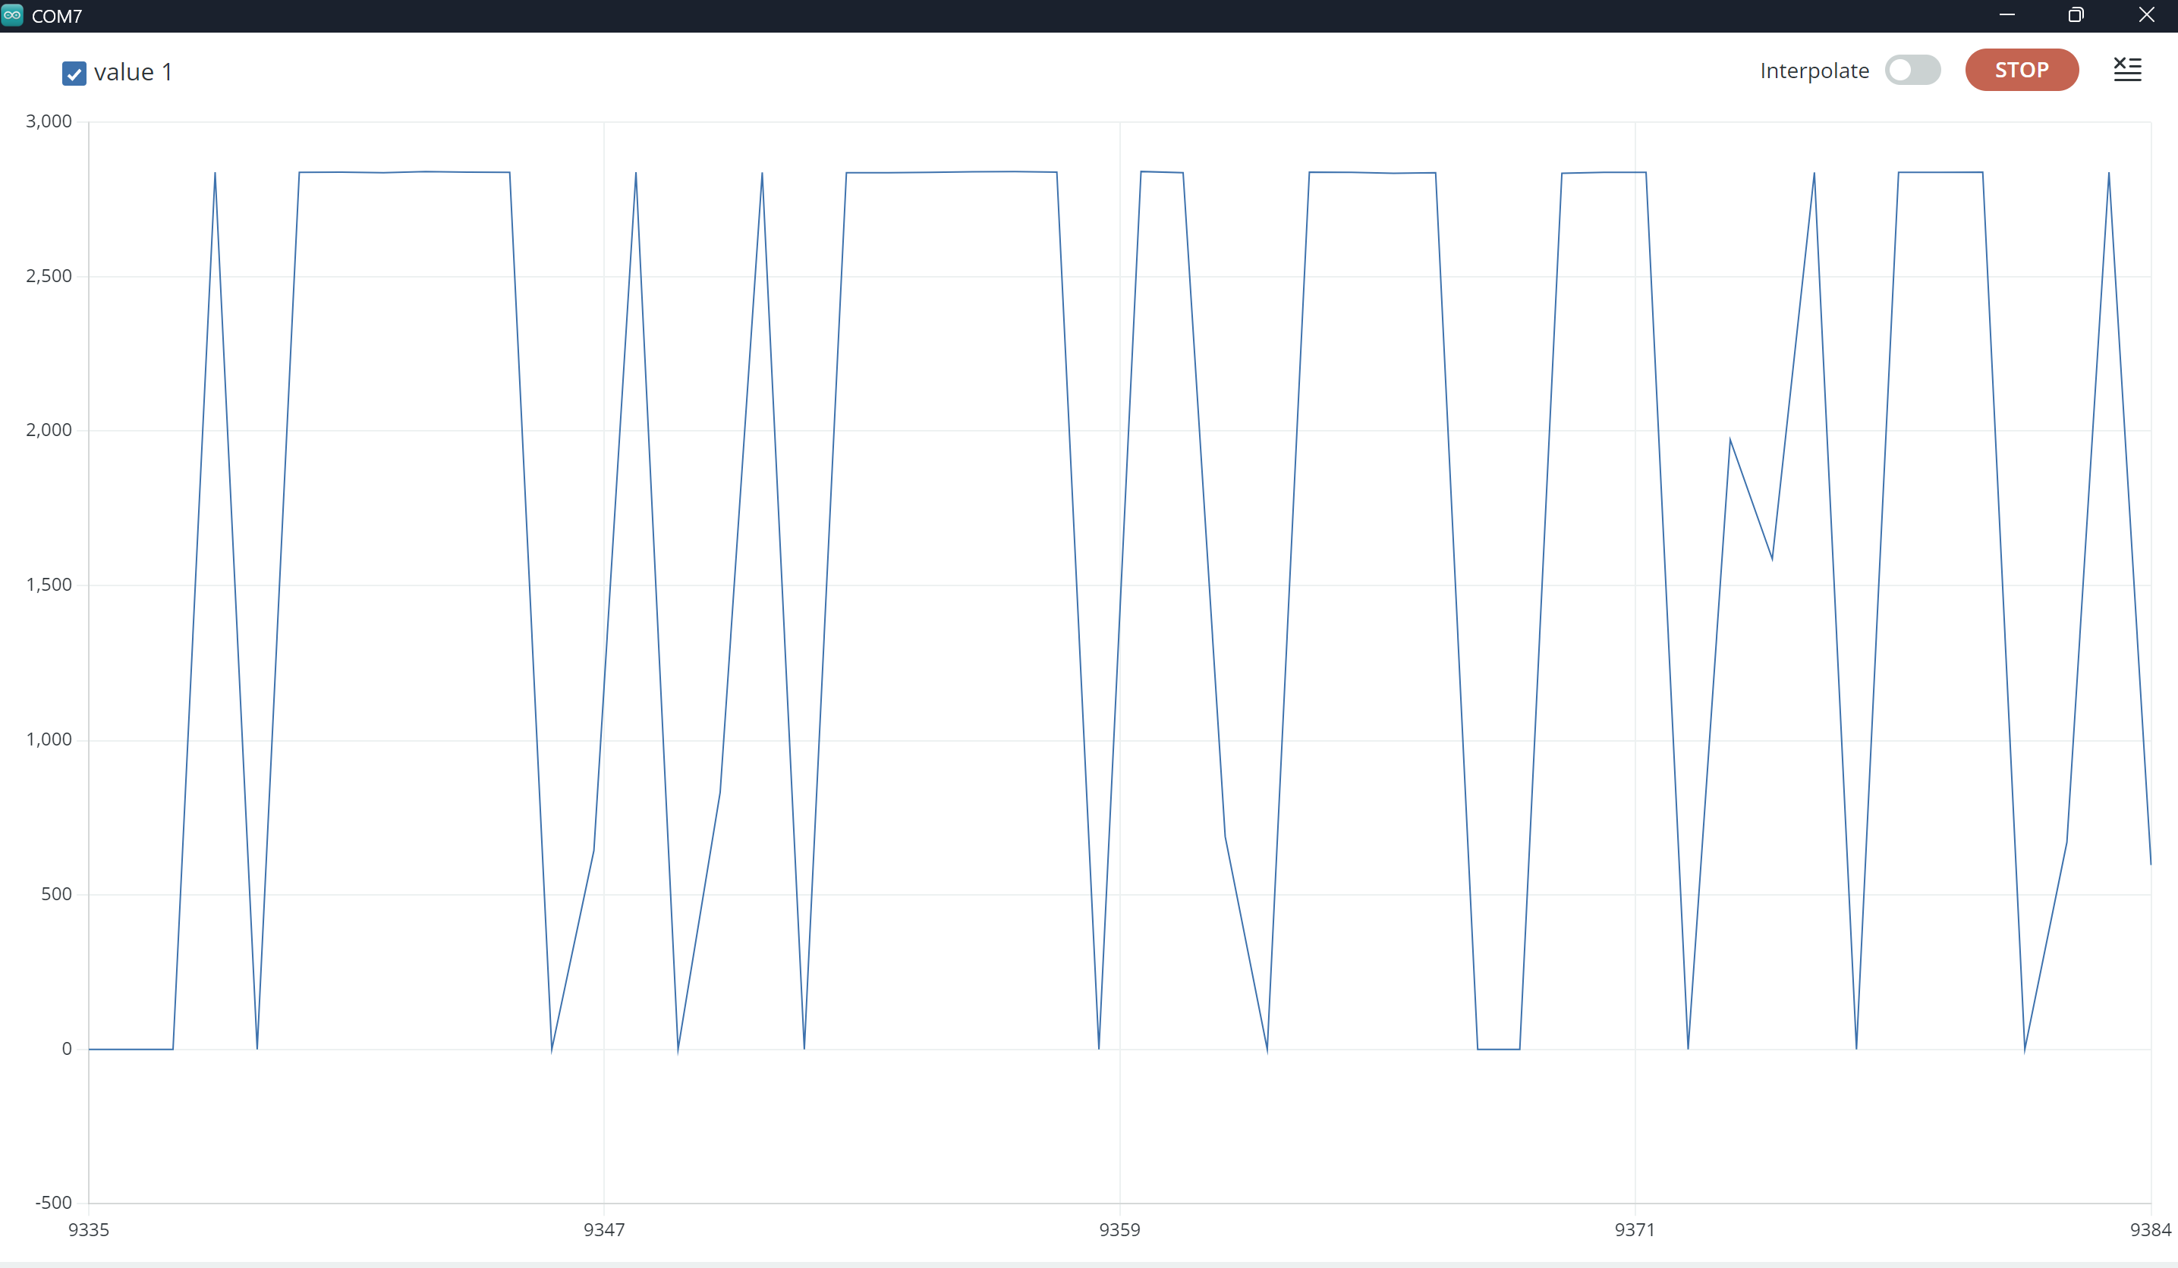




Results and analysis
Raw microphone signal (serial plotter)
Confusion matrix (test, % of class)
Predicted stealth
Predicted normal
92.7%
4.8%
Actual stealth
True positive
False negative
8.3%
87.0%
Actual normal
A: moves around mid-scale, ≈ 660–2150.
B: dropped down to 0
False positive
True negative
Test data (float32): stealth detected 92.7%, missed 4.8%; normal wrongly flagged 8.3%. Uncertain: 2.4% stealth, 4.6% normal.
Amplitude and sharpness differ clearly between the two signals. These are the patterns the MFE + 1D CNN learns to separate.
≈
test accuracy (93.8% validation)
per window · 10.8 kB RAM · 40 kB flash
false triggers in idle test; 19 stealth detections
Result for integration testing; upload of images
8

Slide 9
Conclusion and future work
Theme
Takeaway
Outcome
Low-cost ESP32 detector that confirms stealth movement from sound
Evidence
90.09% test accuracy; ≈ 1 ms, 10.8 kB RAM; full alert chain works
Limits
Small dataset, one microphone, two classes, sound only
Next
Seismic sensor, auto-calibration, battery and secure backend
9

Slide 10
References
[1] K. Okokpujie et al., “Development of an affordable real-time IoT-based surveillance system using ESP32 and TWILIO API,” Int. J. Saf. Secur. Eng., 2023.
[2] F. Humam and M. A. Triawan, “Sistem keamanan ruangan menggunakan ESP32CAM dan sensor gerak berbasis IoT,” Infotek: J. Inform. Teknol., 2024.
[3] X. Jin et al., “Multimodal sensor fusion for personnel detection,” in Proc. 14th Int. Conf. Inf. Fusion, 2011.
[4] P. S. Huang et al., “Multi-sensory features for personnel detection at border crossings,” in Proc. 14th Int. Conf. Inf. Fusion, 2011.
[5] Y. Qu et al., “Indoor multiperson detection and recognition through footsteps: A deep learning approach with acoustic signal analysis,” IEEE Sensors J., 2024.
[6] L. Huang and C. Wang, “Unobtrusive pedestrian identification by leveraging footstep sounds with replay resistance,” Proc. ACM IMWUT, 2021.
[7] V. Viswanatha et al., “Implementation of tiny machine learning models on Arduino 33 BLE for gesture and speech recognition,” arXiv:2207.12866, 2022.
[8] A. Barovic and A. Moin, “TinyML for speech recognition,” arXiv:2504.16213, 2025.
[9] S. Hymel et al., “Edge Impulse: An MLOps platform for tiny machine learning,” in Proc. MLSys, 2023.
10

