Slide 1

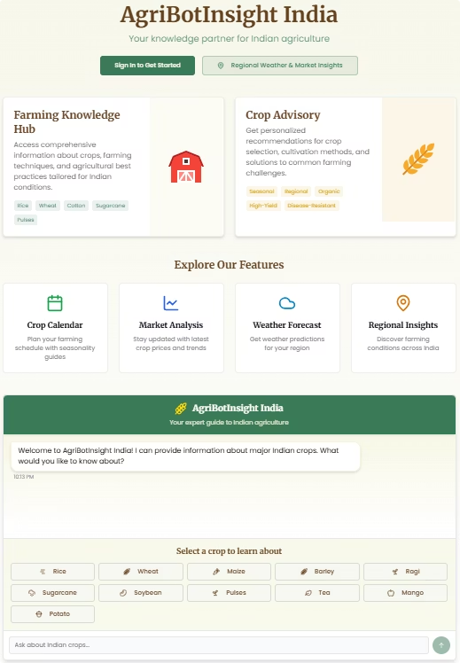
AgriBotInsight India
Your knowledge partner for Indian agriculture
Welcome to AgriBotInsight India, an innovative platform designed to empower Indian farmers with the right knowledge for better farming outcomes. Whether you are looking for crop advice, market trends, or weather updates, AgriBotInsight supports you with reliable, personalized insights based on local conditions.

Slide 2
Farming Knowledge Hub
Access a comprehensive repository of crop information and farming techniques specially tailored for Indian agro-climatic zones. Our platform covers major crops including rice, wheat, cotton, sugarcane, and pulses, providing detailed best practices for cultivation and care.
Explore sustainable methods and improve yields with season-specific guidance tailored for local soil and weather. This knowledge hub is your first step towards precision farming that respects India's diversity.
Popular Crops
Benefits
Rice
Improved crop knowledge
Wheat
Better yield techniques
Cotton
Sustainable farming tips
Sugarcane
Locally relevant advice
Pulses

Slide 3
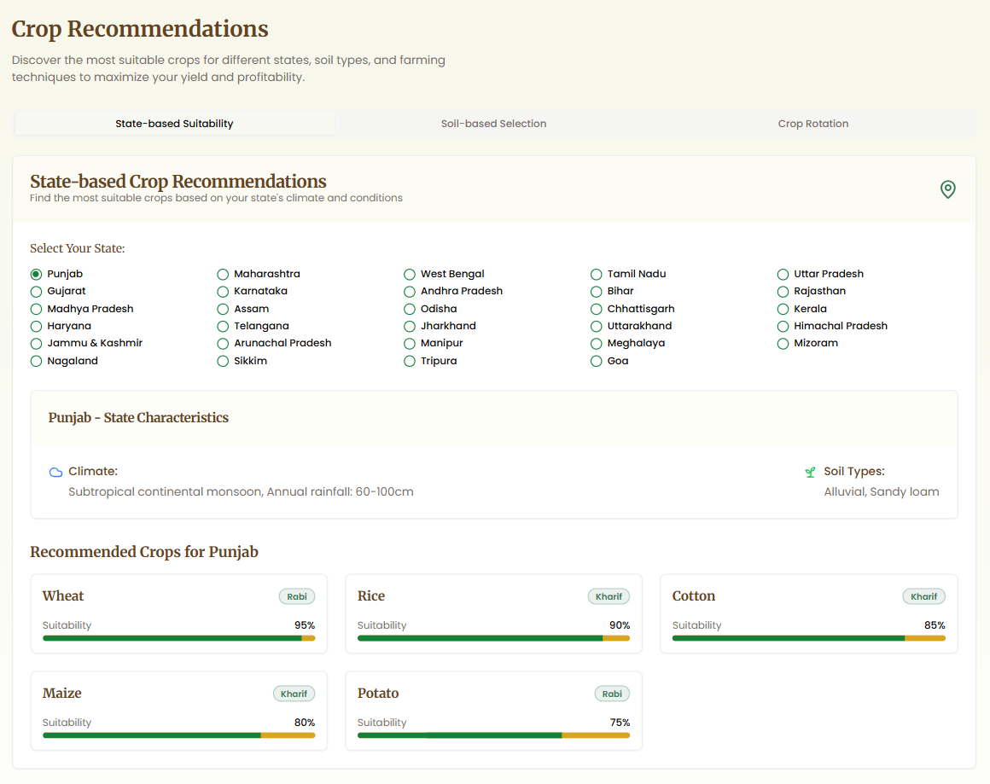
Crop Advisory Services
Receive personalized advice for crop selection, cultivation techniques, pest management, and disease resistance. Our AI-driven system factors in seasonal and regional specifics to help you choose the best crop varieties and farming methods.
Our recommendations promote organic and high-yield practices tailored to your land conditions, ensuring healthy crop growth and maximising production success.
Key Features
Customized Support
Maximized Yields
Seasonal crop choices matched to your region
Organic and disease-resistant crop guidance
High productivity methods backed by data

Slide 4
Explore Our Features
Plan your farming calendar, track market price trends, forecast weather, and get regional insights—all in one place. These features support smart decision-making for Indian farmers across diverse agro-climatic zones.
Stay ahead with tailored updates and tools designed explicitly for India’s agriculture ecosystem.
Crop Calendar
Market Analysis
Weather Forecast
Regional Insights
Plan sowing and harvesting with seasonality guides
Stay updated with latest crop prices and market trends
Accurate weather predictions for your location
Know farming conditions across different Indian states

Slide 5
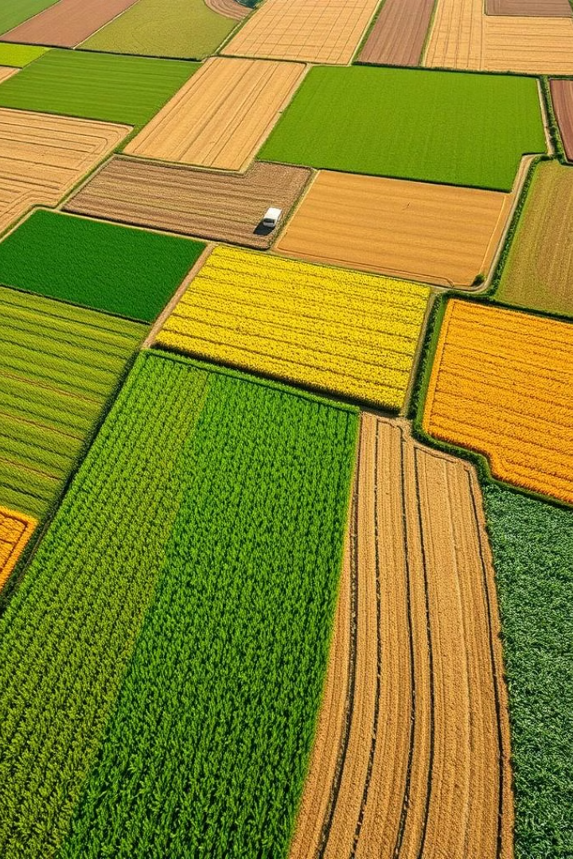




Select a Crop to Learn About
Explore individualized information on a wide range of crops cultivated across India. From staples like rice and wheat to cash crops like sugarcane and tea, learn cultivation tips, pest control strategies, and market potential for each crop.
This selection aids farmers in making informed decisions on crop rotation, diversification, and investment.
Rice
Wheat
Maize
Sugarcane

Slide 6
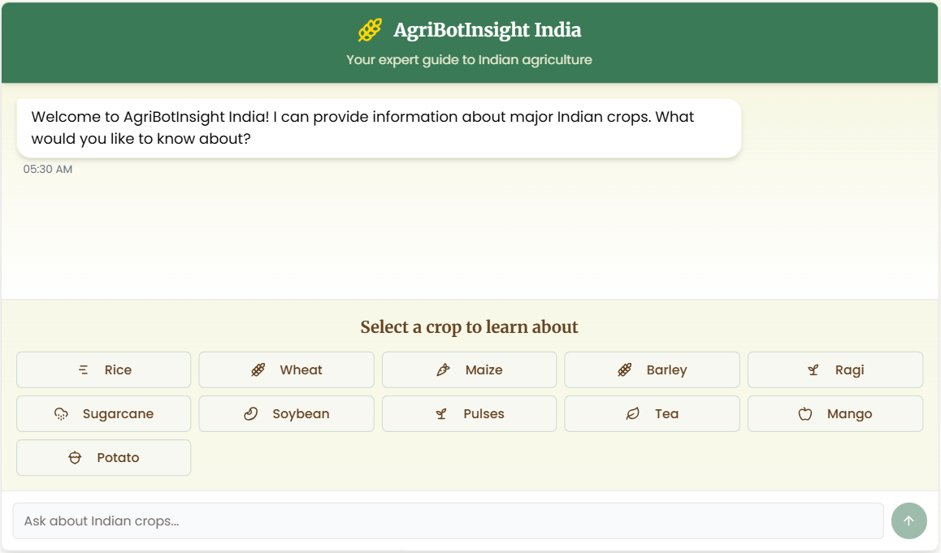
About AgriBotInsight
AgriBotInsight India combines AI technology and extensive agricultural databases to deliver real-time, locally relevant information to farmers and agricultural professionals across India.
Our platform is designed to bridge the knowledge gap by providing actionable insights and guidance that enhance productivity, sustainability, and livelihoods in Indian farming communities.
AI-Powered Assistance
Localized Data
Instant answers for your farming queries, anytime
State-wise crop and soil recommendations

Slide 7
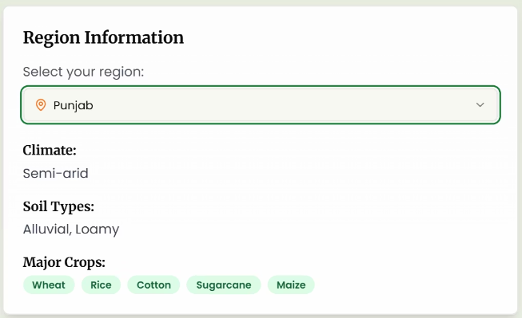
Personalized Crop Recommendations
Receive customized advice based on your state’s climate, soil conditions, and farming challenges. AgriBotInsight supports all 29 Indian states with tailored cultivation strategies for diverse crops.
Our system helps farmers optimize input use, select disease-resistant varieties, and adopt organic practices that improve overall farm resilience and profitability.
State-Specific Guidance
Disease Management
Organic Practices
Recommendations based on local agro-climatic data
Effective control methods for common crop diseases
Sustainable farming techniques for healthier soil

Slide 8
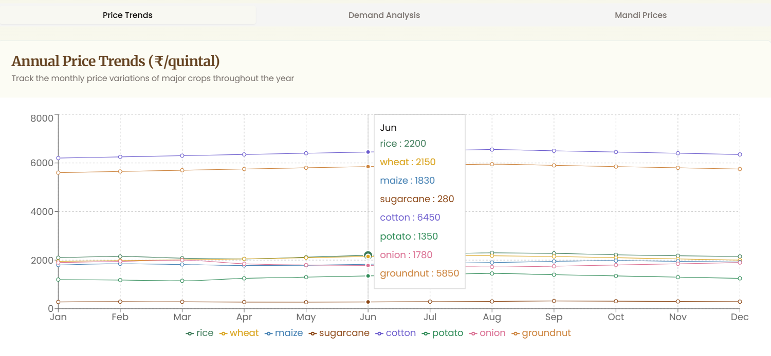
Market Intelligence and Knowledge Repository
Stay informed with up-to-date market prices from key agricultural mandis across India. Our platform provides trend analysis helping you decide the best time to sell your produce for maximum returns.
Additionally, explore real farmer stories and sustainable techniques curated to inspire and educate Indian farmers in improving productivity.
Market Trends
Learning Resources
Price updates and demand forecasts for major crops
Success stories and best practices from Indian farmers

Slide 9
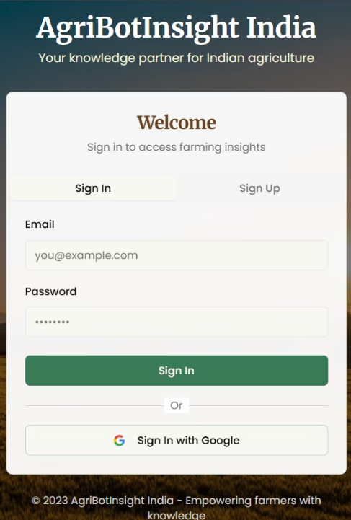
How to Get Started
Create your account to save your preferences and unlock personalized advice tailored to your farming location and crop choices.
Explore regional insights specific to your state and use the chat assistant to ask detailed agriculture-related questions. Check the crop calendar for the best planting and harvesting times.
Create an account for personalized recommendations
Use chat assistant for quick agricultural advice
Explore regional insights for your state
Refer to the crop calendar for scheduling

Slide 10
Data-Driven & Personalized Insights
AgriBotInsight offers real-time market prices, weather-based crop advice, soil-matching recommendations, and cost-effective equipment suggestions to enhance your farming efficiency.
Personalized insights include crop comparisons, government scheme information by state, seasonal advisories, and ROI analysis to help you invest wisely in your agricultural activities.
Data-Driven Features
Personalized Insights
Real-time market prices from agricultural mandis
Crop comparison tools for planning
Weather-based crop recommendations
State-specific government schemes
Soil type matching for optimal crop choices
Seasonal advisories tailored to local history
Equipment suggestions with cost estimates
ROI analysis for informed investments

Slide 11
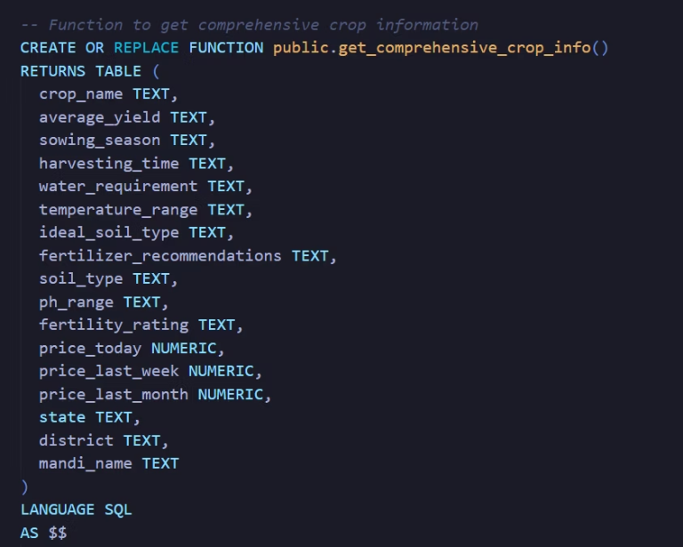
Robust Backend Infrastructure with Supabase
It stores and serves structured crop data, market prices, weather insights, and regional advisories.
Supabase’s PostgreSQL foundation ensures high scalability, data integrity, and fast queries.
The chatbot fetches crop-specific content dynamically from Supabase, enabling personalized responses.
AgriBotInsight India uses Supabase, an open-source Firebase alternative, as the core backend for real-time data access and management.

Slide 12
