Slide 1
A Summary presentation on movie recommendation search system (Submitted in partial fulfilment of the requirement for the award of degree of Bachelor of Computer Application)
Session : 2022-23
Roll number : 200820040088
Name : TANISHQ GUPTA

Slide 2
INTRODUCTION
A recommendation system or recommendation engine is a model used for information filtering where it tries to predict the preferences of a user and provide suggests based on these preferences. These systems have become increasingly popular nowadays and are widely used today in areas such as movies, music, books, videos, clothing, restaurants, food, places and other utilities. These systems collect information about a user's preferences and behaviour, and then use this information to improve their suggestions in the future. Movies are a part and parcel of life.

Slide 3
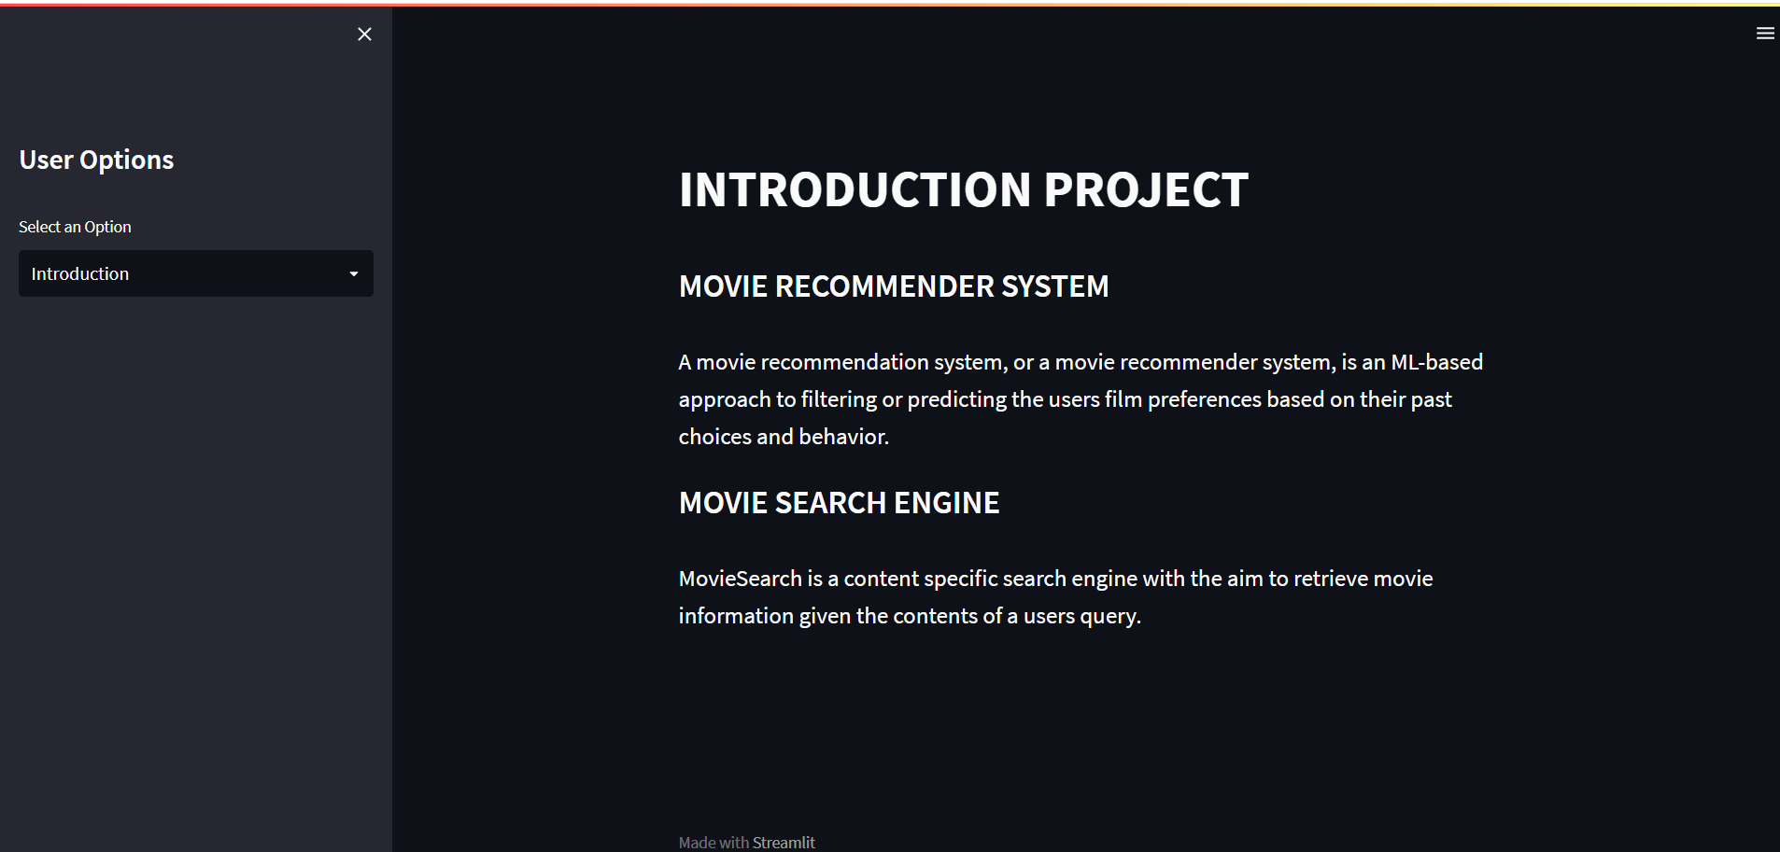
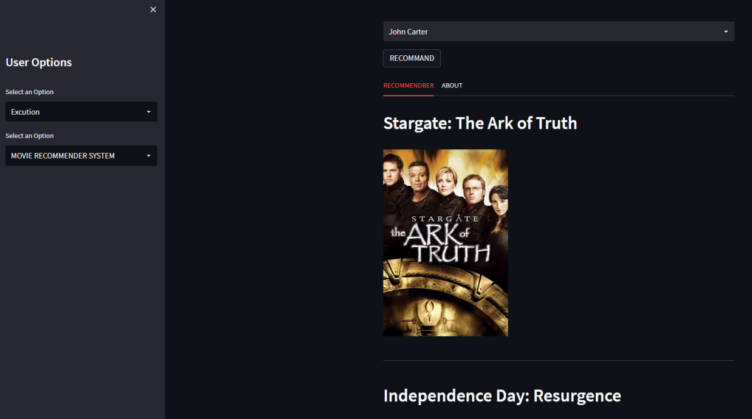
movie recommendation search system

Slide 4
REAL WORLD REQUIREMENT ANALYSIS
PURPOSE
scope
The primary goal of movie recommendation systems is to filter and predict only those movies that a corresponding user is most likely to want to watch. The ML algorithms for these recommendation systems use the data about this user from the system's database.
Excellent film analysis will explain how a film has been made: which filmmaking techniques have been chosen and why, how the visual storytelling supports the narrative, and the effect that filmmaking elements have on the viewer.
Work on several numbers of data:
The number of choices for anything on internet is very high and it’s tedious to refine most wanted data by self while searching. The scope of this proposal system includes working within numerous data, with ease.
Saving of time:
Many people have problem selecting the alternative item of movie due to lack of time and due to search issues. Also movie recommendations from friends can be time consuming. The system helps in saving lots of time.

Slide 5
HARDWARE & SOFTWARE REQUIREMENT
MINIMUM HARDWARE REQUIREMENT
512Mb of RAM
200mb of storage
5’6’’ display size
Web browser
Processor with PII or later version with 2.88 GHz or higher
SOFTWARE REQUIREMENT
Front end: VSCode
Operating system: Windows
Back end: JavaScript
RECOMMENDED
512Mb of RAM
200mb of storage
5’6’’ display size
Web browser
Processor with PII or later version with 2.88 GHz or higher

Slide 6
Methodology
Collecting the data sets : Collecting all the required data set from Kaggle web site.in this project we require movie.csv,ratings.csv,users.csv.
Data Analysis : make sure that that the collected data sets are correct and analysing the data in the csv files. i.e. checking whether all the column Felds are present in the data sets.
Algorithms : in our project we have only two algorithms one is cosine similarity and other is single valued decomposition are used to build the machine learning recommendation model.
Training and Testing the model : once the implementation of algorithm is completed . we have to train the model to get the result. We have tested it several times the model is recommend different set of movies to different users.

Slide 7
Future Scope
In the proposed approach, It has considered Genres of movies but, in future we can also consider age of user as according to the age movie preferences also changes, like for example, during our childhood we like animated movies more as compared to other movies. There is a need to work on the memory requirements of the proposed approach in the future. The proposed approach has been implemented here on different movie datasets only. It can also be implemented on the Film Affinity and Netflix datasets and the performance can be computed in the future.
Studying more Content-based approach and their scalability
Decrease the RMSE
Impment Hybrid CF techniques and run on larger data sets

Slide 8




TOOLS AND PLATFORMS
Python is a high-level, general-purpose programming language. Its design philosophy emphasizes code readability with the use of significant indentation. Python is dynamically-typed and garbage-collected
This project is a website that is developed in Python and streamlit ,more on the platform VSCODE
64-bit IDE.
. NET 6 support.
Intellicode.
Hot reload.
Find in Files is faster.
It helps us create web apps for data science and machine learning in a short time

Slide 9
FUTURE SCOPE OF THE PROJECT
Extending it to Mobile Support.
Studying more Content-based approach and their scalability
Decrease the RMSE
Impment Hybrid CF techniques and run on larger data sets

