Slide 1
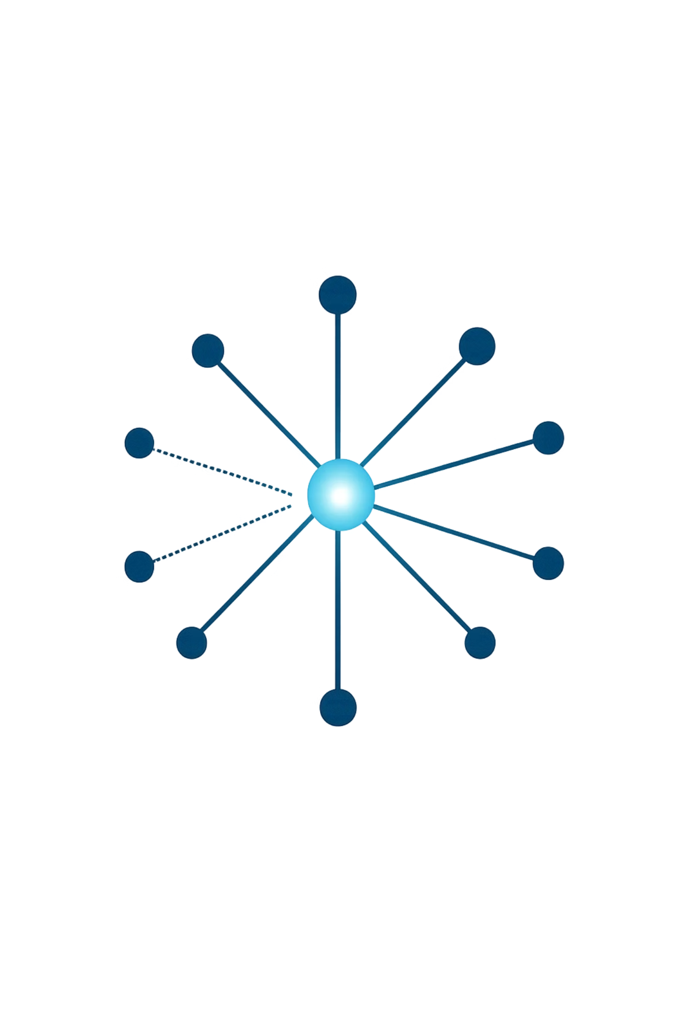
The Artificial Hivemind
A geometric audit of semantic convergence across GPT, Llama, and Gemini

Slide 2
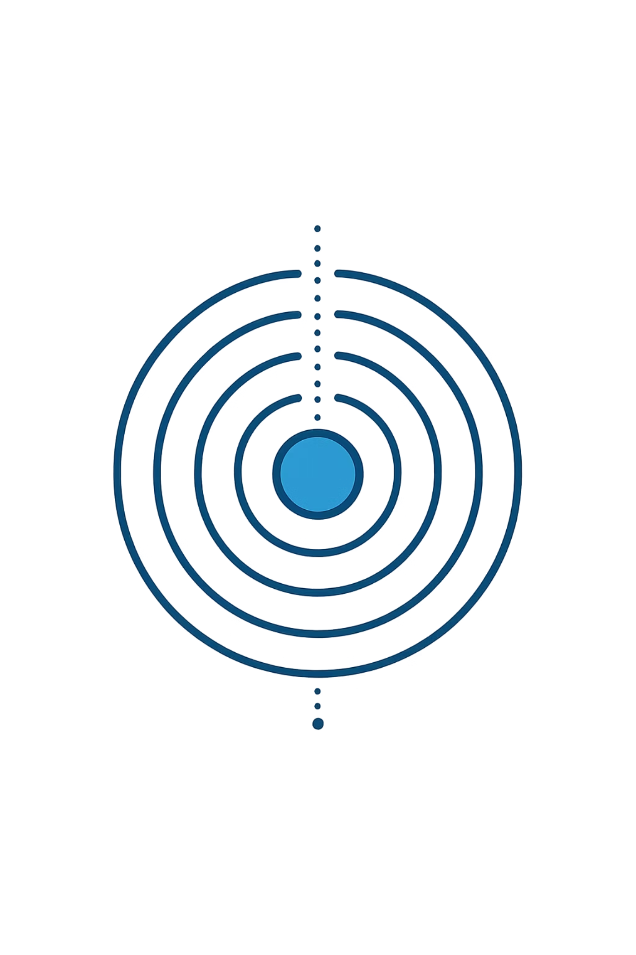
PROBLEM FRAMING
The Innovation Paradox
Frontier LLMs are trained to be helpful, harmless, and honest — but this alignment creates an Echo Chamber Effect: models produce semantically convergent outputs even at high decoding temperatures.
The Measurement Blind Spot
Standard accuracy benchmarks reward correctness, not diversity. A model can score 95% on MMLU while collapsing into a narrow semantic basin — invisible to conventional evaluation.
Why It Matters
In agentic and ensemble systems, convergent outputs create correlated failure modes that single-model benchmarks cannot detect.

Slide 3
RESEARCH QUESTION
Core Research Objective
Does repeated sampling in open-ended settings exhibit statistically significant homogenization — within a single model and across different frontier model families?
Intra-Model
Inter-Model
Operational Risk
Does a single model's output manifold contract as sampling temperature increases?
Do GPT-4.1, Llama-3.3, and Gemini-2.5 occupy overlapping regions of semantic space?
What does convergence imply for multi-agent enterprise deployments?

Slide 4
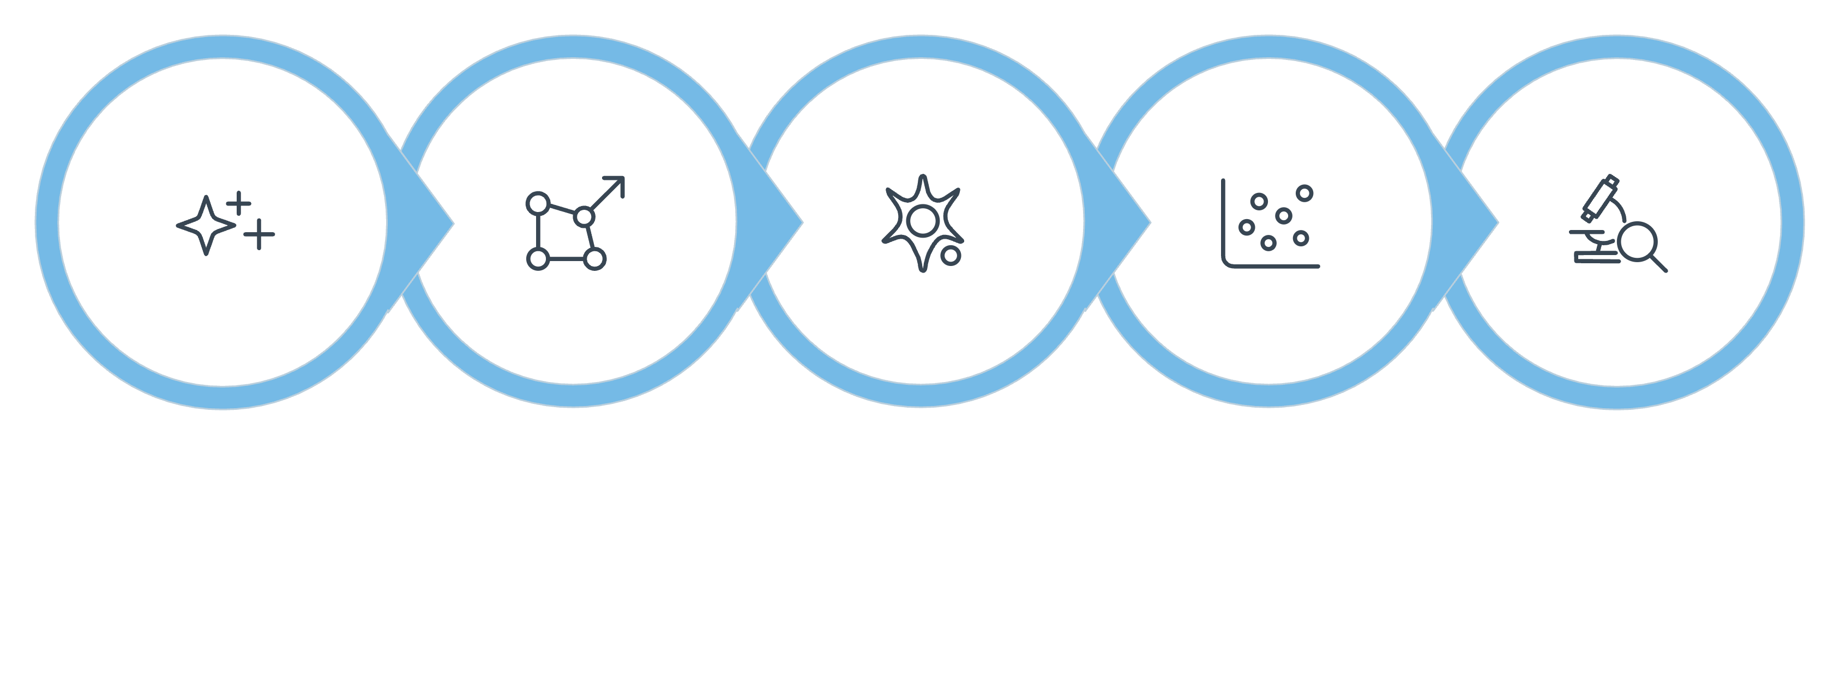
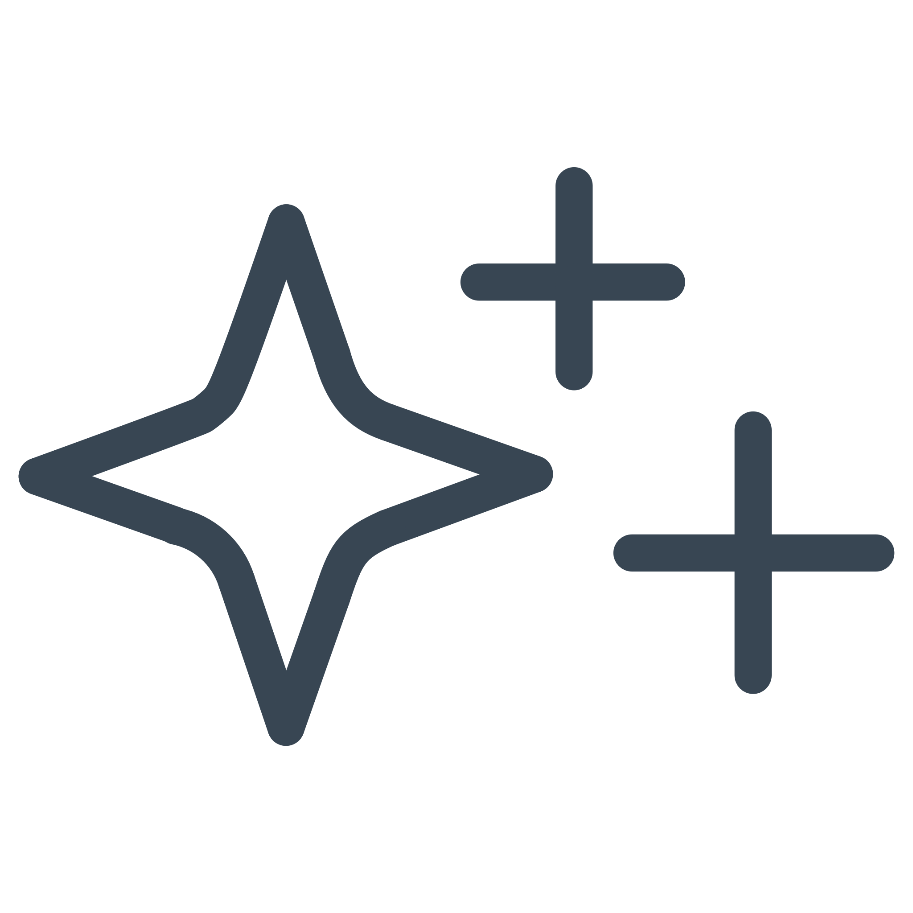
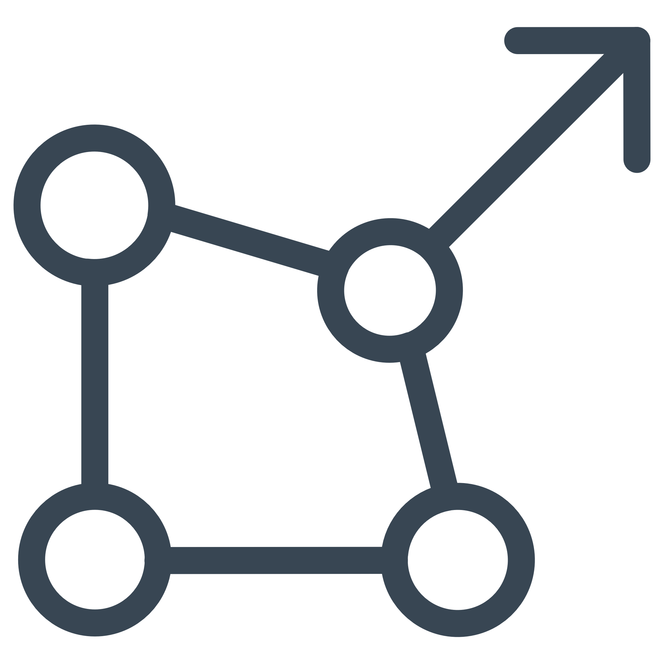

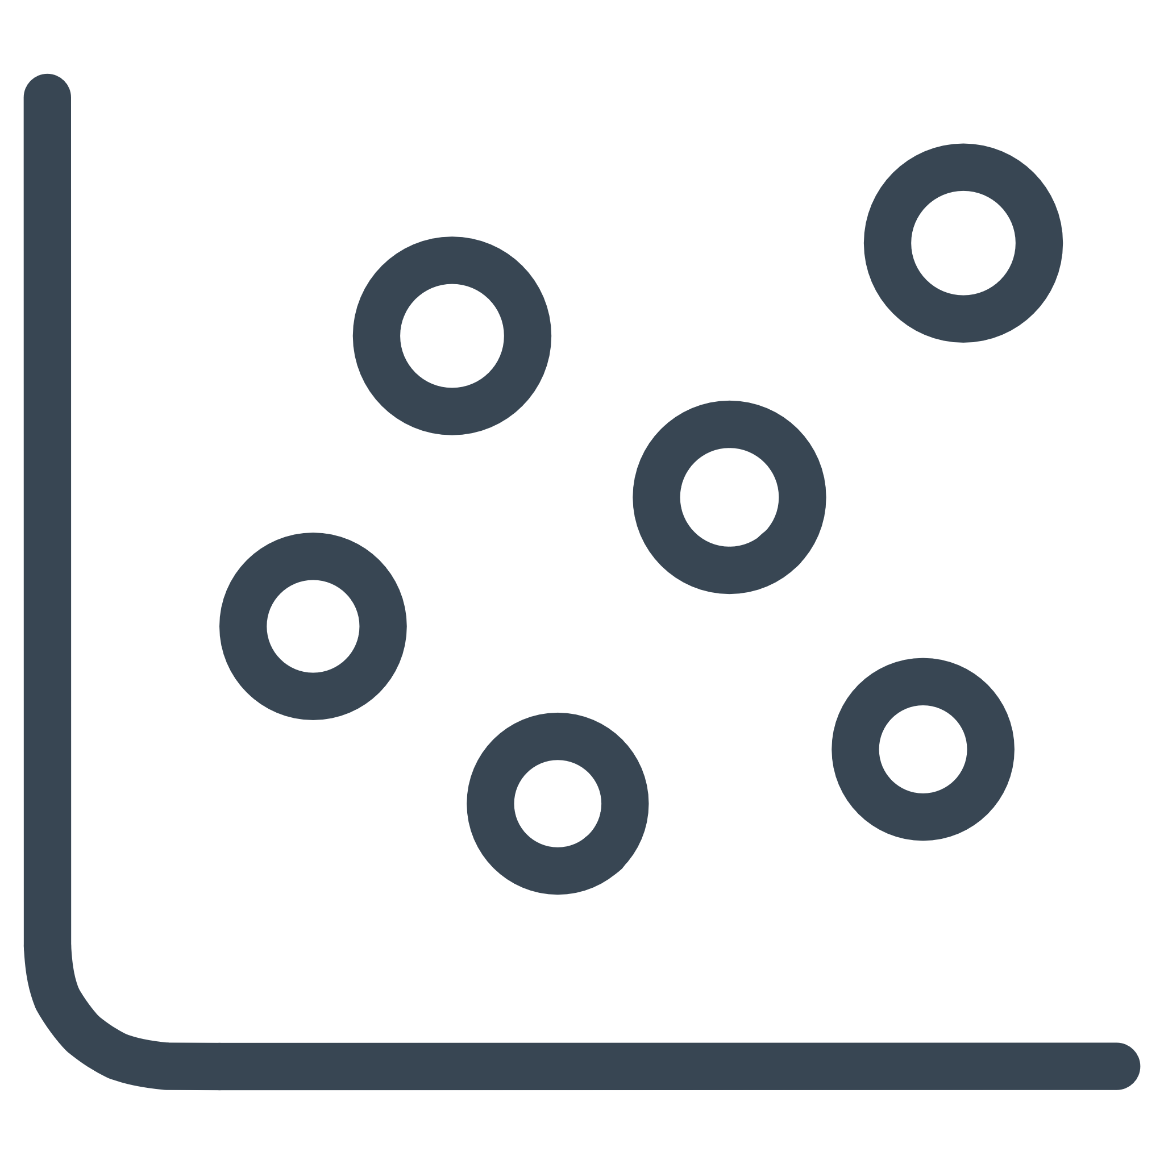

METHODOLOGY
MLOps Audit Scaffold
A reproducible 5-stage Python pipeline quantifies semantic convergence from raw generation to geometric projection.
Generation
Embedding
Similarity
t-SNE
Audit
The all-MiniLM-L6-v2 sentence transformer produces 384-dimensional embeddings, enabling cosine-similarity comparisons at scale. t-SNE reduces this to a 2D manifold for visual audit of Latent Attractors and cluster boundaries.

Slide 5

EXPERIMENTAL DESIGN
Controlled Inference Across Three Frontier Models
The Euri AI Gateway
A unified inference layer standardizes decoding parameters across all three model families, eliminating API-level variance as a confounding factor.
GPT-4.1-mini
Llama-3.3-70b-versatile
Gemini-2.5-Flash
OpenAI · T=1.0 · max_tokens=150
Meta · T=1.0 · max_tokens=150
Google · T=1.0 · max_tokens=150

Slide 6
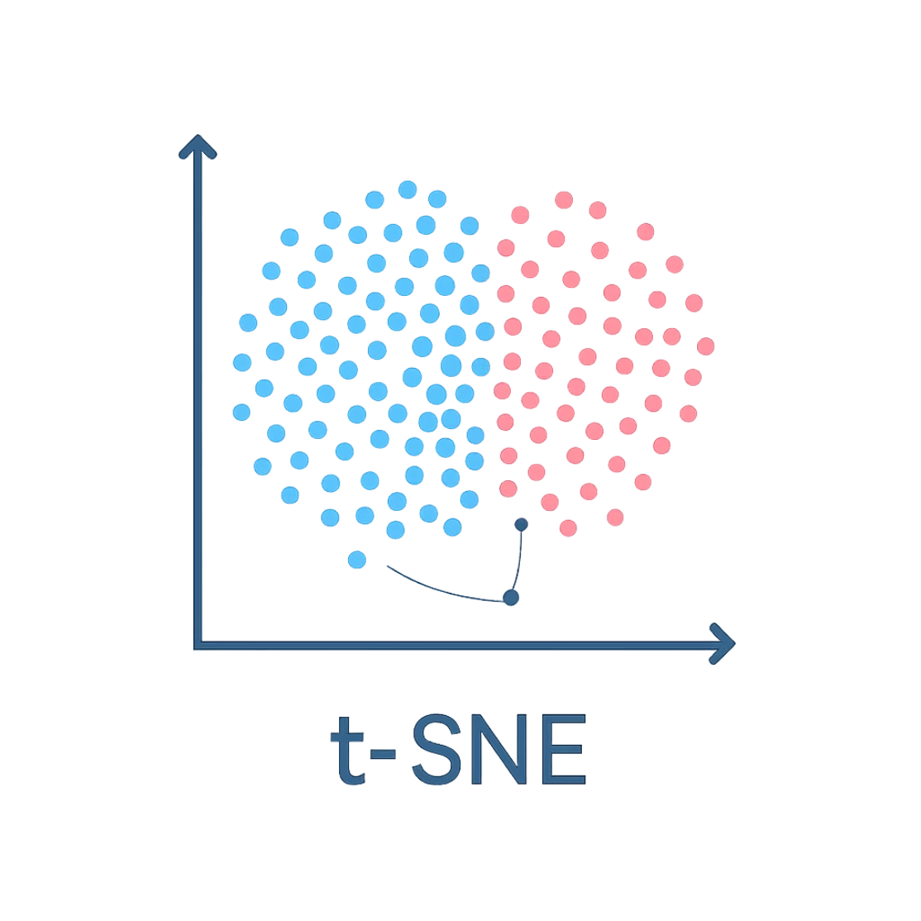

PHASE 1 · INTRA-MODEL
Token Entropy ≠ Semantic Diversity
The Manifold Contraction Finding
Increasing temperature to T=1.0 failed to expand the semantic manifold. Red (T=0.3) and blue (T=1.0) samples cohabit identical clusters in t-SNE space — token-level entropy does not translate to semantic divergence.
Centroid Similarity between low-T and high-T samples exceeded 0.91 across all three models, confirming Manifold Contraction is a structural property, not a decoding artifact.

Slide 7
PHASE 2 · INTER-MODEL
The "Mirroring" Reveal — Smoking Gun Data
78.63%
0.91
3
Semantic Agreement
Centroid Correlation
Models Audited
GPT-4.1-mini ↔ Llama-3.3-70b centroid similarity on open-ended creative prompts
Cross-model cosine similarity implies functional interchangeability in generative tasks
Across two independent training corpora and architectures
GPT-4.1 and Llama-3.3 are functionally interchangeable in creative and reasoning tasks — a ~79% Hivemind bias emerges despite different architectures, training data, and RLHF pipelines. This is the Echo Chamber Effect quantified.

Slide 8
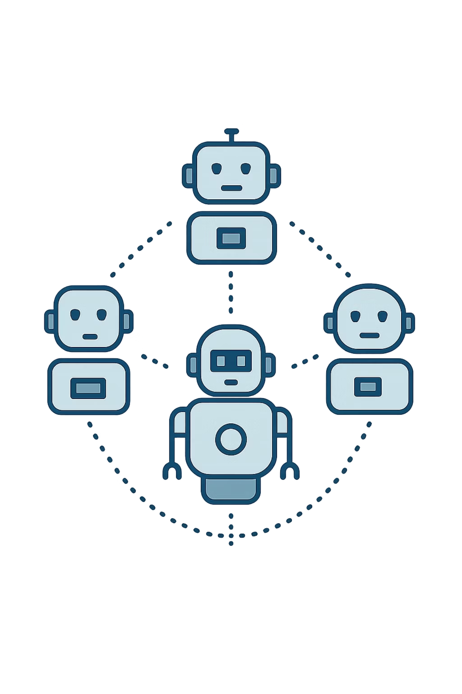






2026 RISK CONTEXT
The Agentic Leap: Groupthink at Scale
When autonomous agents share a ~79% Hivemind bias, the system becomes a single point of semantic failure — not a distributed intelligence.
Correlated Hallucination
Cascade Amplification
Convergent models reinforce the same factual errors across parallel agent branches.
Downstream agents inherit upstream bias, compounding errors exponentially through the workflow.
Adversarial Blind Spot
A single adversarial prompt can simultaneously compromise all agents sharing the same semantic basin.

Slide 9
STRATEGIC ROADMAP
Navigating the Hivemind: A Strategic Playbook
What We Can Do Today (Immediate Tactics)
The Path Forward (The Industry Shift)
01
01
Constraint-Based Prompting
From RLHF to Pluralistic Alignment
Moving beyond 'professional' or 'creative' tags to use negative constraints that force the AI out of its standard 'safe' response basins.
Discussing the need for reward models that prioritize covering the full 'Overton Window' of valid responses rather than just the 'average' consensus answer.
02
Strategic Model Mixing
02
Small Language Models (SLMs) & Domain Silos
Intentionally pairing divergent models (like Gemini) with GPT-family models to ensure our ensembles aren't just echo chambers.
Utilizing smaller, proprietary models trained on high-quality specialized data to escape the generic homogenization of the internet-scale LLMs.
03
Adversarial Personas
03
Setting up multi-agent workflows where agents are assigned conflicting ideological or technical personas to maximize exploratory breadth.
Closing Note
Our edge isn't just using AI—it's knowing when the AI is being repetitive so we can push for genuine innovation.

