Slide 1
Role of Theory in Computer Science
Applications
Basic Research
Connections to other fields
What is the nature of computation?
5

Slide 2






Let’s begin: Finite Automata
0
1
0,1
1
0
1
6

Slide 3










Finite Automata – Formal Definition
Example:
a
0
1
0,1
1
0
 | 0 | 1
7
Notes:
Goal- Precise mathematical description

Slide 4

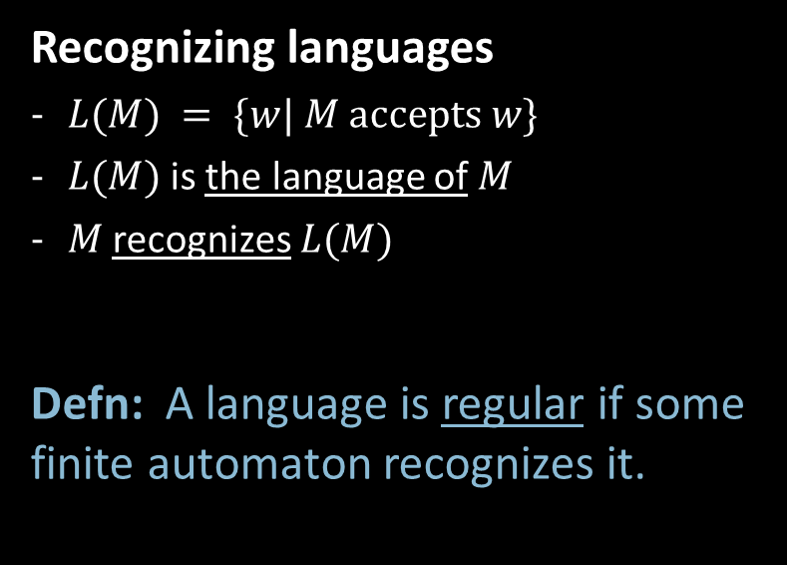
Finite Automata – Computation
8

Slide 5






Regular Languages – Examples
0
1
0,1
1
0
Goal: Understand the regular languages
9
Notes:
"Type equation here."

Slide 6
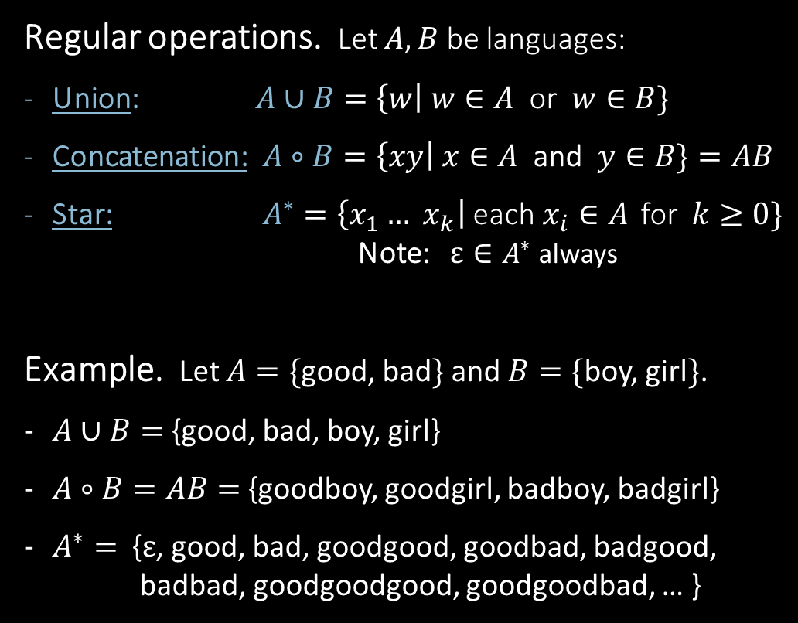

Regular Expressions
Goal: Show finite automata equivalent to regular expressions
10
Notes:
"Type equation here."

Slide 7

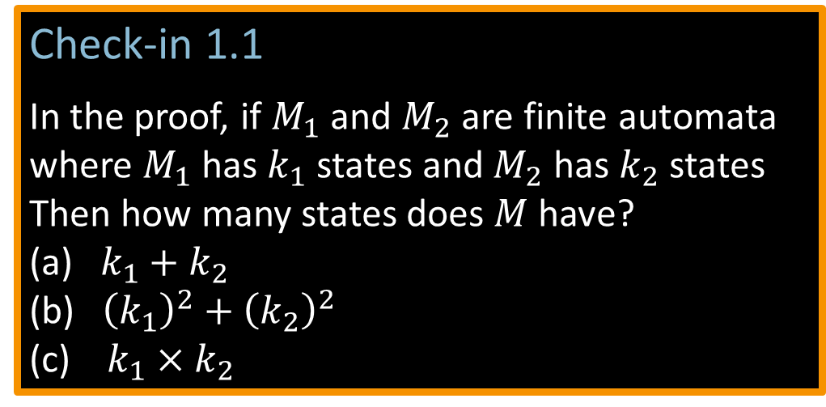







Closure Properties for Regular Languages
?
NO! [gives intersection]
11
Check-in 1.1
Notes:
"Type equation here."

Slide 8









Closure Properties continued
12
Notes:
"Type equation here."

Slide 9

Quick review of today
13
Notes:
"Type equation here."

