Slide 1
Finite-State Machines
Some of the slides below are adapted from slides for CS154 at Stanford University

Slide 2
Introduction
To understand how to match regular expressions we first need to understand finite-state machines, which are are finite collections of states with transition rules that take you from one state to another.
Today, several kinds of software can be modeled by finite automata.

Slide 3
Representing Finite-State Machines
The simplest representation is often a graph.
Nodes = states.
Directed arcs indicate state transitions.
Labels on arcs tell what causes the transition.
We define the size of a finite-state machine to be the total number of nodes and edges in its graph representation.

Slide 4
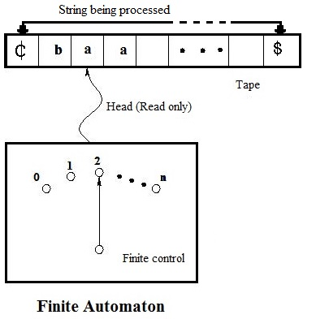
Finite Automata
A finite automaton is a finite-state machine where transitions are defined by reading characters in a text string left-to-right.
^
Image from https://er.yuvayana.org/how-dfa-operates-theory-with-block-diagram-of-fa/

Slide 5
Example: Recognizing Strings Ending in “ing”
Not i or g
A final state accepts the input string and is indicated with a boundary double circle.
Not i
Not i or n
i
nothing
Saw i
Saw in
Saw ing
i
n
g
Start
i
i
Not i

Slide 6
Another Finite Automaton Example: Matching An Even Number of 1’s
0
0
1
even
odd
Start
1
How would it look to accept a number of 1’s that is a multiple of 3?

Slide 7
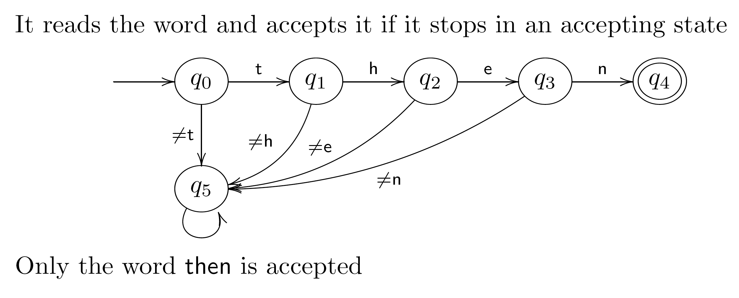
Password/Keyword Example
any character
any character
This is sometimes called a dead state.
BTW, there is a potential security risk on the password application if this finite automaton reports failure too quickly.

Slide 8
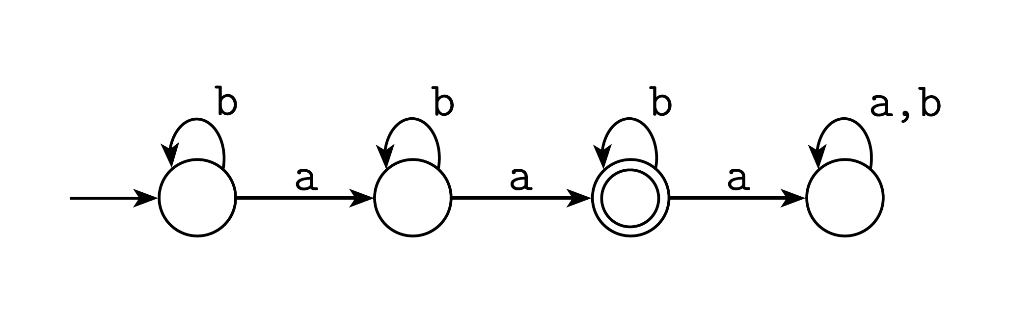
Exactly Two a’s

Slide 9
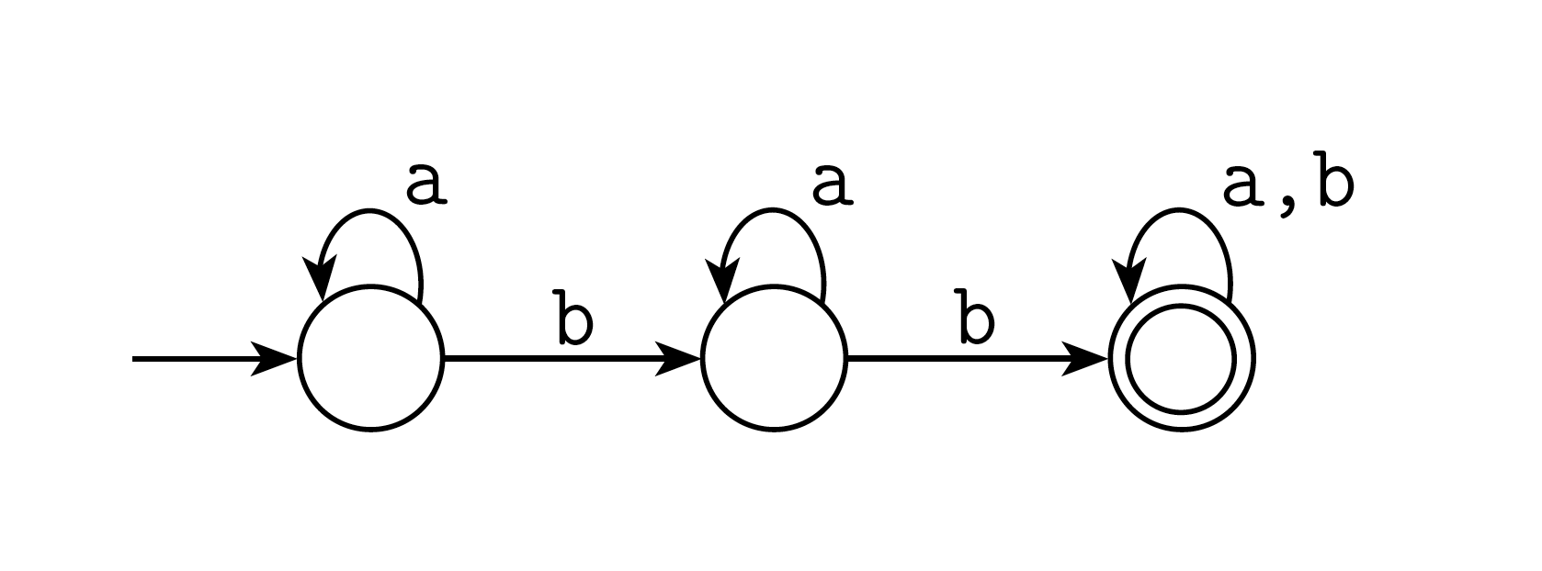
At Least Two b’s

Slide 10
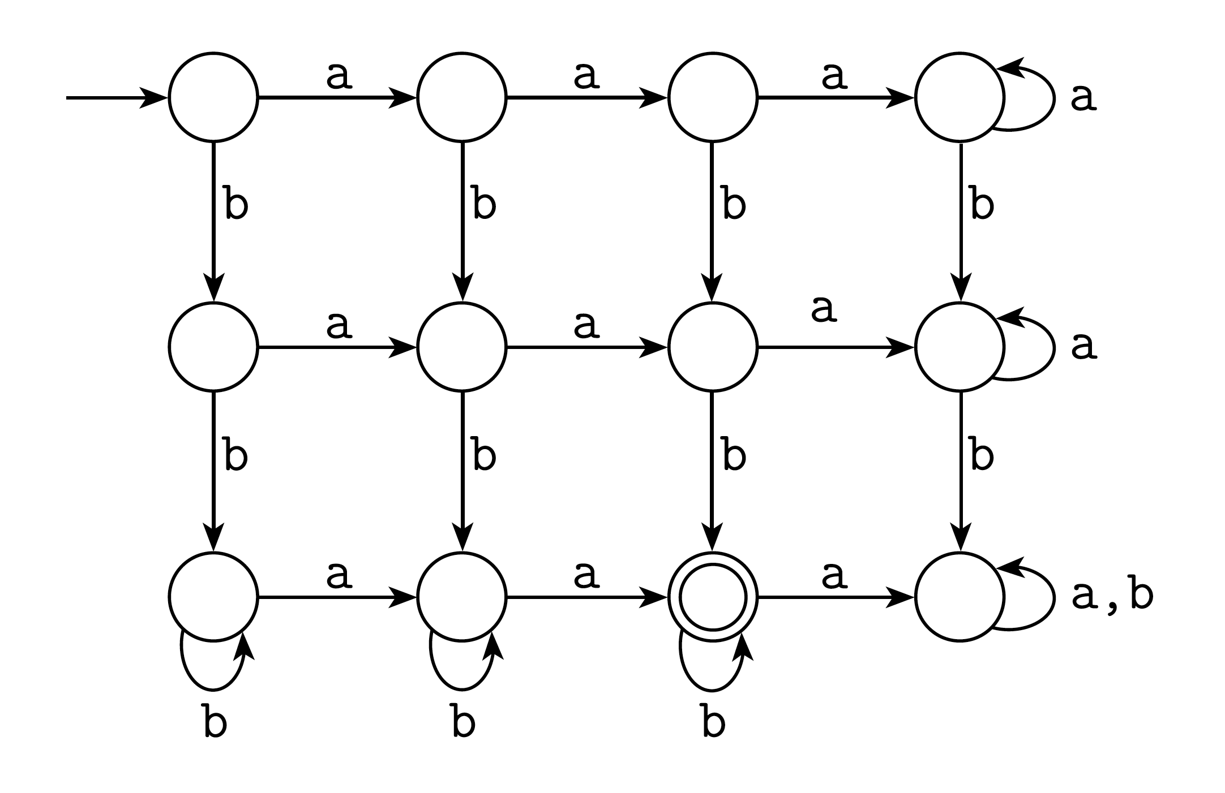
Exactly two a’s and at least two b’s

Slide 11
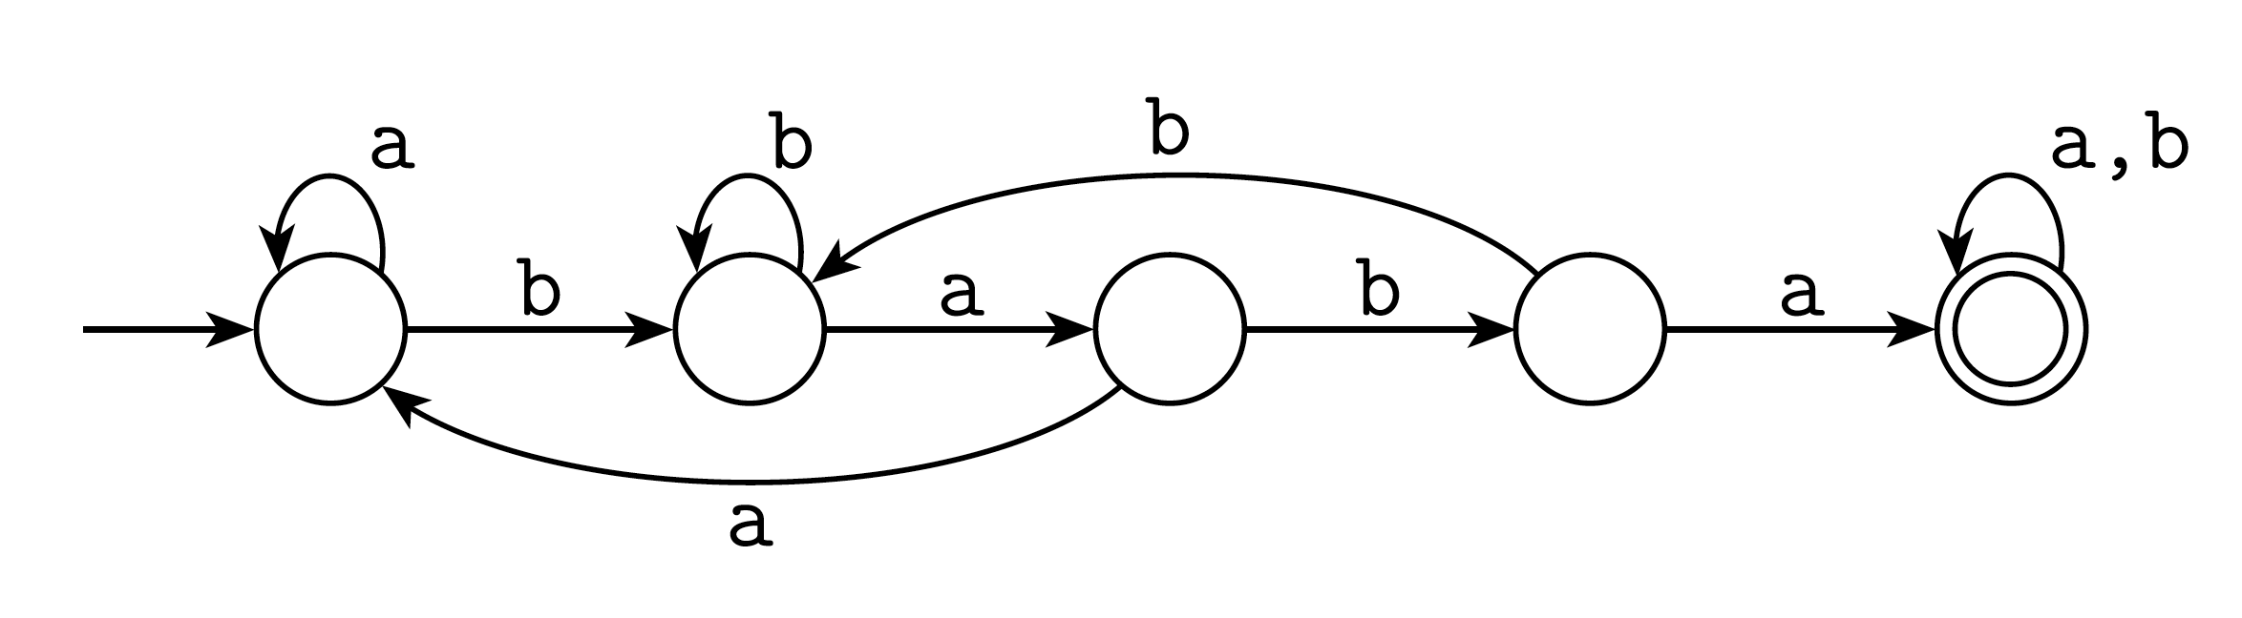
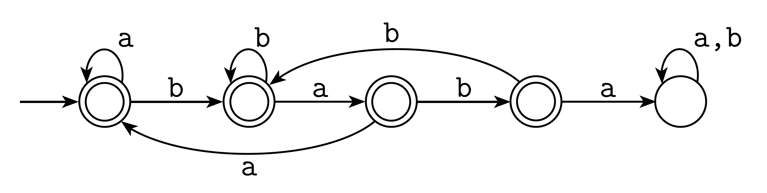
Containing a Substrings or Not
Contains baba:
Does not contain baba:

Slide 12
General Comments
Some things are easy with finite automata:
Substrings (…abcabc…)
Subsequences (…a…b…c…b…a…)
Modular counting (odd number of 1’s)
Some things are impossible with finite automata:
An equal number of a’s and b’s
More 0’s than 1’s
But when they can be used, they are generally fast.

Slide 13
Deterministic Finite Automata (DFA)
A formalism for defining languages, consisting of:
A finite set of states (Q, typically).
An input alphabet (Σ, typically).
A transition function (δ, typically).
A start state (q₀, in Q, typically).
A set of final states (F ⊆ Q, typically).
“Final” and “accepting” are synonyms.

Slide 14
The Transition Function
Takes two arguments: a state and an input symbol.
δ(q, a) = the state that the DFA goes to when it is in state q and input a is received.
Final states
starred *
Columns =
input symbols
0
1
*
A A B
B A C
C C C
Arrow for
start state
*
Rows = states

Slide 15
Graph Representation of DFA’s
Nodes = states.
Arcs represent transition function.
Arc from state p to state q labeled by all those input symbols that have transitions from p to q.
Arrow labeled “Start” to the start state.
Final states indicated by double circles.
Recall that the size of a DFA is the total number of nodes and edges in its graph representation. Note that this is also proportional to the size of the transition table representation.

Slide 16
Example: Graph of a DFA
Accepts all strings without two consecutive 1’s.
0
0,1
1
1
A
B
C
Start
0
Previous
string OK,
does not
end in 1.
Previous
String OK,
ends in a
single 1.
Consecutive
1’s have
been seen.

Slide 17
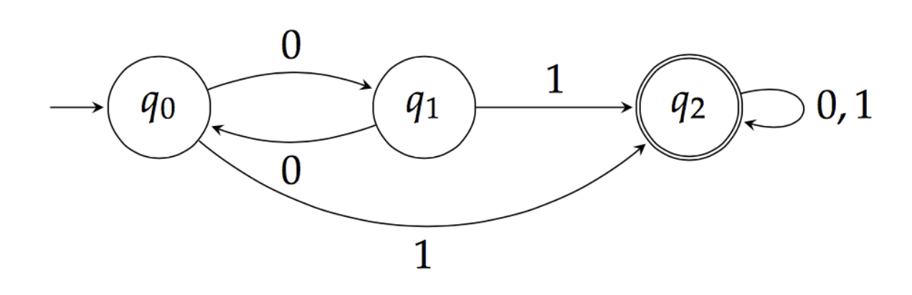
Language of a DFA
Automata of all kinds define languages.
If A is an automaton, L(A) is its language.
For a DFA, A, L(A) is the set of strings labeling paths from the start state to a final state.

Slide 18
Example: String in a Language
String 101 is in the language of the DFA below.
Start at A.
0
0,1
1
1
A
B
C
Start
0

Slide 19
Example: String in a Language
String 101 is in the language of the DFA below.
Follow arc labeled 1.
0
0,1
1
1
A
B
C
Start
0

Slide 20
Example: String in a Language
String 101 is in the language of the DFA below.
Then arc labeled 0 from current state B.
0
0,1
1
1
A
B
C
Start
0

Slide 21
Example: String in a Language
String 101 is in the language of the DFA below.
Finally arc labeled 1 from current state A. Result
is an accepting state, so 101 is in the language.
0
0,1
1
1
A
B
C
Start
0

Slide 22
Example – Concluded
The language of our example DFA is:
{w | w is in {0,1}* and w does not have
two consecutive 1’s}
Such that…
These conditions
about w are true.
Read a set former as
“The set of strings w…

Slide 23
DFA Matching is Fast
Given a DFA, A, of size, m, and an input string, T, of length n, we can test if T is in L(A) in O(m + n) time:
Read in the graph representation for A.
Step 1 takes O(m) time.
Let s = the initial state for A.
For each character, c, in T (in order): Let s = δ(s,c).
Step 3 takes O(n) time in total.
If s is a final state, accept T.

Slide 24
Nondeterminism
A nondeterministic finite automaton has the ability to be in several states at once.
Transitions from a state on an input symbol can be to any set of states.
Start in one start state.
Accept if any sequence of choices leads to a final state.
Intuitively: the NFA always “guesses right.”

Slide 25
Example: Moves on a Chessboard
States = squares.
Inputs = r (move to an adjacent red square) and b (move to an adjacent black square).
Start state, final state are in opposite corners.
1
2
3
4
5
6
7
8
9

Slide 26
Example: Chessboard
1
2
3
r b
2,4 5
4,6 1,3,5
2,6 5
2,8 1,5,7
2,4,6,8 1,3,7,9
2,8 3,5,9
4,8 5
4,6 5,7,9
6,8 5
4
5
6
7
8
9
r
b
b
1
2
1
5
4
3
1
*
5
3
7
7
9
Accept, since final state reached

Slide 27
Formal Nondeterministic Finite Automaton (NFA) Definition
A finite set of states, typically Q.
An input alphabet, typically Σ.
A transition function, typically δ.
δ(q, a) is a set of states.
Extend to strings as follows:
Basis: δ(q, ε) = {q}
Induction: δ(q, wa) = the union over all states p in δ(q, w) of δ(p, a)
A start state in Q, typically q₀.
A set of final states F ⊆ Q.

Slide 28
NFA Properties
A string w is accepted by an NFA if δ(q₀, w) contains at least one final state.
That is, there exists a sequence of valid transitions from q₀ to a final state given the input w.
The language of the NFA is the set of strings it accepts.
As with a DFA, we say that the size of an NFA is the total number of nodes and edges in its graph representation. Note that this is also proportional to the size of the NFA’s transition table representation (where we store each δ(q, w) entry as a list).

Slide 29
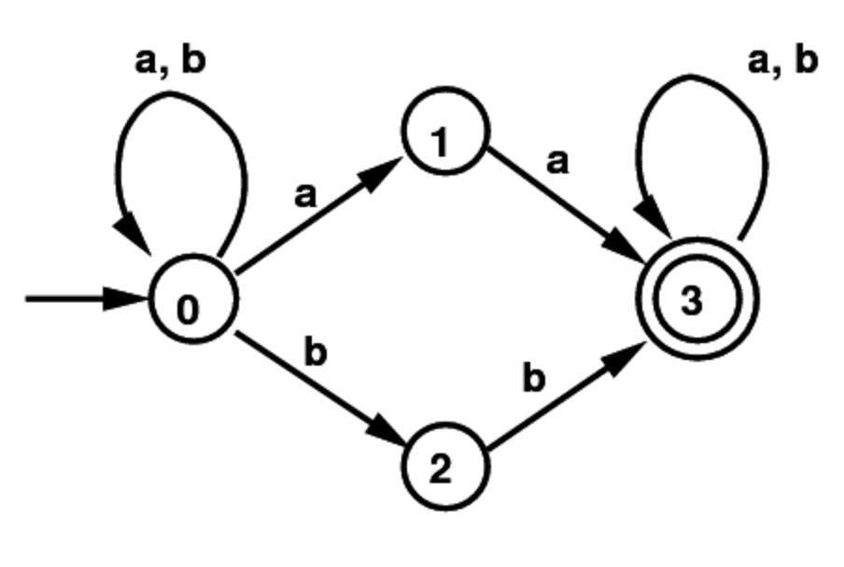
Example NFA
Set of all strings with two consecutive a’s or two consecutive b’s:
Note that some states have an empty transition on an a or b, and some have multiple transitions on a or b.

Slide 30
NFA Simulation
Given an NFA, A, of size, m, and an input string, T, of length n, we can test if T is in L(A) in O(mn) time:
Read in the the graph representation for A.
Step 1 takes O(m) time.
Let S = {q}, where q is the initial state for A.
For each character, c, in T (in order):
Let S be the union of δ(q,c), for each q in S.
Note: we can compute S in O(m) time, since the total size of all the δ(q,c) sets is at most O(m) even counting duplicates.
If S contains a final state, accept T.

Slide 31
Every DFA can be Converted to an Equivalent NFA
A DFA can easily be turned into an NFA that accepts the same language.
If δ_{D}(q, a) = p, let the NFA have δ_{N}(q, a) = {p}.
Then the NFA is always in a state set containing exactly one DFA state – the state the DFA is in after reading the same input.

Slide 32
Every NFA can be Converted to an Equivalent DFA
Surprisingly, for any NFA there is a DFA that accepts the same language.
The proof is called the subset construction.
It was defined by Michael Rabin and Dana Scott.
The drawback is that the number of states of the DFA can be exponential in the number of states of the NFA.

Slide 33
Subset Construction
Given an NFA with states Q, inputs Σ, transition function δ_{N}, state state q₀, and final states F, construct equivalent DFA with:
States 2^{Q} (Set of subsets of Q).
Inputs Σ.
Start state {q₀}.
Final states = all those with a member of F.

Slide 34
Critical Point
The DFA states have names that are sets of NFA states.
So as a DFA state, an expression like {p,q} must be read as a single symbol, not as a set.
Analogy: a class of objects whose values are sets of objects of another class.

Slide 35
Subset Construction – (2)
The transition function δ_{D} is defined by:
δ_{D}({q₁,…,q_{k}}, a) is the union over all i = 1,…,k of δ_{N}(q_{i}, a).
Example: We’ll construct the DFA equivalent of our “chessboard” NFA.

Slide 36
Example: Subset Construction
r b
2,4 5
4,6 1,3,5
2,6 5
2,8 1,5,7
2,4,6,8 1,3,7,9
2,8 3,5,9
4,8 5
4,6 5,7,9
6,8 5
r b
{1}
{2,4} {5}
{2,4}
{5}
*
Alert: What we’re doing here is
the lazy form of DFA construction,
where we only construct a state
if we are forced to.

Slide 37
Example: Subset Construction
r b
2,4 5
4,6 1,3,5
2,6 5
2,8 1,5,7
2,4,6,8 1,3,7,9
2,8 3,5,9
4,8 5
4,6 5,7,9
6,8 5
r b
{1}
{2,4} {5}
{2,4}
{2,4,6,8} {1,3,5,7}
{5}
{2,4,6,8}
{1,3,5,7}
*

Slide 38
Example: Subset Construction
r b
2,4 5
4,6 1,3,5
2,6 5
2,8 1,5,7
2,4,6,8 1,3,7,9
2,8 3,5,9
4,8 5
4,6 5,7,9
6,8 5
r b
{1}
{2,4} {5}
{2,4}
{2,4,6,8} {1,3,5,7}
{5}
{2,4,6,8} {1,3,7,9}
{2,4,6,8}
{1,3,5,7}
* {1,3,7,9}
*

Slide 39
Example: Subset Construction
r b
2,4 5
4,6 1,3,5
2,6 5
2,8 1,5,7
2,4,6,8 1,3,7,9
2,8 3,5,9
4,8 5
4,6 5,7,9
6,8 5
r b
{1}
{2,4} {5}
{2,4}
{2,4,6,8} {1,3,5,7}
{5}
{2,4,6,8} {1,3,7,9}
{2,4,6,8}
{2,4,6,8} {1,3,5,7,9}
{1,3,5,7}
* {1,3,7,9}
* {1,3,5,7,9}
*

Slide 40
Example: Subset Construction
r b
2,4 5
4,6 1,3,5
2,6 5
2,8 1,5,7
2,4,6,8 1,3,7,9
2,8 3,5,9
4,8 5
4,6 5,7,9
6,8 5
r b
{1}
{2,4} {5}
{2,4}
{2,4,6,8} {1,3,5,7}
{5}
{2,4,6,8} {1,3,7,9}
{2,4,6,8}
{2,4,6,8} {1,3,5,7,9}
{1,3,5,7}
{2,4,6,8} {1,3,5,7,9}
* {1,3,7,9}
* {1,3,5,7,9}
*

Slide 41
Example: Subset Construction
r b
2,4 5
4,6 1,3,5
2,6 5
2,8 1,5,7
2,4,6,8 1,3,7,9
2,8 3,5,9
4,8 5
4,6 5,7,9
6,8 5
r b
{1}
{2,4} {5}
{2,4}
{2,4,6,8} {1,3,5,7}
{5}
{2,4,6,8} {1,3,7,9}
{2,4,6,8}
{2,4,6,8} {1,3,5,7,9}
{1,3,5,7}
{2,4,6,8} {1,3,5,7,9}
* {1,3,7,9}
{2,4,6,8} {5}
* {1,3,5,7,9}
*

Slide 42
Example: Subset Construction
r b
2,4 5
4,6 1,3,5
2,6 5
2,8 1,5,7
2,4,6,8 1,3,7,9
2,8 3,5,9
4,8 5
4,6 5,7,9
6,8 5
r b
{1}
{2,4} {5}
{2,4}
{2,4,6,8} {1,3,5,7}
{5}
{2,4,6,8} {1,3,7,9}
{2,4,6,8}
{2,4,6,8} {1,3,5,7,9}
{1,3,5,7}
{2,4,6,8} {1,3,5,7,9}
* {1,3,7,9}
{2,4,6,8} {5}
* {1,3,5,7,9}
{2,4,6,8} {1,3,5,7,9}
*

Slide 43
NFA’s With ε-Transitions
We can allow state-to-state transitions on ε (null) input.
These transitions are done spontaneously, without looking at the input string.
A convenience at times, but still only regular languages are accepted.

Slide 44
Example: ε-NFA
0 1 ε
A {E} {B} ∅
B ∅ {C} {D}
C ∅ {D} ∅
D ∅ ∅ ∅
E {F} ∅ {B, C}
F {D} ∅ ∅
ε
1
1
1
B
C
D
ε
*
A
ε
0
0
E
F
0

Slide 45
Closure of States
CL(q) = set of states you can reach from state q following only arcs labeled ε.
Example: CL(A) = {A};
CL(E) = {B, C, D, E}.
Closure of a set of states = union of the closure of each state.
Can be computed by doing a depth-first search that just follows ε-transitions.
ε
1
1
1
B
C
D
A
ε
ε
0
0
E
F
0

Slide 46
Equivalence of NFA and ε-NFA
Every NFA is an ε-NFA.
It just has no transitions on ε.
The converse requires us to take an ε-NFA with m states and construct an NFA that accepts the same language (also with m states).
We do so by combining ε–transitions with the next transition on a real input.

Slide 47
Picture of ε-Transition Removal
a
a
a
Transitions
on ε
Transitions
on ε

Slide 48
Equivalence – (2)
Start with an ε-NFA with states Q, inputs Σ, start state q₀, final states F, and transition function δ_{E}.
Construct an “ordinary” NFA with states Q, inputs Σ, start state q₀, final states F’, and transition function δ_{N}.
If the ε-NFA has size m, then the resulting equivalent NFA will have size O(m²) in the worst case.

Slide 49
Compute δ_{N} as follows:
For each q in Q, let S_{q} = CL(q).
Step 1 takes O(m²) time (by doing a depth-first search from each q that just follows ε-transitions).
Let δ_{N}(q, a) be the union over all p in S_{q} of δ_{E}(p, a) for which δ_{E}(p, a) is defined.
Step 2 takes O(m) time for each state q, since the total size of all the δ_{E}(p, a) sets is O(m).
So, the total running time for ε-NFA-to-NFA conversion is O(m²). The resulting NFA could have size O(m²), since it will have the same number of nodes, but could have more edges.
F’ = set of states q such that CL(q) contains a state of F.

Slide 50
Example: ε-NFA-to-NFA
Interesting
closures:
CL(B) = {B,D}; CL(E) = {B,C,D,E}
ε-NFA
NFA
δ_{E}
0 1 ε
A {E} {B} ∅
B ∅ {C} {D}
C ∅ {D} ∅
D ∅ ∅ ∅
E {F} ∅ {B, C}
F {D} ∅ ∅
δ_{N}
0 1
A {E} {B}
B ∅ {C}
C ∅ {D}
D ∅ ∅
E {F} {C, D}
F {D} ∅
*
*
*
*
Since closure of
E includes B and
C; which have
transitions on 1
to C and D.
Since closures of
B and E include
final state D.

Slide 51
ε-NFA Matching via DFA Conversion can be Slow for Big Finite Automata
Given an ε-NFA, A, of size m, and an input string, T, of length n, we can test if T is in L(A) in O(2^{m} + n) time:
Convert A into an equivalent DFA, B, using the above ε-NFA to NFA to DFA constructions.
Step 1 takes O(2^{m}) time in the worst case and creates a DFA of size O(2^{m}) in the worst case.
Test if T is in L(B) using the DFA simulation algorithm.
Step 2 takes O(2^{m} + n) time.

Slide 52
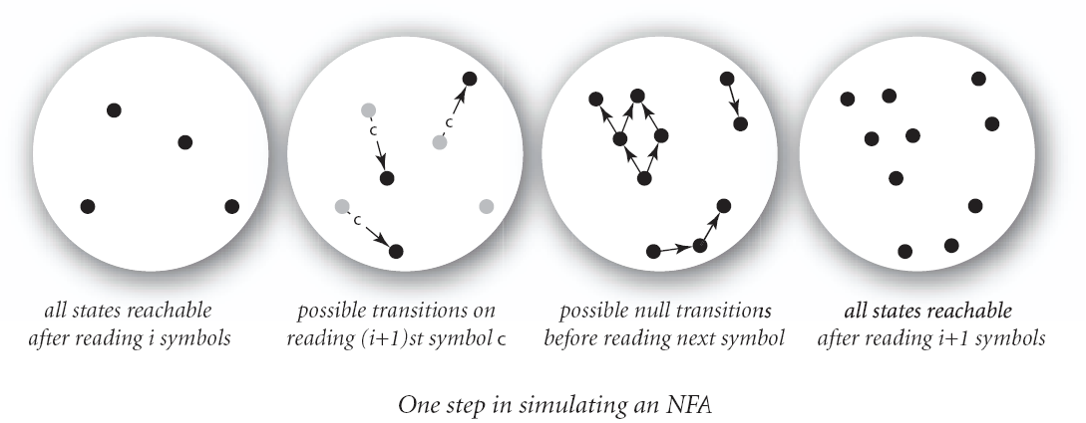
There is an Alternative Approach
Instead of converting the ε-NFA to a DFA, and then matching using the DFA, simulate the ε-NFA directly.

Slide 53
ε-NFA Simulation
Given an ε-NFA, A, of size, m, and an input string, T, of length n, we can test if T is in L(A) in O(mn) time:
Read in the graph representation for A.
Step 1 takes O(m) time.
Let S = {q}, where q is the initial state for A.
For each character, c, in T (in order):
Let S = CL(S). This can be done in O(m) time by a DFS that only follows ε-transitions.
Let S be the union of δ(q,c), for each q in S. This takes O(m) time, since the size of all the δ(q,c) sets is O(m).
If S contains a final state, accept T.

Slide 54
Summary
DFA’s, NFA’s, and ε–NFA’s all accept exactly the same set of languages: the regular languages.
The NFA types are easier to design and may have exponentially fewer states than a DFA.
But only a DFA can be implemented in linear time, that is, O(m + n) time.
Implementing an ε-NFA by the conversion to DFA method takes O(2^{m} + n) time.
Implementing an ε-NFA by the ε-NFA simulation method takes O(mn) time.

