Slide 1
Hierarchy of languages
Non-Recursively Enumerable Languages
Recursively Enumerable Languages
Recursive Languages
Context-Free Languages
Regular Languages
‹#›
Notes:
‹#›

Slide 2
Deterministic Finite State Automata (DFA)
……..
One-way, infinite tape, broken into cells
One-way, read-only tape head.
Finite control, i.e.,
finite number of states, and
transition rules between them, i.e.,
a program, containing the position of the read head, current symbol being scanned, and the current “state.”
A string is placed on the tape, read head is positioned at the left end, and the DFA will read the string one symbol at a time until all symbols have been read. The DFA will then either accept or reject the string.
0 | 1 | 1 | 0 | 0
Finite
Control
‹#›

Slide 3
The finite control can be described by a transition diagram or table:
Example #1:
1 0 0 1 1
q₀ q₀ q₁ q₀ q₀ q₀
One state is final/accepting, all others are rejecting.
The above DFA accepts those strings that contain an even number of 0’s, including the null string, over Sigma = {0,1}
L = {all strings with zero or more 0’s}
Note, the DFA must reject all other strings
1
0
q₀
q₁
1
0
‹#›

Slide 4
Note:
Machine is for accepting a language, language is the purpose!
Many equivalent machines may accept the same language,
but a machine cannot accept multiple languages!
Id’s of the characters or states are irrelevant,
you can call them by any names!
Sigma = {0, 1} ≡ {a, b}
States = {q0, q1} ≡ {u, v}, as long as they have
identical (isomorphic) transition table
M1
M2
….
M-inf
L
‹#›

Slide 5
An equivalent machine to the previous example (DFA for even number of 0’s):
1 0 0 1 1
q₀ q₃ q₁ q₂ q₂ q₂ accept string
One state is final/accepting, all others are rejecting.
The above DFA accepts those strings that contain an even number of 0’s, including null string, over Sigma = {0,1}
Can you draw a machine for a language by excluding the null string from the language? L = {all strings with 2 or more 0’s}
1
1
q₃
q₂
1
0
0
0
q₀
q₁
0
1
‹#›

Slide 6
Example #2:
a c c c b accepted
q₀ q₀ q₁ q₂ q₂ q₂
a a c rejected
q₀ q₀ q₀ q₁
Accepts those strings that contain at least two c’s
a
a
a/b/c
q₀
c
c
q₂
q₁
b
b
‹#›

Slide 7
a
a
a/b/c
q₀
c
q₁
c
q₂
b
b
Inductive Proof (sketch): that the machine correctly accepts strings with at least two c’s
Proof goes over the length of the string.
Base: x a string with |x|=0. state will be q0 => rejected.
Inductive hypothesis: |x|= integer k, & string x is rejected - in state q0 (x must have zero c),
OR, rejected – in state q1 (x must have one c),
OR, accepted – in state q2 (x has already with two c’s)
Inductive steps: Each case for symbol p, for string xp (|xp| = k+1), the last symbol p = a, b or c
 | xa | xb | xc
x ends in q0 | q0 =>reject (still zero c => should reject) | q0 =>reject (still zero c => should reject) | q1 =>reject (still zero c => should reject)
x ends in q1 | q1 =>reject (still one c => should reject) | q1 =>reject (still one c => should reject) | q2 =>accept (two c now=> should accept)
x ends in q2 | q2 =>accept (two c already => should accept) | q2 =>accept (two c already => should accept) | q2 =>accept (two c already => should accept)
‹#›

Slide 8
Formal Definition of a DFA
A DFA is a five-tuple:
M = (Q, Σ, δ, q₀, F)
Q A finite set of states
Σ A finite input alphabet
q₀ The initial/starting state, q₀ is in Q
F A set of final/accepting states, which is a subset of Q
δ A transition function, which is a total function from Q x Σ to Q
δ: (Q x Σ) –> Q δ is defined for any q in Q and s in Σ, and
δ(q,s) = q’ is equal to some state q’ in Q, could be q’=q
Intuitively, δ(q,s) is the state entered by M after reading symbol s while in state q.
‹#›

Slide 9
Revisit example #1:
Q = {q₀, q₁}
Σ = {0, 1}
Start state is q₀
F = {q₀}
δ:
0 1
q₀ q₁ q₀
q₁ q₀ q₁
1
0
q₀
q₁
1
0
‹#›

Slide 10
Revisit example #2:
Q = {q₀, q₁, q₂}
Σ = {a, b, c}
Start state is q₀
F = {q₂}
δ: a b c
q₀ q₀ q₀ q₁
q₁ q₁ q₁ q₂
q₂ q₂ q₂ q₂
Since δ is a function, at each step M has exactly one option.
It follows that for a given string, there is exactly one computation.
a
a
a/b/c
q₀
c
q₁
c
q₂
b
b
‹#›

Slide 11
Extension of δ to Strings
δ^ : (Q x Σ*) –> Q
δ^(q,w) – The state entered after reading string w having started in state q.
Formally:
1) δ^(q, ε) = q, and
2) For all w in Σ* and a in Σ
δ^(q,wa) = δ (δ^(q,w), a)
‹#›

Slide 12
1
Recall Example #1:
What is δ^(q₀, 011)? Informally, it is the state entered by M after processing 011 having started in state q_{0.}
Formally:
δ^(q₀, 011) = δ (δ^(q₀,01), 1) by rule #2
= δ (δ ( δ^(q₀,0), 1), 1) by rule #2
= δ (δ (δ (δ^(q₀, λ), 0), 1), 1) by rule #2
= δ (δ (δ(q₀,0), 1), 1) by rule #1
= δ (δ (q₁, 1), 1) by definition of δ
= δ (q₁, 1) by definition of δ
= q₁ by definition of δ
Is 011 accepted? No, since δ^(q₀, 011) = q₁ is not a final state.
0
q₀
q₁
1
0
‹#›

Slide 13
Note that:
δ^ (q,a) = δ(δ^(q, ε), a) by definition of δ^, rule #2
= δ(q, a) by definition of δ^, rule #1
Therefore:
δ^ (q, a₁a₂…a_{n}) = δ(δ(…δ(δ(q, a1), a2)…), a_{n})
However, we will abuse notations, and use δ in place of δ^:
δ^(q, a₁a₂…a_{n}) = δ(q, a₁a₂…a_{n})
‹#›

Slide 14
Example #3:
What is δ(q₀, 011)? Informally, it is the state entered by M after processing 011 having started in state q_{0.}
Formally:
δ(q₀, 011) = δ (δ(q₀,01), 1) by rule #2
= δ (δ (δ(q₀,0), 1), 1) by rule #2
= δ (δ (q₁, 1), 1) by definition of δ
= δ (q₁, 1) by definition of δ
= q₁ by definition of δ
Is 011 accepted? No, since δ(q₀, 011) = q₁ is not a final state.
Language?
L ={ all strings over {0,1} that has 2 or more 0 symbols}
1
1
1
0
q₀
0
q₁
q₂
0
‹#›

Slide 15
Recall Example #3:
What is δ(q₁, 10)?
δ(q₁, 10) = δ (δ(q₁,1), 0) by rule #2
= δ (q₁, 0) by definition of δ
= q₂ by definition of δ
Is 10 accepted? No, since δ(q₀, 10) = q₁ is not a final state. The fact that δ(q₁, 10) = q₂ is irrelevant, q1 is not the start state!
1
1
1
0
q₀
0
q₁
q₂
0
‹#›

Slide 16
Definitions related to DFAs
Let M = (Q, Σ, δ,q₀,F) be a DFA and let w be in Σ*. Then w is accepted by M iff δ(q₀,w) = p for some state p in F.
Let M = (Q, Σ, δ,q₀,F) be a DFA. Then the language accepted by M is the set:
L(M) = {w | w is in Σ* and δ(q₀,w) is in F}
Another equivalent definition:
L(M) = {w | w is in Σ* and w is accepted by M}
Let L be a language. Then L is a regular language iff there exists a DFA M such that L = L(M).
Let M₁ = (Q₁, Σ₁, δ₁, q₀, F₁) and M₂ = (Q₂, Σ₂, δ₂, p₀, F₂) be DFAs. Then M₁ and M₂ are equivalent iff L(M₁) = L(M₂).
‹#›

Slide 17
Notes:
A DFA M = (Q, Σ, δ,q₀,F) partitions the set Σ* into two sets: L(M) and
Σ* - L(M).
If L = L(M) then L is a subset of L(M) and L(M) is a subset of L (def. of set equality).
Similarly, if L(M₁) = L(M₂) then L(M₁) is a subset of L(M₂) and L(M₂) is a subset of L(M₁).
Some languages are regular, others are not. For example, if
Regular: L₁ = {x | x is a string of 0's and 1's containing an even number of 1's} and
Not-regular: L₂ = {x | x = 0^{n}1^{n} for some n >= 0}
Can you write a program to “simulate” a given DFA, or any arbitrary input DFA?
Question we will address later:
How do we determine whether or not a given language is regular?
‹#›

Slide 18
Give a DFA M such that:
L(M) = {x | x is a string of 0’s and 1’s and |x| >= 2}
Prove this by induction
0/1
q₀
0/1
0/1
q₂
q₁
‹#›

Slide 19
Give a DFA M such that:
L(M) = {x | x is a string of (zero or more) a’s, b’s and c’s such
that x does not contain the substring aa}
Logic:
In Start state (q0): b’s and c’s: ignore – stay in same state
q0 is also “accept” state
First ‘a’ appears: get ready (q1) to reject
But followed by a ‘b’ or ‘c’: go back to start state q0
When second ‘a’ appears after the “ready” state: go to reject state q2
Ignore everything after getting to the “reject” state q2
b/c
a/b/c
a
q₀
q₁
a
q₂
b/c
‹#›

Slide 20
Give a DFA M such that:
L(M) = {x | x is a string of a’s, b’s and c’s such that x
contains the substring aba}
Logic: acceptance is straight forward, progressing on each expected symbol
However, rejection needs special care, in each state (for DFA, we will see this becomes easier in NFA, non-deterministic machine)
b/c
a
a/b/c
a
a
q₀
q₁
b
q₂
q₃
c
b/c
‹#›

Slide 21
Give a DFA M such that:
L(M) = {x | x is a string of a’s and b’s such that x
contains both aa and bb}
First do, for a language where ‘aa’ comes before ‘bb’
Then do its reverse; and then parallelize them.
Remember, you may have multiple “final” states, but only one “start” state
a
b
q₁
a
q₂
q₃
b
a/b
a
a
q₀
q₇
a
b
b
b
a
q₄
b
q₅
q₆
a
b
‹#›

Slide 22
Let Σ = {0, 1}. Give DFAs for {}, {ε}, Σ*, and Σ⁺.
For {}: For {ε}:
For Σ*: For Σ⁺:
0/1
0/1
q₀
0/1
q₁
q₀
0/1
0/1
q₀
0/1
q₁
q₀
‹#›

Slide 23
Problem: Third symbol from last is 1
0/1
q₀
1
0/1
q₂
0/1
q₃
q₁
Is this a DFA?
No, but it is a Non-deterministic Finite Automaton
‹#›

Slide 24
Nondeterministic Finite State Automata (NFA)
An NFA is a five-tuple:
M = (Q, Σ, δ, q₀, F)
Q A finite set of states
Σ A finite input alphabet
q₀ The initial/starting state, q₀ is in Q
F A set of final/accepting states, which is a subset of Q
δ A transition function, which is a total function from Q x Σ to 2^{Q}
δ: (Q x Σ) –> 2^{Q} :2^{Q} is the power set of Q, the set of all subsets of Q δ(q,s) :The set of all states p such that there is a transition
labeled s from q to p
δ(q,s) is a function from Q x S to 2^{Q} (but not only to Q)
‹#›

Slide 25
Example #1: one or more 0’s followed by one or more 1’s
Q = {q₀, q₁, q₂}
Σ = {0, 1}
Start state is q₀
F = {q₂}
δ: 0 1
q₀
q₁
q₂
0
1
0/1
q₀
0
q₁
1
q₂
{q₀, q₁} | {}
{} | {q₁, q₂}
{q₂} | {q₂}
‹#›

Slide 26
Example #2: pair of 0’s or pair of 1’s as substring
Q = {q₀, q₁, q₂ , q₃ , q₄}
Σ = {0, 1}
Start state is q₀
F = {q₂, q₄}
δ: 0 1
q₀
q₁
q₂
q₃
q₄
0/1
0/1
q₀
0
q₃
0
q₄
1
0/1
1
q₂
q₁
{q₀, q₃} | {q₀, q₁}
{} | {q₂}
{q₂} | {q₂}
{q₄} | {}
{q₄} | {q₄}
‹#›

Slide 27
Notes:
δ(q,s) may not be defined for some q and s (what does that mean?)
δ(q,s) may map to multiple q’s
A string is said to be accepted if there exists a path from q₀ to some state in F
A string is rejected if there exist NO path to any state in F
The language accepted by an NFA is the set of all accepted strings
Question: How does an NFA find the correct/accepting path for a given string?
NFAs are a non-intuitive computing model
You may use backtracking to find if there exists a path to a final state (following slide)
Why NFA?
We are primarily interested in NFAs as language defining capability, i.e., do NFAs accept languages that DFAs do not?
Other secondary questions include practical ones such as whether or not NFA is easier to develop, or how does one implement NFA
‹#›

Slide 28
Determining if a given NFA (example #2) accepts a given string (001) can be done algorithmically:
q₀ q₀ q₀ q₀
q₃ q₃ q₁
q₄ q₄ accepted
Each level will have at most n states:
Complexity: O(|x|*n), for running over a string x
0
0
1
0/1
0/1
q₀
0
q₃
0
q₄
1
0/1
q₁
1
q₂
‹#›

Slide 29
Another example (010):
q₀ q₀ q₀ q₀
q₃ q₁ q₃
not accepted
All paths have been explored, and none lead to an accepting state.
0
1
0
0/1
q₀
0
0
q₄
q₃
1
q₁
1
q₂
‹#›

Slide 30
Question: Why non-determinism is useful?
Non-determinism = Backtracking
Compressed information
Non-determinism hides backtracking
Programming languages, e.g., Prolog, hides backtracking => Easy to program at a higher level: what we want to do, rather than how to do it
Useful in algorithm complexity study
Is NDA more “powerful” than DFA, i.e., accepts type of languages that any DFA cannot?
‹#›

Slide 31
Let Σ = {a, b, c}. Give an NFA M that accepts:
L = {x | x is in Σ* and x contains ab}
Is L a subset of L(M)? Or, does M accepts all string in L?
Is L(M) a subset of L? Or, does M rejects all strings not in L?
Is an NFA necessary? Can you draw a DFA for this L?
Designing NFAs is not as trivial as it seems: easy to create bug accepting string outside language
a/b/c
a/b/c
q₀
a
b
q₂
q₁
‹#›

Slide 32
Let Σ = {a, b}. Give an NFA M that accepts:
L = {x | x is in Σ* and the third to the last symbol in x is b}
Is L a subset of L(M)?
Is L(M) a subset of L?
Give an equivalent DFA as an exercise.
a/b
q₀
b
q₁
a/b
q₂
a/b
q₃
‹#›

Slide 33
Extension of δ to Strings and Sets of States
What we currently have: δ : (Q x Σ) –> 2^{Q}
What we want (why?): δ : (2^{Q} x Σ*) –> 2^{Q}
We will do this in two steps, which will be slightly different from the book, and we will make use of the following NFA.
0
q₀
0
q₁
1
q₂
0
1
0
0
q₃
q₄
1
0
‹#›

Slide 34
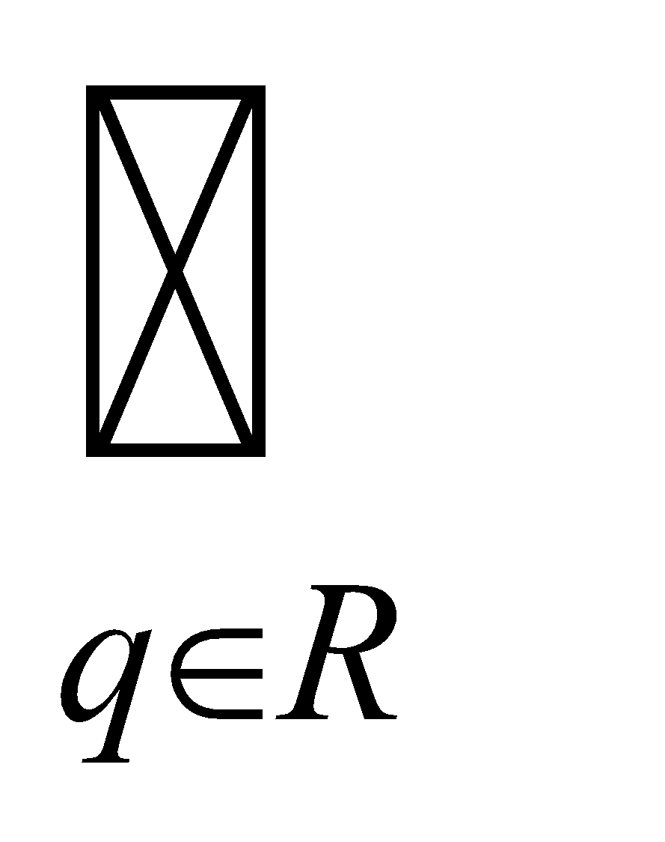
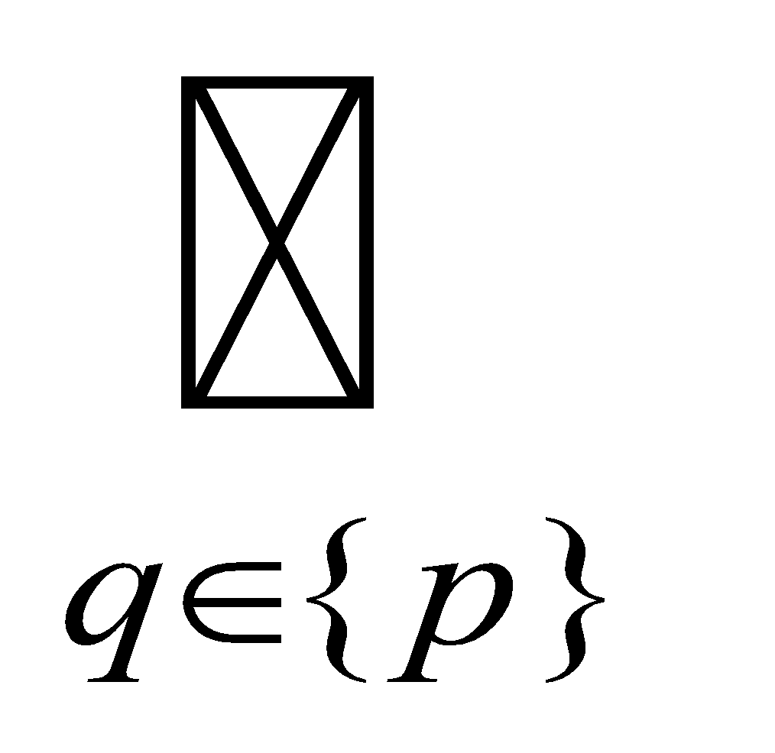
Extension of δ to Strings and Sets of States
Step #1:
Given δ: (Q x Σ) –> 2^{Q} define δ#: (2^{Q} x Σ) –> 2^{Q} as follows:
1) δ#(R, a) = δ(q, a) for all subsets R of Q, and symbols a in Σ
Note that:
δ#({p},a) = δ(q, a) by definition of δ#, rule #1 above
= δ(p, a)
Hence, we can use δ for δ#
δ({q₀, q₂}, 0) These now make sense, but previously
δ({q₀, q₁, q₂}, 0) they did not.
‹#›

Slide 35
Example:
δ({q₀, q₂}, 0) = δ(q₀, 0) U δ(q₂, 0)
= {q₁, q₃} U {q₃, q₄}
= {q₁, q₃, q₄}
δ({q₀, q₁, q₂}, 1) = δ(q₀, 1) U δ(q₁, 1) U δ(q₂, 1)
= {} U {q₂, q₃} U {}
= {q₂, q₃}
‹#›

Slide 36
Step #2:
Given δ: (2^{Q} x Σ) –> 2^{Q} define δ^: (2^{Q} x Σ*) –> 2^{Q} as follows:
δ^(R,w) – The set of states M could be in after processing string w, having started from any state in R.
Formally:
2) δ^(R, ε) = R for any subset R of Q
3) δ^(R,wa) = δ (δ^(R,w), a) for any w in Σ*, a in Σ, and
subset R of Q
Note that:
δ^(R, a) = δ(δ^(R, ε), a) by definition of δ^, rule #3 above
= δ(R, a) by definition of δ^, rule #2 above
Hence, we can use δ for δ^
δ({q₀, q₂}, 0110) These now make sense, but previously
δ({q₀, q₁, q₂}, 101101) they did not.
‹#›

Slide 37
Example:
What is δ({q₀}, 10)?
Informally: The set of states the NFA could be in after processing 10,
having started in state q₀, i.e., {q₁, q₂, q₃}.
Formally: δ({q₀}, 10) = δ(δ({q₀}, 1), 0)
= δ({q₀}, 0)
= {q₁, q₂, q₃}
Is 10 accepted? Yes!
1
0
q₀
0
q₁
1
q₂
0
1
1
q₃
‹#›

Slide 38
Example:
What is δ({q₀, q₁}, 1)?
δ({q₀ , q₁}, 1) = δ({q₀}, 1) ∪ δ({q₁}, 1)
= {q₀} ∪ {q₂, q₃}
= {q₀, q₂, q₃}
What is δ({q₀, q₂}, 10)?
δ({q₀ , q₂}, 10) = δ(δ({q₀ , q₂}, 1), 0)
= δ(δ({q₀}, 1) U δ({q₂}, 1), 0)
= δ({q₀} ∪ {q₃}, 0)
= δ({q₀,q₃}, 0)
= δ({q₀}, 0) ∪ δ({q₃}, 0)
= {q₁, q₂, q₃} ∪ {}
= {q₁, q₂, q₃}
‹#›

Slide 39
Example:
δ({q₀}, 101) = δ(δ({q₀}, 10), 1)
= δ(δ(δ({q₀}, 1), 0), 1)
= δ(δ({q₀}, 0), 1)
= δ({q₁ , q₂, q₃}, 1)
= δ({q₁}, 1) U δ({q₂}, 1) U δ({q₃}, 1)
= {q₂, q₃} U {q₃} U {}
= {q₂, q₃}
Is 101 accepted? Yes! q₃ is a final state.
‹#›

Slide 40
Definitions for NFAs
Let M = (Q, Σ, δ,q₀,F) be an NFA and let w be in Σ*. Then w is accepted by M iff δ({q₀}, w) contains at least one state in F.
Let M = (Q, Σ, δ,q₀,F) be an NFA. Then the language accepted by M is the set:
L(M) = {w | w is in Σ* and δ({q₀},w) contains at least one state in F}
Another equivalent definition:
L(M) = {w | w is in Σ* and w is accepted by M}
‹#›

Slide 41
Equivalence of DFAs and NFAs
Do DFAs and NFAs accept the same class of languages?
Is there a language L that is accepted by a DFA, but not by any NFA?
Is there a language L that is accepted by an NFA, but not by any DFA?
Observation: Every DFA is an NFA, DFA is only restricted NFA.
Therefore, if L is a regular language then there exists an NFA M such that L = L(M).
It follows that NFAs accept all regular languages.
But do NFAs accept more?
‹#›

Slide 42
Consider the following DFA: 2 or more c’s
Q = {q₀, q₁, q₂}
Σ = {a, b, c}
Start state is q₀
F = {q₂}
δ: a b c
q₀ q₀ q₀ q₁
q₁ q₁ q₁ q₂
q₂ q₂ q₂ q₂
a
a
a/b/c
q₀
c
q₁
c
q₂
b
b
‹#›

Slide 43
An Equivalent NFA:
Q = {q₀, q₁, q₂}
Σ = {a, b, c}
Start state is q₀
F = {q₂}
δ: a b c
q₀ {q₀} {q₀} {q₁}
q₁ {q₁} {q₁} {q₂}
q₂ {q₂} {q₂} {q₂}
a
a
a/b/c
q₀
c
q₁
c
q₂
b
b
‹#›

Slide 44
Lemma 1: Let M be an DFA. Then there exists a NFA M’ such that L(M) = L(M’).
Proof: Every DFA is an NFA. Hence, if we let M’ = M, then it follows that L(M’) = L(M).
The above is just a formal statement of the observation from the previous slide.
‹#›

Slide 45
Lemma 2: Let M be an NFA. Then there exists a DFA M’ such that L(M) = L(M’).
Proof: (sketch)
Let M = (Q, Σ, δ,q₀,F).
Define a DFA M’ = (Q’, Σ, δ’,q’₀,F’) as:
Q’ = 2^{Q} Each state in M’ corresponds to a
= {Q₀, Q₁,…,} subset of states from M
where Q_{u} = [q_{i0}, q_{i1},…q_{ij}]
F’ = {Q_{u} | Q_{u} contains at least one state in F}
q’₀ = [q₀]
δ’(Q_{u}, a) = Q_{v} iff δ(Q_{u}, a) = Q_{v}
‹#›

Slide 46
Example: empty string or start and end with 0
Q = {q₀, q₁}
Σ = {0, 1}
Start state is q₀
F = {q₀}
δ: 0 1
q₀
q₁
0/1
0
q₀
q₁
0
{q₁} | {}
{q₀, q₁} | {q₁}
‹#›

Slide 47
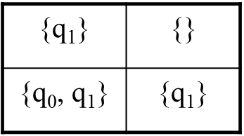
Example of creating a DFA out of an NFA (as per the constructive proof):
-->q₀
δ for DFA: 0 1 q₁
->q₀
[q₁]
[ ]
0/1
0
q₀
q₁
0
{q₁} write as [q₁] | {} write as [ ]
‹#›

Slide 48
Example of creating a DFA out of an NFA (as per the constructive proof):
δ: 0 1
->q₀
[q₁]
[ ]
[q₀₁]
0/1
0
q₀
q₁
0
{q₁} write as [q₁] | {}
{q₀,q₁} write as [q₀₁] | {q₁}
‹#›

Slide 49
Example of creating a DFA out of an NFA (as per the constructive proof):
δ: 0 1
->q₀
[q₁]
[ ]
[q₀₁]
0/1
0
q₀
q₁
0
{q₁} write as [q₁] | {}
{q₀,q₁} write as [q₀₁] | {q₁}
[ ] | [ ]
‹#›

Slide 50
Example of creating a DFA out of an NFA (as per the constructive proof):
δ: 0 1
->q₀
[q₁]
[ ]
[q₀₁]
0/1
0
q₀
q₁
0
{q₁} write as [q₁] | {}
{q₀,q₁} write as [q₀₁] | {q₁}
[ ] | [ ]
[q₀₁] | [q₁]
‹#›

Slide 51
Construct DFA M’ as follows:
δ({q₀}, 0) = {q₁} => δ’([q₀], 0) = [q₁]
δ({q₀}, 1) = {} => δ’([q₀], 1) = [ ]
δ({q₁}, 0) = {q₀, q₁} => δ’([q₁], 0) = [q₀q₁]
δ({q₁}, 1) = {q₁} => δ’([q₁], 1) = [q₁]
δ({q₀, q₁}, 0) = {q₀, q₁} => δ’([q₀q₁], 0) = [q₀q₁]
δ({q₀, q₁}, 1) = {q₁} => δ’([q₀q₁], 1) = [q₁]
δ({}, 0) = {} => δ’([ ], 0) = [ ]
δ({}, 1) = {} => δ’([ ], 1) = [ ]
1
0/1
[ ]
1
[q₀]
0
[q₁]
0
1
[q₀q₁]
0
‹#›

Slide 52
Theorem: Let L be a language. Then there exists an DFA M such that L = L(M) iff there exists an NFA M’ such that L = L(M’).
Proof:
(if) Suppose there exists an NFA M’ such that L = L(M’). Then by Lemma 2 there exists an DFA M such that L = L(M).
(only if) Suppose there exists an DFA M such that L = L(M). Then by Lemma 1 there exists an NFA M’ such that L = L(M’).
Corollary: The NFAs define the regular languages.
‹#›

Slide 53
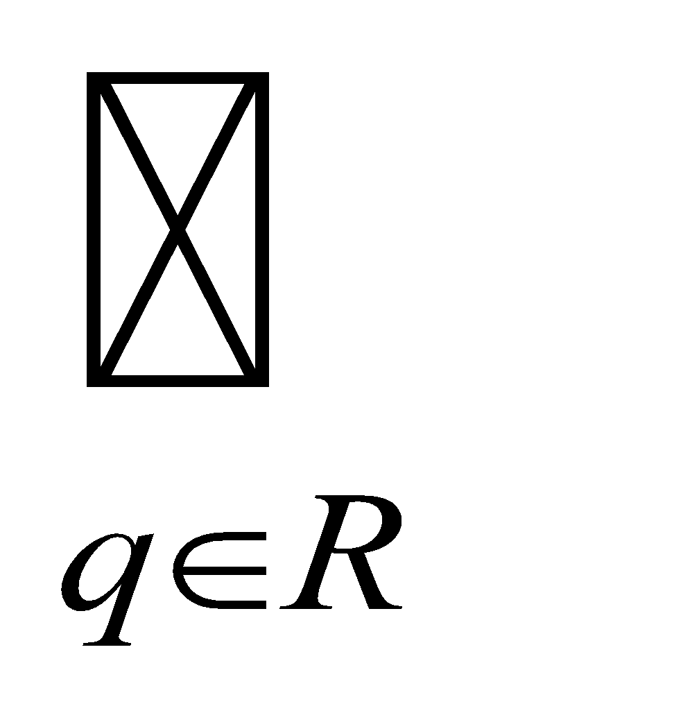
Note: Suppose R = {}
δ(R, 0) = δ(δ(R, ε), 0)
= δ(R, 0)
= δ(q, 0)
= {} Since R = {}
Exercise - Convert the following NFA to a DFA:
Q = {q₀, q₁, q₂} δ: 0 1
Σ = {0, 1}
Start state is q₀ q₀
F = {q₀}
q₁
q₂
{q₀, q₁} | { }
{q₁} | {q₂}
{q₂} | {q₂}
‹#›

Slide 54
Problem: Third symbol from last is 1
0/1
q₀
1
0/1
q₂
0/1
q₃
q₁
Now, can you convert this NFA to a DFA?
‹#›

Slide 55
NFAs with ε Moves
An NFA-ε is a five-tuple:
M = (Q, Σ, δ, q₀, F)
Q A finite set of states
Σ A finite input alphabet
q₀ The initial/starting state, q₀ is in Q
F A set of final/accepting states, which is a subset of Q
δ A transition function, which is a total function from Q x Σ U {ε} to 2^{Q}
δ: (Q x (Σ U {ε})) –> 2^{Q}
δ(q,s) -The set of all states p such that there is a
transition labeled a from q to p, where a
is in Σ U {ε}
Sometimes referred to as an NFA-ε other times, simply as an NFA.
‹#›

Slide 56
Example:
δ: 0 1 ε
q₀ - A string w = w₁w₂…w_{n} is processed
as w = ε*w₁ε*w₂ε* … ε*w_{n}ε*
q₁ - Example: all computations on 00:
0 ε 0
q₂ q₀ q₀ q₁ q₂
:
q₃
q₃
1
0
0
0/1
ε
ε
q₀
q₁
q₂
1
0
{q₀} | { } | {q₁}
{q₁, q₂} | {q₀, q₃} | {q₂}
{q₂} | {q₂} | { }
{ } | { } | { }
‹#›

Slide 57
Informal Definitions
Let M = (Q, Σ, δ,q₀,F) be an NFA-ε.
A String w in Σ* is accepted by M iff there exists a path in M from q₀ to a state in F labeled by w and zero or more ε transitions.
The language accepted by M is the set of all strings from Σ* that are accepted by M.
‹#›

Slide 58
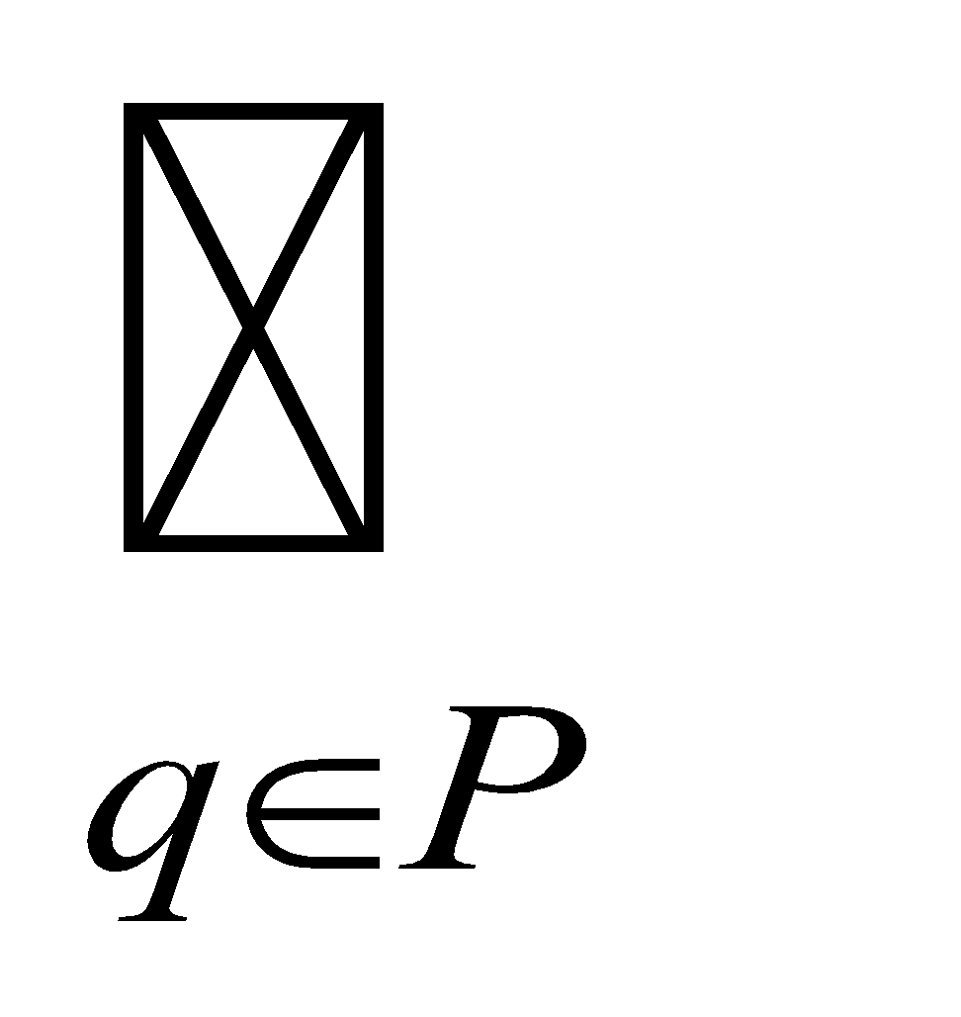
ε-closure
Define ε-closure(q) to denote the set of all states reachable from q by zero or more ε transitions.
Examples: (for the previous NFA)
ε-closure(q₀) = {q₀, q₁, q₂} ε-closure(q₂) = {q₂}
ε-closure(q₁) = {q₁, q₂} ε-closure(q₃) = {q₃}
ε-closure(q) can be extended to sets of states by defining:
ε-closure(P) = ε-closure(q)
Examples:
ε-closure({q₁, q₂}) = {q₁, q₂}
ε-closure({q₀, q₃}) = {q₀, q₁, q₂, q₃}
q₃
1
0
0
0/1
ε
ε
q₀
q₁
q₂
1
0
‹#›

Slide 59
Extension of δ to Strings and Sets of States
What we currently have: δ : (Q x (Σ U {ε})) –> 2^{Q}
What we want (why?): δ : (2^{Q} x Σ*) –> 2^{Q}
As before, we will do this in two steps, which will be slightly different from the book, and we will make use of the following NFA.
q₃
1
0
0
0/1
ε
ε
q₀
q₁
q₂
1
0
‹#›

Slide 60
Step #1:
Given δ: (Q x (Σ U {ε})) –> 2^{Q} define δ#: (2^{Q} x (Σ U {ε})) –> 2^{Q} as follows:
1) δ#(R, a) = δ(q, a) for all subsets R of Q, and symbols a in Σ U {ε}
Note that:
δ#({p},a) = δ(q, a) by definition of δ#, rule #1 above
= δ(p, a)
Hence, we can use δ for δ#
δ({q₀, q₂}, 0) These now make sense, but previously
δ({q₀, q₁, q₂}, 0) they did not.
‹#›

Slide 61
Examples:
What is δ({q₀ , q₁, q₂}, 1)?
δ({q₀ , q₁, q₂}, 1) = δ(q₀, 1) U δ(q₁, 1) U δ(q₂, 1)
= { } U {q₀, q₃} U {q₂}
= {q₀, q₂, q₃}
What is δ({q₀, q₁}, 0)?
δ({q₀ , q₁}, 0) = δ(q₀, 0) U δ(q₁, 0)
= {q₀} U {q₁, q₂}
= {q₀, q₁, q₂}
‹#›

Slide 62
Step #2:
Given δ: (2^{Q} x (Σ U {ε})) –> 2^{Q} define δ^: (2^{Q} x Σ*) –> 2^{Q} as follows:
δ^(R,w) – The set of states M could be in after processing string w, having starting from any state in R.
Formally:
2) δ^(R, ε) = ε-closure(R) - for any subset R of Q
3) δ^(R,wa) = ε-closure(δ(δ^(R,w), a)) - for any w in Σ*, a in Σ, and
subset R of Q
Can we use δ for δ^?
‹#›

Slide 63
Consider the following example:
δ({q₀}, 0) = {q₀}
δ^({q₀}, 0) = ε-closure(δ(δ^({q₀}, ε), 0)) By rule #3
= ε-closure(δ(ε-closure({q₀}), 0)) By rule #2
= ε-closure(δ({q_{0,} q₁, q₂}, 0)) By ε-closure
= ε-closure(δ(q₀, 0) U δ(q₁, 0) U δ(q₂, 0)) By rule #1
= ε-closure({q₀} U {q₁, q₂} U {q₂})
= ε-closure({q₀, q₁, q₂})
= ε-closure({q₀}) U ε-closure({q₁}) U ε-closure({q₂})
= {q₀, q₁, q₂} U {q₁, q₂} U {q₂}
= {q₀, q₁, q₂}
So what is the difference?
δ(q₀, 0) - Processes 0 as a single symbol, without ε transitions.
δ^(q₀ , 0) - Processes 0 using as many ε transitions as are possible.
‹#›

Slide 64
Example:
δ^({q₀}, 01) = ε-closure(δ(δ^({q₀}, 0), 1)) By rule #3
= ε-closure(δ({q₀, q₁, q₂}), 1) Previous slide
= ε-closure(δ(q₀, 1) U δ(q₁, 1) U δ(q₂, 1)) By rule #1
= ε-closure({ } U {q₀, q₃} U {q₂})
= ε-closure({q₀, q₂, q₃})
= ε-closure({q₀}) U ε-closure({q₂}) U ε-closure({q₃})
= {q₀, q₁, q₂} U {q₂} U {q₃}
= {q₀, q₁, q₂, q₃}
‹#›

Slide 65
Definitions for NFA-ε Machines
Let M = (Q, Σ, δ,q₀,F) be an NFA-ε and let w be in Σ*. Then w is accepted by M iff δ^({q₀}, w) contains at least one state in F.
Let M = (Q, Σ, δ,q₀,F) be an NFA-ε. Then the language accepted by M is the set:
L(M) = {w | w is in Σ* and δ^({q₀},w) contains at least one state in F}
Another equivalent definition:
L(M) = {w | w is in Σ* and w is accepted by M}
‹#›

Slide 66
Equivalence of NFAs and NFA-εs
Do NFAs and NFA-ε machines accept the same class of languages?
Is there a language L that is accepted by a NFA, but not by any NFA-ε?
Is there a language L that is accepted by an NFA-ε, but not by any DFA?
Observation: Every NFA is an NFA-ε.
Therefore, if L is a regular language then there exists an NFA-ε M such that L = L(M).
It follows that NFA-ε machines accept all regular languages.
But do NFA-ε machines accept more?
‹#›

Slide 67
Lemma 1: Let M be an NFA. Then there exists a NFA-ε M’ such that L(M) = L(M’).
Proof: Every NFA is an NFA-ε. Hence, if we let M’ = M, then it follows that L(M’) = L(M).
The above is just a formal statement of the observation from the previous slide.
‹#›

Slide 68
Lemma 2: Let M be an NFA-ε. Then there exists a NFA M’ such that L(M) = L(M’).
Proof: (sketch)
Let M = (Q, Σ, δ,q₀,F) be an NFA-ε.
Define an NFA M’ = (Q, Σ, δ’,q₀,F’) as:
F’ = F U {q} if ε-closure(q) contains at least one state from F
F’ = F otherwise
δ’(q, a) = δ^(q, a) - for all q in Q and a in Σ
Notes:
δ’: (Q x Σ) –> 2^{Q} is a function
M’ has the same state set, the same alphabet, and the same start state as M
M’ has no ε transitions
‹#›

Slide 69
Example:
Step #1:
Same state set as M
q₀ is the starting state
q₃
1
0
0
0/1
ε
ε
q₀
q₁
q₂
1
0
q₃
q₀
q₁
q₂
‹#›

Slide 70
Example:
Step #2:
q₀ becomes a final state
q₃
1
0
0
0/1
ε
ε
q₀
q₁
q₂
1
0
q₃
q₀
q₁
q₂
‹#›

Slide 71
Example:
Step #3:
q₃
1
0
0
0/1
ε
ε
q₀
q₁
q₂
1
0
q₃
0
0
q₀
q₁
q₂
0
‹#›

Slide 72
Example:
Step #4:
q₃
1
0
0
0/1
ε
ε
q₀
q₁
q₂
1
0
q₃
1
0/1
q₀
0/1
q₁
q₂
0/1
‹#›

Slide 73
Example:
Step #5:
q₃
1
0
0
0/1
ε
ε
q₀
q₁
q₂
1
0
q₃
1
0/1
0
0/1
0
q₀
q₁
q₂
0/1
‹#›

Slide 74
Example:
Step #6:
q₃
1
0
0
0/1
ε
ε
q₀
q₁
q₂
1
0
q₃
1
0/1
1
0/1
0/1
0/1
q₀
q₁
q₂
1
0/1
‹#›

Slide 75
Example:
Step #7:
q₃
1
0
0
0/1
ε
ε
q₀
q₁
q₂
1
0
q₃
1
0/1
1
0
0/1
0/1
0/1
q₀
q₁
q₂
1
0/1
‹#›

Slide 76
Example:
Step #8: [use table of e-closure]
Done!
q₃
1
0
0
0/1
ε
ε
q₀
q₁
q₂
1
0
q₃
1
0/1
1
0/1
0/1
0/1
0/1
q₀
q₁
q₂
1
0/1
‹#›

Slide 77
Theorem: Let L be a language. Then there exists an NFA M such that L= L(M) iff there exists an NFA-ε M’ such that L = L(M’).
Proof:
(if) Suppose there exists an NFA-ε M’ such that L = L(M’). Then by Lemma 2 there exists an NFA M such that L = L(M).
(only if) Suppose there exists an NFA M such that L = L(M). Then by Lemma 1 there exists an NFA-ε M’ such that L = L(M’).
Corollary: The NFA-ε machines define the regular languages.
‹#›

