Slide 1
ggplot2

Slide 2
Data Set
A dataset is a collection of data, often represented as a table, where:
Rows represent individual observations or entries.
Columns represent variables or attributes associated with each observation.

Slide 3
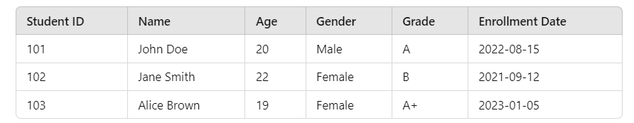
A dataset can store various types of data depending on the nature of the variables it contains
1. Numerical
2. Categorical
3.Boolean
Text
Date/Time

Slide 4
ggplot2 is a powerful data visualization package in R that is based on the grammar of graphics.
It allows you to create complex and customized plots with a consistent, layered approach.

Slide 5
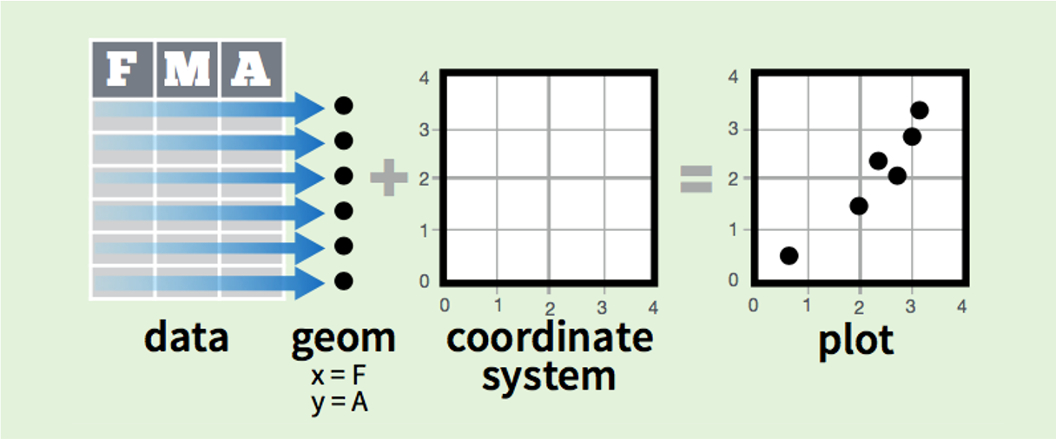
In practice, we can put these elements together a little like this:

Slide 6
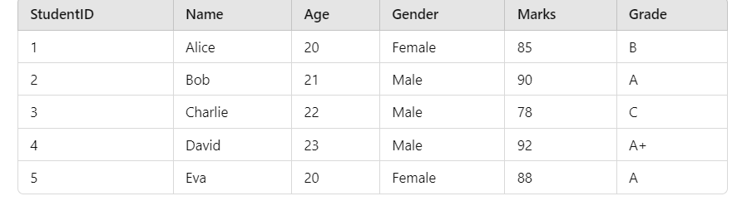
Components of Grammar of Graphics
1. Data
2. Aesthetics (aes)
ggplot(data = student_data, aes(x = Marks, y = Age, color = Gender))
student_data <- data.frame( StudentID = 1:5, Name = c("Alice", "Bob", "Charlie", "David", "Eva"), Age = c(20, 21, 22, 23, 20), Gender = c("Female", "Male", "Male", "Male", "Female"), Marks = c(85, 90, 78, 92, 88), Grade = c("B", "A", "C", "A+", "A"))

Slide 7
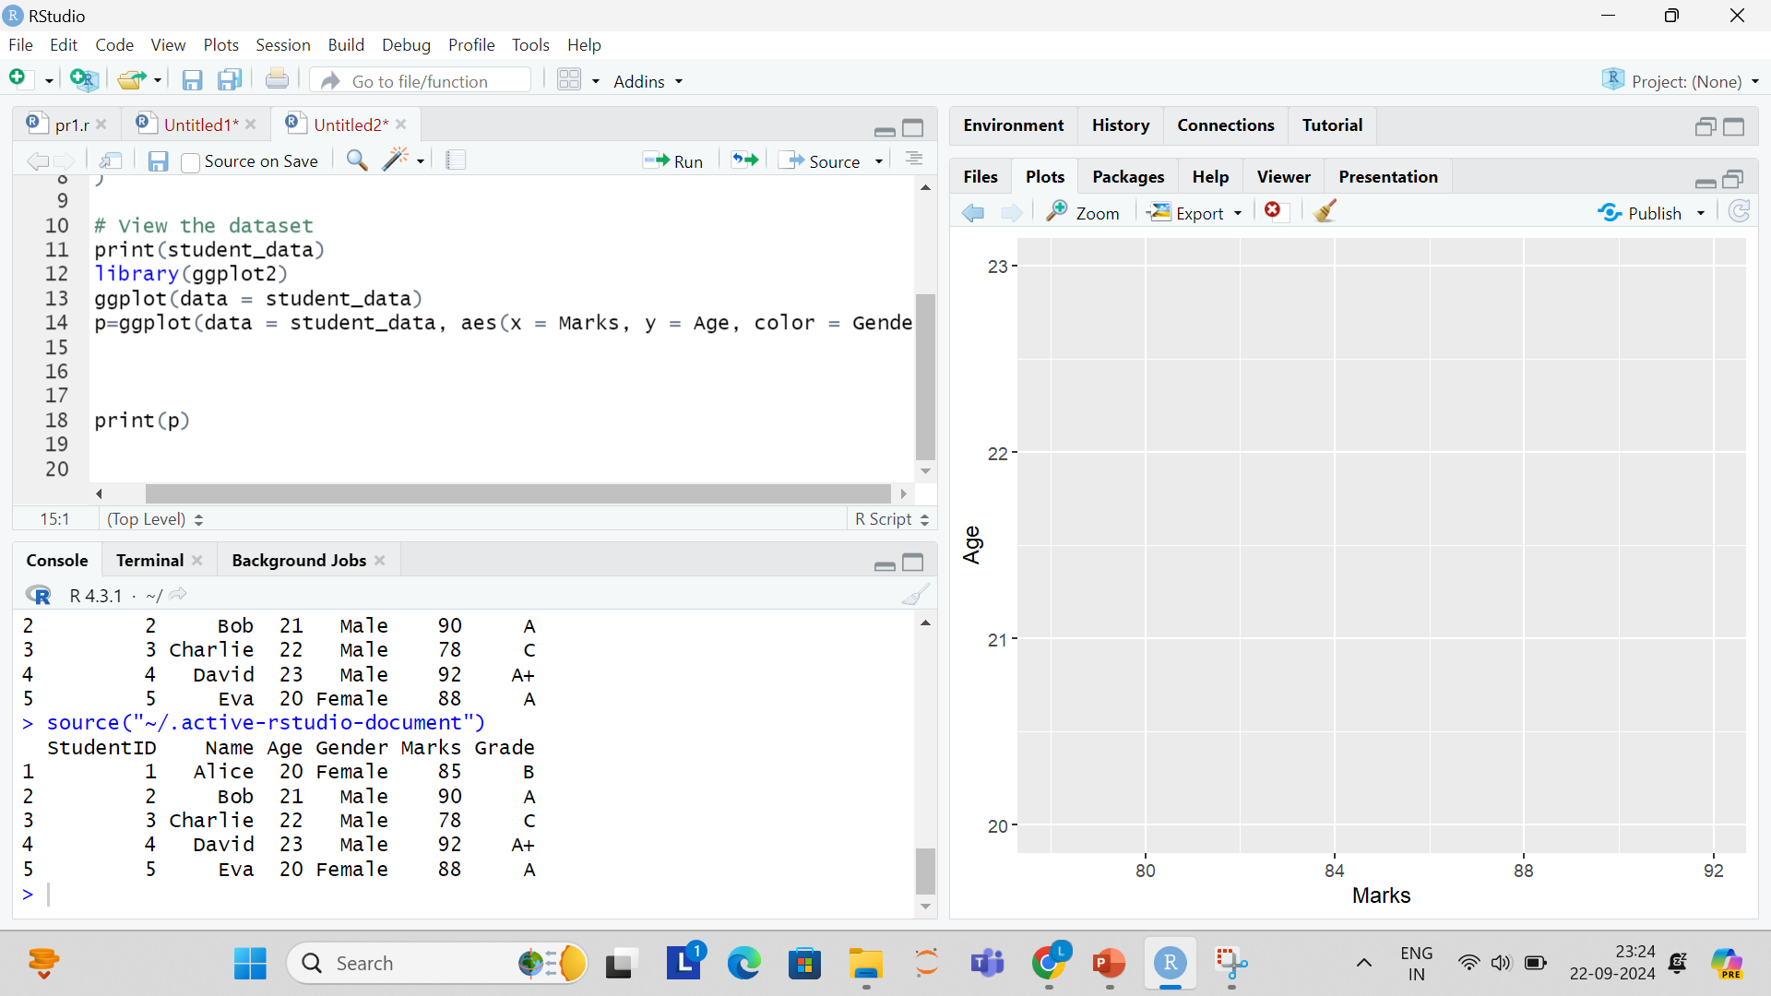

Slide 8
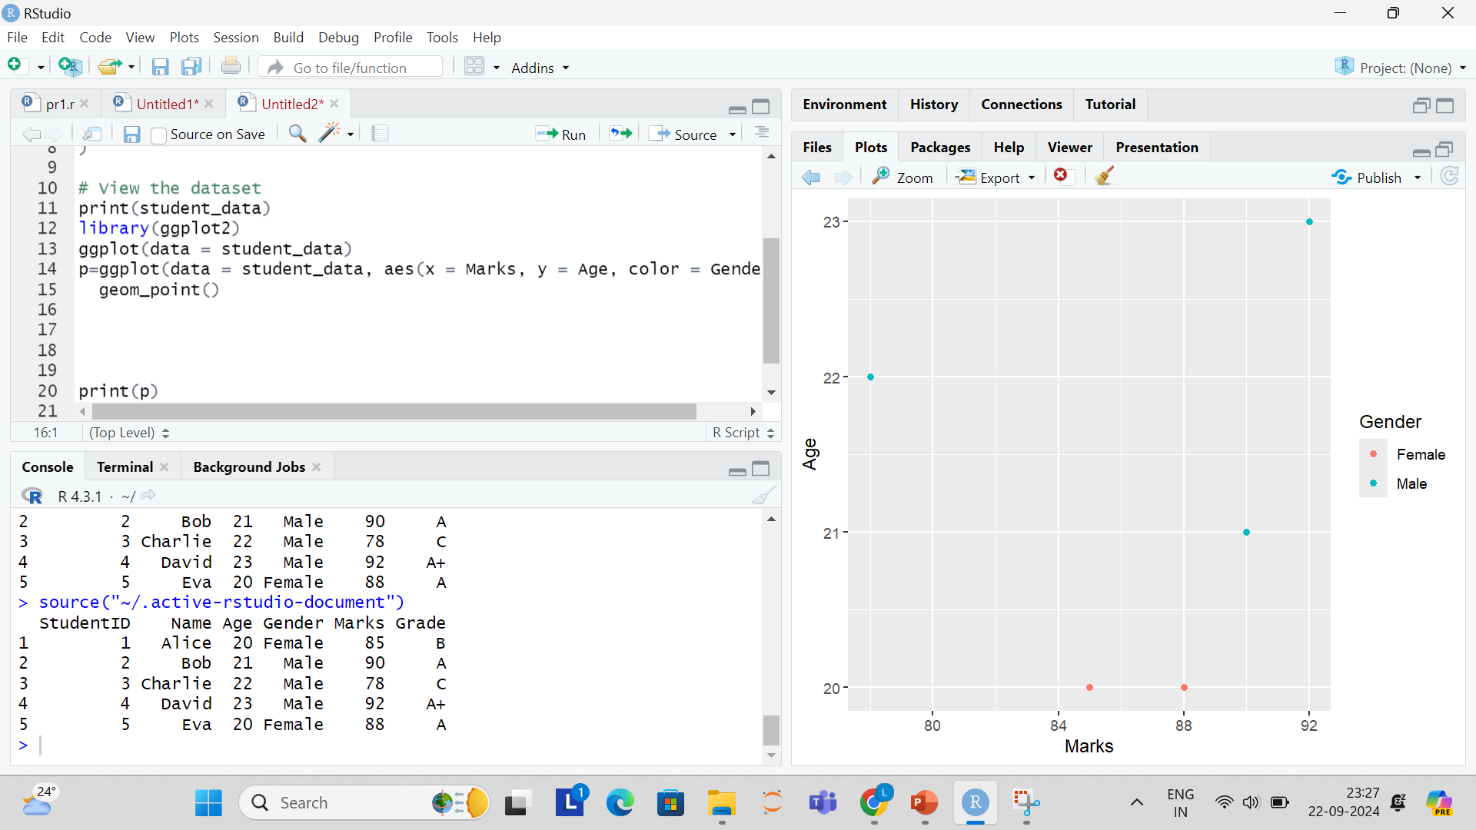
3. Geometries (Geoms)
We’ll use geom_point() to create a scatter plot, showing each student as a point on the graph.

Slide 9
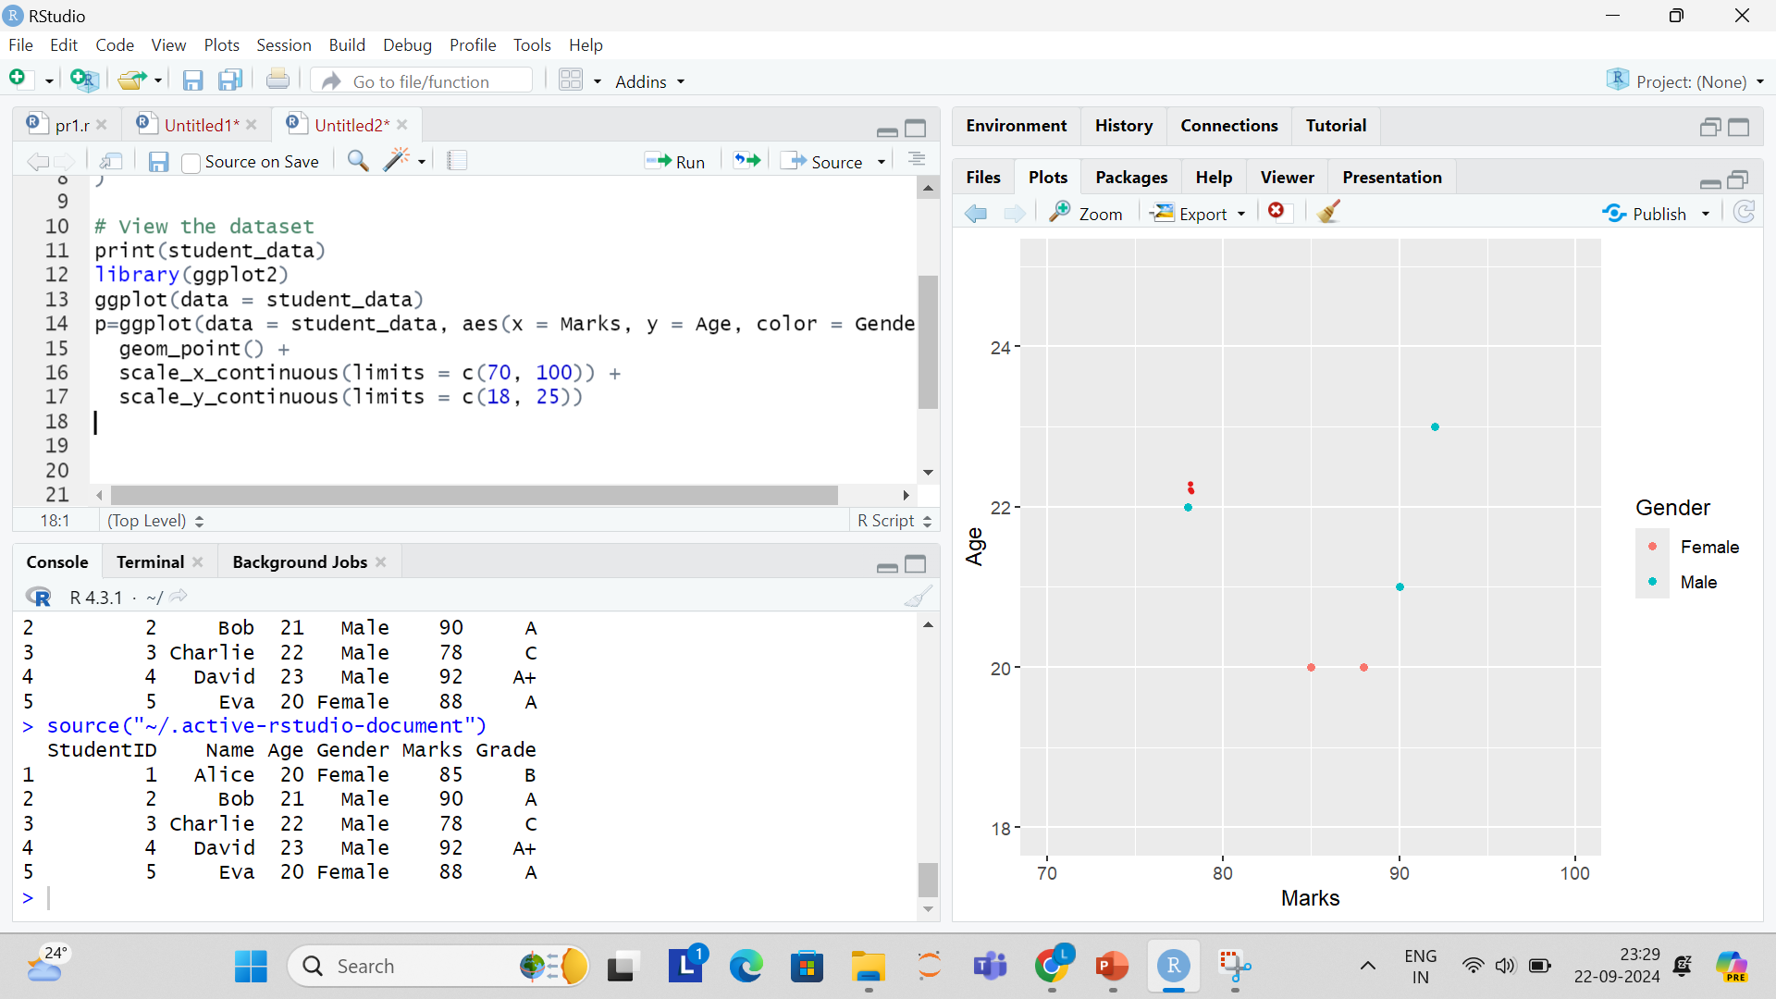
4. Scales Let’s adjust the scales to specify the x and y limits. We’ll limit the x-axis to show marks between 70 and 100, and the y-axis to show ages between 18 and 25.

Slide 10
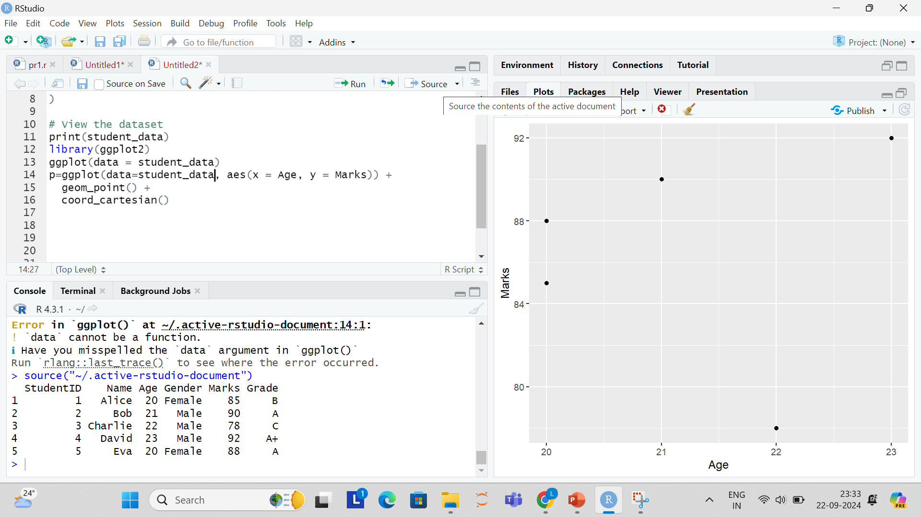
5. Coordinates: By default, ggplot2 uses a Cartesian coordinate system (coord_cartesian()). However, we can flip the x and y axes using coord_flip(), or use polar coordinates for a circular plot. Here, we’ll stick to the default.

Slide 11
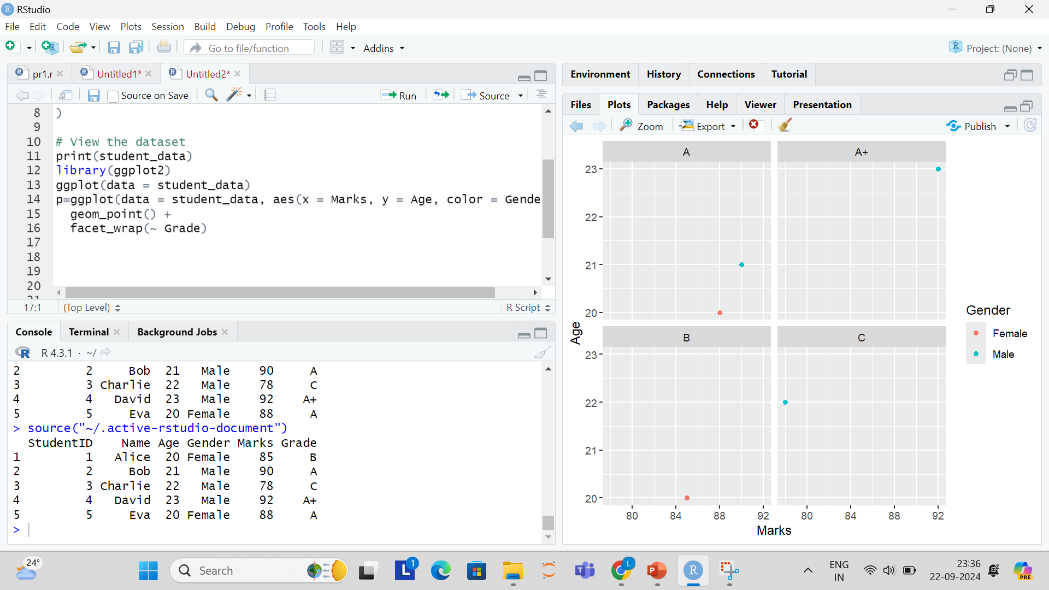
6. Facets We can facet the plot based on the students' grades. This will create separate scatter plots for each grade category

Slide 12
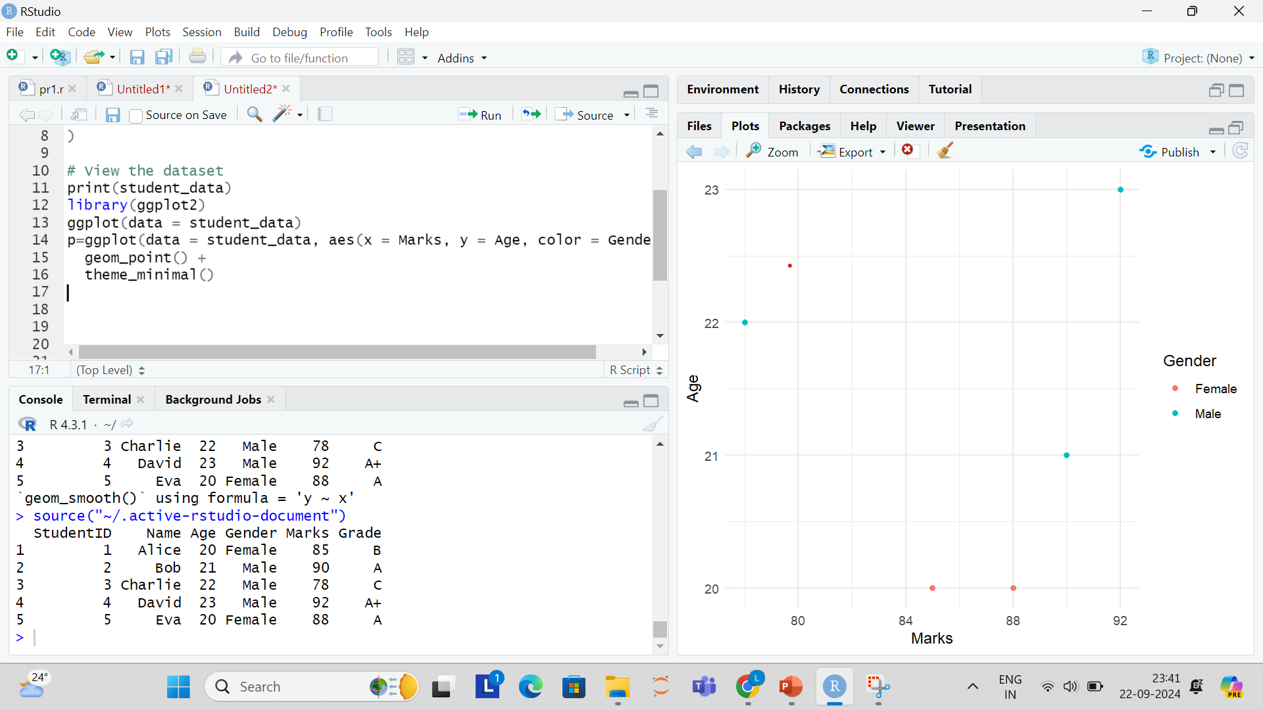
7. Themes
We can change the appearance of the plot using a theme. For a cleaner look, we’ll apply theme_minimal():

Slide 13
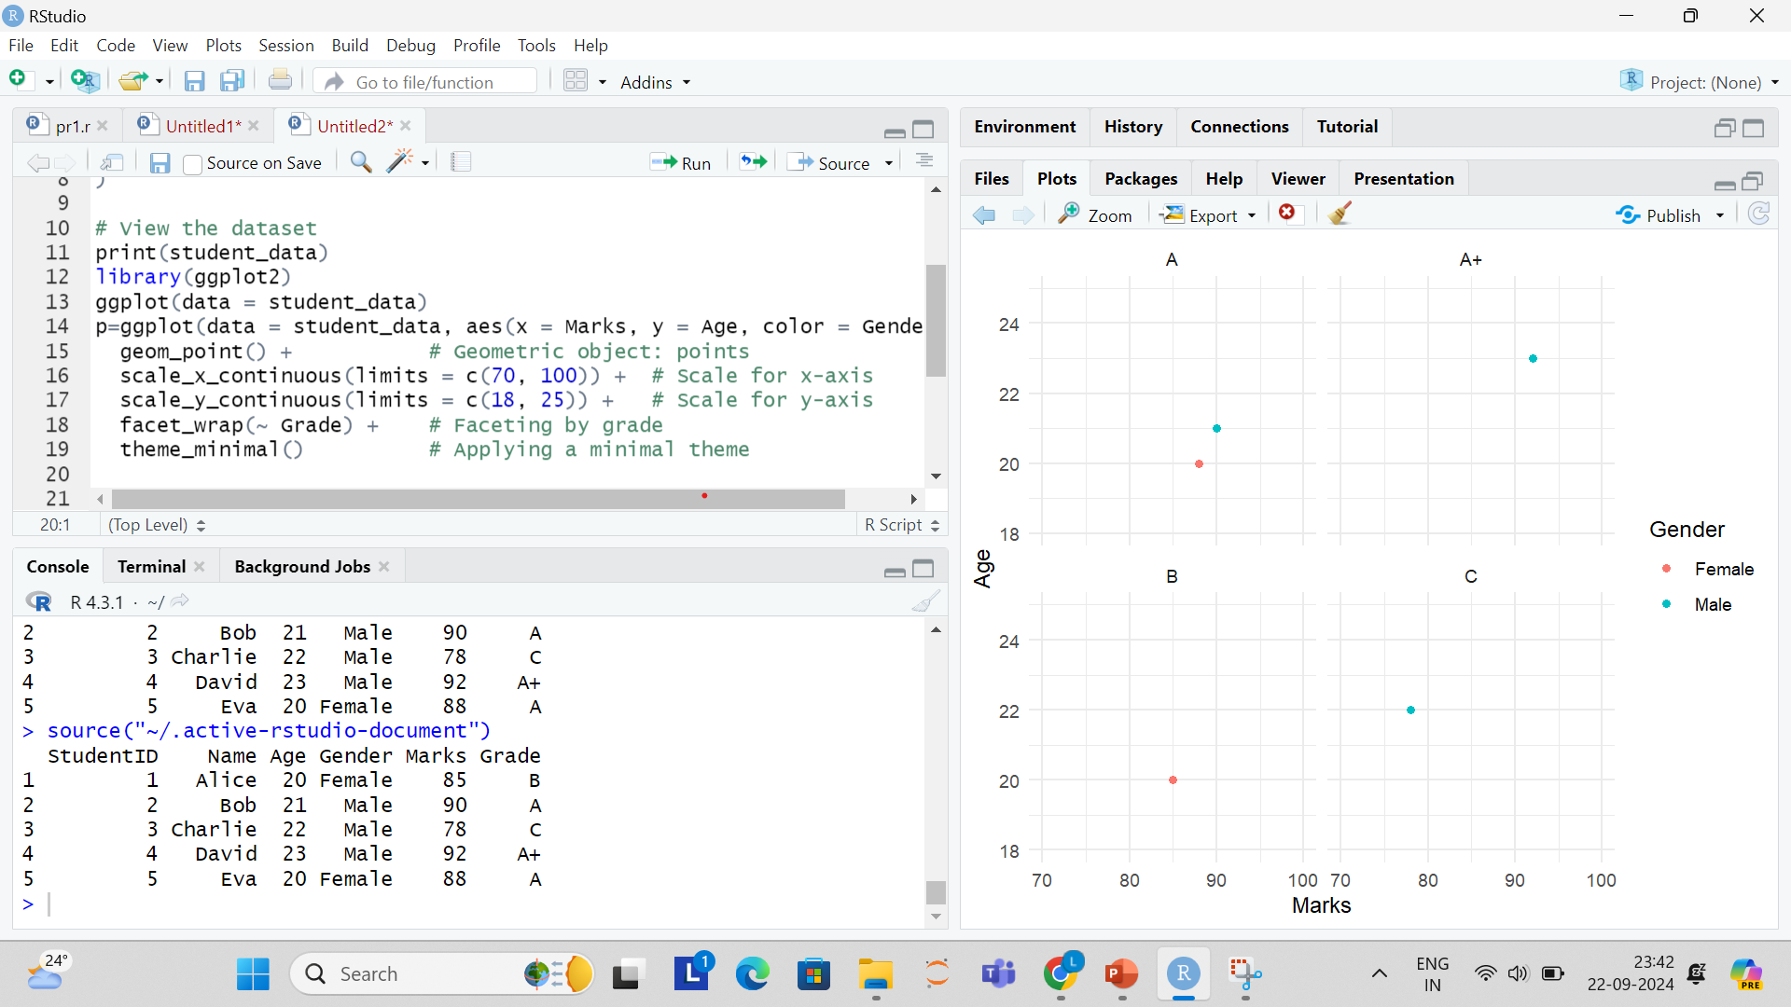
8. Layers Each component (data, aesthetics, geometry, etc.) we add is considered a layer. The final plot combines all the layers.

