Slide 1






MD2201 DATA SCIENCE
DEPARTMENT OF MULTIDISCIPLINARY ENGINEERING
VISHWAKARMA INSTITUTE OF TECHNOLOGY, PUNE
TOPIC : VECTOR NORMS
PRESENTED BY:
Name | PRN
Ruturaj Sutar | 12310720
Tanishq Thuse | 12310237
Arya Barsode | 12420256
Nikhil Rajput | 12420272
GUIDE:
Prof. Gajanan Gambhire Sir

Slide 2
INDEX
Vector Basics
Vectors & ML
Introduction to Vector Space
Vector Norms Introduction
Conditions for Vector Norms
Types of Vectors Norms and Applications
Importance

Slide 3
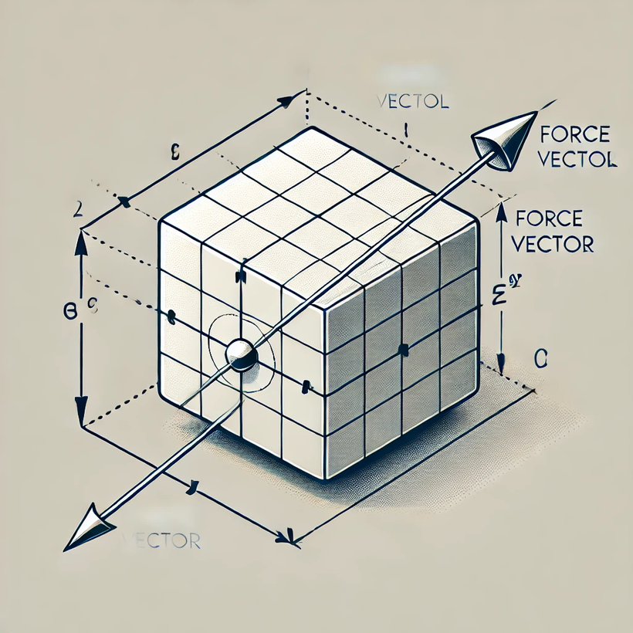
VECTOR BASICS
PHYSICS
A PHYSICAL QUANTITY HAVING MAGNITUDE AND DIRECTION

Slide 4
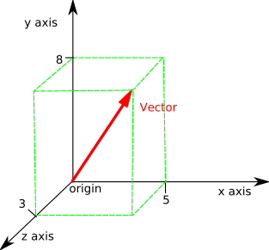
VECTOR BASICS
MATHEMATICS
A POINT IN N-DIMENSIONAL CO-ORDINATE SYSTEM
ANGLE AT WHICH THE LINE IS INCLINED IS DIRECTION
LENGTH UP TO THAT POINT IS MAGNITUDE

Slide 5
VECTOR IN CS
VECTORS ARE TYPICALLY REPRESENTED AS ARRAYS OR LISTS OF NUMBERS.
WIDELY USED IN MACHINE LEARNING, GRAPHICS, PHYSICS SIMULATIONS, AND NLP.
THEY CAN BE 1D OR MULTI-DIMENSIONAL IN NATURE.

Slide 6
VECTOR & ML
IN MACHINE LEARNING, A DATA POINT WITH MULTIPLE FEATURES IS REPRESENTED AS A VECTOR IN A HIGH-DIMENSIONAL SPACE
1.
Each feature of the data point corresponds to a component of the vector.
2.

Slide 7
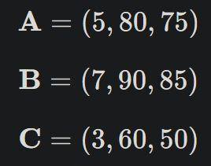

Student | Study Hours | Attendance (%) | Test Score (out of 100)
A | 5 | 80 | 75
B | 7 | 90 | 85
C | 3 | 60 | 50

Slide 8
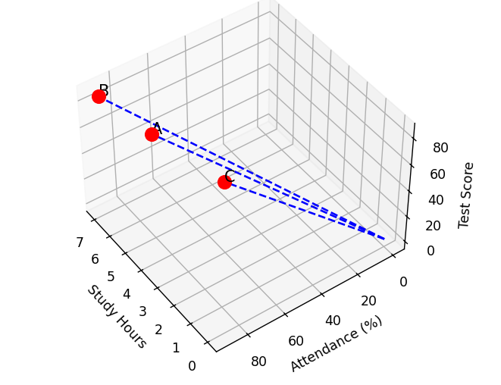

Slide 9
VECTOR SPACE
A VECTOR SPACE IS A MATHEMATICAL STRUCTURE WHERE VECTORS CAN BE ADDED TOGETHER AND MULTIPLIED BY NUMBERS WHILE STILL REMAINING WITHIN THE SPACE.
IN MACHINE LEARNING, A VECTOR SPACE IS WHERE DATA POINTS EXIST, AND ALGORITHMS OPERATE BY FINDING PATTERNS, RELATIONSHIPS, OR DECISION BOUNDARIES WITHIN THIS SPACE.

Slide 10
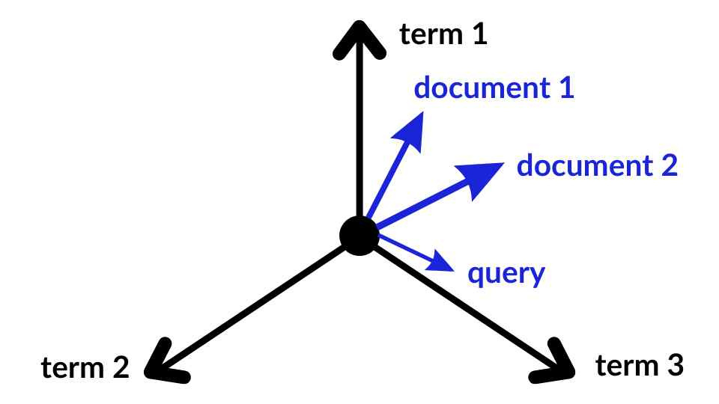
THE VECTOR SPACE MODEL (VSM) IS A MATHEMATICAL FRAMEWORK USED IN INFORMATION RETRIEVAL AND NATURAL LANGUAGE PROCESSING TO REPRESENT TEXT DOCUMENTS.
A DOCUMENT IS THEN REPRESENTED AS A VECTOR, WHERE EACH COMPONENT CORRESPONDS TO A TERM'S WEIGHT, INDICATING ITS IMPORTANCE IN THAT DOCUMENT. THIS REPRESENTATION ALLOWS FOR THE COMPARISON OF DOCUMENTS BY MEASURING THE ANGLES BETWEEN THEIR VECTORS; SMALLER ANGLES INDICATE GREATER SIMILARITY.

Slide 11
VECTOR NORMS
A VECTOR NORM IS A FUNCTION THAT MEASURES THE LENGTH (MAGNITUDE) OF A VECTOR.
1.
EACH VECTOR MUST SATISFY FOUR CONDITIONS SO AS TO BE CLASSIFIED AS A VECTOR NORMS
2.
FUN FACT : VECTOR NORMS ARE THE BACKBONE OF MANY ML CONCEPTS LIKE CLUSTERING (DISTANCE METRICS), CLASSIFICATION (REGULARIZATION), AND OPTIMIZATION (GRADIENT DESCENT).
3.

Slide 12

CONDITIONS FOR VECTOR NORMS
A function ∣v∣ is considered a norm if it satisfies the following four conditions:
1) Non-Negativity (Positivity) :
The norm of any vector is always non-negative.
∣v∣= 0 if and only if v=0 (zero vector).

Slide 13

2. Absolute Homogeneity (Scaling Property) :
Scaling a vector by a constant c scales its norm by ∣cv∣= ∣c∣.∣v∣
If you double a vector, its norm also doubles.

Slide 14
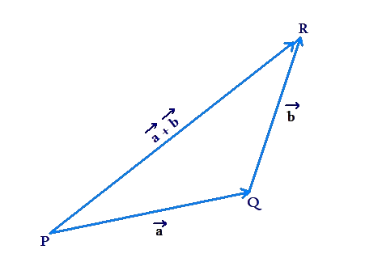
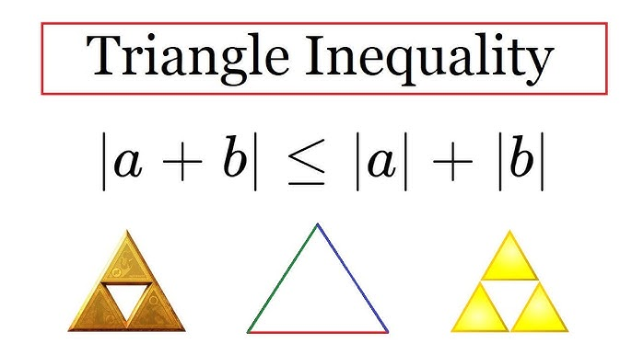
3. Triangle Inequality :
The norm of the sum of two vectors is at most the sum of their norms.
Represents the shortest path property (direct path is always shorter than taking a detour).

Slide 15

4. Definiteness
Only the zero vector has a norm of zero.

Slide 16
TYPES OF NORMS
L₀ norm
L1 NORM (MANHATTAN NORM)
L2 NORM (EUCLIDEAN NORM)
L∞ NORM

Slide 17
L0 NORM
The L₀ norm (L0 norm) is a measure used in mathematics and machine learning to count the number of nonzero elements in a vector.
It is not a true norm in the strict mathematical sense because it does not satisfy the homogeneity property (i.e., scaling a vector does not scale its L₀ norm). However, it is widely used in sparse optimization and feature selection.
Example:
For v=(3,0,4,0,5)
||v0||=3

Slide 18
L0 NORM APPLICATIONS
ANOMALY DETECTION: L0 IS USED in detecting OUTLIERS BY MEASURING THE SPARSITY OF CERTAIN FEATURE REPRESENTATIONS IN HIGH-DIMENSIONAL DATA.
SPARSE REGRESSION MODELS: UNLIKE LASSO (L₁ NORM), WHICH ENCOURAGES SPARSITY BUT DOES NOT STRICTLY LIMIT THE NUMBER OF NONZERO COEFFICIENTS, L₀-REGULARIZED REGRESSION DIRECTLY SELECTS A FIXED NUMBER OF FEATURES. THIS IS USEFUL IN HIGH-DIMENSIONAL DATASETS LIKE FINANCE.

Slide 19

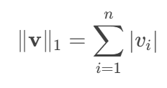
L1 NORM (MANHATTAN NORM)
Measures the sum of the absolute values of vector components.
Commonly used in sparse data analysis and feature selection.
L1 Norm is the sum of the magnitudes of the vectors in a space.

Slide 20
SPARSE DATA ANALYSIS
Sparse Data Analysis refers to the study and processing of datasets where most of the elements are zero or missing.
FEATURE SELECTION
Feature Selection is the process of selecting a subset of relevant features (variables, predictors) from a larger set of features to use in model construction

Slide 21
APPLICATIONS OF L1 NORM
Sparse Data Analysis: Used in scenarios where sparsity is desired (e.g., feature selection in machine learning).
Feature Selection: Encourages sparsity in models (e.g., Lasso regression).
Signal Processing: Measures the total variation in signals.
. The L1 norm is used in the Naive Bayes algorithm to estimate the probability density function of the features

Slide 22
CODING TIME!
CODE FOR L1 NORMS

Slide 23

L2 NORM
L2 norm is nothing but euclidian distance between two point.
Distance is calculated using pythagorean formula.
For vector x = [x₁, x₂, ..., xₙ] distance from origin is given by

Slide 24
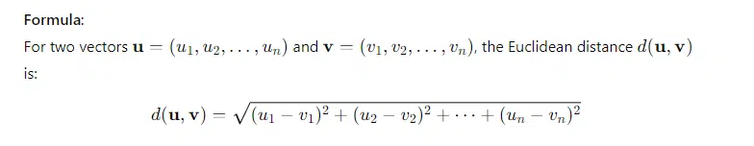
L2 NORM

Slide 25

LET’S DIVE INTO REAL WORLD IMPLEMENTATION

Slide 26

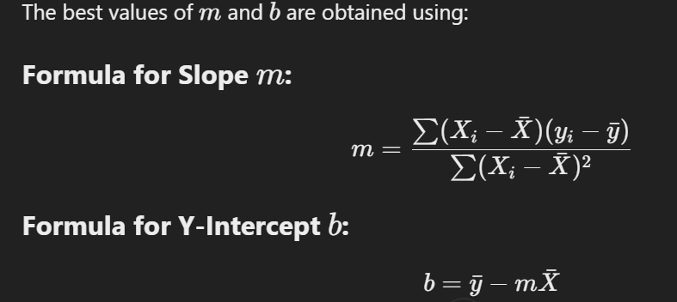
EQUATION OF BEST FIT LINE
FINDING SLOPE AND Y-INTERCEPT

Slide 27
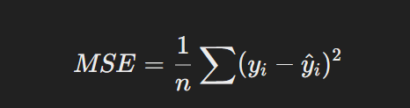
MSE
MEAN SQUARED ERROR IS A LOSS FUNCTION USED TO MEASURE HOW WELL A MODEL'S PREDICTIONS MATCH THE TRUE VALUES

Slide 28
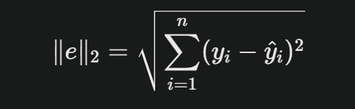
L² NORM OF RESIDUALS
The L² norm of the residuals (or errors) is the square root of the sum of squared differences between actual and predicted values, representing the Euclidean distance

Slide 29
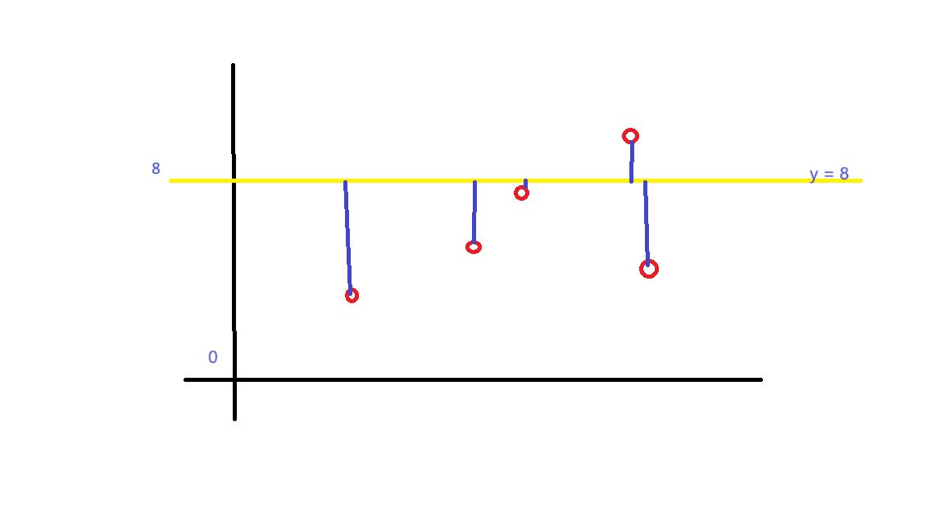

Slide 30
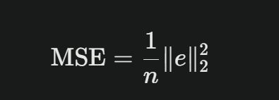
L2 NORM AND MSE RELATION

Slide 31
L2 NORM APLLICATIONS
Machine Learning: As a loss function in regression tasks (e.g., mean squared error) to measure the difference between predicted and actual values.
Optimization: In regularization techniques (e.g., ridge regression) to prevent overfitting by penalizing large coefficients in a model.
Data Analysis: For clustering algorithms like k-means, where the distance between points and centroids is calculated using the L2 norm.

Slide 32

L∞ NORM:
· The length of a vector can be calculated using the max norm.
The notation for max norm is ||v||inf .
· The max norm is calculated as returning the max value of the
vector.
· The max norm of a vector can be calculated using the norm( )
function along with set the parameter as inf which is a order for
norm.
ex:-[1,3,5] o/p :- 5

Slide 33
APPLICATION
1. Feature Scaling (Normalization)
When we scale data (like bringing all values between 0 and 1), sometimes we use max norm scaling:
Xscaled ​=||x|| / ∞​x​
This ensures that the largest value becomes 1 and others are smaller.
Useful in deep learning to keep numbers stable and avoid exploding values.

Slide 34
IMPORTANCE OF VECTOR NORMS
Vector norms provide a way to measure distances, magnitudes, and errors in higher-dimensional spaces, which is essential in fields like:
Machine learning (e.g., regularization, clustering).
Physics (e.g., measuring forces, velocities).
Engineering (e.g., signal processing, control systems).

Slide 35
REFERENCES
1. https://www.geeksforgeeks.org/vector-norms/
2. https://builtin.com/data-science/vector-norms
3. https://www.analyticsvidhya.com/blog/2024/01/vector-norms-in-machine-learning-decoding-l1-and-l2-norms/
4. https://montjoile.medium.com/l0-norm-l1-norm-l2-norm-l-infinity-norm-7a7d18a4f40c
8. Towards Data Science. (2025, January 23). Vector Norms in Machine Learning. A guide to p-norms. https://towardsdatascience.com/vector-norms-in-machine-learning-5b8381a5130c/
9. Statistics by Jim. (2024, September 24). Mean Squared Error (MSE). https://statisticsbyjim.com/regression/mean-squared-error-mse/
10. QuestionPro. (n.d.). Regression Analysis: Definition, Types, Usage & Advantages. https://www.questionpro.com/blog/regression-analysis/

Slide 36
ANY QUESTIONS ?

Slide 37
THANK YOU !

