Slide 1
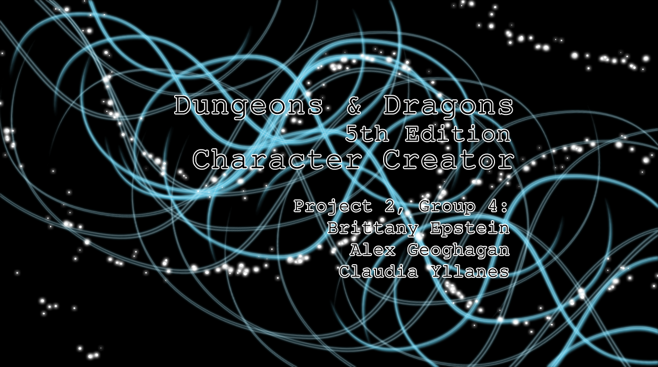

Slide 2

Tabletop Role-playing Game
Five Editions
Released in 1974
Fifth Edition in 2014
Communal Storytelling
Dungeon Master
Players

Slide 3

Languages
HTML5 and CSS
SQL
TypeScript
Java
Programs and Platforms
Visual Studio Code
Spring Tools Suite
AWS
git
Jenkins

Slide 4

Users can...
Store User and character information in a database.
Create subclass options that persist with the character (customized not shared).
Create multiple characters.
Choose to make character sheets publicly viewable.
Stretch Goals:
Create mock battles
Export character data to PDF
Add a picture to character sheets

Slide 5

Asynchronous Threads
Observables
CORS
node_modules
middleware

Slide 6

Parsing the API
Displaying Spells
Graphical User Interface
Jasmine
Communication

Slide 7

Automatic login upon registering
Parsing and display of monsters
More detail on spells
Dynamic forms to edit profiles
Dice roller
More robust character details
Tutorials
Improved user profile functionality

Slide 8


