Slide 1


Image processing
8BIMP
Sunke Manikanta - 221210103
Tanishq Kumar Toliya – 221210107
Tanmay Mittal – 221210108
Vaibhav Goel – 221210116221210103

Slide 2

CONTENT
01
What is image processing
02
Theory of image processing
03
BMP format cheatsheet
04
Operations Performed
05
Code summary

Slide 3
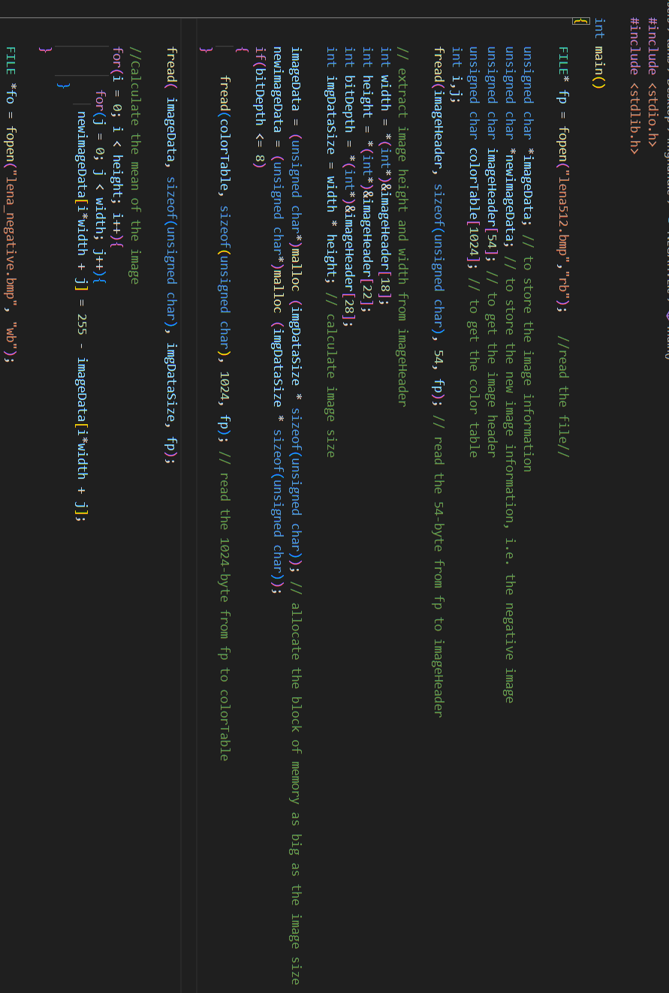



What is Image processing?
The process of reading, manipulating, and configuring an image.
this project aims to accomplish some of the basic tasks associated with images such as -.

Slide 4


Theory of image processing
Image formats
There are various widely available image formats such as JPEG, PNG, TIFF, BMP, etc. For ease, we would be discussing all the programs and operations around the Bitmap file format. As the BMP is less complex to understand and decode than the compressed formats such as JPEG, we would be preferring this. As we do not intend to use any library as much as possible, we will have to deal with all the image headers and the smallest byte of information through our own code, BMP comes in handy to use.

Slide 5

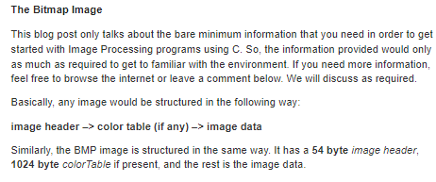
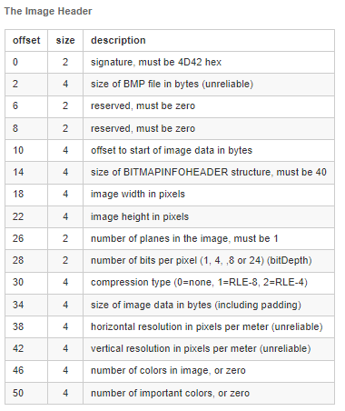
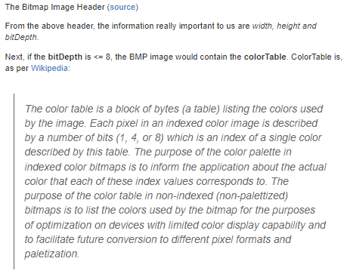
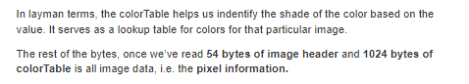
BMP FORMAT CHEATSHEET

Slide 6


Operations Performed
01
02
03
04
Rotation tasks
Negative
Brightness control
Flip Image
Rotate 90 degrees clockwise
Rotate 90 degrees Anti clockwise
Rotate 180 degrees
Show the negative of the Image,
i.e. complement of the image
Mirror the image through z
Increasing or decreasing the brightness of the image

Slide 7
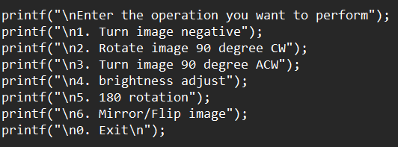
Code Summary:
Library used :The necessary header files are included: stdio.h , stdlib.h , string.h.
Input taken : The program prompts the user to enter the name of the image file.
choice to run any one of operation.
An output file is created with the user-specified name.
The main function is defined:
A loop is started, allowing the user to perform multiple image operations . Within the loop, the user is presented with a menu of available operations and asked to choose one .
The chosen operation is executed based on the user's input.
For each operation :
The input image file is opened in read mode . Memory is allocated to store image information and the new image . The image header, color table (if applicable), and image data are read from the file . The chosen image processing operation is performed on the image data, and the result is stored in the new image .

Slide 8
Code Summary:
An output file is created with the user-specified name .The image header, color table, and new image data are written to the output file . Both the files are closed. The user is informed about the creation of the output file and the file is displayed using the system command . The loop continues until the user chooses to exit (by entering 0).The program terminates . Note: It's worth mentioning that the code has some issues and potential improvements, such as the use of the unsafe gets function, lack of error handling, and repetitive code for file opening and closing. These aspects could be addressed to enhance the code's reliability and maintainability

Slide 9

Thank you

