Slide 1
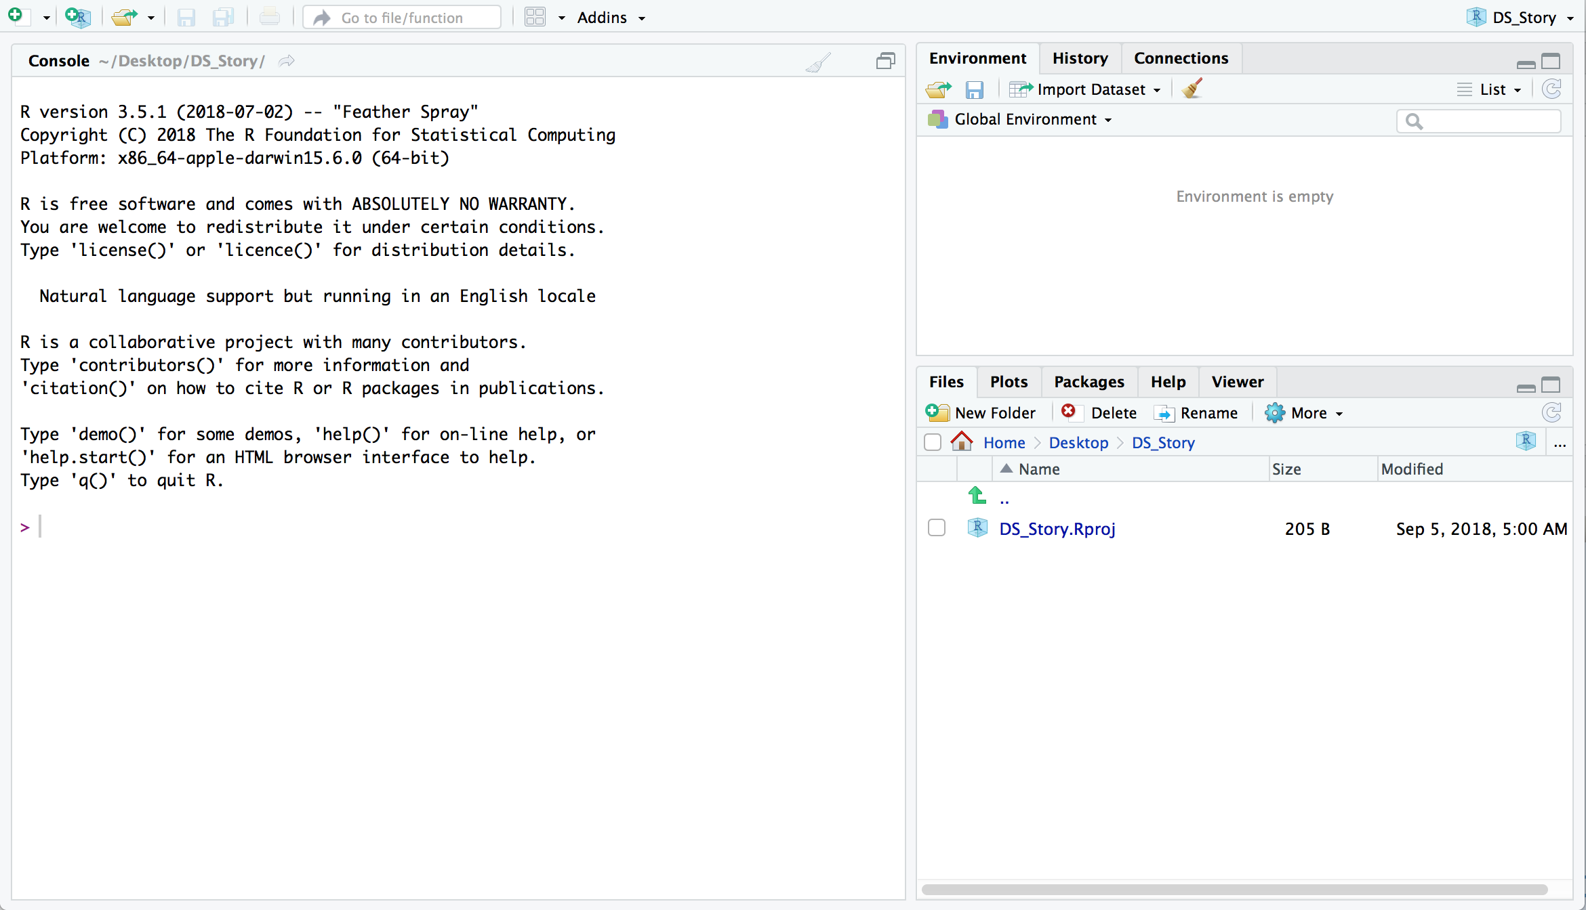
Data and Functions Created
Console
Files/Help

