Slide 1
Team 4 - CS 535 Term Project
Automated Text Summarization
Tanjim Bin Faruk
Zarin Tasnim Promi
Tony Kappen

Slide 2
Problem Background
01
Extracting context aware summaries
What Problem Did We Choose?
02
Many use cases/users
Many different approaches
Why Did We Choose This Problem?
03
CNN/Dailymail: Human labelled training dataset
What Dataset Did We Use?
Notes:
We sought to explore different solutions to the problem of text summarization. Essentially extracting a summary from a block of text.
We chose this problem because we believed it was an interesting problem space to solve. There were many different possible approaches that could be taken and there are many possible use cases. Potential users included students, researchers, journalists etc.
The dataset that we used as a starting point was the CNN/Dailymail dataset. This dataset contains roughly 300,000 news articles each with a human created summary. This dataset was is actively used in existing research based around this problem

Slide 3
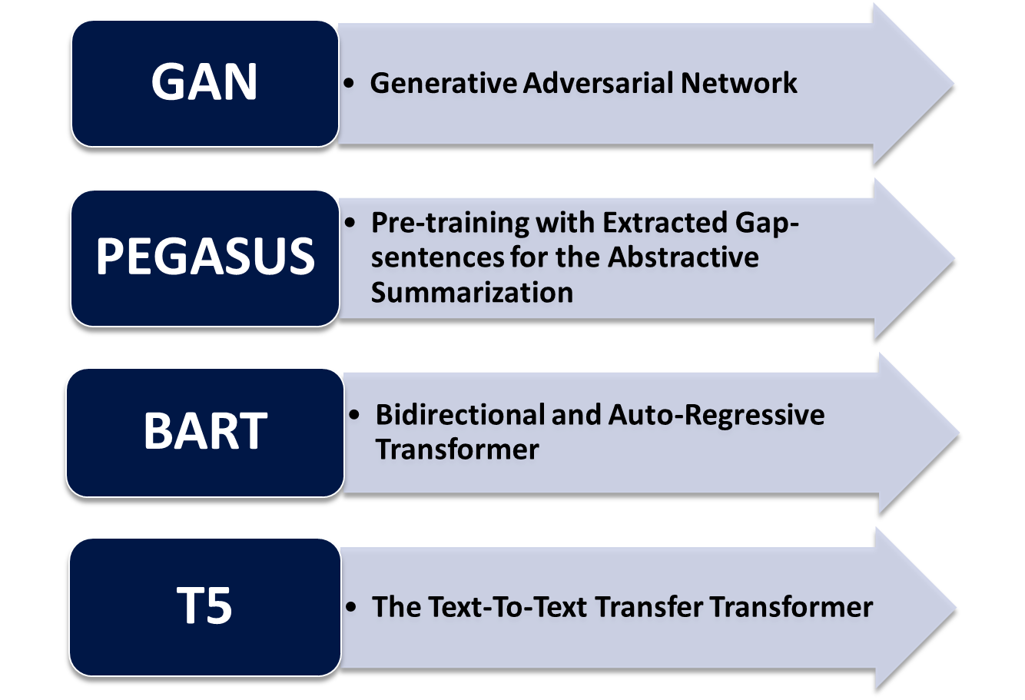
Model Selection
Notes:
As part of We considered these 4 model designs
Generative Adverserial Networks consist of two sub models, a discriminator model and a generator model. The generator model takes as input a news article and attempts to generate a summary. The discriminator model takes as input a summary and tries to determine if it is an accurate summary based on its training from the dataset. In this way the two models compete with each other until the generator network is able to successfully fool the discriminator.
The next three models all utilize a transformer architecture. Based on our review of the available literature, this architecture design currently performs the best in natural language processing tasks. In essence this architecture consists of a series of layers of encoders followed by decoders. Transformer models are able to process entire sequences of text at once, with the encoder layers taking in the input sequence and mapping it into a higher dimensional space (n-dimensional vector). That abstract vector is fed into the Decoder which turns it into an output sequence.
What separates the transformer architecture from the previous generation of architectures used in natural language processing, namely CNNs and RNNs, is its ability to “remember” the entire sequence of text and extract context from it. CNNs and RNNs either processed each token at a time or remembered only a small amount of the sequence.
Of these class of models, PEGASUS, BART and T5 are the state of the art.
The PEGASUS architecture is the most recent. It is a transformer model finely tuned to the task of text summarization. From our review of the pertinent literature, PEGASUS performs the best for text summarization in most cases. Ultimately, we opted not to experiment with this model as it’s large size of 2.5 GB made it impractical to load on the infrastructure available to us.
Our experiments focused on the BART and T5 architectures. These two models are very similar but vary in their size (with BART being the much larger model), input representation and their training strategy.

Slide 4
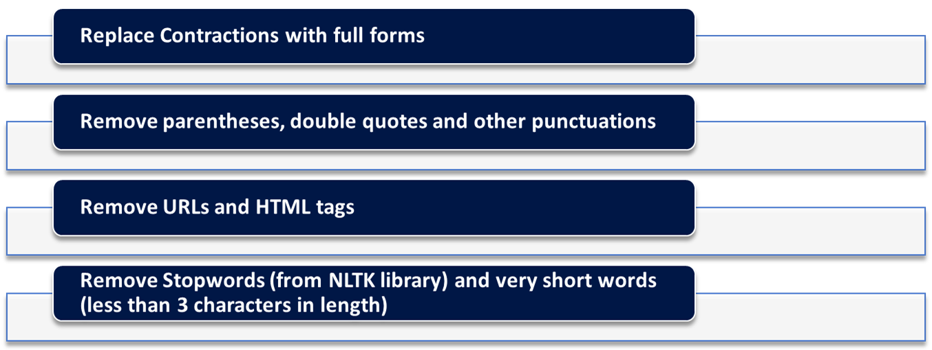
Methodology - Data Processing
• Preprocessing applied on both article and highlights columns
• Preprocessing Steps
Notes:
Before the training process, we applied some preprocessing steps on the dataset. These were done on both the article column and the highlights column.
We first replaced the contractions with their full forms. So something like I'll became I will. This was done to ensure that tokenizers handle contractions consistently and the model receives consistent input. Also, there could be ambiguity in contraction meaning. For example, something like I'd can mean either I had or I would depending on the context. If the model learns the wrong intended meaning, it would generate incorrect summaries.
Then we removed the parentheses, double quotes and other punctuations. This step together with removing the URLs and HTML tags helped remove the noise and simplified the text.
We also removed the stopwords ('a', 'an', 'the') and very short words as we felt that they didn't carry any significant meaning. Doing this step allowed the model to focus on more meaningful and informative words.

Slide 5
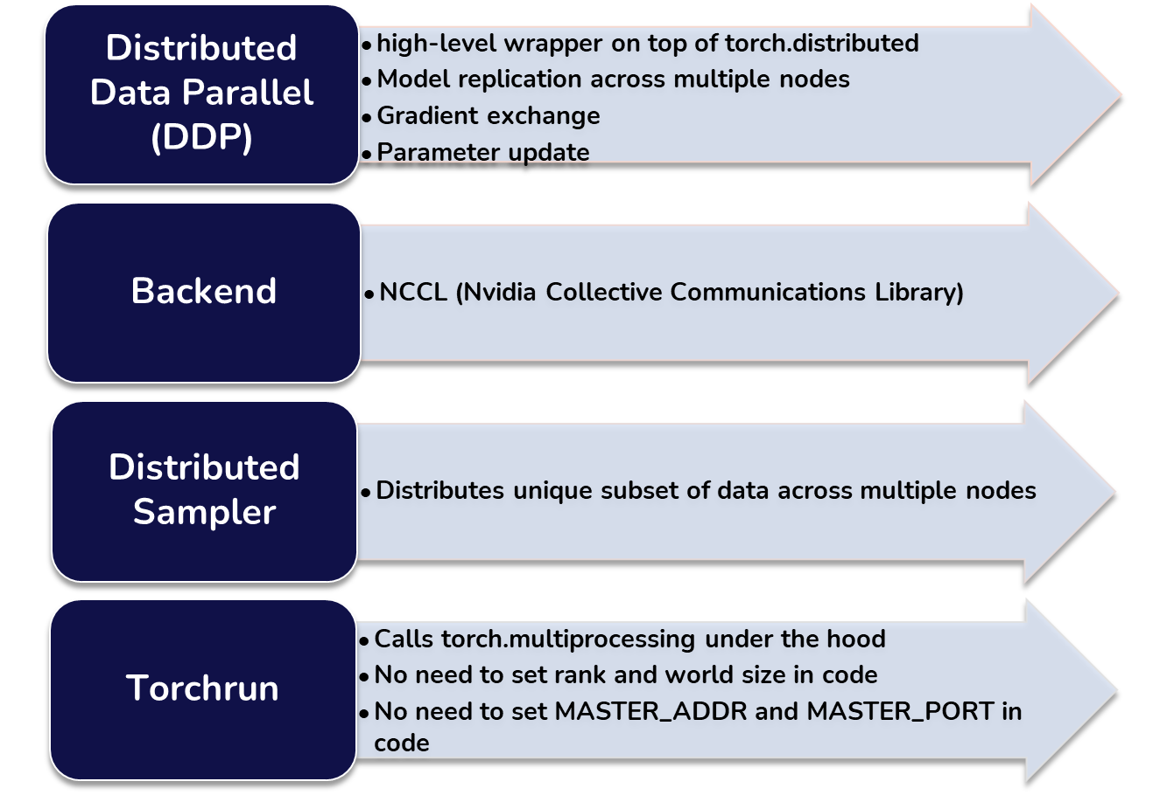


Methodology - Distributed Training
Notes:
We wrote our code using PyTorch. For distributed training, we used Distributed Data Parallel (DDP) which is a high level wrapper on top of torch.distributed. It essentially replicated our model across nodes the nodes where training occured. It carried out tasks like gradient exchange and parameter update, which are at the core of distributed training.
To facilitate the communication between the nodes, we used the NCCL protocol which is Nvidia's Collective Communications Library.
To ensure that our dataset was partitioned across multiples nodes and was not duplicated in any nodes, we used the distributed sampler class in PyTorch. For training we used, Trainer and TrainingArguments from huggingface transformers.
And finally we used torchrun to initialize the processes in each node, which basically calls torch.multiprocessing under the hood. This let us do away with setting the rank and world size code, and specify them in terminal. We also specified the rendezvous address and port in the command line.

Slide 6

Evaluation Metric
Automated evaluation of generated summary with reference summary using ROUGE metrics
ROUGE-1, ROUGE-2, ROUGE-L and ROUGE-LSum metrics are well suited for this problem
ROUGE-1, ROUGE-2
Based on overlap of n-gram between generated and reference summary
ROUGE-L
Based on entire summary-level LCS
Based on computing LCS for each sentence
ROUGE-LSum
Library: Python rouge

Slide 7
Experiment Results
distilbart-6-6 (82M Parameters)
t5-small (60M Parameters)
bart-base (139 Parameters)
ROUGE-1: 3.955%
ROUGE-L: 3.487%
ROUGE-LSum: 3.808%
ROUGE-1: 1.254%
ROUGE-L: 1.12057%
ROUGE-LSum: 1.243%
ROUGE-1: 4.336%
ROUGE-L: 3.4717%
ROUGE-LSum: 3.974%
Experiment setup
Evaluation Strategy: Epoch
Learning Rate: 5.6 × 10−5
lr Scheduler Type: linear
Per Device Train Batch Size: 8/16/20
Train Epochs: 2/3/5
Weight Decay: 0.01
Warmup Ratio: 0.1

Slide 8
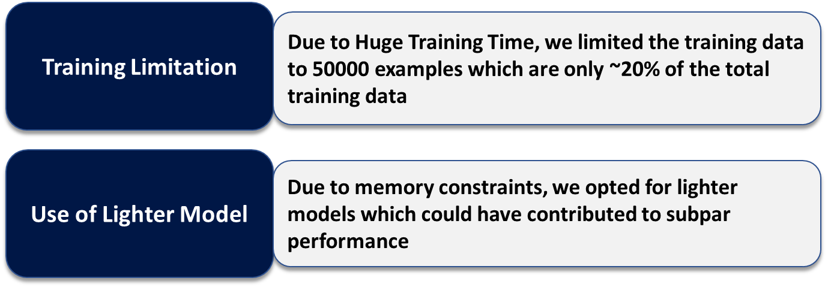
Result Analysis
As a higher ROUGE score indicates better model performance, our results were not satisfactory

Slide 9
Conclusion
Challenges Faced
sshleifer/distilbart-cnn-6-
Setting up the Distributed Environment
Cuda Memory Issues
Huge Training Time
Future Direction
Experimentation using Larger Models
Despite the challenges, this was quite an interesting project. We hope to refine our model through experimenting with the parameters.

Slide 10
Thank You! Any Questions?

