Slide 1
80286
Microprocessor
Department of Computer Science and Engineering
BRAC University
Course ID: CSE - 341
Course Title: Microprocessors

Slide 2
80186
80186 is a 16 bit microprocessor with 16 bit data bus and 20 bit address bus similar to 8086.
80186 has several additional functional chips:
clock generator
2 independent DMA channels
PIC
3 programmable 16-bit timers
more a microcontroller than a microprocessor
used mostly in industrial control applications

Slide 3
80286

Slide 4
Comparison between 8086 and 80286
1. 16 bit microprocessor | 1. 16 bit microprocessor
2. Data bus is 16 bit (D0 to D15) | 2. Data bus is 16 bit (D0 to D15)
3. Address bus is 20 bit (A0 to A19) | 3. Address bus is 24 bit (A0 to A23)
4. Works in two modes (Minimum and Maximum) | 4. Works in two modes (Real and Virtual protected Mode)
5. Has Multiplexed buses so the number of pins are 40. | 5. Has non-multiplexed buses so the number of pins are 68.
6. Operates between 5 to 10 MHz having standard frequency of 6MHz. So slower than 80286 | 6. Operates in 8 MHz, 10 MHz & 12.5 MHz . So faster than 8086
7. Does not support memory management and protection | 7. High performance microprocessor with memory management and protection
8086
80286

Slide 5
Intel 80286 has 2 operating modes:
Real Address Mode :
80286 is just a fast 8086 --- up to 6 times faster
All memory management and protection mechanisms are disabled
286 is object code compatible with 8086
Protected Virtual Address Mode
80286 works with all of its memory management and protection capabilities with the advanced instruction set.
it is source code compatible with 8086

Slide 6
80286 INTERNAL ARCHITECTURE

Slide 7
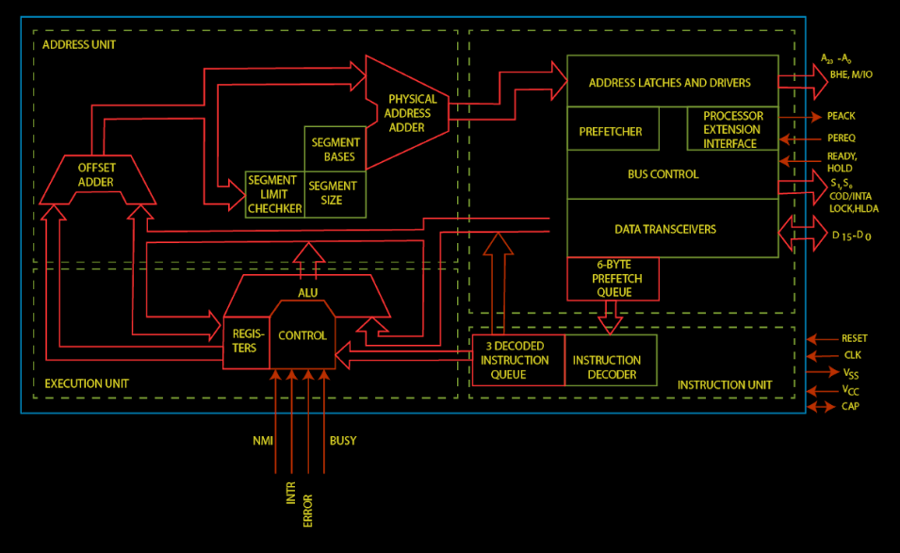
BUS INTERFACE UNIT

Slide 8
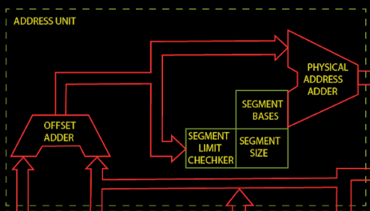
Address unit

Slide 9
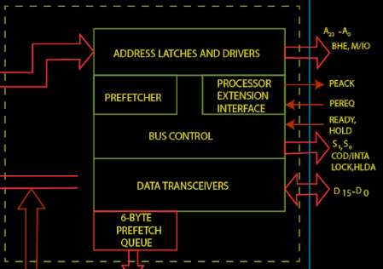
Bus Interface unit

Slide 10
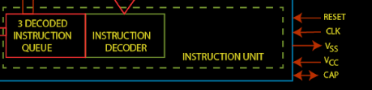
Instruction unit

Slide 11
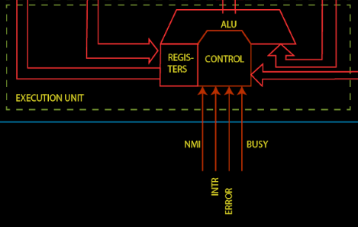
Execution unit

Slide 12
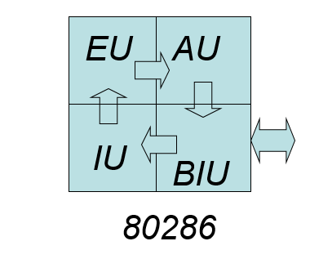
Functional Parts
Address unit
Bus Interface unit
Instruction unit
Execution unit

Slide 13
Address Unit
Calculate the physical addresses of the instruction and data that the CPU want to access
Address lines derived by this unit may be used to address different peripherals.
Physical address computed by the address unit is handed over to the Bus Unit.

Slide 14
Bus Interface Unit
Performs all memory and I/O read and write operations.
Take care of communication between CPU and a coprocessor.
Transmit the physical address over address bus A₀ – A_{23.}
Prefetcher module in the bus unit performs this task of prefetching.
Bus controller controls the prefetcher module.
Fetched instructions are arranged in a 6 – byte prefetch queue.

Slide 15
Instruction Unit
Receive arranged instructions from 6 byte prefetch queue.
Instruction decoder decodes up to 3 prefetched instruction and are latched them onto a decoded instruction queue.
Output of the decoding circuit drives a control circuit in the Execution unit.

Slide 16
Execution unit
EU executes the instructions received from the decoded instruction queue sequentially.
Contains Register Bank.
contains one additional special register called Machine status word (MSW) register --- lower 4 bits are only used.
ALU is the heart of execution unit.
After execution ALU sends the result either over data bus or back to the register bank.

Slide 17
Register organization of 80286
The 80286 CPU contains the same set of registers, as in 8086.
Eight 16-bit general purpose registers.
Four 16 bit segment registers.
One Flag register.
One Instruction pointer.
plus
one new 16-bit machine status word (MSW) register

Slide 18
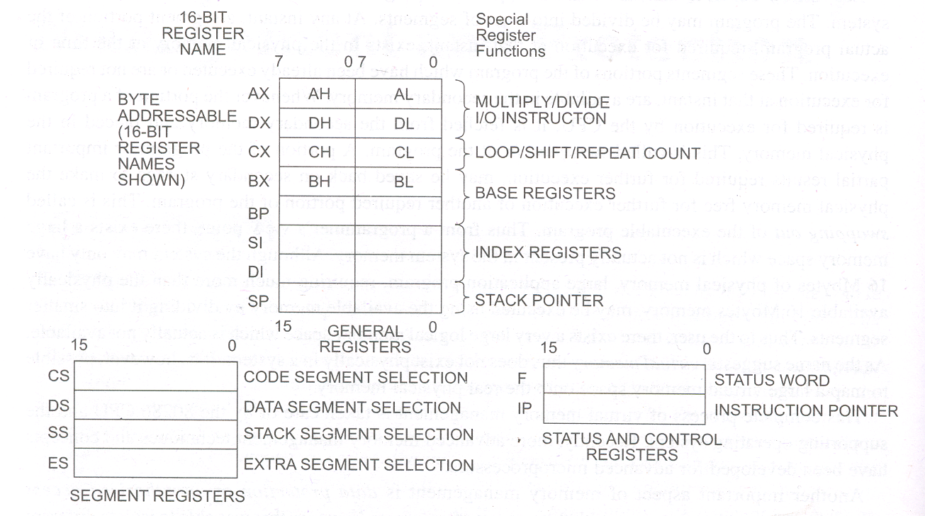

Slide 19
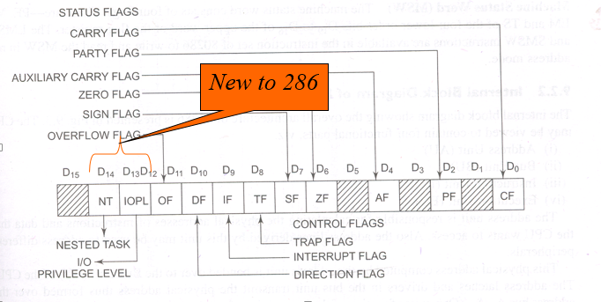
Flag Register

Slide 20
IOPL – Input Output Privilege Level flags (bit D12 and D13)
IOPL=00 = 0
IOPL=01 =1
IOPL=10 =2
IOPL=11= 3
Most Privilege
Level
PL = 0
PL=1
PL=2
PL=3

Slide 21
NT – Nested task flag (bit D14)
When set, it indicates that one system task has invoked another through a CALL instruction as opposed to a JMP.
For multitasking this can be manipulated to our advantage

Slide 22
IOPL – Input Output Privilege Level flags (bit D12 and D13)
IOPL is used in protected mode operation to select the privilege level for I/O devices. If the current privilege level is higher or more trusted than the IOPL, I/O executed without hindrance.
If the current privilege level is lower than the IOPL, an interrupt occurs, causing execution to suspend.
Note that IOPL 00 is the highest or more trusted; and IOPL 11 is the lowest or least trusted.

Slide 23
Machine Status Word Register
Consist of four flags
PE,
MP,
EM and
TS

Slide 24
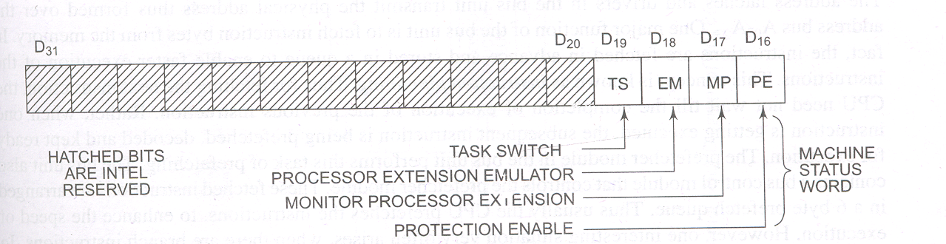
Machine Status Word...

Slide 25
PE - Protection enable
Protection enable flag places the 80286 in protected mode, if set. This can only be cleared by resetting the CPU.
MP – Monitor processor extension
Flag allows WAIT instruction to generate a processor extension.

Slide 26
EM – Emulate processor extension flag:
if set , causes a processor extension absent exception and permits the emulation of processor extension by CPU.
TS – Task switch: if set, this flag allows task switching and if TS=0 there is no task switching. Task switching means the operating system switches from one task to another.

Slide 27
80286 ADDRESS TRANSLATION-SEGMENTATION

Slide 28
Operating Modes of 80286
80286 operates in either the
real or
protected mode.
Real mode operation allows addressing of only the first 1M byte of memory space—even in Pentium or Core2 microprocessor.
the first 1M byte of memory is called the real memory, conventional memory, or DOS memory system

Slide 29
Why is this Real Mode there?
Protected Mode cannot be entered directly
To work in protected mode, various system tables are required. They are:
Global Descriptor Table
Local Descriptor Table
Page Tables

Slide 30
Segments and Offsets
All real mode memory addresses must consist of a segment address plus an offset address.
segment address defines the beginning address of any 64K-byte memory segment
offset address selects any location within the 64K byte memory segment

Slide 31
Protected Mode:
In real mode, PE=0
When PE=1, 80286 enters into protected mode
Then it continues to work in protected mode till the time processor is turned off
Thus, after entering into protected mode, PE bit cannot be made 0.
In protected mode, the calculation of physical address is different than that of real mode.

Slide 32
Protected Mode: Virtual Address
Virtual address is the combination of segment address and offset address.
Segment address tells which segment will be accessed. So, from segment address, the number of segments are to be known.
Offset address tells the location within the segment and from it the maximum size of the segment is known

Slide 33
Descriptor
There are mainly the LDT and GDT
Global descriptors contain segment definitions that apply to all programs.
Local descriptors are usually unique to an application.
a global descriptor might be called a system descriptor, and local descriptor an application descriptor

Slide 34
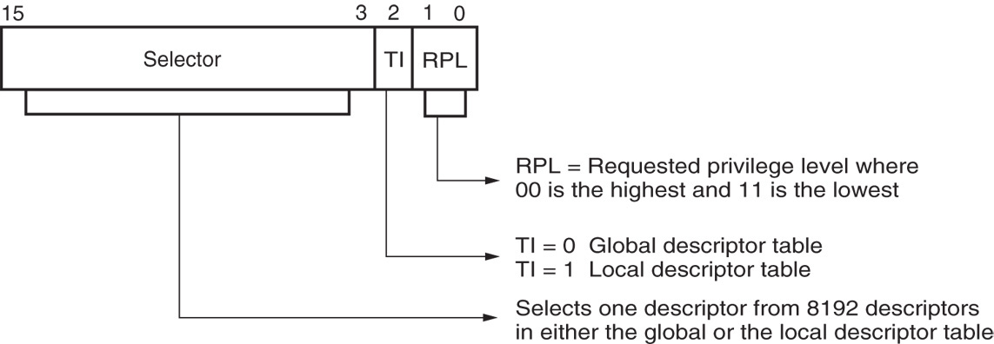
Contents of segment register
Segment descriptors are each 8k bytes

Slide 35
80286 Address Translation- Segmentation
OFFSET(16)
Base
Target Location
+
Limit
Access Right
GDT/LDT
Target Segment

Slide 36
PROTECTED MODE MEMORY ADDRESSING
Protected mode is where Windows operates.
In place of a segment address, the segment register contains a selector that selects a descriptor from a descriptor table.
The descriptor describes the memory segment’s location, length, and access rights.

Slide 37
Descriptors are chosen from the descriptor table by the segment register.
register contains a 13-bit selector field, a table selector bit, and requested privilege level field
The TI bit selects either the global or the local descriptor table.
Requested Privilege Level (RPL) requests the access privilege level of a memory segment.
If privilege levels are violated, system normally indicates an application or privilege level violation

Slide 38
Selectors and Descriptors
The selector, located in the segment register, selects one of 8192 descriptors from one of two tables of descriptors.
Descriptor describes the location, length, and access rights of the segment of memory.
In protected mode, this segment number can address any memory location in the system.
Indirectly, the segment register still selects a memory segment, but not directly as in real mode.

Slide 39
Global descriptors contain segment definitions that apply to all programs.
Local descriptors are usually unique to an application.
a global descriptor might be called a system descriptor, and local descriptor an application descriptor
The global descriptor table’s base address is stored in GDTR
The local descriptor table’s base address is stored in LDTR
The two privileged instructions LGDT and LLDT loads the GDTR and LDTR.

Slide 40
80286
Descriptor

Slide 41
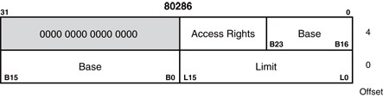
The 80286 descriptors

Slide 42
The 80286 descriptors
The 80286 descriptor has 3 parts:
1) Limit:
16-bit limit or size allows memory segment lengths of max^{m} 64K bytes.
2)Base:
The base address of the descriptor indicates the starting location of the memory segment.
the paragraph boundary limitation is removed in protected mode
segments may begin at any address
3) Access rights byte:
It controls access to the protected mode segment.
describes segment function in the system and allows complete control over the segment
if the segment is a data segment, the direction of growth is specified

Slide 43

Access Right Byte

Slide 44
Access Right Byte --- Bit 7 Present?
P
P=1 Valid Descriptor info, Segment is mapped into physical memory
P=0 Descriptor is undefined, no mapping to physical memory exists

Slide 45
Access Right Byte --- Bit 5,6 Privilege Level
P
DPL
Sets the Descriptor privilege level necessary for protection

Slide 46
Access Right Byte --- Bit 4 Descriptor Type
P
DPL
S
S=0 System descriptor
S=1 Application Descriptor

Slide 47
Access Right Byte --- Bit 3 Executable?
P
DPL
S
E
E=0 No Data/Stack Segment
E=1 YES Code Segment

Slide 48
Access Right Byte
ED=0 Segment expands upward (Data segment)
ED=1 Segment expands downward (Stack Segment)
Bit 2
P
DPL
S
E=0
E=1
ED
C
C=1 Ignore DPL
C=0 Abide by DPL

Slide 49
Access Right Byte --- Bit 1
W=0 Data segment not writable
W=1 Data segment writable
P
DPL
S
E=0
E=1
ED
C
W
R
R=0 Code Segment execute only, not readable
R=1 Code Segment both executable & readable

Slide 50
Access Right Byte --- Bit 0 Accessed?
P
DPL
S
E=0
E=1
ED
C
W
R
A
A=0 Segment not accessed
A=1 Segment has been accessed

Slide 51
80286 Protection

Slide 52
Protection Mechanism
There are three checks in protection mechanism:
Limit Check
Type Check
Privilege Check

Slide 53
Limit Check
Offset is compared with the limit
For 8 bit data,
Offset < = Limit
For 16 bit data,
Offset < = Limit - 1

Slide 54
Type Check
S E ED W
Or
S E C R
DESCRIPTOR BITS

Slide 55
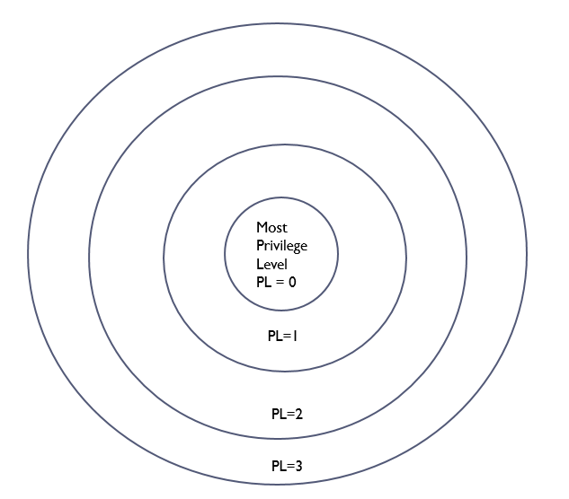
Privilege Check

Slide 56
Privilege Check
Descriptor Privilege Level (DPL) – It is the privilege level of the segment to be accessed. It is there in the target segment descriptor.
Request Privilege Level (RPL) – It is the privilege level of the program to be executed.
Current Privilege Level (CPL) – It is there in the code segment register that is currently running.
Effective Privilege Level (EPL) – Max (CPL,RPL)

Slide 57
Privilege Check
CS Descriptor
CPL
Segment Address
RPL
EPL
Privilege Check
Target Segment
Descriptor
DPL
Target DPL>= EPL

Slide 58
Privilege levels and Protection
Every segment has an associated privilege level and hence any code segment will have an associated privilege level.
The CPL (Current Privilege Level) of a process is the privilege level of the code segment, the code stored in which, it is executing.
A process can access segments that have privilege levels numerically greater than or equal to (less privileged than) its CPL.

Slide 59
Thank You !! and

