Slide 1

Pattern Matching: Boyer and Moore
组员：212122-茅伟龙 212099-邹刘文

Slide 2

目 录
1
Boyer and Moore Algorithmrm
2
Bad Character Rule
3
Good Suffix Rule 1
4
Good Suffix Rule 2
5
How to construct suffix function?
6
How to use suffix function?
7
Example and Complexity

Slide 3
1
Boyer and Moore Algorithm

Slide 4
1.1 Boyer and Moore Algorithm
输入您的文字
The algorithm compares the pattern P with the substring of sequence T within a sliding window in the right-to-left order.
The bad character rule and good suffix rule are used to determine the movement of sliding window.
输入您的文字

Slide 5
2
Bad Character Rule

Slide 6
2.1 Bad Character Rule
Suppose that P₁ is aligned to T_{s} now, and we perform a pair-wise comparing between text T and pattern P from right to left. Assume that the first mismatch occurs when comparing T_{s+j-1} with P_{j} .
Since T_{s+j-1} ≠P_{j} , we move the pattern P to the right such that the largest position c in the left of P_{j} is equal to T_{s+j-1}. We can shift the pattern at least (j-c) positions right.
输入您的文字
s
s +j -1
T |  |  | x | t
P |  | x |  | y | t
输入您的文字
1
c
j
m
Shift
P |  | x |  | y | t
1
j
m

Slide 7
2.2 Character Matching Rule
Bad character rule uses Rule 2-1 (Character Matching Rule).
For any character x in T, find the nearest x in P which is to the left of x in T.
输入您的文字
输入您的文字

Slide 8
2.2 Character Matching Rule
Case 1. If there is a x in P to the left of T, move P so that the two x’s match.
输入您的文字
输入您的文字

Slide 9
2.2 Character Matching Rule
Case 2: If no such a x exists in P, consider the partial window defined by x in T and the string to the left of it.
输入您的文字
输入您的文字

Slide 10
2.3 Example
Ex: Suppose that P₁ is aligned to T₆ now. We compare pair-wise between T and P from right to left. Since T_{16,17} = P_{11,12} = “CA” and T₁₅ =“G” ≠P₁₀ = “T”. Therefore, we find the rightmost position c=7 in the left of P₁₀ in P such that P_{c} is equal to “G” and we can move the window at least (10-7=3) positions.
directing of the scan
s=6
 | 1 | 2 | 3 | 4 | 5 | 6 | 7 | 8 | 9 | 10 | 11 | 12 | 13 | 14 | 15 | 16 | 17 | 18 | 19 | 20
T | A | A | A | A | A | A | T | C | A | C | A | T | T | A | G | C | A | A | A | A
mismatch
P | A | T | C | A | C | A | G | T | A | T | C | A
 | 1 | 2 | 3 | 4 | 5 | 6 | 7 | 8 | 9 | 10 | 11 | 12
c
j=10
m=12
P | A | T | C | A | C | A | G | T | A | T | C | A
 | 1 | 2 | 3 | 4 | 5 | 6 | 7 | 8 | 9 | 10 | 11 | 12

Slide 11
3
Good Suffix Rule 1

Slide 12
3.1 Good Suffix Rule 1
If a mismatch occurs in T_{s+j-1}, we match T_{s+j-1} with P_{j’-m+j} , where j’ (m-j+1≦ j’ < m) is the largest position such that
(1) P_{j+1,m} is a suffix of P_{1,j’}
(2) P_{j’-(m-j)} ≠P_{j}.
We can move the window at least (m-j’) position(s).
输入您的文字
s
s+j-1
T |  |  | x | t
P |  | z | t |  | y | t
1
j'-m+j
j’
j
m
Shift
P |  | z | t |  | y | t
1
j’-m+j
j’
j
m
z≠y

Slide 13
3.2 The Substring Matching Rule
For any substring u in T, find a nearest u in P which is to the left of it. If such a u in P exists, move P; otherwise, we may define a new partial window.
输入您的文字
输入您的文字

Slide 14
3.3 Example
Ex: Suppose that P₁ is aligned to T₆ now. We compare pair-wise between P and T from right to left. Since T_{16,17} = “CA” = P_{11,12} and T₁₅ =“A” ≠P₁₀ = “T”. We find the substring “CA” in the left of P₁₀ in P such that “CA” is the suffix of P_{1,6} and the left character to this substring “CA” in P is not equal to P₁₀ = “T”. Therefore, we can move the window at least m-j’ (12-6=6) positions right.
输入您的文字
s=6
s+j-1
 | 1 | 2 | 3 | 4 | 5 | 6 | 7 | 8 | 9 | 10 | 11 | 12 | 13 | 14 | 15 | 16 | 17 | 18 | 19 | 20
T | A | A | A | A | A | A | G | C | C | T | A | G | C | A | A | C | A | A | A | A
mismatch
P | A | T | C | A | C | A | T | C | A | T | C | A
 | 1 | 2 | 3 | 4 | 5 | 6 | 7 | 8 | 9 | 10 | 11 | 12
输入您的文字
m=12
j’=6
j=10
Shift
P | A | T | C | A | C | A | T | C | A | T | C | A
 | 1 | 2 | 3 | 4 | 5 | 6 | 7 | 8 | 9 | 10 | 11 | 12
A≠T

Slide 15
3.4 Applying Bad Character Rule
Let Bc(a) be the rightmost position of a in P. The function will be used for applying bad character rule.
We can move our pattern right j-B(T_{s+j-1}) position by above Bc function.
j | 1 | 2 | 3 | 4 | 5 | 6 | 7 | 8 | 9 | 10 | 11 | 12
P | A | T | C | A | C | A | T | C | A | T | C | A
Σ | A | C | G | T
B | 12 | 11 | 0 | 10
输入您的文字
j | 1 | 2 | 3 | 4 | 5 | 6 | 7 | 8 | 9 | 10 | 11 | 12 | 13 | 14 | 15 | 16 | 17 | 18
T | A | G | C | T | A | G | C | C | T | G | C | A | C | G | T | A | C | A
输入您的文字
j | 1 | 2 | 3 | 4 | 5 | 6 | 7 | 8 | 9 | 10 | 11 | 12
P | A | T | C | A | C | A | T | C | A | T | C | A
Move
10-B(G) = 10 positions

Slide 16
4
Good Suffix Rule 2

Slide 17
4.1 Good Suffix Rule 2
Good Suffix Rule 2 is used only when Good Suffix Rule 1 can not be used. That is, t does not appear in P(1, j). Thus, t is unique in P.
输入您的文字
If a mismatch occurs in T_{s+j-1}, we match T_{s+m-j’} with P₁, where j’ (1≦ j’ ≦ m-j) is the largest position such that
P_{1,j’} is a suffix of P_{j+1,m}.
s
s+j-1
s+m-j’
T |  |  | x | t
输入您的文字
t’
P | t’ |  | y | t
1
j’
j
t’
m
Shift
P | t’ |  | y | t
1
j’
j
m
P.S. : t’ is suffix of substring t.

Slide 18
4.2 Unique Substring Rule
The substring u appears in P exactly once.
If the substring u matches with T_{i,j} , no matter whether a mismatch occurs in some position of P or not, we can slide the window by l.
T:
P:
The string s is the longest prefix of P which equals to a suffix of u.
输入您的文字
i
u
j
 |  | s
u
s |  |  | s
输入您的文字
s |  | u
l

Slide 19
4.3 The Suffix to Prefix Rule
For a window to have any chance to match a pattern, in some way, there must be a suffix of the window which is equal to a prefix of the pattern.
输入您的文字
T
输入您的文字
P

Slide 20
4.4 Take Care！
Note that the above rule also uses Rule 1.
It should also be noted that the unique substring is the shorter and the more right-sided the better.
A short u guarantees a short (or even empty) s which is desirable.
输入您的文字
i
j
 | u
u
s |  |  | s
输入您的文字
s |  | u
l

Slide 21
4.5 Example
Ex: Suppose that P₁ is aligned to T₆ now. We compare pair-wise between P and T from right to left. Since T₁₂ ≠ P₇ and there is no substring P_{8,12} in left of P₈ to exactly match T_{13,17}. We find a longest suffix “AATC” of substring T_{13,17}, the longest suffix is also prefix of P. We shift the window such that the last character of prefix substring to match the last character of the suffix substring. Therefore, we can shift at least 12-4=8 positions.
输入您的文字
s=6
 | 1 | 2 | 3 | 4 | 5 | 6 | 7 | 8 | 9 | 10 | 11 | 12 | 13 | 14 | 15 | 16 | 17 | 18 | 19 | 20
T | A | A | A | A | A | A | T | C | A | C | A | T | T | A | A | T | C | A | A | A
j’=4
j=7
mismatch
P | A | A | T | C | A | T | C | T | A | A | T | C
 | 1 | 2 | 3 | 4 | 5 | 6 | 7 | 8 | 9 | 10 | 11 | 12
m=12
输入您的文字
Shift
P | A | A | T | C | A | T | C | T | A | A | T | C
 | 1 | 2 | 3 | 4 | 5 | 6 | 7 | 8 | 9 | 10 | 11 | 12
j’=4
j=7
m=12

Slide 22
4.6 Applying good suffix rule
Let Gs(j) be the largest number of shifts by good suffix rule when a mismatch occurs for comparing P_{j} with some character in T.
输入您的文字
输入您的文字

Slide 23
4.6 Applying good suffix rule
gs₁(j) be the largest k such that P_{j+1,m} is a suffix of P_{1,k} and P_{k-m+j} ≠ P_{j}, where m-j+1 ≦k<m ; 0 if there is no such k.
(gs₁ is for Good Suffix Rule 1)
gs₂(j) be the largest k such that P_{1,k} is a suffix of P_{j+1,m}, where 1≦k ≦m-j; 0 if there is no such k.
(gs₂ is for Good Suffix Rule 2.)
Gs(j) = m – max{gs₁, gs₂}, if j = m ,Gs(j)=1.
输入您的文字
gs₁(7)=9
∵ P_{8,12} is a suffix of P_{1,9}
and P₄ ≠ P₇
j | 1 | 2 | 3 | 4 | 5 | 6 | 7 | 8 | 9 | 10 | 11 | 12
P | A | T | C | A | C | A | T | C | A | T | C | A
gs₁ | 0 | 0 | 0 | 0 | 0 | 0 | 9 | 0 | 0 | 6 | 1 | 0
gs₂ | 4 | 4 | 4 | 4 | 4 | 4 | 4 | 4 | 1 | 1 | 1 | 0
Gs | 8 | 8 | 8 | 8 | 8 | 8 | 3 | 8 | 11 | 6 | 11 | 1
输入您的文字
gs₂(7)=4
∵P_{1,4} is a suffix of P_{8,12}

Slide 24
4.6 Applying good suffix rule
How do we obtain gs₁ and gs₂?
In the following, we shall show that by constructing the Suffix Function, we can kill two birds with one arrow.
输入您的文字
输入您的文字

Slide 25
4.6 Applying good suffix rule
For 1≦j ≦m-1, let the suffix function f’(j) for P_{j} be the smallest k such that P_{k,m} = P_{j+1,m-k+j+1}; ( j+2 ≦k ≦m)
If there is no such k, we set f’ = m+1.
If j=m, we set f’(m)=m+2.
Ex:
输入您的文字
P |  | t |  | t
j
j+1
k
m
j+1,m-k+j+1
j | 1 | 2 | 3 | 4 | 5 | 6 | 7 | 8 | 9 | 10 | 11 | 12
P | A | T | C | A | C | A | T | C | A | T | C | A
f’ | 10 | 11 | 12 | 8 | 9 | 10 | 11 | 12 | 13 | 13 | 13 | 14
输入您的文字
f’(4)=8, it means that P_{f’(4),m} = P_{8,12} = P_{5,9} =P_{4+1,4+1+m-f’(4)}
Since there is no k for 13= j+2 ≦ k≦12, we set f’(11)=13.

Slide 26
4.6 Applying good suffix rule
Suppose that the Suffix is obtained. How can we use it to obtain gs₁ and gs₂?
gs₁ can be obtained by scanning the Suffix function from right to left.
输入您的文字
输入您的文字

Slide 27
4.6 Applying good suffix rule
 | 1 | 2 | 3 | 4 | 5 | 6 | 7 | 8 | 9 | 10 | 11 | 12 | 13 | 14 | 15 | 16 | 17 | 18 | 19 | 20 | 21 | 22 | 23 | 24
T | G | A | T | C | G | A | T | C | A | A | T | G | A | T | C | A | C | A | T | G | A | T | C | A
输入您的文字
P | A | T | C | A | C | A | T | C | A | T | C | A
 | 1 | 2 | 3 | 4 | 5 | 6 | 7 | 8 | 9 | 10 | 11 | 12
j | 1 | 2 | 3 | 4 | 5 | 6 | 7 | 8 | 9 | 10 | 11 | 12
P | A | T | C | A | C | A | T | C | A | T | C | A
f’ | 10 | 11 | 12 | 8 | 9 | 10 | 11 | 12 | 13 | 13 | 13 | 14
输入您的文字

Slide 28
4.6 Applying good suffix rule
 | 1 | 2 | 3 | 4 | 5 | 6 | 7 | 8 | 9 | 10 | 11 | 12 | 13 | 14 | 15 | 16 | 17 | 18 | 19 | 20 | 21 | 22 | 23 | 24
T | G | A | T | C | G | A | T | C | A | A | T | C | A | T | C | A | C | A | T | G | A | T | C | A
输入您的文字
P | A | T | C | A | C | A | T | C | A | T | C | A
 | 1 | 2 | 3 | 4 | 5 | 6 | 7 | 8 | 9 | 10 | 11 | 12
j | 1 | 2 | 3 | 4 | 5 | 6 | 7 | 8 | 9 | 10 | 11 | 12
P | A | T | C | A | C | A | T | C | A | T | C | A
f’ | 10 | 11 | 12 | 8 | 9 | 10 | 11 | 12 | 13 | 13 | 13 | 14
输入您的文字

Slide 29
4.6 Applying good suffix rule
Example
As for Good Suffix Rule 2, it is relatively easier.
输入您的文字
j | 1 | 2 | 3 | 4 | 5 | 6 | 7 | 8 | 9 | 10 | 11 | 12
P | A | T | C | A | C | A | T | C | A | T | C | A
f’ | 10 | 11 | 12 | 8 | 9 | 10 | 11 | 12 | 13 | 13 | 13 | 14
输入您的文字

Slide 30
5
How to construct suffix function?

Slide 31
5.1 Prefix Function vs. Suffix Function
Commonalities:
both performed on the pattern string for preprocessing;
both search the maximum matched number of characters between prefix and suffix of a specific string （i.e. a character array）, but the matched prefix or suffix cannot be the whole string
Differences:
Denote the prefix function as P, the suffix function as S. The pattern string is p[0…m-1],
then P(i) calculates and returns the maximum matched number of substring p[0…i-1],
S(i) calculates the maximum matched number of substring p[ i+1 …. m-1] and returns
the index right before the maximum matched suffix.
输入您的文字
0
P(i)
i-1
A
B
i
i+1
S(i)
m-1
输入您的文字
C
D

Slide 32
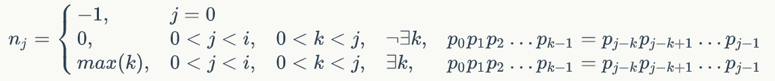
5.2 KMP Prefix Function Implementation Review
If the pattern string is p₀p₁p₂…p_{i-1}, the next array is n₀n₁n₂…n_{i-1}:
输入您的文字
Method 1: Brute Force
j = 5
 | A | B | C | D | A | B | D
k = 5 – 1 = 4
Initialize k = len(substring) – 1
= j – 1;
Judge whether p[1…k] == p[j – k ….j-1] is satisfied or not, if yes we get next[j] =
k, program ends; otherwise k = k – 1;
Repeat step2 until k = 0, set next[j] = 0.
 | A | B | C | D | A | B | D
ABCD != BCDA, k = 3
 | A | B | C | D | A | B | D
输入您的文字
ABC != CDA, k = 2
 | A | B | C | D | A | B | D
AB != DA, k = 1
 | A | B | C | D | A | B | D
A ==A, next[5] = 1

Slide 33
5.2 KMP Prefix Function Implementation Review
Method 2: Recursive
We use already calculated next[0, 1, …, j-1] to calculate next[j].
Case 1:
if next[j-1] = -1,
then undoubtedly j – 1 = 0, j = 1,
next[j] = 0
Case 2: if P[j-1] == P[next[j-1]], then next[j] = next[j-1] +1
Proof: 1) next[j - 1] = k has been known, then we have:
P[0… k-1] = P[j-2-(k-1) …j-2];
if P[j-1] == P[next[j-1]] (P[k]), then we have:
P[0…k-1] + P[k] = P[j-2-(k-1)…j-2] + P[j-1]
P[0…k] = P[j-2-(k-1)…j-1]
P[0…k] = P[j-1-(k+1-1)…j-1]
2) Could next[j] > k+1 ?
we can suppose next[j] = k + 2, then we have
P[0…k+1] = P[j-1-(k+2-1)…j-1]
P[0…k+1][:k+1] = P[j-1-(k+2-1)…j-1][:k+1]
P[0…k] = P[j-1-(k+2-1)…j-2]
P[0…k] = P[j-2-(k-1)-1…j-2]
so next[j-1] = k + 1, this is a conflict
so next[j] <=k+1 , next[j] = k + 1 = next[j-1] +1
输入您的文字
j – 1 = 0
j = 1
 | 0 | 1
P | A | B
next[j-1]=3
j – 1 = 9
j = 10
 | 0 | 1 | 2 | 3 | 4 | 5 | 6 | 7 | 8 | 9 | 10
P | A | B | C | D | K | E | A | B | C | D | X

Slide 34
5.2 KMP Prefix Function Implementation Review
Case 3: if P[j-1] != P[next[j-1]]:
next[j – 1]= 7
j – 1 = 17
j = 18
Proof:
 | 0 | 1 | 2 | 3 | 4 | 5 | 6 | 7 | 8 | 9 | 10 | 11 | 12 | 13 | 14 | 15 | 16 | 17 | 18
P | A | F | A | C | A | F | A | D | K | E | A | F | A | C | A | F | A | F | X
Because P[0…6] = P[10…16]
And P[7] != P[17]:
we have next[18] != 8 (7+1)
输入您的文字
next[7]= 3
P[0…2] = P[4…6]
P[4…6] = P[0…6][-3:]
= P[10…16][-3:]
= P[14…16]
So P[0…2] = P[14…16]
Because P[3] != P[17],
we have next[18] != 4(3+1)
 | 0 | 1 | 2 | 3 | 4 | 5 | 6 | 7 | 8 | 9 | 10 | 11 | 12 | 13 | 14 | 15 | 16 | 17 | 18
P | A | F | A | C | A | F | A | D | K | E | A | F | A | C | A | F | A | F | X
输入您的文字
next[3]= 1
P[0] = P[2]
P[2] = P[0...2][-1:]
= P[14…16][-1:] = P[16]
so P[0] = P[16]
Because P[1] == P[17],
we have next[18] = 2(1+1)
 | 0 | 1 | 2 | 3 | 4 | 5 | 6 | 7 | 8 | 9 | 10 | 11 | 12 | 13 | 14 | 15 | 16 | 17 | 18
P | A | F | A | C | A | F | A | D | K | E | A | F | A | C | A | F | A | F | X

Slide 35
5.2 KMP Prefix Function Implementation Review R
Method 3: Recursive Unfold
https://www.zybuluo.com/wzhang1117/note/27431
输入您的文字

Slide 36
5.3 Suffix Function Implementation
If the pattern string is p₁p₂…p_{m}:
输入您的文字
Case 1: j = m, f’(j) = m + 2
m=12
m+1=13
m+2=14
输入您的文字
 | 1 | 2 | 3 | 4 | 5 | 6 | 7 | 8 | 9 | 10 | 11 | 12
P | A | T | C | A | C | A | T | C | A | T | C | A
f’ |  |  |  |  |  |  |  |  |  |  |  | 14

Slide 37
5.3 Suffix Function Implementation
Case 2: f’(j) = f’^{(k’)}(j+1) – 1, if 1<=j<=m-1 and there exists the smallest integer k>= 1such that P[j+1] = P[f’^{(k)}(j+1)-1]
j=3
j+1=4
f’(j+1)-1=7
f’(j+1)=8
Proof:
 | 1 | 2 | 3 | 4 | 5 | 6 | 7 | 8 | 9 | 10 | 11 | 12
P | A | T | C | A | C | A | T | C | A | T | C | A
P | A | T | C | A | C | A | T | C | A | T | C | A
f’ |  |  |  | 8 | 9 | 10 | 11 | 12 | 13 | 13 | 13 | 14
输入您的文字
Because P[5…9] = P[8…12]
and P[4] != P[7]:
we have f’(3) != 7 ( 8 – 1)
Because f’⁽²⁾(j+1) = f’( f’(j+1) – 1 )
= f’( 8 – 1 )
= f’( 7 )
= 11
we have P[11…12] = P[8…9]
= P[8…12][:2]
= P[5…9][:2]
= P[5…6]
Also because P[4] != P[10], we have:
f’(3) != 10 (11-1)
f’⁽²⁾(j+1)=11
f’⁽²⁾(j+1)-1=10
输入您的文字
 | 1 | 2 | 3 | 4 | 5 | 6 | 7 | 8 | 9 | 10 | 11 | 12
P | A | T | C | A | C | A | T | C | A | T | C | A
P | A | T | C | A | C | A | T | C | A | T | C | A
f’ |  |  |  | 8 | 9 | 10 | 11 | 12 | 13 | 13 | 13 | 14

Slide 38
5.3 Suffix Function Implementation
f’⁽³⁾(j+1) = f’( f’⁽²⁾(j+1) – 1 )
= f’( 11 – 1 )
= f’( 10 )
= 13
Because P[4] == P[13-1], i.e.
P[j+1] == P[f’⁽³⁾(j+1)-1]
we have:
f’(3) = f’⁽³⁾(j+1)-1 = 12
f’⁽³⁾(j+1)=13
f’⁽³⁾(j+1)-1=12
输入您的文字
 | 1 | 2 | 3 | 4 | 5 | 6 | 7 | 8 | 9 | 10 | 11 | 12
P | A | T | C | A | C | A | T | C | A | T | C | A
P | A | T | C | A | C | A | T | C | A | T | C | A
f’ |  |  | 12 | 8 | 9 | 10 | 11 | 12 | 13 | 13 | 13 | 14
输入您的文字

Slide 39
5.3 Suffix Function Implementation
Case 3: otherwise f’(j) = m + 1
j=m-1
j+1= m
 | 1 | 2 | 3 | 4 | 5 | 6 | 7 | 8 | 9 | 10 | 11 | 12
P | A | T | C | A | C | A | T | C | A | T | C | A
f’ |  |  |  |  |  |  |  |  |  |  |  | 14
Because f’(j+1) = m+2 = 14,
P[j+1] = ‘A’.
P[f’(j+1) -1] =P[13] not exist
输入您的文字
j
j+1
 | 1 | 2 | 3 | 4 | 5 | 6 | 7 | 8 | 9 | 10 | 11 | 12
P | A | T | C | A | C | A | T | C | A | T | C | A
P | A | T | C | A | C | A | T | C | A | T | C | A
f’ |  |  |  |  |  |  |  |  | 13 | 13 | 13 | 14
We have :
f’(j+1) = 13,
f’⁽²⁾(j+1) = f’(12)=14
P[j+1] = ‘T’.
P[f’(j+1) -1] =P[12]= ‘A’
So P[j+1] != P[f’(j+1) -1],
P[f’⁽²⁾(j+1) – 1] = P[13] not exist
输入您的文字

Slide 40
5.3 Suffix Function Implementation
j
j+1
P |  |  |  | A
f’(j+1)=m+1
j+1
m
a）
P |  |  | a |  | b
f’(j)=m+1
b）
j+1
m
f’(j)=1
P |  |  | a |  | b
j+1
m
If ac == bd,
Then c = b
Then f’(j+1) != m+1,
This is a conflict!
P |  |  | a | c |  | d | b

Slide 41
6
How to use the suffix function?

Slide 42
6.1 The aim and method of using suffix function function
Aim:
kill two birds with one arrow;
Reduce complexity to apply good suffix rule1 and good suffix rule2;
输入您的文字
Method:
Step 1: use the suffix function to get good suffix rule1 info(gs1) and corresponding G’ (m – gs1);
Step 2: use the suffix function to get good suffix rule2 info(gs2) and corresponding G’ (m – gs2)
j | 1 | 2 | 3 | 4 | 5 | 6 | 7 | 8 | 9 | 10 | 11 | 12
P | A | T | C | A | C | A | T | C | A | T | C | A
f’ | 10 | 11 | 12 | 8 | 9 | 10 | 11 | 12 | 13 | 13 | 13 | 14
G’ | 0 | 0 | 0 | 0 | 0 | 0 | 0 | 0 | 0 | 0 | 0 | 0
输入您的文字
Let G’(j), 1≦j≦m, to be the largest number of shifts by good suffix rules.
First, we set G’(j) to zeros as their initializations.

Slide 43
6.2 How to get gs1 info using suffix function ?
Conclusion
We scan from right to left. For position j, denote f’(j) – 1 as t,
if P[j] != P[t] and gs1(t) not assigned, then we could have:
gs1(t) = j + (m – t ) = j + (m – (f’(j) – 1)) = j + m – f’(j) + 1
G’(t) = m – max{gs1(t), gs2(t)} = m – gs1(t) = f’(j) – 1 - j
Proof
t = f’(j) - 1
T |  | a | D
gs1(t)
输入您的文字
j
t
f’(j)
P |  | b | E |  | c | F
G’(t)
First, we prove that gs1(t) is equal to the end position of the prefix E:
When text string T and pattern string P are mismatched at t, we have: D = F, a!=c;
if P[j] != P[t], then b != c; according to the meaning of f’ function, we have E = F;
D = F , E = F, then we have E = D;

Slide 44
6.2 How to get gs1 info using suffix function ?
T |  | a | D
P |  | b | E |  | c | F
P |  | g | H |  | c | F
输入您的文字
j’
we have to ensure the end of E is the most right position in P that matches the suffix D, we can suppose there is a righter position that matches D: the end of H, but since we scan from right to left, if H exists, the gs1(t) must has been assigned, so this is a conflict.
输入您的文字
输入您的文字
2) Then we prove gs1(t) >= gs2(t):
gs1(t) means we could find full matched suffix, gs2(t) we can only find partially matched suffix,
so gs1(t) >= gs2(t);
thus for those t whose gs1(t) have been assigned, there is no need to update its G’(t).

Slide 45
6.2 How to get gs1 info using suffix function ?
Example
j | 1 | 2 | 3 | 4 | 5 | 6 | 7 | 8 | 9 | 10 | 11 | 12
P | A | T | C | A | C | A | T | C | A | T | C | A
f’ | 10 | 11 | 12 | 8 | 9 | 10 | 11 | 12 | 13 | 13 | 13 | 14
G’ | 0 | 0 | 0 | 0 | 0 | 0 | 0 | 0 | 0 | 0 | 0 | 1
When j=12, t=13. t > m.
When j=11, t=12. Since P₁₁=‘C’≠ ‘A’= P₁₂ ,
G’(t) = m – max{gs₁(t), gs₂(t)} = m – gs₁(t)
= f’(j) – 1 – j
=> G’(12)=13-1-11= 1.

Slide 46
6.2 How to get gs1 info using suffix function ?
j | 1 | 2 | 3 | 4 | 5 | 6 | 7 | 8 | 9 | 10 | 11 | 12
P | A | T | C | A | C | A | T | C | A | T | C | A
f’ | 10 | 11 | 12 | 8 | 9 | 10 | 11 | 12 | 13 | 13 | 13 | 14
G’ | 0 | 0 | 0 | 0 | 0 | 0 | 3 | 0 | 0 | 6 | 0 | 1
When j=10, t=12. Since P₁₀=‘T’≠‘A’ =P₁₂ , G’(12) ≠0.
When j=9, t=12. P₉ = ‘A’ =P₁₂.
When j=8, t=11. P₈ = ‘C’ =P₁₁.
When j=7, t=10. P₇ = ‘T’ =P₁₀
When j=6, t=9. P₆ = ‘A’ =P₉
When j=5, t=8. P₅ = ‘C’ =P₈
When j=4, t=7. Since P₄ = ‘A’ ≠ P₇ = ‘T’, G’(7) = 8 – 1 – 4= 3
Besides, t = f’⁽²⁾(4) – 1=f’(f’(4) – 1) – 1=10. Since P₄ = ‘A’≠
P₁₀ = ‘T’, G’(10) =f’(7) – 1 – j= 11 – 1 – 4 = 6.

Slide 47
6.2 How to get gs1 info using suffix function ?
j | 1 | 2 | 3 | 4 | 5 | 6 | 7 | 8 | 9 | 10 | 11 | 12
P | A | T | C | A | C | A | T | C | A | T | C | A
f’ | 10 | 11 | 12 | 8 | 9 | 10 | 11 | 12 | 13 | 13 | 13 | 14
G’ | 0 | 0 | 0 | 0 | 0 | 0 | 3 | 0 | 6 | 0 | 0 | 1
When j=3, t=11. P₃=‘C’=P₁₁.
When j=2, t=10. P₂=‘T’=P₁₀
When j=1, t=9. P₁=‘A’=P₉.

Slide 48
6.3 How to get gs2 info using suffix function ?
Conclusion1
1
f’⁽¹⁾(1)-1
a | B |  | c | D
1
f’^{(k’)}(1) - 1
P | a | F |  | c | H
a = c
1<=j<= f’^{(k’)}(1)-2
Find smallest k in {1,2, …, m} such that P[1] = P[f’^{(k)}(1)-1] as k’.
If G’(j) is not determined in the first scan and 1<=j<= f’^{(k’)}(1)-2, thus, in the second scan, we set G’(j)=m - max{gs₁(j), gs₂(j)}= m - gs₂(j)= f’^{(k’)}(1) - 2. If no such k exists, set each undetermined value of G to m in the second scan.
Proof: satisfy the definition of good suffix rule2; maximum subarray

Slide 49
6.3 How to get gs2 info using suffix function ? function ?
Example
j | 1 | 2 | 3 | 4 | 5 | 6 | 7 | 8 | 9 | 10 | 11 | 12
P | A | T | C | A | C | A | T | C | A | T | C | A
f’ | 10 | 11 | 12 | 8 | 9 | 10 | 11 | 12 | 13 | 13 | 13 | 14
G’ | 8 | 8 | 8 | 8 | 8 | 8 | 3 | 8 | 0 | 6 | 0 | 1
k’=1, since P_{f’(1)-1}=P₉=“A”=P₁, we set G’(j)=f’ (1)-2 for j=1,2,3,4,5,6,8.

Slide 50
6.3 How to get gs2 info using suffix function ?
z+1 = f’^{(k’)}(1) - 1
Conclusion2 and Proof:
z = f’^{(k’)}(1) - 2
1
P | e | F |  | g | H
f’(z) - 1
X1= [1<=j<= f’^{(k’)}(1)-2]
x2
f’(z)
P | e | I |  |  | g | J | k | L
e + I = g + J, g + J = L, so e + I = L
So for z+1 <=j <= f’(z) -1,
gs2(j) = e + I = m – (f’(z) – 1) ,
G’(j) = m –gs1(j) = f’(z) -1
…

Slide 51
6.3 How to get gs2 info using suffix function ?
Example
Let z be f’^{(k’)}(1)-2. Let k’’ be the largest value k such that f’’^{(k)}(z)-1<=m.
Then we set G’(j) = m - gs₂(j) = m - (m - f’’^{(i)}(z) - 1) = f’’^{(i)}(z) - 1, where 1<=i<=k’’ and f’’^{(i-1)}(z) < j <= f’’^{(i)}(z)-1 and f’’⁽⁰⁾(z) = z.
For example, z=8 :
k=1, f’’⁽¹⁾(8)-1=11≦m=12
k=2, f’’⁽²⁾(8)-1=12≦m=12 => k’’=2
i=1, f’’⁽⁰⁾(8)-1 = 7 < j ≦ f’’⁽¹⁾(8)-1=11. 个人觉得这里不太正确，应该是大于8而不是大于7, 8这个已经被计算过了
i=2, f’’⁽¹⁾(8)-1 =11< j ≦ f’’⁽²⁾(8)-1=12.
We set G(9) and G(11)= f’’⁽¹⁾(8) – 1= 12-1 = 11.
j | 1 | 2 | 3 | 4 | 5 | 6 | 7 | 8 | 9 | 10 | 11 | 12
P | A | T | C | A | C | A | T | C | A | T | C | A
f’ | 10 | 11 | 12 | 8 | 9 | 10 | 11 | 12 | 13 | 13 | 13 | 14
G’ | 8 | 8 | 8 | 8 | 8 | 8 | 3 | 8 | 11 | 6 | 11 | 1

Slide 52
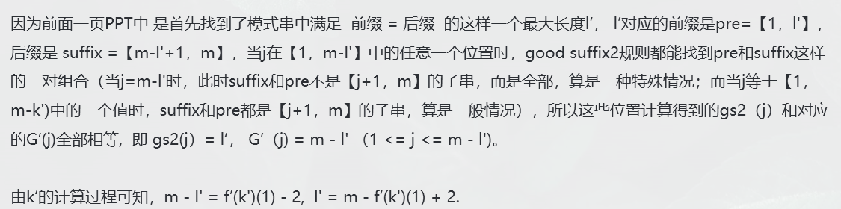
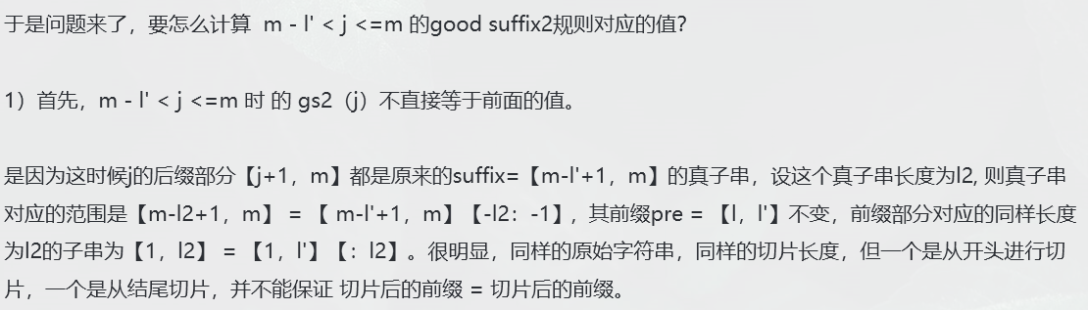
6.4 Supplementary

Slide 53
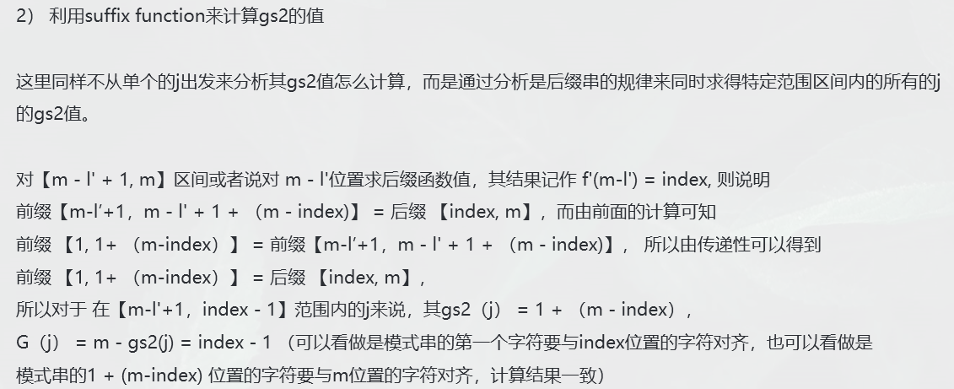
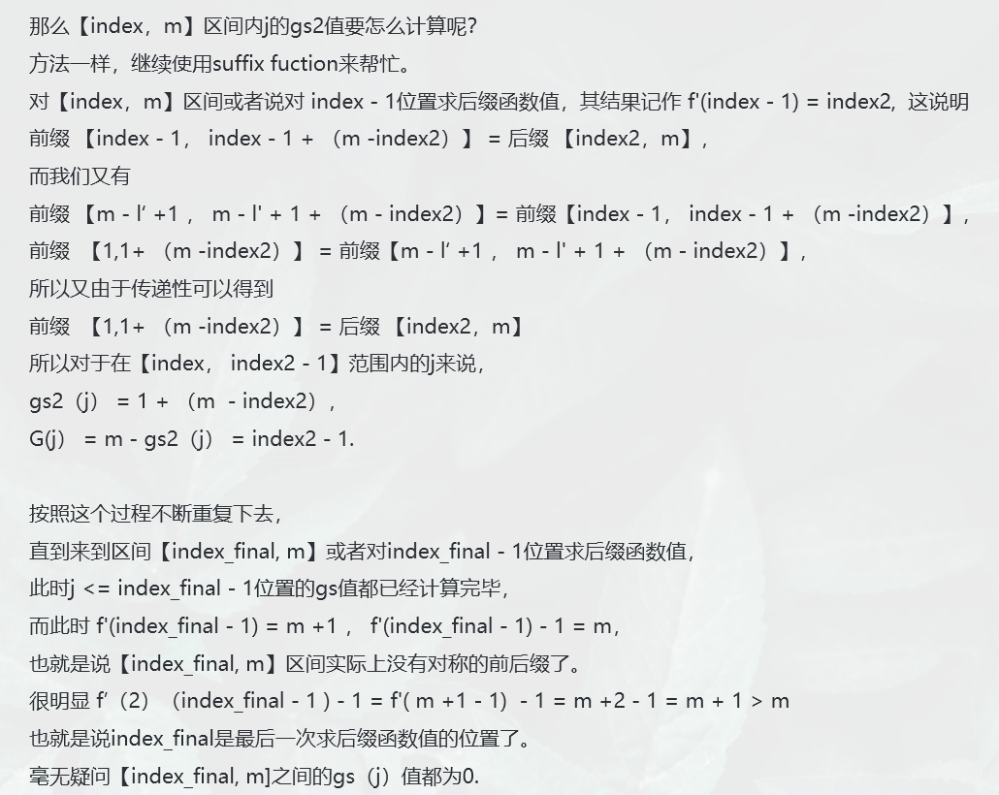
6.4 Supplementary

Slide 54
7
Example and Complexity

Slide 55
7.1 The overall pipeline
Construct the suffix array recursively
Scan the suffix function value array from right to left, update gs1 and G’
Scan the suffix function value array from left to right, update gs2 and G’
Combine G’ and Bad Character Rule1,
max{G’(j), j-B(T_{s+j-1})}

Slide 56
7.2 Example
 | 1 | 2 | 3 | 4 | 5 | 6 | 7 | 8 | 9 | 10 | 11 | 12 | 13 | 14 | 15 | 16 | 17 | 18 | 19 | 20 | 21 | 22 | 23 | 24
T | G | A | T | C | G | A | T | C | A | C | A | T | A | T | C | A | C | A | T | C | A | T | C | A
mismatch
输入您的文字
P | A | T | C | A | C | A | T | C | A | T | C | A
 | 1 | 2 | 3 | 4 | 5 | 6 | 7 | 8 | 9 | 10 | 11 | 12
P | A | T | C | A | C | A | T | C | A | T | C | A
 | 1 | 2 | 3 | 4 | 5 | 6 | 7 | 8 | 9 | 10 | 11 | 12
Shift
j | 1 | 2 | 3 | 4 | 5 | 6 | 7 | 8 | 9 | 10 | 11 | 12
P | A | T | C | A | C | A | T | C | A | T | C | A
f’ | 10 | 11 | 12 | 8 | 9 | 10 | 11 | 12 | 13 | 13 | 13 | 14
G’ | 8 | 8 | 8 | 8 | 8 | 8 | 3 | 8 | 11 | 6 | 11 | 1
输入您的文字
Σ | A | C | G | T
B | 12 | 11 | 0 | 10
We compare T and P from right to left. Since T₁₂=“T”≠P₁₂=“A”, the largest movement = max{G’(j), j-B(T_{s+j-1})} = max{G’(12), 12-B(T₁₂)}= max{1,12-10} = 2.

Slide 57
7.3 Complexity
The preprocessing phase in O(m+Σ) time and space complexity and searching phase in O(mn) time complexity.
The worst case time complexity for the Boyer-Moore method would be O((n-m+1)m).
It was proved that this algorithm has O(m) comparisons when P is not in T. However, this algorithm has O(mn) comparisons when P is in T.
输入您的文字
A new proof of the linearity of the Boyer-Moore string searching algorithm
输入您的文字
Tight bounds on the complexity of the Boyer-Moore string matching algorithm

Slide 58

感谢您的观看
组员：212122-茅伟龙 212099-邹刘文

