Slide 1



DOCTORAL SCHOOL OF COMPUTER SCIENCE FOR CLIMATE CHANGE
COMPUTER MODELLING APPROACHES OF COMPLEX SYSTEM
Computer Vision modelling using Deep Learning
Student
Zourkalaini BOUBAKAR
Lecturer
Prof. Alese B. K.
October 08, 2021

Slide 2
Introduction
1
Problem statement and Objective
2
Motivation
3
Data and Tools
OUTLINE
4
Conceptual Model
5
Mathematical Modelling
6
Computer Modelling
7
Demonstration
Conclusion

Slide 3
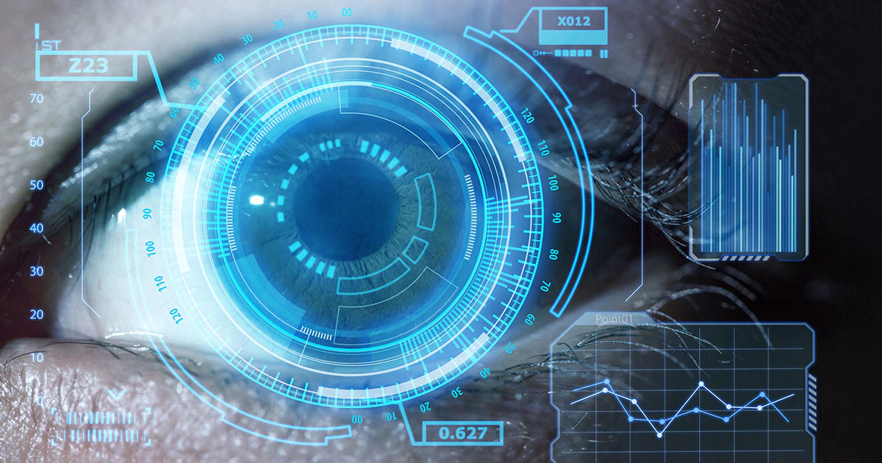
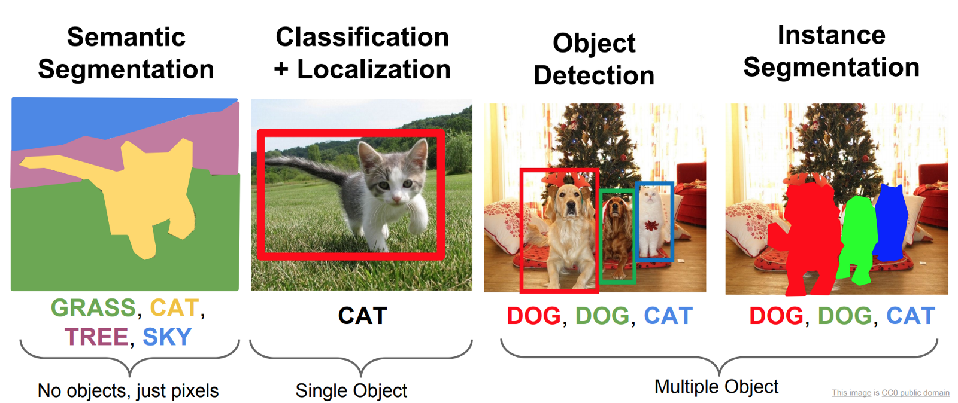
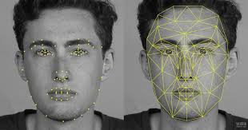
Introduction
What is a Computer Vision ?
Computer vision is the field of computer science that focuses on applying human vision complexity systems and enabling computers to identify and process objects in images and videos in the same manner that a human brain does.
Until recently, computer vision only worked in limited capacity but the current scenarios in artificial intelligence and in deep learning, the field has been able to take great leaps in recent years and has been able to surpass humans in some tasks related to detecting and labeling objects.
Face recognition

Slide 4
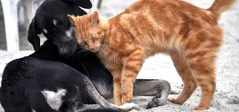
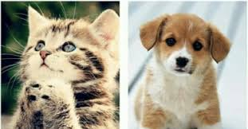
1- Problem
Can a computer “see” and “understand” an image ?. This task is easy for human being because of his brain and eyes. Knowing that a computer does not have eyes and that computer only understand numbers, is it possible to model such human vision complexity for dogs and cats images recognition ?
1- Objectives
The objective of this project is to write a computer model that can predict whether a given images contain either a dog or a cat.

Slide 5
2- Motivation
Computer Science as background and current field of study
The aim of the program Informatics for climate change is to learn how climate change can be tackled using computer science.
Literature:
ANNs has attracted the most attention from researchers in recent time, for instance, the study found that forecasting of crops and animals yield are helpful in agricultural development. Interestingly, this application of ANN has led to an increase in agricultural production which has enhanced food security in many nations. In the past two decades, ANNs have applied in different fields of agriculture, particularly to crop area estimation and classification. Also, agricultural data can be predicted using a neural network. There are diverse approaches proposed for data analysis such as neural network models.
Big climate data with huge climate satellite imagery
Computer Hardware with performance GPU and massively Parallelizable

Slide 6






3- Data and Tools
Data | images | units
Training (labeled) | Dogs | 500
 | Cats | 500
Validation (labeled) | Dogs | 500
 | cat | 500
Testing (unlabeled) | Dogs and cats | 1000
VS code
Tensorflow
Keras
Google Colab
python

Slide 7
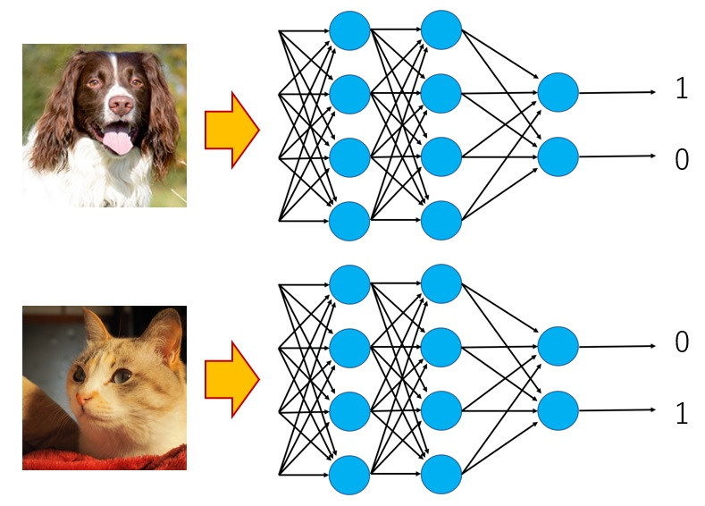
4- Conceptuel Model
100% Dog
0% Cat
100% Cat
0% Dog
Deep Learning

Slide 8
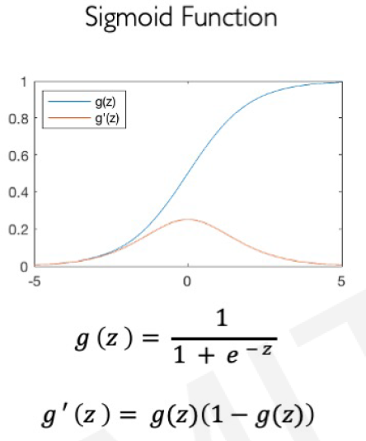
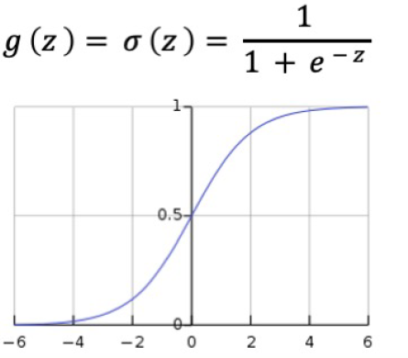
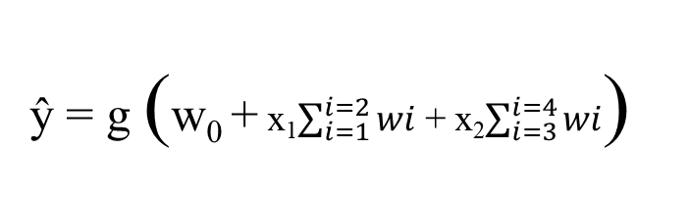
5- Mathematical Model
Output
Linear combination of inputs
Forward Propagation (→)
ŷ = g (w₀ + x₁$\sum_{i=1}^{i=2}{wi}$ + x₂$\sum_{i=3}^{i=4}{wi}$)
x₁
w₁
∑
w₂
Non-linear activation function
Bias
g
ŷ
Error
w₃
y
∑
w₀
x₂
w₄
Back Propagation (←)
Implemented in Tensorflow and Keras

Slide 9
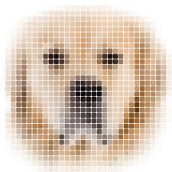
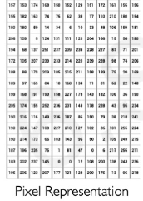
6- Computer model
Dog 0.8
Cat 0.2
Binary Classification
Input Image
Images are 3D vectors (height, width, color channel)

Slide 10
6- Computer model
Neural Networks
Model evaluation
(Testing)
Training
And
Validation
Datasets
2
4
3
1
Save the Model
Deep Learning is a :
Static model
Stochastic Model
Discrete Model (probability distribution)
Data driven Model
Graphical User interface

Slide 11
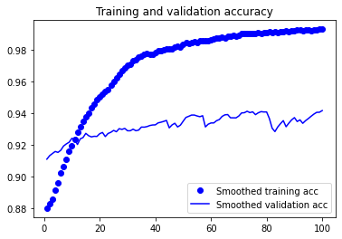
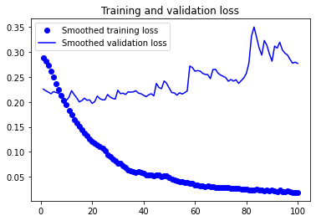
6- Computer model
Model Performances

Slide 12
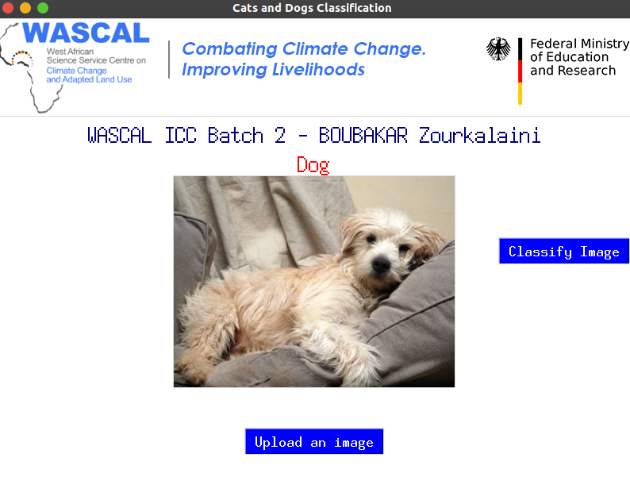
7 –Demonstration

Slide 13
Conclusion
Climate Change: Challenge for ANN
-It has Only scratched the surface
Fire mapping
Land degradation
Food security (crops classification…)…

