Slide 1
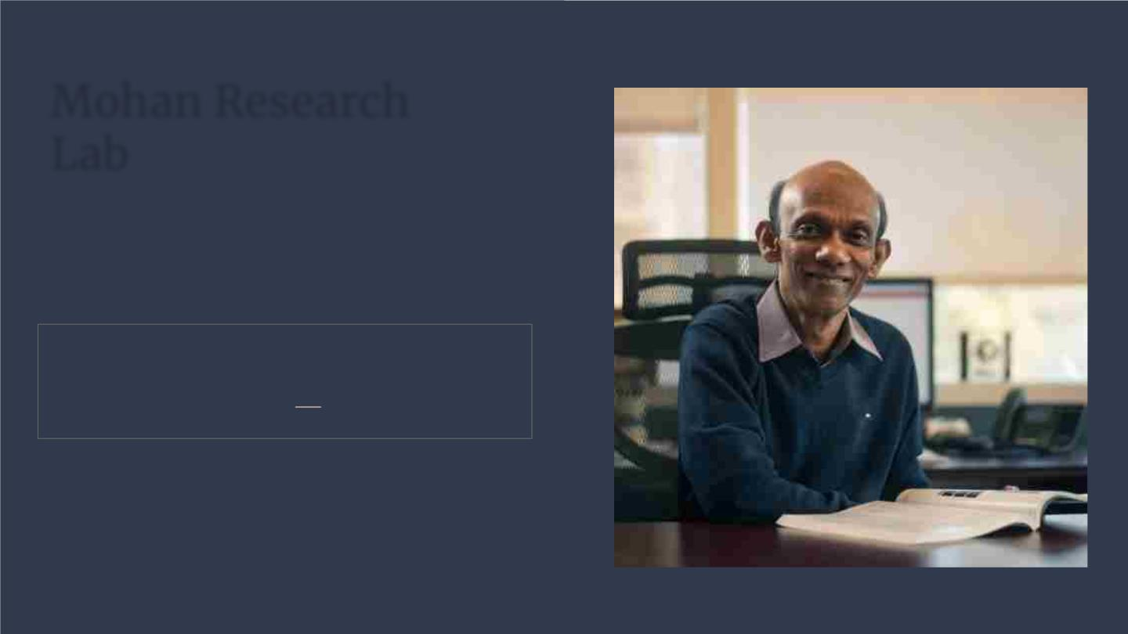
Mohan Research
Lab
“The mind, once stretched by a new idea,
never returns to its original dimensions.”
Ralph Waldo Emerson

Slide 2
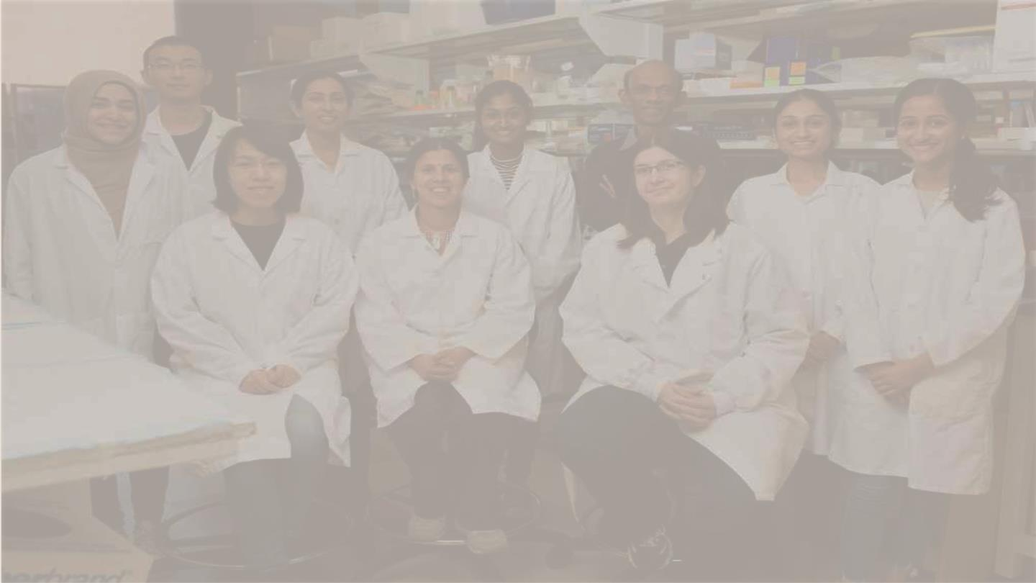
Mission statement:
Mine proteomic data for novel
biomarkers and targets in autoimmune
diseases and cancers then apply the
latest bioengineering technologies to
improve patient outcomes.

Slide 3
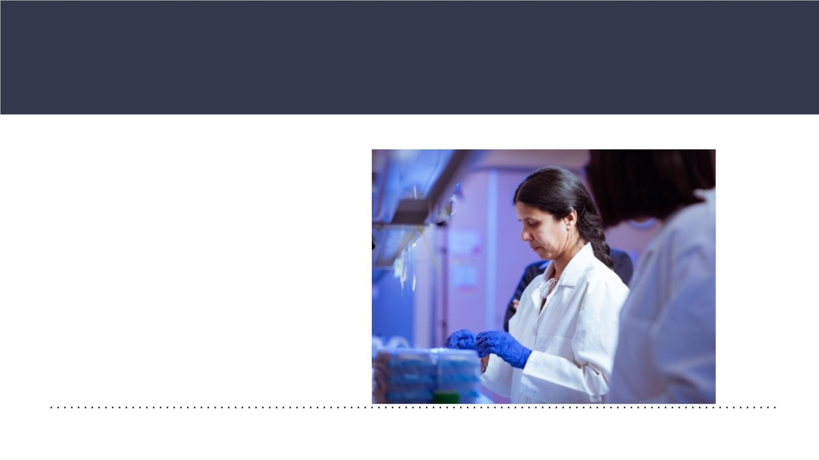
The problem
Research opportunities for
undergraduates.
Are there any labs in which
undergraduates can conduct actual
research that directly impacts
patient health and also get it
published?

Slide 4
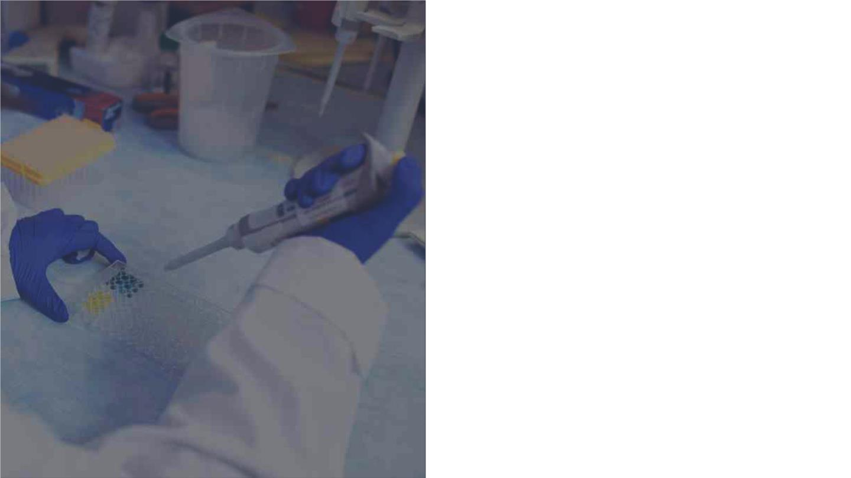
Yes there are!
At the Mohan Research Lab
we encourage
undergraduates to take up
the pipette and join a team
conducting potentially life-
changing (and publishable)
experiments.
The solution

Slide 5

The team
An international group of lead researchers
Kamala Vanarsa
Annie Yanping
Anto Sam Crosslee
Yaxi Li
The lab manager. Research
interests include using novel
proteomic technologies to
quantitate biomarkers in human
body fluids.
A senior staff. Research
interests include working with
animal models and mouse
colony management involving
different diseases.
A Post-Doctoral Fellow.
Research interests include
understanding molecular
pathways involved in
autoimmunity and creating
novel disease models.
A Post-Doctoral Fellow.
Research interests include
discovery of novel biomarkers
and drug targets for
autoimmune diseases and
cancers.

Slide 6
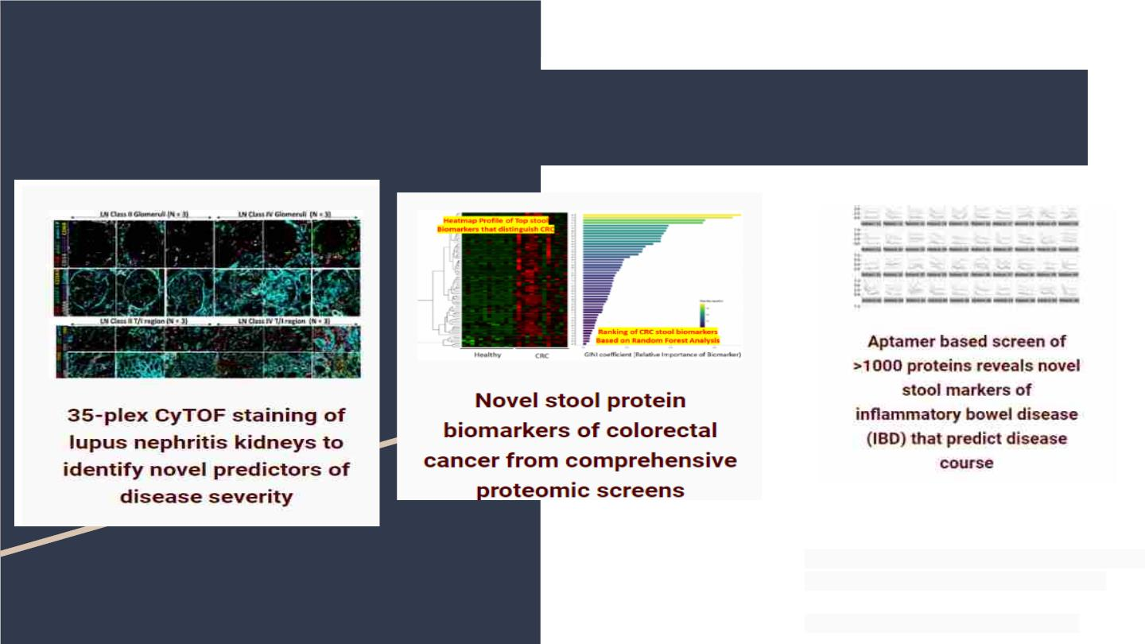
Projects- Identifying novel biomarkers
Lead: Kamala Vanarsa
Team Members: Pietro Cicalese
Collaborator: Dr. S-H Chen
Lead: Hao Li
Team Members: Kamala Vanarsa, Yanping Chen
Collaborator: Drs. Chia, Bresalier, Pedroza
Team Members: Malavika Nidhi, Ramya Susarla,
Ting Zhang, Prashanth Sasidharan, Sanam
Soomro, Suresh Venkateswaran
Collaborator: Drs. Kugathasan, Pedroza

Slide 7
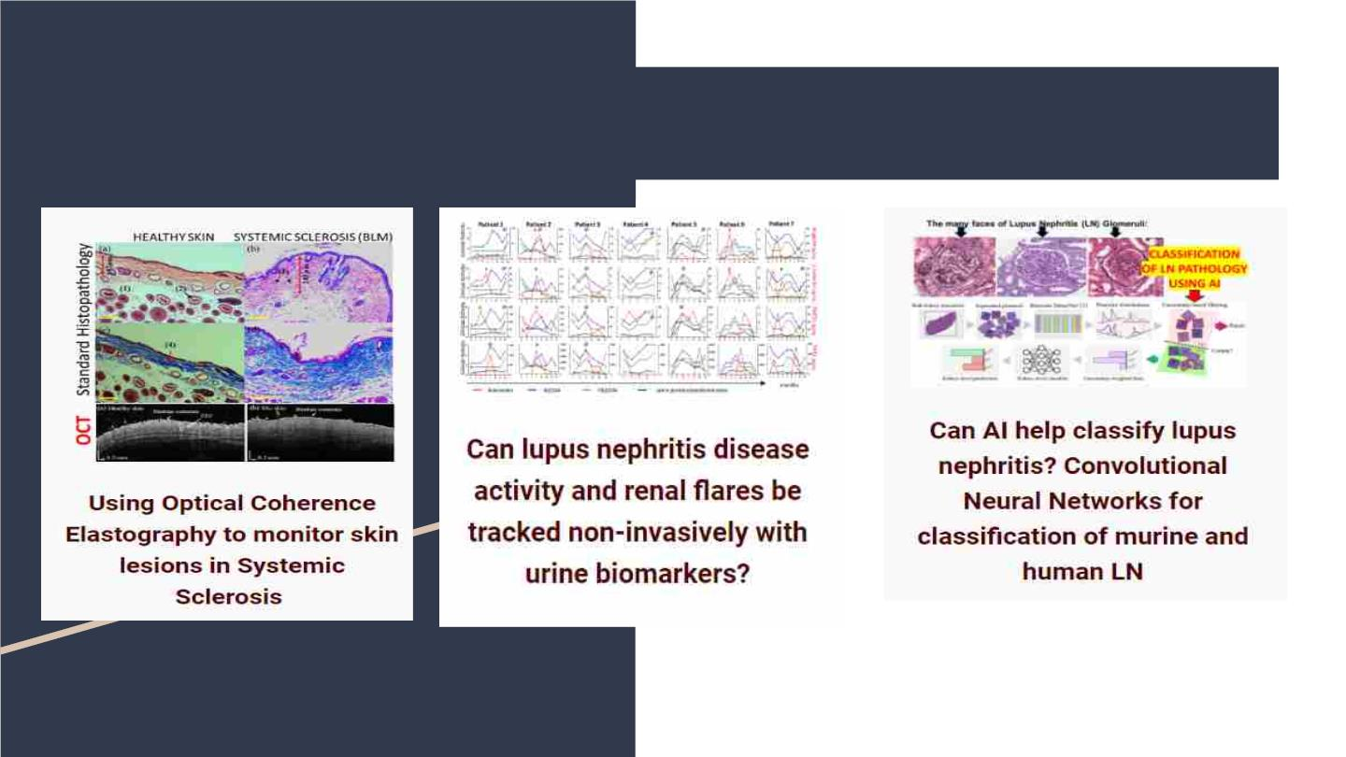
Projects- classify & monitor disease using
biotechnology
Lead: Pietro Antonio Cicalese
Lead: Yanping Chen
Team Members: Phuongthy Tran, Yong Du
Collaborator: Drs. Assassi, Larin
Lead: Ting Zhang
Team Members: Kamala Vanarsa
Collaborator: Drs. Petri, Saxena, Pedroza
Co-mentor: Dr. Hien Van Nguyen
Collaborators: Drs. Chang, Truong, Becker,
Sadhna, Khambam, Torrealba

Slide 8
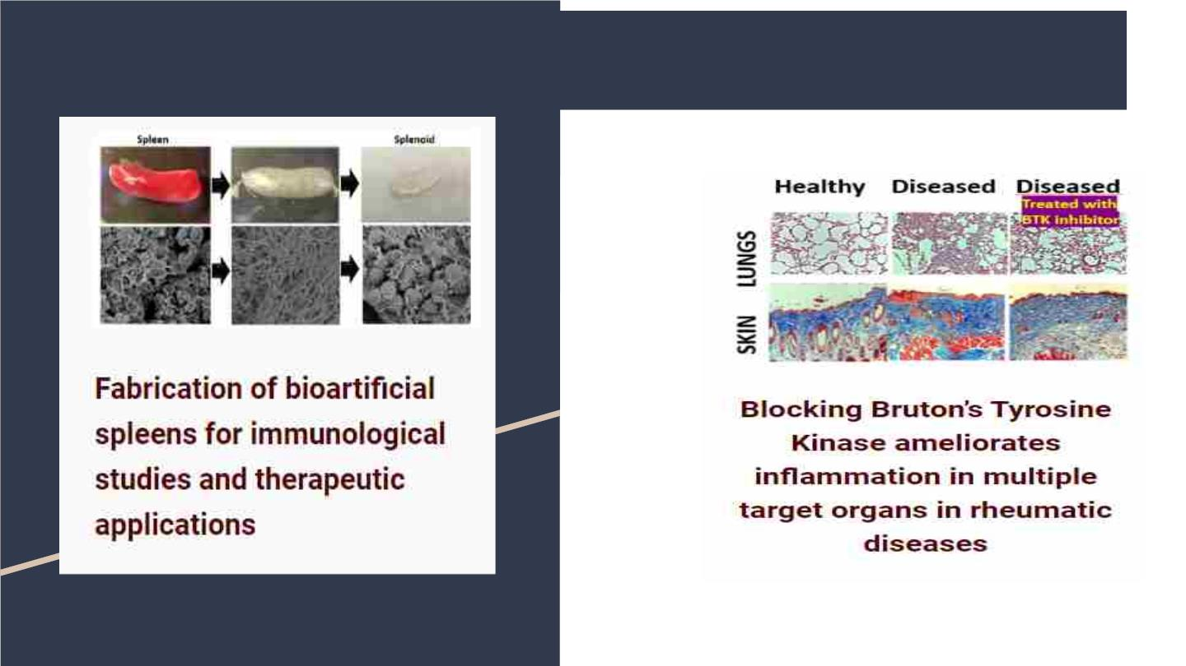
Projects- Novel Therapeutics
Lead: Srinandhini Chandran
Team Members: Thao Nguyen, Maliha Mir
Collaborator: Dr. Balan
Lead: Yanping Chen
Team Members: Phuongthy Tran, Yong Du

Slide 9

The technology:
Equipment
Procedures
- Single and Multi Channel Pipettes
- Automatic plate washer
- POC Cartridge material and
preparation
- Centrifuge & Vortex Machines
- Incubators & Microscopes
- Micro Plate Reader
- Prepare Buffers and Serial Dilutions
- Techniques For Extraction & Storage of
Biomolecules
- Point of Care (POC) Testing
- Cell Culture Techniques
- FACS Flow Cytometry Techniques
- Chromatographic Processes
- Spectroscopic Techniques
- Enzyme-linked Immunoassay (ELISA)
- many, many more…
- Mine RNAseq/proteomic data
- Big Data Analysis packages

Slide 10

Current List of Undergraduate Students
and their research
Hufsa Arain - research focus is on creating and optimizing an point-of-care diagnostic test: an in-house vertical flow assay which will be used for the detection of IL-6.
Amy Bui - research focus is assisting with the development of a protocol and to conduct testing on Mesenchymal Stem Cell treatments on breast cancer cells on different disease models. Amy
was awarded the Provost Undergraduate Research Scholarship (PURS) for Summer 2021.
Shanzeh Imran - research focuses on will focus on identifying novel serum proteins and autoantibodies for blood brain barrier breach in neuropsychiatric systemic lupus erythematosus using
proximity ligation assays. Shanzeh was awarded the Summer Undergraduate Research Fellowship (SURF) for Summer 2022.
Maryann Ivbievbiokun - research focus is on using imaging mass cytometry to identify when and where various proteins are expressed in kidney tissues and using the results to qualitatively
compare protein levels in both mild and severe cases of LN.
Christina Kuruvilla - research focus is on the synthesis and biomedical applications of 2D nanomaterials, specifically layered double hydroxides. She works in collaboration with Dr. Varghese’s
Physics Lab on exploring the efficiency of nanoparticles as an adjuvant for immunotherapy.
Maliha Mir - research focus is on exploring appropriate conditions for growth of immune cells and nvestigating the viability of splenocytes using splenoid culture and flow cytometry analysis.
Rani Nune - research focus is on ALCAM (CD166), a protein biomarker, and the mechanism by which it promotes the development of lupus nephritis. She also explores the molecular
mechanisms of BANK1, to determine how the gene promotes autoimmunity. Rani was awarded the Summer Undergraduate Research Fellowship (SURF) for Summer 2022.
Nhi Nguyen - currently working on immunohistochemistry to identify specific genes on specific tissues of the mouse’s kidney such as CD31 to compare the difference in tissue structure and
gene expression between the healthy mouse and the lupus mouse. Nhi was awarded the Provost Undergraduate Research Scholarship (PURS) for Summer 2021.
Maryam Obaid- Research focuses on identifying selective ligands using combinatorial assays
Kala Pham - research focus is on developing a high-throughput 3D glomerular platform that will help in identifying the key biomolecules and their relevant signaling pathways involved in the
disease pathogenesis of multiple renal diseases. Kala was awarded the Summer Undergraduate Research Scholarship for Summer 2021.
Navriti Sabhnani - her primary focus will be on learning protocols and procedures involving 3D cell cultures and to gain familiarity of flow cytometry and reporting.
Michelle (Nga) Thai - research focuses on developing and optimizing a point-of-care diagnostic test: a Schimer strip-coupled vertical flow essay (VFA) that will be used to detect MMP-9 levels
in tears of Dry Eye disease patients to diagnose and quantify disease severity. Michelle was awarded the Summer Undergraduate Research Fellowship (SURF) for Summer 2022.
Phunongthy T. Tran - literature review of the top ten themes of systemic lupus erythematosus with a focus on environmental and genetic factors. She is also helping to develop a lupus
tracking app that can be used in future clinical research. Phuongthy was awarded the Summer Undergraduate Research Fellowship (SURF) for Summer 2020.

Slide 11
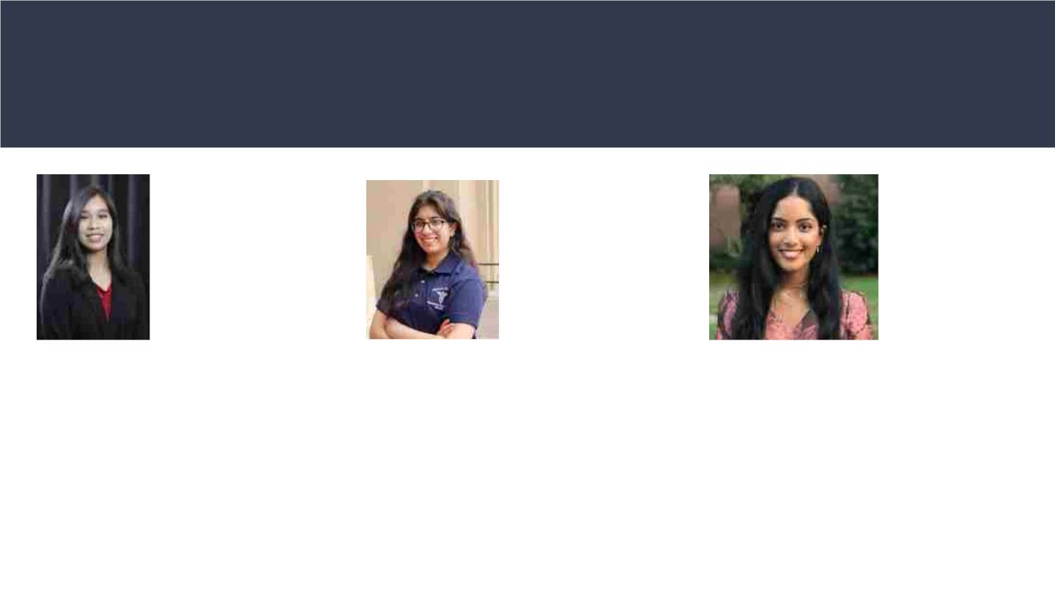
Recent Recipients of the SURF scholarship
Michelle (Nga)
Thai
Shanzeh
Imran
Rani Nune
Undergra
duate
Researcher
Undergraduate
Researcher
Undergraduate
Researcher
Her research focuses on developing
and optimizing a point-of-care
diagnostic test: a Schimer strip-
coupled vertical flow essay (VFA) that
will be used to detect MMP-9 levels in
tears of Dry Eye disease patients in
order to diagnose and quantify
disease severity.
Her research focuses on will focus on
identifying novel serum proteins and
autoantibodies for blood brain barrier
breach in neuropsychiatric systemic
lupus erythematosus using proximity
ligation assays, validating top hits using
ELISA assays and researching the
biology of the top hits.
Her research focus is on ALCAM (CD166),
a protein biomarker, and the mechanism
by which it promotes the development of
lupus nephritis. She also explores the
molecular mechanisms of BANK1, the
disease gene for SLE, to determine how
the gene promotes autoimmunity.

Slide 12

Openings for
Undergraduate Research
Positions
How to Join
Volunteer positions are available to UH
undergraduates interested in participating in
medically-oriented research.
Good academic standing
Interest in pursuing medical or
graduate studies
No research experience is required as the
necessary skills will be taught.
Devote two or more semester to
research work
Ability to balance ongoing coursework and
laboratory research is critical.
Forward resume (w/GPA) &
brief description of your
research interests to
Undergraduate students are strongly
encouraged to apply for SURF and PURS
funding.
cmohan@central.uh.edu

