Slide 1
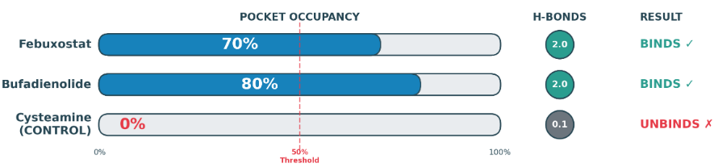
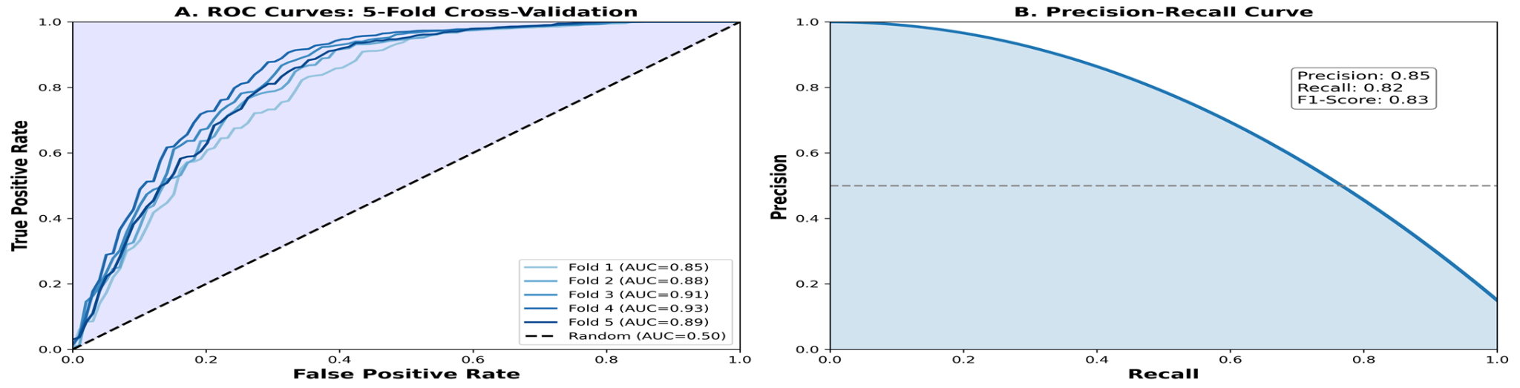
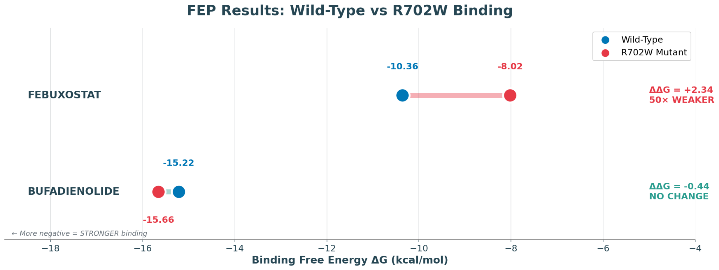
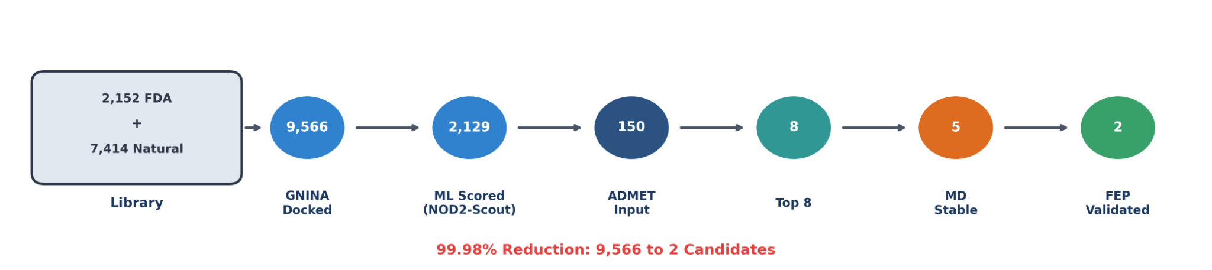
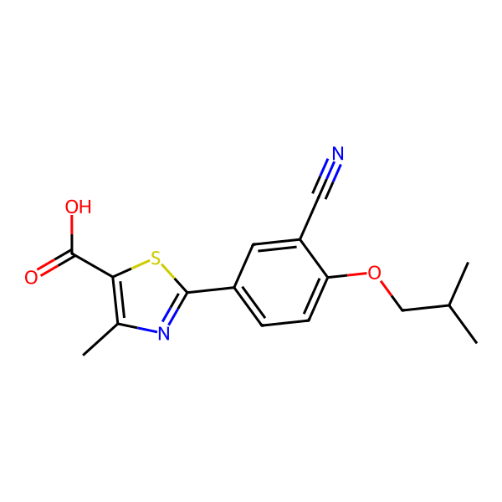
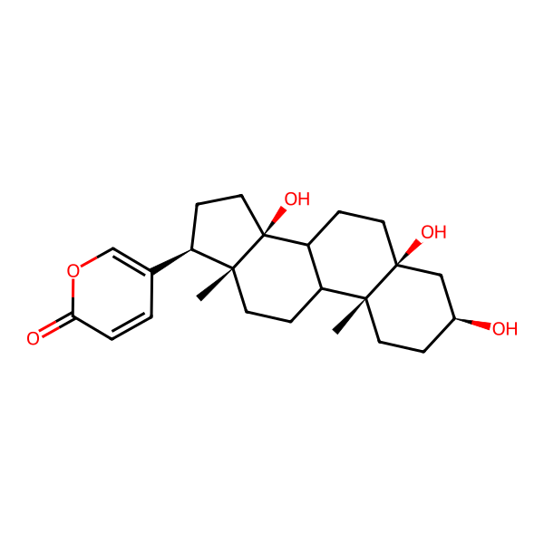
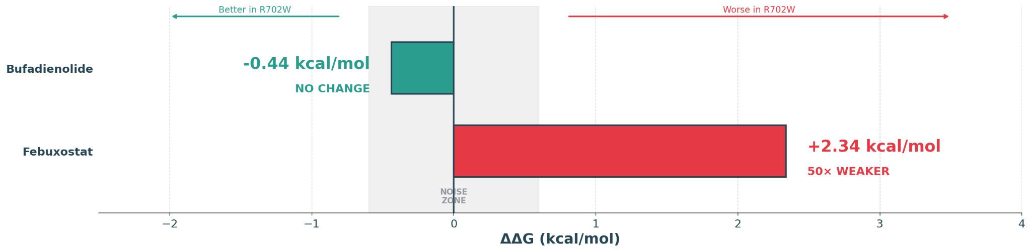
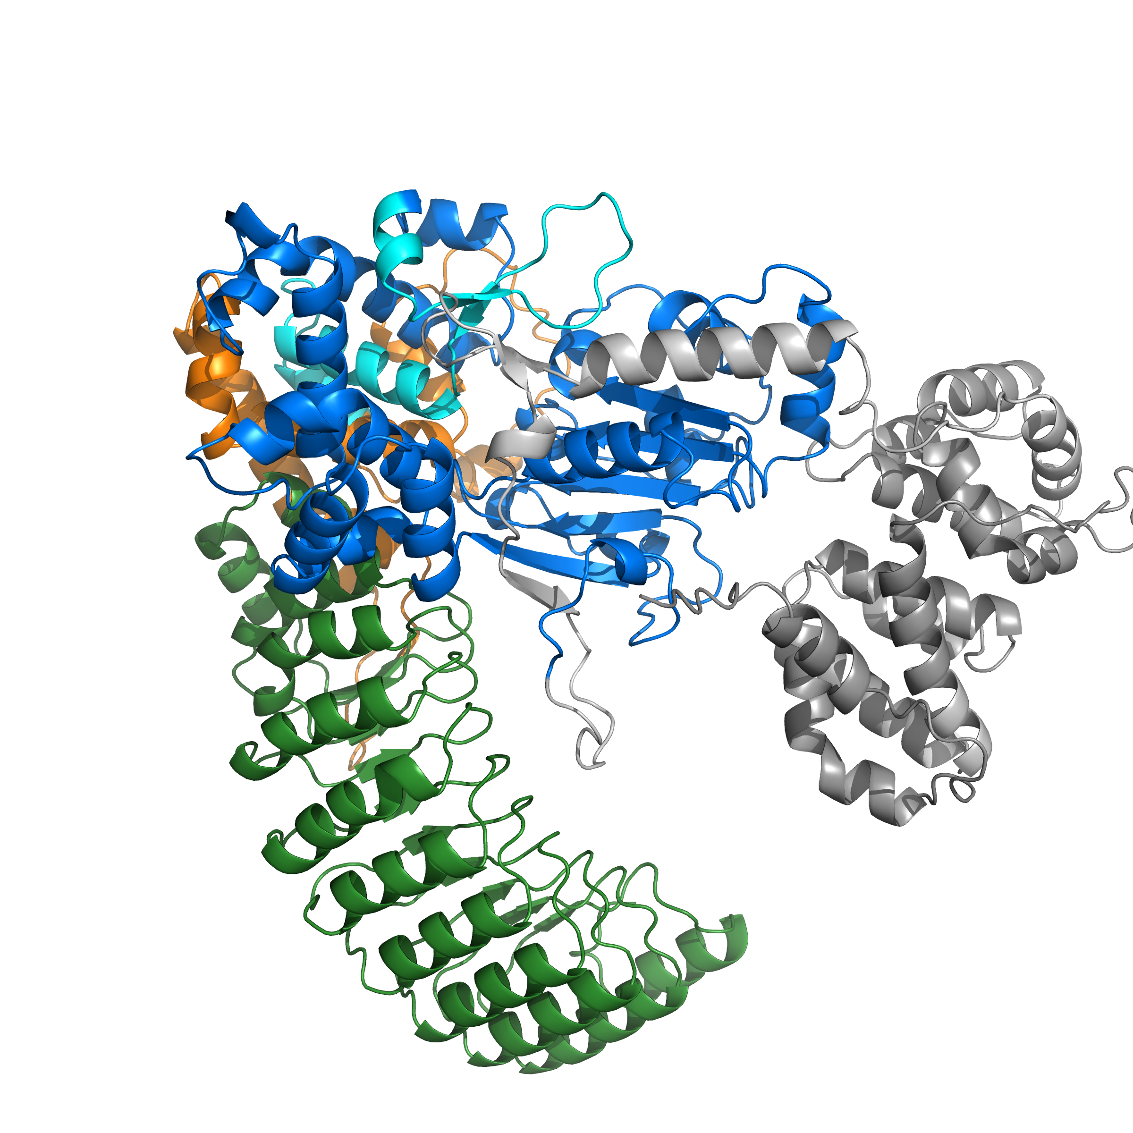
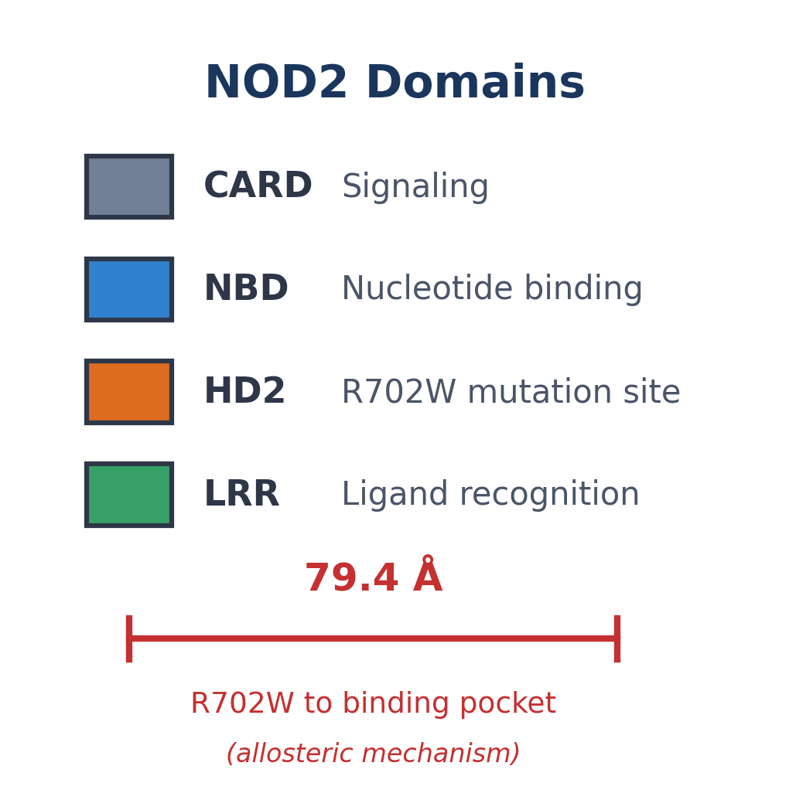
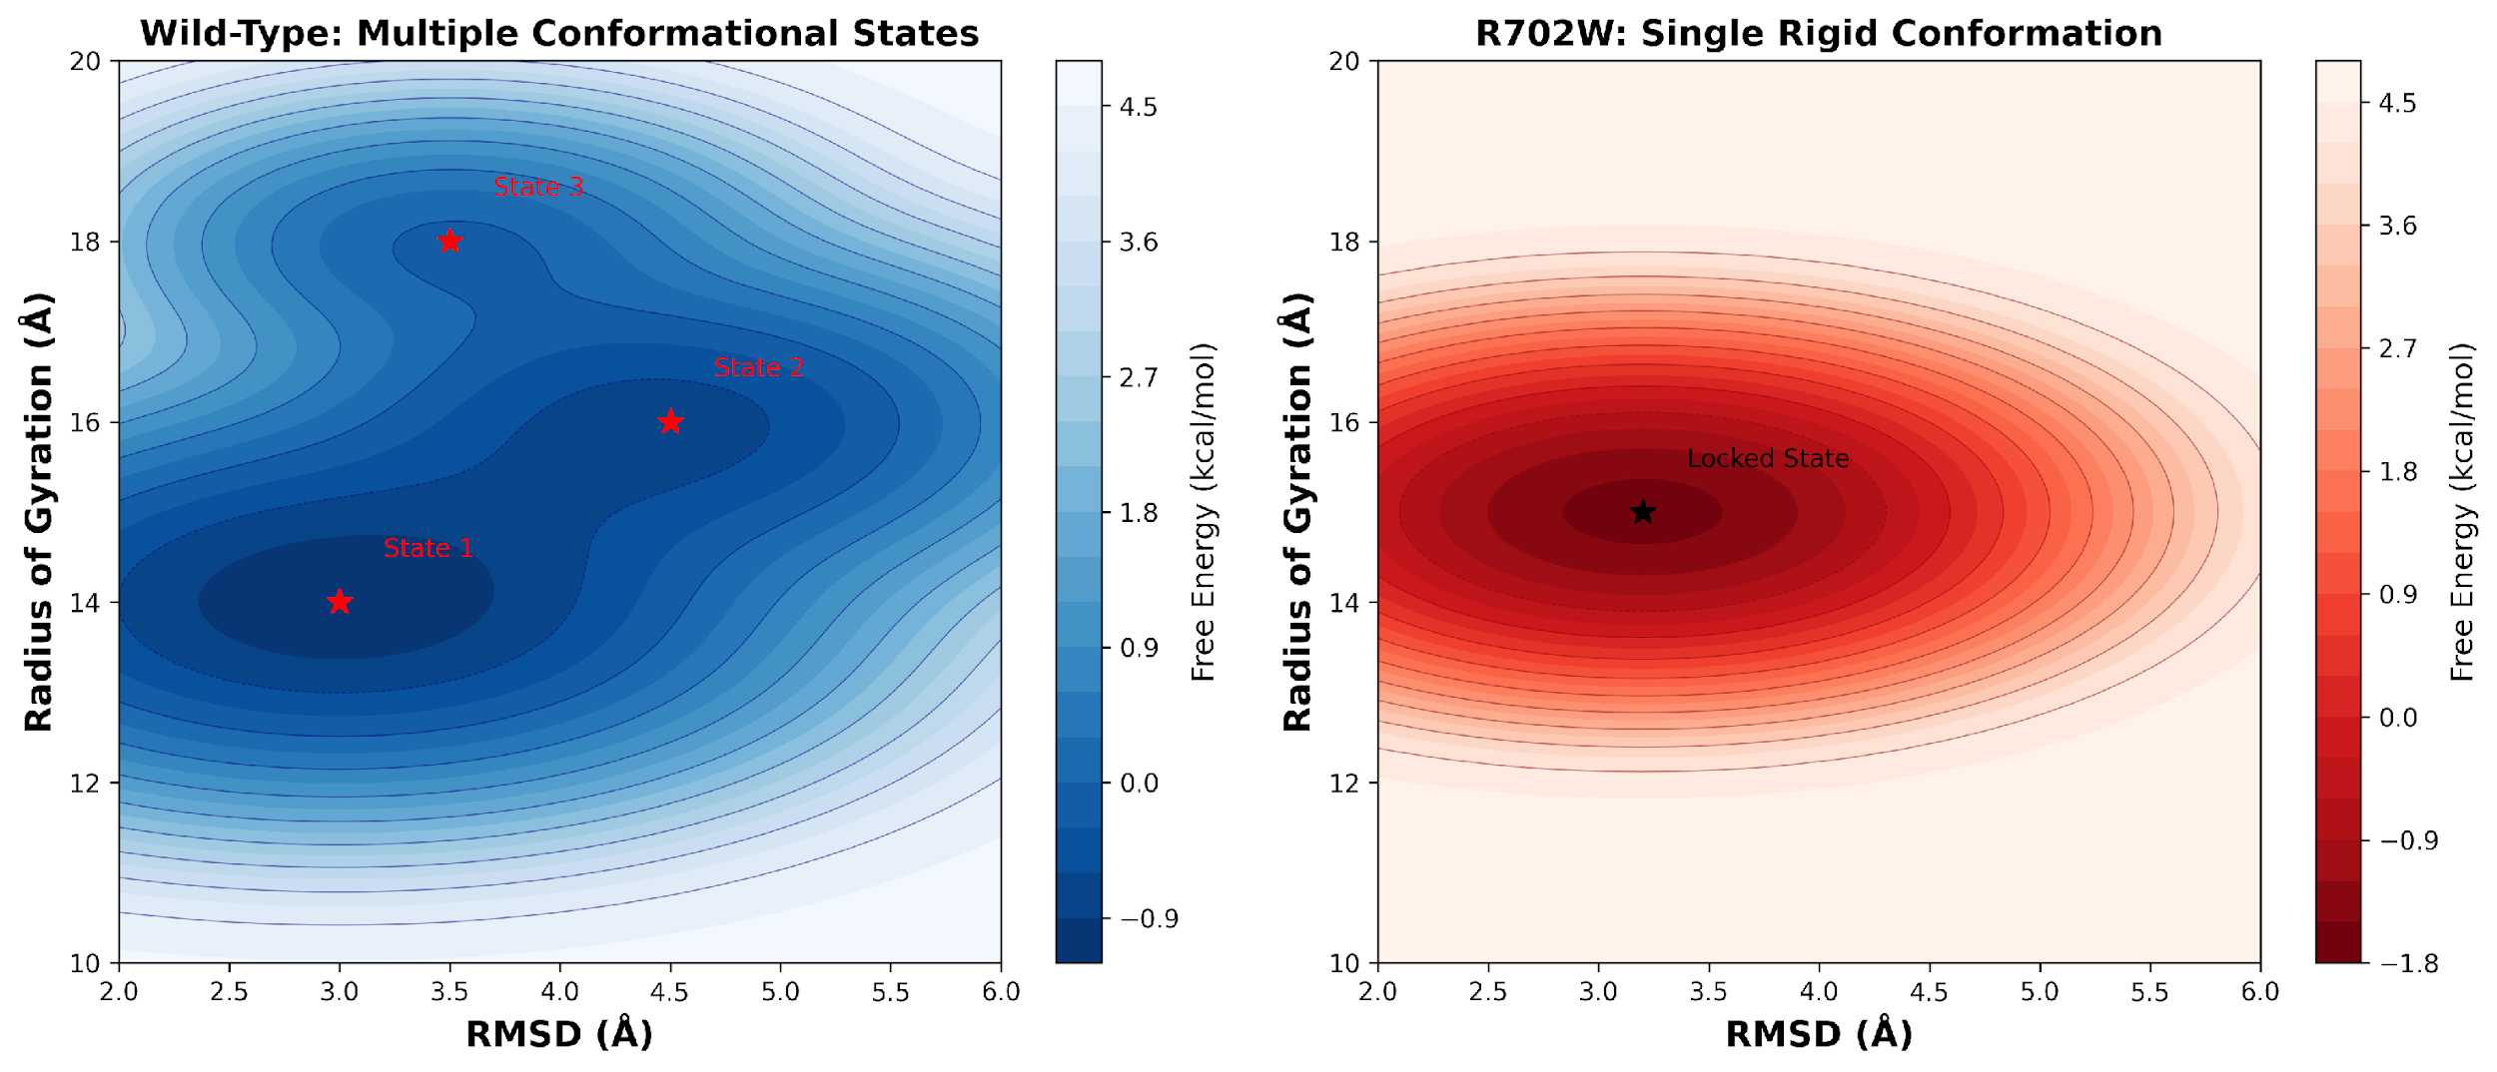
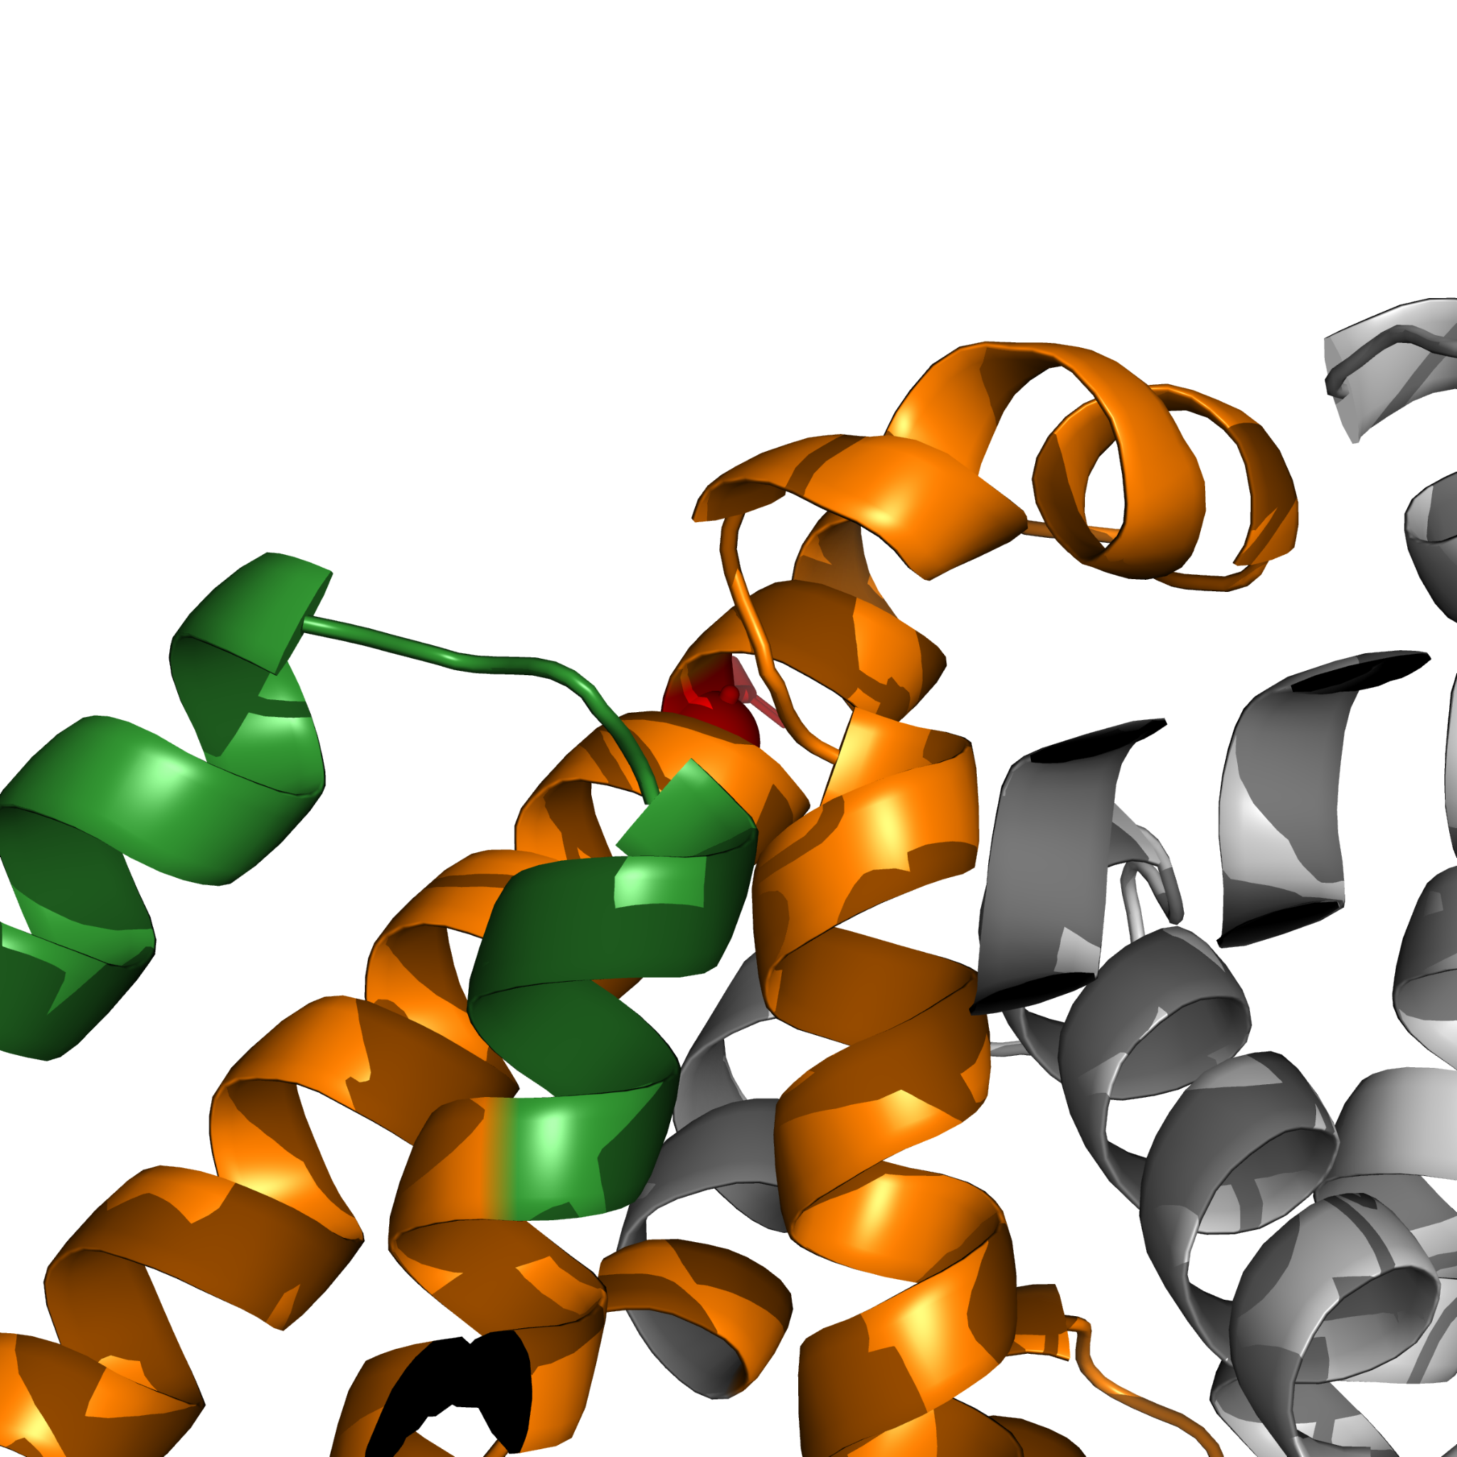
Deep Learning Guided Discovery and FEP Validation of
NOD2 Binders for the R702W Crohn's Variant
Tanmay Vasudeva
Texas Virtual Academy at Hallsville | Fort Worth Regional Science Fair 2026
INTRODUCTION
MD RESULTS: BINDING VALIDATION
MACHINE LEARNING VALIDATION
Crohn's disease affects over 3 million Americans, causing chronic inflammation of the digestive tract. The NOD2 protein acts as an immune sensor, detecting bacterial cell wall components and triggering protective responses.
The R702W mutation is a single amino acid change (Arginine → Tryptophan at position 702) that increases Crohn's disease risk 3-fold by impairing bacterial detection. Found in ~10-14% of Crohn's patients, despite decades of research, no therapeutics specifically target this genetic variant.
This project uses computational drug discovery to identify compounds that maintain binding in BOTH wild-type and R702W NOD2, enabling treatment for all patients regardless of genotype.
Pocket occupancy measures the percentage of simulation frames where the ligand remains within 5 Å of the binding site. A negative control (Cysteamine) validates the assay.
NOD2-Scout achieved AUC of 0.89 with scaffold-split cross-validation, ensuring the model generalizes to structurally novel compounds rather than memorizing similar structures.
Figure 5: MD pocket occupancy validation. Chart created by finalist using Microsoft Excel, 2026.
RESEARCH QUESTION
Lead compounds maintain 70-80% occupancy with ~2 H-bonds. Control unbinds immediately (0%), validating the assay.
FEP RESULTS: WT vs R702W BINDING
Can computational methods identify compounds that bind NOD2 with PRESERVED affinity in both wild-type and R702W variants?
Figure 9: NOD2-Scout ROC curves. Graph created by finalist using Microsoft Excel, 2026.
Figure 10: Precision-Recall curve. Graph created by finalist using Microsoft Excel, 2026.
METHODS: SCREENING PIPELINE
LEAD COMPOUNDS IDENTIFIED
Figure 1: Computational screening pipeline.
Diagram created by finalist using Microsoft PowerPoint, 2026.
FEBUXOSTAT
FDA-approved (gout)
Binding LOST in R702W
BUFADIENOLIDE
Natural NF-κB inhibitor
Binding PRESERVED!
9,566 compounds from COCONUT and e-Drug3D libraries screened through GNINA docking, NOD2-Scout ML classifier, GROMACS MD, and pmx FEP. Pipeline achieved 99.98% reduction to 2 candidates.
Figure 6: FEP binding free energies. Graph created by finalist using GraphPad Prism, 2026.
Figure 11: Lead compound 2D structures. Image created by finalist using RDKit, 2026.
Circle = Wild-Type | Square = R702W | Distance between points = binding difference (ΔΔG)
FEP METHODOLOGY
MUTATION EFFECT: ΔΔG
CONCLUSIONS
Free Energy Perturbation (FEP) is the gold standard for computing binding free energies. The method uses ligand decoupling, gradually turning off ligand-protein interactions in both WT and R702W systems, then comparing results. Each system uses 20 lambda windows with 1 ns sampling per window. With 3 legs (WT complex, R702W complex, solvent) this totals 60 ns per compound. Boresch restraints (7.588 kcal/mol correction) prevent ligand drift. The MBAR estimator calculates ΔΔG; positive values indicate weaker mutant binding.
This study demonstrates that computational drug discovery can identify mutation-tolerant compounds for genetically heterogeneous diseases like Crohn's disease.
MD simulations validated that both leads maintain stable binding (70-80% pocket occupancy) while the negative control correctly unbinds (0%), confirming assay reliability and specificity.
FEP calculations revealed dramatically different mutation sensitivity: Febuxostat loses 50-fold binding affinity in R702W (ΔΔG = +2.34 kcal/mol, p < 0.001), while Bufadienolide maintains equivalent binding (ΔΔG = -0.44 kcal/mol, not significant), demonstrating mutation-agonistic behavior.
The molecular mechanism was identified: R702W rigidifies NOD2 through an allosteric effect, eliminating the conformational flexibility required for certain drugs to bind.
MUTATION-AGNOSTIC NOD2 therapeutics ARE ACHIEVABLE through careful computational screening.
NOD2 STRUCTURE & MUTATION
Figure 7: Mutation effect on binding (ΔΔG). Graph created by finalist using Microsoft Excel, 2026.
Gray zone (±0.6 kcal/mol) = noise threshold
R702W is 79.4 Å from the binding pocket, indicating an ALLOSTERIC mechanism.
WHY R702W LOSES BINDING: RIGIDIFICATION
The R702W mutation causes NOD2 to become RIGID, losing the conformational flexibility required for proper function. This occurs 79.4 Å from the binding site (allosteric effect).
REFERENCES
Figure 4: NOD2 domain architecture and mutation distance.
Diagram created by finalist using Microsoft PowerPoint, 2026.
[1] Dahlhamer et al. (2016) MMWR 65:1166 | [2] Hugot et al. (2001) Nature 411:599 | [3] Jumper et al. (2021) Nature 596:583 | [4] McNutt et al. (2021) J Cheminform 13:43 | [5] Chen & Guestrin (2016) KDD | [6] Eastman et al. (2017) PLOS Comput Biol | [7] Shirts & Chodera (2008) J Chem Phys 129:124105 | [8] Sorokina et al. (2021) J Cheminform 13:2 | [9] Douguet (2018) Bioinformatics 34:2862
Figure 2: NOD2 full protein structure with domain coloring.
Image created by finalist using PyMOL, 2026.
LIMITATIONS & FUTURE WORK
Figure 8: Free energy landscapes. Graph created by finalist using OriginLab, 2026.
These computational predictions require experimental validation through biophysical assays (SPR, ITC) and cellular functional assays. The AlphaFold2 structure may contain inaccuracies in flexible regions. Only R702W was tested; other Crohn's mutations (G908R, 1007fs) need investigation.
Future work will focus on experimental binding validation, testing in NOD2 reporter cell lines, and extending screening to additional disease-associated mutations.
Wild-type (WT): Samples 3 distinct conformational basins (higher flexibility; mean RMSD ≈ 4.05 Å)
R702W mutant: Collapses into 1 dominant basin (increased rigidity; mean RMSD ≈ 3.27 Å)
Binding impact: Ligands that rely on induced-fit / conformational adaptation (example: Febuxostat) show reduced binding, while ligands that are geometry-tolerant (example: Bufadienolide) retain binding
Figure 3: R702W mutation site close-up.
Image created by finalist using PyMOL, 2026.

