Slide 1
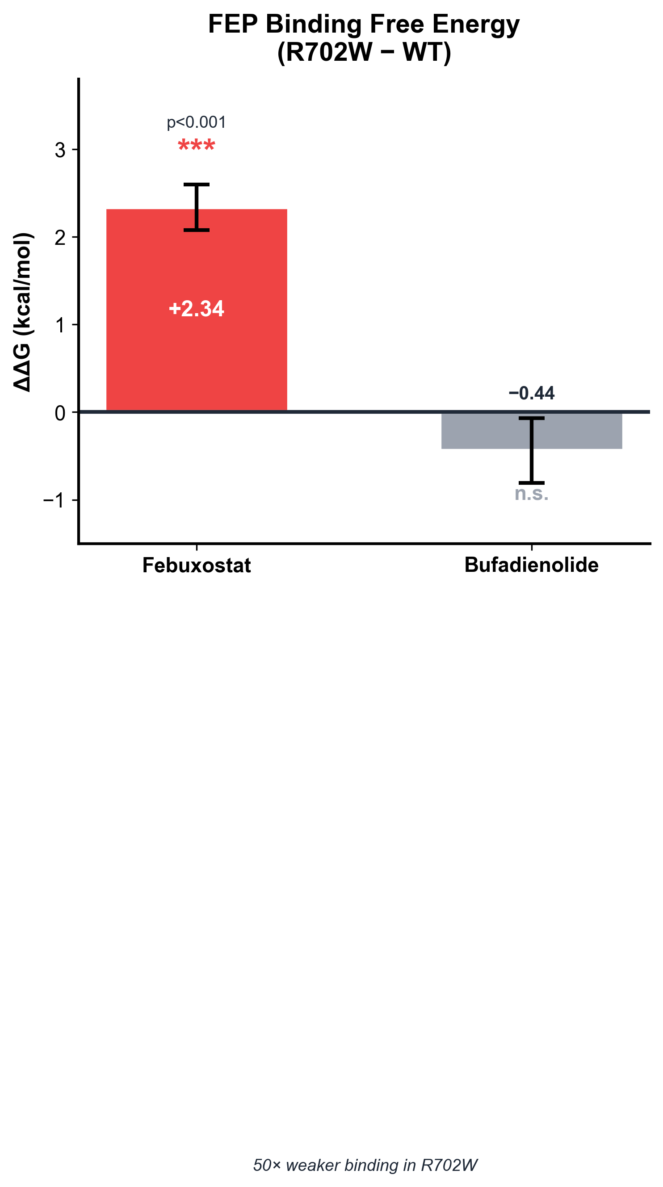
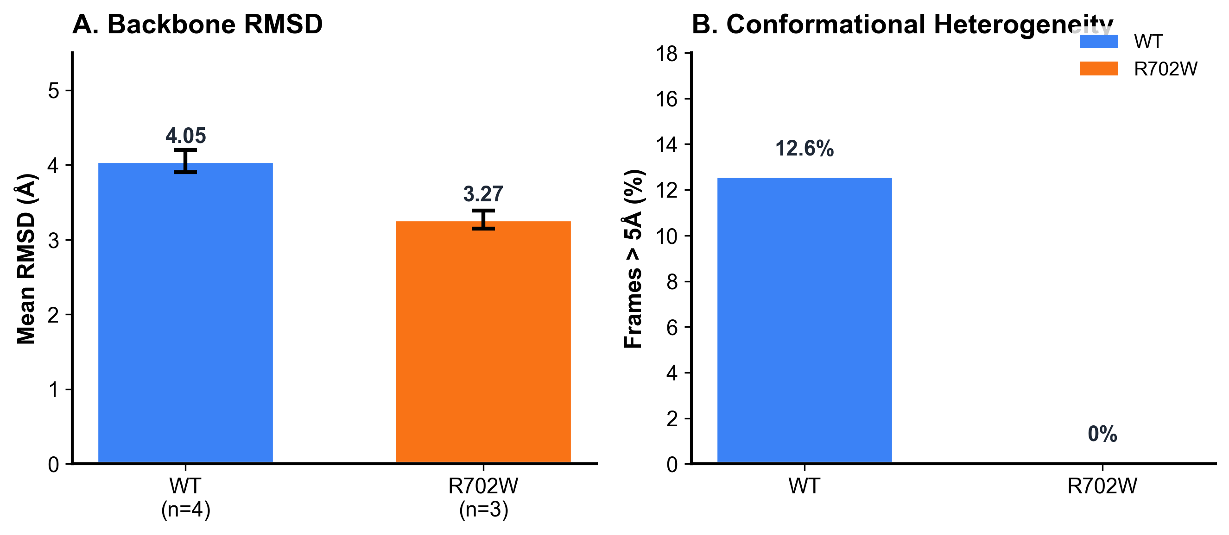
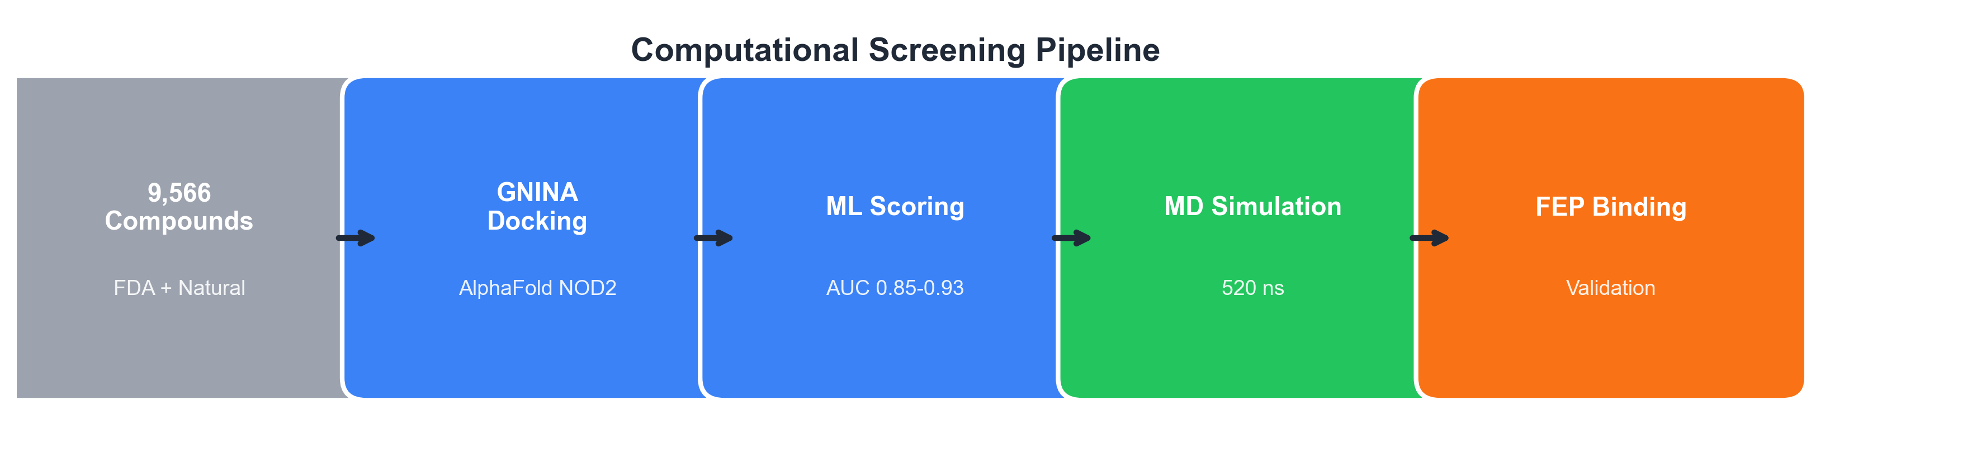
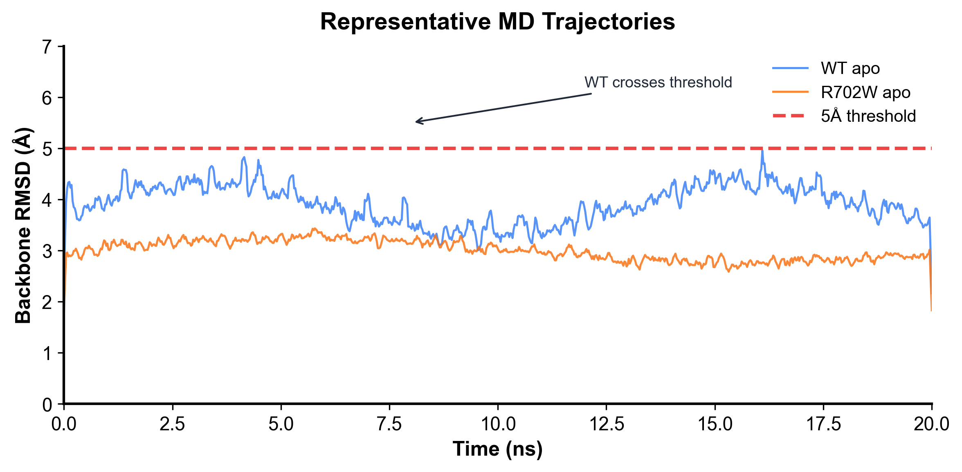
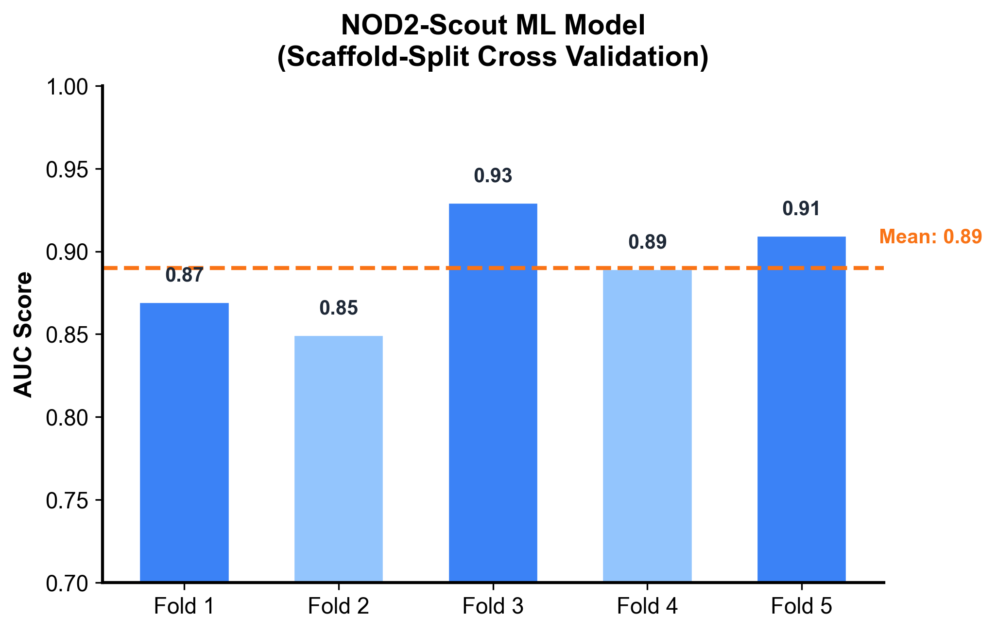
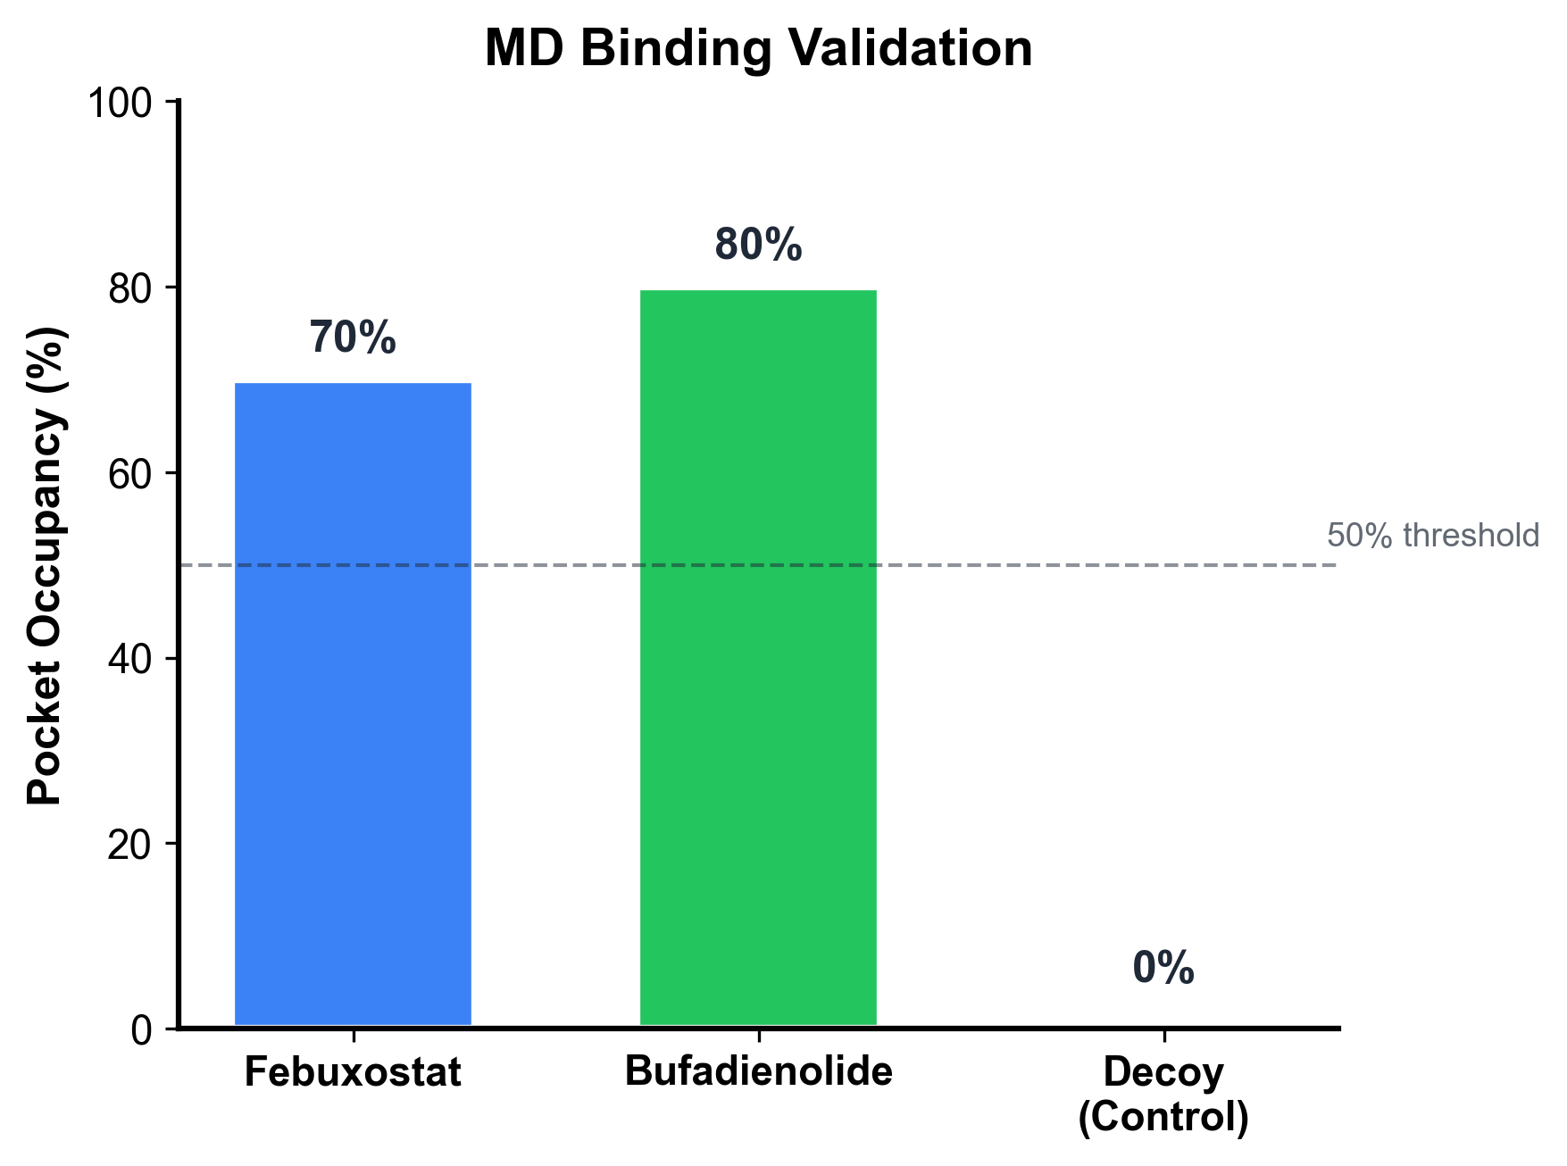
Deep Learning Guided Discovery and FEP Validation of NOD2 Binders for the R702W Crohn's Variant
Tanmay Vasudeva
Texas Virtual Academy at Hallsville
I built a screening pipeline for NOD2 binders and used FEP to quantify how the R702W variant changes binding for specific ligands, with apo MD providing supporting context.
Introduction
FEP Binding Free Energy (Key Result)
Apo MD Dynamics (Supporting Context)
• NOD2 mutations cause 15-25% of Crohn's disease cases
• R702W is the most common mutation (~10% of patients)
• Hypothesis: Test mutation effects at molecular level with MD and FEP
Computational Pipeline
FEP Results (Gold Standard):
• Febuxostat: ΔΔG = +2.34 kcal/mol
→ 50× weaker binding in R702W (p<0.001)
• Bufadienolide: ΔΔG = -0.44 kcal/mol
→ No significant change (n.s.)
Key Finding: Ligand-dependent binding differences between WT and R702W
• WT: 12.6% frames exceed 5Å RMSD threshold
• R702W: 0% frames exceed threshold
• R702W shows reduced conformational sampling
• Consistent with mutation-sensitive binding in FEP
• 9,566 compounds screened (FDA + natural products)
• GNINA CNN-based docking on AlphaFold NOD2 LRR
• NOD2-Scout ML model (AUC 0.85-0.93, scaffold-split CV)
• 520 ns total MD simulation (OpenMM, AMBER14)
• FEP binding validation (gold standard thermodynamics)
MD Binding Validation
Conclusions
Limitations
Future Work
1. Built deep learning pipeline screening 9,566 compounds against NOD2 LRR domain
2. FEP quantifies mutation-sensitive binding:
• Febuxostat: ΔΔG = +2.34 kcal/mol (50× weaker in R702W, p<0.001)
• Bufadienolide: ΔΔG = -0.44 kcal/mol (no significant change)
3. Apo MD shows reduced conformational sampling in R702W vs WT (0% vs 12.6% frames >5Å)
4. Identified key binding residues: GLU1008, ARG1037, ASP1011
• FEP performed on 2 ligands only
• Apo MD simulations only
• Computational predictions require
experimental validation
• SPR/ITC experimental validation
• Test additional mutations
(G908R, L1007fs)
• HDX-MS experiments
Generated with Claude Code | ISEF 2026

