Slide 1
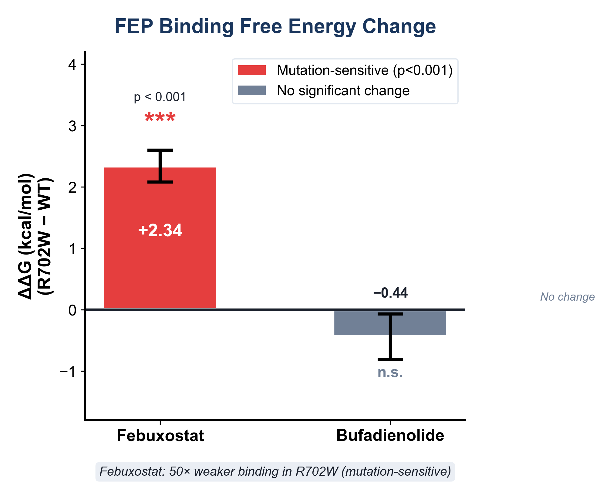
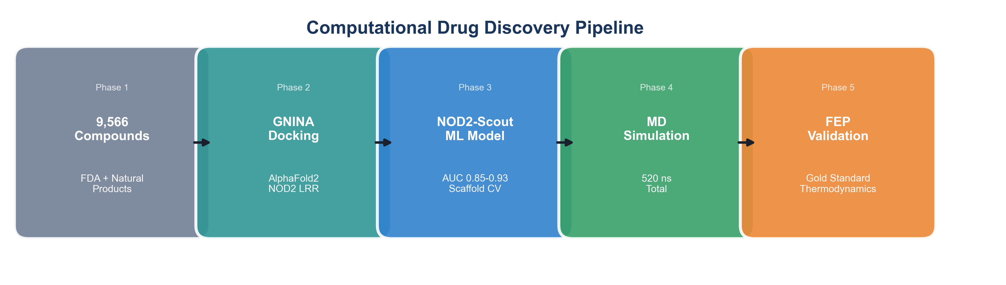
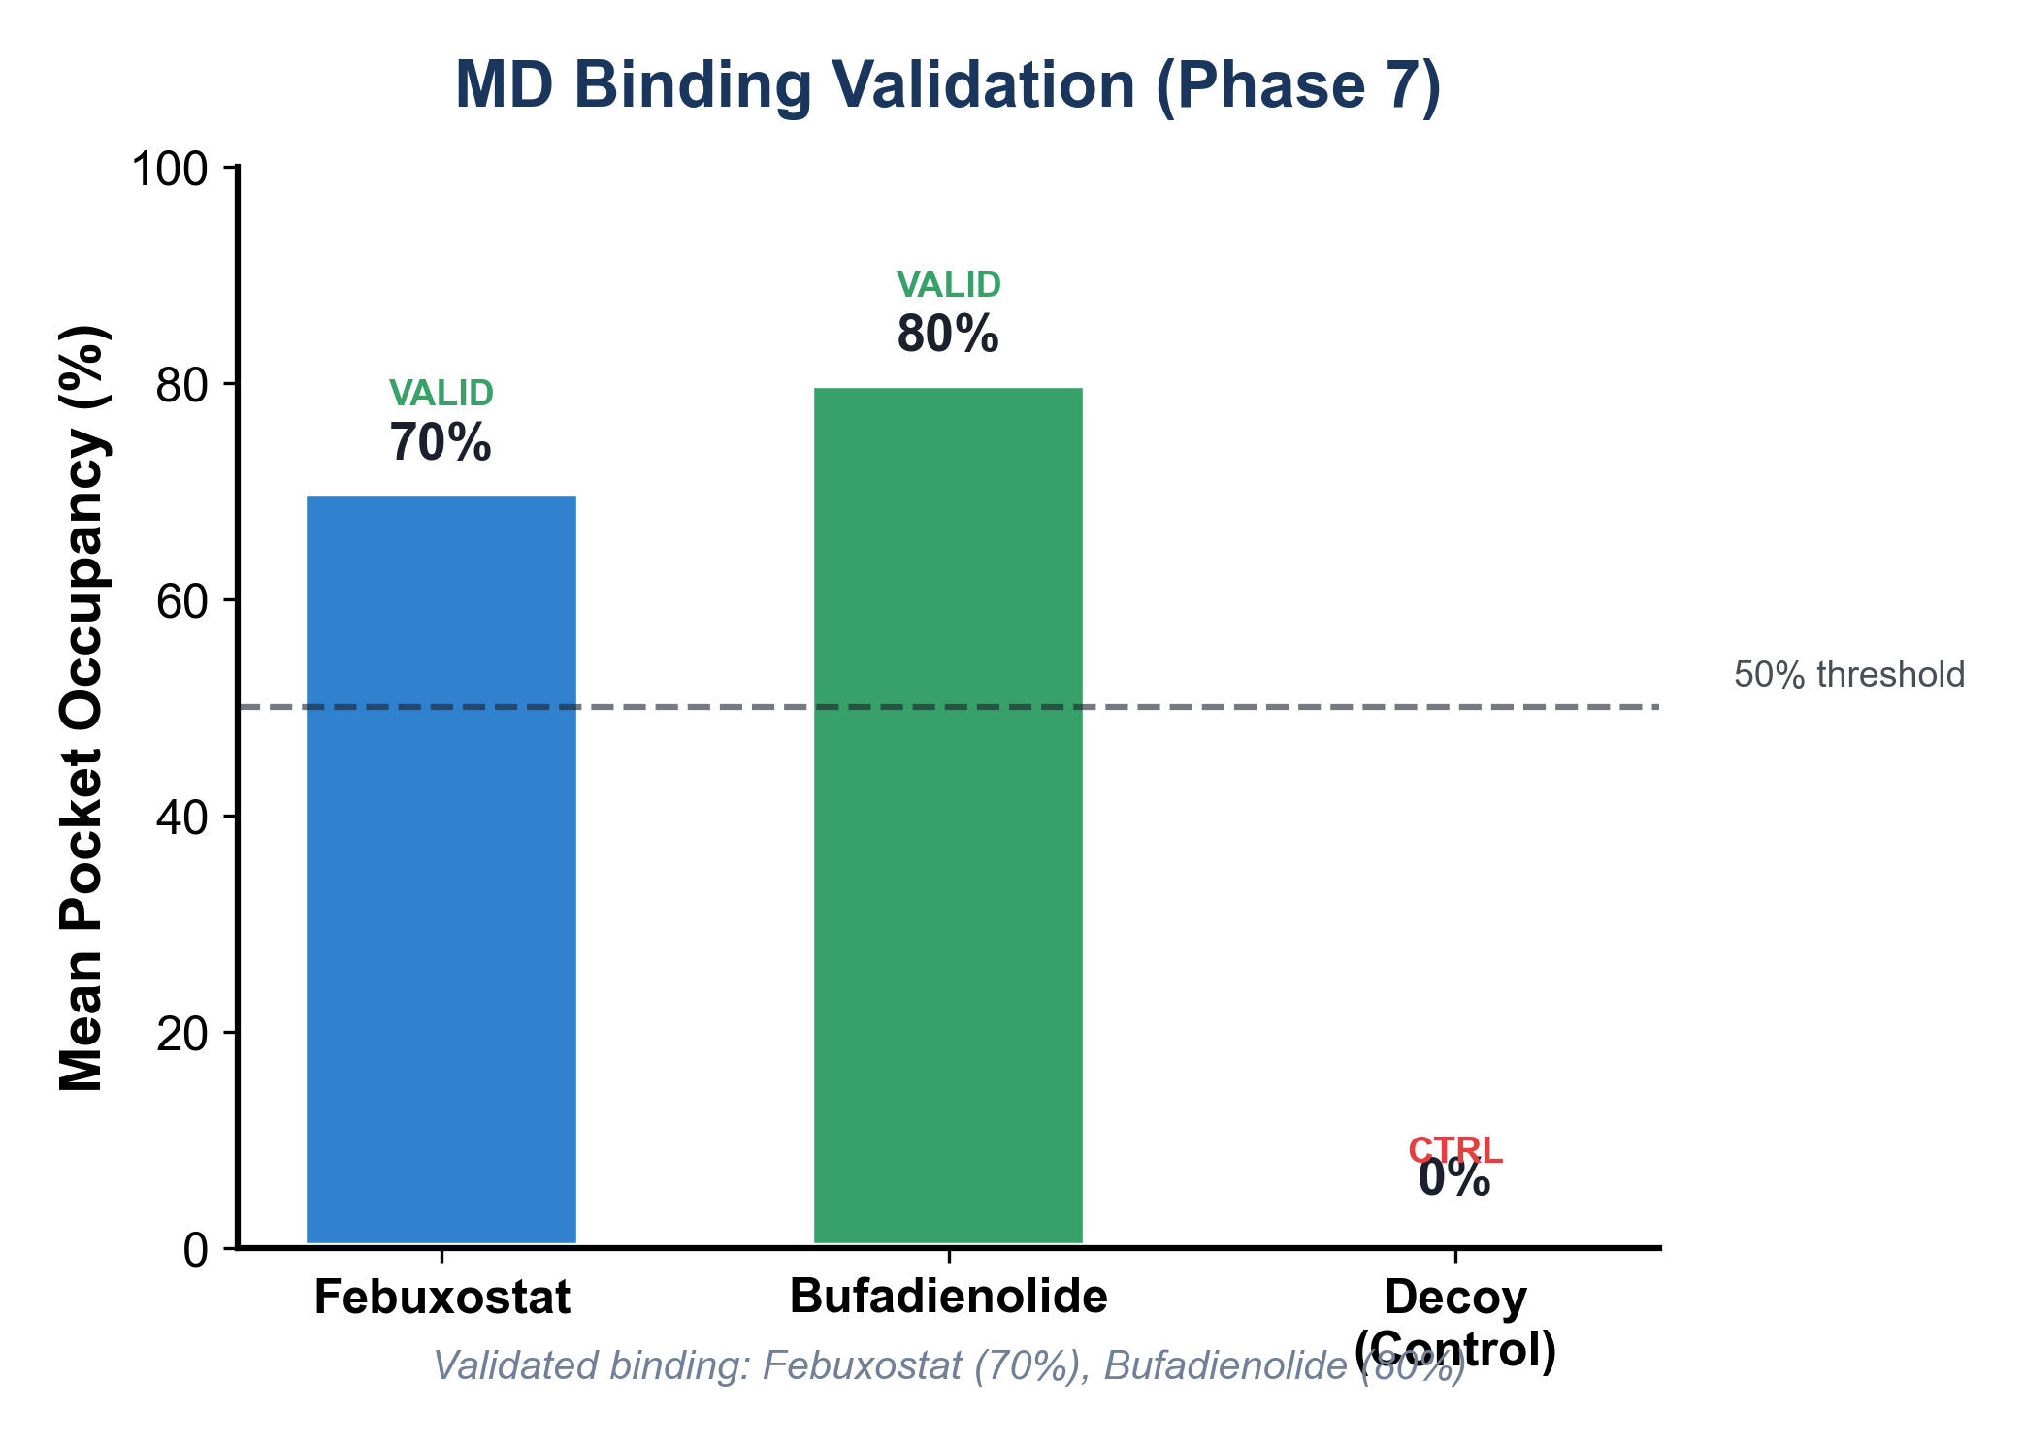
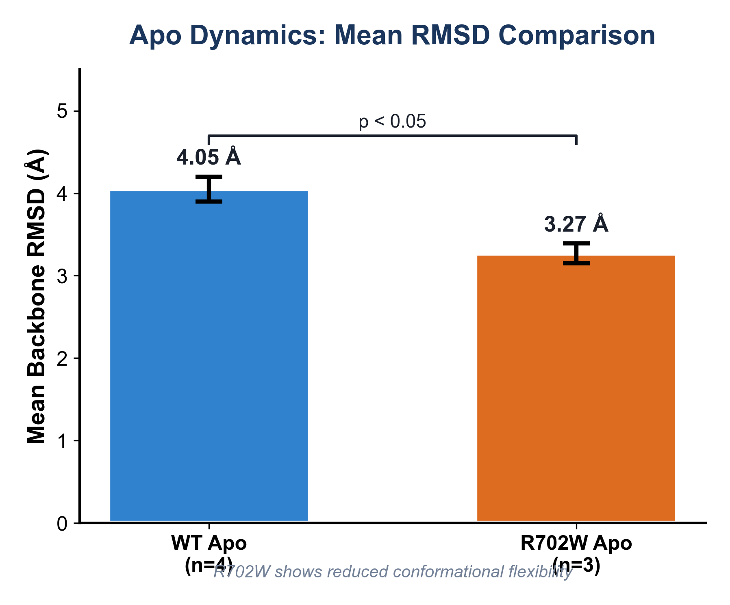
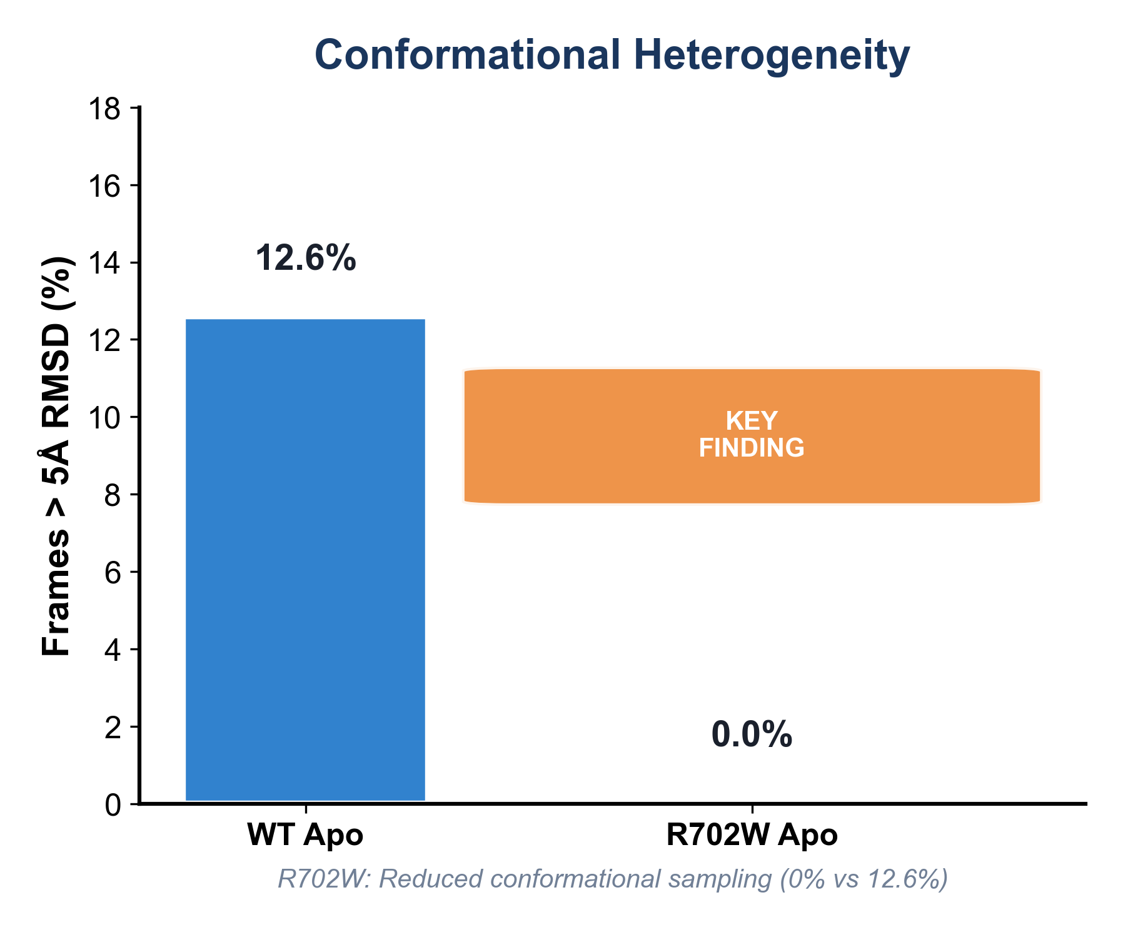
Deep Learning Guided Discovery and FEP Validation of NOD2 Binders for the R702W Crohn's Variant
Tanmay Vasudeva • Texas Virtual Academy at Hallsville • ISEF 2026
I built a screening pipeline for NOD2 binders and used FEP to quantify how the R702W variant changes binding for specific ligands, with apo MD providing supporting context.
1
FEP: Febuxostat Mutation-Sensitive
2
FEP: Bufadienolide No Change
3
Apo MD: Reduced R702W Sampling
ΔΔG = +2.34 kcal/mol, 50× weaker (p<0.001)
ΔΔG = -0.44 kcal/mol (NS)
WT: 12.6% vs R702W: 0% frames >5Å
Introduction
FEP Binding Results (Gold Standard)
NOD2 Structure & Binding Site
• NOD2 mutations cause 15-25% of Crohn's disease
• R702W is the most common mutation (~10% of patients)
• Literature describes R702W as "destabilizing" NOD2
• Hypothesis: Test binding differences at molecular level
[Insert PyMOL structure images here] • Run pathway_diagram_10K.pml in PyMOL • Insert img1-img6 from pathway_diagram folder Domain colors: • Gray: CARD domains • Blue: NBD • Cyan: HD1 • Orange: HD2 (R702W location) • Green: LRR (binding domain)
Methods
FEP Quantitative Results
MD Binding Validation
• 9,566 compounds (2,152 FDA + 7,414 natural products)
• GNINA CNN-docking on AlphaFold2 NOD2 LRR
• NOD2-Scout ML: AUC 0.85-0.93 (scaffold-split CV)
• MD: OpenMM, AMBER14 + OpenFF 2.1.0, 520 ns total
• FEP: Gold-standard thermodynamic binding validation
Compound ΔG(WT) ΔG(R702W) ΔΔG Significance
━━━━━━━━━━━━━━━━━━━━━━━━━━━━━━━━━━━━━━━━━━━━━━━━━━━━━━━━━━━━━━━━━━
Febuxostat -10.36 -8.02 +2.34 kcal/mol *** (8σ)
Bufadienolide -15.22 -15.66 -0.44 kcal/mol NS (1.8σ)
Key: *** = p<0.001 (highly significant), NS = not significant
Apo MD: Supporting Context
Conclusions
Limitations
Future Work
1. Built deep learning pipeline screening 9,566 compounds against NOD2 LRR
2. FEP quantifies mutation-sensitive binding:
• Febuxostat: ΔΔG = +2.34 kcal/mol (50× weaker in R702W, p<0.001)
• Bufadienolide: ΔΔG = -0.44 kcal/mol (no significant change)
3. Apo MD shows reduced conformational sampling in R702W (0% vs 12.6% >5Å)
4. Identified key binding residues: GLU1008, ARG1037, ASP1011
• FEP on 2 ligands only (compute-intensive)
• Apo MD only (no drug comparisons)
• Computational predictions require
experimental validation
• Bufadienolide statistical significance
not reached (1.8σ)
• Experimental validation: SPR, ITC binding assays
• Test additional NOD2 mutations (G908R, L1007fs)
• HDX-MS conformational dynamics studies
• Cell-based NF-κB reporter assays
• Analog screening for improved drug-likeness
Acknowledgments: TACC Frontera allocation, AlphaFold2 structure (UniProt Q9HC29), OpenMM/AMBER14 force fields
GitHub Repository

