Slide 1
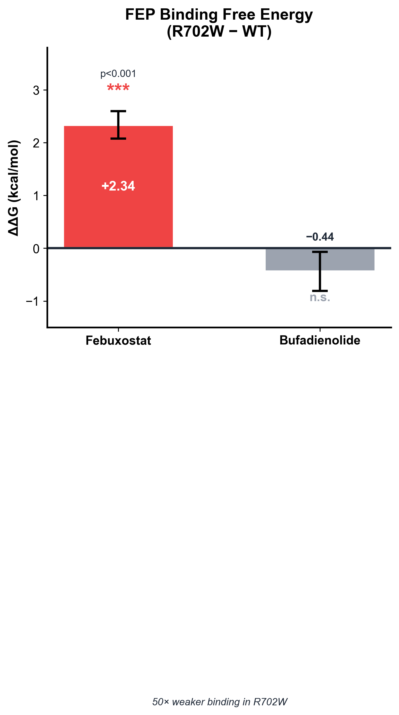
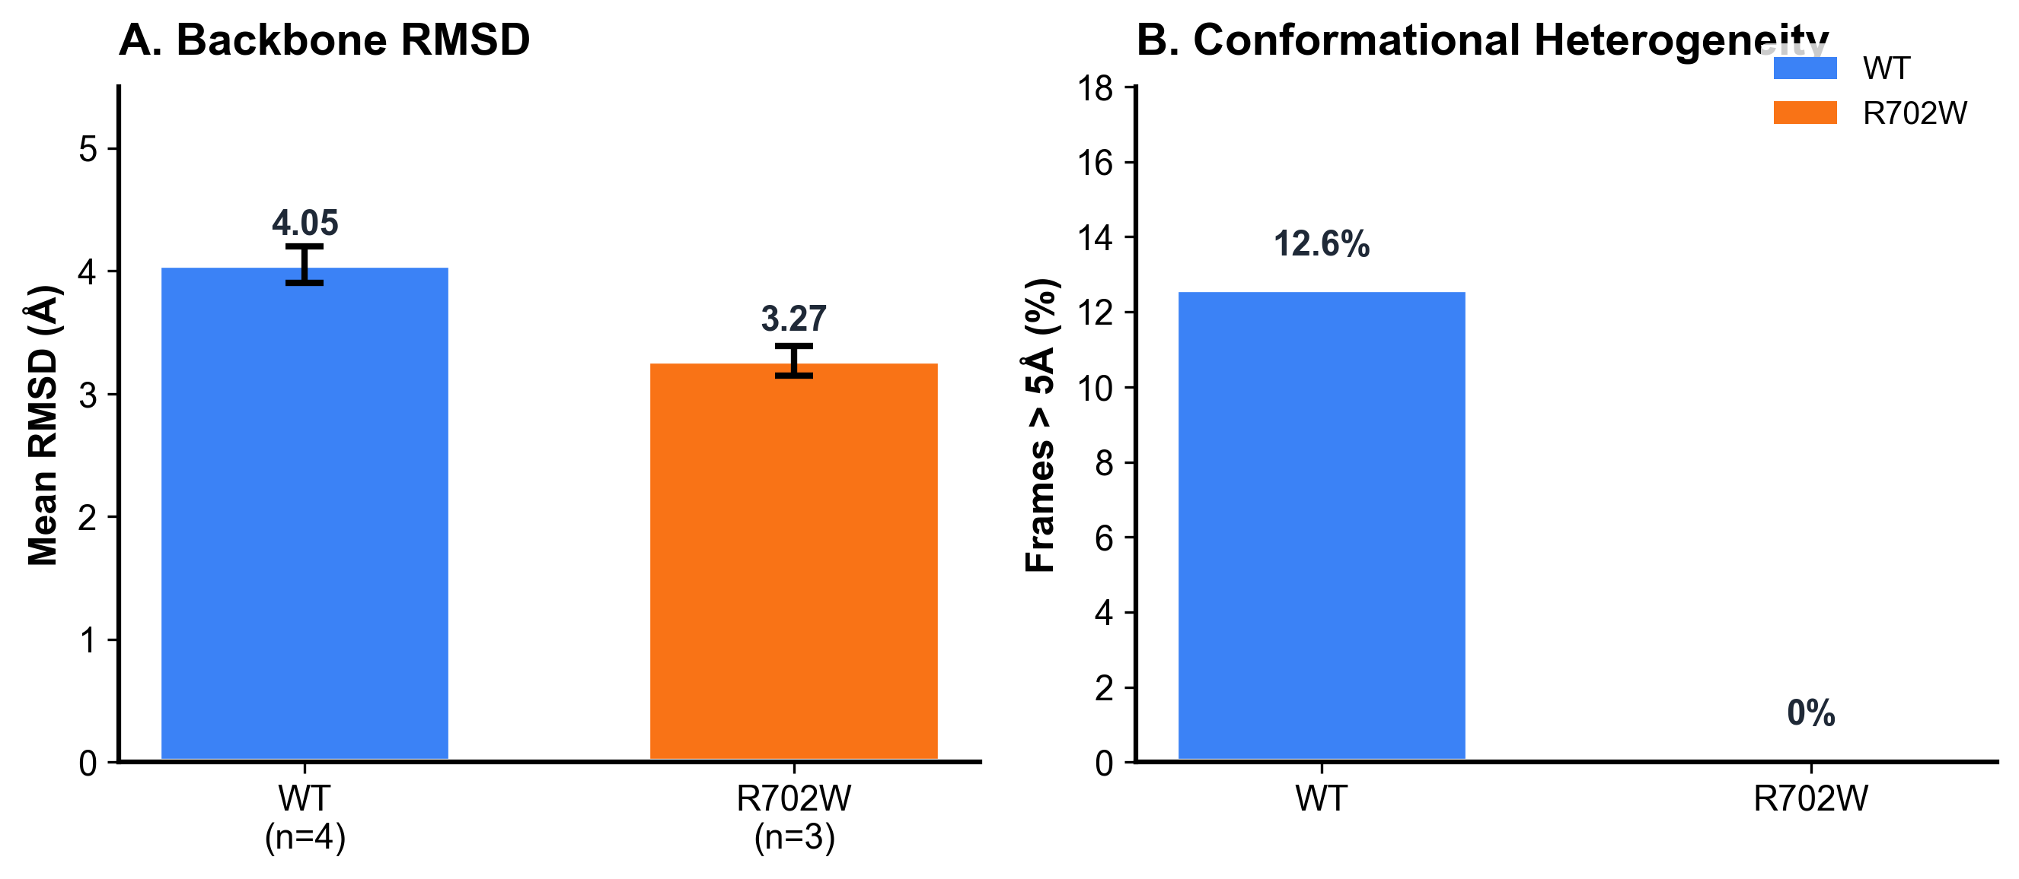
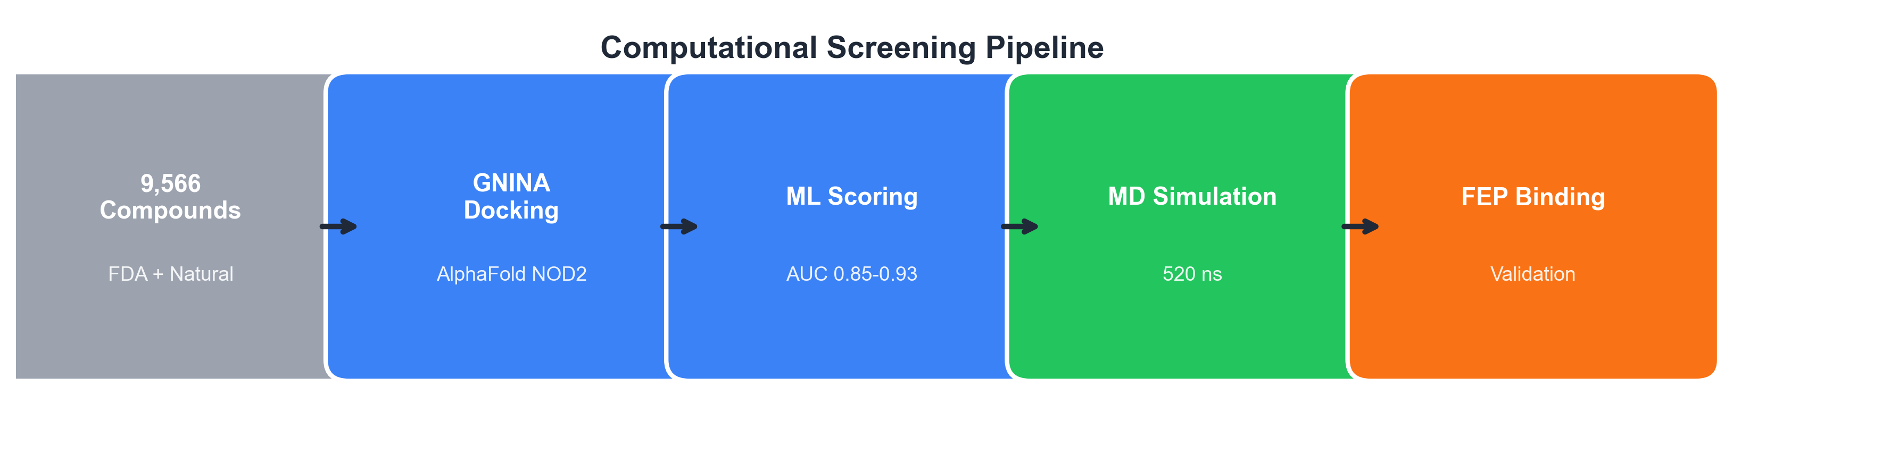
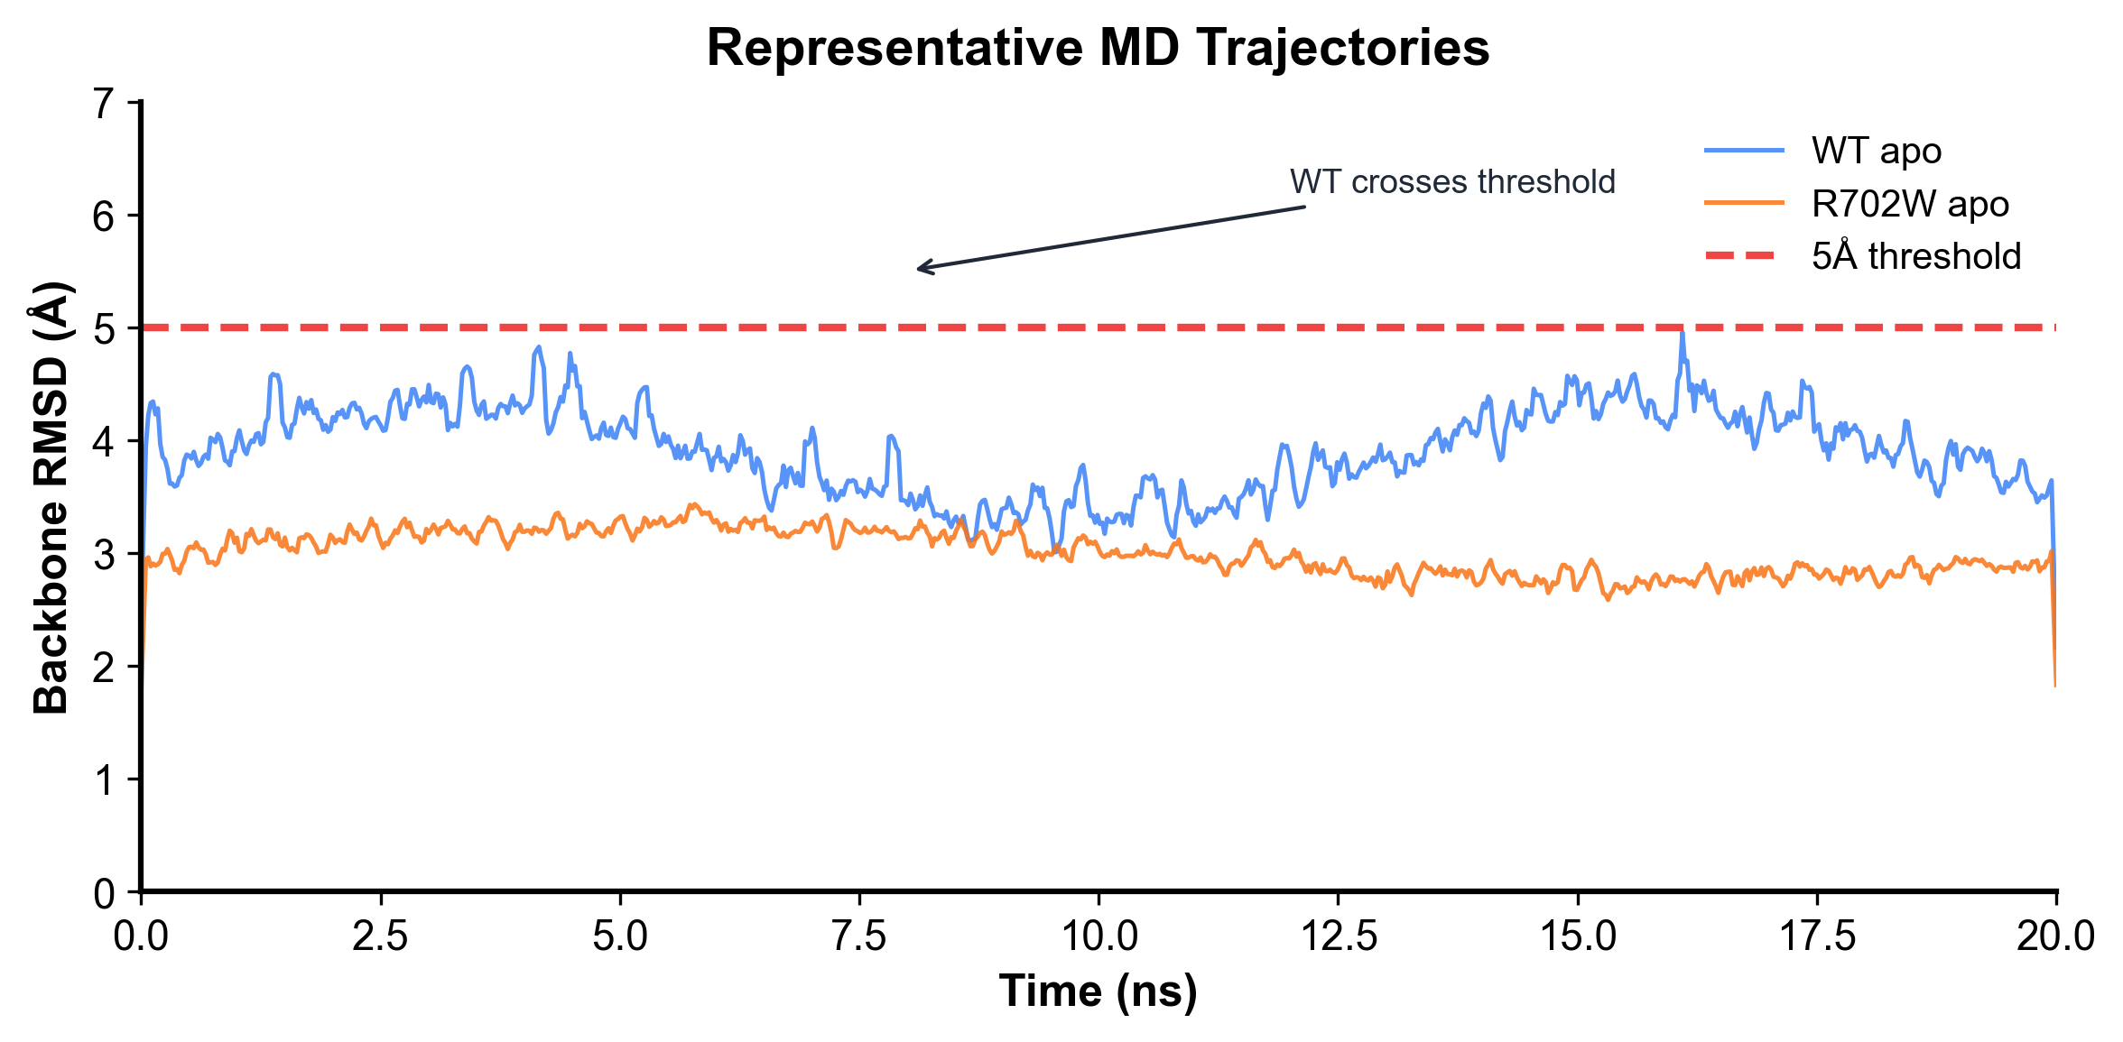
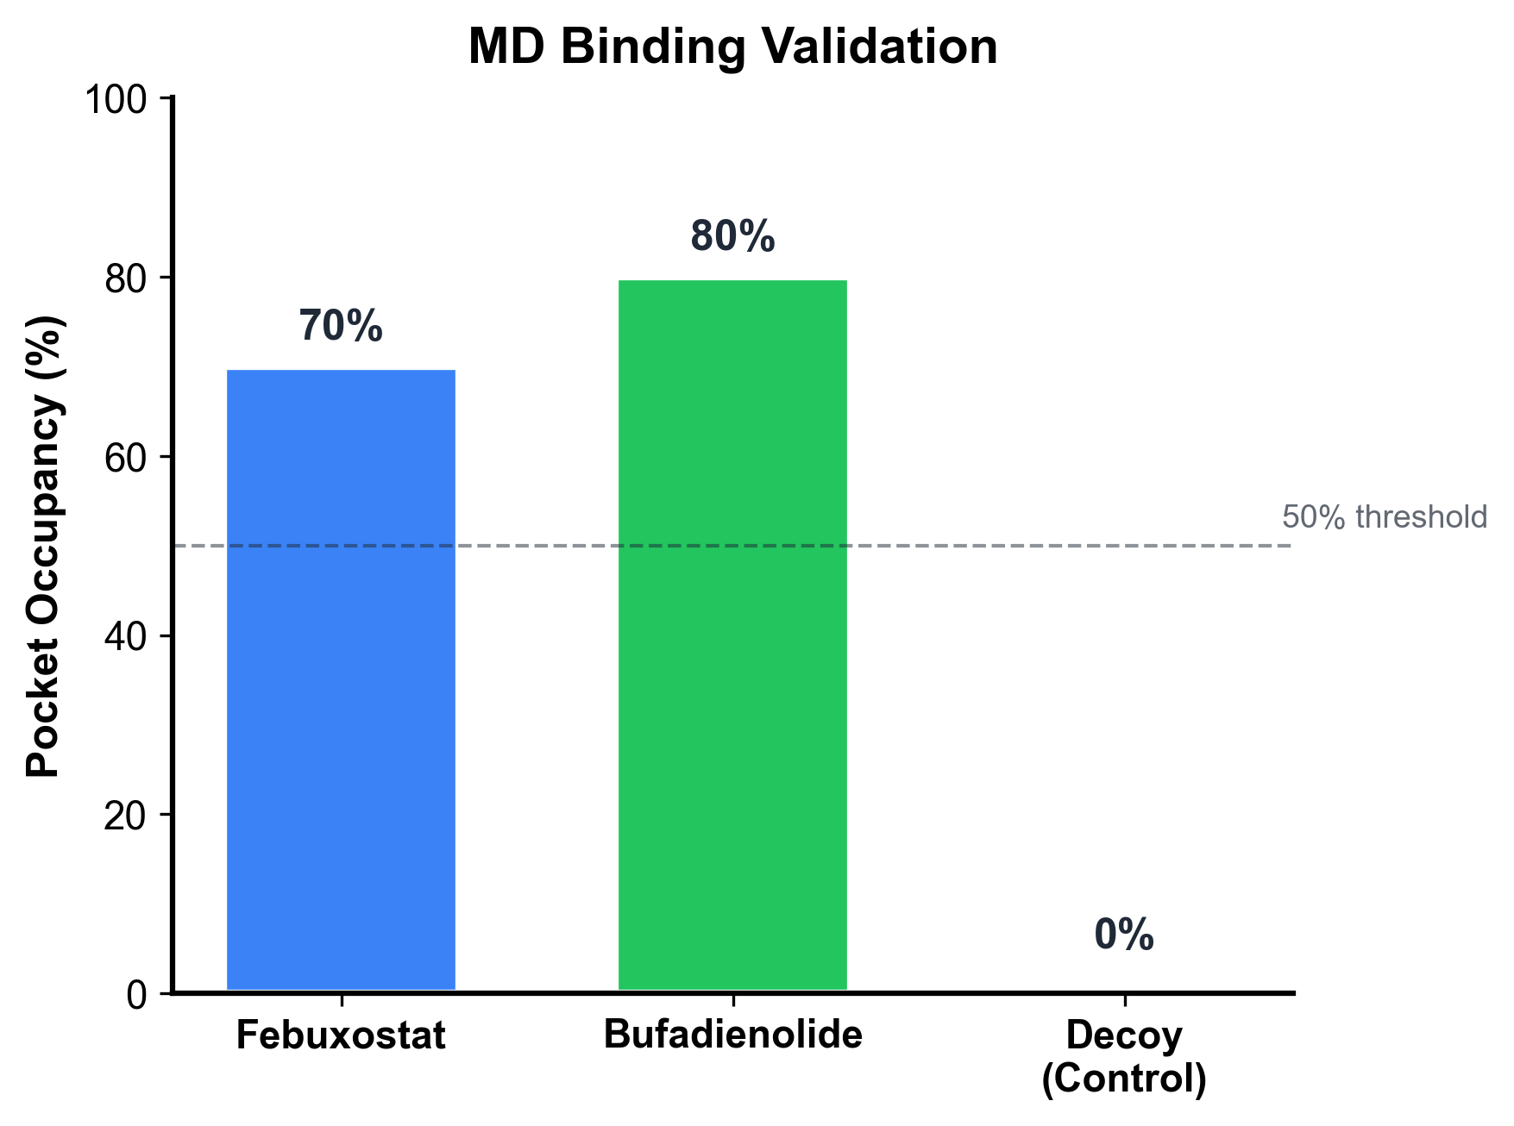
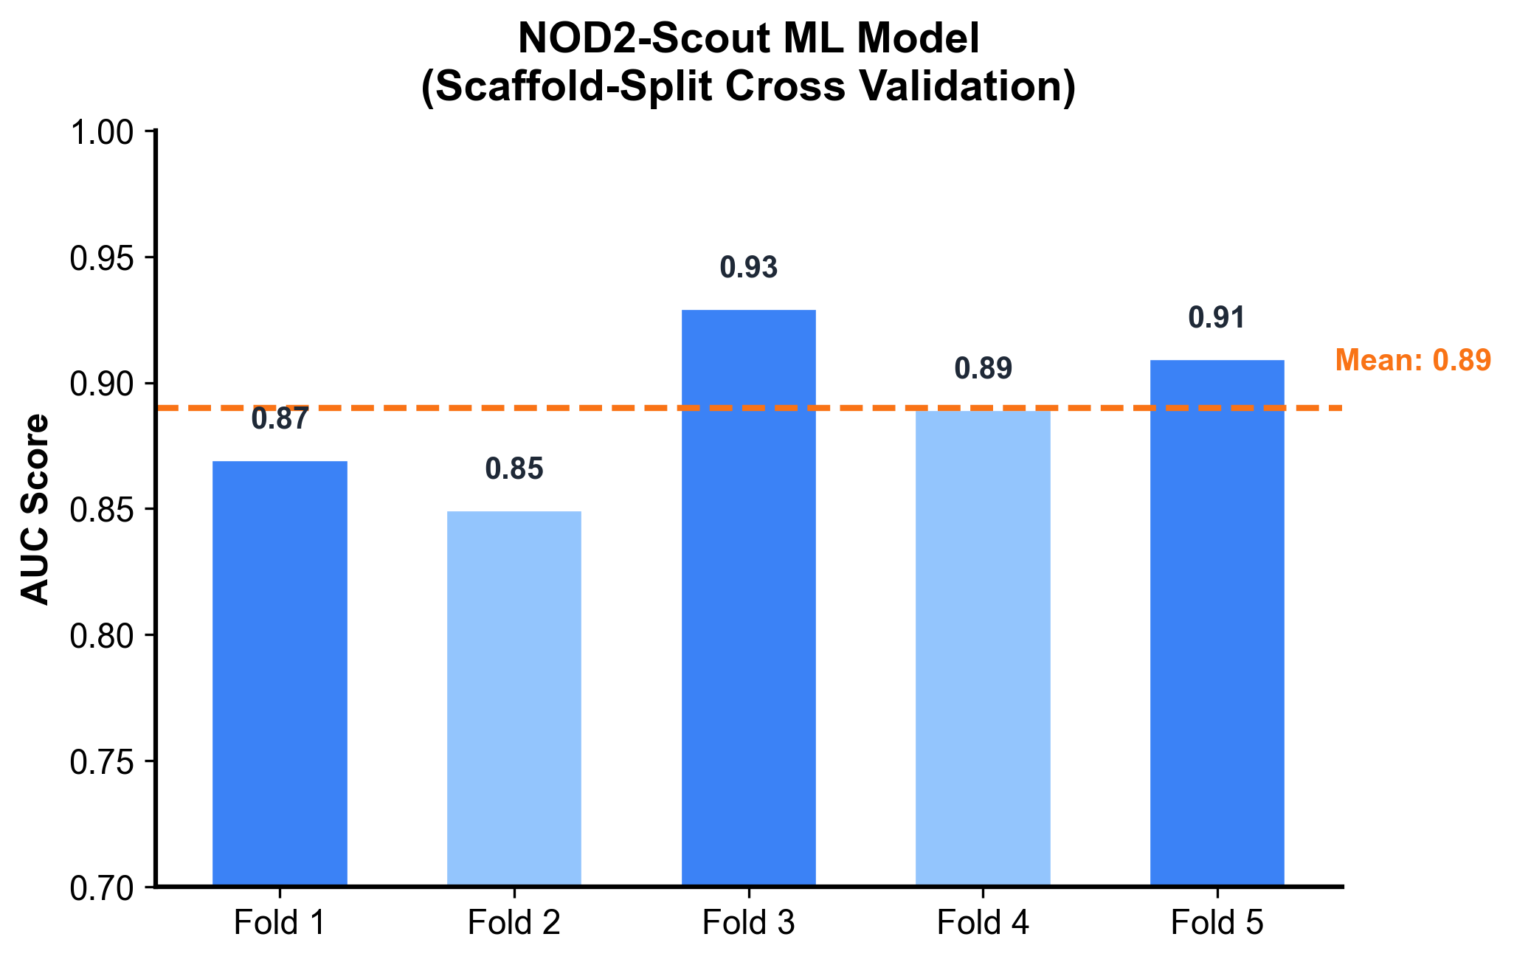
Deep Learning Guided Discovery and FEP Validation of NOD2 Binders
for the R702W Crohn's Variant
Tanmay Vasudeva
Texas Virtual Academy at Hallsville
I built a screening pipeline for NOD2 binders and used FEP to quantify how the R702W variant changes binding for specific ligands, with apo MD providing supporting context.
INTRODUCTION
FEP BINDING FREE ENERGY (KEY RESULT)
APO MD DYNAMICS (SUPPORTING CONTEXT)
CROHN'S DISEASE & NOD2
NOD2 (Nucleotide-binding Oligomerization Domain 2) mutations cause 15-25% of Crohn's disease cases. The R702W variant is the most common mutation, affecting ~10% of patients.
PROBLEM STATEMENT
Current treatments target symptoms, not the underlying molecular dysfunction. No targeted small-molecule modulators exist for NOD2.
HYPOTHESIS
If computational screening identifies NOD2-LRR binders, then FEP can quantify how the R702W mutation affects binding affinity for specific ligands.
COMPUTATIONAL METHODOLOGY
REPRESENTATIVE MD TRAJECTORIES
Fig. 5. Apo MD comparison: WT vs R702W backbone dynamics
APO SIMULATION RESULTS (No Ligand Bound)
Metric | WT apo (n=4) | R702W apo (n=3)
--------------------|--------------|----------------
Mean RMSD | 4.05 Å | 3.27 Å
% Frames > 5Å | 12.6% | 0%
INTERPRETATION: R702W shows reduced conformational sampling
compared to WT, consistent with mutation-sensitive binding in FEP.
Fig. 1. Computational screening pipeline overview
MD BINDING VALIDATION
SCREENING PIPELINE
• 9,566 compounds screened (FDA-approved + natural products)
• GNINA CNN-based docking on AlphaFold2 NOD2 LRR domain
• NOD2-Scout ML model: AUC 0.85-0.93 (scaffold-split cross validation)
MOLECULAR DYNAMICS PROTOCOL
• Engine: OpenMM with AMBER14 + OpenFF 2.1.0 force fields
• Temperature: 310 K | Solvent: TIP3P-FB water model
• Production: 20 ns per replicate | Total: 520 ns across all systems
FREE ENERGY PERTURBATION (FEP)
• Gold standard for binding free energy calculations
• 120 total FEP windows (80 complex + 40 solvent)
• Thermodynamic cycle: WT and R702W systems compared
ML MODEL VALIDATION
KEY BINDING RESIDUES
IDENTIFIED FROM CONTACT ANALYSIS (Phase 7 MD)
Residue | Contact Frequency | Role
-----------|-------------------|---------------------------
GLU1008 | 50-71% | H-bond acceptor
ARG1037 | 71-86% | Electrostatic anchor
ASP1011 | 67-93% | H-bond acceptor
ARG1034 | 82-88% | Secondary contact
LEU1007 | 61-65% | Hydrophobic packing
Fig. 6. RMSD time series showing WT crosses 5Å threshold, R702W does not
Fig. 4. Pocket occupancy during 20 ns MD simulations
POCKET OCCUPANCY (Ligand within 5Å of binding site)
• Febuxostat: 70% mean occupancy | H-bonds: 2.02 ± 1.78
• Bufadienolide: 80% mean occupancy | H-bonds: 1.99 ± 1.74
• Decoy (control): 0% occupancy - validates binding specificity
Fig. 3. FEP binding free energy difference (R702W - WT)
FEP RESULTS SUMMARY (Gold Standard Thermodynamics)
COMPOUND | ΔG_WT (kcal/mol) | ΔG_R702W | ΔΔG | Significance
----------------|------------------|---------------|------------|-------------
Febuxostat | -10.36 ± 0.18 | -8.02 ± 0.19 | +2.34 | *** (8σ, p<0.001)
Bufadienolide | -15.22 ± 0.26 | -15.66 ± 0.26 | -0.44 | n.s. (1.8σ)
KEY FINDING: Febuxostat shows 50× weaker binding in R702W mutant
Bufadienolide shows no significant binding difference
Fig. 2. NOD2-Scout model performance across 5-fold scaffold-split CV
CONCLUSIONS
LIMITATIONS
KEY REFERENCES
SCIENTIFIC CONTRIBUTIONS
1. PIPELINE DEVELOPMENT
Built deep learning screening pipeline for 9,566 compounds against NOD2 LRR domain
2. FEP QUANTIFIES MUTATION-SENSITIVE BINDING (Primary Finding)
• Febuxostat: ΔΔG = +2.34 kcal/mol → 50× weaker in R702W (p<0.001)
• Bufadienolide: ΔΔG = -0.44 kcal/mol → No significant change
• Demonstrates ligand-dependent binding differences
3. APO DYNAMICS PROVIDE MECHANISTIC CONTEXT (Supporting Finding)
• WT: 12.6% frames exceed 5Å RMSD threshold
• R702W: 0% frames exceed threshold
• Reduced conformational sampling in mutant
4. STRUCTURAL INSIGHTS
Key binding residues identified: GLU1008, ARG1037, ASP1011
• FEP performed on 2 representative ligands only
• Apo MD simulations (no ligand-bound comparisons)
• Computational predictions require experimental validation
• Force field and sampling limitations inherent to MD
[1] Hugot JP, et al. Association of NOD2 leucine-rich repeat variants with susceptibility to Crohn's disease. Nature. 2001.
[2] Jumper J, et al. Highly accurate protein structure prediction with AlphaFold. Nature. 2021.
[3] McNutt AT, et al. GNINA 1.0: molecular docking with deep learning. J Cheminform. 2021.
[4] Shirts MR, et al. Best practices for alchemical free energy calculations. Living J Comp Mol Sci. 2019.
FUTURE WORK
ACKNOWLEDGMENTS
• SPR/ITC experimental binding validation
• Test additional NOD2 mutations (G908R, L1007fs)
• HDX-MS conformational studies
• Analog optimization for lead compounds
• Computational resources provided by vast.ai GPU cloud
• AlphaFold2 structure from DeepMind/EMBL-EBI
• OpenMM and GROMACS development teams
• Open-source cheminformatics community (RDKit, OpenFF)

