Slide 1
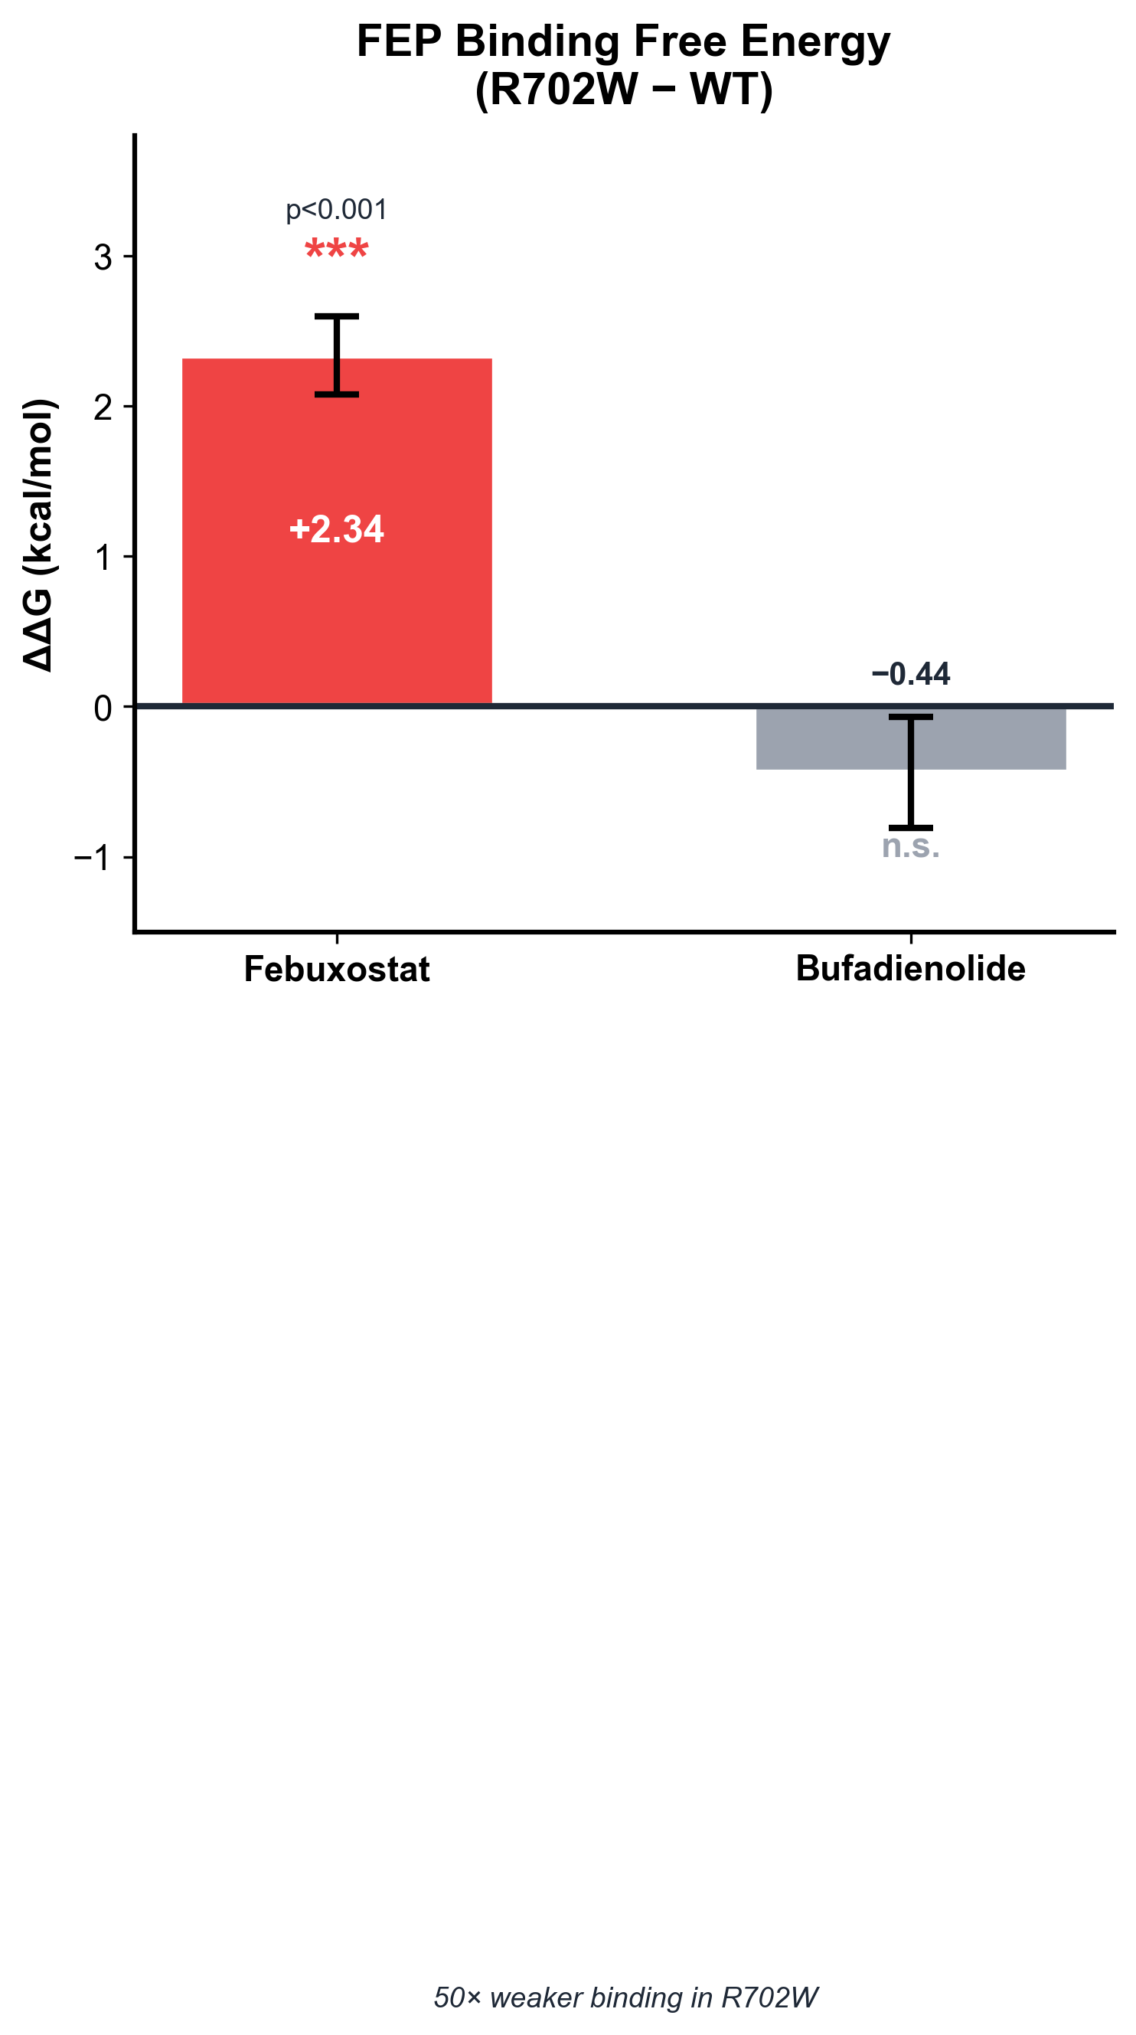
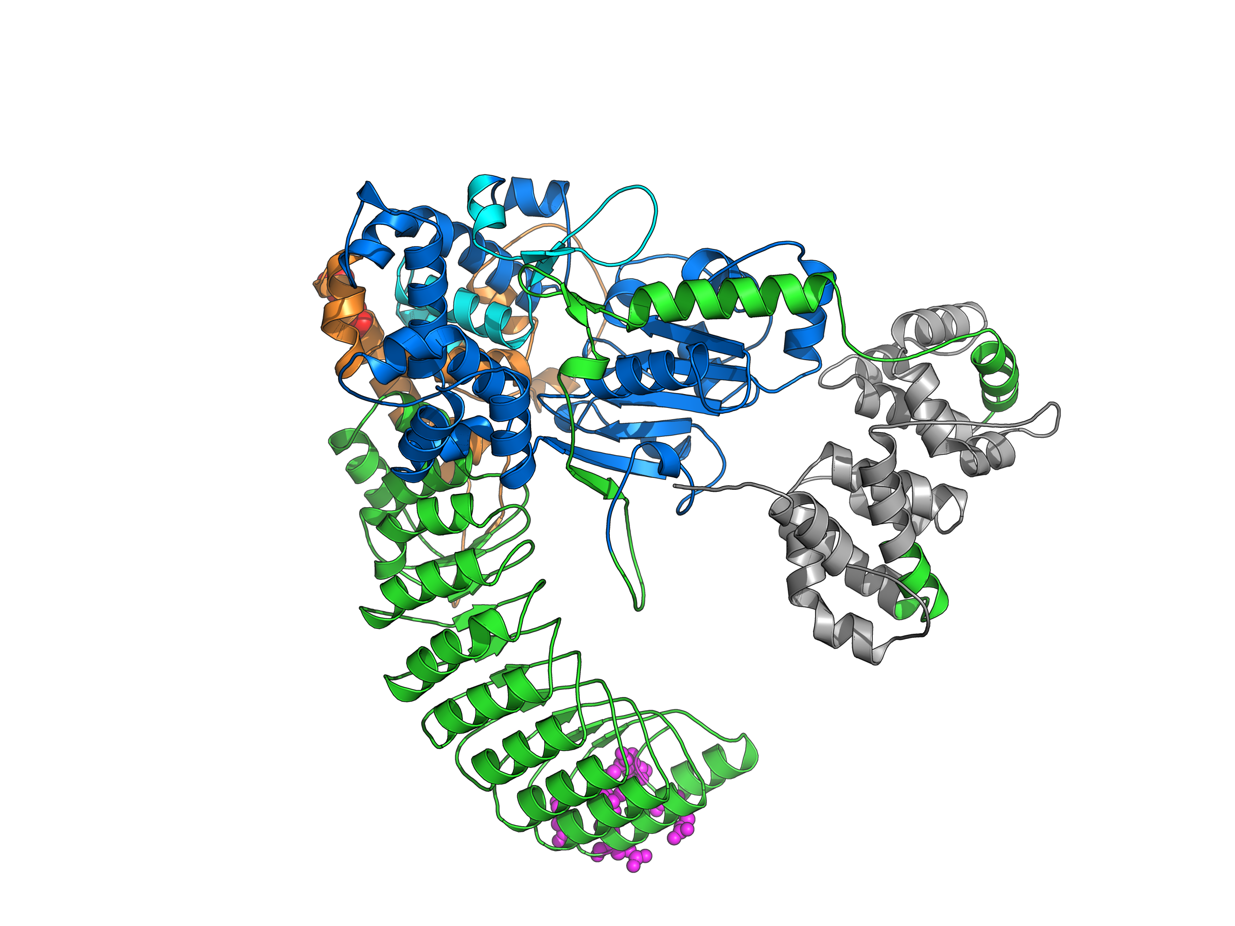
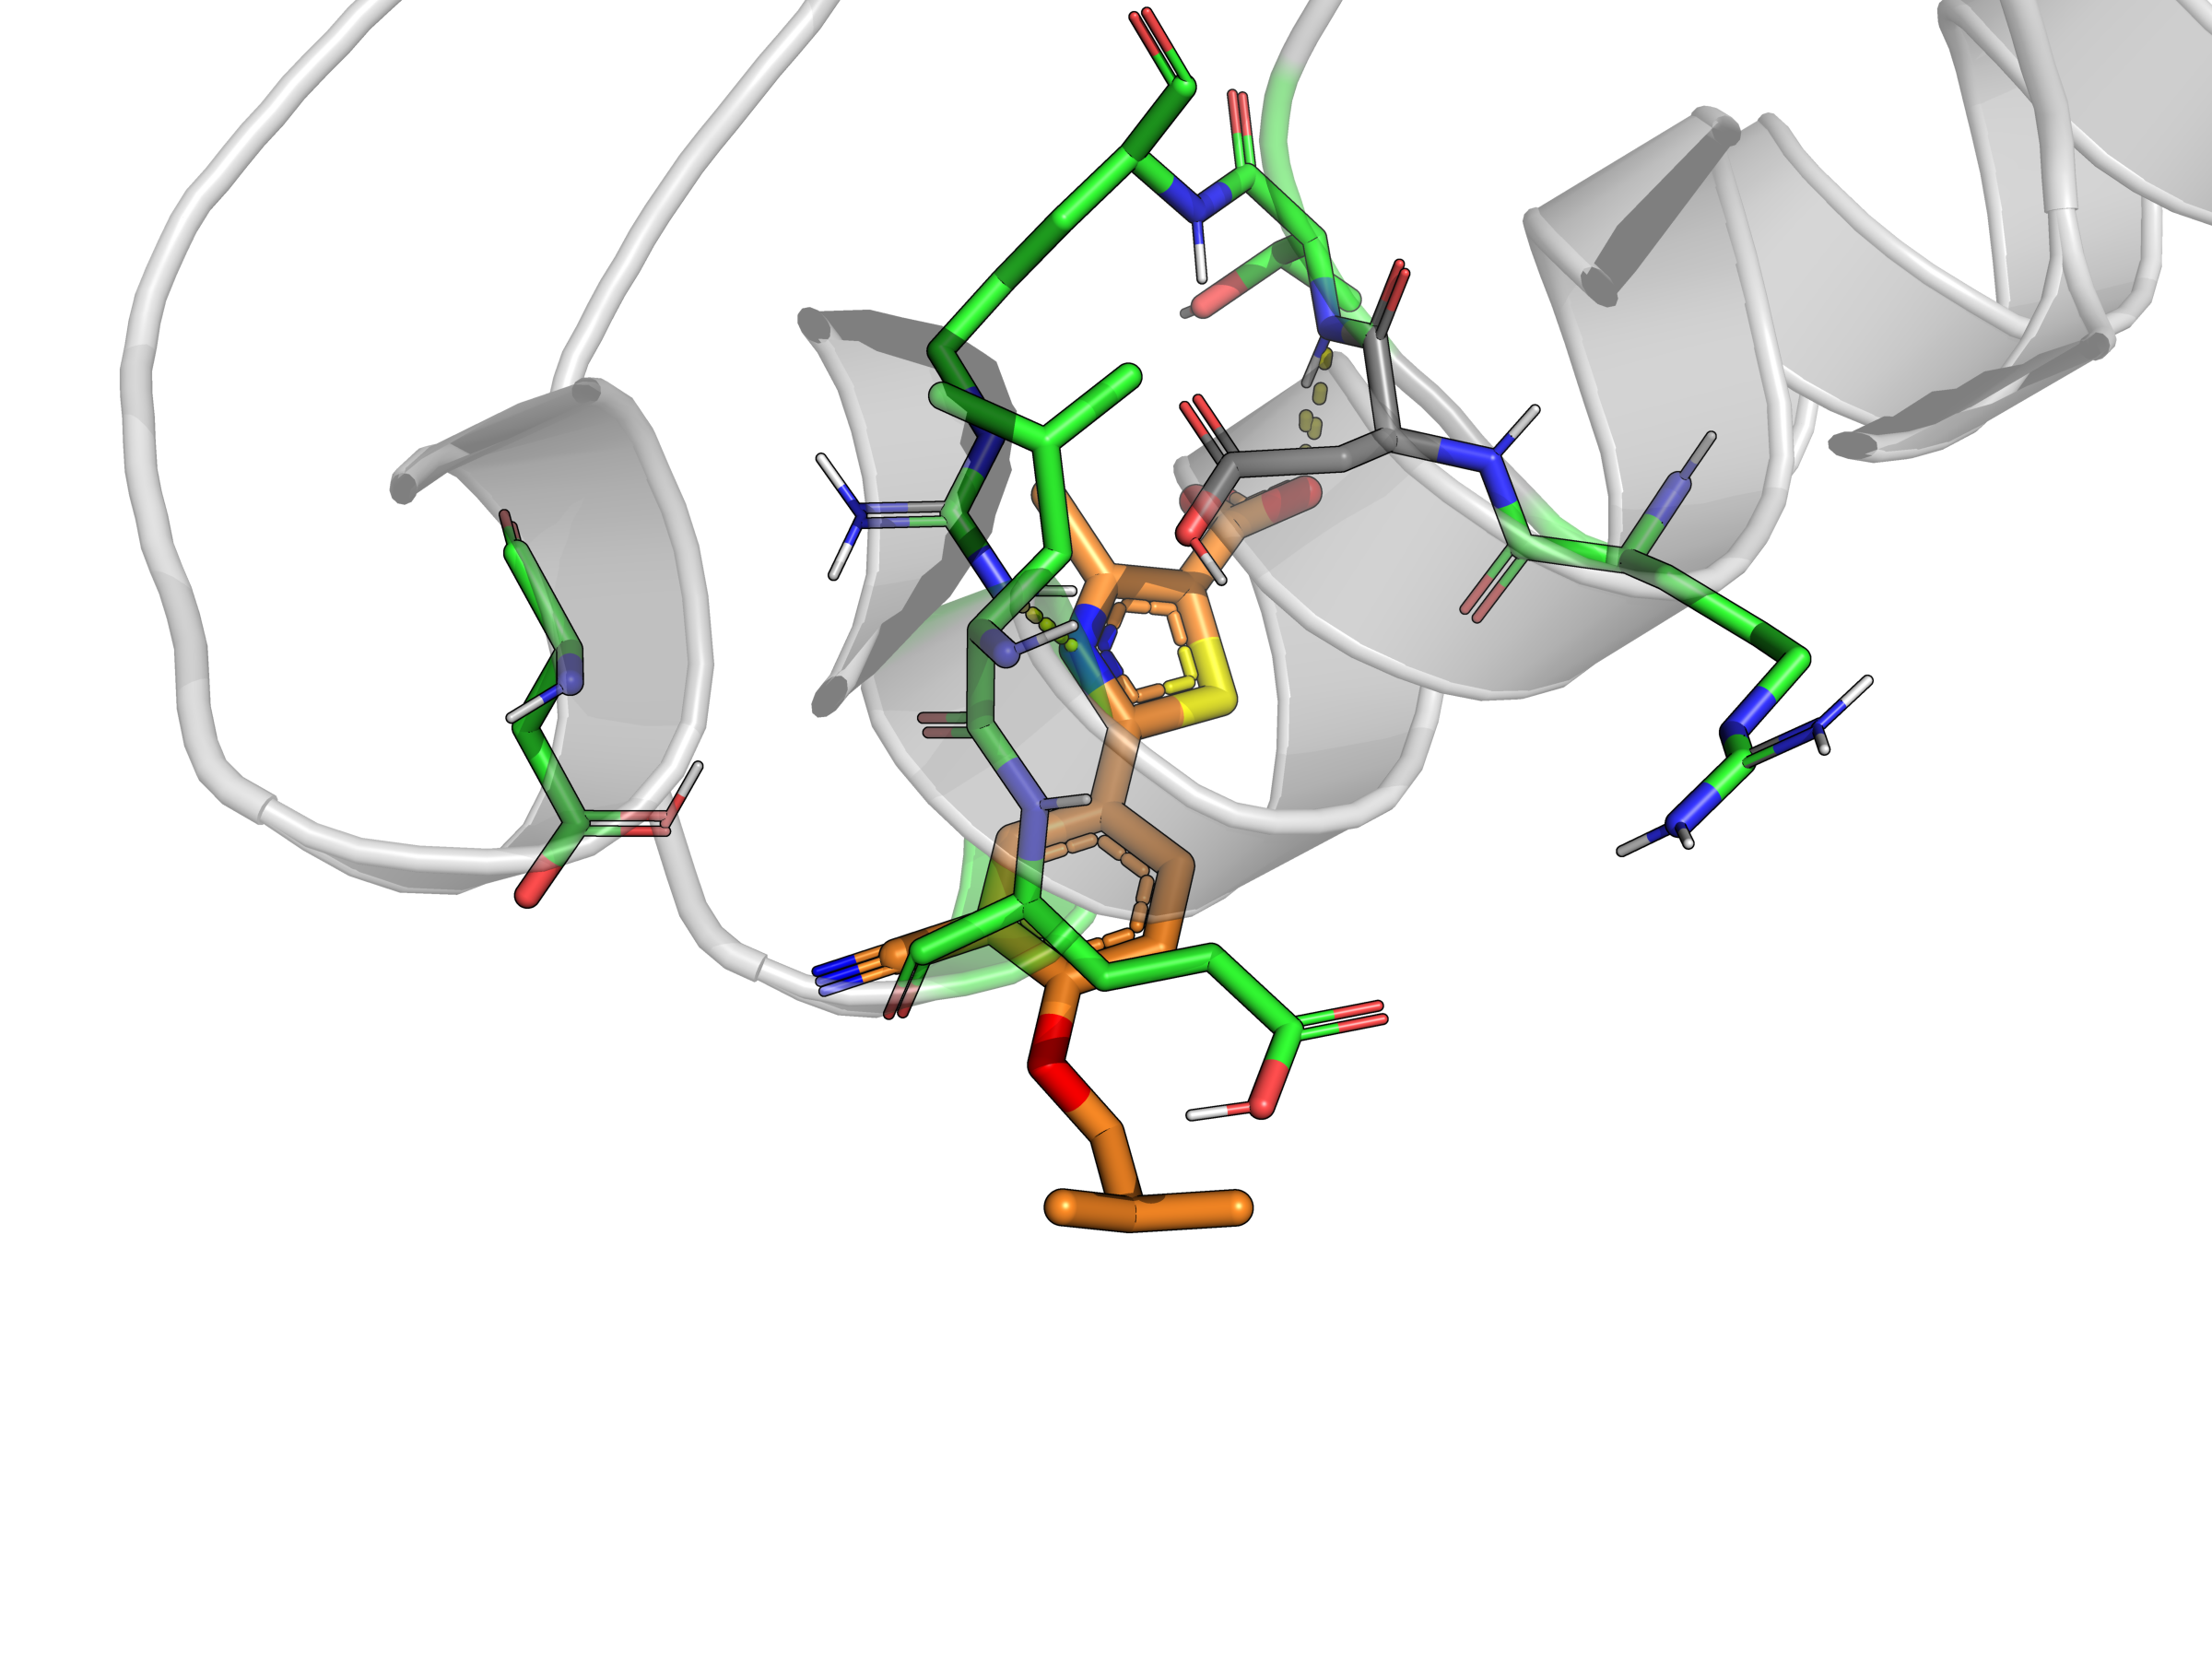
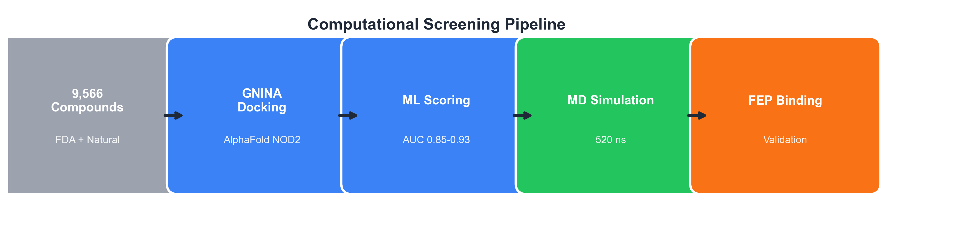
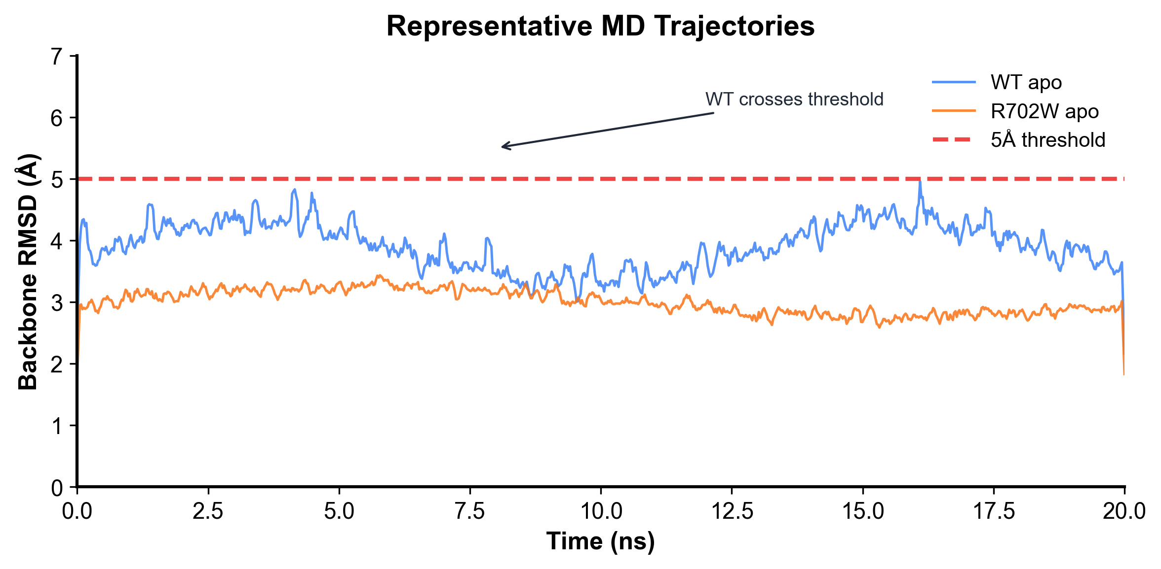
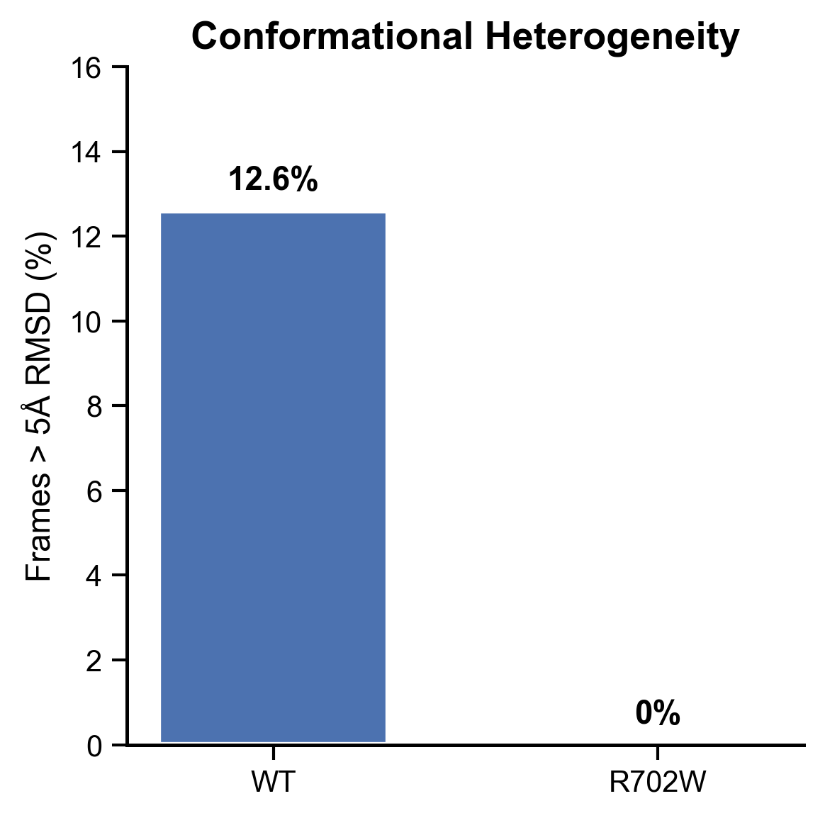
Deep Learning Guided Discovery and FEP Validation of NOD2 Binders
for the R702W Crohn's Disease Variant
Tanmay Vasudeva | Texas Virtual Academy at Hallsville | ISEF 2026
KEY FINDING: Febuxostat shows 50x weaker binding in R702W mutant (ddG = +2.34 kcal/mol, p<0.001)
RESEARCH QUESTION
FEP BINDING FREE ENERGY
STRUCTURAL ANALYSIS
What mechanisms explain how the NOD2 R702W variant alters drug binding? I developed a pipeline combining ML screening with FEP calculations to quantify mutation-sensitive binding for FDA compounds.
FEP is the gold standard for binding affinity. Positive ddG = weaker binding in mutant.
R702W is 80A from binding site - requires allosteric mechanism.
BACKGROUND
NOD2 detects bacterial peptidoglycans and initiates NF-kB signaling. R702W causes 15-25% of Crohn's disease cases. The mutation is in HD2 domain, 80A from the LRR binding site. No targeted therapies exist for R702W carriers. Drug repurposing offers faster path to therapy.
METHODS
1. Structure: AlphaFold2 NOD2 (Q9HC29), LRR domain extracted (res 744-1040) 2. Screening: 9,566 FDA + natural compounds via GNINA CNN docking 3. ML Scoring: NOD2-Scout classifier, AUC 0.85-0.93 (scaffold-split CV) 4. MD Simulation: OpenMM, AMBER14, 520 ns total, 310K, TIP3P-FB 5. FEP Binding: 120 windows per ligand, thermodynamic cycle, ddG = dG(mut) - dG(WT)
Fig 2: FEP binding calculations
Fig 4: NOD2 domains. HD2 (orange)=R702W site, LRR (green)=binding
FEBUXOSTAT: ddG = +2.34 kcal/mol | 50x weaker | p<0.001 (8s) BUFADIENOLIDE: ddG = -0.44 kcal/mol | No change | NS (1.8s)
Febuxostat shows significant mutation-sensitive binding while Bufadienolide is unaffected. This ligand-dependent effect suggests R702W selectively disrupts certain binding modes through allosteric communication.
APO MD CONFORMATIONAL ANALYSIS
MD without ligand reveals how R702W affects protein dynamics.
Fig 5: Febuxostat binding. H-bonds to GLU1008, ARG1037
CONCLUSIONS
1. Built NOD2-Scout ML pipeline (AUC 0.85-0.93), screened 9,566 compounds 2. FEP shows ligand-dependent mutation effects: - Febuxostat: 50x weaker in R702W (p<0.001) - Bufadienolide: No significant change 3. Apo MD: R702W has reduced conformational sampling (0% vs 12.6% >5A) 4. 80A distance implies allosteric mechanism
Fig 1: Computational pipeline
LIMITATIONS
FEP on 2 ligands (compute cost). Predictions need experimental validation. Apo MD only.
Fig 3: RMSD traces and conformational heterogeneity
WT: 12.6% frames >5A (higher flexibility) | R702W: 0% frames >5A (reduced sampling)
FUTURE WORK
R702W shows reduced conformational sampling - the mutant is 'rigidified'. This may prevent induced-fit binding, explaining mutation-sensitive effects.
- SPR/ITC binding validation - HDX-MS for allosteric pathway - Test G908R, L1007fs mutations - Cell-based NOD2 reporter assays
References: Hugot et al. Nature 2001 | Jumper et al. Nature 2021 | Wang et al. JACS 2015 | Figures by author (PyMOL, matplotlib)

