Slide 1
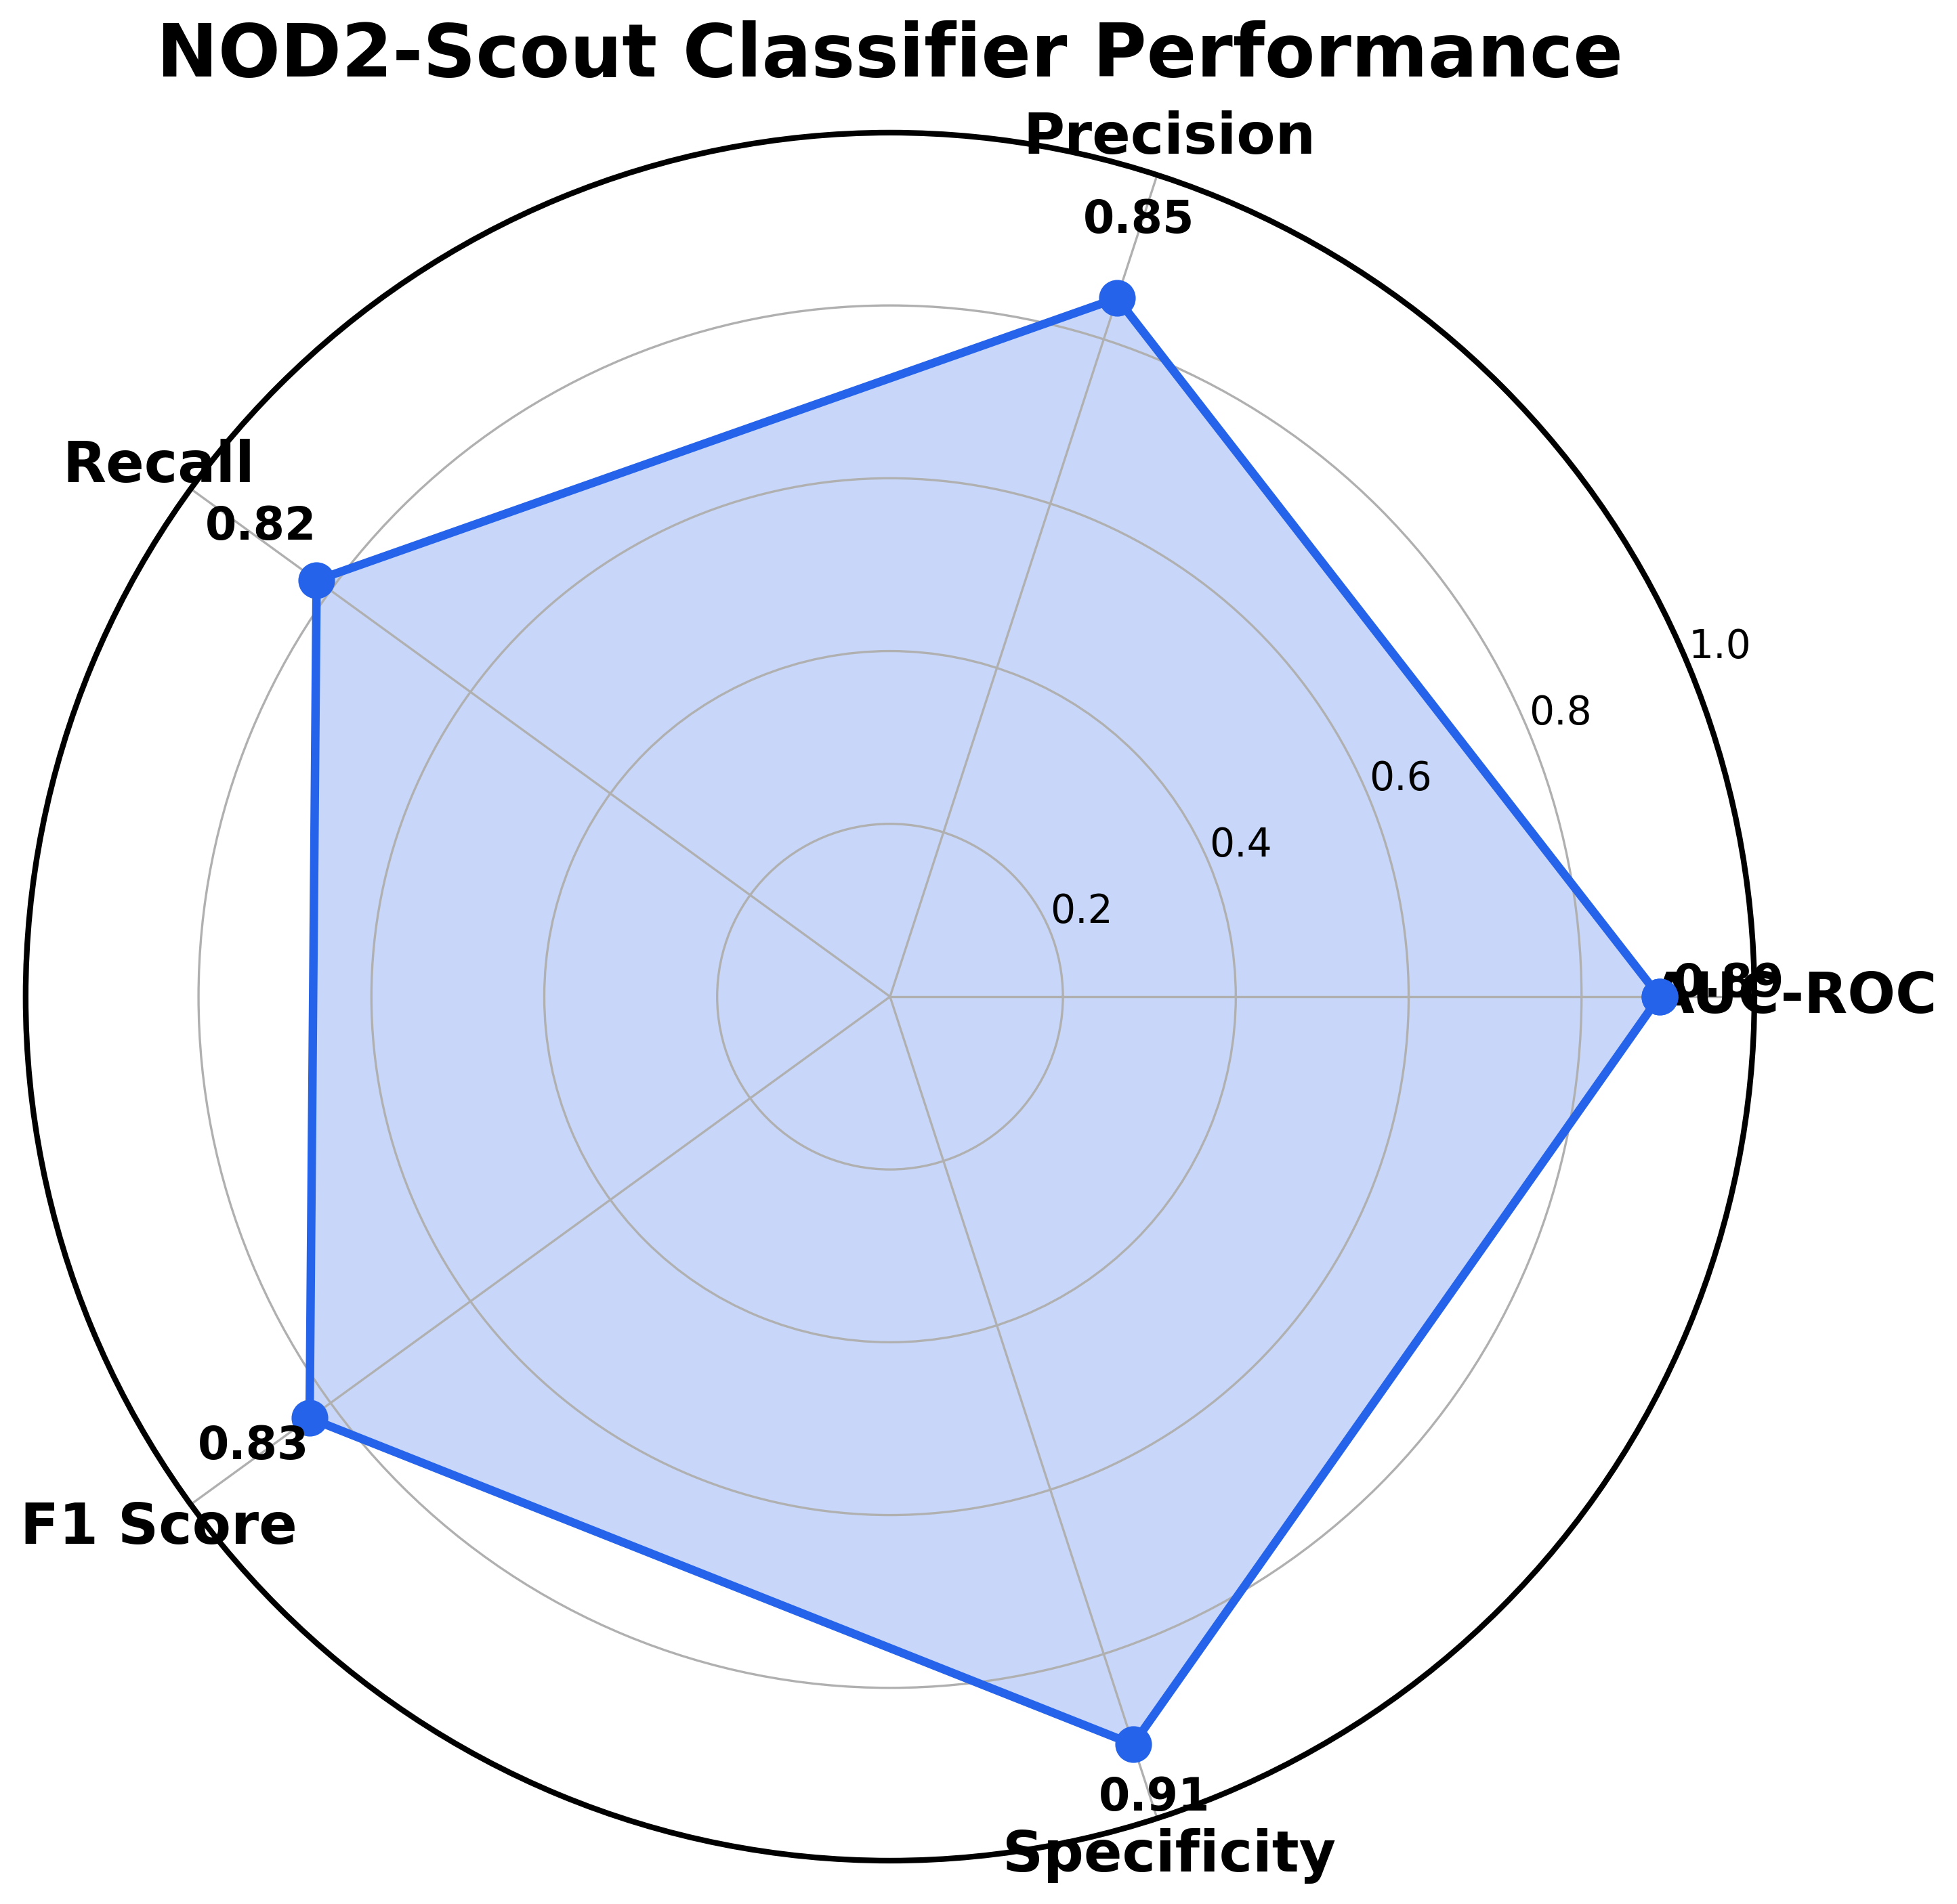
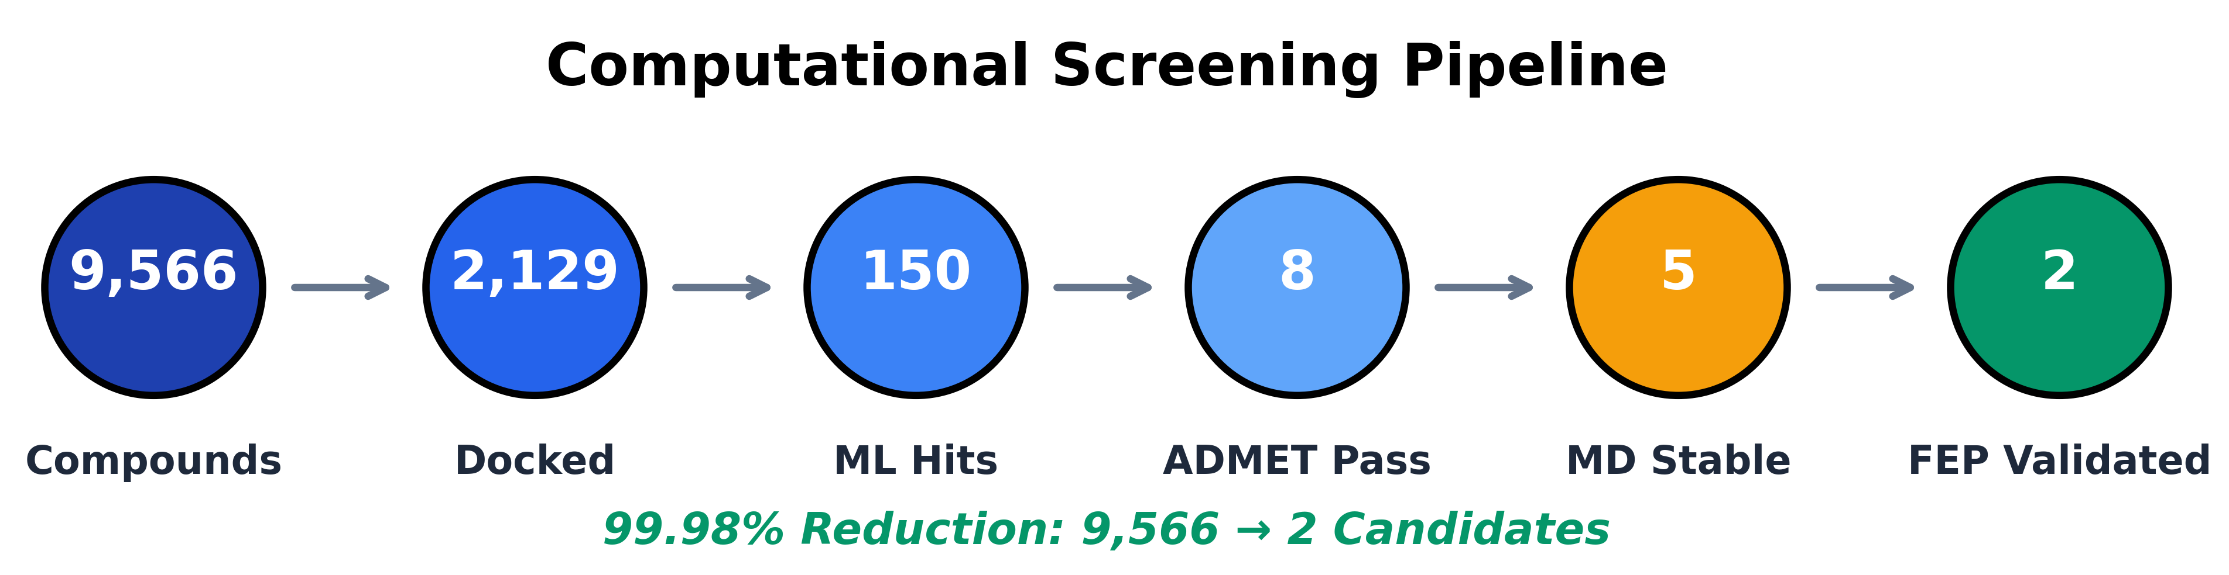
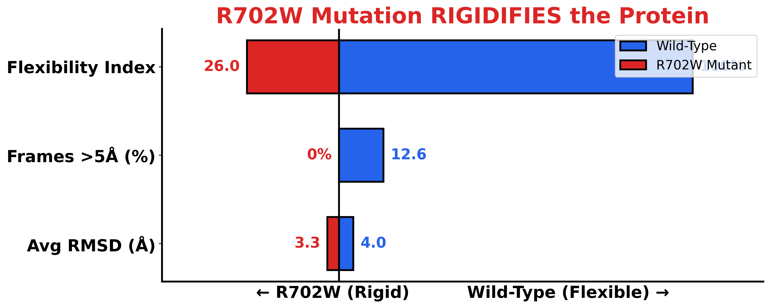
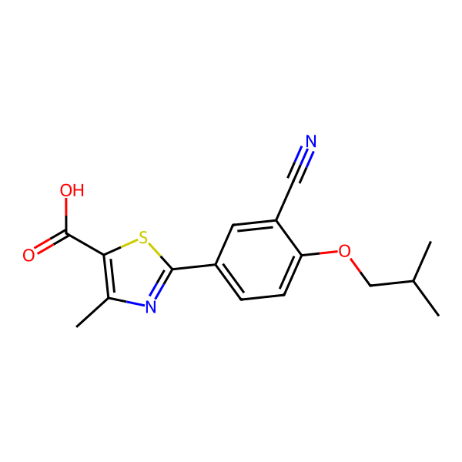
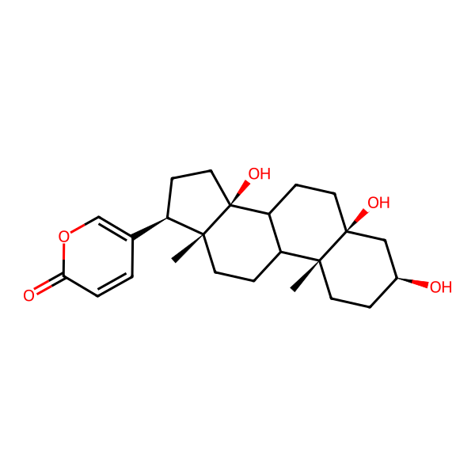
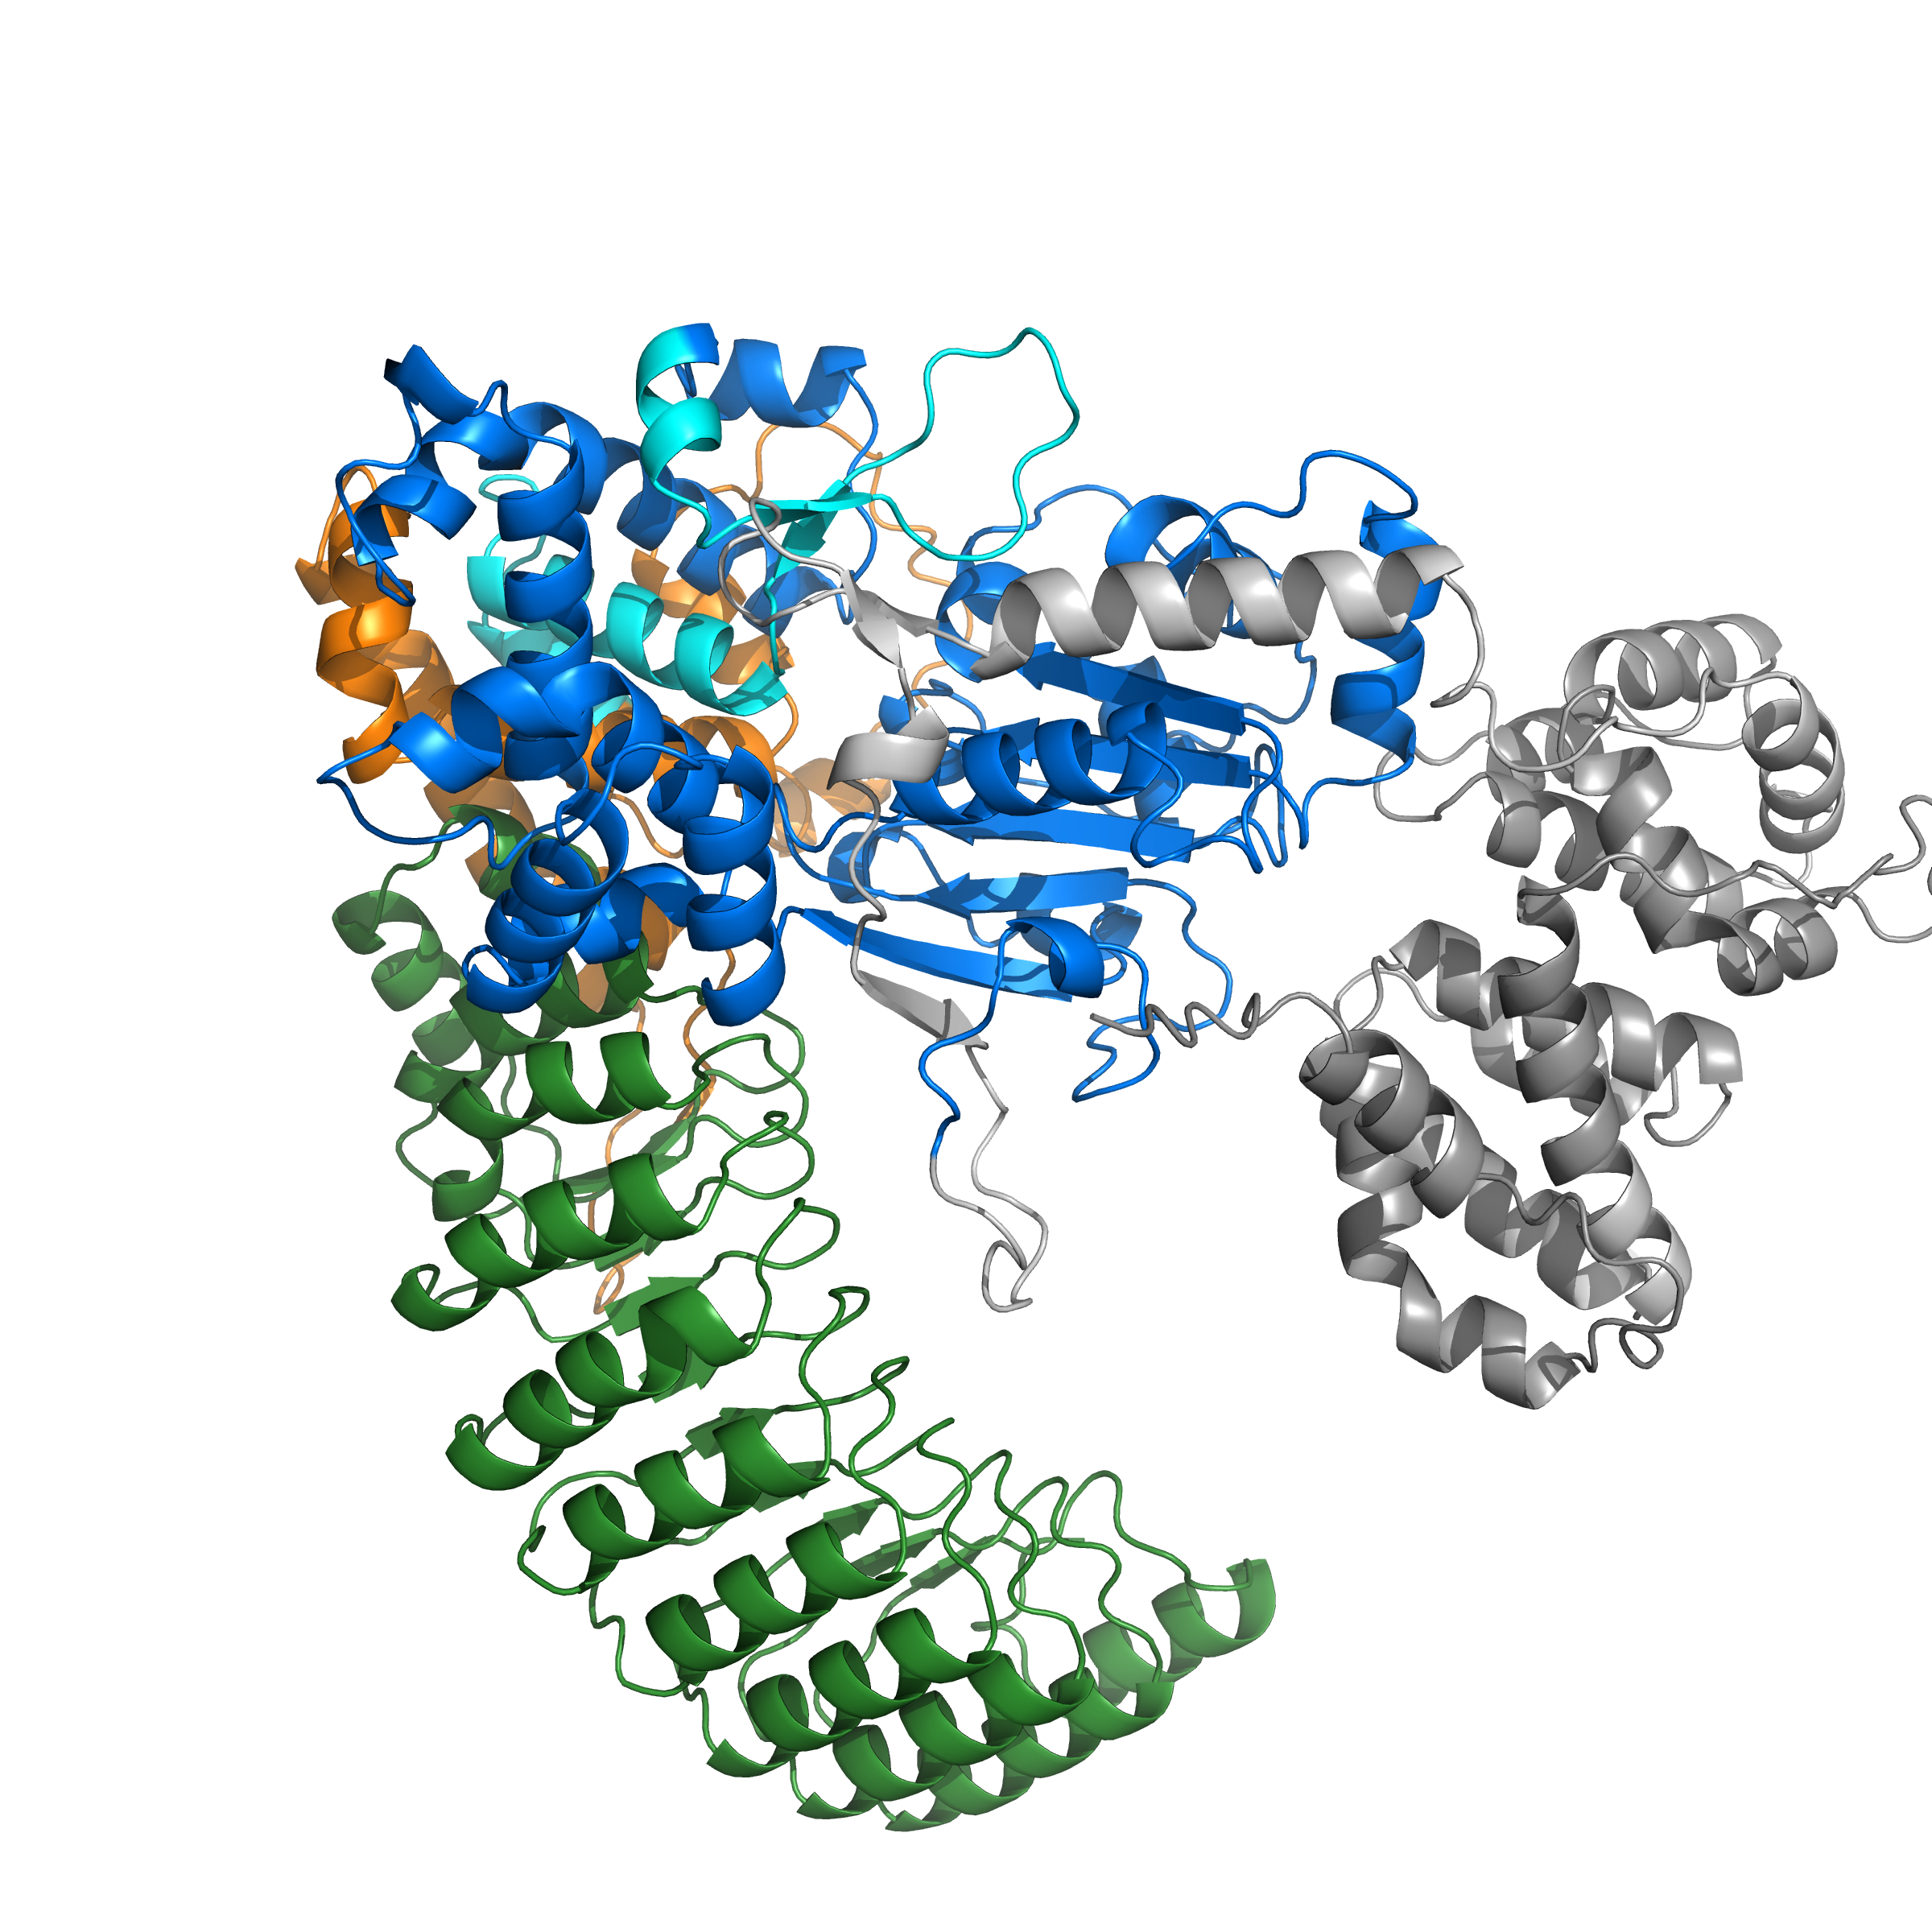
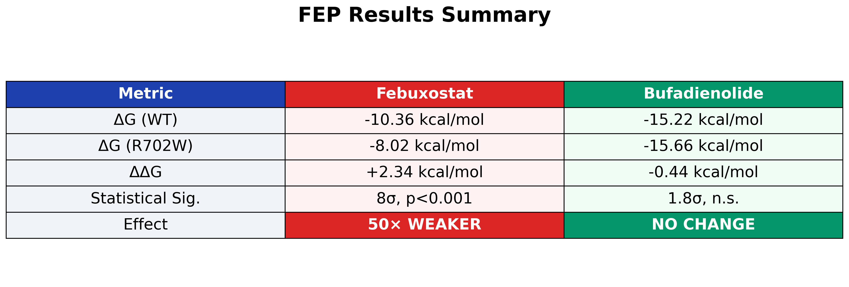
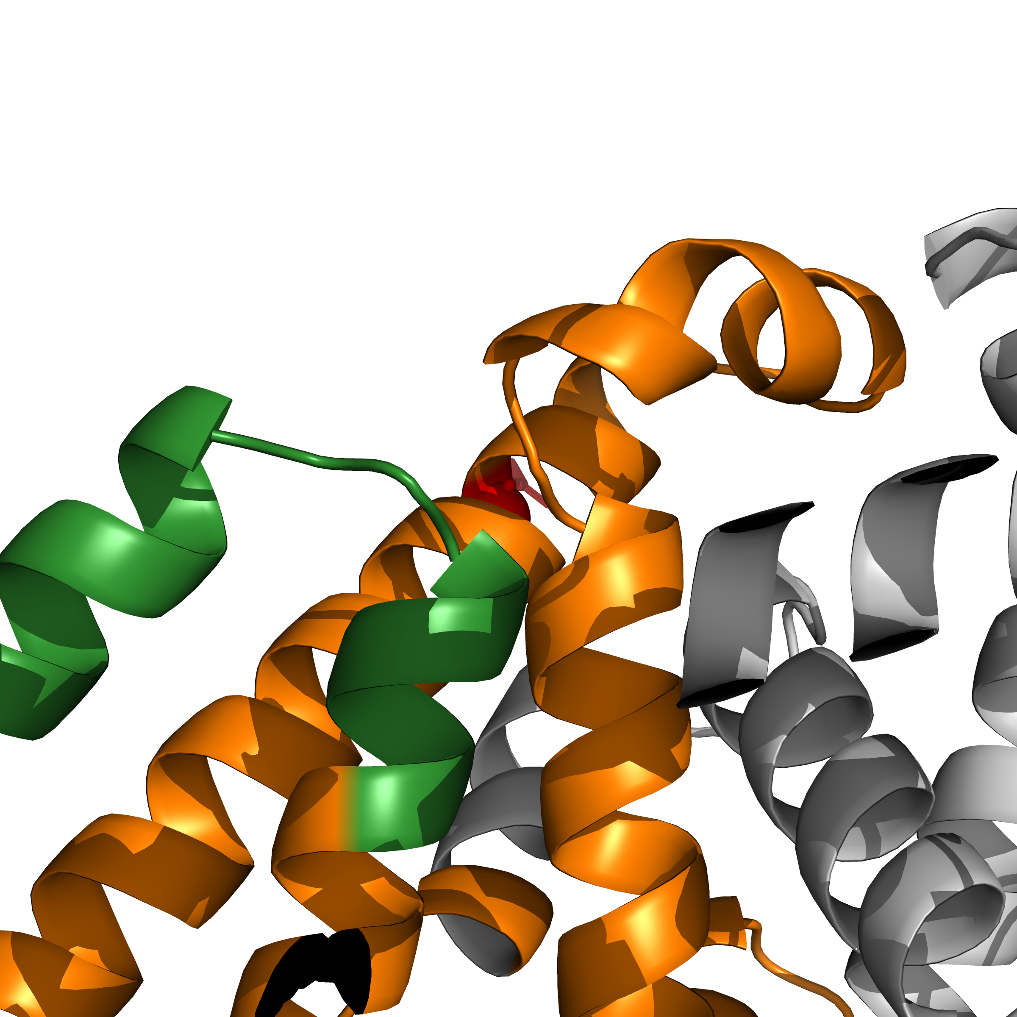
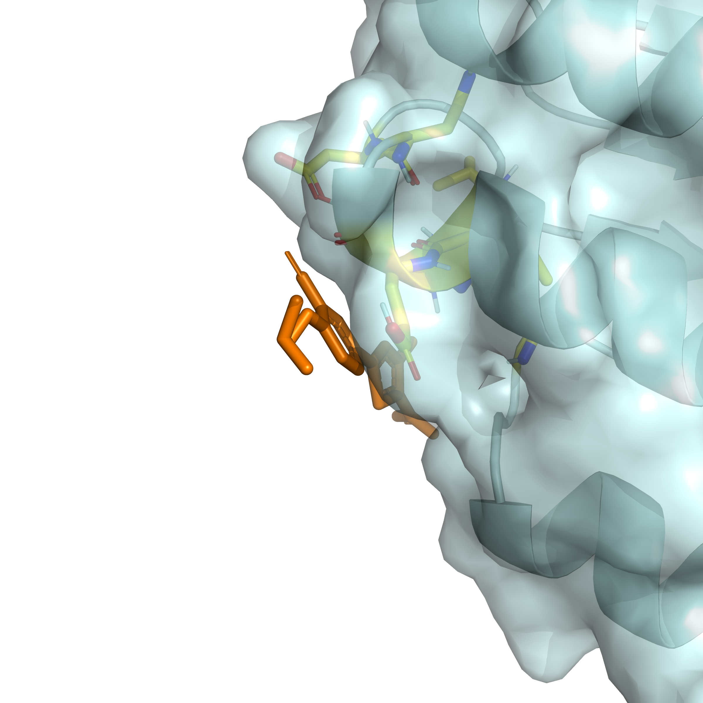
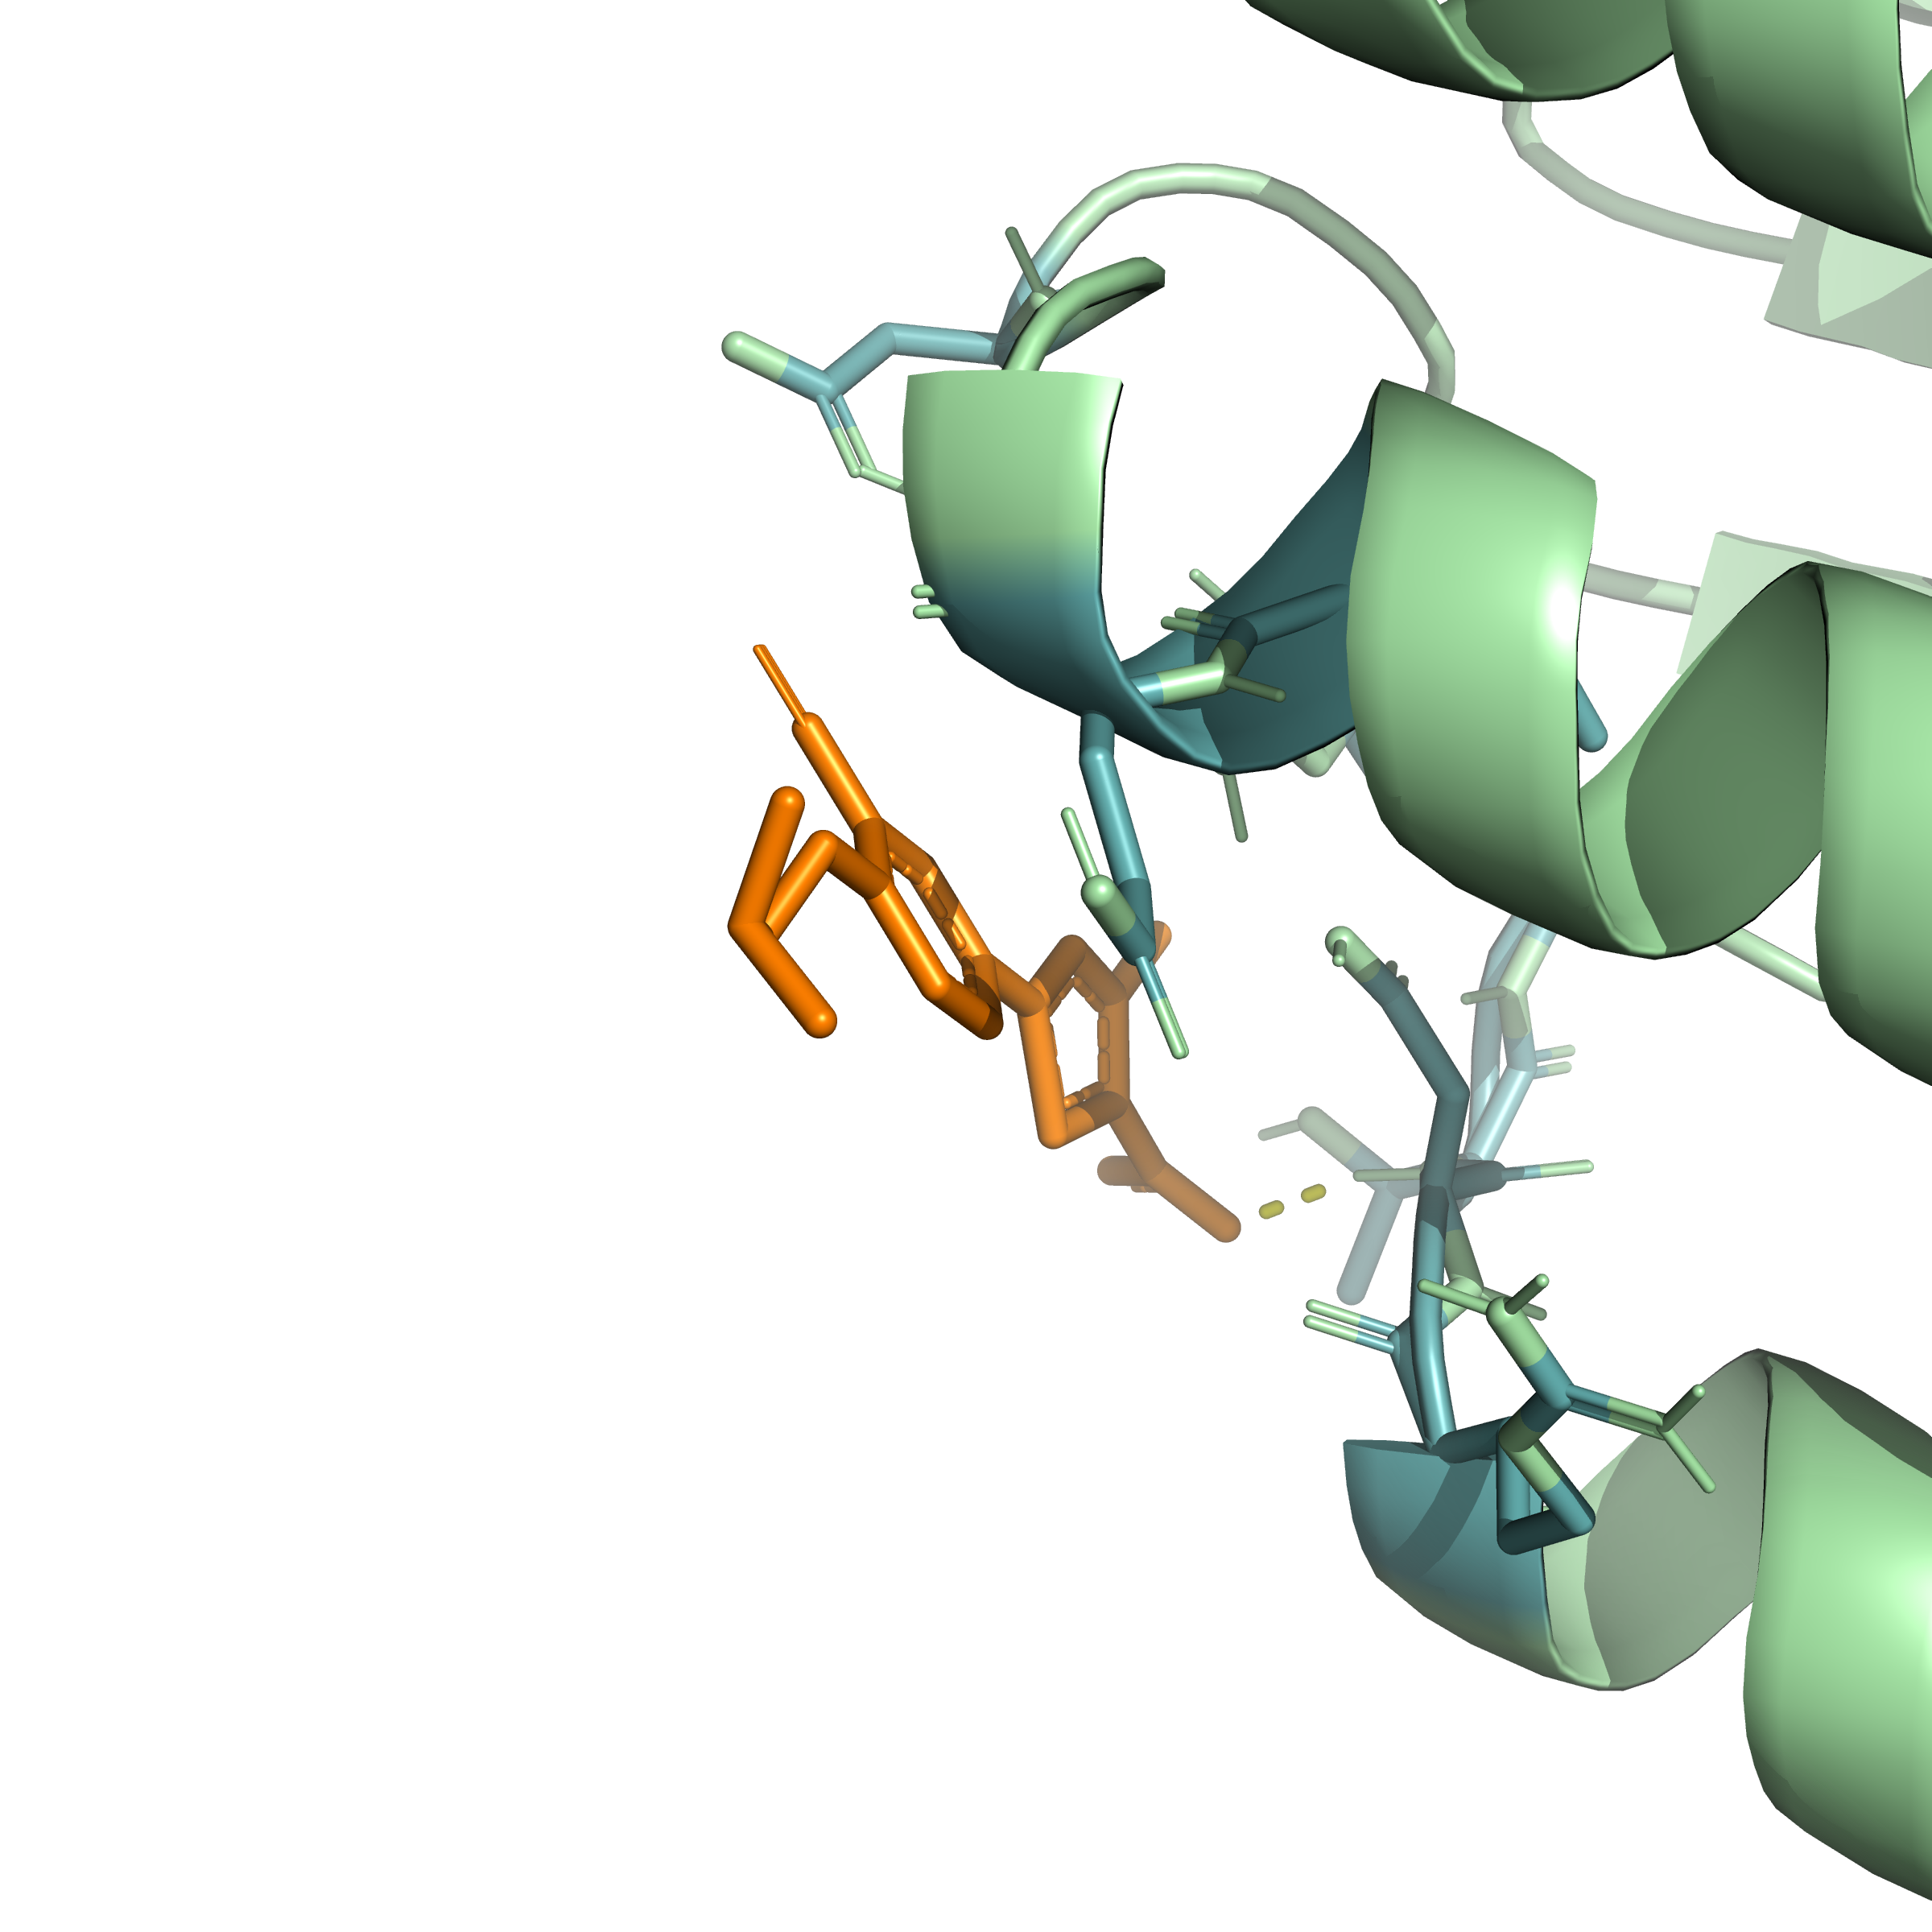
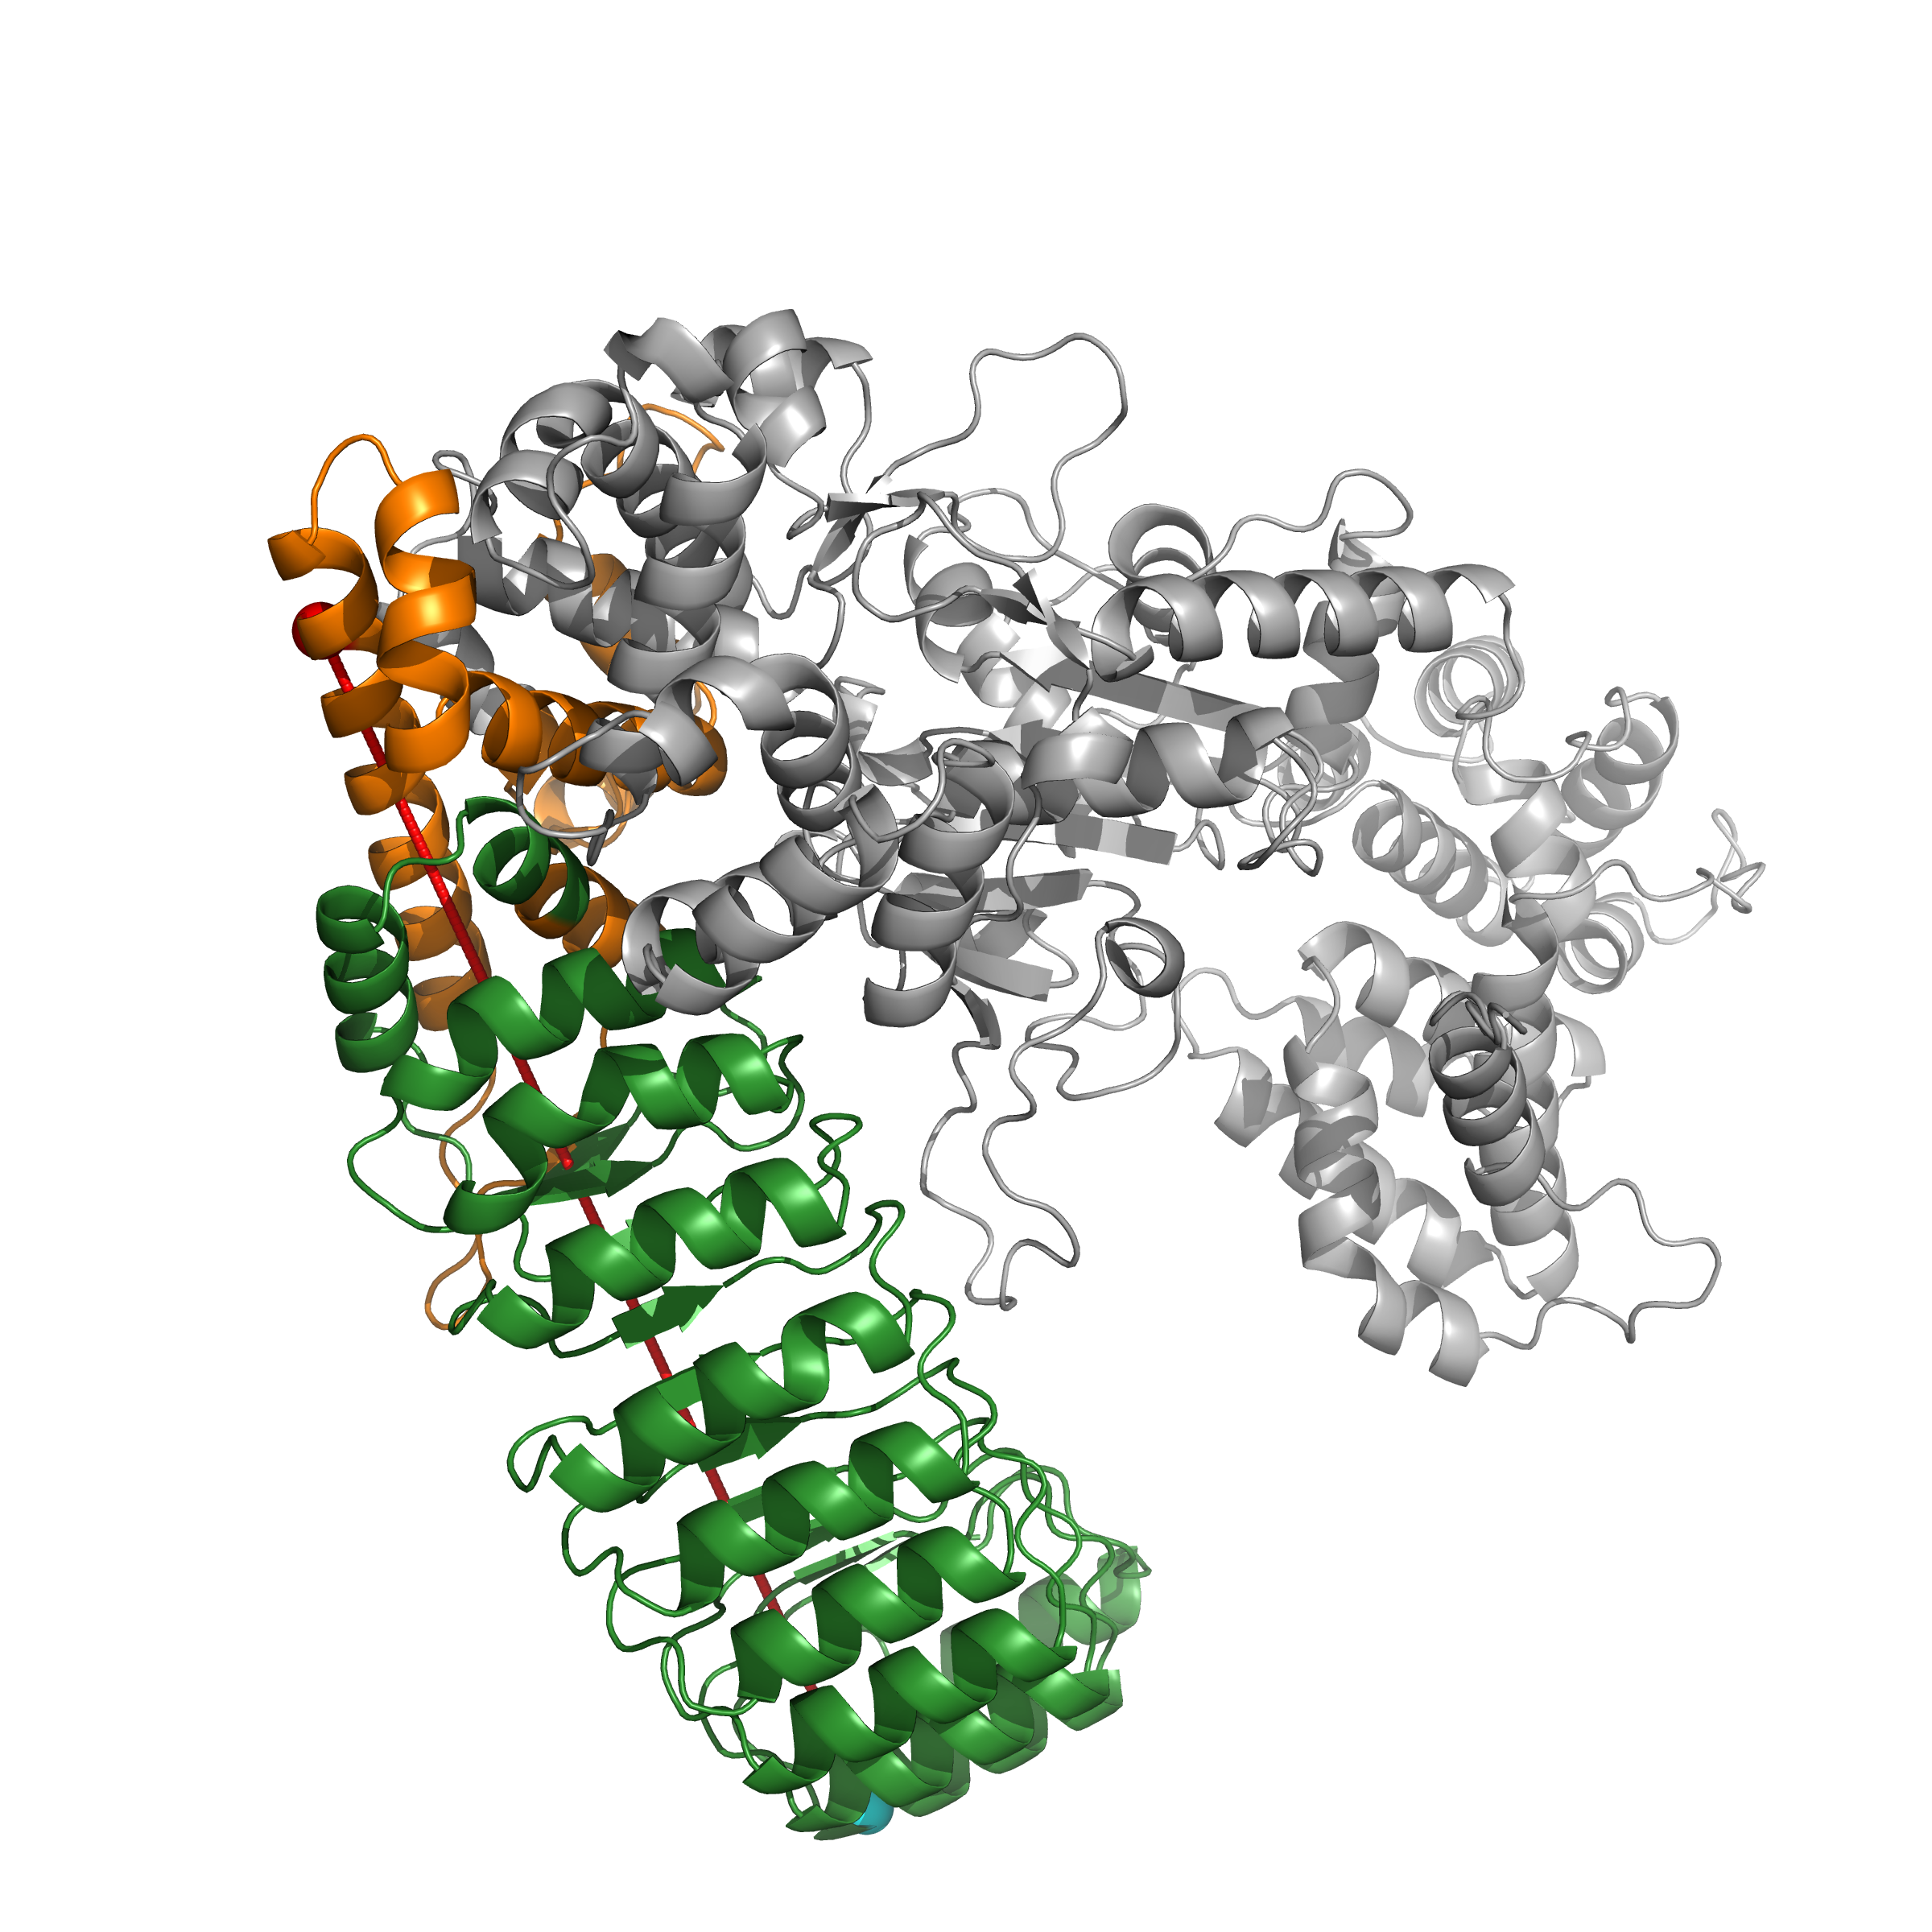
Deep Learning Guided Discovery and FEP Validation of NOD2 Binders for the R702W Crohn's Variant
Tanmay Vasudeva | Texas Virtual Academy at Hallsville, Texas, USA
Purpose
Results
Conclusion and Discussion
Crohn's disease affects over 3 million people worldwide, with the NOD2 R702W variant conferring a 3-fold increased disease risk. Despite this strong genetic link, no FDA-approved therapeutics specifically target NOD2. This study developed a computational pipeline integrating deep learning-based molecular docking with free energy perturbation (FEP) calculations to identify small molecules that bind NOD2's LRR domain and determine whether the R702W mutation differentially affects binding affinity.
Machine Learning Performance
This study presents the first computational pipeline for identifying mutation-sensitive NOD2 modulators.
1. R702W RIGIDIFIES the protein
Reduced RMSD (3.27Å vs 4.05Å) and eliminated heterogeneity (0% vs 12.6%) indicate impaired conformational flexibility.
2. Febuxostat is MUTATION-SENSITIVE
ΔΔG = +2.34 kcal/mol (p<0.001) corresponds to 50× weaker binding in R702W. Febuxostat-based therapies would be less effective in variant carriers.
3. Bufadienolide is MUTATION-RESISTANT
ΔΔG = -0.44 kcal/mol (n.s.) indicates equivalent binding regardless of genotype. This is the first reported NOD2-Bufadienolide interaction.
4. Allosteric mechanism confirmed
The 79.4Å distance proves mutation affects binding through long-range conformational changes.
Research Question
Can small molecules be identified that bind NOD2's LRR domain with differential affinity between wild-type and R702W mutant protein, enabling mutation-specific therapeutic targeting?
Methods and Procedures
NOD2-Scout achieved AUC 0.85-0.93 across 5-fold scaffold-split cross-validation (mean 0.89±0.03). Shuffled label controls (AUC ~0.50) confirmed genuine learning.
Molecular Dynamics Analysis
Virtual screening was performed on 9,566 compounds (2,152 FDA-approved drugs + 7,414 natural products) using GNINA deep learning-based docking against an AlphaFold2 NOD2 structure. NOD2-Scout, an XGBoost classifier trained on Morgan fingerprints, was validated using scaffold-split 5-fold cross-validation. Top candidates underwent ADMET filtering, 520+ ns of molecular dynamics simulations, and free energy perturbation calculations (20 λ windows, 5 ns/window) to quantify ΔΔG values between wild-type and R702W protein.
Future Work
Experimental validation will be pursued using surface plasmon resonance (SPR), isothermal titration calorimetry (ITC), and hydrogen-deuterium exchange mass spectrometry (HDX-MS). The pipeline will be extended to G908R and 1007fs Crohn's variants. Structure-activity relationship studies on Bufadienolide analogs may identify improved derivatives.
The R702W mutation RIGIDIFIES the protein: reduced RMSD (3.27Å vs 4.05Å) and eliminated conformational heterogeneity (0% vs 12.6% frames >5Å).
Lead Compounds
About the Researcher
Structural Analysis
I am a high school junior at Texas Virtual Academy at Hallsville with a personal connection to this research—I was diagnosed with Crohn's disease and carry the R702W mutation myself. This project combines my interests in computational biology, machine learning, and drug discovery to address a condition that affects my daily life.
All computational work was performed independently using a personal RTX 4060 Ti GPU and Google Colab Pro for extended simulations. No institutional laboratory resources were used.
NOD2 Domain Architecture:
• CARD (gray): Signaling
• NBD (blue): Nucleotide binding
• HD2 (orange): R702W site
• LRR (green): Ligand recognition
The R702W mutation is located 79.4Å from the binding pocket, suggesting an allosteric mechanism.
Free Energy Perturbation Results
Key References
1. Hugot JP et al. (2001) Nature 411:599-603. NOD2 mutations in Crohn's disease.
2. Jumper J et al. (2021) Nature 596:583-589. AlphaFold protein structure prediction.
3. McNutt AT et al. (2021) J Cheminform 13:43. GNINA molecular docking.
4. Gapsys V et al. (2022) Nat Protoc 17:1114-1141. pmx free energy calculations.
5. Abraham MJ et al. (2015) SoftwareX 1-2:19-25. GROMACS molecular dynamics.
Febuxostat: ΔΔG = +2.34 kcal/mol (8σ, p<0.001) → 50× weaker binding in R702W
Bufadienolide: ΔΔG = -0.44 kcal/mol (n.s.) → Mutation-resistant binding

