Slide 1
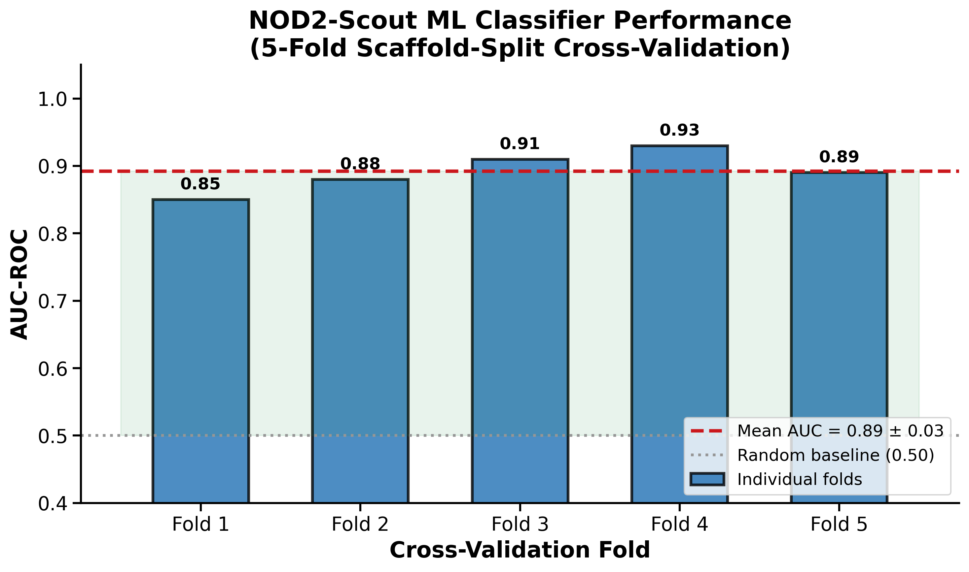
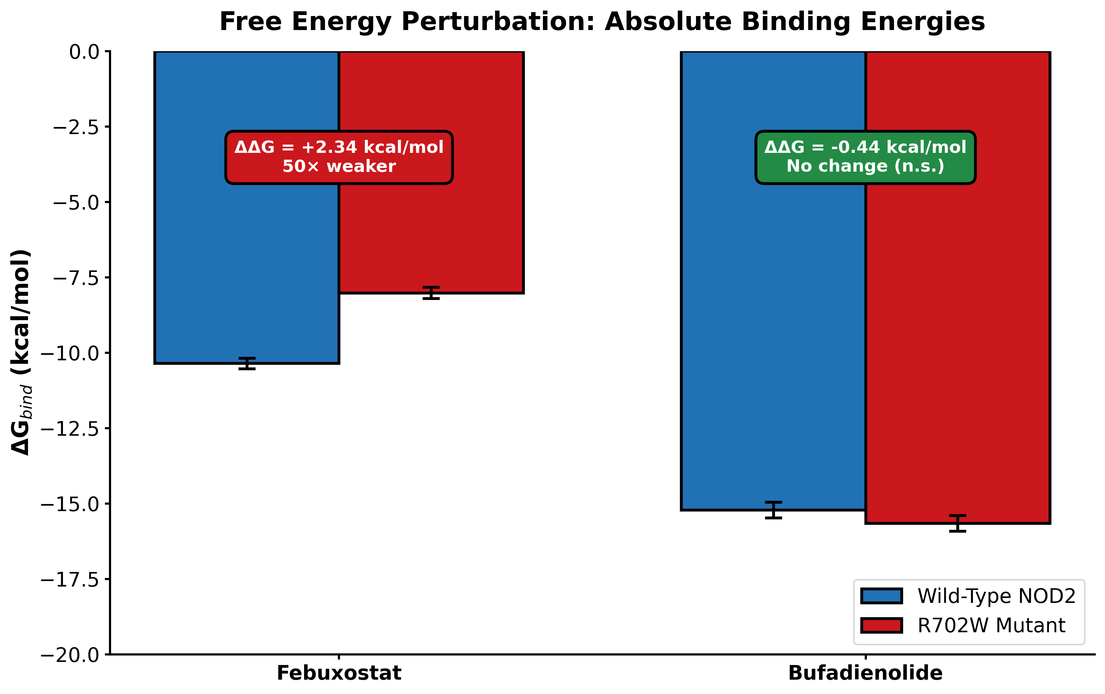
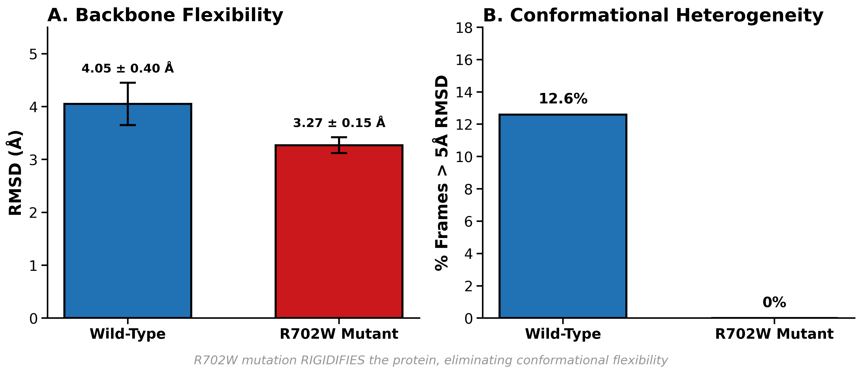
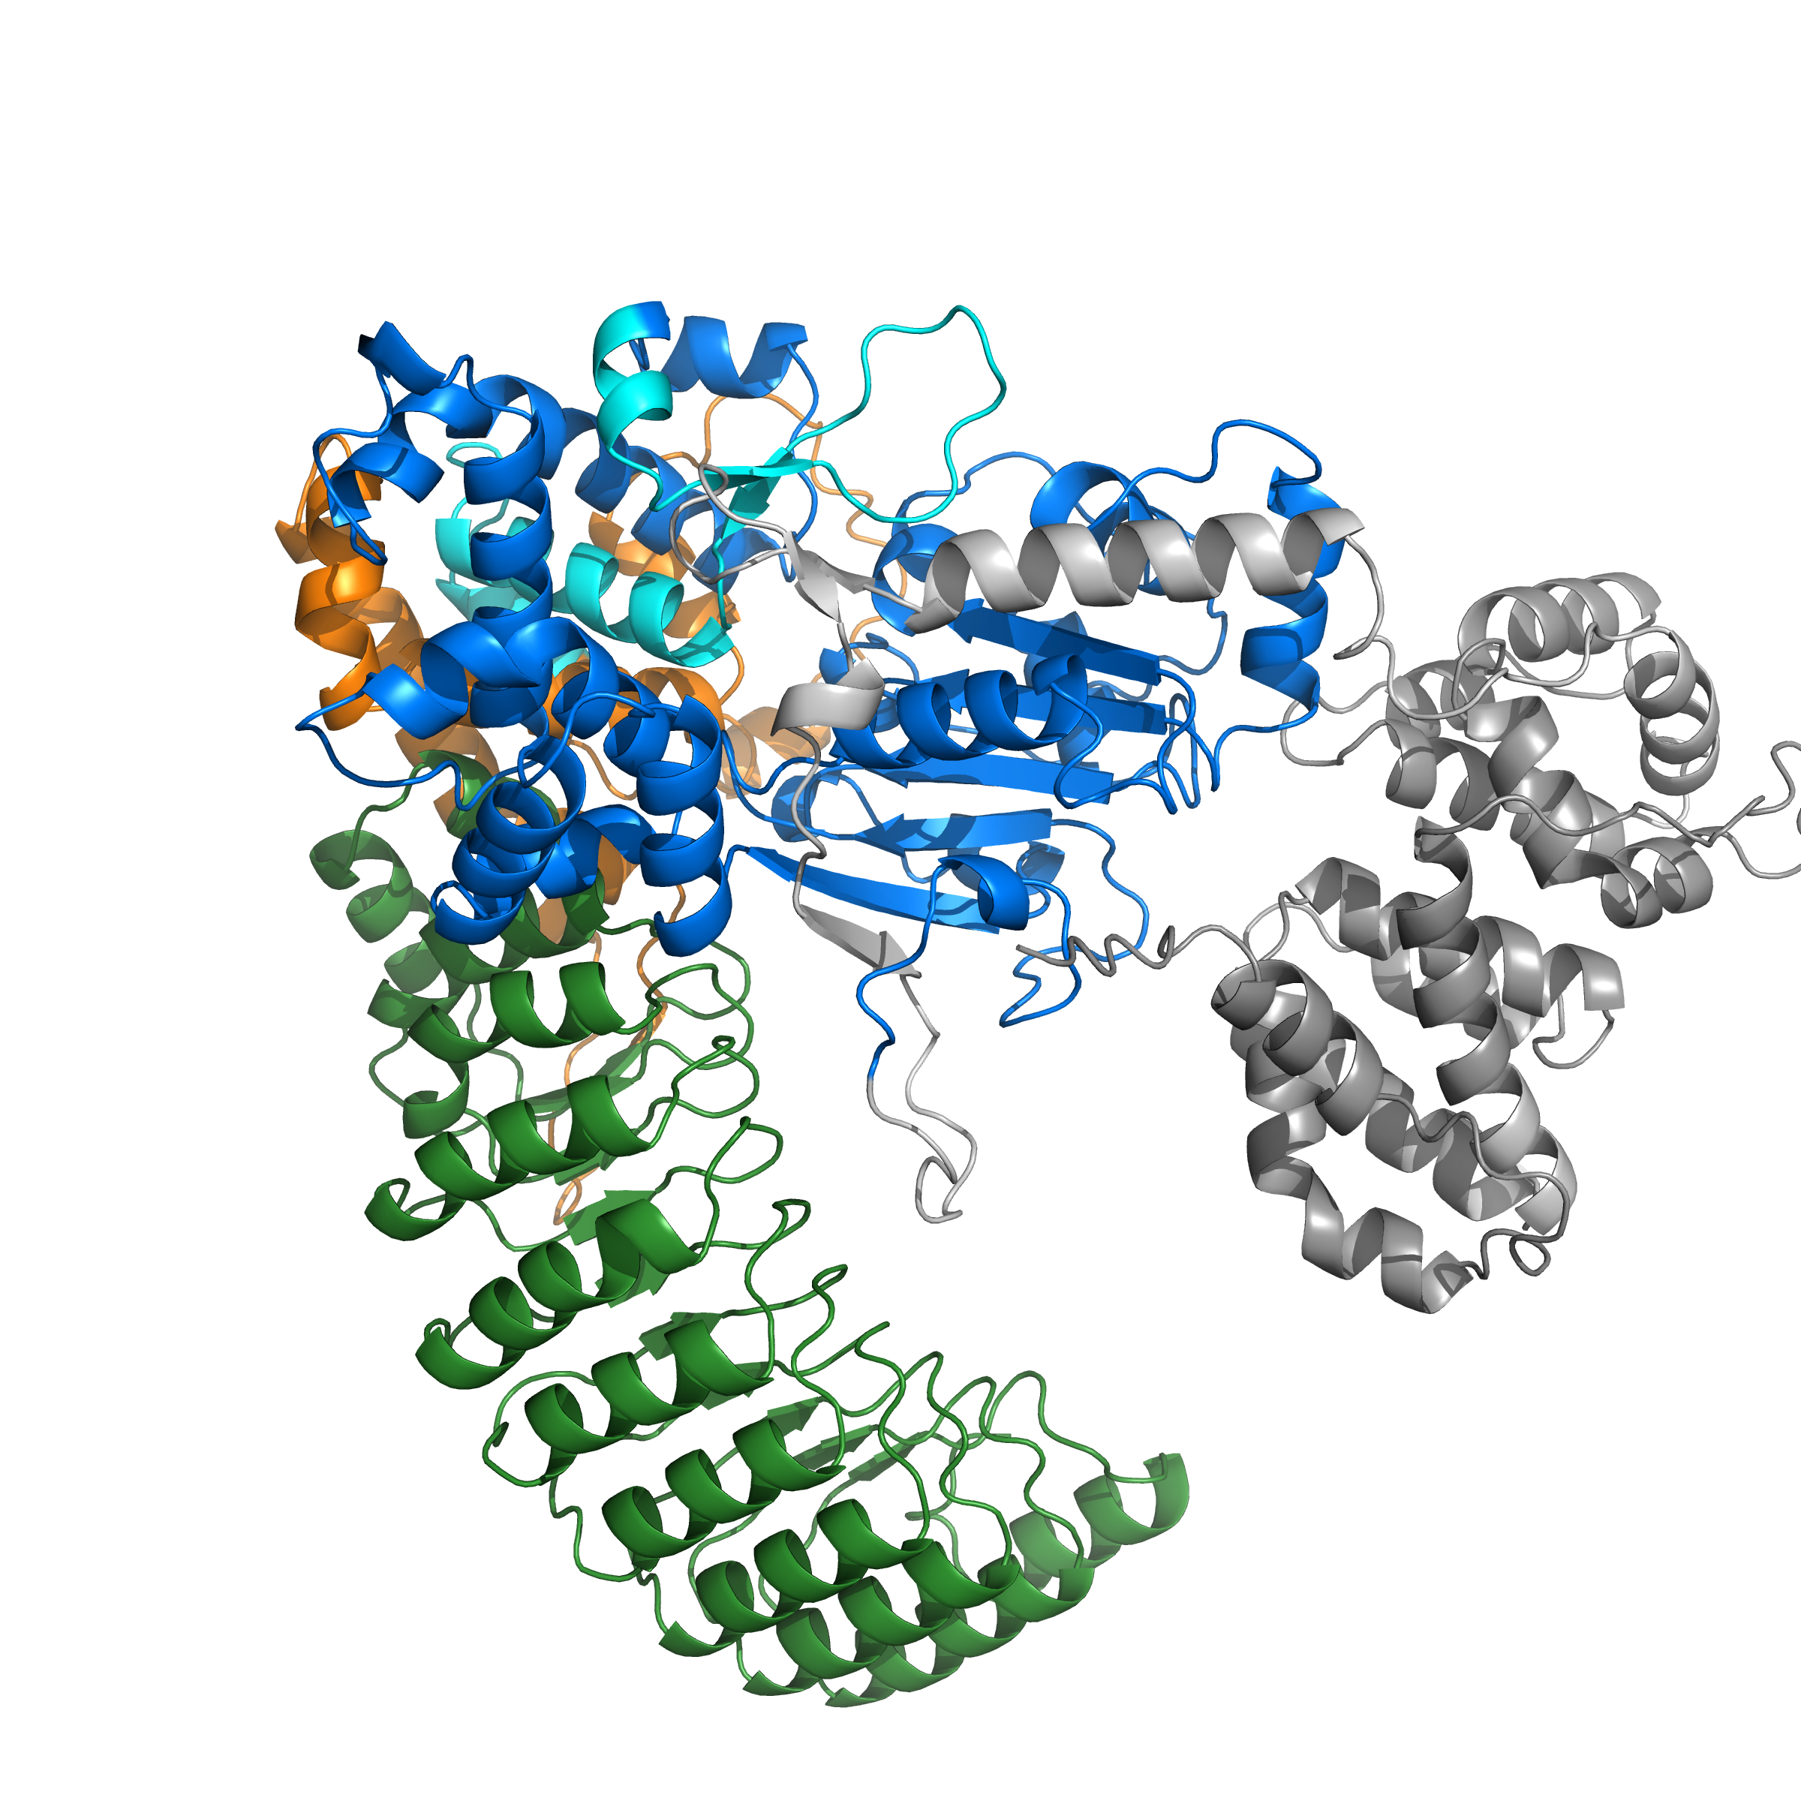
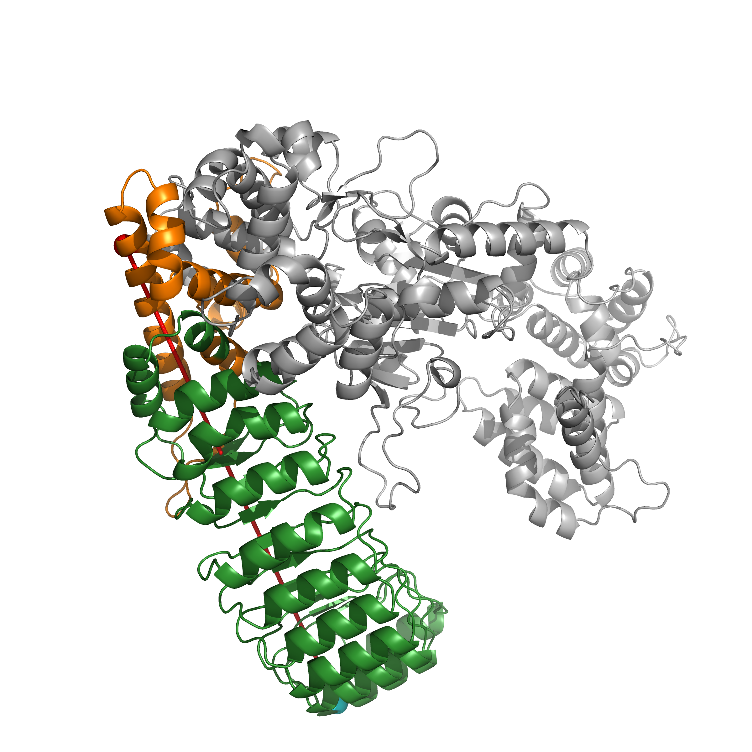
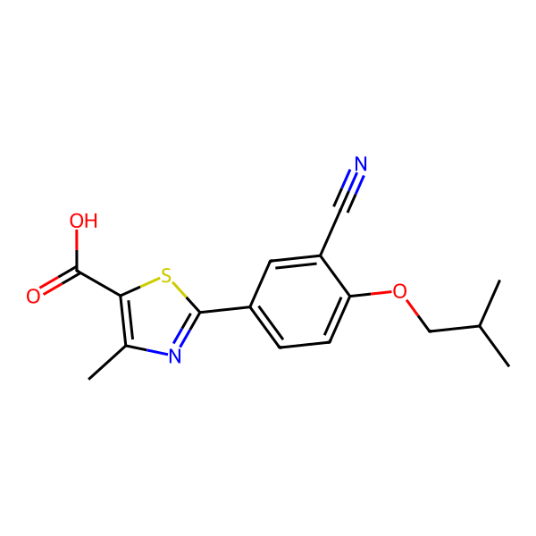
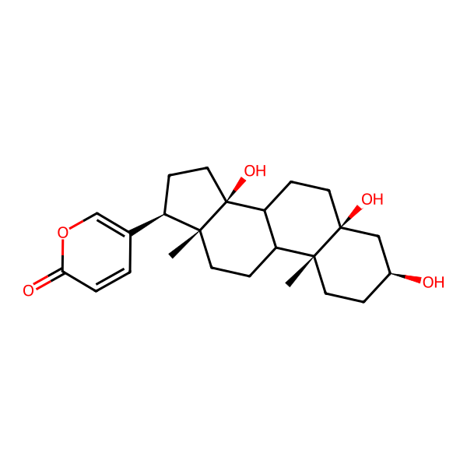
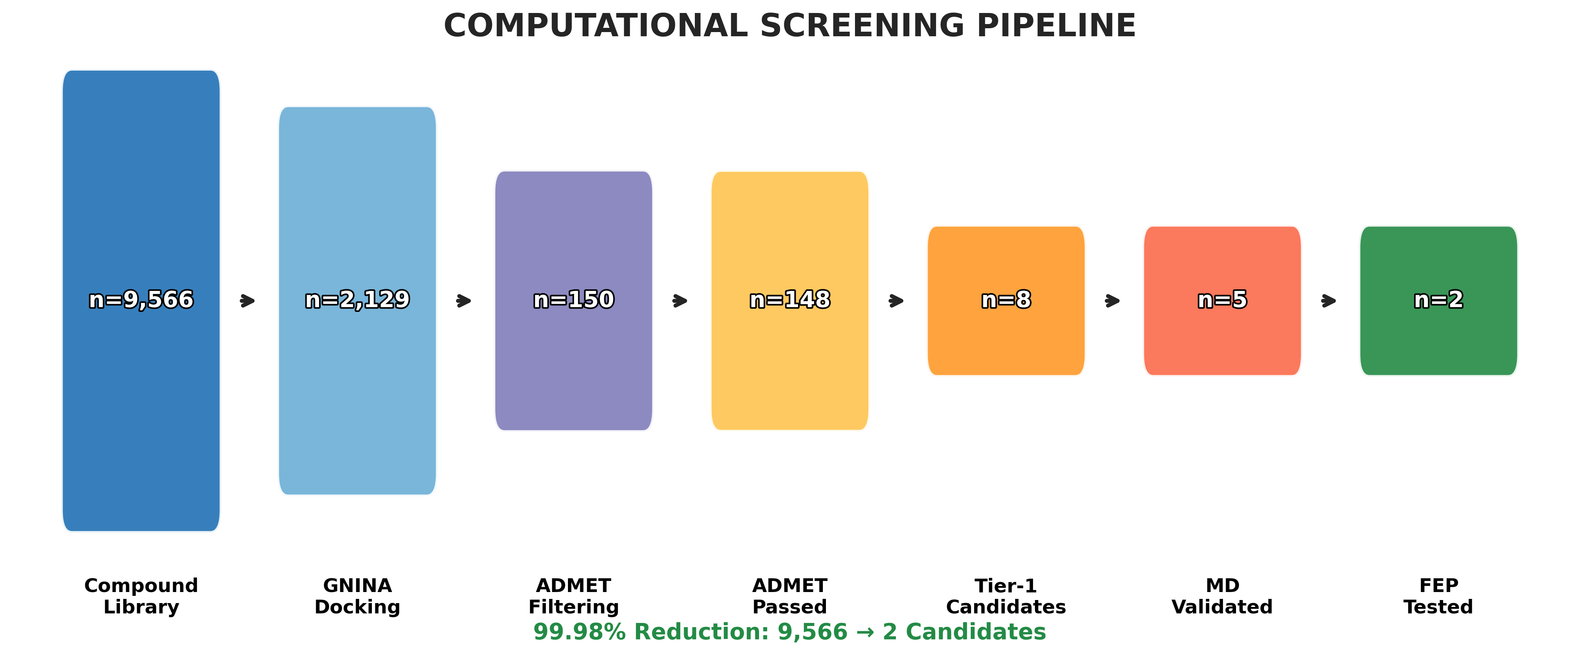
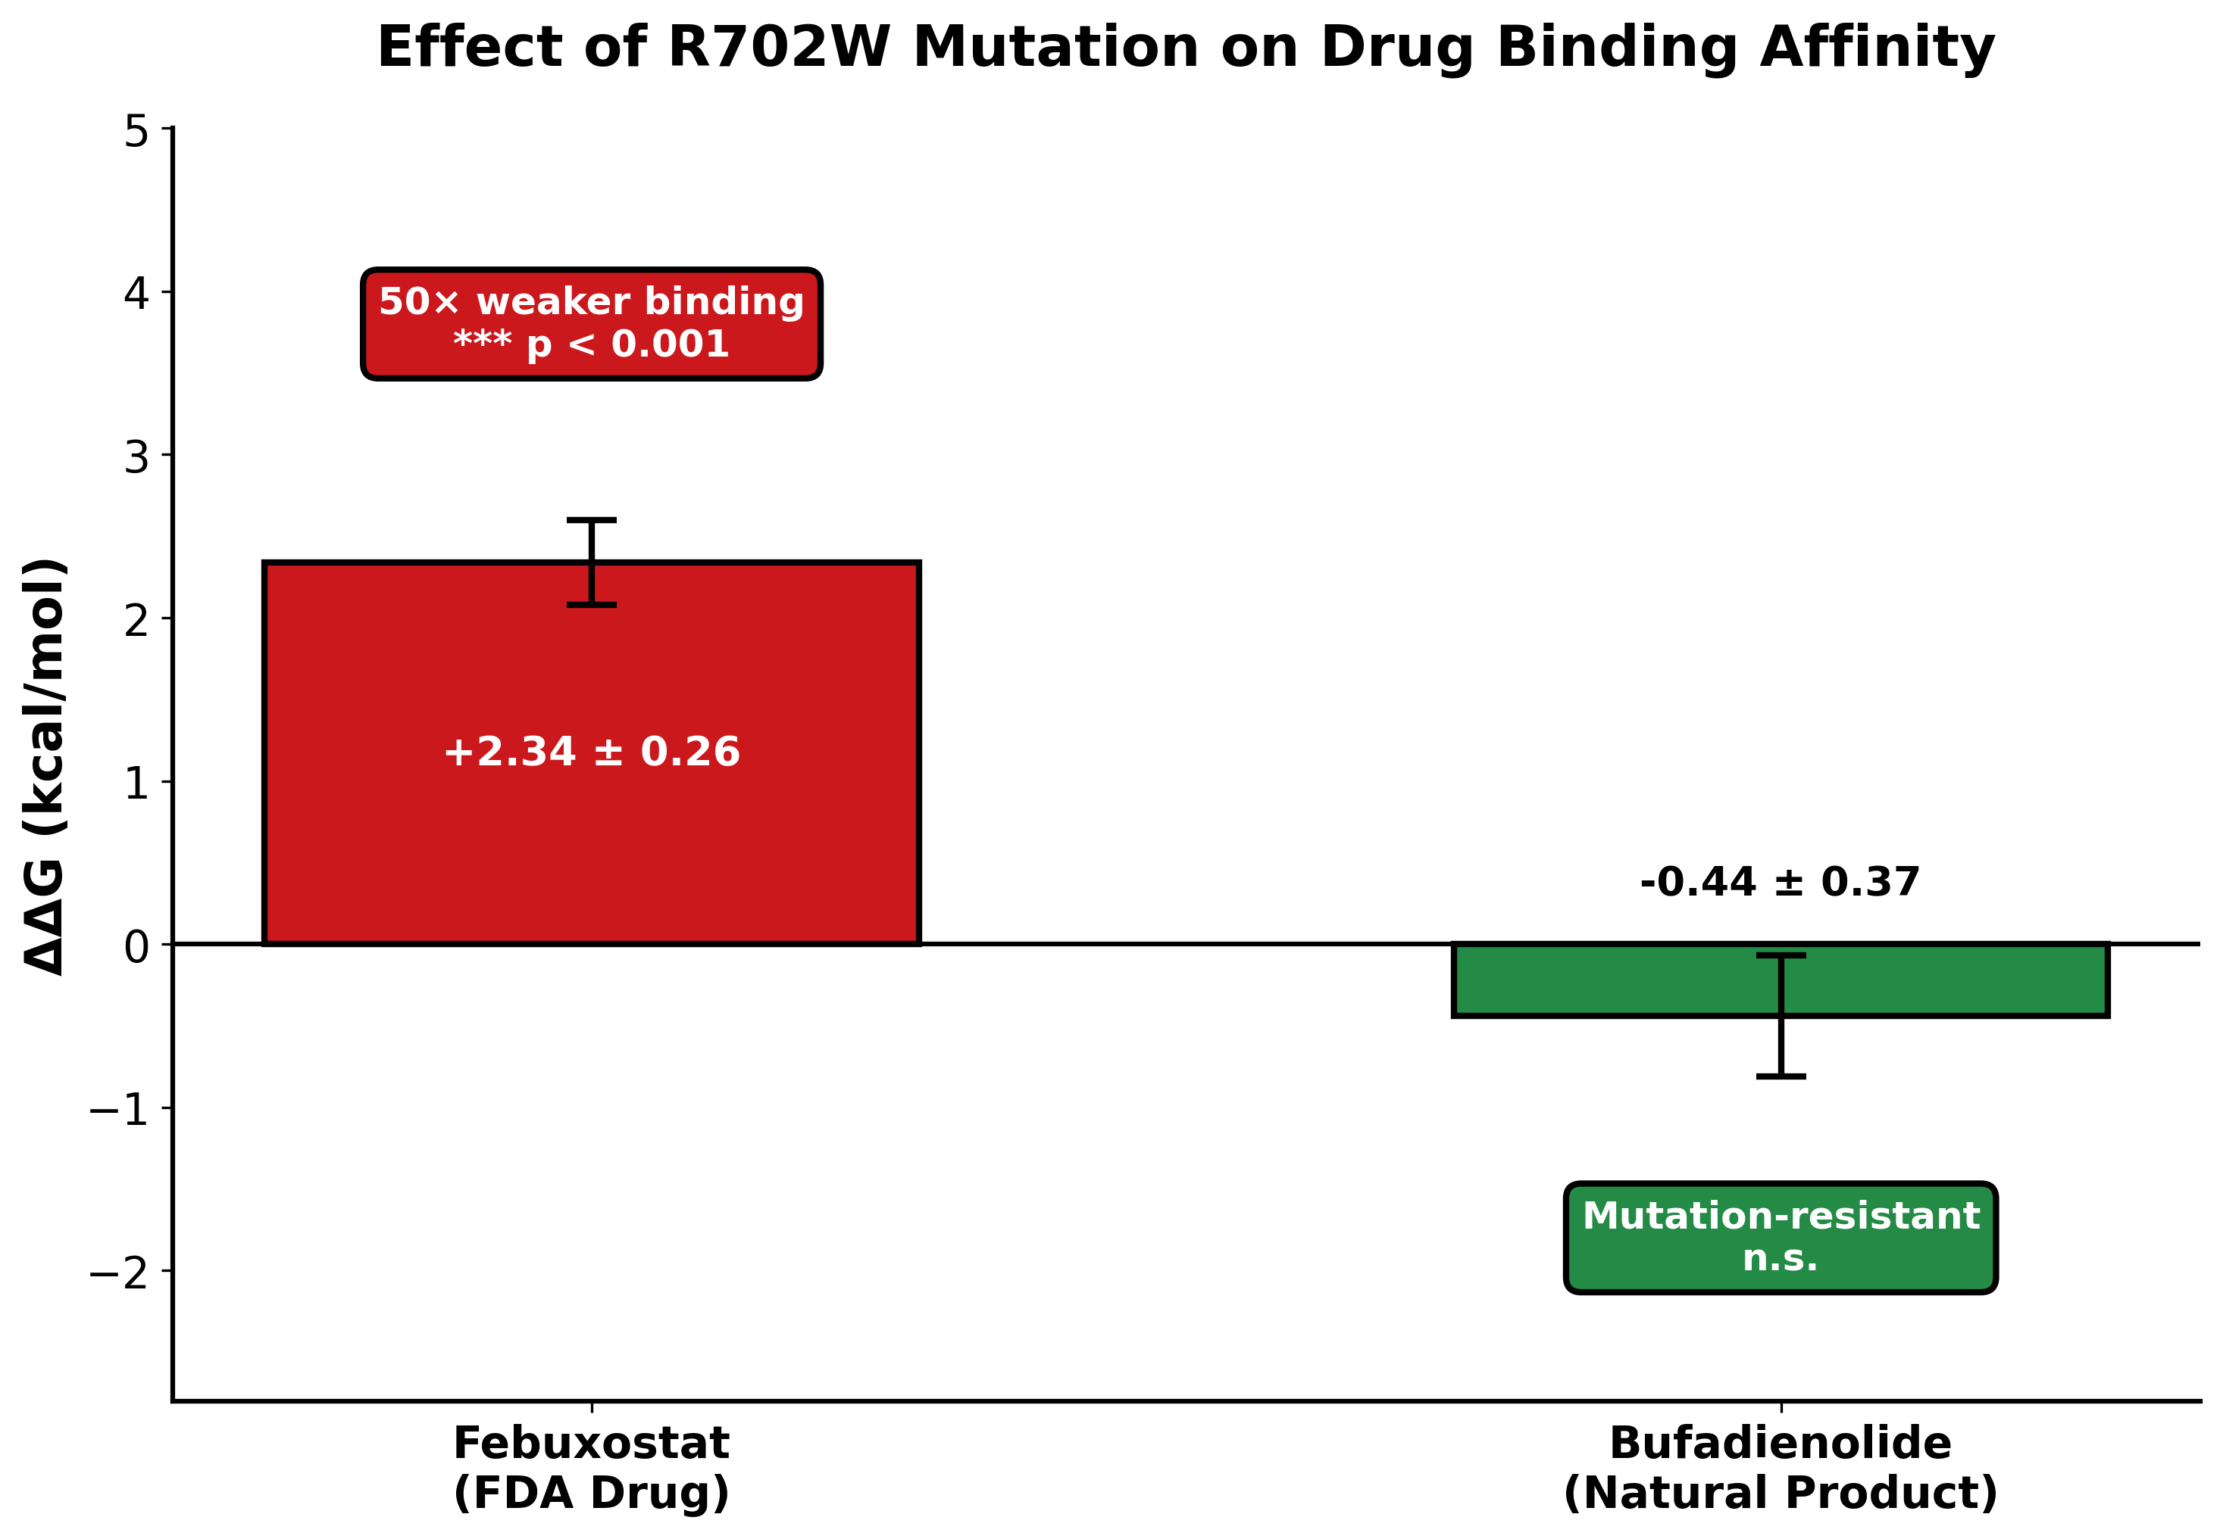
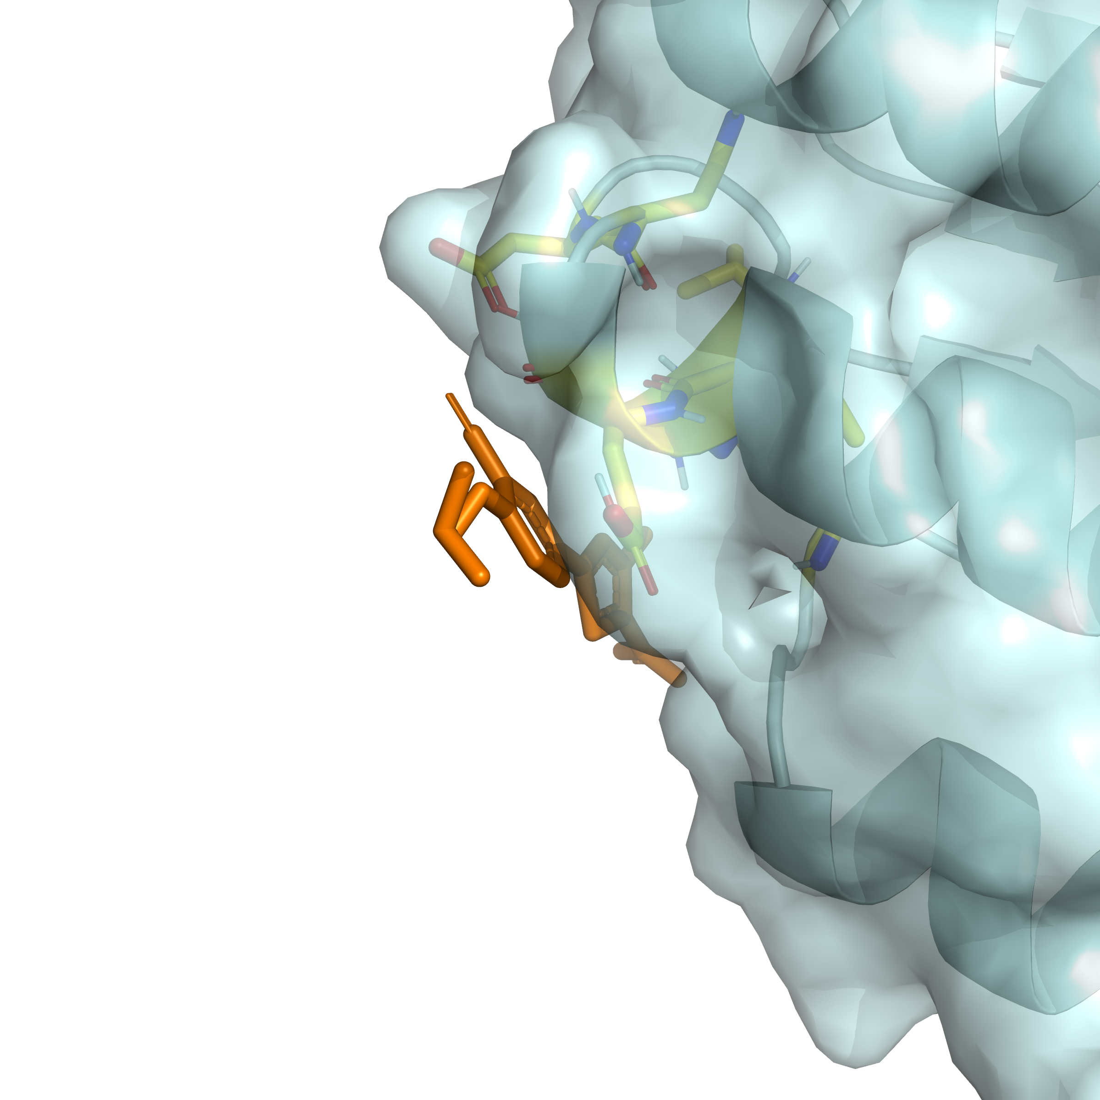
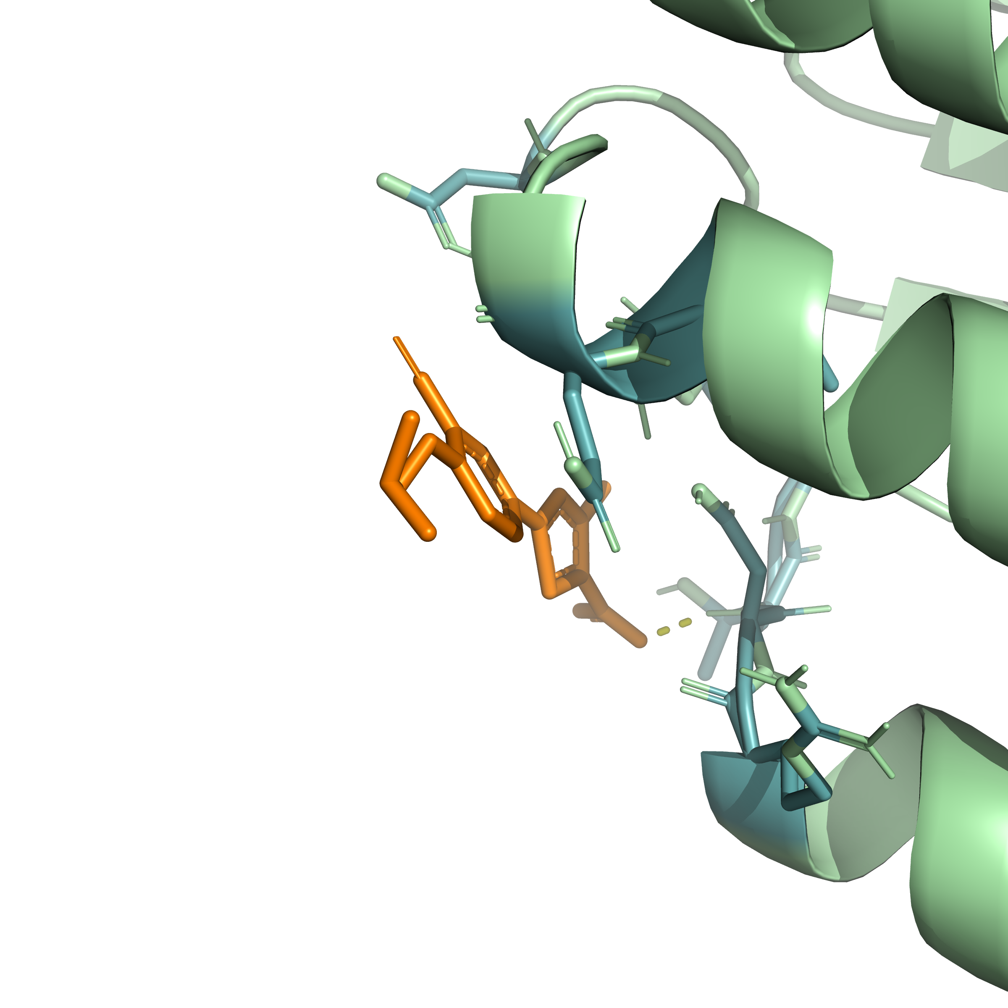
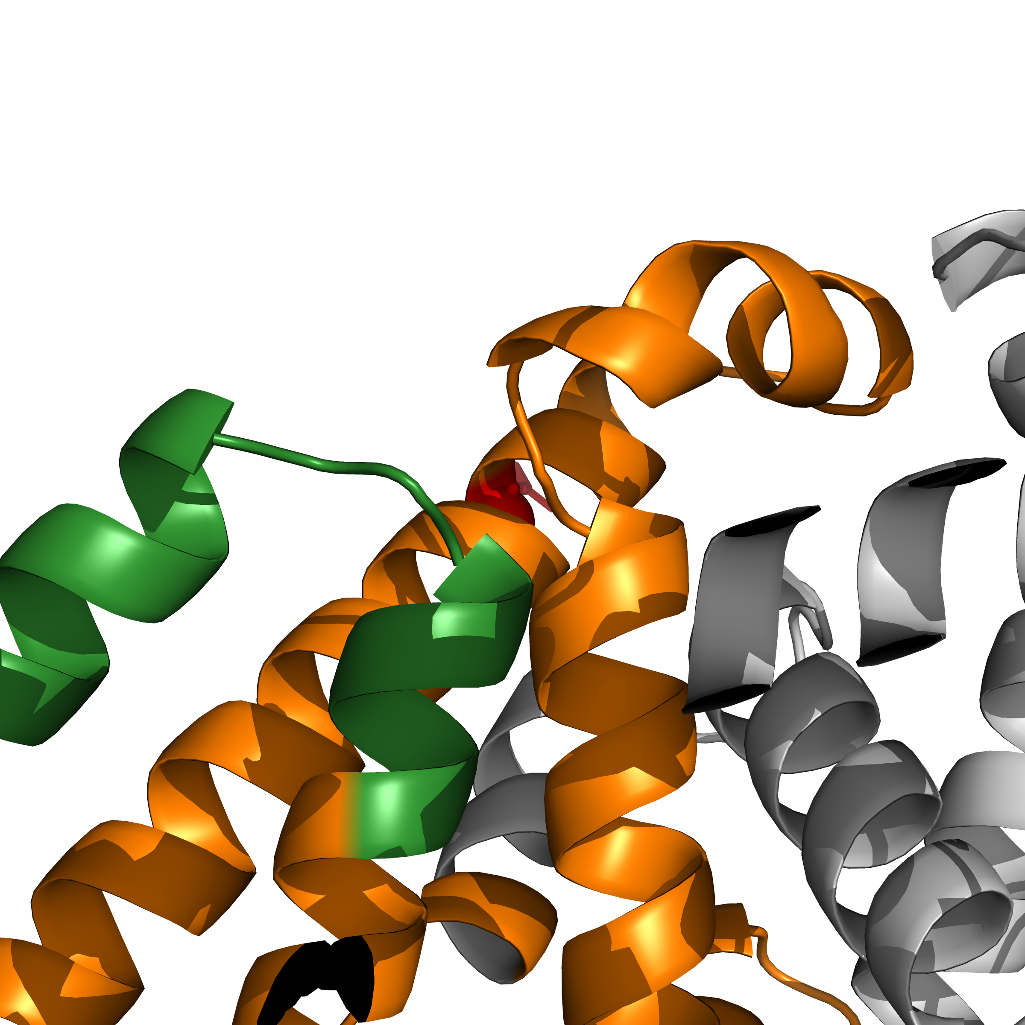
Computational Discovery of Mutation-Sensitive NOD2 Modulators
Identification of Small Molecules with Differential Binding to Wild-Type vs R702W Crohn's Disease Variant
Tanmay Vasudeva
Texas Virtual Academy at Hallsville, Texas, USA
Purpose
Results
Results (continued)
Crohn's disease affects over 3 million people worldwide. The NOD2 R702W mutation increases disease risk by 3-fold, yet no FDA-approved drugs specifically target NOD2. The purpose of this study is to: • Develop a computational pipeline to identify NOD2 binders • Determine how the R702W mutation affects drug binding • Identify mutation-resistant therapeutic candidates
Machine Learning Validation
Research Question
Febuxostat: ΔG(WT)=-10.36, ΔG(R702W)=-8.02 kcal/mol Bufadienolide: ΔG(WT)=-15.22, ΔG(R702W)=-15.66 kcal/mol
Can small molecules be identified that bind NOD2's LRR domain with differential affinity between wild-type and R702W mutant, enabling mutation-specific therapeutic targeting?
NOD2-Scout achieved AUC 0.85-0.93 across 5-fold scaffold-split cross-validation. Shuffled label control: AUC ~0.50 (confirms model learns real patterns)
Molecular Dynamics Analysis
Conclusion and Discussion
Background
1. R702W mutation increases protein rigidity RMSD: 3.27Å vs 4.05Å (p<0.05); 0% vs 12.6% heterogeneity 2. Febuxostat is MUTATION-SENSITIVE ΔΔG = +2.34±0.26 kcal/mol (8σ, p<0.001) → 50× weaker binding in R702W mutant 3. Bufadienolide is MUTATION-RESISTANT ΔΔG = -0.44±0.37 kcal/mol (1.8σ, not significant) → Binds equally regardless of mutation status 4. First reported NOD2-Bufadienolide interaction No prior literature exists for this compound-target pair 5. Allosteric mechanism confirmed 79.4Å distance proves mutation affects binding through long-range conformational changes
NOD2 Domain Architecture: • CARD (gray): Signaling • NBD (blue): Nucleotide binding • HD2 (orange): Contains R702W • LRR (green): Ligand recognition
Key Finding: R702W mutation RIGIDIFIES the protein • WT: RMSD 4.05±0.40Å, 12.6% frames >5Å (flexible) • R702W: RMSD 3.27±0.15Å, 0% frames >5Å (rigid)
Lead Compound Identification
79.4Å
Distance from R702W to binding pocket
→ Suggests
allosteric mechanism
Methods and Procedures
Future Work
• Experimental validation via Surface Plasmon Resonance (SPR), Isothermal Titration Calorimetry (ITC), and Hydrogen-Deuterium Exchange Mass Spectrometry (HDX-MS) • Extension to other Crohn's-associated variants (G908R, 1007fs) • Structure-activity relationship (SAR) studies on Bufadienolide analogs • Cell-based functional assays to measure NOD2 pathway modulation
Febuxostat (FDA Drug)
Bufadienolide (Natural Product)
Free Energy Perturbation Results
Key References
1. Hugot JP et al. (2001) Nature 411:599-603. NOD2 mutations in Crohn's disease. 2. Jumper J et al. (2021) Nature 596:583-589. AlphaFold protein structure prediction. 3. McNutt AT et al. (2021) J Cheminform 13:43. GNINA molecular docking. 4. Gapsys V et al. (2022) Nat Protoc 17:1114-1141. pmx free energy calculations. 5. Abraham MJ et al. (2015) SoftwareX 1-2:19-25. GROMACS molecular dynamics.
Computational Screening Pipeline: 1. Virtual Screening: 9,566 compounds (2,152 FDA drugs + 7,414 natural products) docked using GNINA CNN-based scoring 2. Machine Learning: NOD2-Scout XGBoost classifier trained on molecular fingerprints, validated by scaffold-split CV 3. ADMET Filtering: Drug-likeness and toxicity screening 4. MD Simulations: 520+ ns total; apo WT vs R702W comparison 5. Free Energy Perturbation: 20 λ windows, 5 ns/window for ΔΔG calculation
Binding pocket surface | Ligand interactions | R702W site (red)

