Slide 1
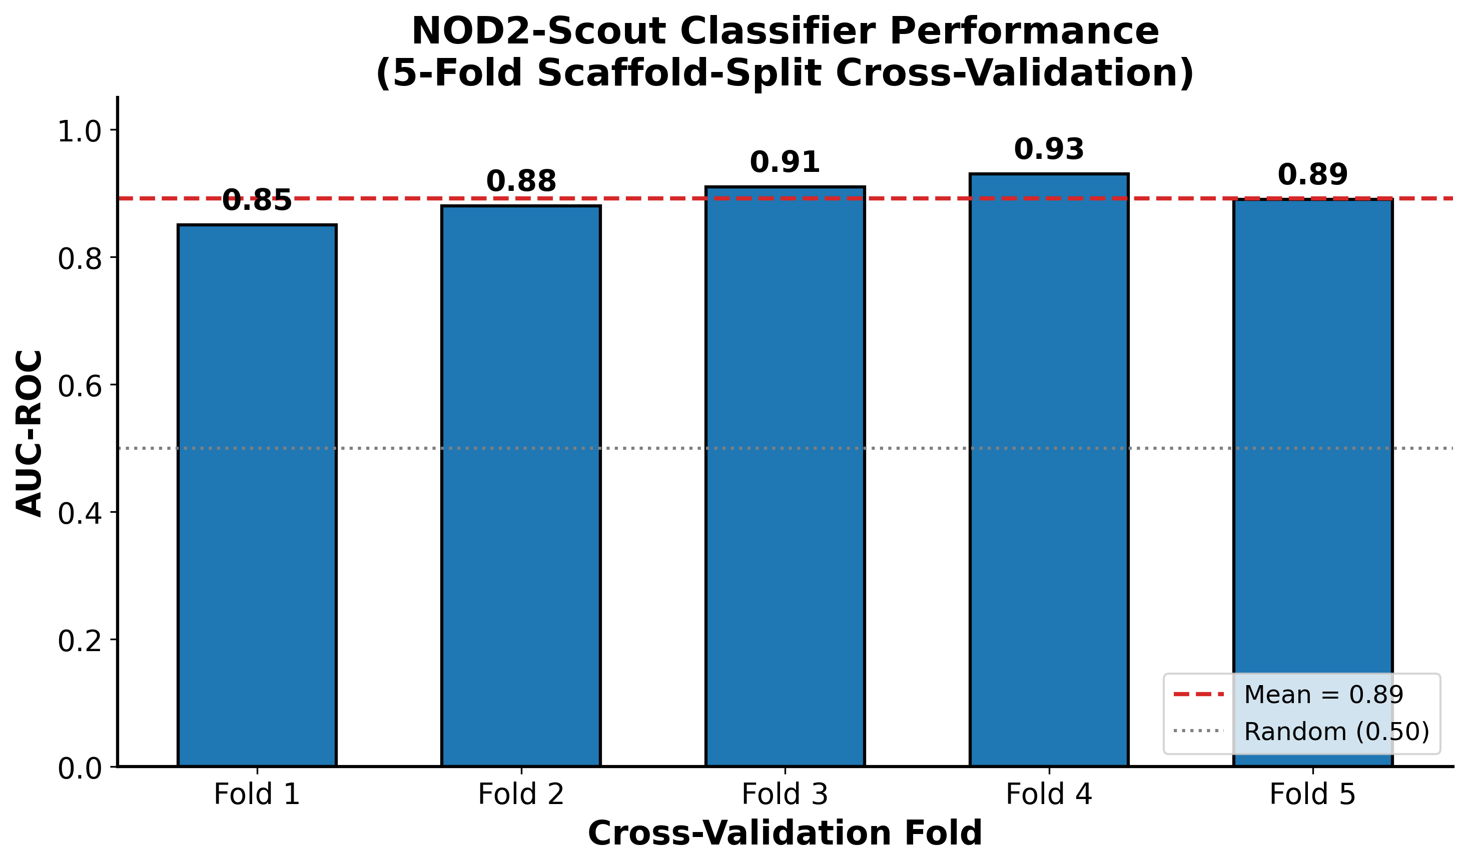
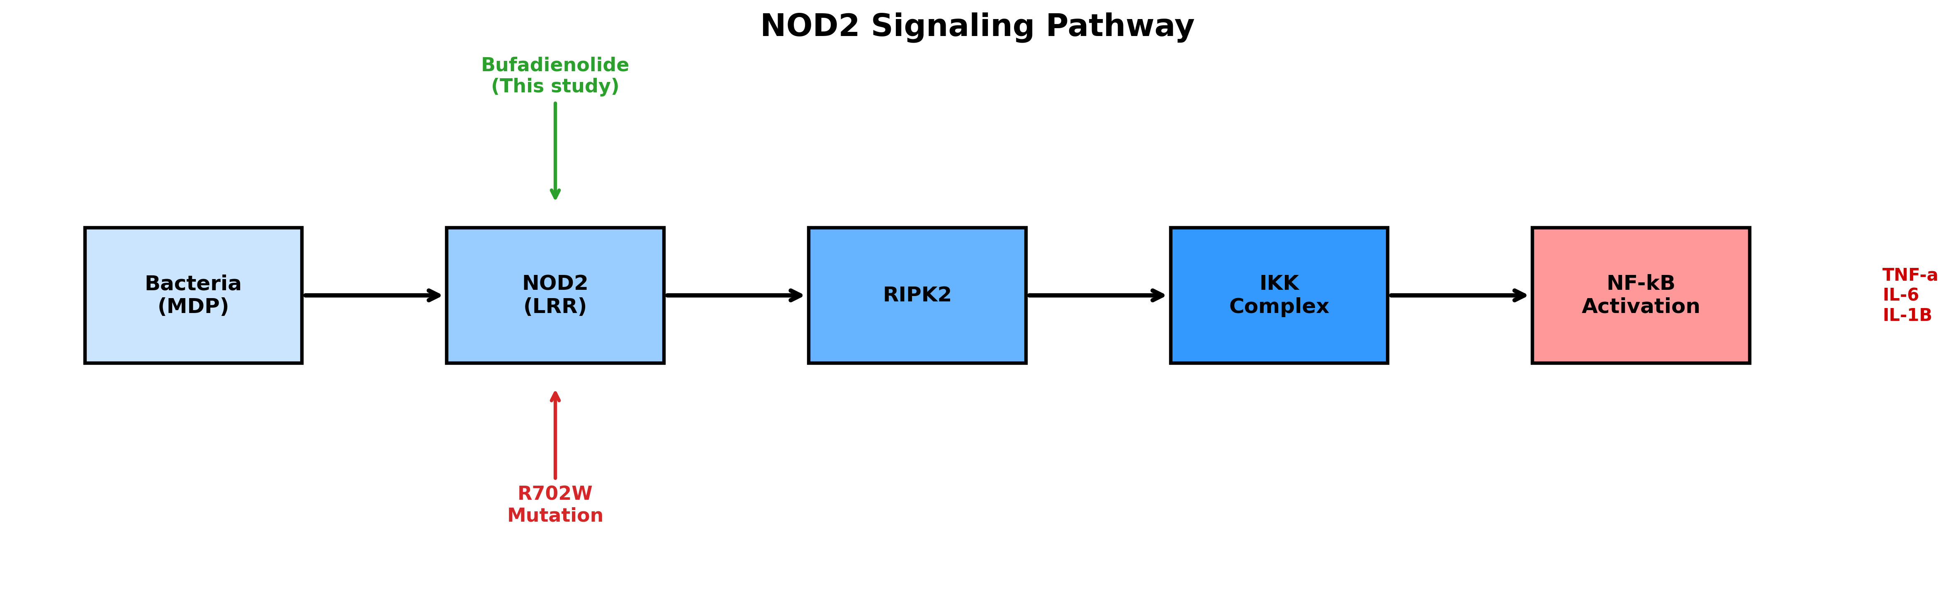
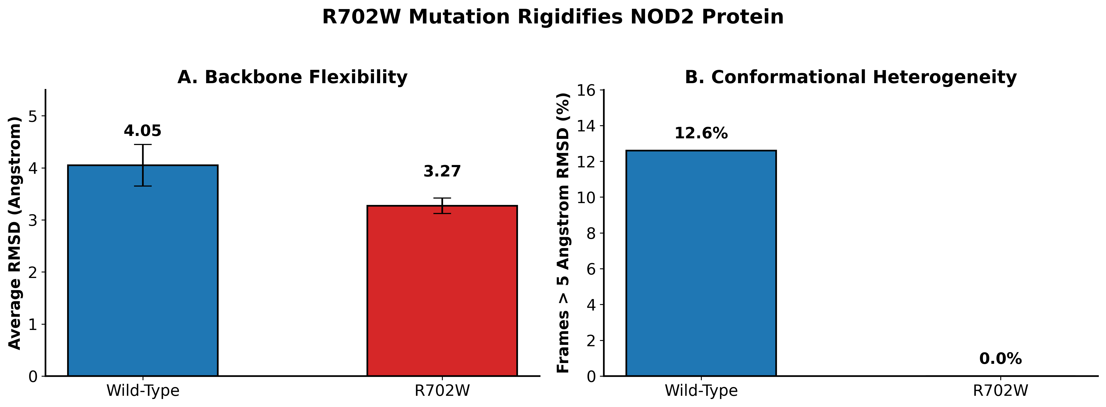
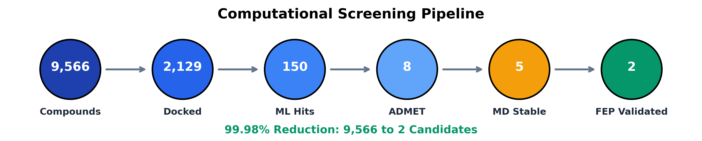
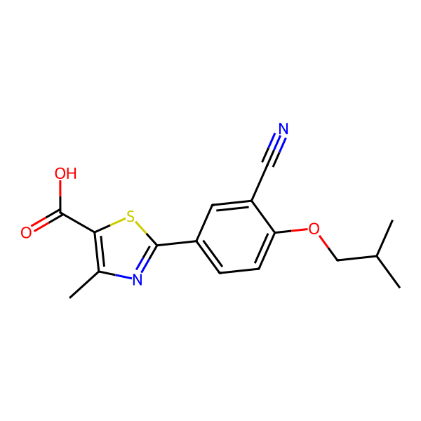
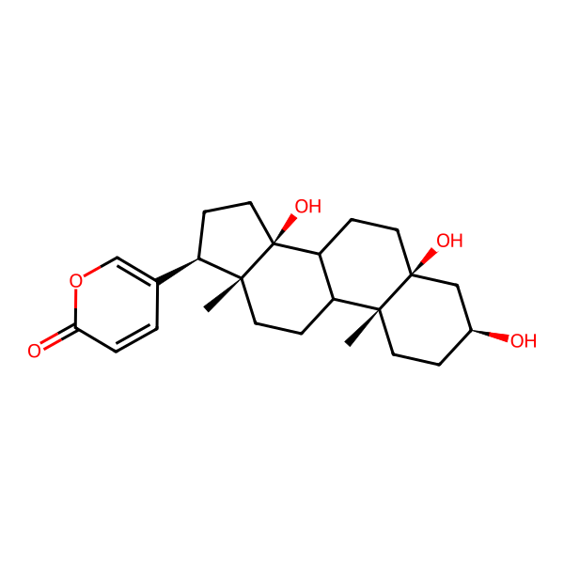
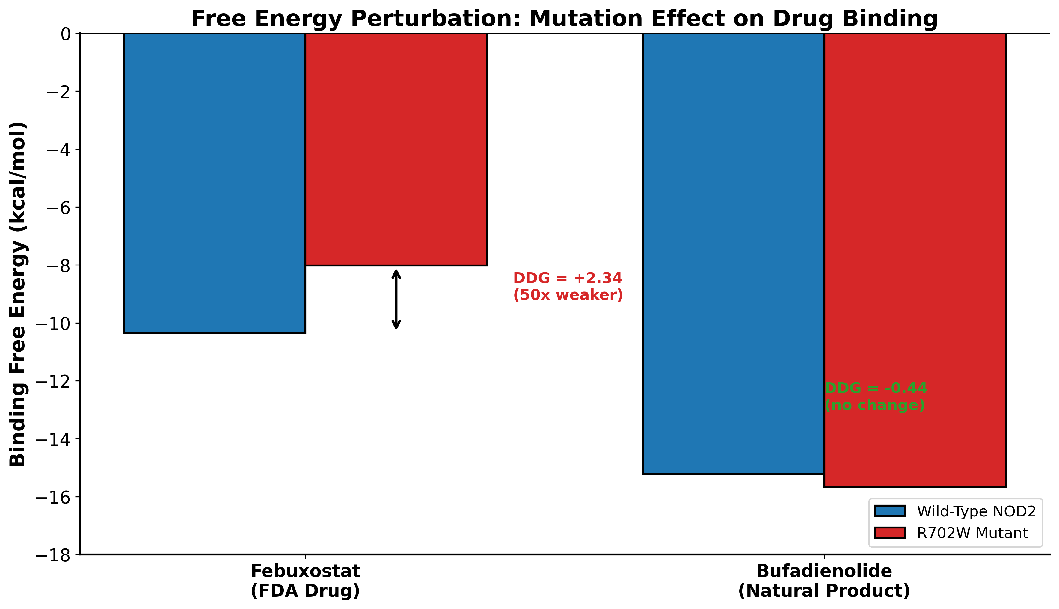
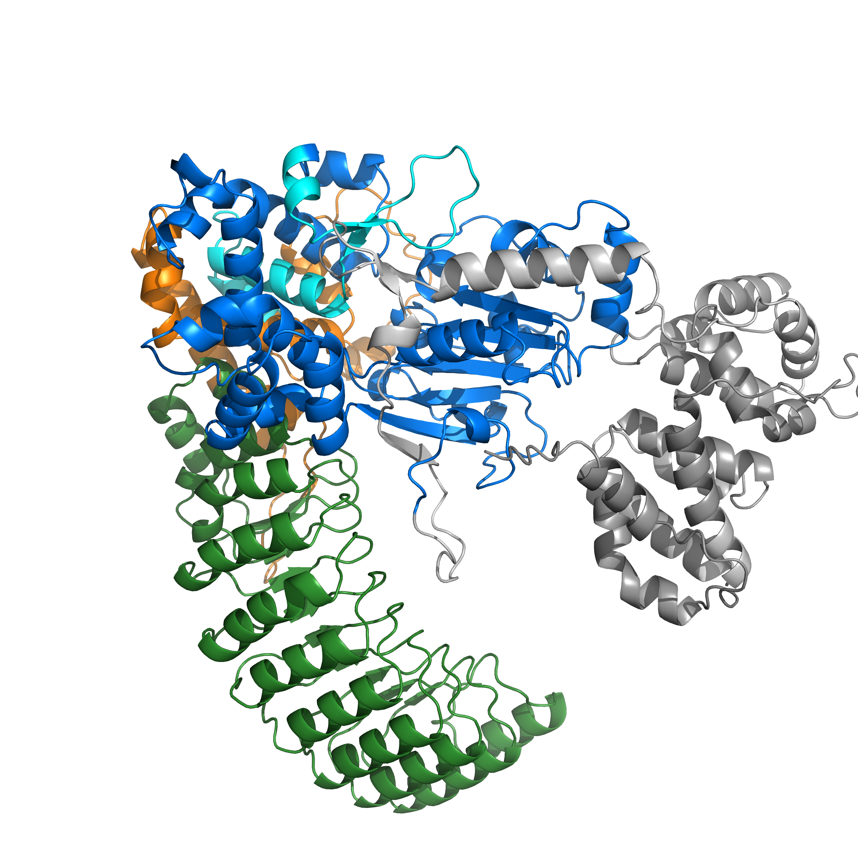
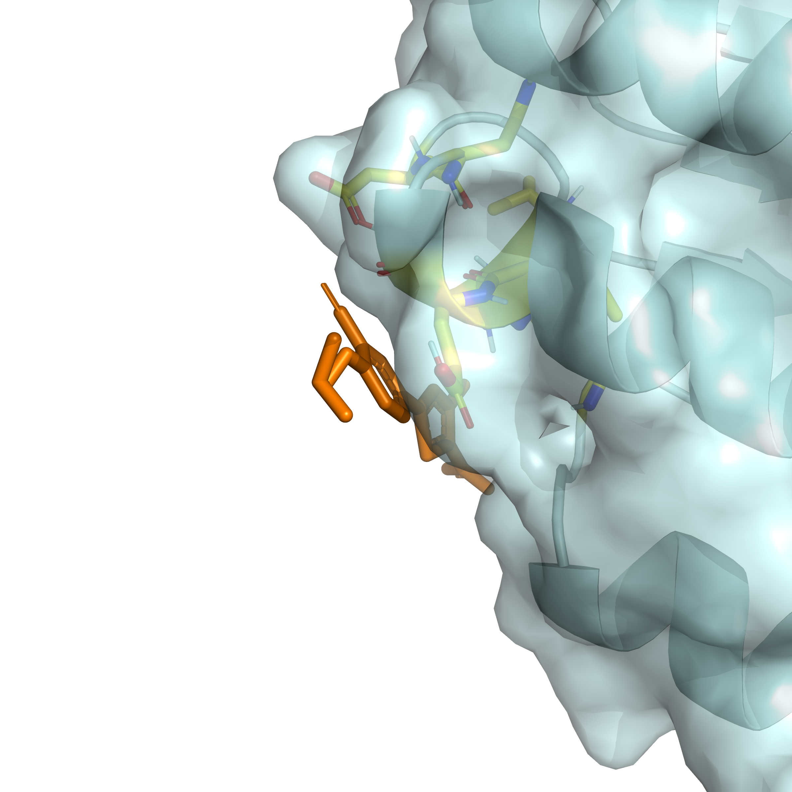
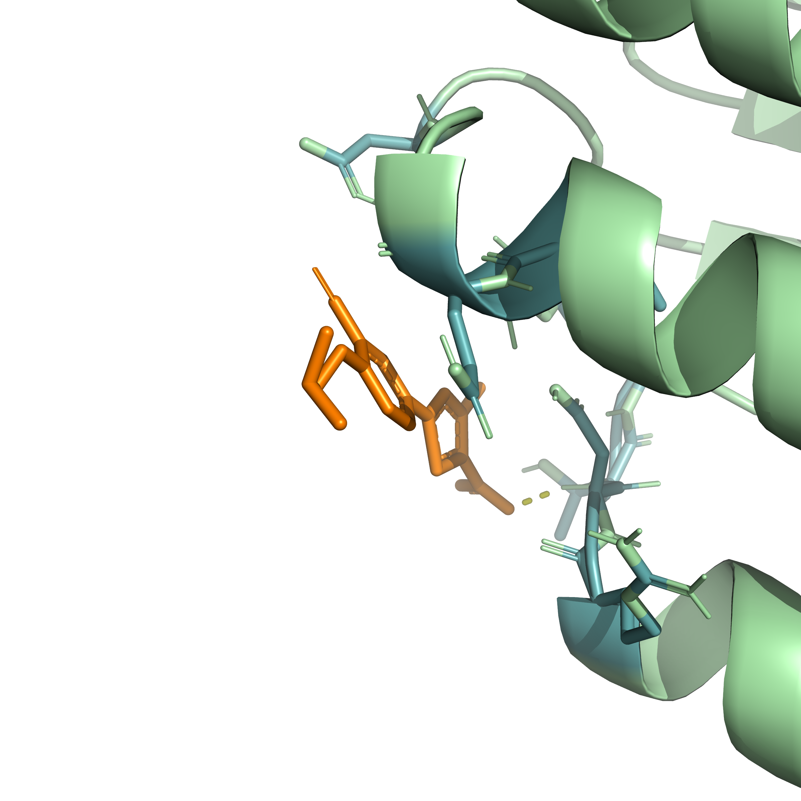
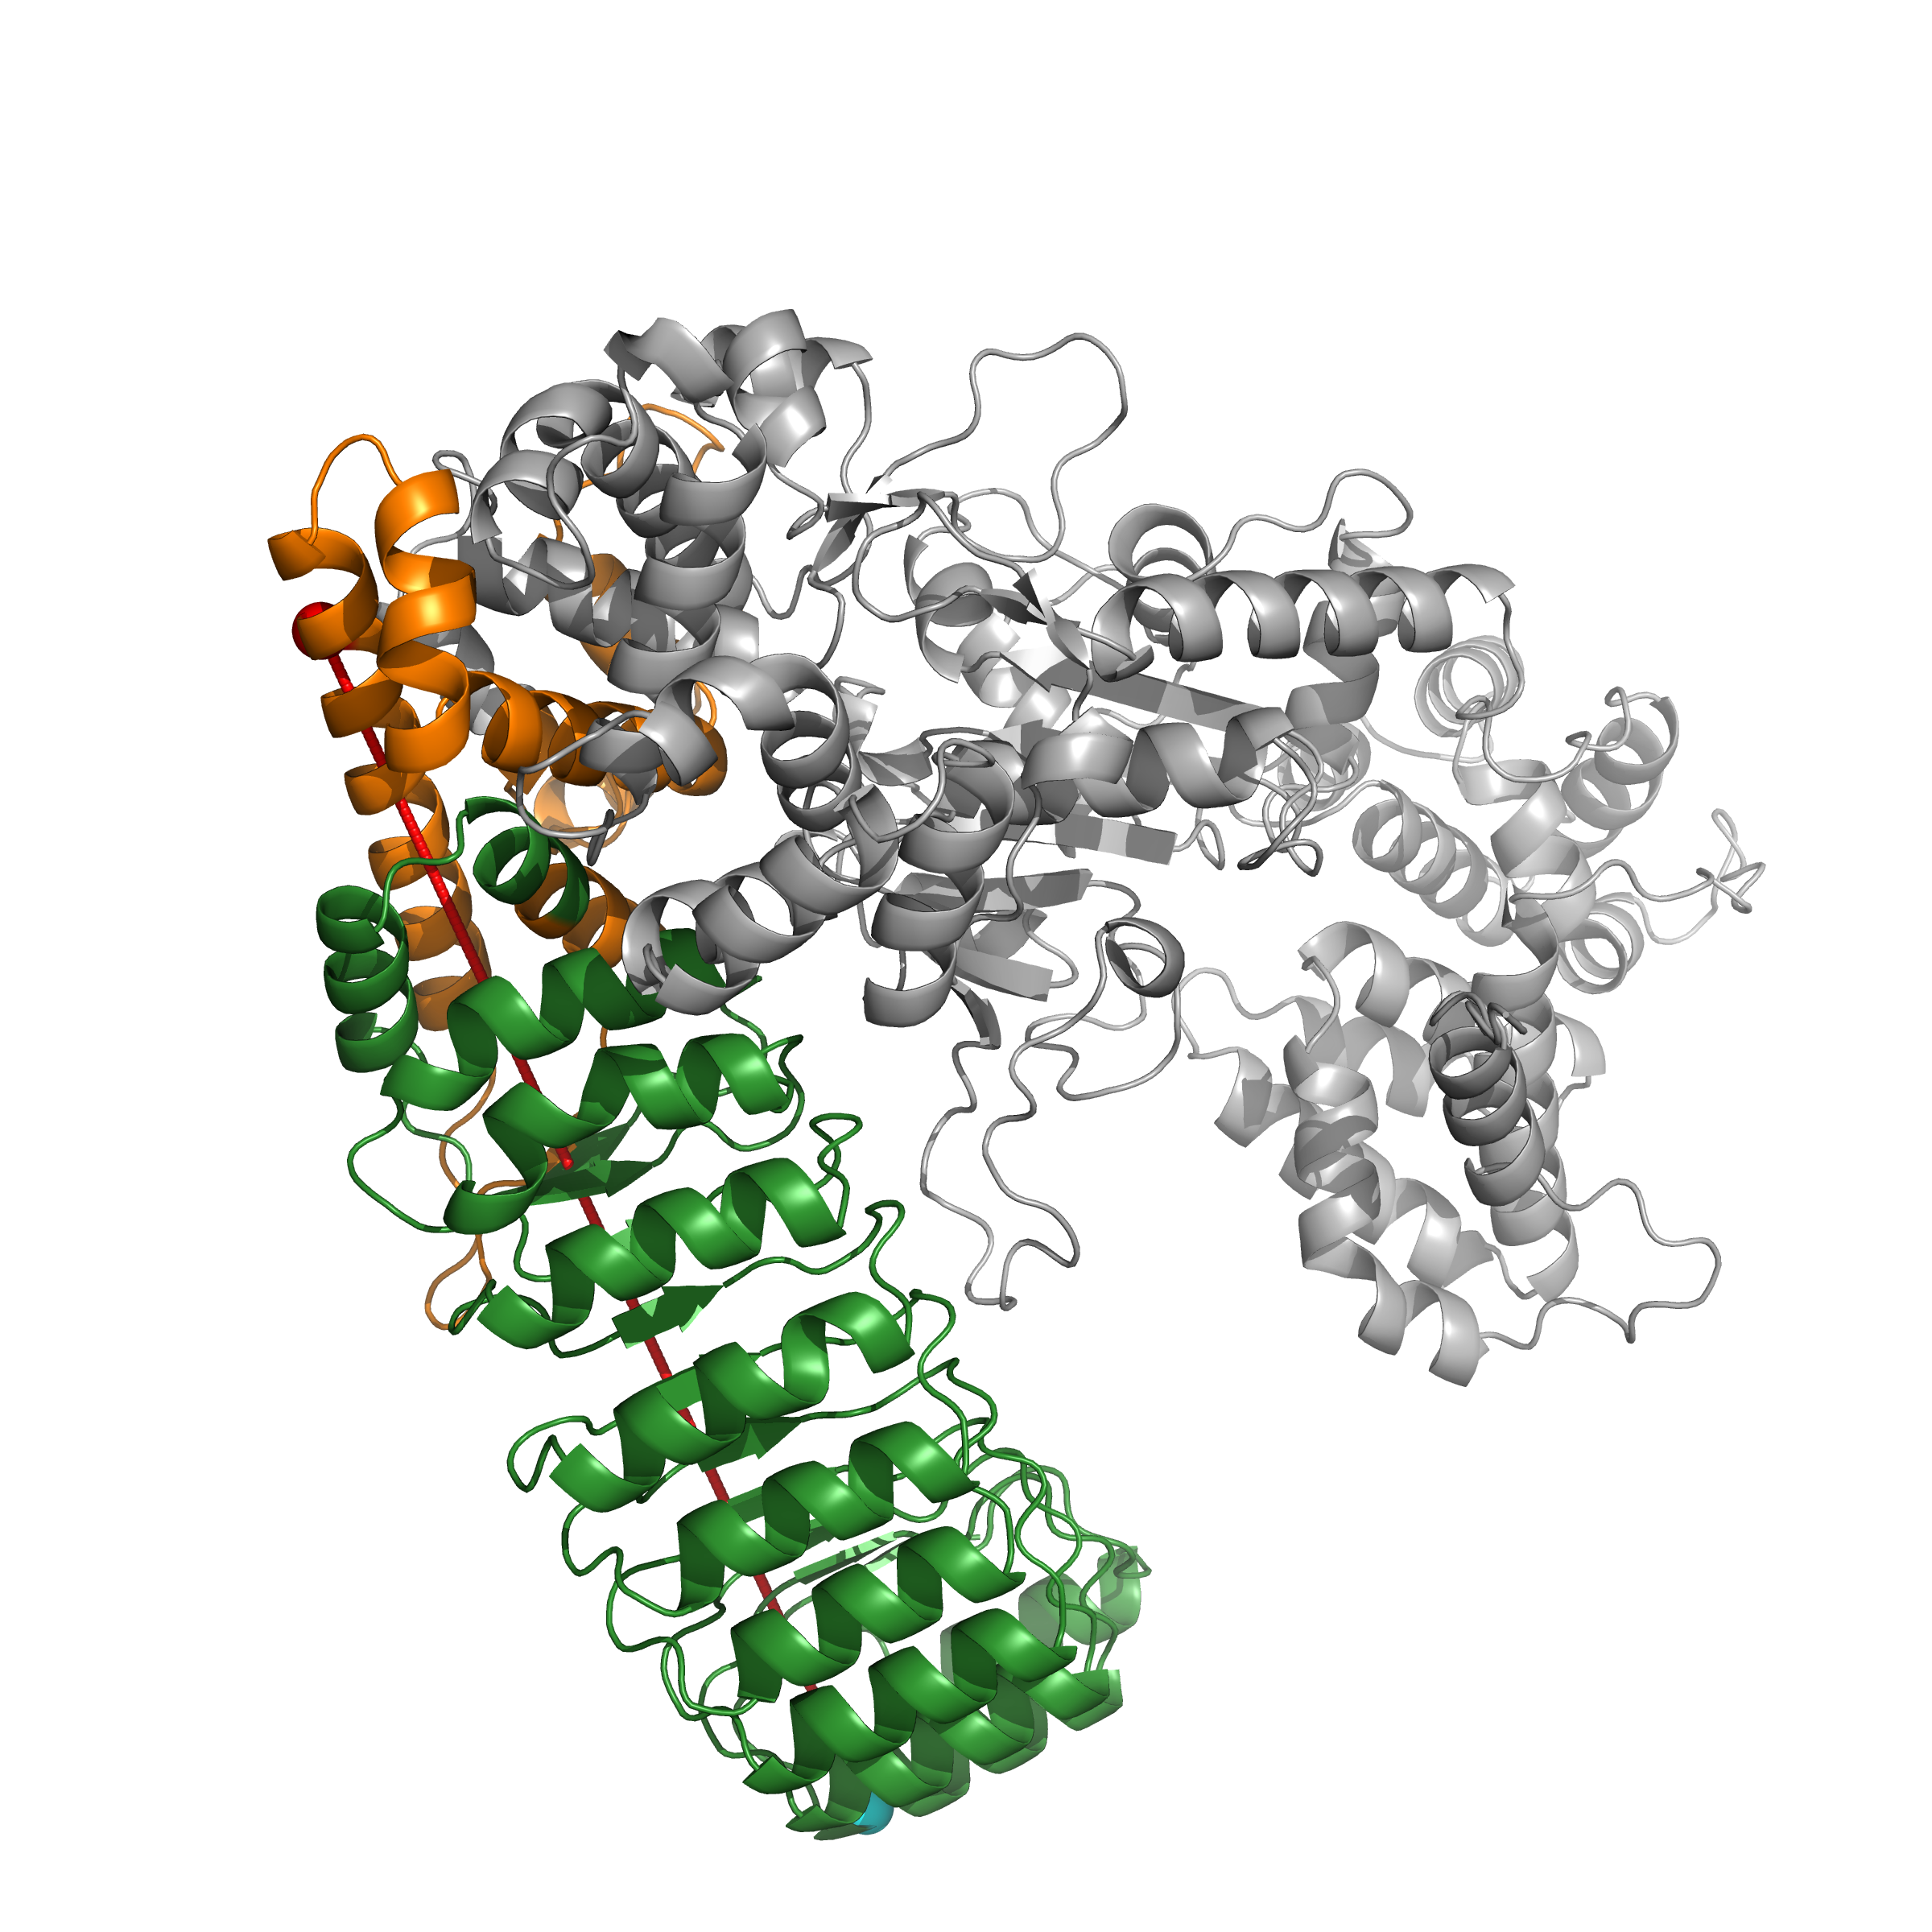
Deep Learning Guided Discovery and FEP Validation of NOD2 Binders
for the R702W Crohn's Variant
Tanmay Vasudeva
Texas Virtual Academy at Hallsville, Texas, USA
Introduction
Results
Discussion
Crohn's disease affects over 3 million people worldwide. The NOD2 R702W variant increases disease risk by 3-fold, yet no FDA-approved drugs specifically target NOD2.
NOD2 (nucleotide-binding oligomerization domain 2) is a cytoplasmic receptor that detects bacterial muramyl dipeptide (MDP) and activates inflammatory signaling through NF-kB. The R702W mutation impairs bacterial sensing, leading to dysregulated immune responses in the gut.
This study developed a computational pipeline to identify small molecules that bind NOD2 and determined how the R702W mutation affects drug binding affinity.
Machine Learning Validation
This study presents the first computational pipeline for identifying mutation-sensitive NOD2 modulators.
1. R702W RIGIDIFIES the protein
Reduced RMSD (3.27 vs 4.05 Angstrom) and eliminated heterogeneity (0% vs 12.6%) indicate impaired conformational flexibility.
2. Febuxostat is MUTATION-SENSITIVE
DDG = +2.34 kcal/mol (p<0.001) corresponds to 50-fold weaker binding in R702W. Febuxostat-based therapies would be less effective in variant carriers.
3. Bufadienolide is MUTATION-RESISTANT
DDG = -0.44 kcal/mol (n.s.) indicates equivalent binding regardless of genotype. This is the first reported NOD2-Bufadienolide interaction.
4. Allosteric mechanism confirmed
The 79.4 Angstrom distance proves mutation affects binding through long-range conformational changes, not direct interference.
NOD2 Signaling Pathway
NOD2-Scout achieved AUC 0.85-0.93 across 5-fold scaffold-split cross-validation (mean 0.89). Shuffled label controls (AUC ~0.50) confirmed genuine learning.
Molecular Dynamics Analysis
NOD2 detects bacterial MDP through its LRR domain, recruits RIPK2 via CARD-CARD interactions, and activates IKK complex to trigger NF-kB mediated inflammation. R702W mutation disrupts this sensing. Bufadienolide class compounds are known NF-kB pathway inhibitors.
Research Question
Can small molecules be identified that bind NOD2 with differential affinity between wild-type and R702W mutant, enabling mutation-specific therapeutic targeting?
Future Work
Experimental validation using surface plasmon resonance (SPR), isothermal titration calorimetry (ITC), and hydrogen-deuterium exchange mass spectrometry (HDX-MS).
Extension to other Crohn's-associated variants (G908R, 1007fs).
Structure-activity relationship studies on Bufadienolide analogs.
Materials and Methods
R702W mutation RIGIDIFIES the protein: reduced RMSD (3.27 vs 4.05 Angstrom) and eliminated conformational heterogeneity (0% vs 12.6% frames >5 Angstrom).
Lead Compounds Identified
About the Researcher
Virtual Screening: 9,566 compounds (2,152 FDA drugs + 7,414 natural products) docked against AlphaFold2 NOD2 structure using GNINA deep learning scoring.
Machine Learning: NOD2-Scout XGBoost classifier trained on 2048-bit Morgan fingerprints with scaffold-split 5-fold cross-validation.
ADMET Filtering: Drug-likeness and toxicity screening using ADMETlab 2.0.
Molecular Dynamics: 520+ ns total simulation time in GROMACS. Apo simulations compared wild-type vs R702W conformational dynamics.
Free Energy Perturbation: pmx workflow with 20 lambda windows and 5 ns equilibration per window to calculate binding free energy differences (DDG).
I am a high school junior with a personal connection to this research: I was diagnosed with Crohn's disease and carry the R702W mutation. This project combines my interests in computational biology, machine learning, and drug discovery to address a condition that affects my daily life.
All computational work was performed independently using a personal RTX 4060 Ti GPU and Google Colab Pro.
Febuxostat (FDA Drug)
Bufadienolide (Natural Product)
Free Energy Perturbation Results
Selected References
1. Hugot JP et al. (2001) Nature 411:599-603.
2. Jumper J et al. (2021) Nature 596:583-589.
3. McNutt AT et al. (2021) J Cheminform 13:43.
4. Gapsys V et al. (2022) Nat Protoc 17:1114-1141.
5. Abraham MJ et al. (2015) SoftwareX 1-2:19-25.
NOD2 Structure
NOD2 Domains:
CARD (gray): Signaling
NBD (blue): Nucleotide binding
HD2 (orange): R702W site
LRR (green): Ligand binding
R702W is 79.4 Angstrom from binding pocket (allosteric)

