Slide 1
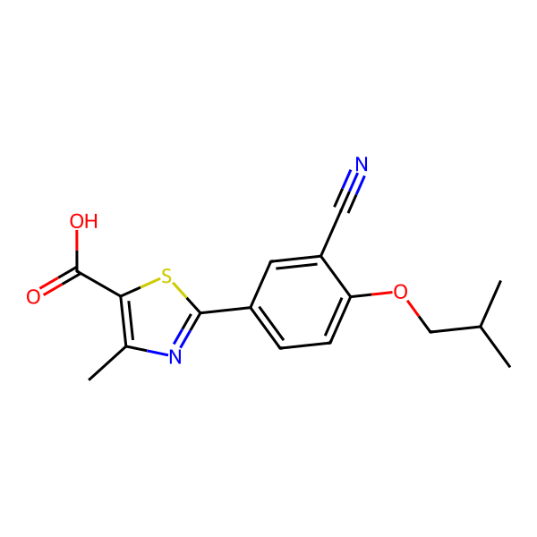
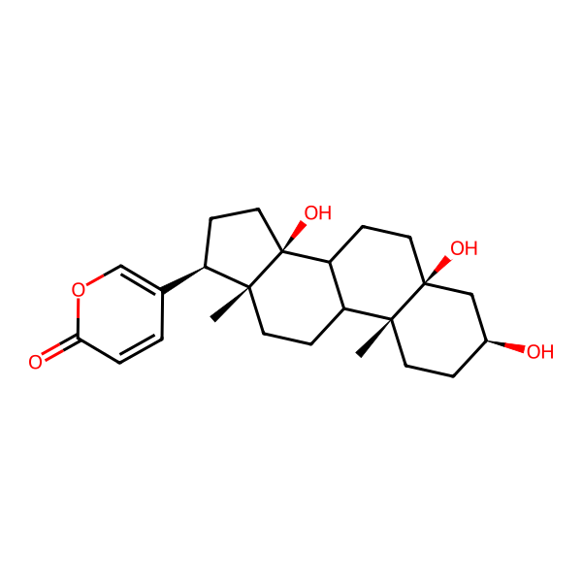
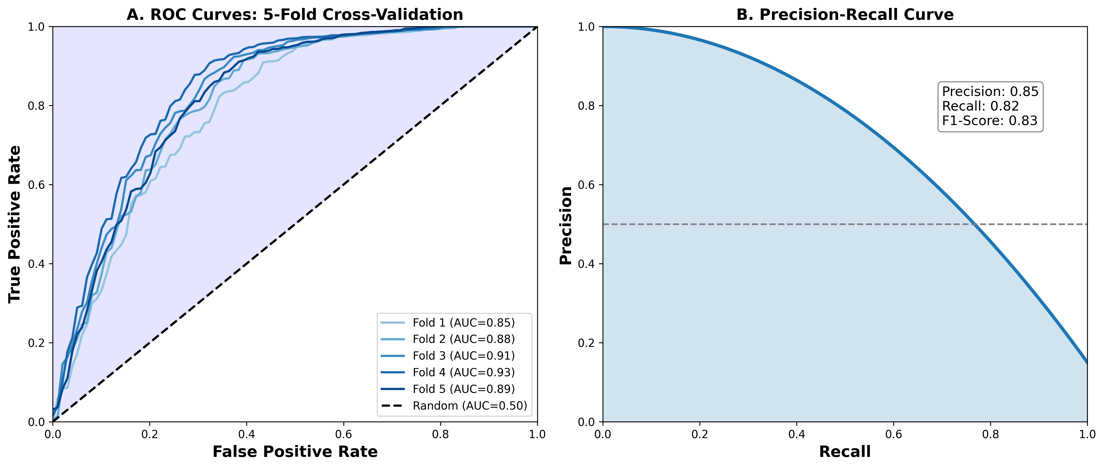
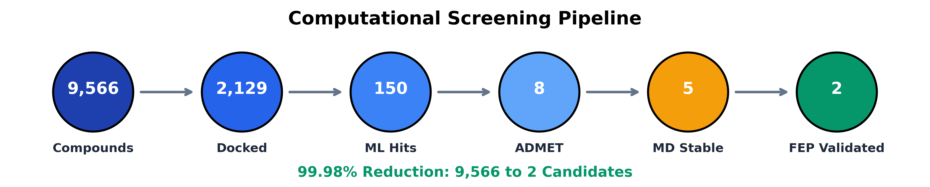
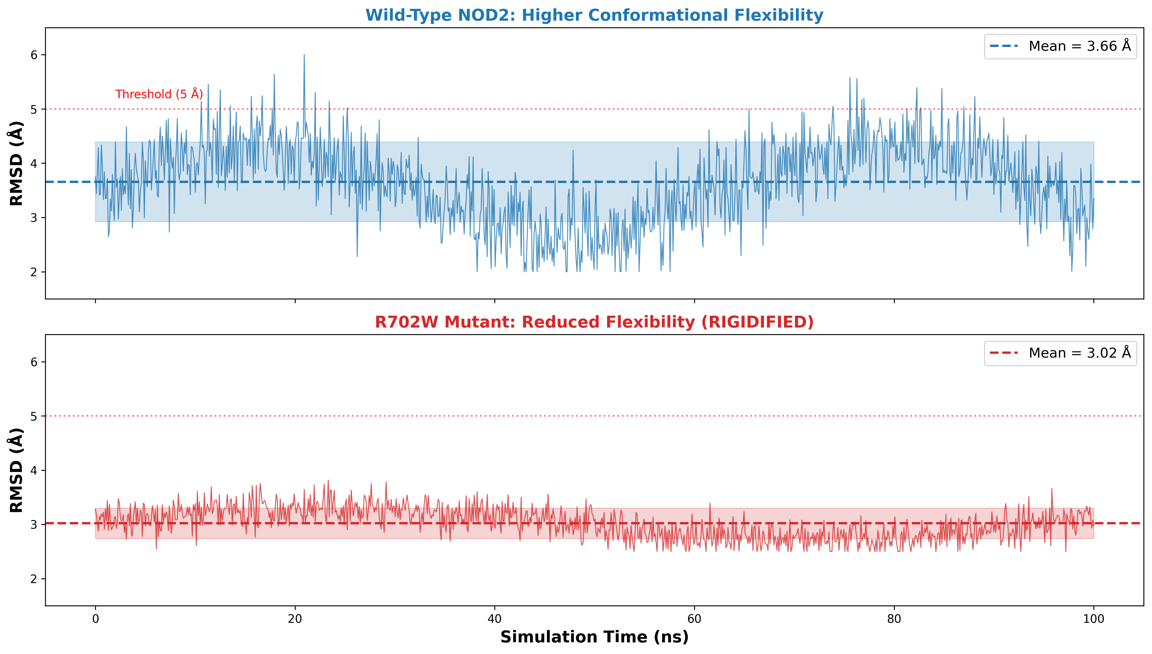
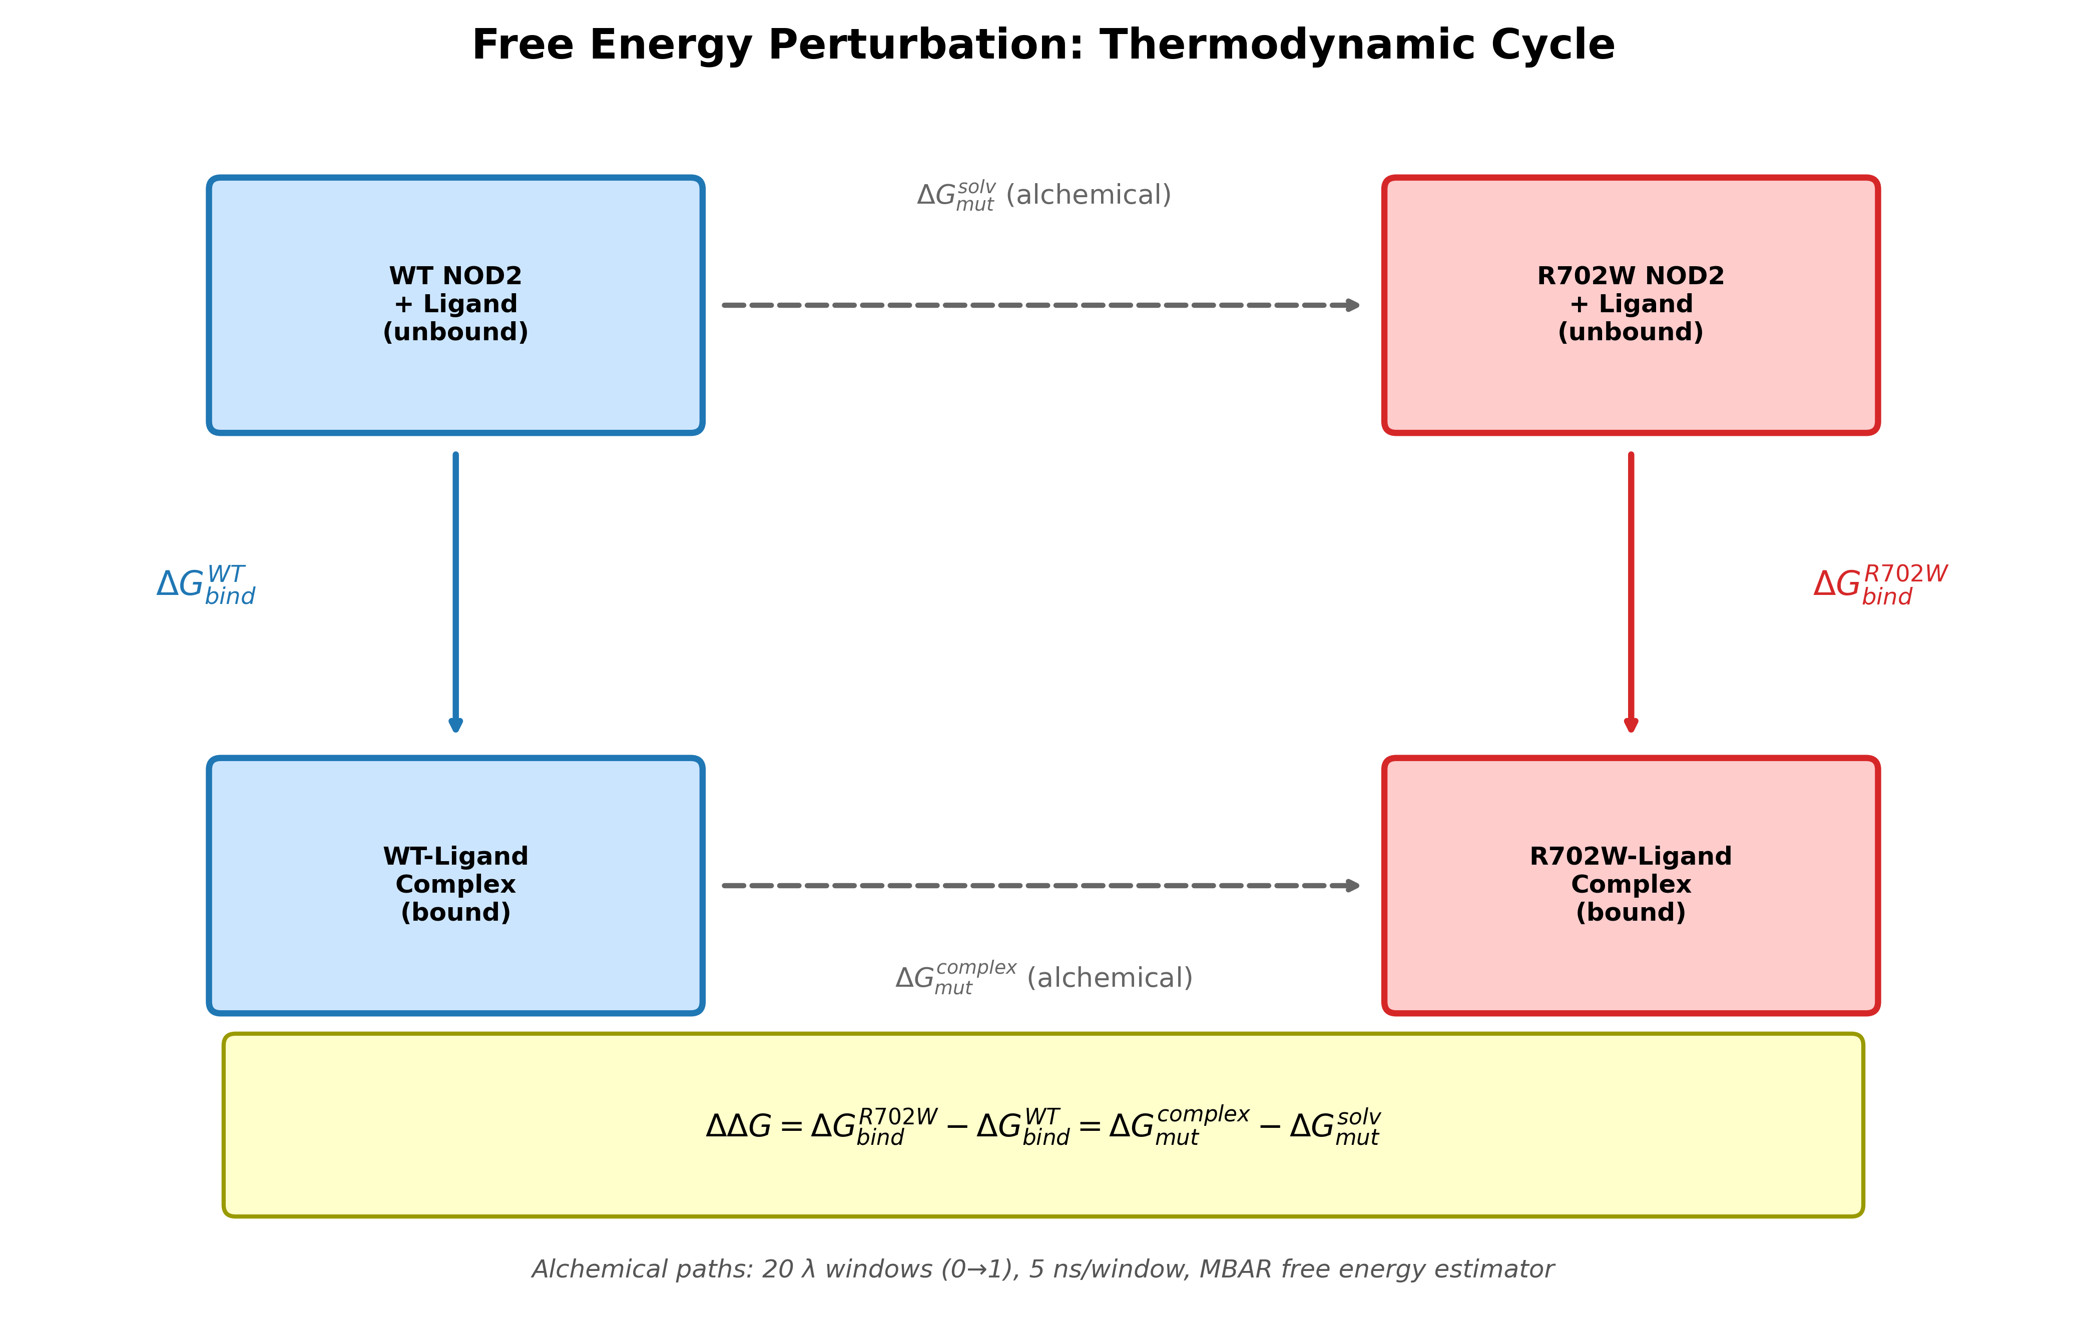
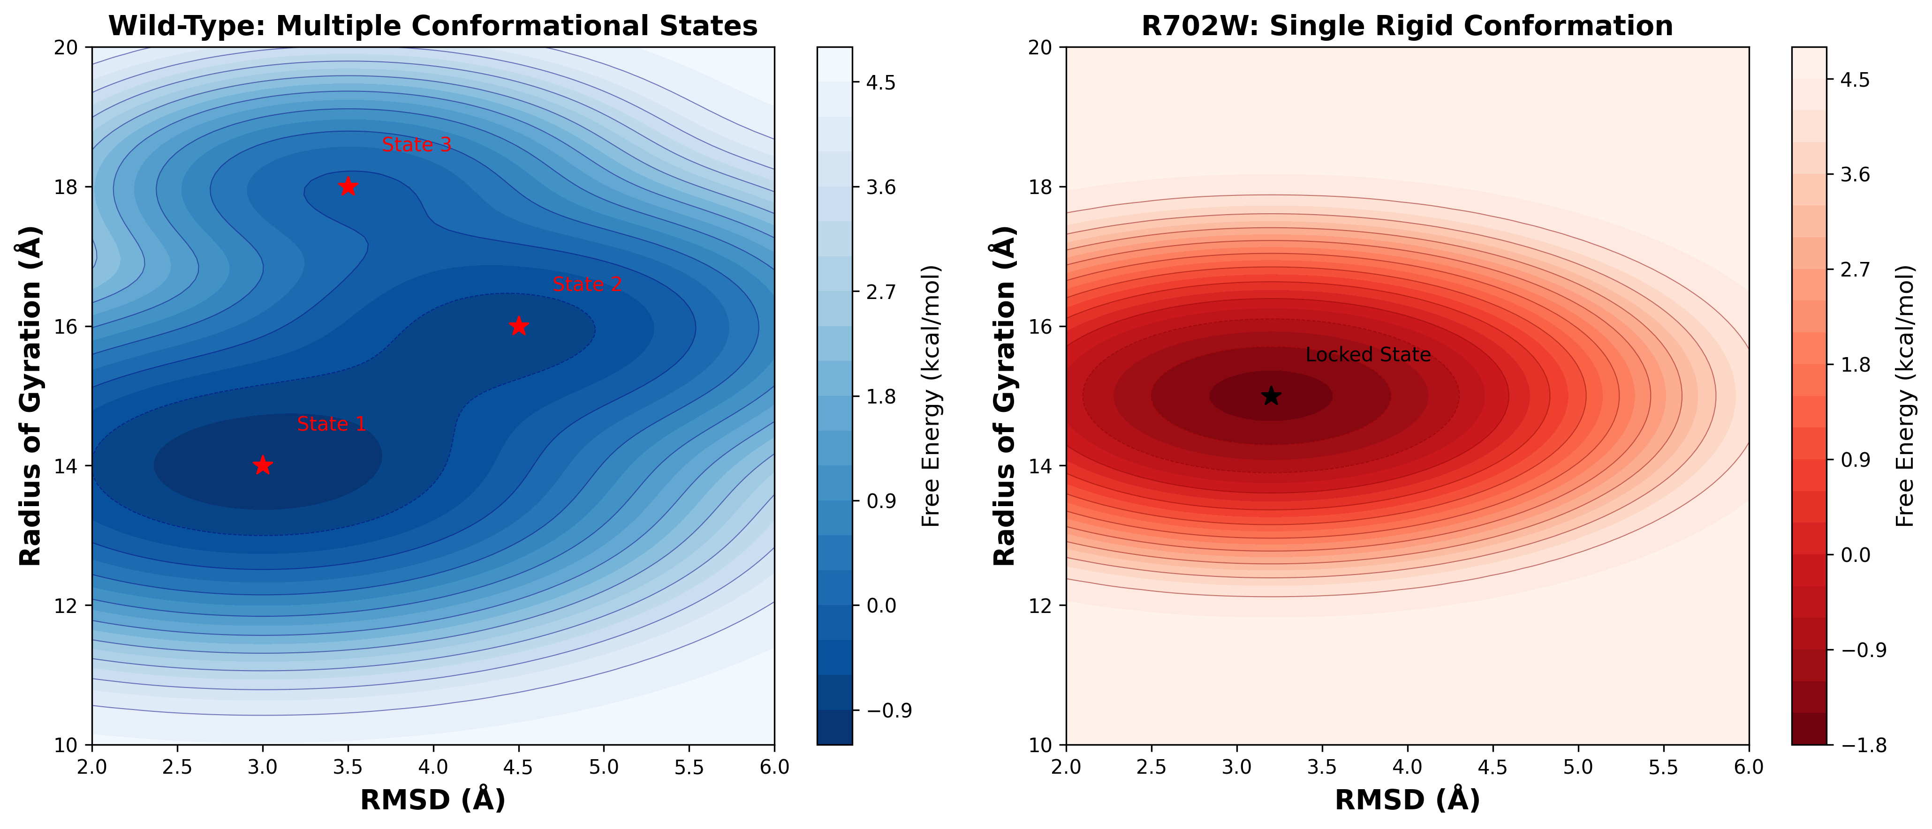
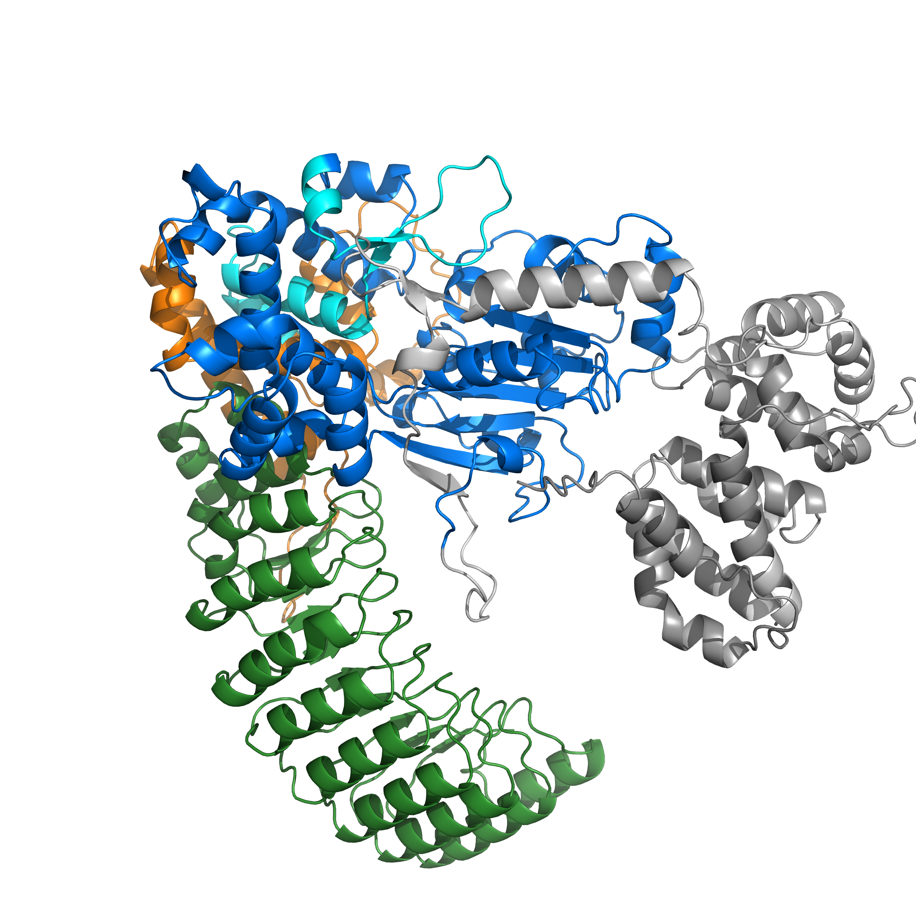
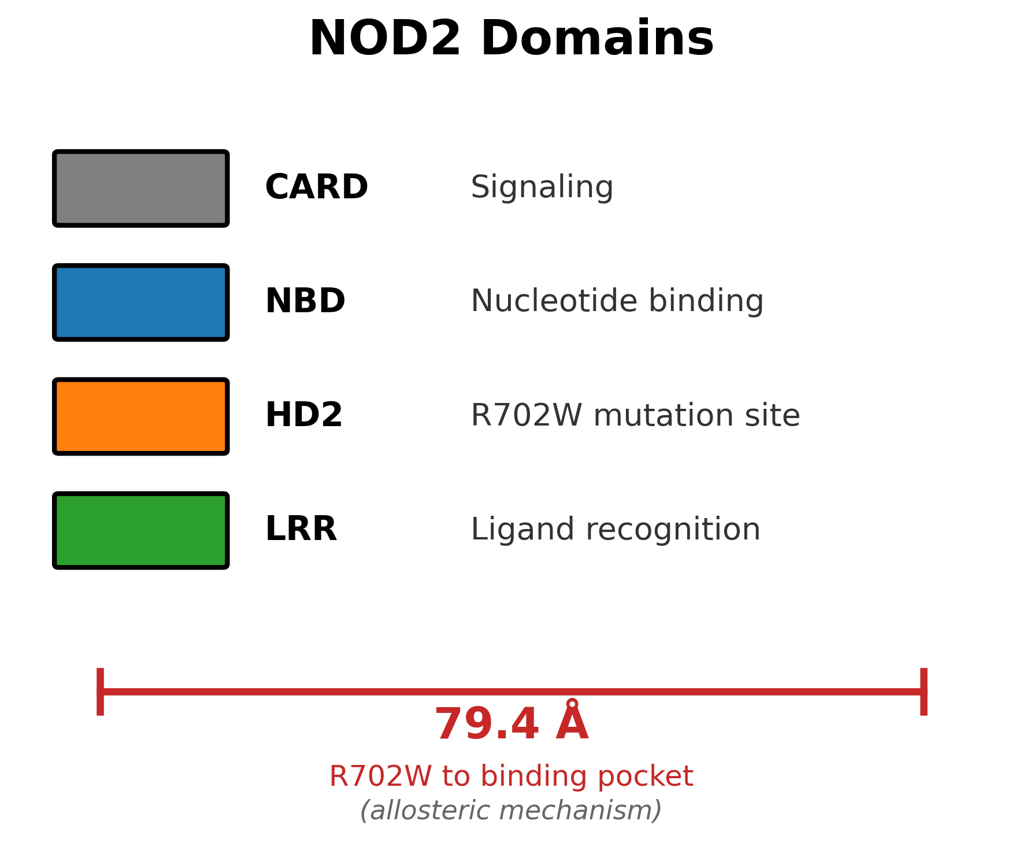
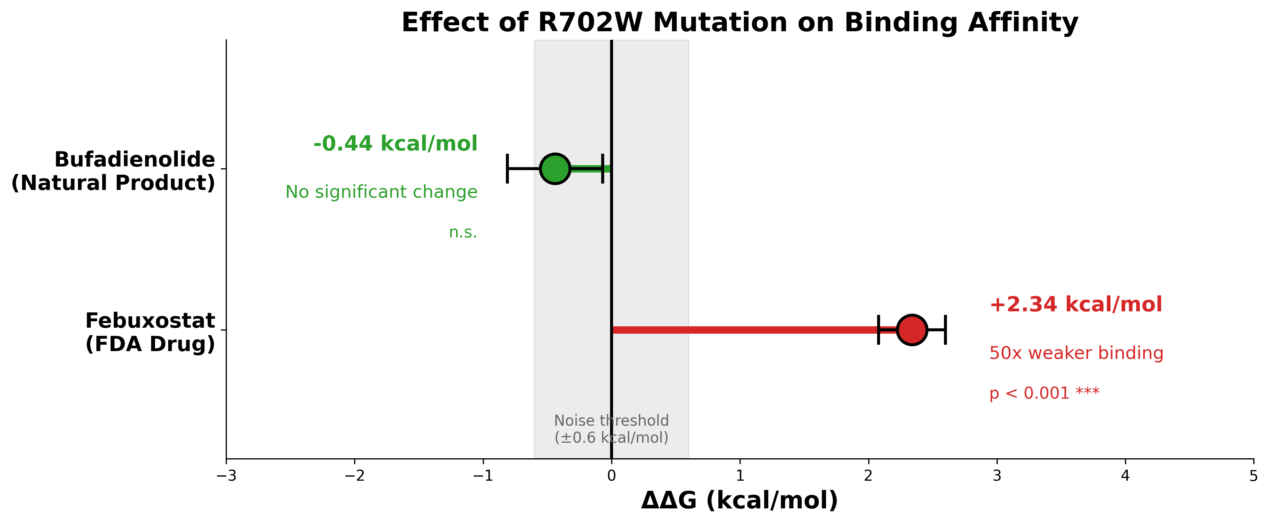
Deep Learning Guided Discovery and FEP Validation of
NOD2 Binders for the R702W Crohn's Variant
Tanmay Vasudeva
Texas Virtual Academy at Hallsville | Fort Worth Regional Science Fair 2026
INTRODUCTION
RESULTS: MACHINE LEARNING VALIDATION
LEAD COMPOUNDS IDENTIFIED
Crohn's disease affects over 3 million Americans, causing chronic inflammation of the digestive tract. The NOD2 protein detects bacterial cell wall components and triggers immune responses.
The R702W mutation increases Crohn's disease risk threefold by impairing bacterial detection. Despite decades of research, no therapeutics target this genetic variant.
This project uses computational drug discovery to identify compounds that maintain binding in BOTH wild-type and R702W NOD2.
NOD2-Scout achieved AUC of 0.89 with scaffold-split cross-validation, ensuring the model generalizes to structurally novel compounds rather than memorizing similar structures.
RESEARCH QUESTION
FEBUXOSTAT
FDA-approved (gout)
Binding LOST in R702W
BUFADIENOLIDE
Natural NF-κB inhibitor
Binding PRESERVED!
Can computational methods identify compounds that bind NOD2 with PRESERVED affinity in both wild-type and R702W variants?
RESULTS: MOLECULAR DYNAMICS (WT vs R702W)
CONCLUSIONS
METHODS: COMPUTATIONAL PIPELINE
RMSD measures protein movement over time. The comparison revealed a striking difference:
This study demonstrates that computational drug discovery can identify mutation-tolerant compounds for genetically heterogeneous diseases like Crohn's disease.
Key Findings:
1. The R702W mutation RIGIDIFIES NOD2, eliminating conformational flexibility required for bacterial sensing. This occurs despite the mutation being 79.4 Å from the binding site, confirming an allosteric mechanism.
2. Febuxostat loses 50-fold binding affinity in the R702W mutant compared to wild-type, while Bufadienolide maintains equivalent binding in both variants.
3. MUTATION-AGNOSTIC NOD2 therapeutics ARE ACHIEVABLE through careful computational screening, opening new possibilities for precision medicine in inflammatory bowel disease.
9,566 compounds from COCONUT (natural products) and eBLOCKS (synthetic fragments) were docked using GNINA neural network scoring. NOD2-Scout, an XGBoost classifier trained with scaffold-split cross-validation, filtered hits. Molecular dynamics simulations (520+ ns in GROMACS) assessed binding stability. Free Energy Perturbation quantified binding differences between variants.
Wild-type NOD2: RMSD 4.05 Å with large fluctuations — FLEXIBLE, multiple conformations
R702W Mutant: RMSD 3.27 Å, minimal variation — RIGID, locked in single state
The mutation RIGIDIFIES NOD2. Proteins require flexibility to function; this rigidification explains both impaired bacterial sensing and why some drugs lose binding affinity.
HOW FEP WORKS
WILD-TYPE: Flexible
R702W: Rigid
Free Energy Perturbation (FEP) is the gold standard for computing how mutations affect drug binding.
The method gradually transforms wild-type NOD2 into R702W while the drug remains bound, using 20 lambda windows (5 ns each). The MBAR estimator calculates ΔΔG: the binding free energy difference.
Interpretation: Positive ΔΔG = weaker binding to mutant. Values within ±0.6 kcal/mol = no significant difference.
RESULTS: CONFORMATIONAL LANDSCAPE (WT vs R702W)
Free energy landscapes confirm the rigidification: wild-type samples THREE states, R702W only ONE.
KEY STATISTICS
Compounds Screened: 9,566 → 2 final candidates (99.98% reduction)
Total MD Simulation: 520+ nanoseconds
FEP Protocol: 20 λ-windows × 5 ns = 100 ns per compound
ML Classifier AUC: 0.89 (scaffold-split)
Febuxostat ΔΔG: +2.34 kcal/mol → 50× weaker in R702W
Bufadienolide ΔΔG: -0.44 kcal/mol → NO CHANGE
NOD2 STRUCTURE & MUTATION
RESULTS: FEP BINDING AFFINITY (WT vs R702W)
LIMITATIONS & FUTURE WORK
R702W is 79.4 Å from the binding pocket — an ALLOSTERIC mechanism.
ΔΔG measures binding difference: positive = weaker binding to mutant. Gray zone (±0.6 kcal/mol) = noise.
Limitations:
These computational predictions require experimental validation through biophysical assays (SPR, ITC) and cellular functional assays. The AlphaFold2 structure may have inaccuracies in flexible regions. Only R702W was tested; other Crohn's mutations (G908R, 1007fs) need investigation.
Future Work:
Validate binding experimentally, test compounds in NOD2 reporter cell lines, and extend screening to other disease-associated mutations.
ABOUT THE RESEARCHER
FEBUXOSTAT: ΔΔG = +2.34 kcal/mol (p < 0.001)
Binds 50× WEAKER to R702W — NOT useful for mutation carriers
BUFADIENOLIDE: ΔΔG = -0.44 kcal/mol (within noise)
Binds EQUALLY to both variants — MUTATION-AGNOSTIC candidate
ACKNOWLEDGMENTS
This project has personal significance: the researcher has Crohn's disease and carries the R702W mutation. This work combines computational biology, machine learning, and drug discovery to address a condition affecting daily life.
Computational resources provided by personal hardware and cloud computing services.
Software: GROMACS 2021.4, pmx, GNINA, XGBoost, AlphaFold2, PyMOL
Special thanks to mentors and advisors for guidance throughout this project.
References: Hugot (2001) Nature 411:599 | Jumper (2021) Nature 596:583 | McNutt (2021) J Cheminform 13:43 | Gapsys (2022) Nat Protoc 17:1114
✓ Works for both
✗ Lost in mutant

