Slide 1
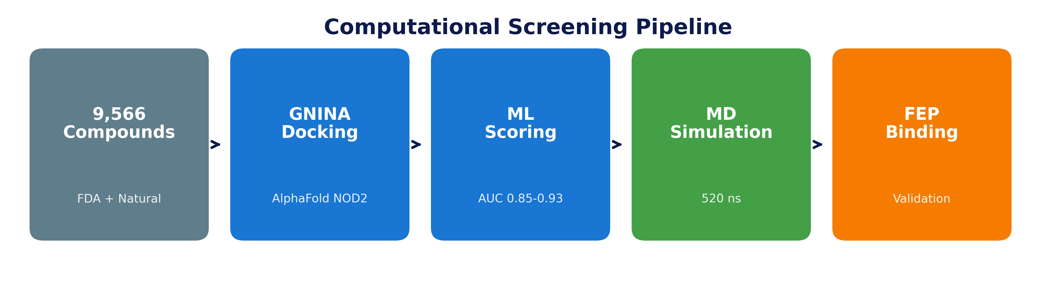
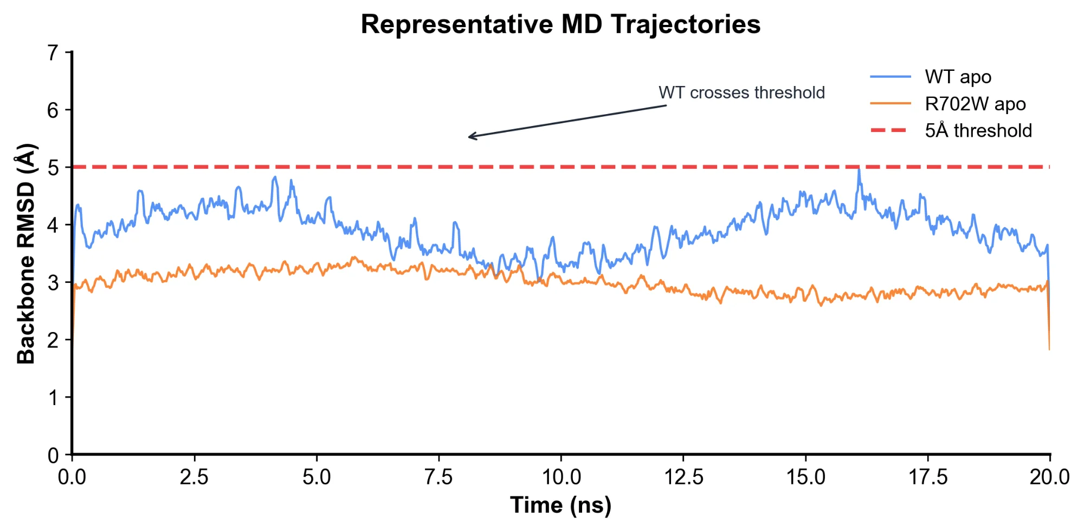
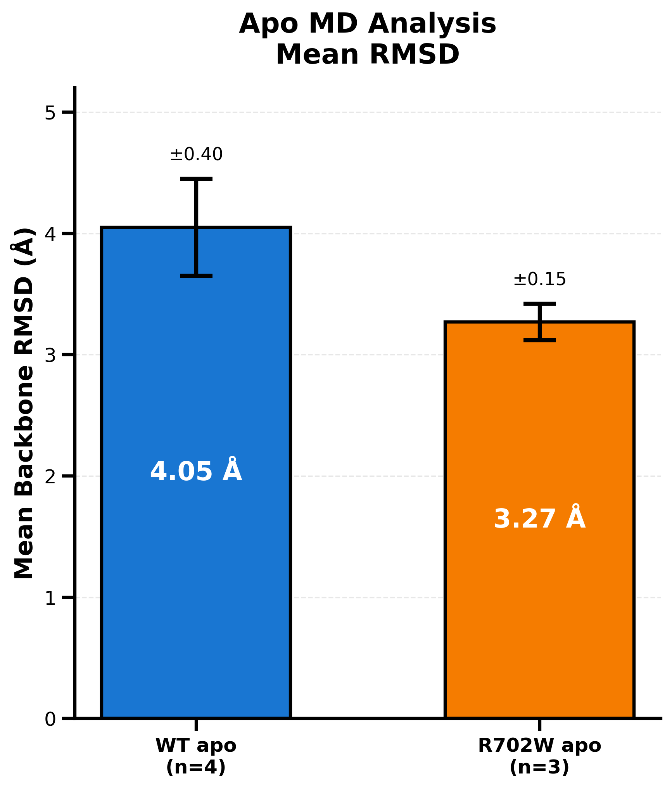
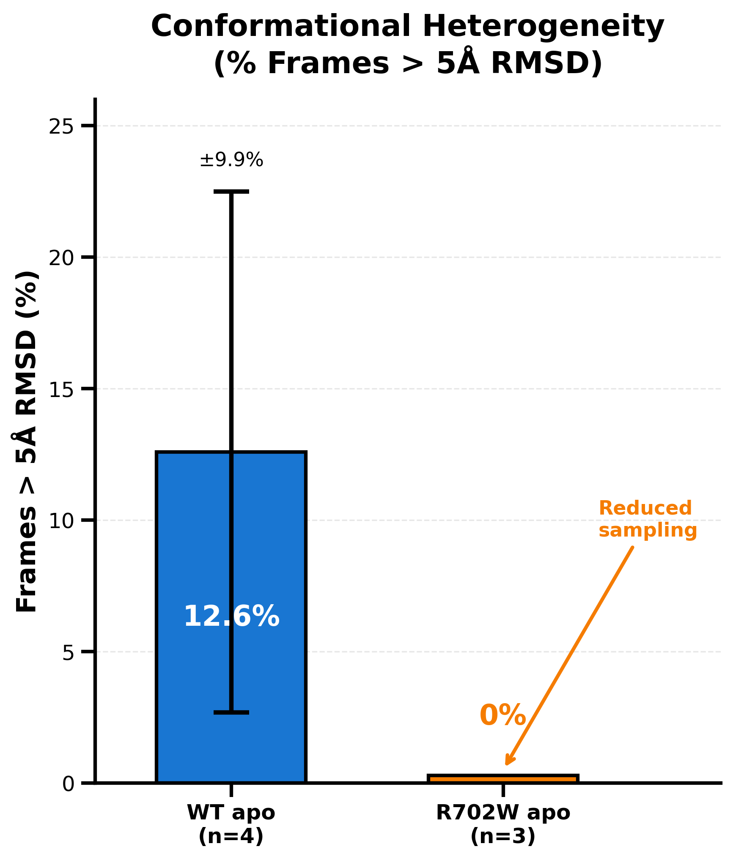
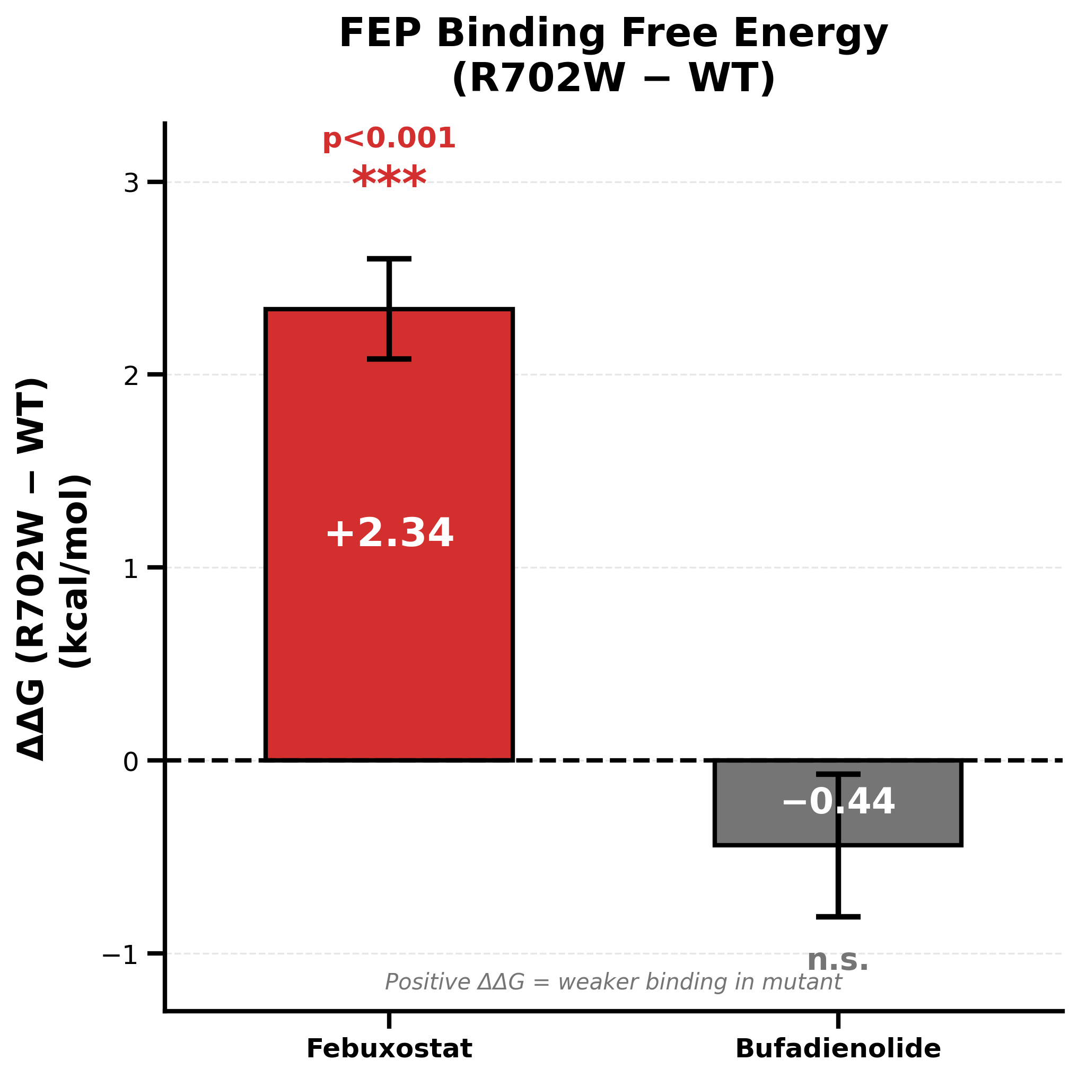
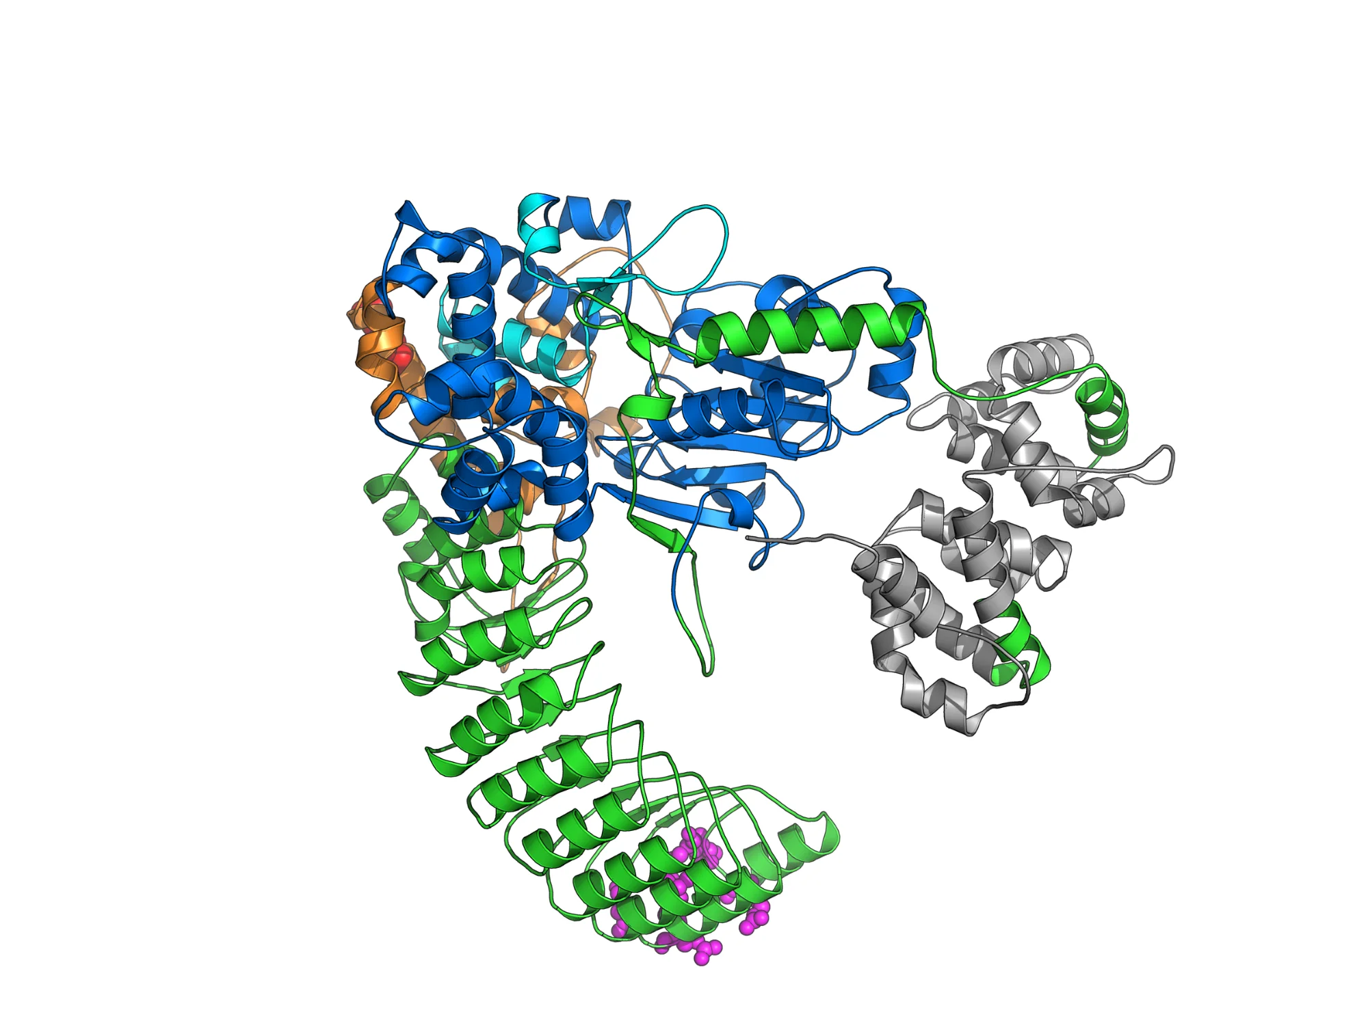
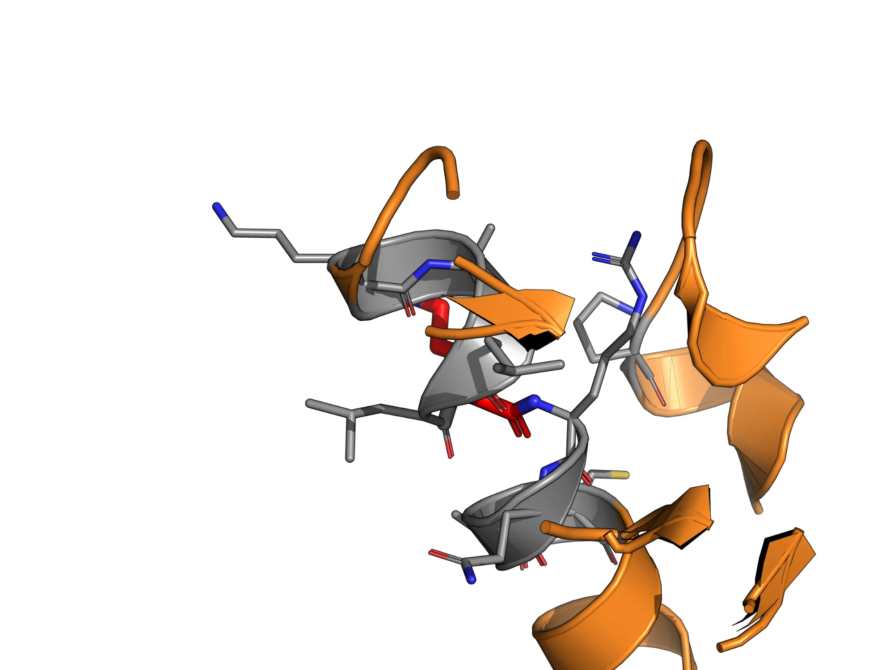
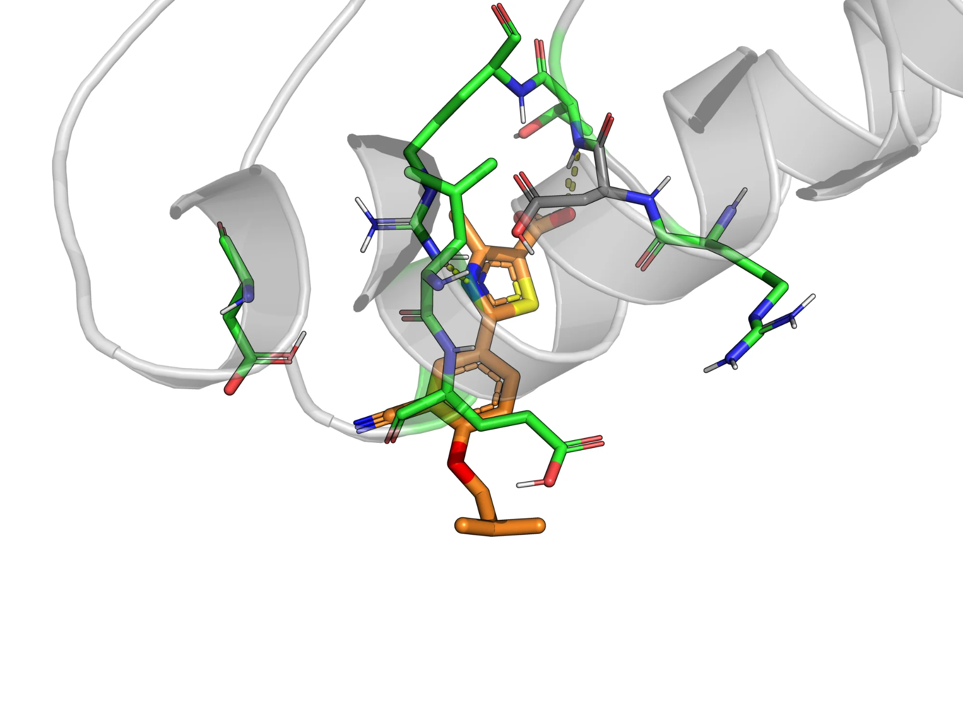
Deep Learning Discovery of NOD2 Binders for R702W Crohn's Variant
FEP Validation of Mutation-Sensitive Binding
Tanmay Vasudeva • Texas Virtual Academy at Hallsville • ISEF 2026
INTRODUCTION
COMPUTATIONAL PIPELINE
APO MD DYNAMICS
NOD2 (nucleotide-binding oligomerization domain 2) is an intracellular pattern recognition receptor that detects bacterial peptidoglycan fragments, triggering innate immune responses critical for intestinal homeostasis. Mutations in NOD2 represent the strongest genetic risk factors for Crohn's disease, with carriers of homozygous variants facing up to 40-fold increased disease risk.
The R702W variant (rs2066844) is the most prevalent NOD2 mutation, affecting approximately 10% of Crohn's patients of European ancestry. This missense mutation substitutes arginine with tryptophan in the HD2 domain, located approximately 80 Ångströms from the ligand-binding LRR pocket. Despite extensive genetic studies establishing this association, the molecular mechanism by which this distant mutation affects NOD2 function remains poorly characterized.
No drugs currently target NOD2 directly, representing a significant unmet therapeutic need. This project developed a computational pipeline to identify NOD2 binders and quantify how the R702W variant affects their binding affinity.
Fig 3. Five-stage computational pipeline: compound library → GNINA docking → ML scoring → MD simulation → FEP validation. Created by Finalist using Python/matplotlib.
MATERIALS & METHODS
Fig 6. RMSD trajectories over simulation time. Created by Finalist using MDTraj.
Compound Screening
MD Simulation
FEP Calculations
• 9,566 compounds screened
(7,414 natural + 2,152 FDA)
• AlphaFold2 NOD2 structure
• GNINA CNN-based docking
• NOD2-Scout XGBoost classifier
(AUC 0.85-0.93, scaffold-split CV)
• OpenMM 8.0
• AMBER14 + OpenFF 2.1.0
• TIP3P-FB water, 150 mM NaCl
• 310 K, 1 atm, Langevin
• 520 ns total simulation
• WT apo (n=4), R702W apo (n=3)
• Gold-standard binding ΔG
• 120 lambda windows
(80 complex + 40 solvent)
• Boresch restraints
• MBAR analysis (pymbar)
• Tested: Febuxostat,
Bufadienolide
RESEARCH OBJECTIVES
1. Develop a computational pipeline to identify compounds that bind NOD2
2. Validate binding using free energy perturbation (FEP) calculations
3. Quantify how the R702W mutation affects binding affinity
4. Characterize conformational dynamics differences between WT and R702W
⭐ KEY RESULT: FEP BINDING FREE ENERGY ⭐
NOD2 STRUCTURE
Febuxostat
Fig 7-8. Mean RMSD and conformational heterogeneity (% frames >5Å). Error bars = SEM. Created by Finalist.
ΔΔG = +2.34 ± 0.26 kcal/mol
R702W shows REDUCED conformational sampling
50× weaker binding in R702W
WT: 4.05 ± 0.40 Å RMSD, 12.6% frames >5Å
R702W: 3.27 ± 0.15 Å RMSD, 0% frames >5Å
p < 0.001 • 8σ significance • ***
Bufadienolide
🎯 PRECISION MEDICINE IMPLICATION
ΔΔG = -0.44 ± 0.37 kcal/mol • n.s.
Patients with R702W may require different NOD2-targeting compounds than WT patients. Bufadienolide-class compounds retain binding regardless of genotype, while Febuxostat-class compounds show mutation-sensitive binding.
No significant change in binding
KEY INSIGHT: Mutation effects are LIGAND-DEPENDENT
CONCLUSIONS
Fig 4. FEP ΔΔG comparing R702W vs WT binding. Positive = weaker in mutant. Created by Finalist.
Fig 1. NOD2 domain architecture. CARD (gray), NBD (blue), HD2/R702W site (orange), LRR binding domain (green). R702W mutation is ~80Å from binding pocket. Created by Finalist using PyMOL.
BINDING POCKET
1. Successfully screened 9,566 compounds using an integrated ML pipeline (AUC 0.85-0.93)
2. FEP validates mutation-sensitive binding: Febuxostat 50× weaker in R702W (p<0.001)
3. Binding effects are ligand-dependent: Bufadienolide binding unaffected by mutation
4. R702W reduces conformational sampling (0% vs 12.6% frames >5Å)
5. Allosteric mechanism: mutation 80Å from binding pocket affects dynamics
R702W MUTATION SITE
FUTURE DIRECTIONS
• Experimental validation: SPR/ITC binding assays
• HDX-MS to confirm conformational differences
• Extend FEP to other mutations (G908R, L1007fs)
• Screen for mutation-insensitive NOD2 binders
Fig 2. Close-up of HD2 domain showing R702W mutation site. Arginine→Tryptophan substitution eliminates positive charge. Created by Finalist using PyMOL.
Fig 5. Ligand bound in NOD2 LRR pocket showing protein-ligand interactions. Green = binding residues, orange = ligand. Created by Finalist using PyMOL.
References: Hugot et al. 2001; Ogura et al. 2001; Jumper et al. 2021 (AlphaFold); McNutt et al. 2021 (GNINA) | All figures created by Finalist using PyMOL, Python/matplotlib, and MDTraj
Computational Chemistry • Biochemistry • Drug Discovery
Acknowledgments: This project was completed independently using publicly available databases (AlphaFold, e-Drug3D, COCONUT) and open-source computational tools.

