Slide 1
MERSCOPE NBL subclustering of macrophage and adrenergic
Objectives:
Identify M0 and A2 classes
Measure colocalization of these classes

Slide 2
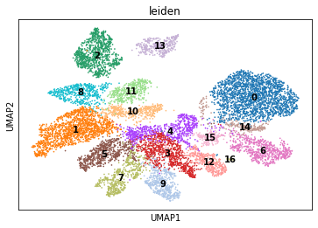
Macrophage reclustering

Slide 3
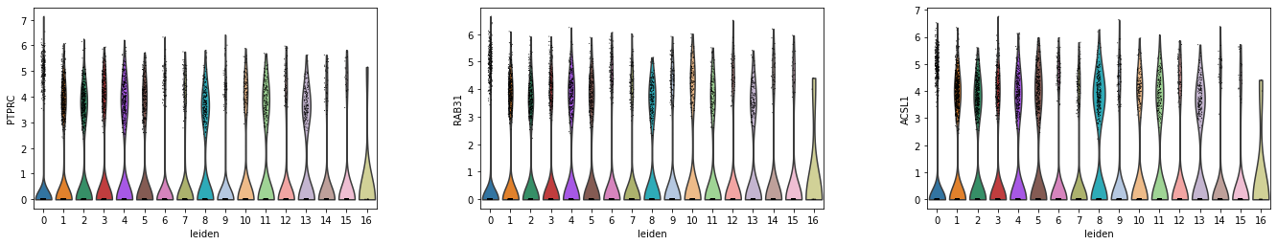
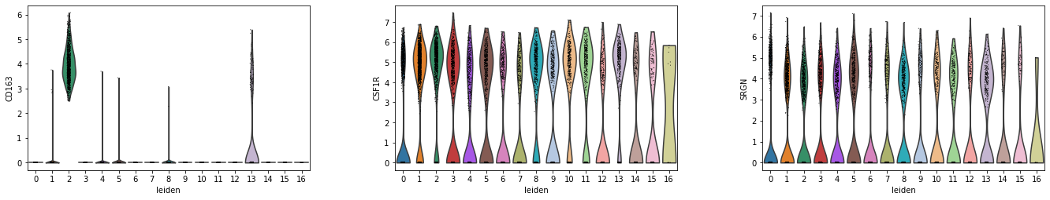
Best M0 markers (identified from snRNA-seq)
Clusters 1,2,8,11,13 were selected for C0

Slide 4
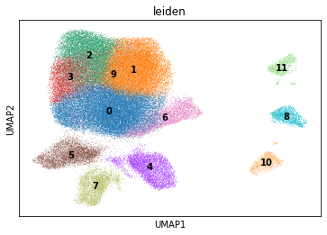
Adrenergic reclustering

Slide 5
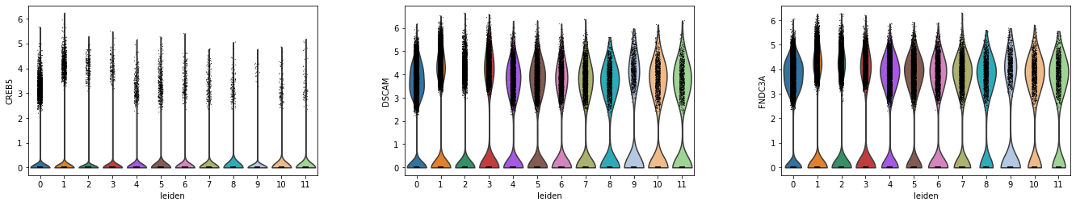
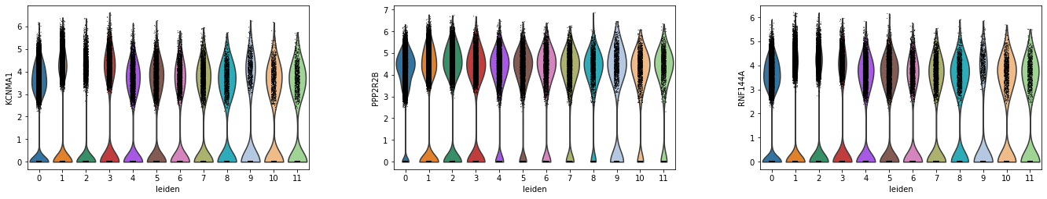
Best A2 markers (identified from snRNA-seq)
Clusters 0,4,5 were selected for C2

Slide 6
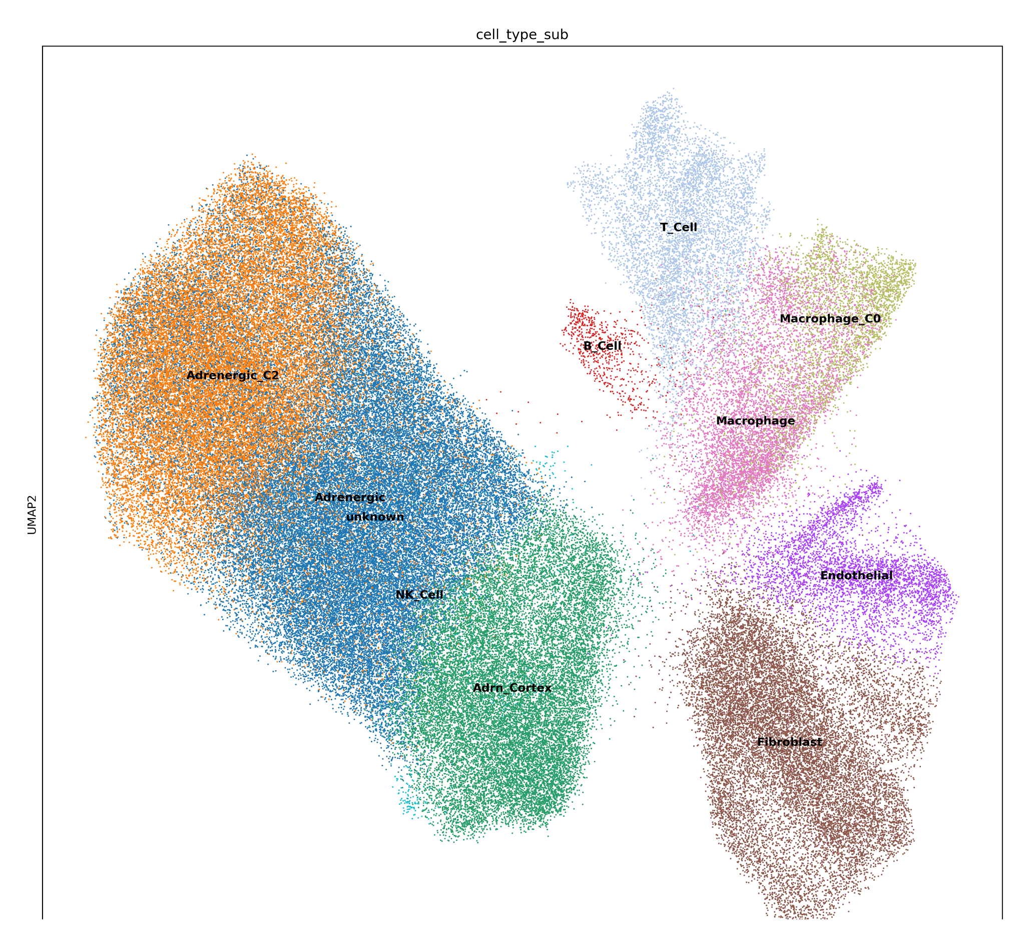
Subclasses in global context

Slide 7

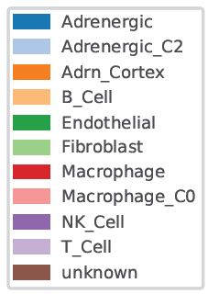
Spatial context

Slide 8
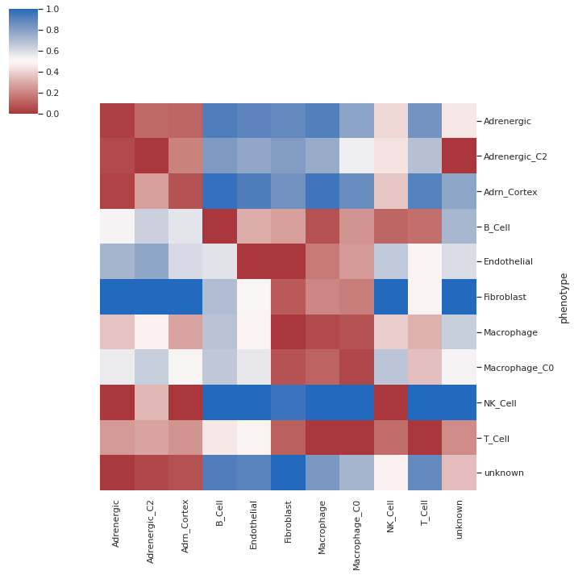
Spatial distance

Slide 9
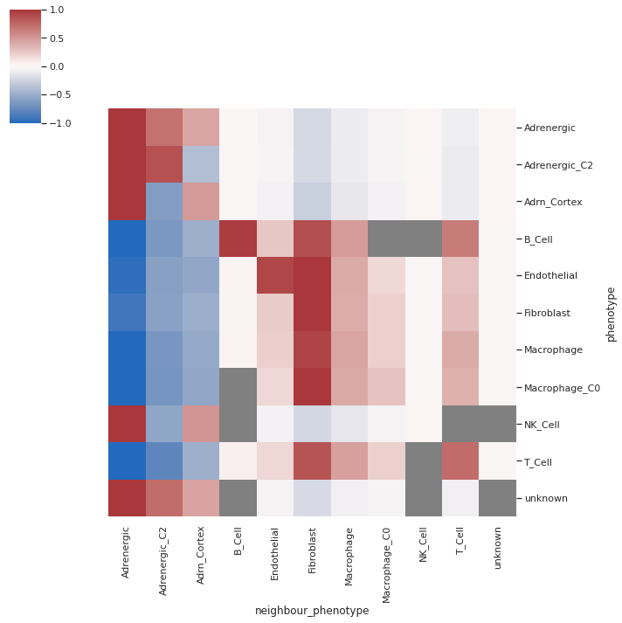
Spatial interaction
*Still tweaking. Because there are so many physical gaps in the tissue, I’m trying a few different parameters in this calculation

Slide 10
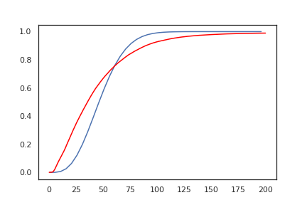
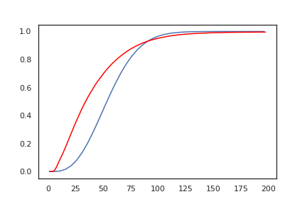
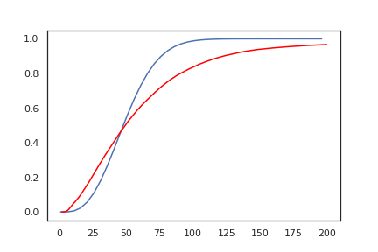
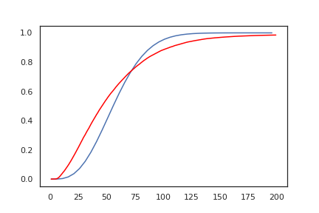
Distance CDFs
Macrophage -> Adrenergic
Macrophage -> A2
M0 -> Adrenergic
M0 -> A2

Slide 11
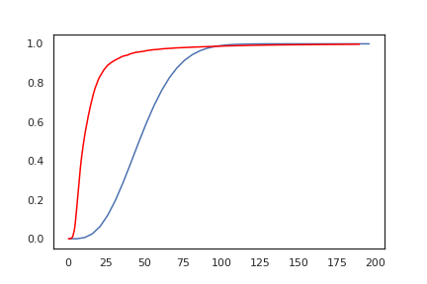
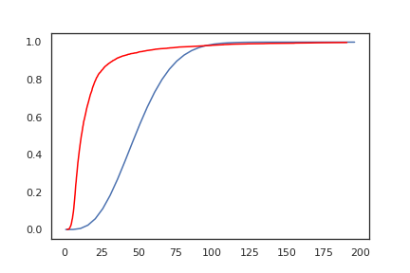
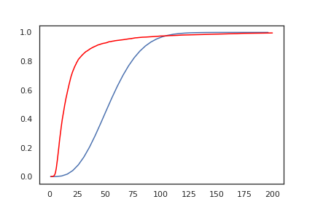
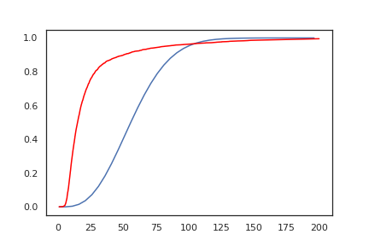
Distance CDFs
Adrenergic -> Macrophage
Adrenergic -> M0
A2 -> Macrophage
A2 -> M0

