Slide 1
CS2310 Computer Programming
LT08: Pointer II
Computer Science, City University of Hong Kong
Semester B 2024-25

Slide 2
Outline
More about pointer
Applications of pointer
More about class

Slide 3
Pointers
Difference with common variables
About its size?
Variable type | int x; | float x; | double x; | char x;
Pointer type | int*Pointx; | float*Pointx; | double*Pointx; | char*Pointx;
Value
Contents
Meaning
Address
8*8=64bits
Code: lec08-01-size.cpp

Slide 4
The NULL pointer
A special value that can be assigned to any type of pointer variable (e.g., int *a=NULL; double*b=NULL;)
A symbolic constant defined in several standard library headers, e.g. <iostream>
When assigned to a pointer variable, that variable points to nothing
Example
  int *ptr1 = NULL;
  int *ptr2 = 0;
Code: lec08-02-null.cpp

Slide 5
Operations on pointers
Copying the address
  p = q;
  p and q both point to the same variable

Slide 6
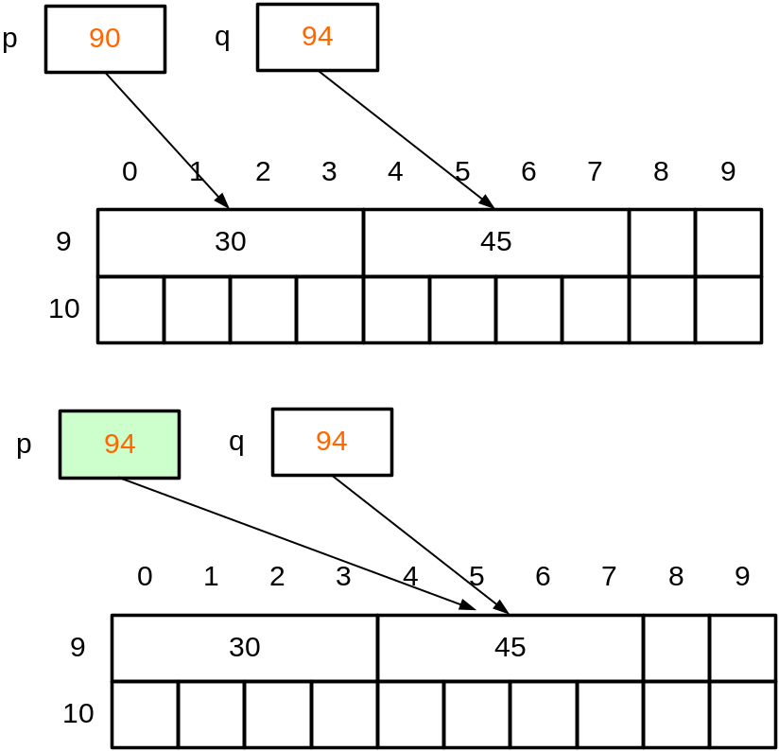
Copy the address
Copy address: p = q;
We copy the content (which is an address) of q to p.
After the assignment, p and q point to the same location in memory.
Therefore, if we change *p, *q will also be changed

Slide 7
Operations on pointers
Copying the content
  Copy the value of the variable which is pointed by the p to the variable which is pointed by q
  *p = *q;
  p and q may point to different variables

Slide 8
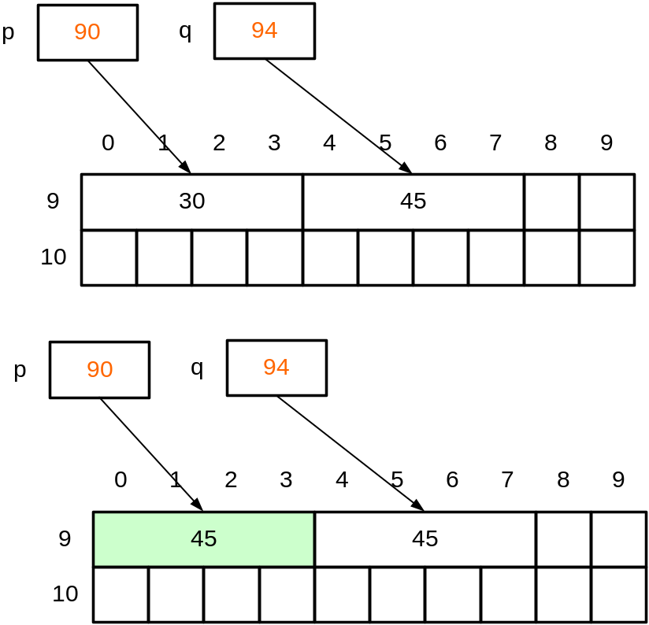
Copy the content
*p = *q;
We copy the value of the variable pointed by q to the variable pointed by p.
After the assignment, p and q still point to different locations in memory.
If we change *p, *q will not be changed as p and q point to different location in memory.

Slide 9
Outline
More about pointer
Applications of pointer
More about class

Slide 10
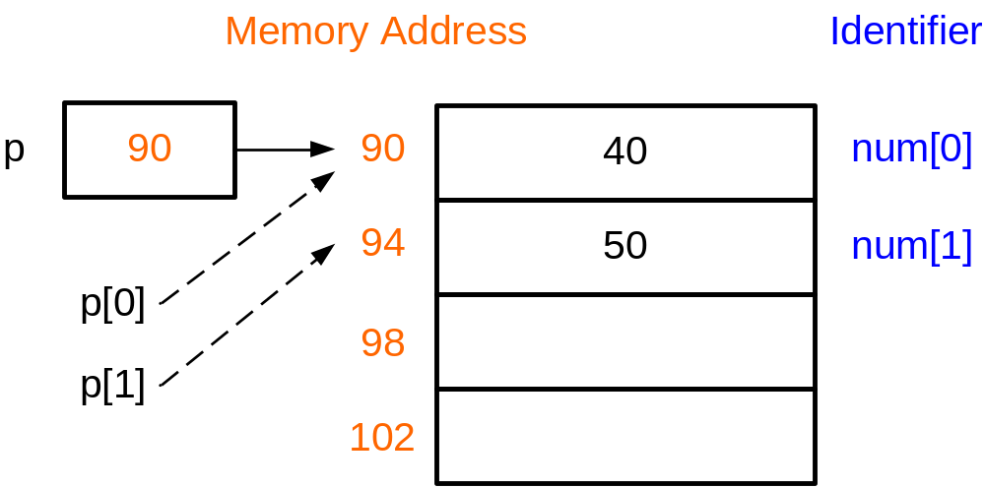
Relationship between arrays and pointers
int num[2]={40,50};
num[0]=400;
num[1]=500;
Equivalent to
int num[2]={40,50};
int *p=num;
p[0]=400;
p[1]=500;
We can use array-like notation in pointers
num is a constant pointer to the first byte of the array;
p is a pointer variable; and thus the value of p can be changed.
p=num;
However, the value of num cannot be changed.
num=p; /*illegal*/

Slide 11
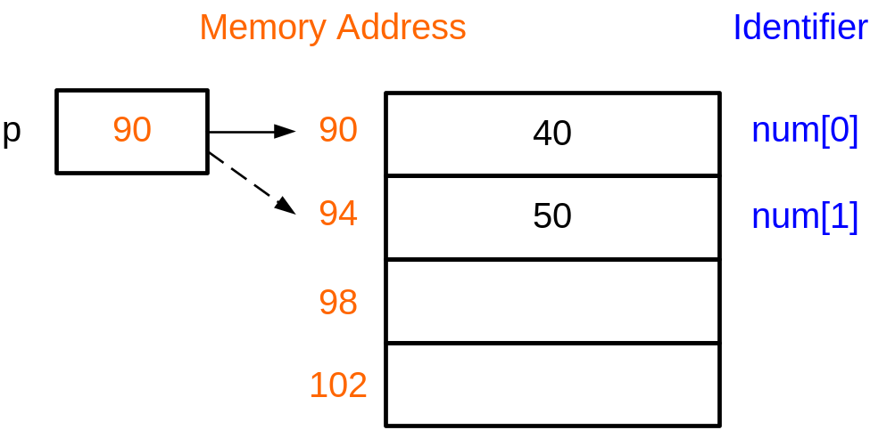
Relationship between arrays and pointers
int num[2]={40,50};
int *p=num;
p[0]=400;
p[1]=500;
Equivalent to
int num[2]={40,50};
int *p=num; /* p points to 90
*p=400;
++p;
*p=500;
++p increments the content of p (an address) by sizeof(int) bytes

Slide 12
Arrays and pointers
Equivalent representation |  | Remark
num | &num[0] | num is the address of the 0th element of the array
num+i | &(num[i]) | Address of the ith element of the array
*num | num[0] | The value of the 0th element of the array
*(num+i) | num[i] | The value of the ith element of the array
(*num)+i | num[0]+i | The value of the 0th element of the array plus i
Code: lec08-03-array.cpp

Slide 13
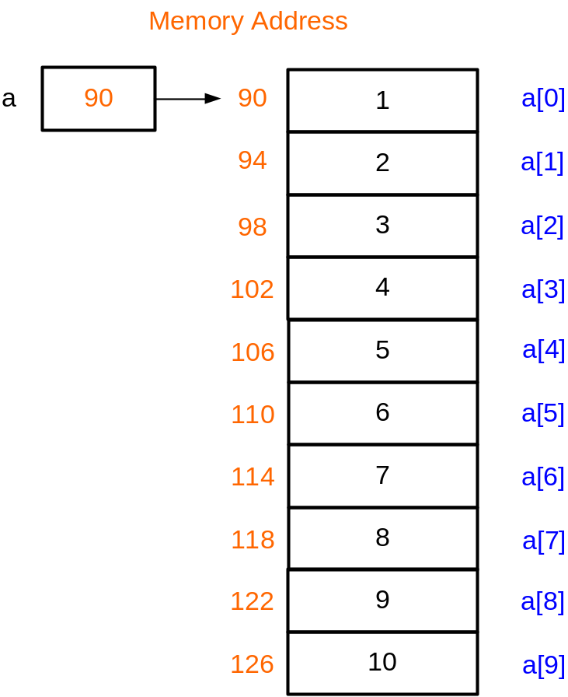
Example 2: summing an array
#define N 10
void main()
{
}
int a[N]={1,2,3,4,5,6,7,8,9,10};
int sum = 0;
for(int i = 0; i < N; ++i)
sum+=*(a+i);//sum+=a[i];
cout << sum;/*55 is printed*/
a+0 is the address of a[0]
a+1 is the address of a[1]
...
a+i is the address of a[i]
So, *(a+i) means a[i]
Code: lec08-04-sum.cpp

Slide 14
Passing arrays to functions
When an array is being passed, its base address is passed; the array elements themselves are not copied → This is call-by-pointer
As a notational convenience, the compiler allows array bracket notation to be used in declaring pointers as parameters, e.g.
double sum(int *a); is the same as
double sum(int b[]);

Slide 15
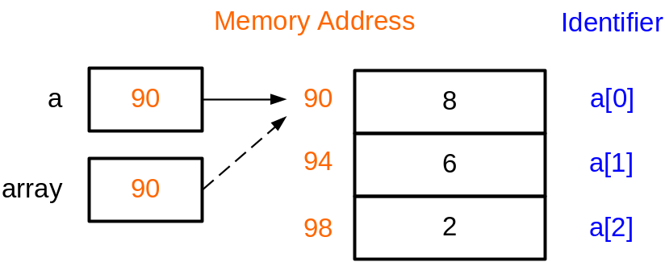
Example 3: Parameter Passing
#define N 5
double sum(int *b);
void main()//Compute the mean value
{
int a[N] = {8,6,2,7,1};
double mean;
mean = sum(a)/N;
cout << "mean = “ << mean;
}
double sum(int *b)
{
int i;
double total = 0.0;
for (i=0; i<N; i++)
total += b[i];
return total;
}
When sum(a) is called, the content of a (address of a[0]) is copied to the pointer variable b.
Therefore the pointer b points to a[0]
a
b

Slide 16
Access elements in 2D array with pointers
We can use a pointer to access a 2D array
For a 2D array int a[4][3], a[i] (i=0,1,2,3) is the address of the first element in the i-th. row
For each row, it is equivalent to one 1D array
We can declare a pointer int *p = a[i] to access every element on the i-th. row

Slide 17
Access elements in 2D array with pointers
Like the 1D array, we use the ‘*’ sign to access the elements in one 2D array
int a[4][3] = {1,2,3,4,5,6,7,8,9,10,11,12};
int *p = a[0];
for(int i = 0; i<12; i++){
cout << *(p++) << endl;
}
char b[2][6];
cin >> b[0] >> b[1];
f1(b);
cout << endl;
f2(b);
void f1(char b[][6]) {
for (int i=0; i<2; i++) {
cout << b[i] << endl;
}
}
void f2(char (*p)[6]) {
for (int i=0; i<2; i++) {
cout << *(p++) << endl;
}
}
Code: lec08-05-2DArray.cpp

Slide 18
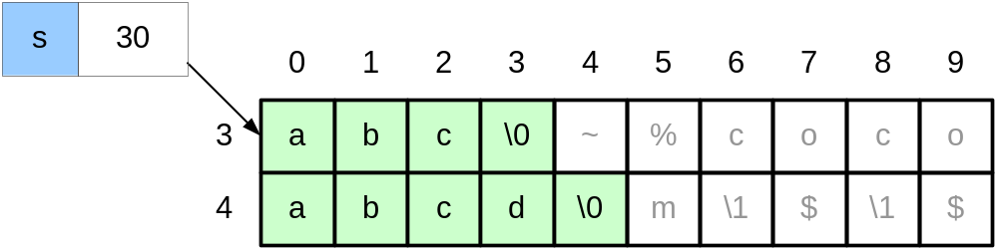
Arrays, pointers and strings
char s[]="abc";
s="abcd";
Illegal as s is a constant pointer and cannot be modified

Slide 19
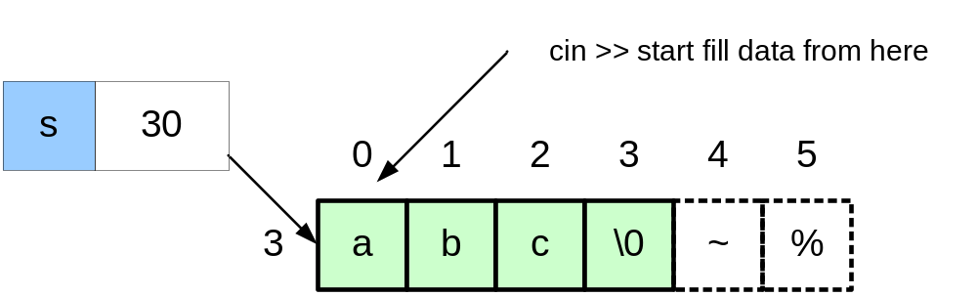
cin >> a string (I)
char s[]="abc";
cin >> s;
input: “Hello World”

Slide 20
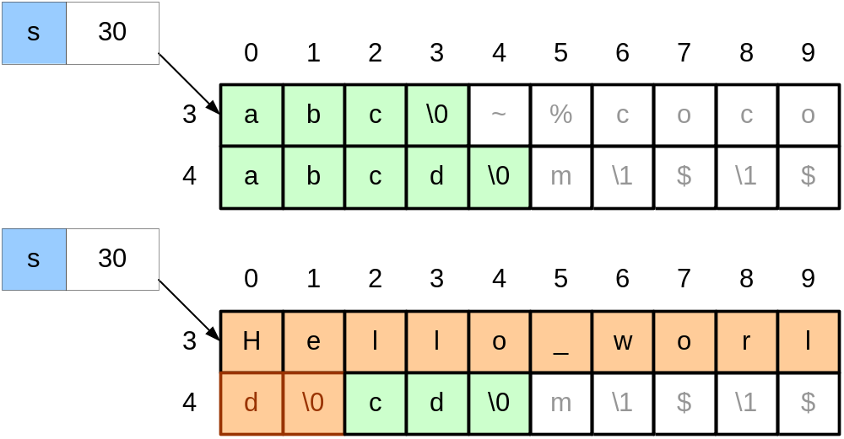
cin >> a string (I)
Size of s is 4. Array out-of-bound! cin >> does not perform bound-checking
Better to use:
cin.getline(s,4); /*read at most 3 characters*/
Leaving space for the final '\0' character
Code: lec08-06-cin.cpp

Slide 21
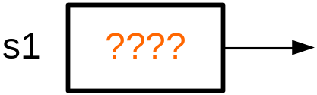
cin >> a string (II)
#include <iostream>
using namespace std;
void main () {
char *s1;
cin >> s1;
cout << s1 <<endl;
}
Problem: when we declare the pointer s1, we do not know where s1 points to.
In this example, we try to read a string and store it in the location pointed by s1.
This may generate errors as we may overwrite some important locations in memory

Slide 22
Dynamic memory allocation
Keywords: new & delete
  int *p = new int;
  int *p = new int(10);
  char *p = new char(‘a’);
  delete p;
  *p = 10; // illegal
Keywords: new [] & delete []
  int *p = new int[20];
  char *p = new char[20];
  delete [] p;
int a;
int *p = &a;
int a[20];
int *p = a;
Code: lec08-07-dynamic.cpp

Slide 23
Dynamic memory allocation
#include <iostream>
void main () {
char *s1=NULL;
s1=new char[4];
cin >> s1; /*input "abc"*/
cout << s1;
delete [] s1;
s1=new char[6];
cin >> s1;
cout << s1;
delete [] s1;
s1=NULL;
}

Slide 24
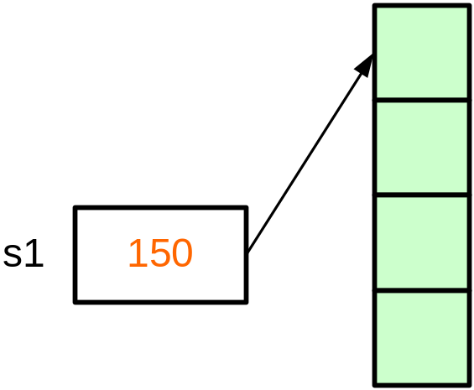
Dynamic memory allocation
#include <iostream>
void main () {
char *s1=NULL;
s1=new char[4];
cin >> s1; /*input "abc"*/
cout << s1;
delete [] s1;
s1=new char[6];
cin >> s1;
cout << s1;
delete [] s1;
s1=NULL;
}
new dynamically allocates 4 bytes of memory. new returns a pointer to the 1st byte of the chunk of memory, which is assigned to s1

Slide 25
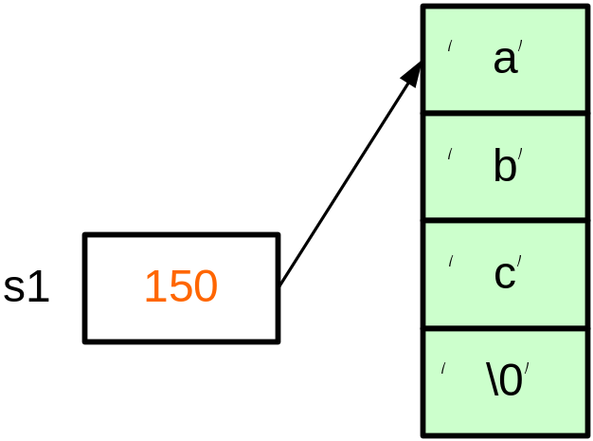
Example 4: Dynamic memory allocation
#include <iostream>
void main () {
char *s1=NULL;
s1=new char[4];
cin >> s1; /*input "abc"*/
cout << s1;
delete [] s1;
s1=new char[6];
cin >> s1;
cout << s1;
delete [] s1;
s1=NULL;
}

Slide 26
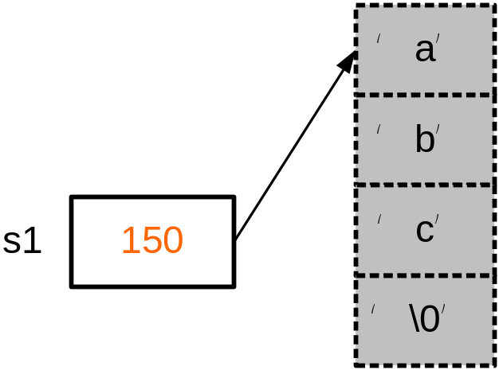
Example 4: Dynamic memory allocation
#include <iostream>
void main () {
char *s1=NULL;
s1=new char[4];
cin >> s1; /*input "abc"*/
cout << s1;
delete [] s1;
s1=new char[6];
cin >> s1;
cout << s1;
delete [] s1;
s1=NULL;
}
Memory is free and can be used to store other data

Slide 27
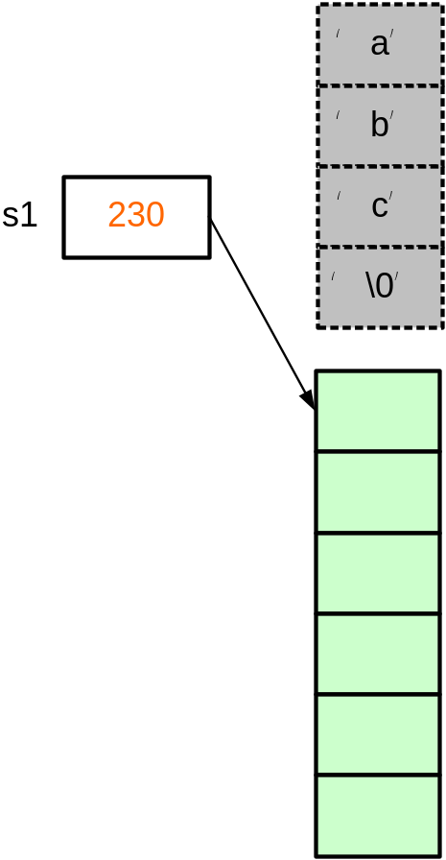
#include <iostream>
void main () {
char *s1=NULL;
s1=new char[4];
cin >> s1; /*input "abc"*/
cout << s1;
delete [] s1;
s1=new char[6];
cin >> s1;
cout << s1;
delete [] s1;
s1=NULL;
}
new dynamically allocates 6 bytes of memory. new returns a pointer to the 1st byte of the chunk of memory, which is assigned to s1

Slide 28
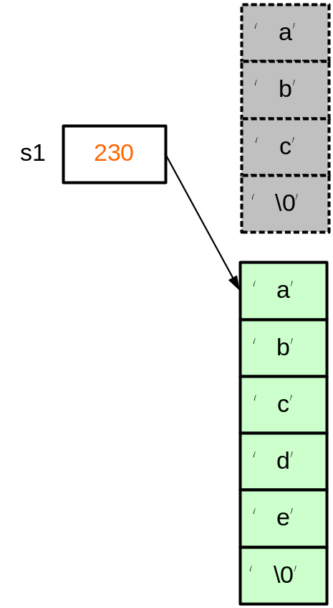
#include <iostream>
void main () {
char *s1=NULL;
s1=new char[4];
cin >> s1; /*input "abc"*/
cout << s1;
delete [] s1;
s1=new char[6];
cin >> s1;
cout << s1;
delete [] s1;
s1=NULL;
}

Slide 29
#include <iostream>
void main () {
char *s1=NULL;
s1=new char[4];
cin >> s1; /*input "abc"*/
cout << s1;
delete [] s1;
s1=new char[6];
cin >> s1;
cout << s1;
delete [] s1;
s1=NULL;
}

Slide 30
#include <iostream>
void main () {
char *s1=NULL;
s1=new char[4];
cin >> s1; /*input "abc"*/
cout << s1;
delete [] s1;
s1=new char[6];
cin >> s1;
cout << s1;
delete [] s1;
s1=NULL;
}

Slide 31
Dynamic memory allocation
Define an array
  int name[20];
What if:
  I don’t know the size in advance, or
  I want to change the size later

Slide 32
Dynamic memory allocation
void main()
{
//int s1[4];
int*s1;
int length = 4;
s1=new int[length];
cin >> s1[0];
cin >> s1[1];
cin >> s1[2];
cin >> s1[3];
delete [] s1;
s1=NULL;
}
10
150
154
158
// input: 10
162

Slide 33
Example
The input file score.txt contains the scores of 3 different courses for n students.
  The first line of score.txt gives the value of n
  Reads all the scores, find all the students who have a failed score (<60) and output their scores for every course
As the number of the students is read from the input, we cannot define a normal 2D array (array size is not a constant). Hence , we can use dynamic allocation to solve the problem
Code: lec08-08-score.cpp

Slide 34
Example
We will skip the file I/O part in this lecture
Focus: 2D dynamic memory allocation
int n = 4;
int scores[4][3] = {
85, 89, 64,
93, 82, 94,
55, 92, 59,
59, 88, 70
};
int **p = new int*[n];
for (int i=0; i<n; i++) {
p[i] = new int[3];
}
for (int i=0; i<n; i++) {
for (int j=0; j<3; j++) {
p[i][j] = scores[i][j];
}
}
for (int i=0; i<n; i++) {
for (int j=0; j<3; j++) {
if (p[i][j] < 60) {
for (int k=0; k<3; k++) {
cout << p[i][k] << " ";
}
cout << endl;
break;
}
}
}
for (int i=0; i<n; i++) {
delete [] p[i];
}
delete [] p;
p = NULL;
Code: lec08-08-score.cpp

Slide 35
Guidelines on using pointers
Initialize a pointer to NULL after declaration
  char *cPtr=NULL;
Check its value before use
  if (cptr!=NULL){
  ….
  }
Free the memory allocated by the “new” operator using delete
  cPtr = new char[6]; …
  delete [] cPtr;
Set it NULL again after free
  delete [] cPtr;
  cPtr = NULL;

Slide 36
Outline
More about pointer
Applications of pointer
More about class

Slide 37
Copy Constructor
We have learned two types of constructors
  Default constructor
    DayOfYear() {}
  Parameterized constructor
    DayOfYear(int m, int d):m_Month(m), m_Day(d) {}
Copy constructor
  Use another object of the same class to initialize a new object
    DayOfYear(const DayOfYear &d) {
      m_Month = d.m_Month;
      m_Day = d.m_Day;
    }
Code: lec08-09-copy.cpp

Slide 38
Copy Constructor
When the copy constructor is called
  Use an existing object to initialize a new object of the same class
    DayOfYear d1(1, 1);
    DayOfYear d2(d1); // or DayOfYear d2 = d1;
  Call-by-value
void f(DayOfYear d2) {
// …
}
void main() {
DayOfYear d1;
f(d1);
}

Slide 39
Copy Constructor
If we do not provide a user-defined copy constructor, compiler provides a default copy constructor
  member-wise copy
The default copy constructor may cause errors

Slide 40
Copy Constructor
Shallow copy
  s1.pID and s2.pID point to the same dynamic variable, new int (id)
  After one object is destructed, the destruction of the other object tries to delete it again, which causes an error
class Student {
public:
Student(int id, int a){
pID = new int(id);
age = a;
}
~Student() {
delete[] pID;
pID = NULL;
}
int *pID;
int age;
};
void f() {
Student s1(123456, 20);
Student s2(s1);
}

Slide 41
Copy Constructor
Deep copy
  Add the following user-defined copy constructor in the class
Student(const Student &s) {
age = s.age;
pID = new int(*s.pID);
}
Code: lec08-10-deep.cpp

