Slide 1
CS2310 Computer Programming
LT10: C++ Polymorphism
Computer Science, City University of Hong Kong
Semester B 2024-25

Slide 2
Outline
Introduction to Polymorphism
Virtual function and dynamic/late binding
Virtual destructor

Slide 3
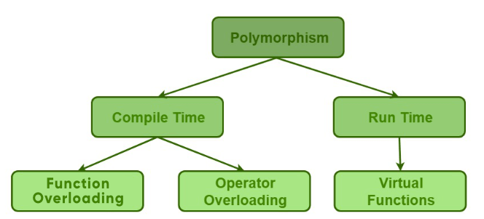
Polymorphism
Have multiple functions with the same name, with different operations
  Real-world examples?
Types of polymorphism in C++
  Compile-time polymorphism
    Function overloading
    Operator overloading
  Run-time polymorphism

Slide 4
Types of Polymorphism
Compile-time polymorphism
  Function overloading
    Change the number of parameters, and/or
    Change the type of parameters
  Early binding (in the compilation)
class A {
public:
void func() { //… }
void func(int x) { //… }
};
void f() {
A a;
a.func();
a.func(10);
}
Code: lec10-01-function.cpp

Slide 5
Types of Polymorphism
Compile-time polymorphism
  Operator overloading
  Early binding (in the compilation)

Slide 6
Types of Polymorphism
Run-time polymorphism
  Achieved by function overriding (redefinition, not overloading)
    Not run-time polymorphism yet
class Machine {
public:
void start() { cout << “starting” << endl; }
};
class Car :public Machine {
public:
void start() {
cout << “driving” << endl;
}
};
class Drone :public Machine {
public:
void start() {
cout << “flying” << endl;
}
};
class Boat :public Machine {
public:
void start() {
cout << “sailing” << endl;
}
};
void f1() {
Car c;
c.start();
Car *cPtr = &c;
cPtr->start();
cPtr->Machine::start();
}
void f2() {
Car c;
Machine *mPtr = &c;
// binding at compile time
mPtr->start();
}
Code: lec10-02-overriding.cpp

Slide 7
Outline
Introduction to Polymorphism
Virtual function and dynamic/late binding
Virtual destructor

Slide 8
Types of Polymorphism
Run-time polymorphism
  virtual function: run-time binding
class Machine {
public:
virtual void start() { cout << “starting” << endl; }
};
class Car :public Machine {
public:
void start() {
cout << “driving” << endl;
}
};
class Drone :public Machine {
public:
void start() {
cout << “flying” << endl;
}
};
class Boat :public Machine {
public:
void start() {
cout << “sailing” << endl;
}
};
void f1() {
Machine *mPtr;
Car c;
mPtr = &c
mPtr->start();
Drone d;
mPtr = &d
mPtr->start();
Boat b;
mPtr = &b
mPtr->start();
}
void launch(Machine *mPtr) {
mPtr->start();
}
void f2() {
Car c;
launch(&c);
Drone d;
launch(&d);
Boat b;
launch(&d);
}
Code: lec10-03-virtual.cpp

Slide 9
Summary
To achieve run-time polymorphism,
  1) inheritance happens, and
  2) the virtual function in the base class is overridden in the derived class
How to use?
  Base class pointer pointing to derived class object

Slide 10
Summary
Virtual and non-virtual functions
  Virtual function: binding at run time
  Non-virtual function: binding at compile time
class Machine {
public:
virtual void start() {
cout << “starting” << endl;
}
virtual void end() {
cout << “ending” << endl;
}
void playSound() {
cout << “playing sound” << endl;
}
};
class Car :public Machine {
public:
void start() {
cout << “driving” << endl;
}
void end() {
cout << “breaking” << endl;
}
void playSound() {
cout << “beep” << endl;
}
};
void f() {
Car c;
Machine *mPtr = &c;
// virtual function, binding at run time
mPtr->start(); // driving
// non-virtual func, binding at compile time
mPtr->playSound(); // playing sound
}
Code: lec10-04-compare.cpp

Slide 11
Critical Thinking
How late binding works?
  vtable: a table of (virtual) function pointers, one table per class
  vptr: a pointer to vtable, one vptr per object
The compiler does additional operations for vptr at runtime
  In constructor, it first sets vptr to point to the vtable of the class
  When we make a call to the virtual function through the base class pointer, it finds vptr to access the corresponding function in the vtable of the derived class

Slide 12
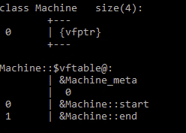
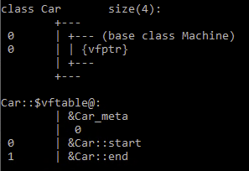
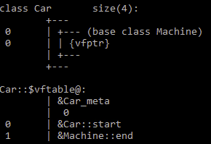
Critical Thinking
How it works?
class Machine {
public:
virtual void start() {
cout << “starting” << endl;
}
virtual void end() {
cout << “ending” << endl;
}
};
class Car :public Machine {
public:
void start() {
cout << “driving” << endl;
}
void end() {
cout << “breaking” << endl;
}
};

Slide 13
Critical Thinking
Machine m;
Machine *mPtr = &m;
mPtr->start();
&M: vtable
M: start() {…}
m
&Machine::start()
&Machine::end()
vptr
Car c1;
Machine *mPtr = &c1;
mPtr->start();
M: end() {…}
c1
vptr
&C: vtable
C: start() {…}
&Car::start()
&Car::end()
Car c2;
Machine *mPtr = &c2;
mPtr->start();
C: end() {…}
c2
vptr

Slide 14
Practice
Virtual function in multi-level inheritance
class Machine {
public:
virtual void start() { cout << “starting” << endl; }
};
class Car :public Machine {
};
class Truck :public Car {
};
class Bus :public Car {
};
void launch(/* */) {
//…
}
int main() {
Machine *mPtr[4];
//…
for (int i=0; i<4; i++) {
launch(mPtr[i]);
}
}
Output:
starting
driving
delivering cargos
carrying passengers
Code: lec10-05-example.cpp

Slide 15
Memory Layout
class Base {
public:
virtual void start() {}
virtual void end() {}
int b;
};
class Derived :public Base {
public:
void start() {} // overriding
int d;
};
Base: vtable
Other Info.
Base
vptr
Base::start()
int b
Base::end()
Derived: vtable
Other Info.
Derived
vptr
Derived::start()
subobject
int b
Base ::end()
int d
Code: lec10-06-layout.cpp

Slide 16
Pure Virtual Functions and Abstract Classes
Pure virtual function
  Syntax
Abstract class
  A class is abstract if it has at least one pure virtual function
virtual returnType funcName([paraList]) = 0;
class Machine {
public:
virtual void start() = 0;
};
void f() {
Car c;
Machine *mPtr = &c;
mPtr->start(); // driving
}
class Car :public Machine {
public:
void start() {
cout << “driving” << endl;
}
};
Code: lec10-06-pure.cpp

Slide 17
Abstract Class
Some notes
  We cannot create objects of abstract classes
  If the pure virtual function is not overridden in the derived class, the derived class also becomes an abstract class
class Machine {
public:
virtual void start() = 0;
};
void f() {
Car c; // Error
}
class Car :public Machine {
// Do not override start()
// Car is also an abstract class
};
Code: lec10-07-abstract.cpp

Slide 18
Outline
Introduction to Polymorphism
Virtual function and dynamic/late binding
Virtual destructor

Slide 19
Virtual Destructor
Why we need it? Consider the following case
  When we use a base class pointer to point to a derived class object, if a variable is created on the heap (using new), the pointer cannot call the destructor of the derived class
  So, the variables in the heap will not be released (memory leak)
class Car :public Machine {
public:
Car () {
nPtr = new int;
cout << "car-con" << endl;
}
~Car() {
if (nPtr != NULL) {
delete nPtr;
nPtr = NULL;
}
cout << "car-des" << endl;
}
int *nPtr;
};
class Machine {
public:
Machine() {
cout << "machine-con" << endl;
}
~Machine() {
cout << "machine-des" << endl;
}
};
void f() {
Machine *mPtr = new Car;
delete mPtr;
mPtr = NULL;
}
Code: lec10-09-destructor.cpp

Slide 20
Critical Thinking
Analyze f2() below:
class Car :public Machine {
public:
Car () {
nPtr = new int;
cout << "car-con" << endl;
}
~Car() {
if (nPtr != NULL) {
delete nPtr;
nPtr = NULL;
}
cout << "car-des" << endl;
}
int *nPtr;
};
class Machine {
public:
Machine() {
cout << "machine-con" << endl;
}
~Machine() {
cout << "machine-des" << endl;
}
};
void f() {
Machine *mPtr = new Car;
delete mPtr;
mPtr = NULL;
}
void f2() {
Car c;
Machine *mPtr = &c;
}

Slide 21
Virtual Destructor
How to avoid this memory leak?
  virtual destructor
class Car :public Machine {
public:
Car () {
nPtr = new int;
cout << "car-con" << endl;
}
~Car() {
if (nPtr != NULL) {
delete nPtr;
nPtr = NULL;
}
cout << "car-des" << endl;
}
int *nPtr;
};
class Machine {
public:
Machine() {
cout << "machine-con" << endl;
}
virtual ~Machine() {
cout << "machine-des" << endl;
}
};
void f() {
Machine *mPtr = new Car;
delete mPtr;
mPtr = NULL;
}

Slide 22
Summary of Virtual Destructor
When a base class is designed to support polymorphism, it is better to provide the virtual destructor
  Unless you are sure that there is no variable defined on the heap, no need to define virtual destructor
Only destructors can be virtual. Constructor cannot be declared as virtual function

Slide 23
Practice
class Shape {
public:
virtual double area() = 0;
virtual void print() = 0;
virtual ~Shape() {}
};
Input the number of shapes:
3
~~~~~~~~1~~~~~~~~
c: circle
r: rectangle
t: triangle
~~~~~~~~~~~~~~~~~
c
Radius: 10
~~~~~~~~2~~~~~~~~
c: circle
r: rectangle
t: triangle
~~~~~~~~~~~~~~~~~
r
Two sides: 5 6
~~~~~~~~3~~~~~~~~
c: circle
r: rectangle
t: triangle
~~~~~~~~~~~~~~~~~
t
Three sides: 3 4 5
The radius of the circle is 10
The area of the circle is 314.15
The width of the rectangle is 5 and the length is 6
The area of the rectangle is 30
The sides of the triangle is 3, 4, and 5
The area of the triangle is 6
class Circle :public Shape {
public:
Circle(double d) {}
double area() {}
void print() {}
private:
double r;
};
class Rectangle :public Shape {
public:
Rectangle(double a, double b) {}
double area() {}
void print() {}
private:
double wide, len;
};
class Triangle :public Shape {
public:
Triangle(double a, double b, double c) {}
double area() {}
void print() {}
private:
double a, b, c;
};
int main () {
int n;
cout << "Input the number of shapes: " << endl;
cin >> n;
Shape** arr = new Shape*[n];
//…
}
Code: lec10-10-area.cpp

