Slide 1

E-Commerce store analysis
– using RFM Clustering
Karthikeyan RV – CB.EN.U4CSE18331
Mighil Dath – CB.EN.U4CSE18339
Tanmaay Kankaria – CB.EN.U4CSE18362

Slide 2
Project Overview
Objective
Identify customer segments based on the overall buying behaviour of the client
Dataset
Online E-Commerce Business Data Set
Outcome
Create an unsupervised model that generates the optimum number of segments for the customer base
Success Criteria
Segments generated can be interpreted and transposed into business actions

Slide 3
Business Understanding
To be on par with the competition, an UK based online retail company wants to understand their customers buying preferences in order to, pinpoint their marketing strategy and deepen customer loyalty
To achieve these goals we need to analyze the store’s transactional dataset to create segments based on the customers purchase history

Slide 4
Data Understanding
The dataset contains transactions occurring between 01/12/2010 and 09/12/2011
No. of Observation : 541,909
No. of features: 8
No. of Transactions: 22,190
No. of Customers: 4,372
No. of Products: 3,684

Slide 5
Columns Description :
InvoiceNo : Unique ID for every time a consumer visits the store
StockCode: Unique ID for a product
Description : Description of the product
Quantity : No of units bought
InvoiceDate : Date and time of purchase
Unit Price : Price for 1 unit of the product
CustomerId : Unique ID for each customer
Country : Country where transaction happened
Also for our analysis we need to calculate the total sales for each product by multiplying Quantity with Unit Price.

Slide 6
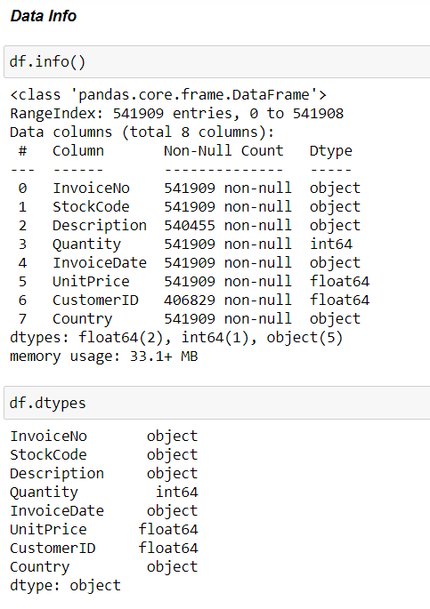
Data Exploration and Pre-Processing

Slide 7
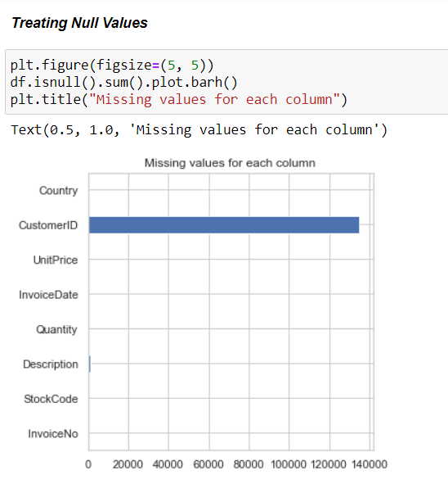
Missing Values

Slide 8
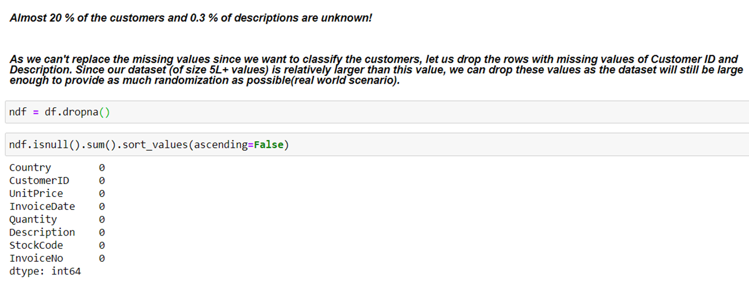

Slide 9
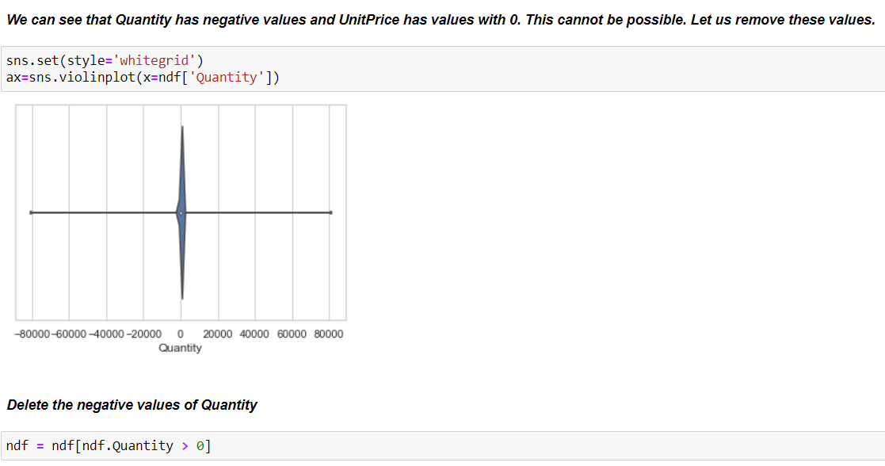
Feature Exploration

Slide 10
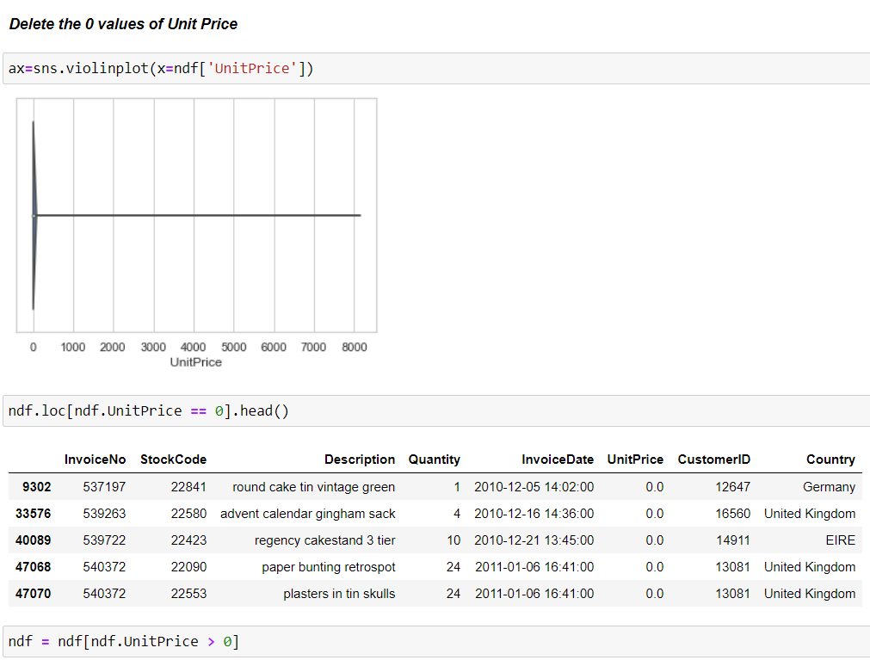

Slide 11
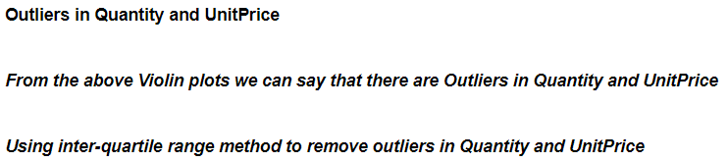
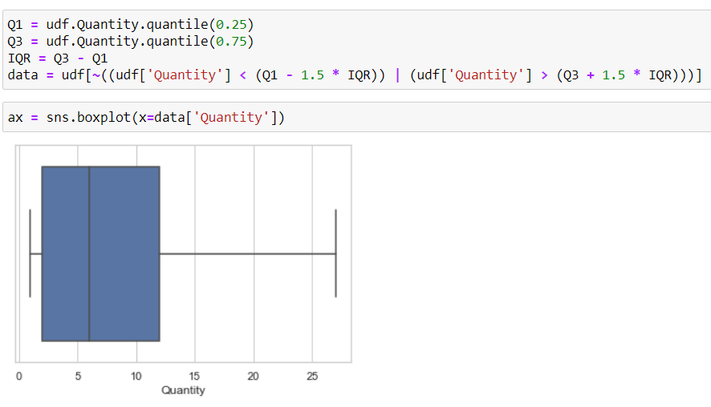

Slide 12
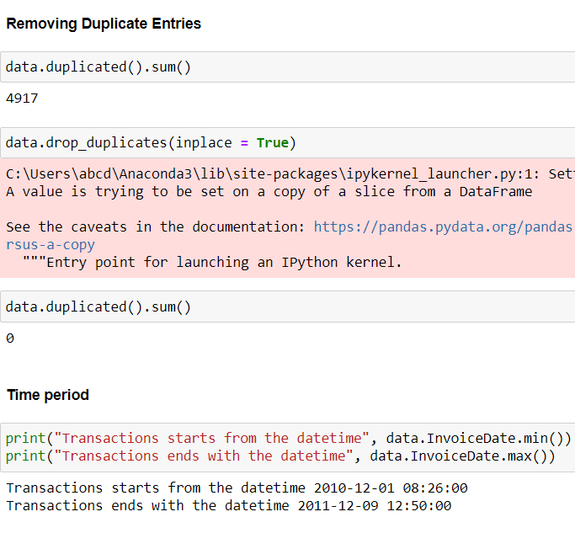

Slide 13
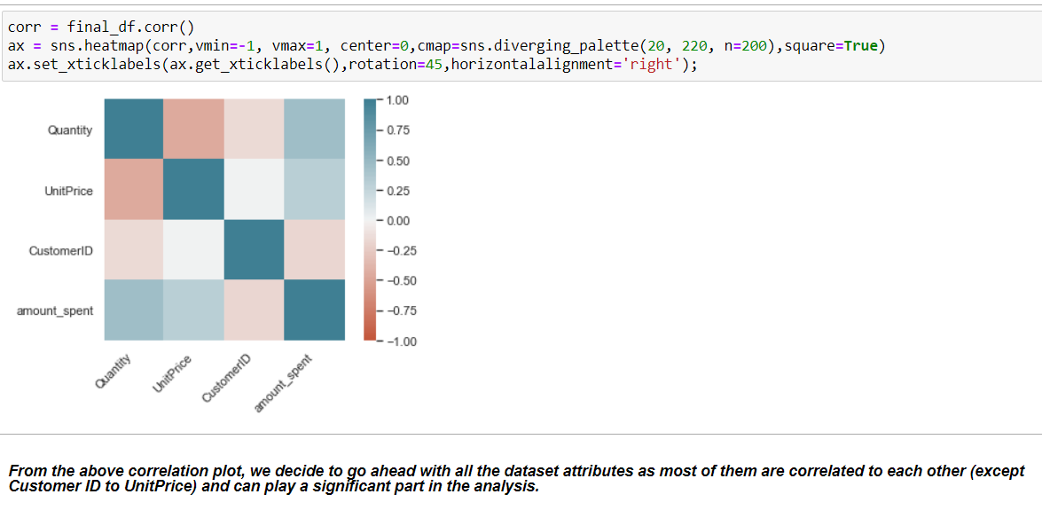

Slide 14
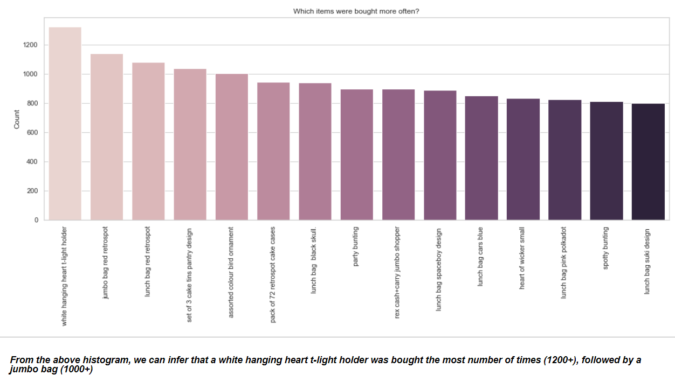
Knowing more about the Store

Slide 15
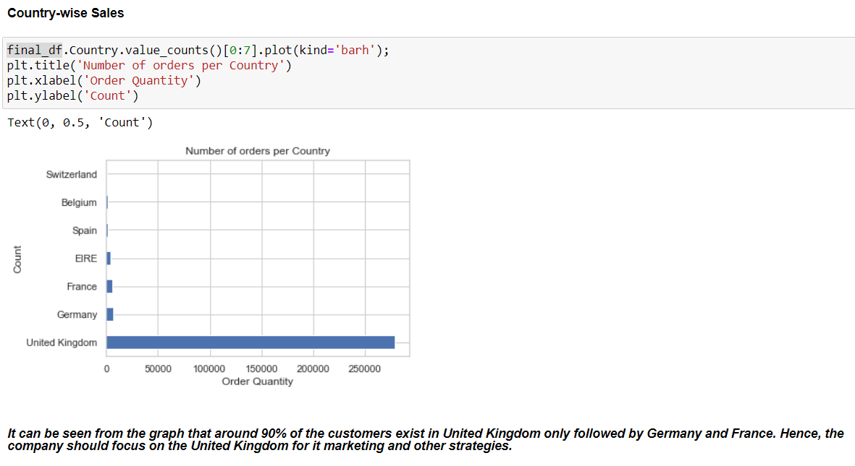

Slide 16
Data Modeling and Evaluation
K-Means Clustering
Optimization & Metrics
RFM Analysis
Segments Mapping & Business Actions

Slide 17
RFM Analysis
Recency - Given a current or specific date in the past, when was the last time that the customer made a transaction
Frequency - Given a specific time window, how many transactions did the customer do during that window
Monetary Value or Revenue - Given a specific window, how much did the customer spend

Slide 18
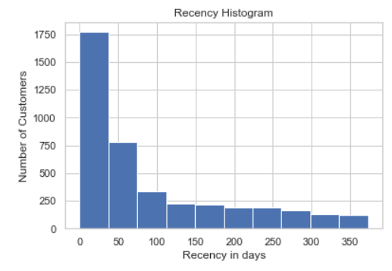
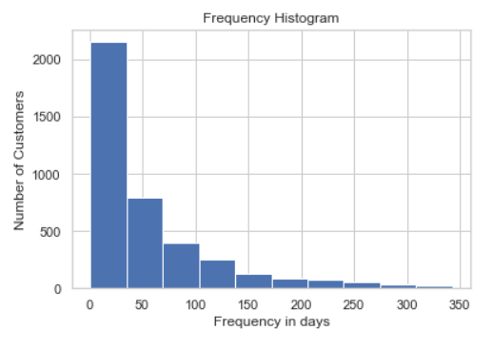
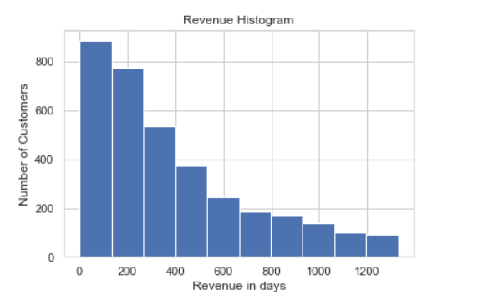

Slide 19
K-means Clustering:
K-means is clustering algorithm that aims to partition n observations into k clusters such that each observation belongs to the cluster with the nearest mean, serving as a prototype of the cluster.
Why k-means?
As our feature variables are numerical and our goal is unsupervised to find out some sort of structure in the customers, we used k-means clustering

Slide 20
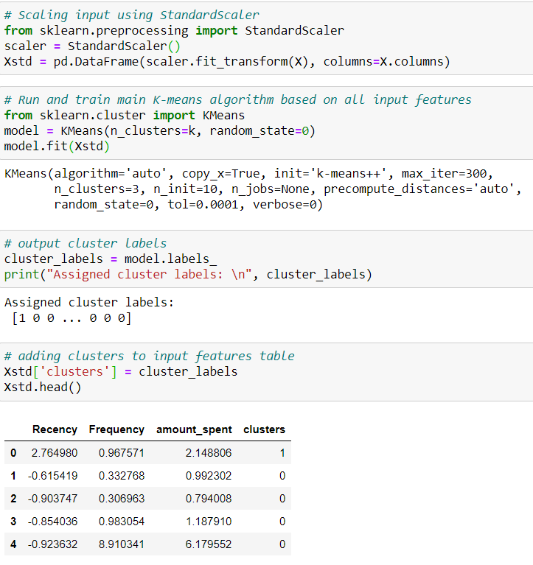
K-means Clustering:
Input X:
Recency
Frequency
Revenue
Initial configuration
K=3

Slide 21
Evaluation Metrics - Silhouette and Inertia scores
Silhouette score is a metric used to calculate the goodness of a clustering technique. Its value ranges from -1 to 1. As the value goes towards 1, the clusters are well apart from each other and clearly distinguished.
Inertia tells how far away the points within a cluster are. Therefore, we are aiming for a small inertia.

Slide 22
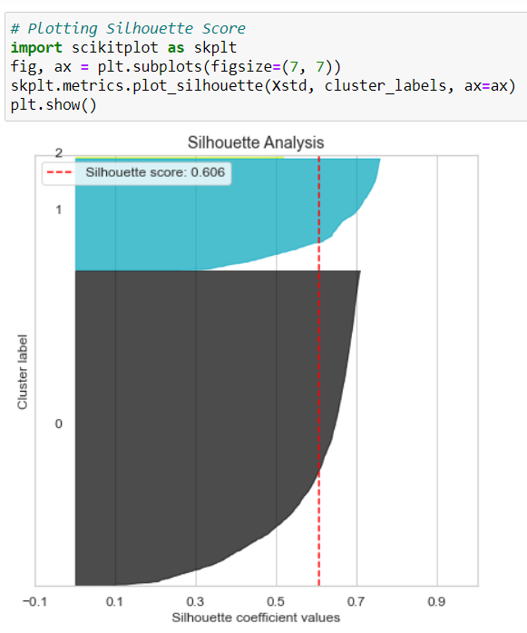

Slide 23
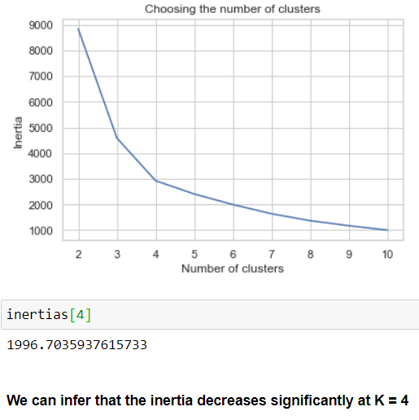
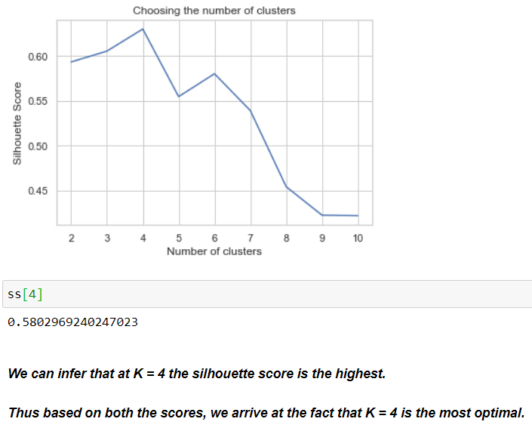
K-Means Optimization:
Initial configuration: K = 3
New configuration: K = 4

Slide 24
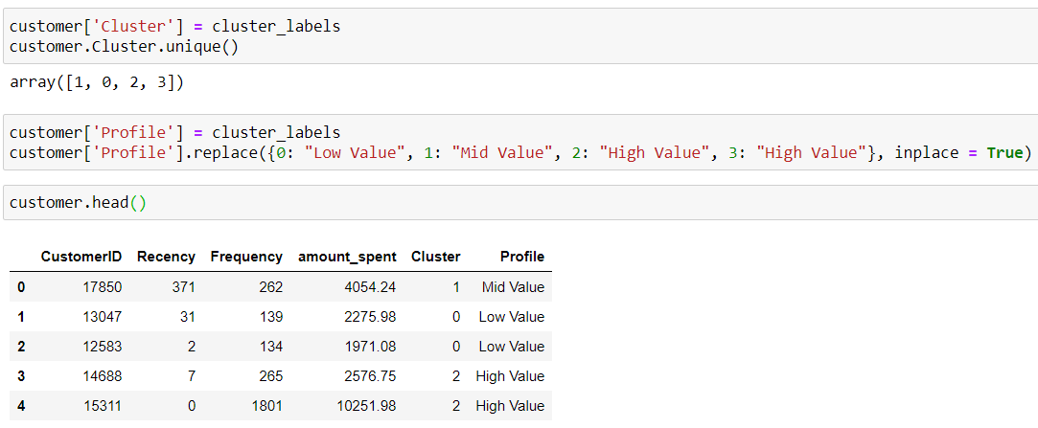
We started off with 3 segments, but computationally it proved that 4 segments were the optimal. We can combine these in order to be able to communicate the results to the business better and do the following grouping:
Low Segment: 0
Mid Segment: 1
High Segment: 2-3

Slide 25
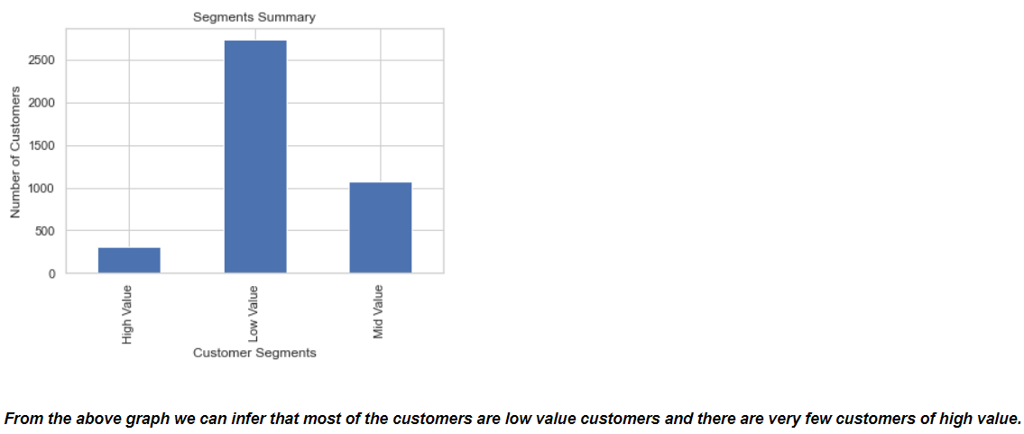
Segmentation Summary:

Slide 26
High Value:
Improve Retention of these customers as they are the most valuable asset
Mid Value:
Increase Retention and Frequency and bring them closer to the brand and the product so eventually they become High Value
Low Value:
Increase Frequency and understand if there are any potential issues around the product or service
Business Actions

Slide 27
Business Actions
High Value:
They are the best and most reliable customers. Business should focus on making customized promotional strategies and loyalty schemes for these customers in order to retain this valuable customer base.
Mid Value:
Business should provide more incentives and offers to these customers and try to retain these customers. More analysis can be done to see customer buying pattern or assess the success of marketing strategies by analyzing the response of these customers.
Low Value:
These customers might stop visiting the store. Business should focus on these customers and look out for the reason why they abandoned visiting the stores.

Slide 28
THANK YOU

