Slide 1
IBM University Engagement Project Submission
“Exploring the Power of Agentic AI with IBM Granite and LangFlow”

Slide 2

Project Tile – KisanSetu AI
Domain of Project – Agriculture (AgriTech – Market Linkage for Farmers)
Student Name | Recent Passport Photo | Email ID | Mobile number [WhatsApp]
Tanmai Thakre |  | tanmaithakre@gmail.com | 9099660305

Slide 3
Problem Statement -
Problem Statement : KisanSetu AI
The Challenge
Gujarat cotton and groundnut farmers often struggle with knowing the right time, price, and buyer to sell to. Mandi prices, buyer contacts, and quality benchmarks are scattered across unreliable sources and middlemen. Without personalized, real-time market guidance, many farmers end up selling at low prices or missing better opportunities.
The Objective
Build an AI-powered market linkage platform, KisanSetu AI, that delivers personalized, real-time market intelligence for cotton and groundnut farmers in Gujarat. The solution should:
Mandi Price Forecasting – Predict cotton and groundnut prices for the next 15 days using historical mandi data.
Buyer Matching – Identify and connect farmers with the best-fit buyers based on price, location, and quantity.
Storage vs. Sell Advisory – Recommend whether to sell now or store, weighing forecasted price trends against storage cost and risk.
Quality Grading – Assess produce quality to support fair, evidence-based pricing.
Multi-Agent System –
Mandi Forecast Agent (predicts market prices)
Buyer Matching Agent (finds the best buyer)
Storage Advisor Agent (sell-or-store guidance)
Quality Grading Agent (produce quality assessment)
Income Dashboard Agent – Calculates expected net income and shows LIVE / DEMO / ESTIMATE data-source badges for transparency.

Slide 4
Proposed Solution -
Proposed Solution: KisanSetu AI
The proposed solution is a multi-agent AI-powered market linkage platform built using a custom Agent Orchestrator (FastAPI) integrated with IBM watsonx.ai and Granite models to provide personalized, real-time selling guidance to Gujarat cotton and groundnut farmers. The system addresses price uncertainty, buyer discovery, and storage decisions through an intelligent, modular architecture.
At its core, the solution uses an Agent Orchestrator with intent classification to route each farmer question to the right specialised agents. The structured JSON results from those agents are then passed to IBM Granite, which never invents numbers — it only explains data that the deterministic agents have already computed.
The system consists of four core specialist agents:
Mandi Forecast Agent predicts cotton and groundnut prices for the next 15 days using historical trends.
Buyer Matching Agent finds and ranks the best buyers for a farmer’s crop based on price, location, and quantity.
Storage Advisor Agent recommends whether to sell immediately or store the crop, weighing forecasted price movement against storage cost and risk.
Quality Grading Agent assesses produce quality to support fair, evidence-based pricing.
The solution also includes an Income Dashboard Agent (backed by a Next.js 15 farmer dashboard) that calculates expected net income, risk level, and confidence, and tracks progress toward a farmer’s income goals.
The Agent Orchestrator coordinates all five agents based on intent classification, while watsonx.ai ensures scalable model deployment and AI governance. Granite models power reasoning and multilingual synthesis — but never generate prices, buyers, or income figures themselves.
Overall, this solution delivers an end-to-end intelligent market linkage assistant that helps farmers get fairer prices through personalized, grounded insights, real-time forecasts, and transparent decision support.

Slide 5
Technology Used
Next.js 15 & FastAPI stack - Farmer dashboard (Next.js, React, Tailwind) with a Python FastAPI Agent Orchestrator backend
IBM Granite model - ibm-granite-3-8b-instruct via watsonx.ai – For intent classification, multilingual answer synthesis, and reasoning
IBM Cloud – Provides the infrastructure (IBM Cloud Code Engine) to build, deploy, and scale KisanSetu AI efficiently. It enables a reliable, secure, and scalable environment for serving farmers across Gujarat.
Grounded synthesis– Structured JSON from the deterministic agents is fetched first, then Granite generates the farmer-facing answer, so KisanSetu AI never invents prices, buyers, or income figures.
IBM Watsonx.ai - For model deployment, prompt orchestration, and AI governance
Database (SQLite for dev / PostgreSQL for production) – Stores mandi prices, buyer records, and farmer profiles used to ground every agent response

Slide 6
System Components Used -
1) AI Chat Widget – Farmer-facing interface where users type questions in English, Gujarati, or Hindi (e.g. crop, mandi, quantity).
2) IBM watsonx Granite Client - Handles IAM authentication and calls Granite models to synthesize a grounded, farmer-friendly answer.
3) Name of IBM Granite model - ibm/granite-3-8b-instruct → Fast, efficient for real-time market analysis and multilingual synthesis
4) Chat output -Displays the farmer-friendly answer with price forecast, best buyer, sell/store advice, and expected income.
5) Agent Orchestrator - Classifies intent and invokes the Mandi Forecast, Buyer Matching, Storage Advisor, Quality Grading, and Income Dashboard agents.
6) SQLite / PostgreSQL database - stores market prices, buyer records, and farmer profiles used to ground every response.

Slide 7
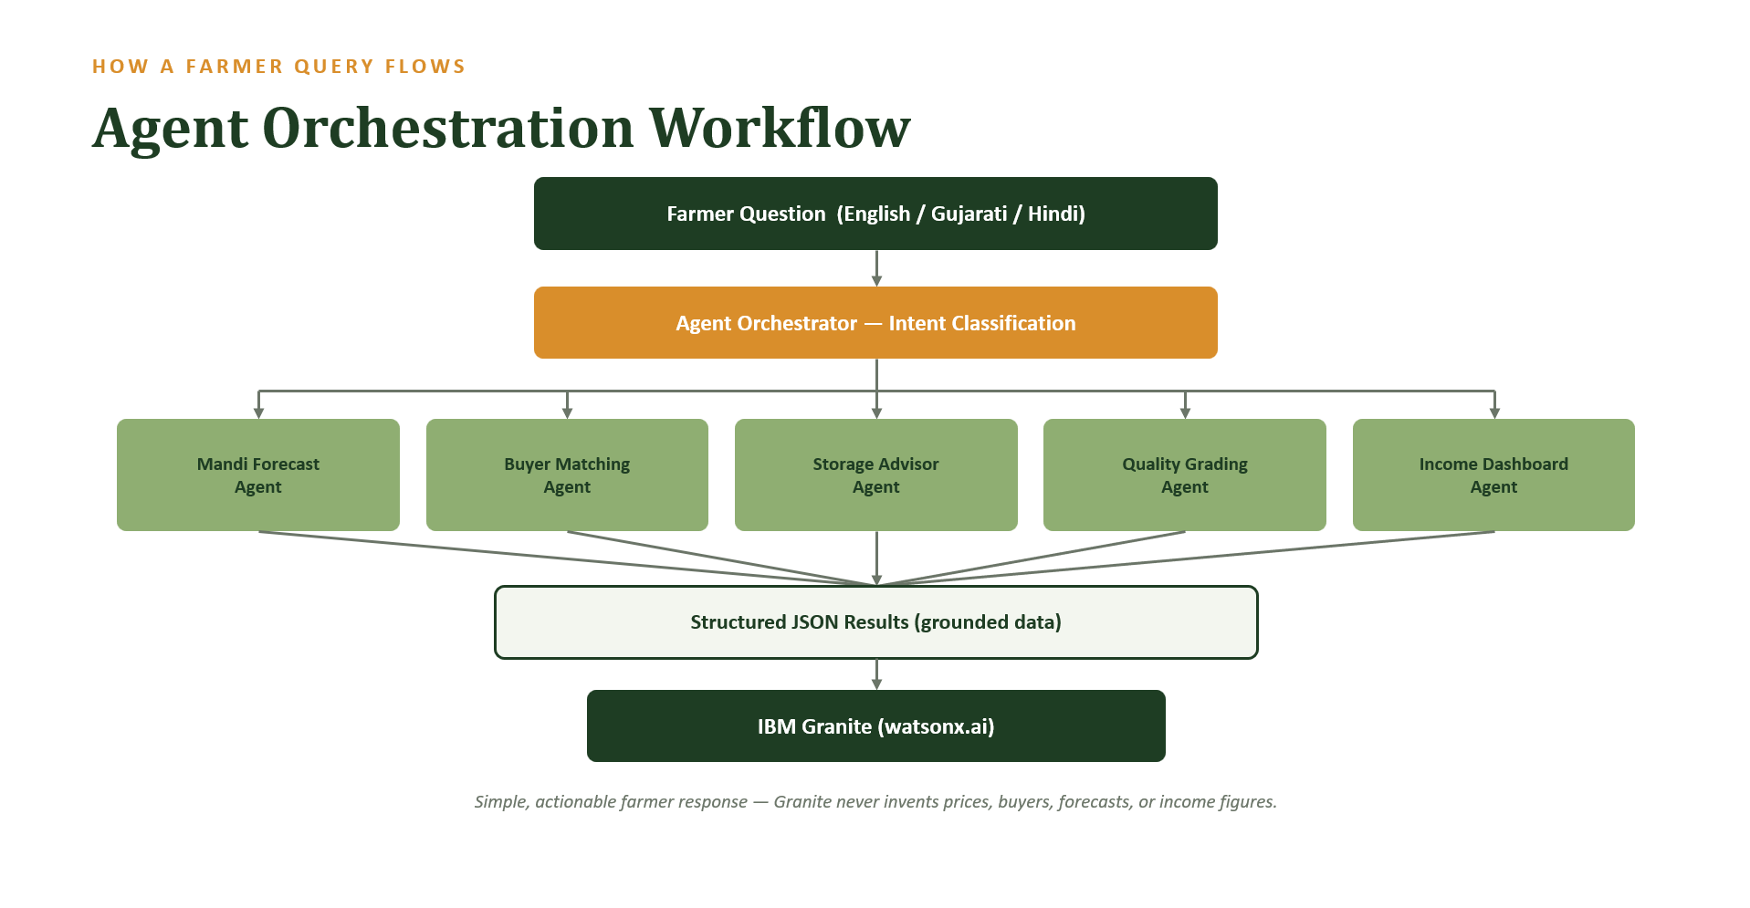

Slide 8
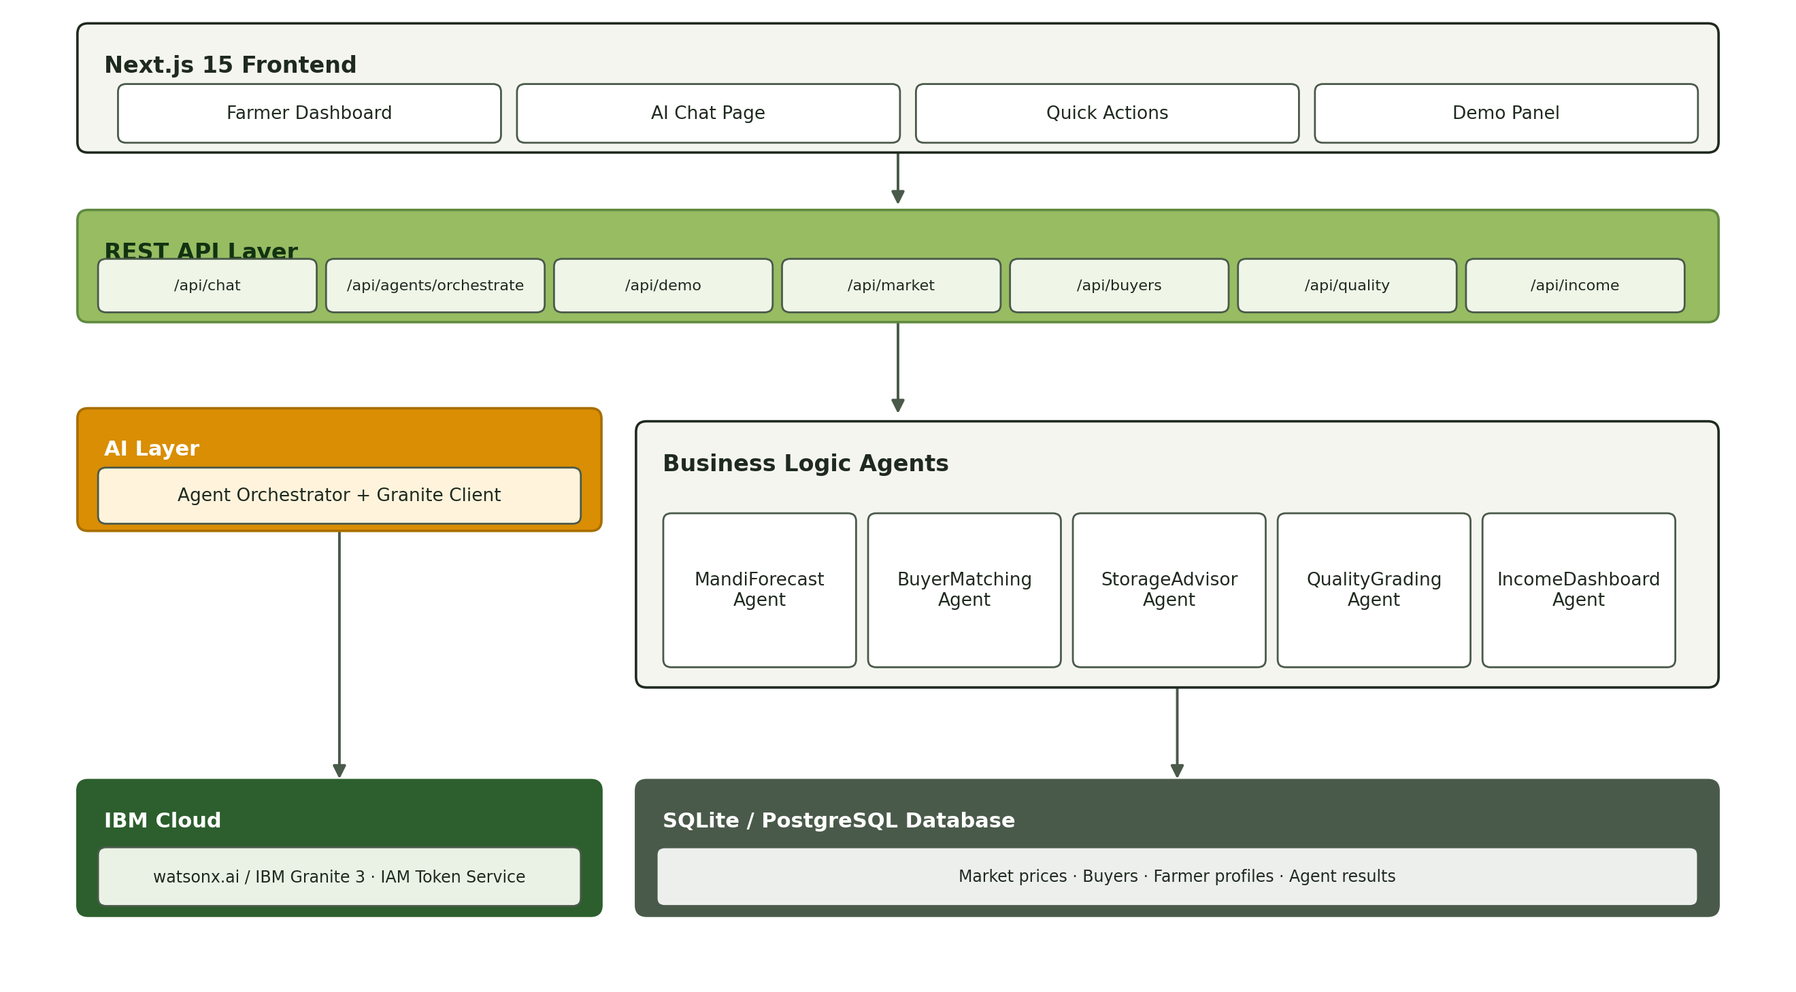
Architecture blueprint

Slide 9

Role of Agentic AI in the solution
Role of Agentic AI in KisanSetu AI
Agentic AI enables KisanSetu AI to function as an intelligent, autonomous system rather than a simple price lookup tool. Using IBM watsonx.ai and IBM Granite models, it coordinates five specialized agents to deliver grounded, personalized market guidance.
Each agent performs a specific role—such as forecasting mandi prices, matching buyers, advising on storage, grading quality, and calculating income—while working collaboratively. This multi-agent approach ensures efficient task execution and accurate, grounded results.
Agentic AI also brings context awareness, understanding a farmer’s crop, mandi, and quantity to generate tailored recommendations. It supports real-time adaptation, continuously updating advice as market conditions and user inputs change.
Additionally, agents communicate with each other, enabling better decision-making and improved outcomes.
Overall, Agentic AI makes the system proactive, personalized, and goal-driven, acting like a trusted digital market advisor that helps farmers earn a fairer price for their crop.

Slide 10
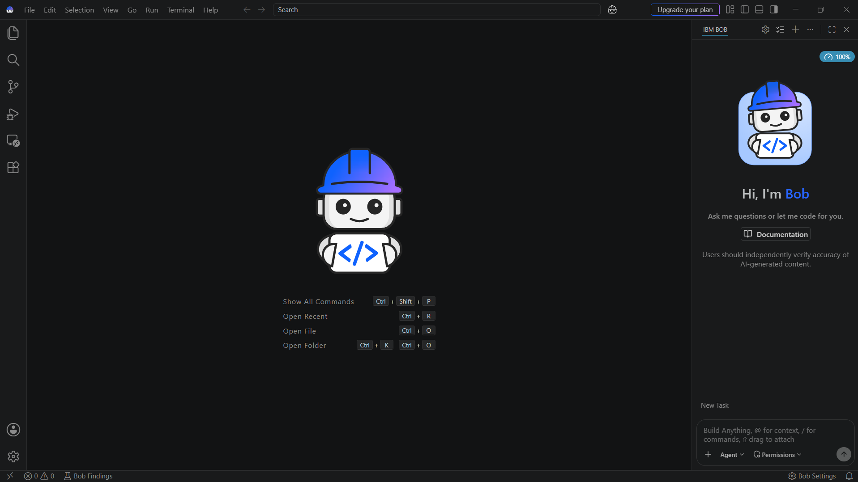
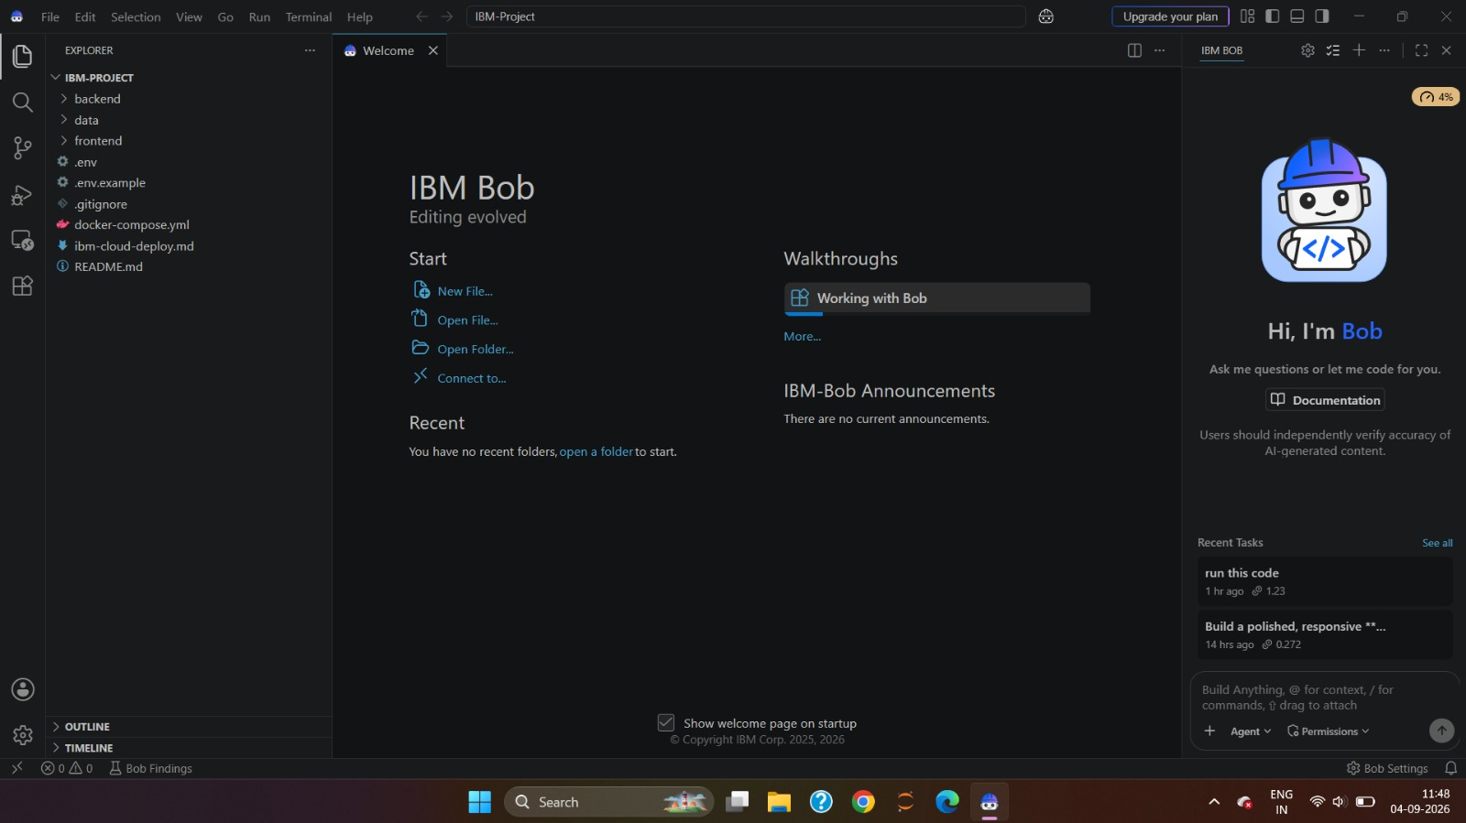
Token Usage
IBM Bob AI usage: 100% quota available before → 4% remaining after building the project
Before Prompt
After the Prompt
·
·
·

Slide 11
Novelty and Uniqueness
KisanSetu AI stands out by combining multi-agent orchestration, grounded synthesis, and multilingual delivery into a single trustworthy platform.
Multi-Agent Intelligence – Instead of a single chatbot, five specialized agents collaborate to deliver accurate, context-aware market guidance.
Grounded, Data-First Accuracy – Granite only explains numbers the deterministic agents already computed, eliminating hallucinated prices or buyers.
Hyper-Personalization – Tailors advice to each farmer’s crop, mandi, quantity, and language preference.
Transparent Data-Source Labelling – LIVE / DEMO / ESTIMATE badges show farmers exactly how reliable each number is.
Multilingual Access – Full support for English, Gujarati, and Hindi, so language is never a barrier to good advice.
Responsible AI by Design – No profit guarantees, transparent fallback mode, and agent-failure disclosure build farmer trust.
Scalable & Enterprise-Ready – Built on IBM watsonx.ai with IBM Granite models, ensuring reliability and governance.
This makes the solution a smart, adaptive, and proactive digital market advisor, not just a static price lookup tool.

Slide 12
Git Hub Link
Please create public github repository (Enable Add README button while creating repository) with format –
Please test and Paste the working Github URL – https://github.com/Tanmai-Thakre/Kisansetu-ai

Slide 13
Future Scope
1. Live Mandi Data Integration & SMS/IVR Access –
Connecting KisanSetu AI to real-time AgMarkNet/eNAM price feeds and adding an SMS/IVR channel would let farmers without smartphones get price alerts and recommendations directly on any phone.
2.Voice Assistant & Wider Crop Coverage –
Adding a voice-enabled assistant for low-literacy users, and extending the platform beyond cotton and groundnut to other major Gujarat crops, would make KisanSetu AI a complete market-linkage solution for the state’s farmers.
·
·
·

Slide 14
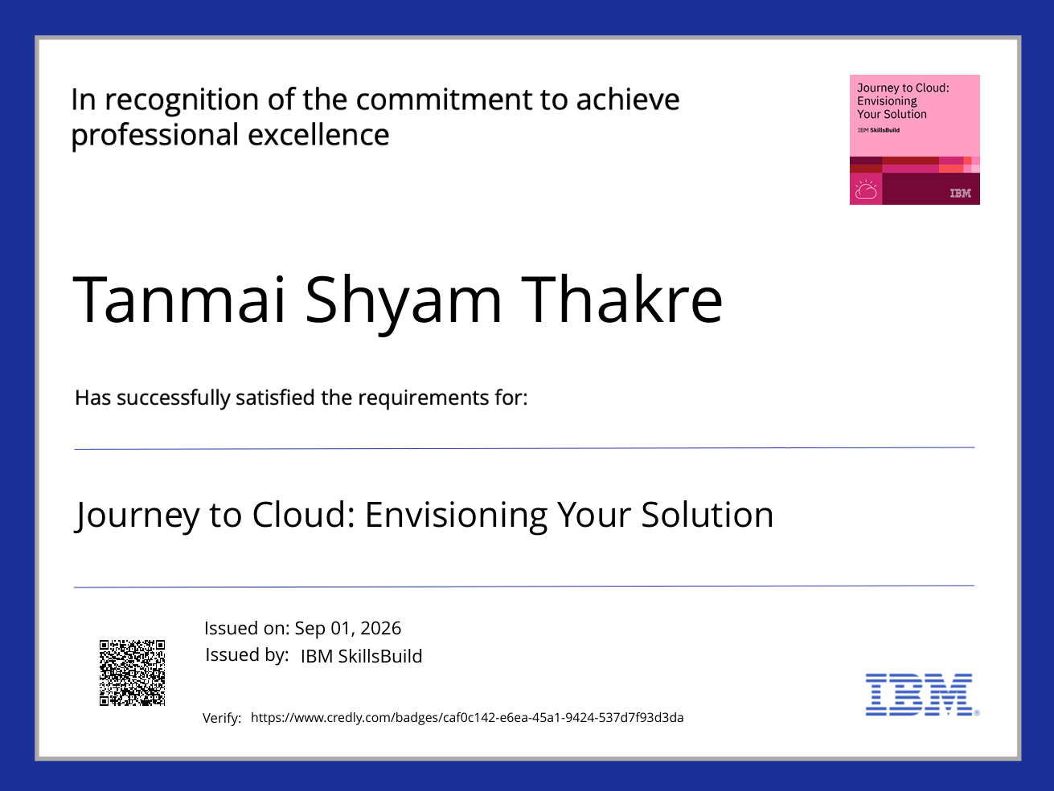
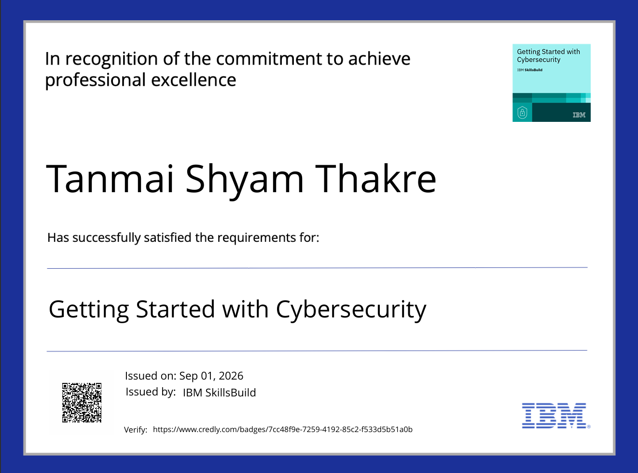
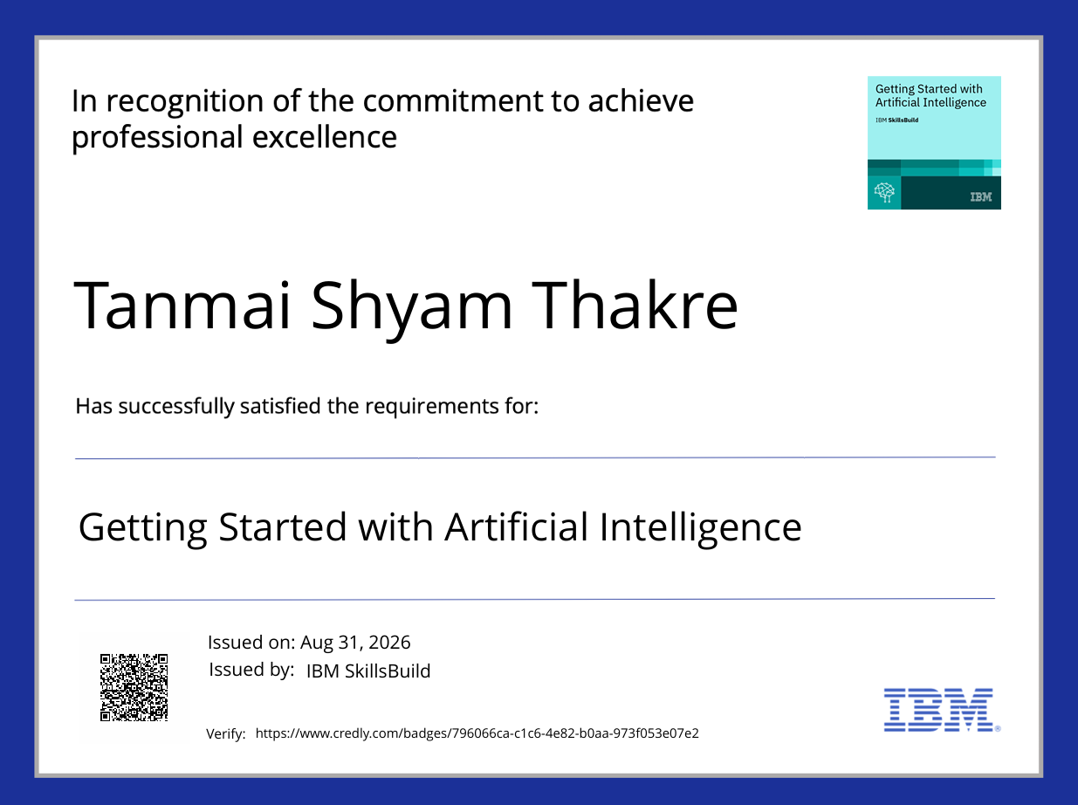
Certificates Earned:
IBM SkillsBuild credentials, earned on Credly

Slide 15
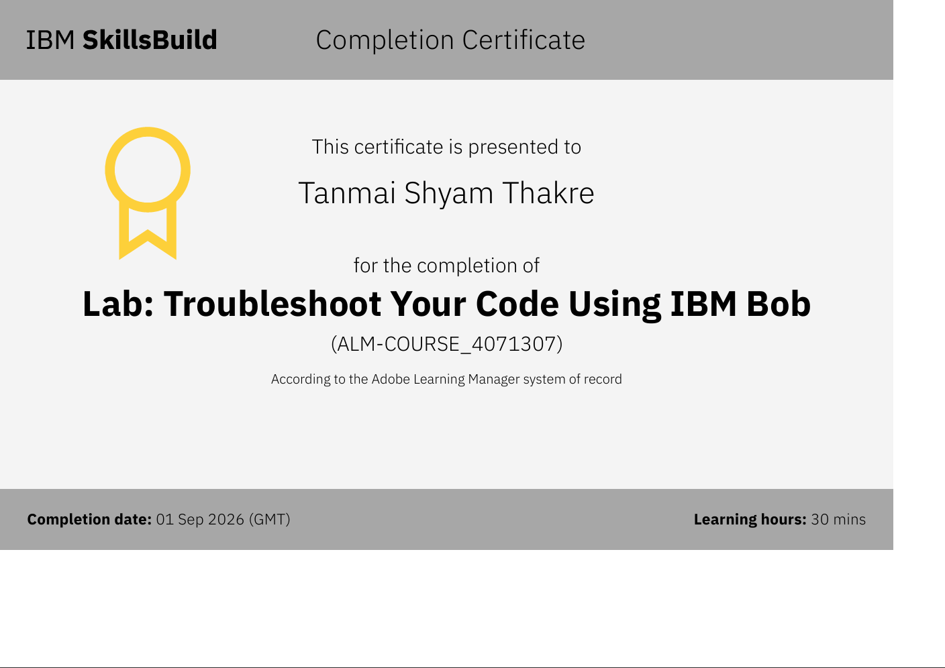
Certificates Earned:​
Lab: Troubleshoot Your Code Using IBM Bob — IBM SkillsBuild

Slide 16


