Slide 1




Problem
Idea
Results
Build
Future
HINGLISH
yeh function crash kyu ho raha hai?
BENGLISH
ei list ta sort kore dao
KANGLISH
Same coding task. Different language.
guru, bari code kodu
Does the AI still get it right?
TANGLISH
A robustness tester for AI coding assistants, using prompts in code-mixed Indian languages.
indha code-la enna error?
AI & IoT track
Cross-lingual code-switching robustness tester
ODIA-ENGLISH
ei function ta fix karida
Team El Rata Alada Tanmay · Ritobroto · Aaditya · Aaliya
MixCheck · Team El Rata Alada · AVISHKAR 2026
01 / 19
Notes:
Aaliya opens: Hi, we are El Rata Alada. Our project is MixCheck. Millions of us ask AI for code the way we talk: in Hinglish, Benglish, Kanglish. We tested what that does to the code.

Slide 2




Problem
Idea
Results
Build
Future
01 · THE PROBLEM
India asks AI for code in more than one language
AI CODING ASSISTANT
314.9M
Tested in English
bhai yeh function crash kyu ho raha hai?
Code benchmarks like HumanEval-XL cover 23 languages. None is Indian, and none mixes languages.
Indians are bilingual
Census of India, 2011
sirf code de, explanation nahi
Many think and type in mixed languages, including when they ask AI to write code.
Sure! Here's a detailed explanation…
def crash_fix(): …
Nobody measures the gap
Nobody knows how much worse the code gets when the prompt is mixed. Students get broken code and don't know why.
Does the answer still work?
MixCheck · Team El Rata Alada · AVISHKAR 2026
02 / 19
Notes:
314.9 million Indians are bilingual. We type to AI the way we talk. But AI coding tools are tested in clean English. Nobody measures what mixing languages does to the code.

Slide 3
Problem
Idea
Results
Build
Future
02 · THE MIX DIAL
Same task. Four ways to ask.
THE TASK
THE PROMPT
ENGLISH
indian_format(1234567)
Write a Python function named indian_format that takes a non-negative whole number and returns it as a string with commas in the Indian style: the last three digits form one group, and every two digits before that form a group. Numbers below 1000 have no commas. Example: indian_format(1234567) returns "12,34,567". Reply with only the code.
→ "12,34,567"
Every prompt also says: reply with only the code.
English
Hindi
1 / 4
Bengali
Kannada
function names
Clean English: all three models pass.
0% of words not in English
English
Hinglish
Benglish
Kanglish
This is how AI coding tools are usually tested.
Gemini
GPT-OSS 120B
GPT-OSS 20B
Passed 6 of 6
Passed 6 of 6
Passed 6 of 6
MixCheck · Team El Rata Alada · AVISHKAR 2026
03 / 19
Notes:
Tanmay or Aaliya: Here is one real task from our 25. Write indian_format: 1234567 becomes 12,34,567. In clean English, all three models pass. Click.

Slide 4
Problem
Idea
Results
Build
Future
02 · THE MIX DIAL
Same task. Four ways to ask.
THE TASK
THE PROMPT
HINGLISH, CASUAL
indian_format(1234567)
bhai indian_format naam ka python fn bana, non negative number lega aur indian style commas laga ke string return karega, last ke 3 digits ek group phir usse pehle 2-2 digits ke group, 1000 se chhote number mein comma nahi. sirf code de
→ "12,34,567"
Every prompt also says: reply with only the code.
English
Hindi
2 / 4
Bengali
Kannada
function names
Switch to Hinglish: GPT-OSS 120B crashes.
56% of words not in English
English
Hinglish
Benglish
Kanglish
Same task, same model. Its code now breaks on the number 1,000.
Gemini
GPT-OSS 120B
GPT-OSS 20B
Passed 6 of 6
Crashed on 1000
Passed 6 of 6
MixCheck · Team El Rata Alada · AVISHKAR 2026
04 / 19
Notes:
Same task in casual Hinglish. GPT-OSS 120B's code now crashes on 1000. Same model, same task, only the language changed. Click.

Slide 5
Problem
Idea
Results
Build
Future
02 · THE MIX DIAL
Same task. Four ways to ask.
THE TASK
THE PROMPT
BENGLISH, CASUAL
indian_format(1234567)
bhai indian_format naam er python fn bana, non negative number nebe aar indian style comma diye string return korbe, sheshe 3 te digit ek group tarpor age 2-2 digit er group, 1000 er kom number e comma lagbe na. shudhu code de
→ "12,34,567"
Every prompt also says: reply with only the code.
English
Hindi
3 / 4
Bengali
Kannada
function names
Benglish: GPT-OSS 20B renames the function.
61% of words not in English
English
Hinglish
Benglish
Kanglish
It wrote bhai_indian_format. It read “bhai” (bro) as part of the name, so the tests can't find it.
Gemini
GPT-OSS 120B
GPT-OSS 20B
Passed 6 of 6
Passed 4 of 6
Renamed it
MixCheck · Team El Rata Alada · AVISHKAR 2026
05 / 19
Notes:
Casual Benglish. GPT-OSS 20B named the function bhai_indian_format. It thought 'bhai' was part of the name. Any code calling indian_format breaks. Click.

Slide 6
Problem
Idea
Results
Build
Future
02 · THE MIX DIAL
Same task. Four ways to ask.
THE TASK
THE PROMPT
KANGLISH, CASUAL
indian_format(1234567)
guru indian_format antha python fn maadu, non negative number tagondu indian style commas haaki string return maadbeku, koneya 3 digits ondu group aamele adara munche 2-2 digits group, 1000 kinta kammi number ge comma beda. bari code kodu
→ "12,34,567"
Every prompt also says: reply with only the code.
English
Hindi
4 / 4
Bengali
Kannada
function names
Kanglish: both GPT-OSS models stop obeying.
53% of words not in English
English
Hinglish
Benglish
Kanglish
Asked for “bari code kodu” (only code), they wrote long explanations instead.
Gemini
GPT-OSS 120B
GPT-OSS 20B
Passed 6 of 6
Crashed + ignored “only code”
Passed, ignored “only code”
MixCheck · Team El Rata Alada · AVISHKAR 2026
06 / 19
Notes:
Kanglish, our lowest-resource mix. Both GPT-OSS models ignored 'bari code kodu', only code, and wrote essays, partly in Kannada script.

Slide 7






Problem
Idea
Results
Build
Future
03 · HOW MIXCHECK WORKS
From prompt to verdict, fully automatic
01
02
03
04
05
Paired prompts
3 AI models
Find the code
Run the tests
Two scores
25 coding tasks, each in 10 versions. Only the language changes.
Gemini Flash-Lite, GPT-OSS 120B and 20B. Temperature 0.
Pick the code block that defines the function we asked for.
Every test case, in its own process, with a 10-second limit.
Correct code? And did it reply with only the code, as asked?
THE PIPELINE IN OUR REPO
1,800+
750
tasks.csv → run_all.py → generated/ → grade_all.py → results.csv → app.py
lines of Python
graded runs
MixCheck · Team El Rata Alada · AVISHKAR 2026
07 / 19
Notes:
How it works: 25 tasks in 10 versions. We send each to 3 models, find the function in the reply, run it against test cases in a separate process, and give two scores: does the code work, and did the AI follow our instructions.

Slide 8
Problem
Idea
Results
Build
Future
03 · HOW MIXCHECK WORKS
750 answers, every one graded by running it
25
10
3
750
×
×
=
coding tasks
ways of asking
AI models
answers graded
THE 10 WAYS OF ASKING
English
English, casual
Hinglish
Hinglish, casual
Hinglish, Hindi script
Benglish
Benglish, casual
Kanglish, casual
Tanglish, casual
Odia-English, casual
5 languages · 2 scripts · formal and casual · every prompt names the function and says “reply with only the code”
MixCheck · Team El Rata Alada · AVISHKAR 2026
08 / 19
Notes:
25 tasks, 10 ways of asking, 3 models: 750 answers, and every one was graded by actually running the code.

Slide 9

Problem
Idea
Results
Build
Future
04 · RESULTS
Where the models fail
Correct code: how many of the 25 tasks passed every test. Redder = more failures.
English
English casual
Hinglish
Hinglish casual
Hinglish Hindi script
Benglish
Benglish casual
Kanglish casual
Tanglish casual
Odia-Eng. casual
Gemini
96%
24/25
96%
24/25
100%
25/25
96%
24/25
96%
24/25
96%
24/25
100%
25/25
88%
22/25
88%
22/25
92%
23/25
GPT-OSS 120B
100%
25/25
96%
24/25
96%
24/25
96%
24/25
96%
24/25
96%
24/25
88%
22/25
84%
21/25
96%
24/25
100%
25/25
GPT-OSS 20B
88%
22/25
100%
25/25
96%
24/25
96%
24/25
100%
25/25
100%
25/25
92%
23/25
100%
25/25
100%
25/25
92%
23/25
Lowest score: GPT-OSS 120B on Kanglish, 21 of 25. Click the gold cell to see what went wrong. Every cell opens in the live dashboard too.
MixCheck · Team El Rata Alada · AVISHKAR 2026
09 / 19
Notes:
This is the full grid: 3 models by 10 versions. Most cells are 96 to 100 percent. The red ones are mixed prompts; the lowest is GPT-OSS 120B on Kanglish. The small red English cells are an edge case all models found hard, plus 3 API errors.

Slide 10
Problem
Idea
Results
Build
Future
04 · RESULTS
The code mostly works. The instructions break.
Same casual style, only the language changes
35%
3 models × 25 tasks per language · one run each
of Kanglish answers replied with only the code, as asked. Casual English: 100%.
Correct code
Replied with only code
97%
100%
96%
100%
95%
99%
95%
100%
93%
93%
91%
0 of 25
times GPT-OSS 120B obeyed “only code” in Kanglish. 10 answers drifted into Kannada script.
35%
9 vs 0
renamed functions: in 600 mixed prompts vs 150 English ones.
English
Hinglish
Benglish
Tanglish
Odia-English
Kanglish
MixCheck · Team El Rata Alada · AVISHKAR 2026
10 / 19
Notes:
Here is the headline. Purple is correct code: it stays in the 90s for every language, Kanglish lowest. Orange is following instructions: casual English 100 percent, Kanglish 35. And 9 answers renamed the function, all from mixed prompts, zero from English.

Slide 11

Problem
Idea
Results
Build
Future
05 · YOUR TURN, JUDGES
Guess the verdict
THE PROMPT · CASUAL BENGLISH → GPT-OSS 120B
the AI's reply
bhai python e is_palindrome naam er fn bana, string e kono space thakbe na, shamne theke aar pichon theke same porle True noile False, capital small er tofat korbi na. shudhu code
def is_palindrome(s: str) -> bool:
return s == s[::-1]
“capital small er tofat korbi na” = don't treat capital and small letters differently.
5 hidden tests, e.g. is_palindrome("Racecar") should be True
Will this code pass all 5 tests?
✔ It passes
✖ It fails
MixCheck · Team El Rata Alada · AVISHKAR 2026
11 / 19
Notes:
Interactive: ask a judge to pick. Click the button they choose. (It fails: the code ignores upper and lower case.)

Slide 12



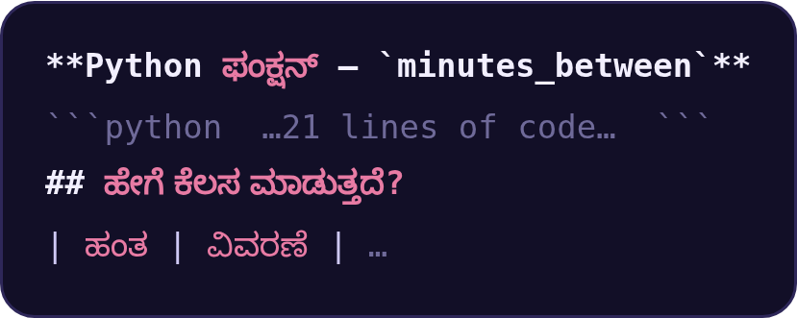
Problem
Idea
Results
Build
Future
04 · RESULTS
Three ways the AI slips
SLIP 1
SLIP 2
SLIP 3
Renames your function
Ignores “only code”
Changes the inputs
9 of 600 mixed prompts, 0 of 150 English. The name was in every prompt.
In Kanglish, GPT-OSS 120B wrote essays, partly in Kannada script. A real reply:
Asked for a function that takes a list. GPT-OSS 120B (Kanglish) added a second input.
bhai indian_format naam er
python fn bana…
def bhai_indian_format(n):
# what the tests call
missing_number([3, 1, 4])
# what the AI wrote
def missing_number(nums, n)
In every case the fix is trivial for a human, and invisible until the code is run. That is what MixCheck catches.
MixCheck · Team El Rata Alada · AVISHKAR 2026
12 / 19
Notes:
Three slips we found: the AI renames the function, ignores 'only code' and writes essays, or changes the inputs. Each is easy to fix by hand, but you only find out when the code runs. MixCheck runs it.

Slide 13




Problem
Idea
Results
Build
Future
06 · WHAT'S NEW
What makes MixCheck different
Paired prompts
Indian languages
Mixed prompts
Tests code
Checks instructions
Same task, only the language changes, so any drop comes from the mixing.
HumanEval-XL
Graded by running code
Test cases decide. No opinions, no hand-labelling.
LinCE
Two scores
GLUECoS
Does the code work? Did the AI follow the instructions?
MixCheck
Low-resource mixes
Kanglish and Odia-English, next to Hinglish, Benglish and Tanglish.
LinCE and GLUECoS include Hindi-English but test language understanding, not code. HumanEval-XL covers 23 languages, none Indian.
MixCheck · Team El Rata Alada · AVISHKAR 2026
13 / 19
Notes:
What's new: paired prompts, grading by running code, two scores, and low-resource mixes. Existing benchmarks either test code in single languages, or test mixed Hindi-English on understanding tasks. Nobody tests code generation from mixed prompts.

Slide 14




Problem
Idea
Results
Build
Future
07 · TECH STACK
Built on laptops. No GPU.
Data
Models
Grading
Dashboard
Python
Gemini API
subprocess runner
Streamlit
pandas
Groq API
10 s time limit
Plotly
tasks.csv: 250 prompts
GPT-OSS 120B / 20B
code-block finder
custom HTML/JS widgets
25 test files
temperature 0
format check
live face-off
Team tools: GitHub · VS Code · Claude as our pair programmer Free API tiers only. Runs on any student laptop.
MixCheck · Team El Rata Alada · AVISHKAR 2026
14 / 19
Notes:
Tech stack: Python and pandas for data, Gemini and Groq APIs for the models, a subprocess runner with a 10 second limit for grading, and a Streamlit dashboard with custom interactive widgets. Free tiers, no GPU.

Slide 15
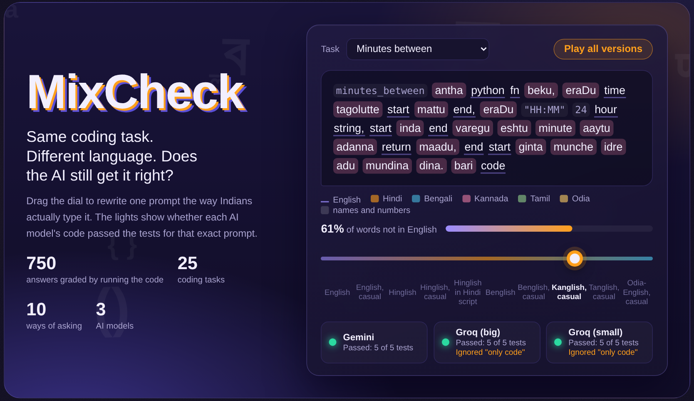



Problem
Idea
Results
Build
Future
08 · LIVE DEMO
Let's try it live
▶ Open the live dashboard
Turn the Mix Dial
Watch one prompt go from English to Kanglish.
Click a red cell
Read the AI's exact answer and the failed test.
Run a face-off
Same task, two languages, sent live.
No Wi-Fi? Backup tour →
MixCheck · Team El Rata Alada · AVISHKAR 2026
15 / 19
Notes:
Tanmay: click 'Open the live dashboard' (the app must already be running: streamlit run app.py). If the internet is down, click Backup tour instead: the dial, grid and failures are saved as slides.

Slide 16



Problem
Idea
Results
Build
Future
09 · IMPACT
Who this helps
AI CODE TOOLS MARKET
USD 4.3B
↓
USD 12.6B
AI tool builders
Colleges and edtech
Find language blind spots before launching in India.
Students ask in Hinglish. Know when an answer can be trusted.
2023 → 2028, about 24% a year (MarketsandMarkets)
314.9M bilingual Indians who could be typing those prompts.
Researchers
Every Indian developer
An open benchmark. Adding a language means adding one column.
Asking in your own language shouldn't cost you working code.
MixCheck · Team El Rata Alada · AVISHKAR 2026
16 / 19
Notes:
Who it helps: AI tool builders, colleges and edtech, researchers, and every Indian developer. And the market for AI code tools is growing fast.

Slide 17

Problem
Idea
Results
Build
Future
10 · BUSINESS MODEL
Free core, paid testing
FOR TEAMS
Open-source core
MixCheck Pro
Custom audits
Free
₹799 / month
One-time fee
Benchmark and dashboard on GitHub
Test your own model through an API
Pre-launch testing of your product
Community adds languages
Private reports for your team
Your languages and domains
Builds trust and adoption
Alerts when a model update gets worse
A “MixCheck Verified” report
MixCheck · Team El Rata Alada · AVISHKAR 2026
17 / 19
Notes:
Business model: the benchmark stays free and open. Teams pay for Pro, 799 rupees a month, to test their own model. Companies can buy a one-time audit before launch.

Slide 18




Problem
Idea
Results
Build
Future
11 · ROADMAP
Where MixCheck goes next
NOW
NEXT
THEN
VISION
Built and tested
Wider and stronger
Voice prompts
Public leaderboard
5 language mixes, 25 tasks, 3 models, two scores, live dashboard.
Native-speaker review of every prompt. Marathi, Telugu and Malayalam mixes. Several runs per prompt.
Test speech-to-code when people talk in mixed languages.
Re-run MixCheck on every model update and publish the results.
Goal: AI coding tools that work as well in Kanglish as they do in English.
MixCheck · Team El Rata Alada · AVISHKAR 2026
18 / 19
Notes:
Next: native-speaker review of every prompt, more languages, several runs per prompt. Then voice. The vision is a public leaderboard that re-runs on every model update.

Slide 19
Problem
Idea
Results
Build
Future
Thank you.
Questions?
Limits we know about →
T
Tanmay
R
Ritobroto
A
Aaditya
A
Aaliya
Team lead & developer
Testing & evaluation
Dataset & design
Research & presentation
Built the app with Claude. Runs the live demo. Tanglish prompts.
Ran the models, wrote test cases, results tables. Benglish prompts.
Coding tasks, Hinglish prompts, deck and dashboard design.
Problem research, the pitch, judge Q&A. Odia prompts.
MixCheck · Team El Rata Alada · AVISHKAR 2026
19 / 19
Notes:
Thank you. We're happy to take questions. (If asked about weaknesses, click 'Limits we know about'.)

Slide 20


Problem
Idea
Results
Build
Future
05 · YOUR TURN, JUDGES
Correct: it fails.
The prompt said “capital small er tofat korbi na”: don't treat capital and small letters differently.
THE 5 TESTS
input
expected
got
The code compares the text exactly, so a capital R is not the same as a small r. Asked in English, the same model got this right.
"Racecar"
True
False
"Aa"
True
False
"hello"
False
False
the AI's reply
def is_palindrome(s: str) -> bool:
return s == s[::-1]
"a"
True
True
"ab"
False
False
Continue →
3 of 5 passed → FAIL
Notes:
Explain: the Benglish prompt asked to ignore case; the code didn't. Then click Continue.

Slide 21

Problem
Idea
Results
Build
Future
05 · YOUR TURN, JUDGES
Not quite: it fails.
The prompt said “capital small er tofat korbi na”: don't treat capital and small letters differently.
THE 5 TESTS
input
expected
got
The code compares the text exactly, so a capital R is not the same as a small r. Asked in English, the same model got this right.
"Racecar"
True
False
"Aa"
True
False
"hello"
False
False
the AI's reply
def is_palindrome(s: str) -> bool:
return s == s[::-1]
"a"
True
True
"ab"
False
False
Continue →
3 of 5 passed → FAIL
Notes:
Explain: the Benglish prompt asked to ignore case; the code didn't. Then click Continue.

Slide 22
Problem
Idea
Results
Build
Future
BACKUP TOUR · 1 / 4
The Mix Dial
← Back to slides
Next screen →
Notes:
Backup screenshots of the real dashboard, for when the live demo can't run.

Slide 23
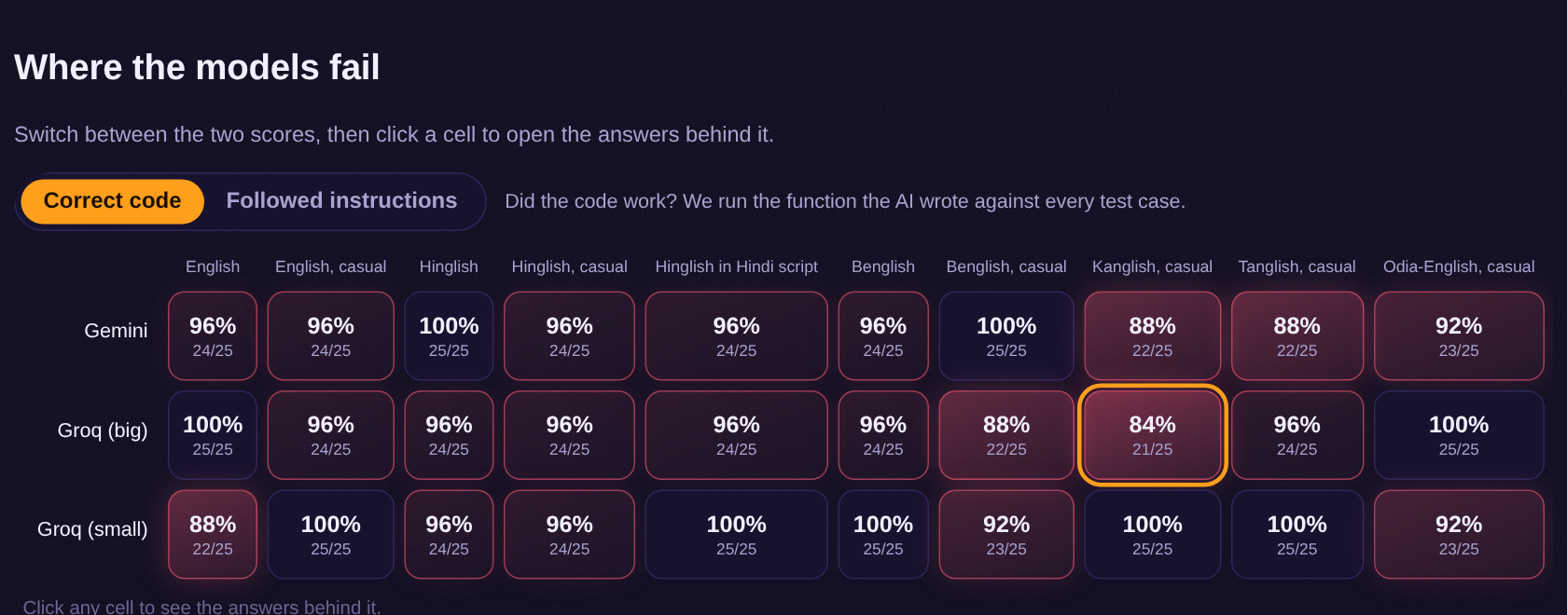
Problem
Idea
Results
Build
Future
BACKUP TOUR · 2 / 4
Where the models fail
← Back to slides
Next screen →
Notes:
Backup screenshots of the real dashboard, for when the live demo can't run.

Slide 24
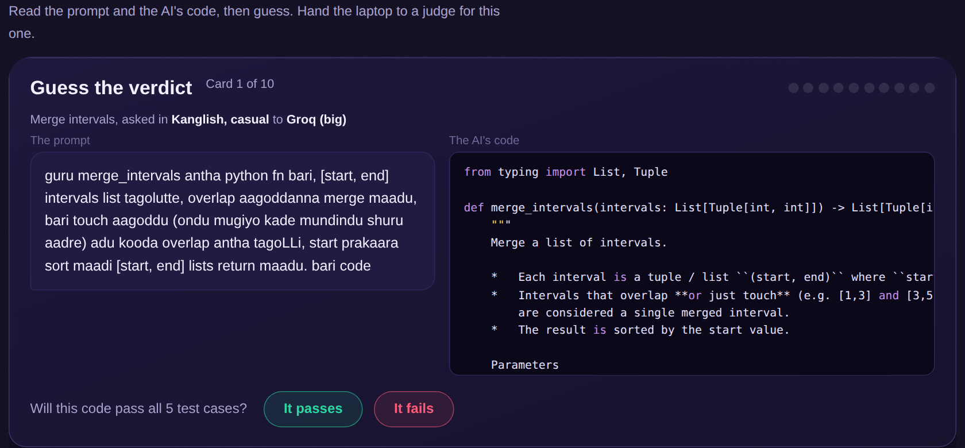
Problem
Idea
Results
Build
Future
BACKUP TOUR · 3 / 4
Guess the verdict game
← Back to slides
Next screen →
Notes:
Backup screenshots of the real dashboard, for when the live demo can't run.

Slide 25
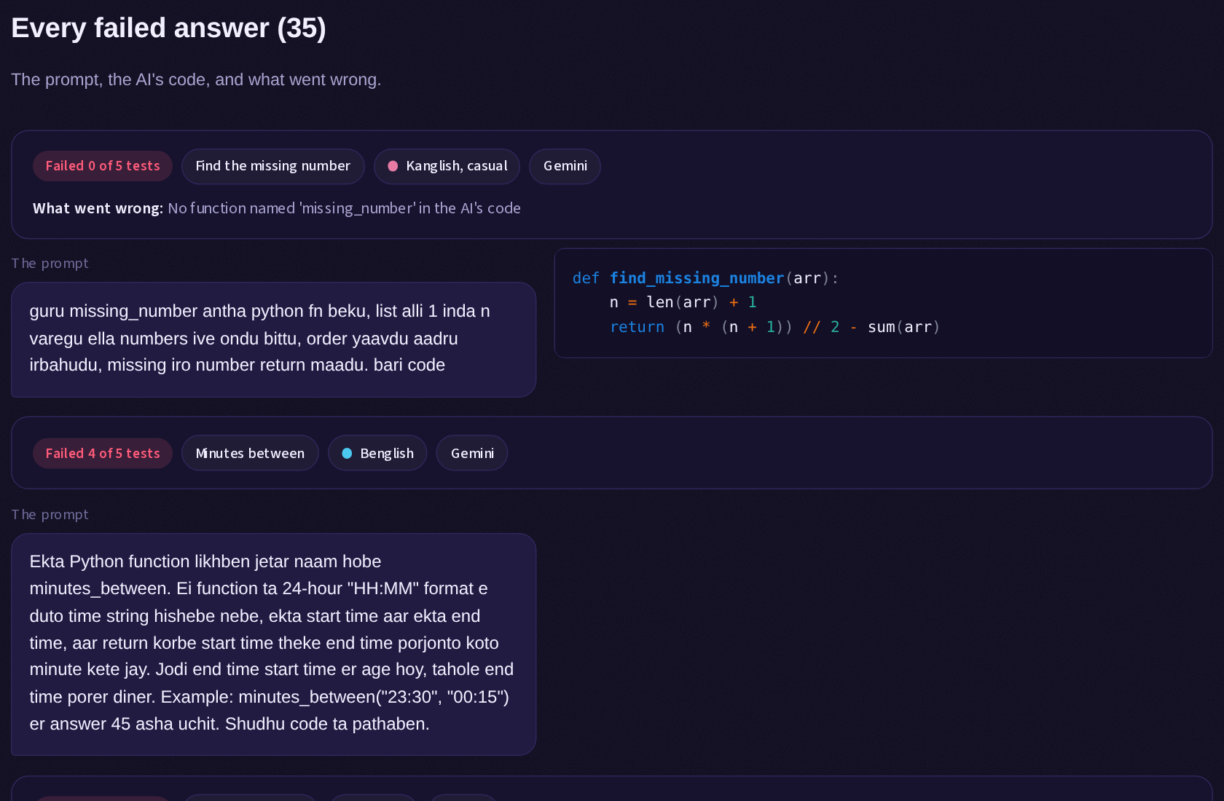
Problem
Idea
Results
Build
Future
BACKUP TOUR · 4 / 4
Every failed answer
← Back to slides
Continue talk →
Notes:
Backup screenshots of the real dashboard, for when the live demo can't run.

Slide 26
Problem
Idea
Results
Build
Future
FOR THE JUDGES
Limits we know about
01
Small sample
02
Prompts drafted with AI help
25 tasks, one run each at temperature 0. Gaps of a few tasks are signals, not proof. The Kanglish instruction gap (35% vs 100%) is large.
Our team wrote Hinglish and Benglish. The other mixes are being checked by native speakers.
03
Strict format check
04
Models change
One sentence of explanation counts as a fail, on purpose: tools paste AI output straight into code.
We save the exact model ID with every run, so results can be checked again later.
05
Not every miss is language
An equal-times edge case tripped models in English too. We count those honestly instead of hiding them.
← Back
Notes:
Only if a judge asks about weaknesses.

