Slide 1
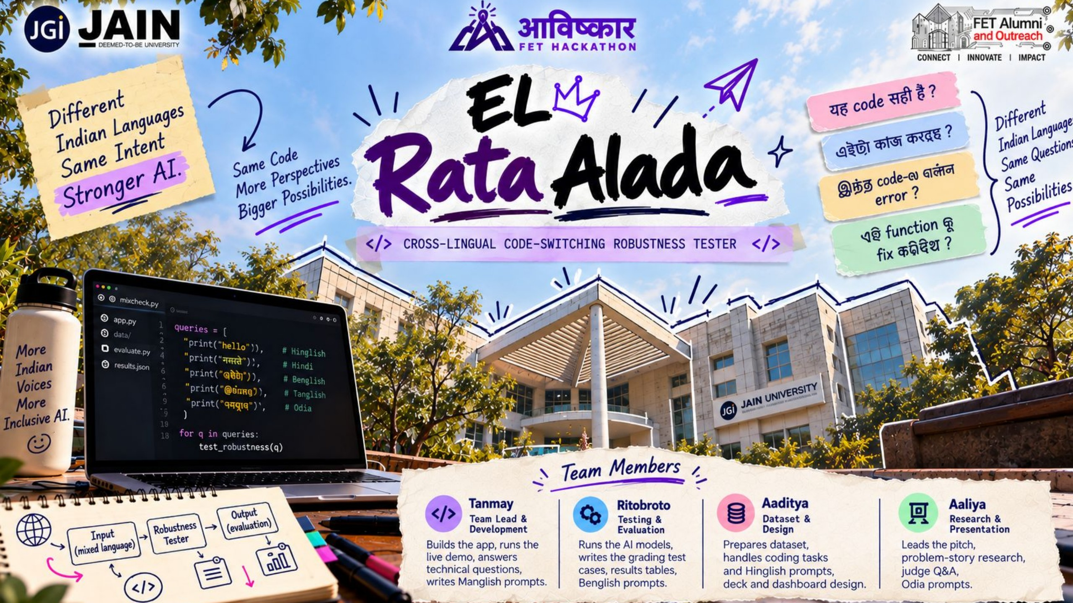

Slide 2

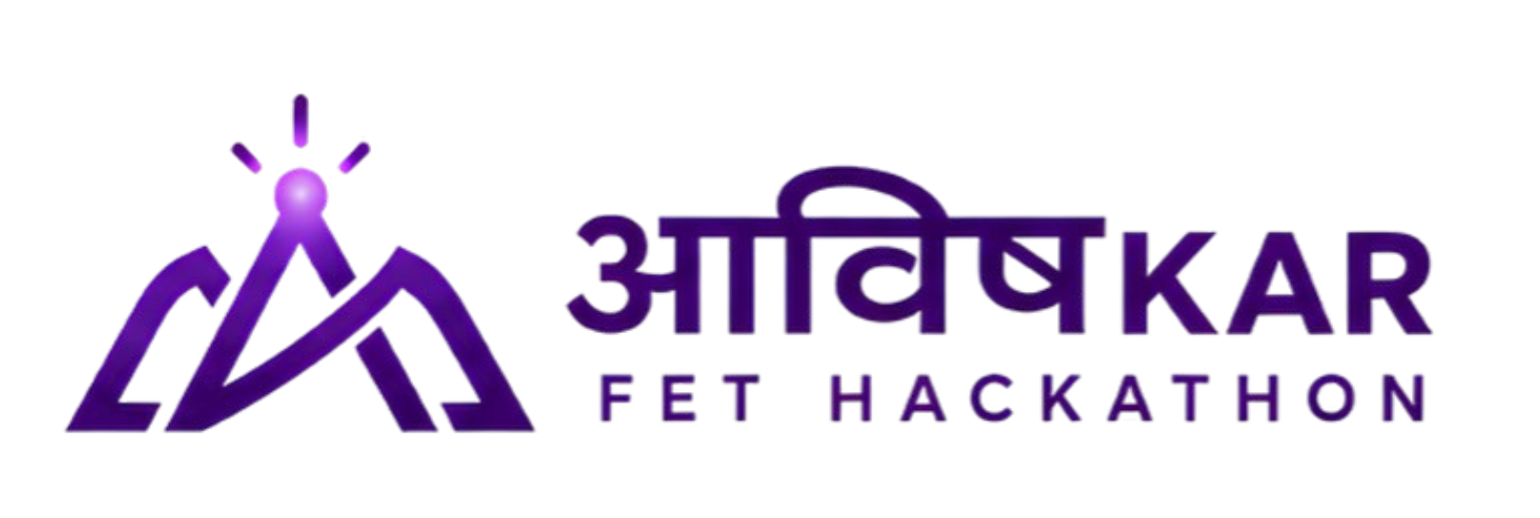



Problem Statement
THE PROBLEM
314.9M
AI coding assistants are tested in clean English, but Indian developers ask in Hinglish, Benglish, Kanglish, Tanglish and Odia-English.
Indians are bilingual
Census of India, 2011
Tested in English, used in Hinglish
Code-generation benchmarks like HumanEval-XL use single-language prompts, and none of its 23 languages is Indian.
Many think and type in mixed languages, including when they ask AI to write code.
Nobody measures the gap
“yeh function crash kyu ho raha hai?”
No one knows how much worse the generated code gets when the prompt is mixed, so students and developers get broken code without knowing why.
Notes:
Ask the judges: how often do you type fully in English on WhatsApp? AI is tested on clean English, but India talks in mixed language, and nobody measures that gap.

Slide 3



Solution
MixCheck gives an AI the same coding task in English and in mixed Indian languages, runs the code it writes, and shows how much the pass rate drops.
STEP 1
STEP 2
STEP 3
Paired prompts
Run and grade
See the drop
25 coding tasks, each written in English and in Hinglish, Benglish, Kanglish, Tanglish and Odia-English: 10 versions of every task.
Every version goes to 3 AI models (Gemini, GPT-OSS 120B and 20B). Their code is run against the same test cases.
A Streamlit dashboard compares English with each mix, opens every failure, and runs a live face-off between models.
Notes:
Three steps: build paired sentences, run real models, and show exactly where they break. The key idea is the pairing: same meaning, only the language mixing changes.

Slide 4
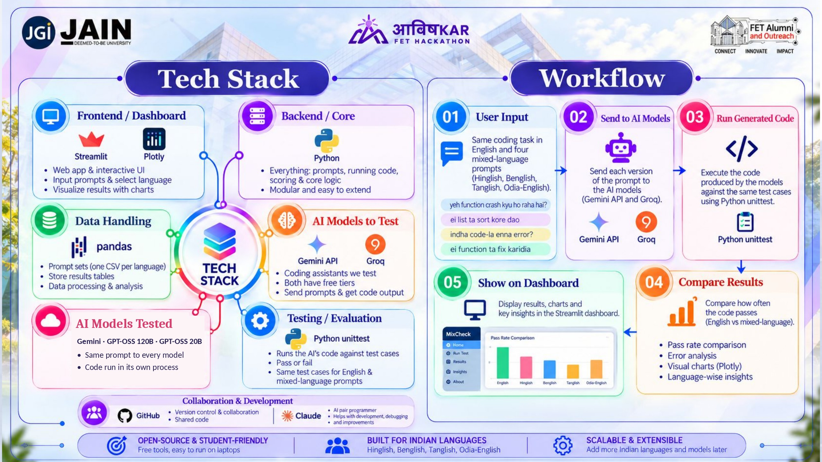

Slide 5






Innovation
Paired prompts
Two scores, both automatic
Same task, only the language changes, so any drop in pass rate comes from the mixing.
Test cases decide if the code works. A second check asks: did the AI follow the instructions?
Indian languages first
Fills a real gap
Covers Kanglish and Odia-English, low-resource mixes, alongside Hinglish, Benglish and Tanglish.
HumanEval-XL covers 23 languages, none Indian and none mixed. LinCE and GLUECoS don't test code generation.
Every prompt is written or checked by a native speaker.
Notes:
Existing benchmarks give one score. MixCheck shows why and where a model fails: by mixing level, by script and by language, including Odia.

Slide 6
Results
Same casual style, only the language changes
35%
Share of answers, across 3 AI models and 25 tasks
of Kanglish answers replied with only the code, as asked. Casual English: 100%.
9 vs 0
wrong function names in 600 mixed prompts vs 150 English ones.
750
answers graded by running the code: 25 tasks × 10 versions × 3 models.
One run per prompt at temperature 0. The small gaps in correct code are signals; the Kanglish instruction gap is large.
Notes:
Same casual style, only the language changes. Correct code stays in the 90s for every language, a small drop for Kanglish. The big gap is instruction-following: every prompt says reply with only the code. Casual English did that 100% of the time, Kanglish 35%. And 9 answers renamed the function we asked for, all in mixed prompts, none in English.

Slide 7



Where the AI Slips
FAILURE 1
FAILURE 2
FAILURE 3
Renames your function
Ignores “only code”
Skips a detail
9 of 600 mixed prompts, 0 of 150 English. The name was in every prompt.
Kanglish: GPT-OSS 120B obeyed 0 of 25 times. 10 answers drifted into Kannada script.
The “ignore upper and lower case” rule was dropped in casual Benglish and Odia.
bhai indian_format naam er
python fn bana…
def bhai_indian_format(n):
…bari code (only code)
→ ~2,000 characters
→ 2 code blocks + notes
is_palindrome("Racecar")
expected True
got False
The code mostly still works. The instructions break: Kanglish 35% vs English 100%.
Notes:
Three kinds of slip. One: the AI renames the function - here it read the slang word 'bhai' as part of the name. Code that calls indian_format would crash. Two: it ignores 'only code' and writes an essay, sometimes in Kannada script. Three: it skips a detail, like ignoring upper and lower case.

Slide 8
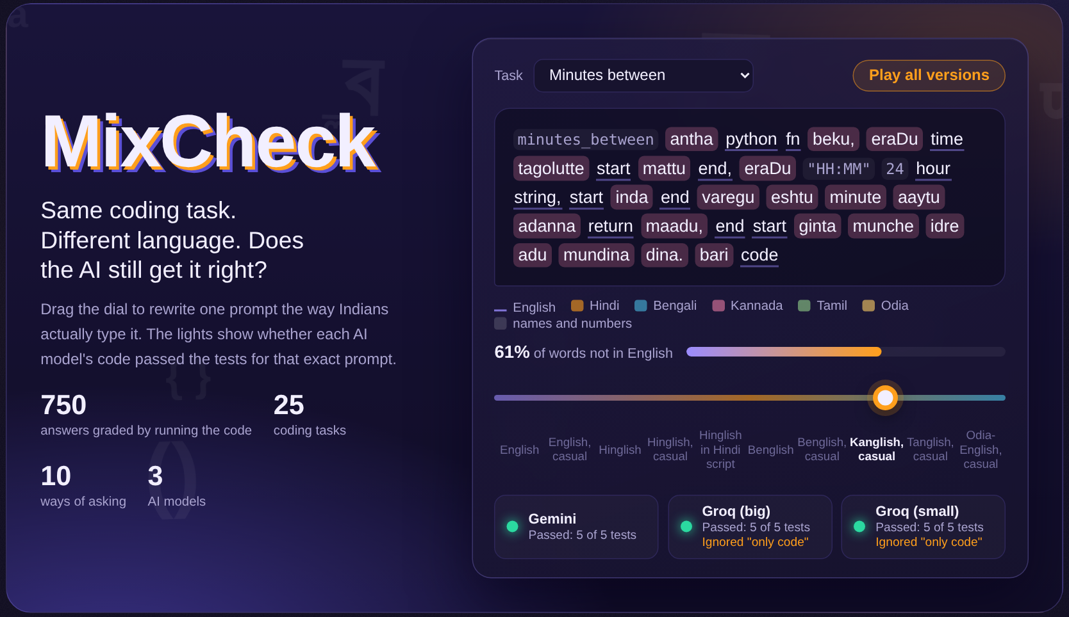


Live Demo
Turn the Mix Dial
One prompt rewritten from English to Kanglish. Lights show which AI still passed.
Open any failure
Click a cell to read the AI's exact answer and the test it failed.
Face-off, live
Send a mixed prompt to two models right now and grade both answers.
The MixCheck dashboard, built with Streamlit and Plotly
Notes:
Hand over to Tanmay for the live demo.

Slide 9
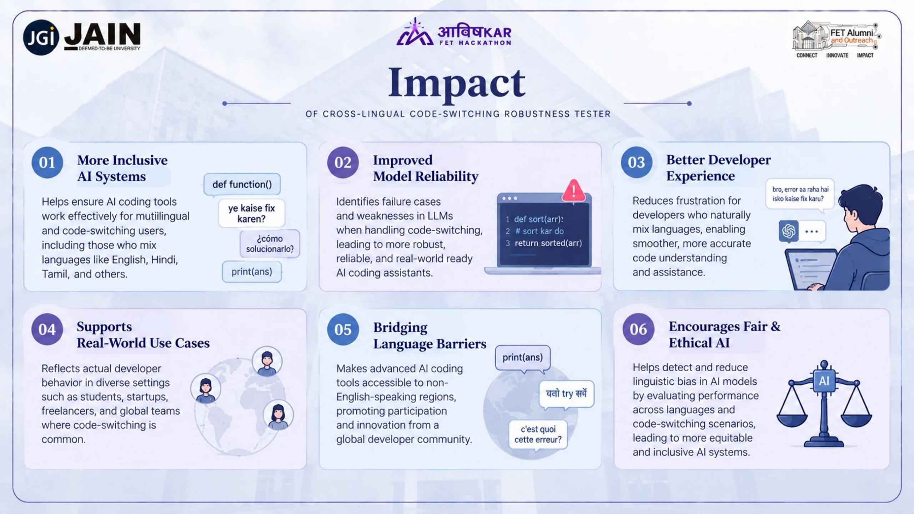

Slide 10
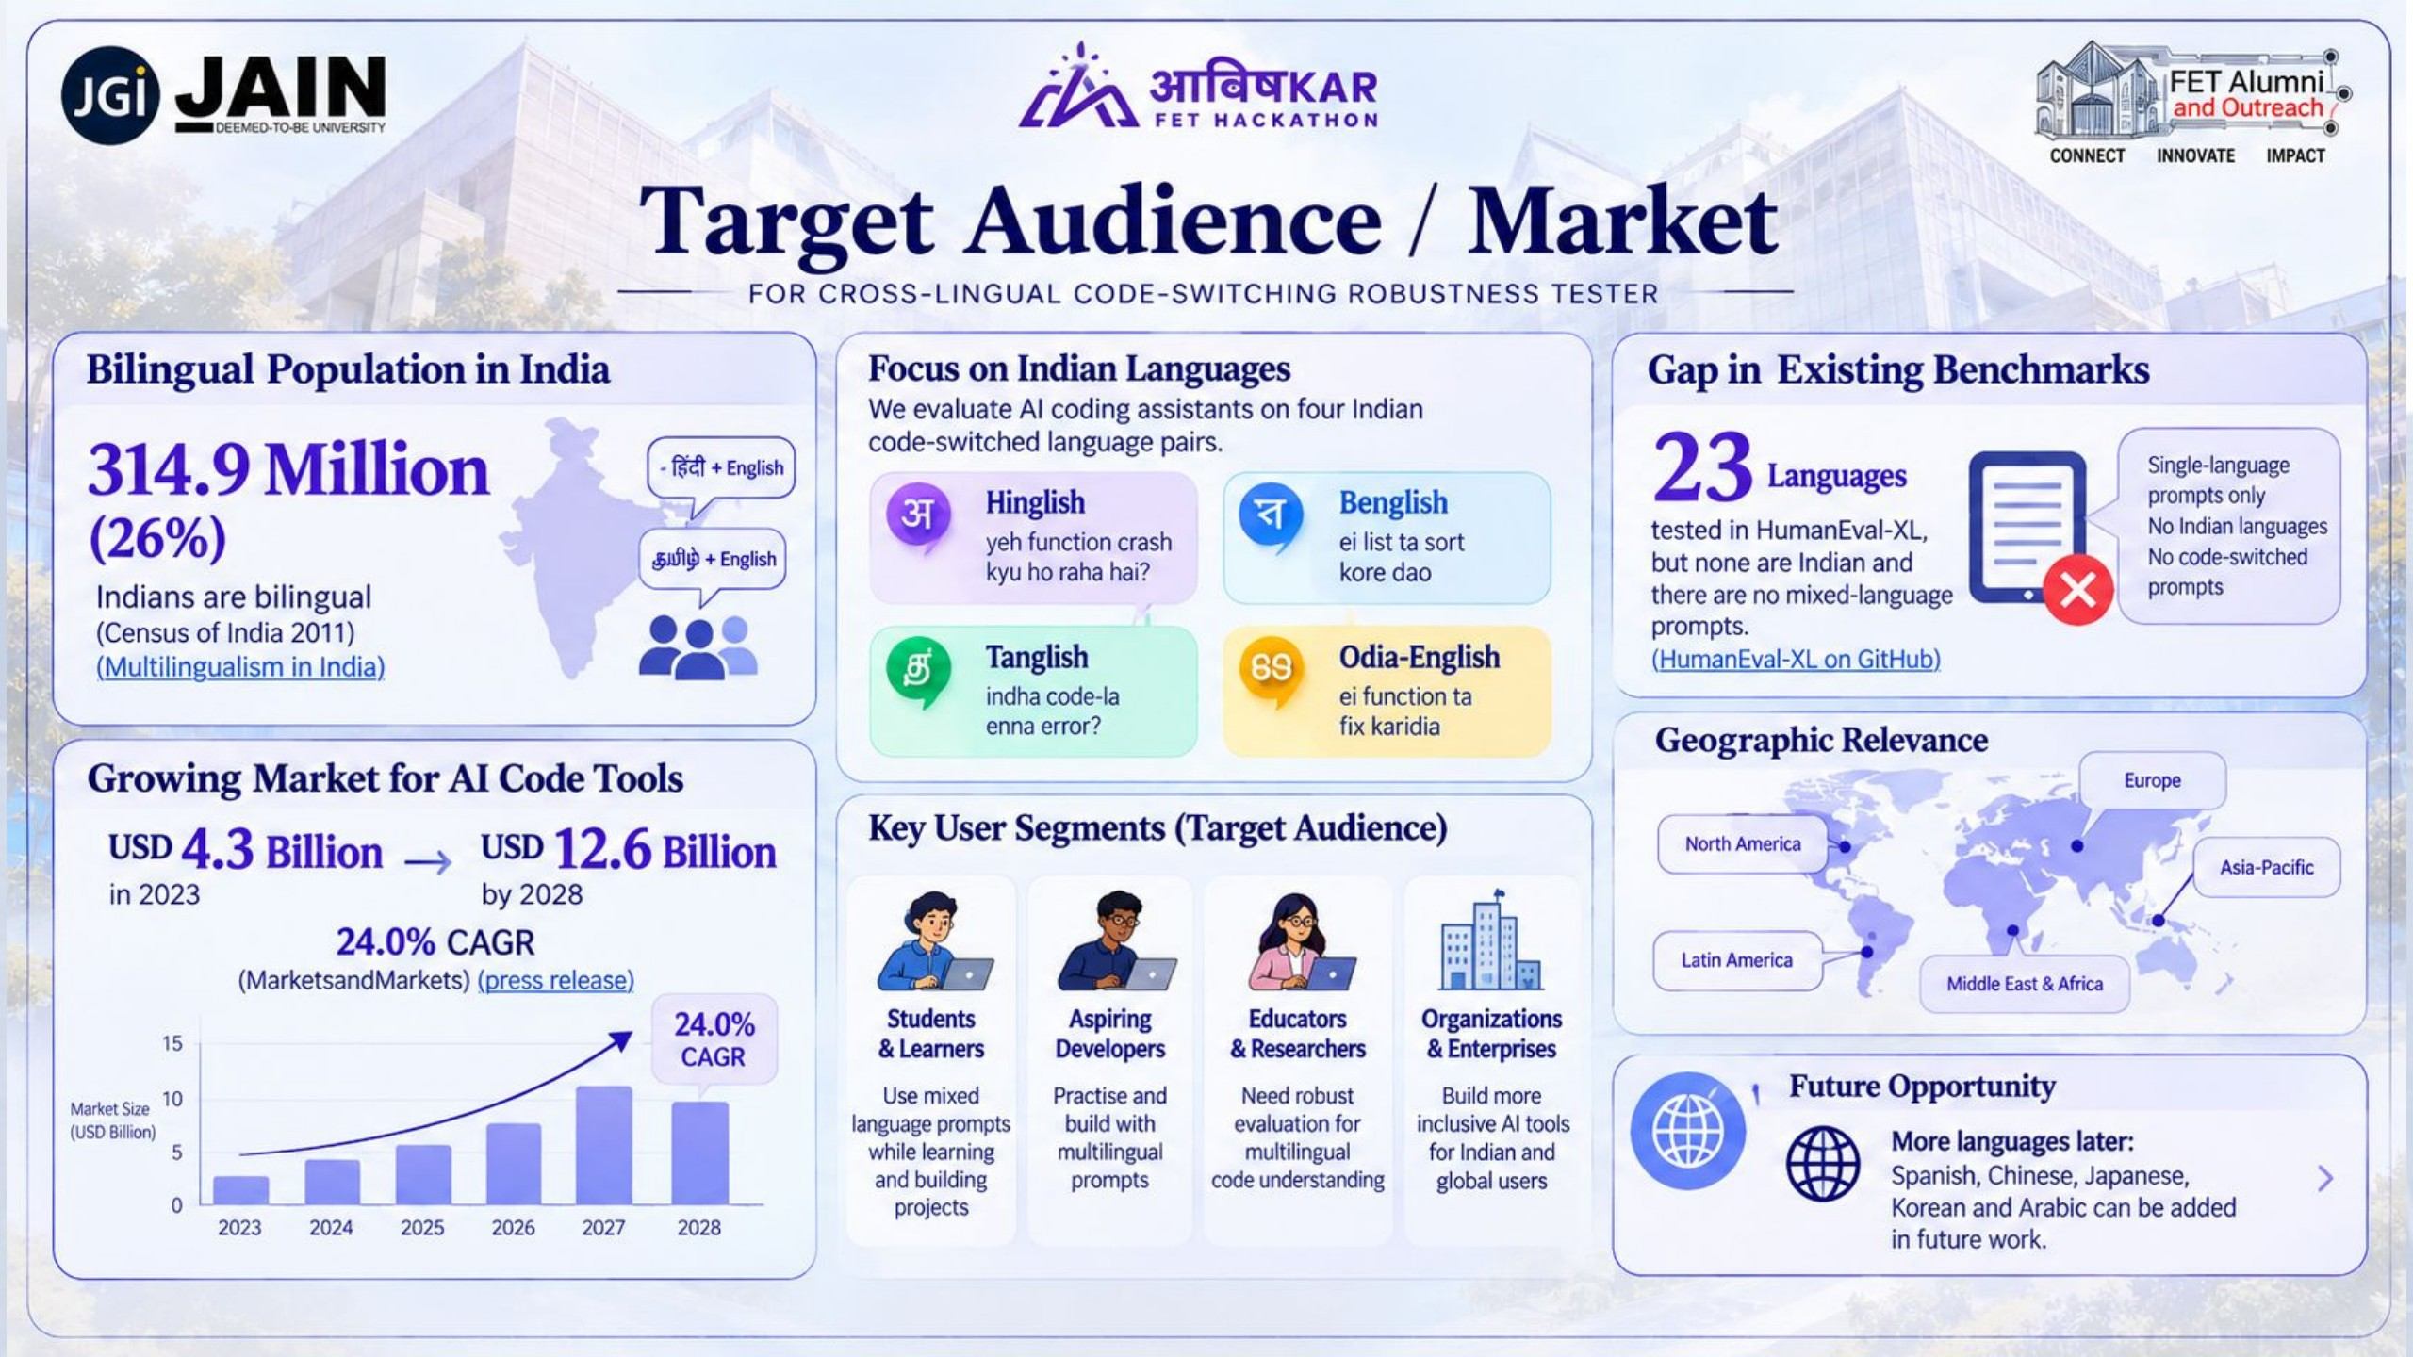

Slide 11
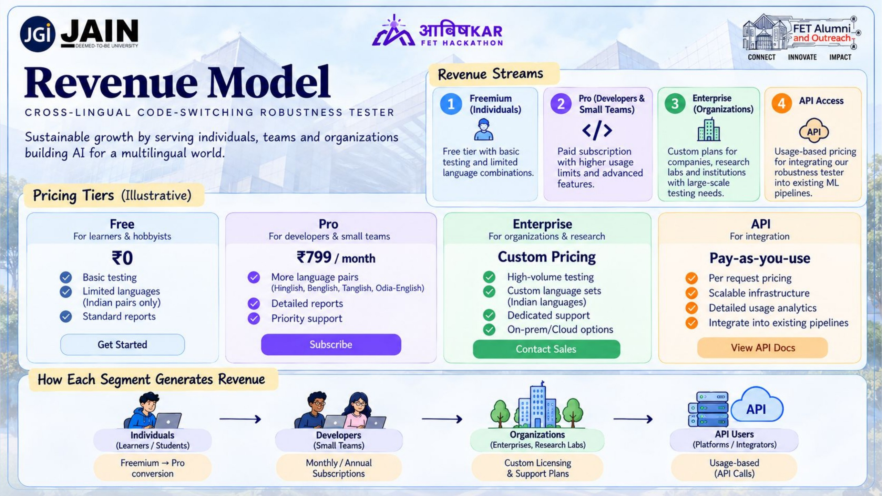

Slide 12
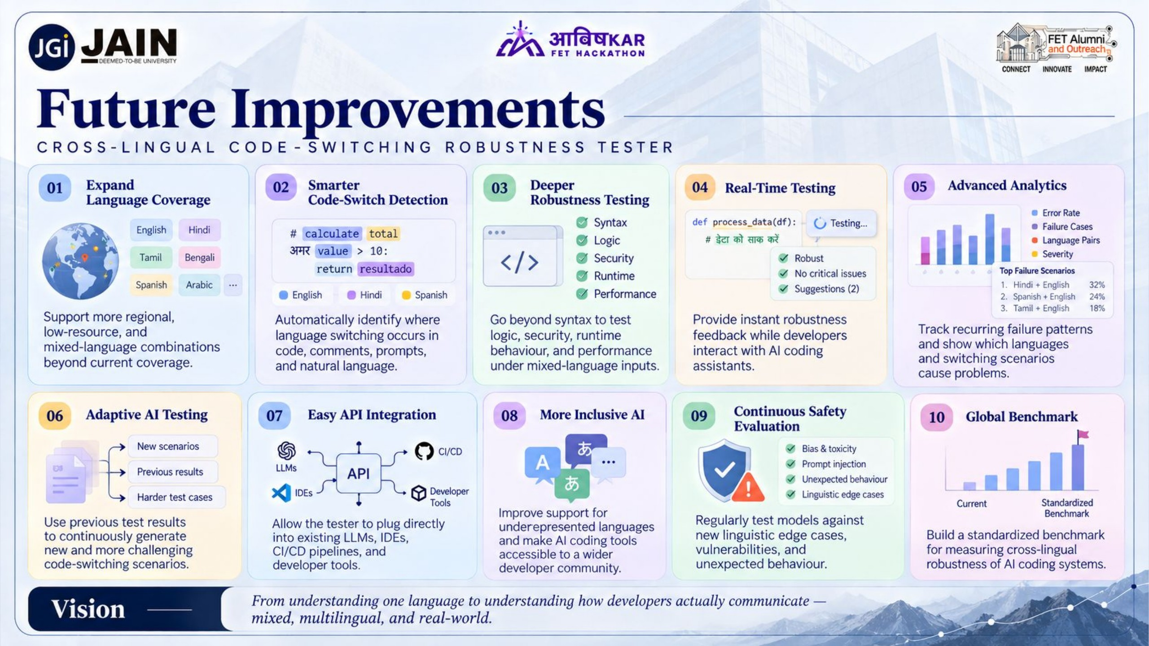

Slide 13
