Slide 1
Web Based Recruitment System
Project Guide:- Mr. Milind Arjun
-Tanmay Pagare 1169 -Shubham Rode 1204

Slide 2
Introduction
The Web Based Recruitment System is a web based Application intended to provide complete solution for the Recruiter as well as for Job seeker through a single get way using an internet.
It will enable the Job recruiters to post various job related openings in there company, and job seeker can browse and search job and apply according to him/her education, location and skills through internet.
By doing so Particular Recruiter can get all the information related to job Seeker and can contact him/her through email and contact number.
The Admin module will have all the right to rectify fake and unrelated information uploaded in the web and manage various job related post.

Slide 3
Scope
This web based recruitment system allows the job seeker and the recruiter to fulfil their job related requirement.
Recruiter can Post update Delete Job Vacancy.
Candidate can view Job as per Job Title and City and he/she can Apply that particular job.
Recruiter can view all the details of candidate who had applied to the job and can arrange a interview.

Slide 4
Scope Continue…
This system works on internet server, so it will be operated by any end to end user for job related activity with secure platform due to authorization and authentication.
This system protects their personal details of both job seeker and recruiter and provides easy communication between them.

Slide 5
Functional Details
The system will record all the details of the candidate and the recruiter.
The system will provide candidate to edit his profile details.
The system will allow the recruiter to delete the particular job related post.
The system will allow the recruiter to edit the particular job related post.
The system allows candidate to sort according to job profile and location.

Slide 6
Functional Details Continue…
The system allows Recruiter to post Job Details.
Recruiter can Post various number of Jobs.
The system allows candidate to apply for the job posted by the recruiter.
The system allows recruiters to view all the his posted job details.
The system allows recruiters to view all the information of candidate which had applied to his job details profile.

Slide 7
Functional Details Continue…
The Admin have all the authority to delete, edit and view post of both candidates and recruiters.
The system allows candidate to sort according to job profile and location.
Candidate can filter job by Industry Type, Employee Type, Skill required and Designation.

Slide 8
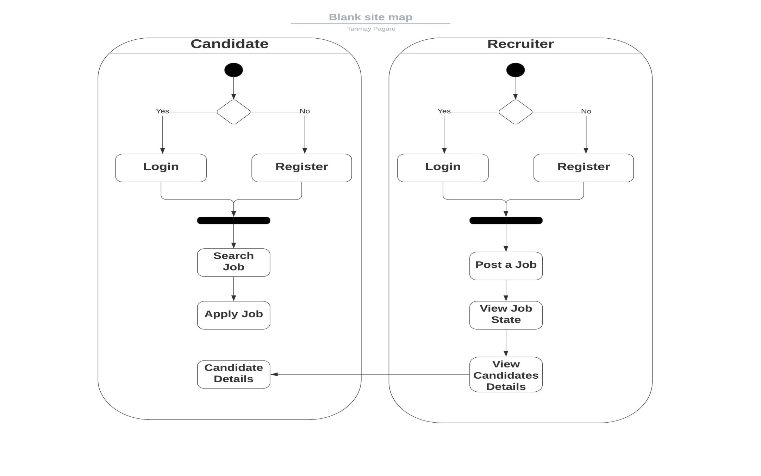
Activity Diagram

Slide 9
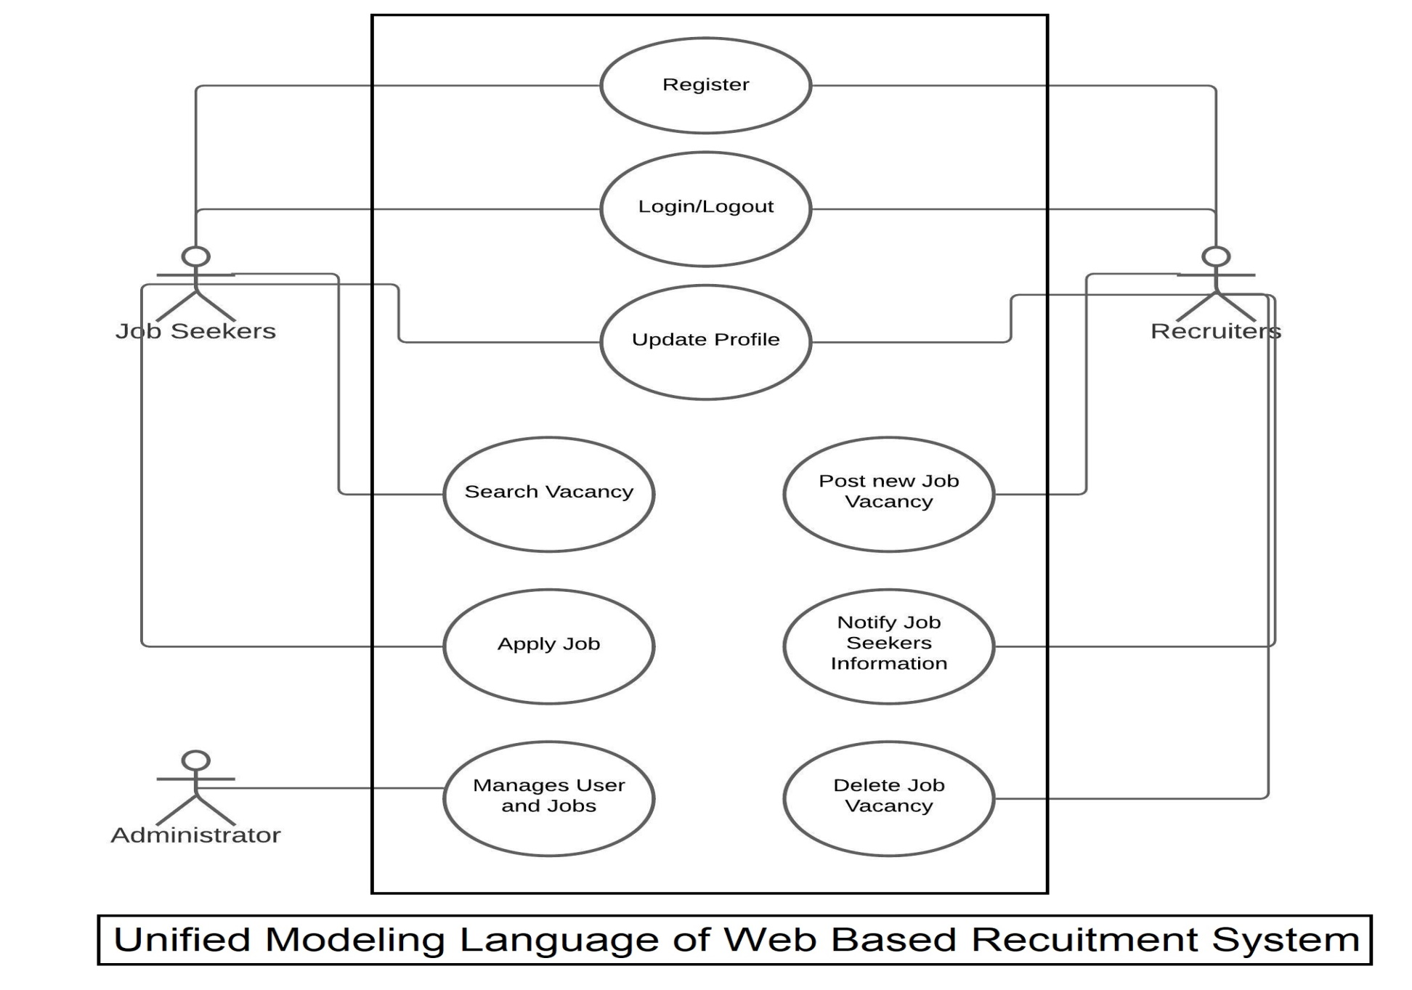
UML Diagram

Slide 10
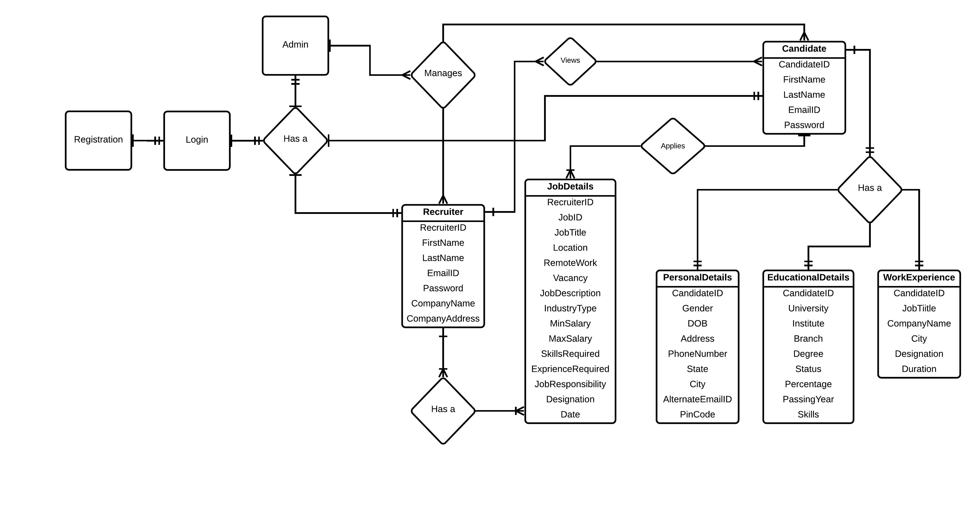
ER Diagram

Slide 11
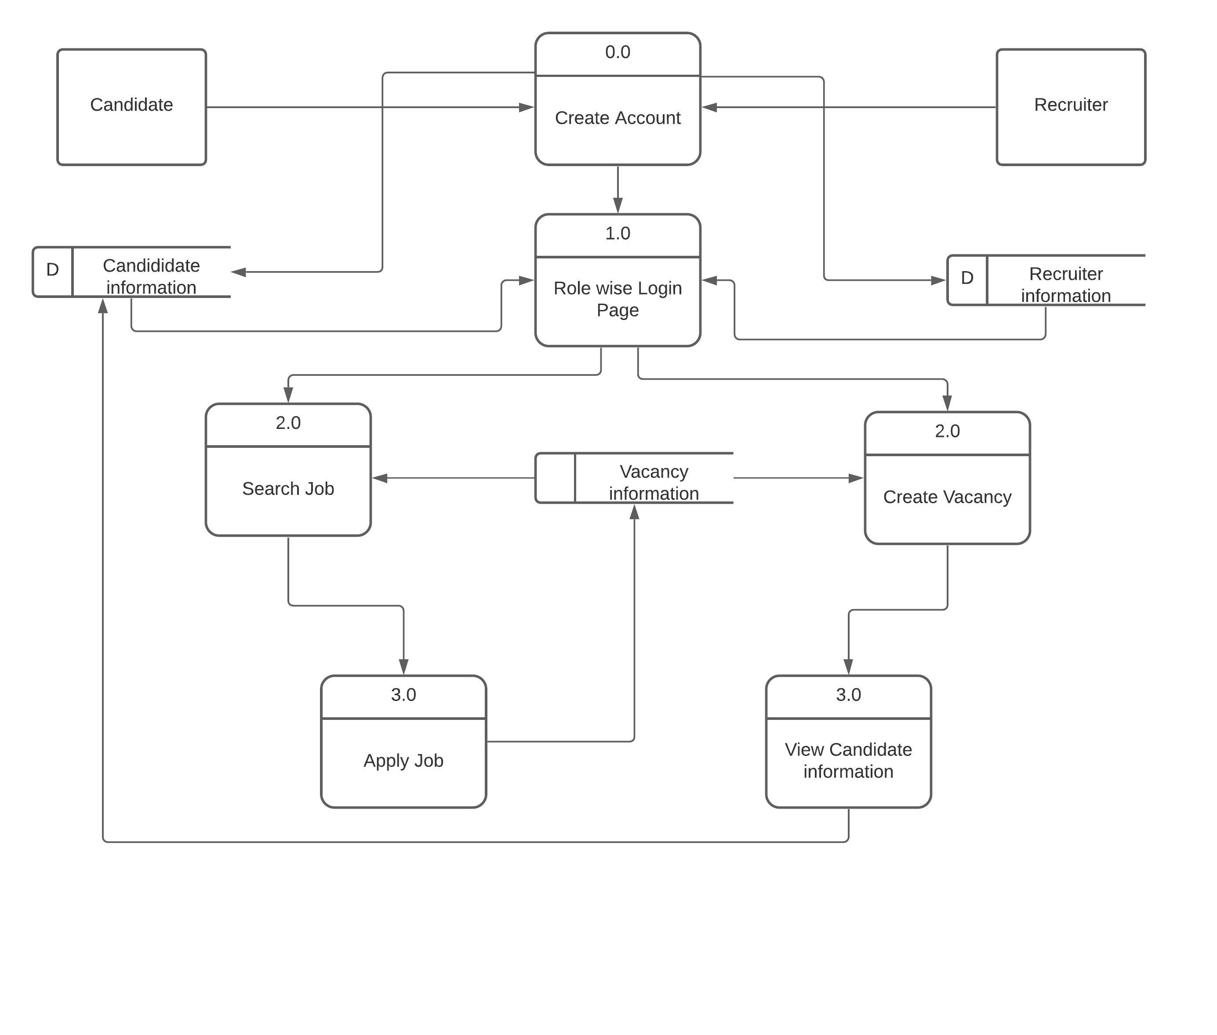
DFD Diagram

Slide 12
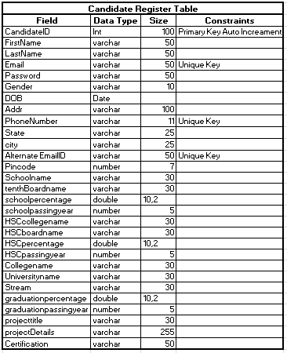
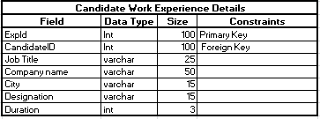
Candidate Table

Slide 13
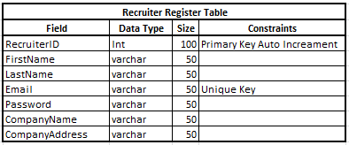
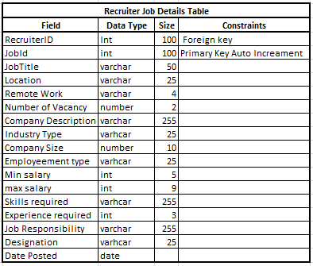
Recruiter Table

Slide 14
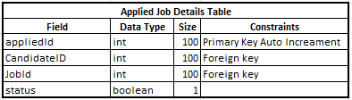
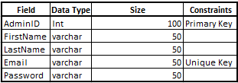
Applied Job Table
Admin Table

Slide 15
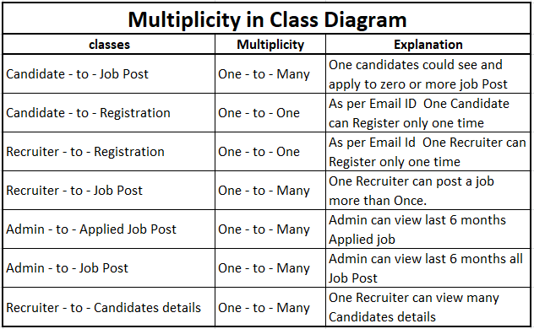
Relationship Between Tables

Slide 16
Web Page Screen Shots

Slide 17
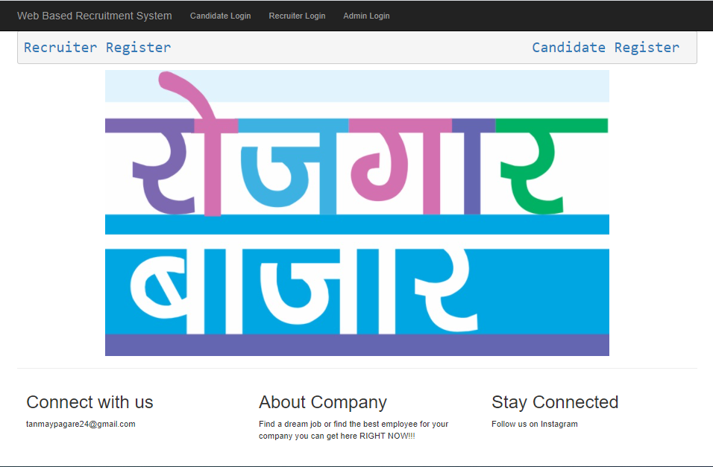
Main Page

Slide 18
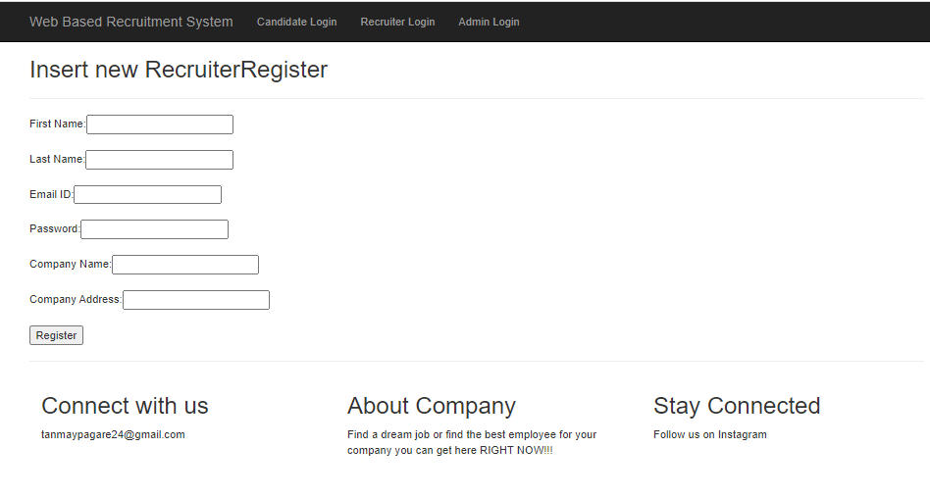
Recruiter Register

Slide 19
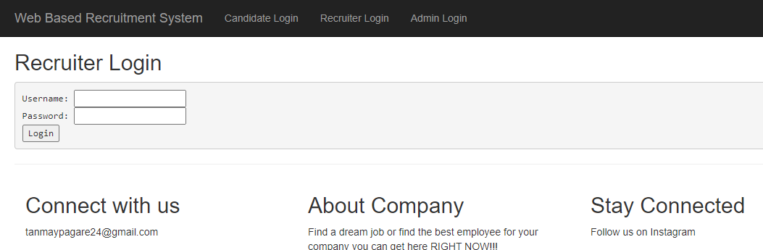
Recruiter Login

Slide 20
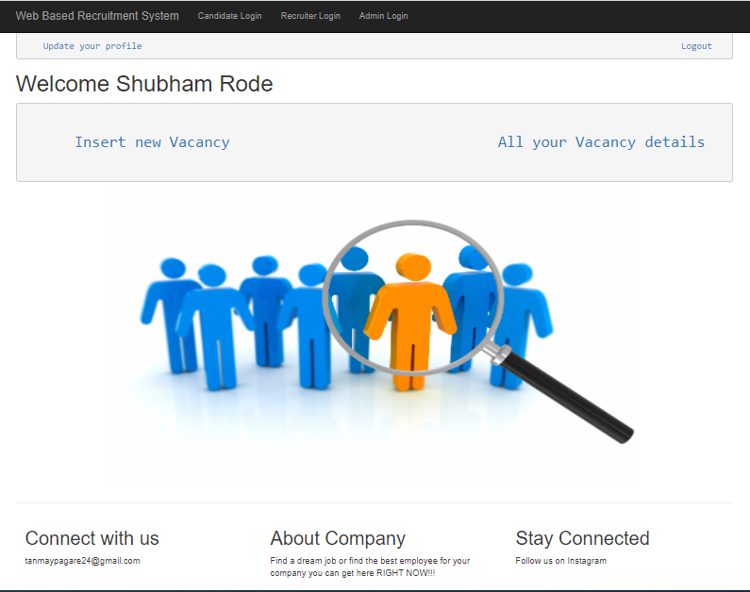
Recruiter Home Page

Slide 21
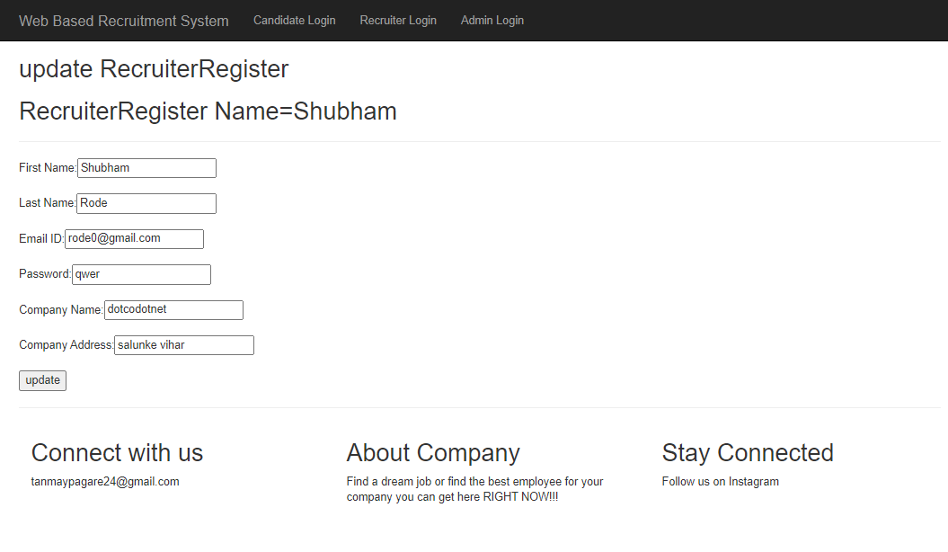
Update Recruiter Profile

Slide 22
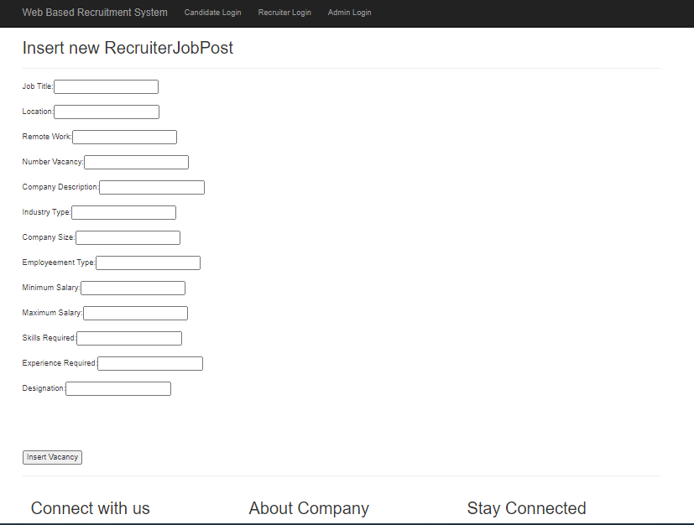
Recruiter Insert Vacancy

Slide 23
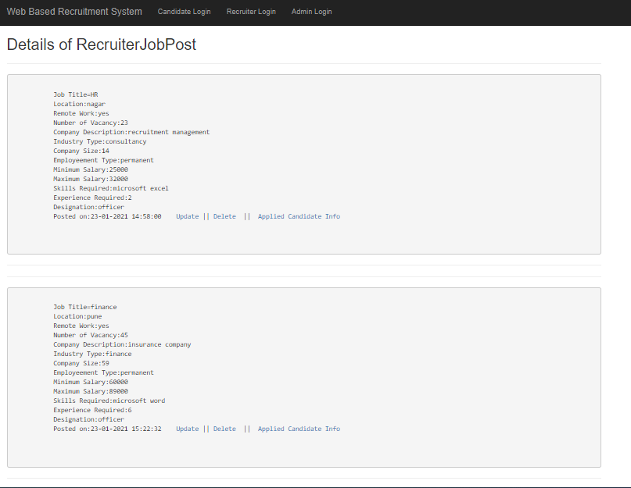
View all Recruiter Job Vacancy

Slide 24
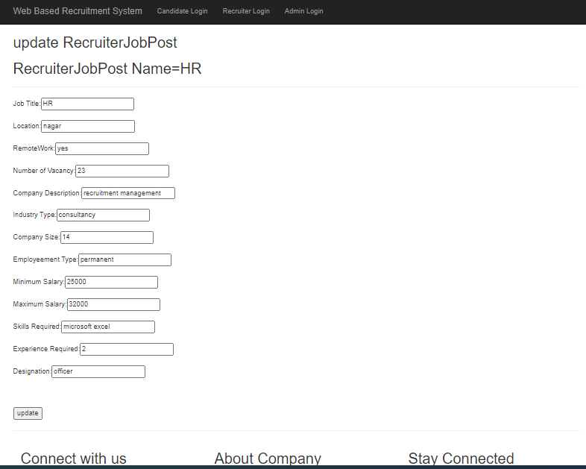
Update Job Vacancy

Slide 25
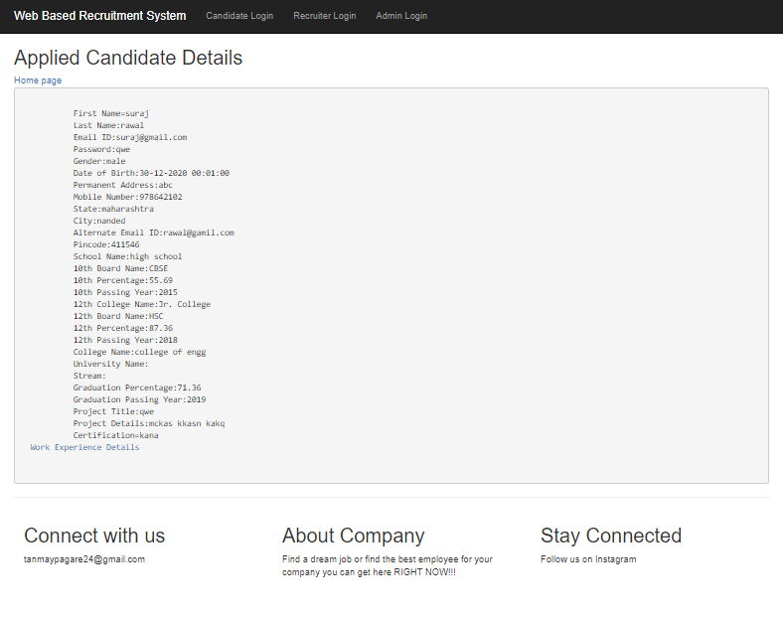
View Profile of Applied Candidate

Slide 26
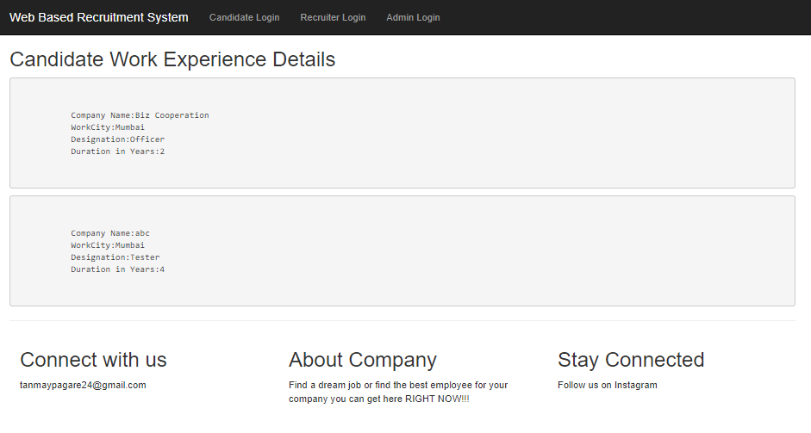
View Work Experience of Applied Candidate

Slide 27
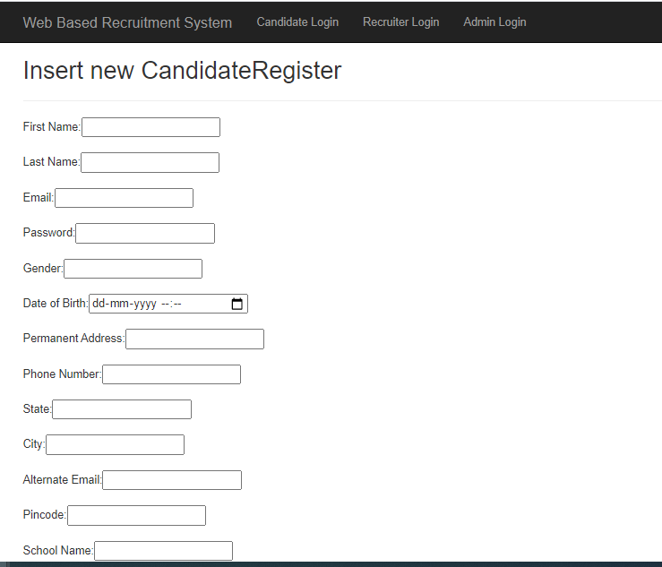
Candidate Register

Slide 28
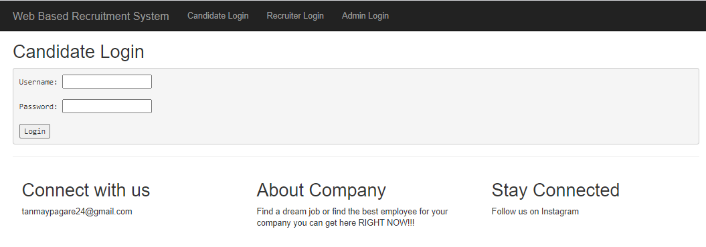
Candidate Login

Slide 29
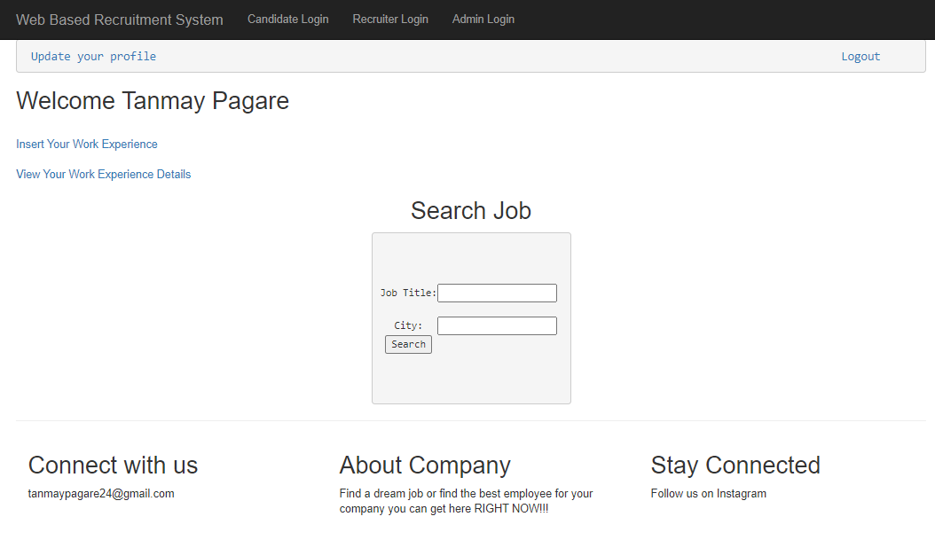
Candidate Home Page

Slide 30
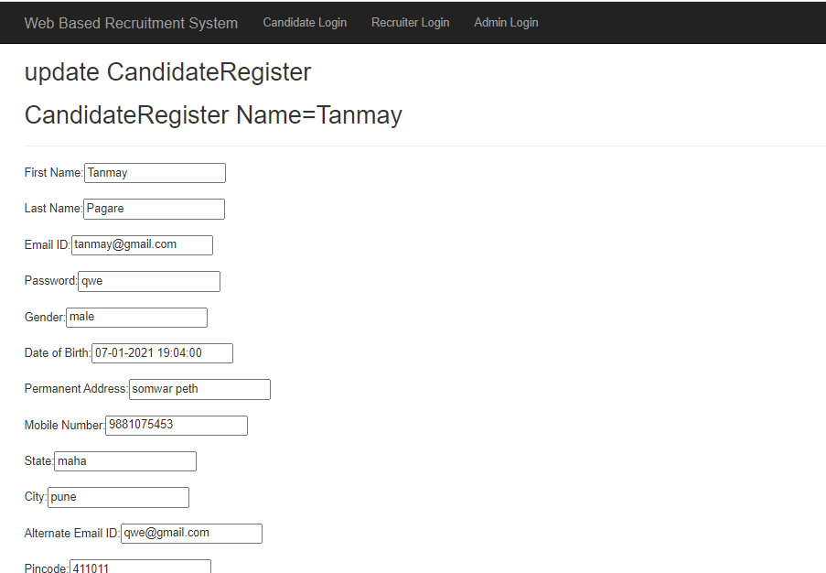
Update Candidate Profile

Slide 31
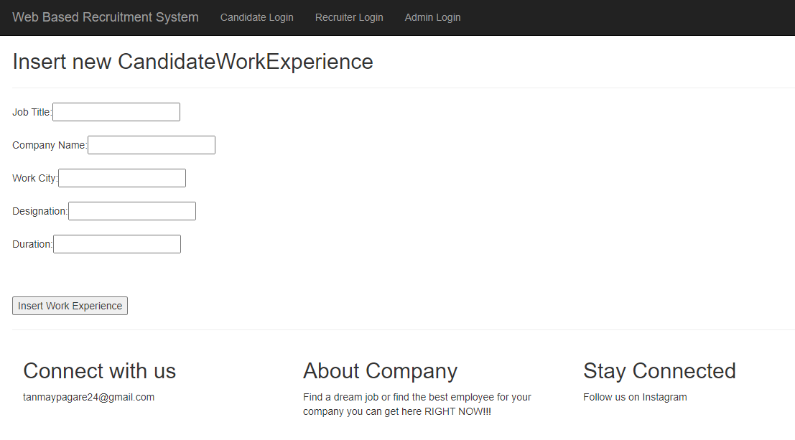
Insert Candidate Work Experience

Slide 32
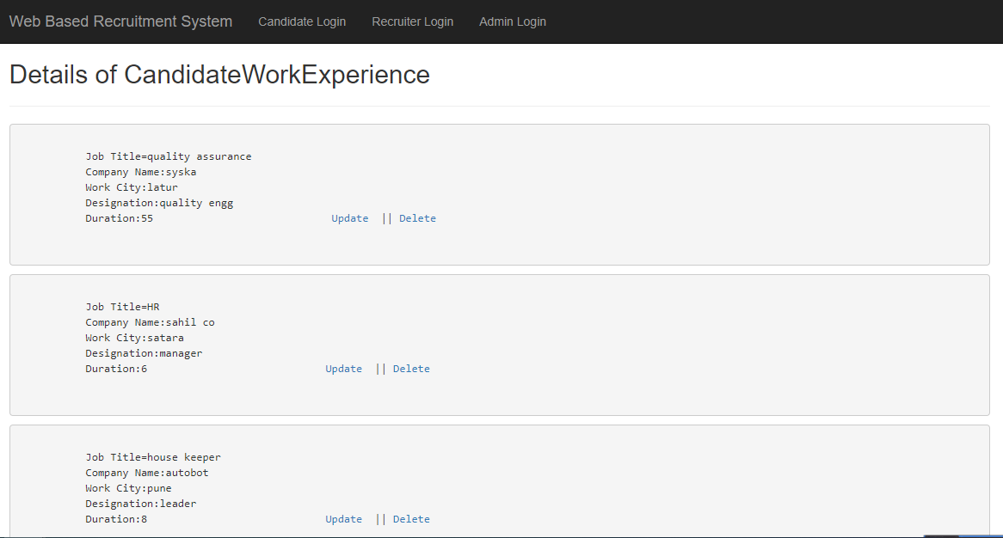
View Candidate Work Experience

Slide 33
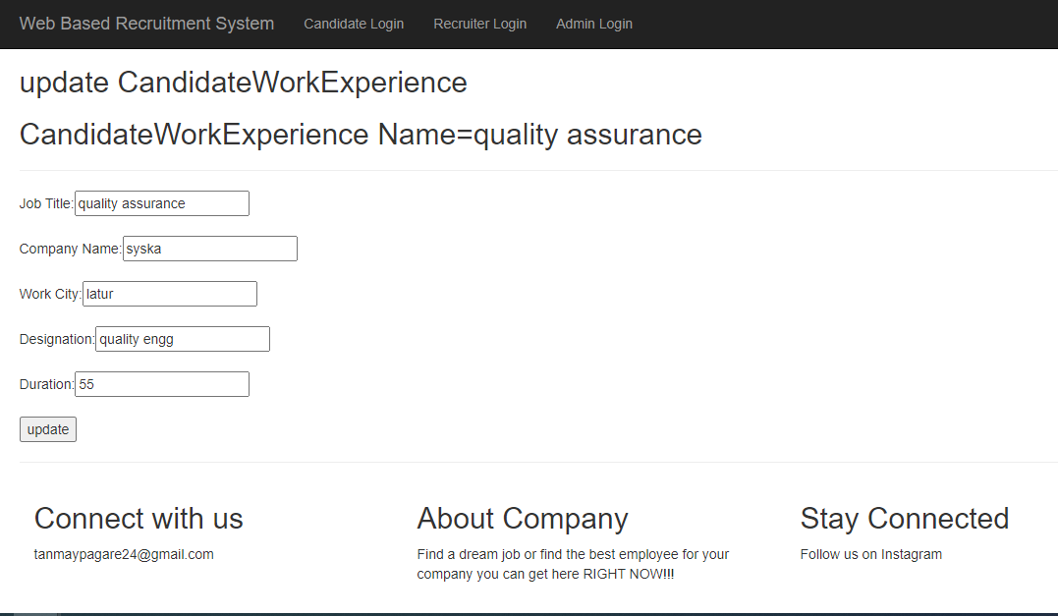
Update Candidate Work Experience

Slide 34
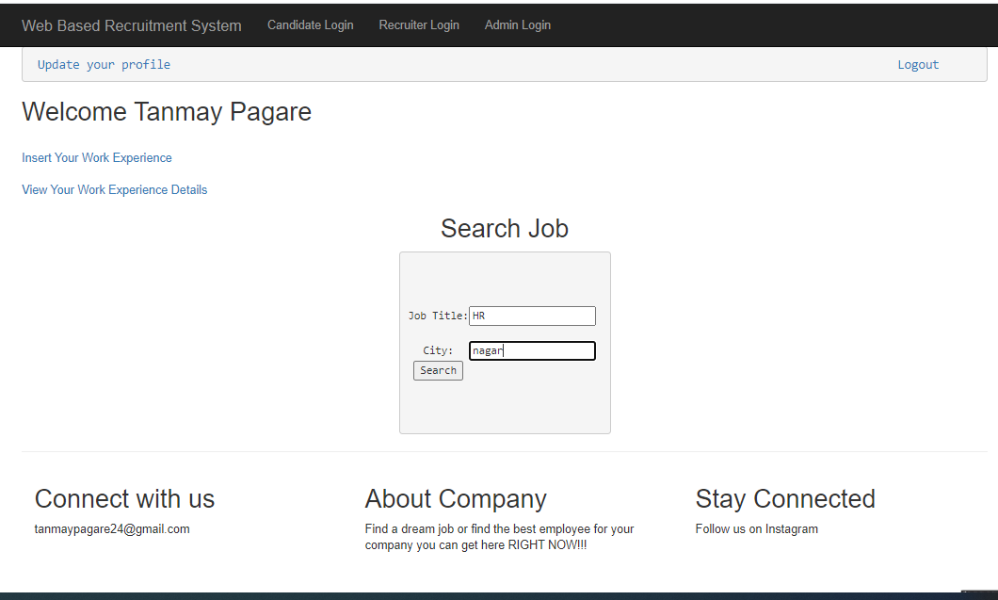
Search Job By Job Title and City

Slide 35
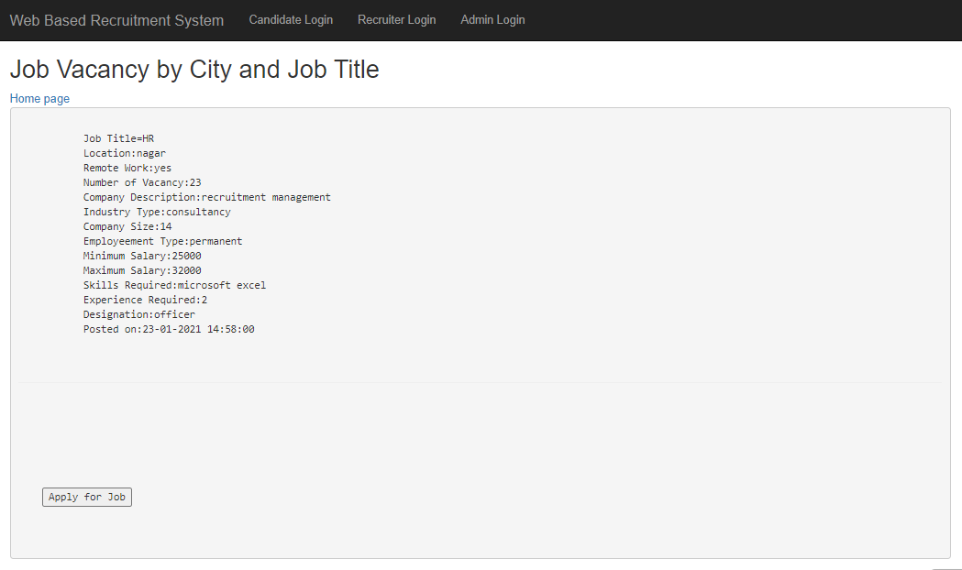
All Job’s By Job Title and City

Slide 36
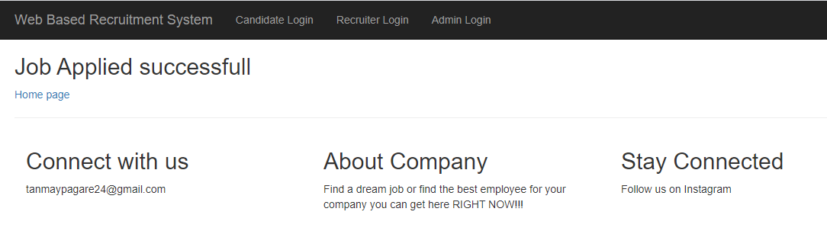
Job applied successfully

Slide 37
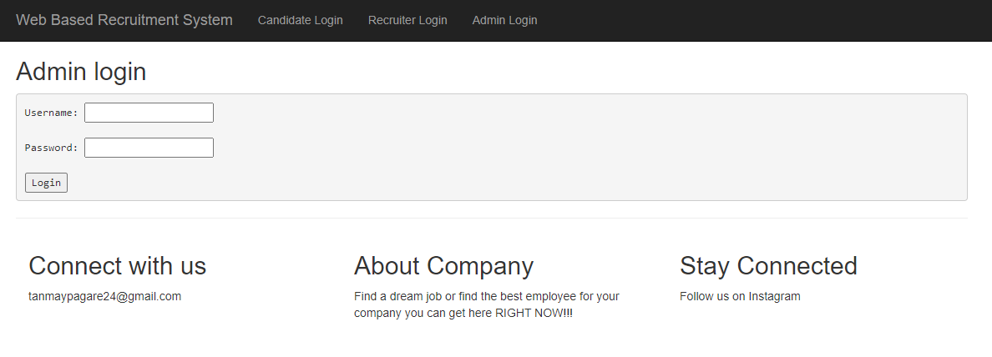
Admin Login Page

Slide 38
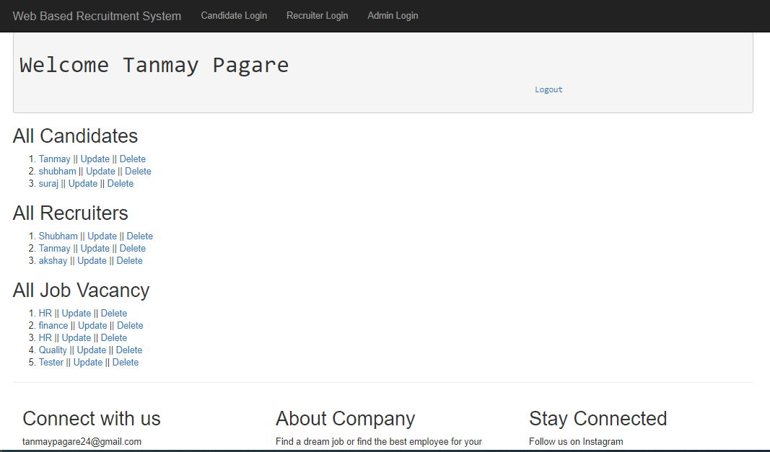
Admin Home Page

Slide 39
Admin Privileges
Admin Can View all the Details to Candidate, Recruiter And Job Post.
Admin can Update Information of Candidate, Recruiter And Job Post.
Admin can Delete Any Candidate, Recruiter and Job Post.

Slide 40
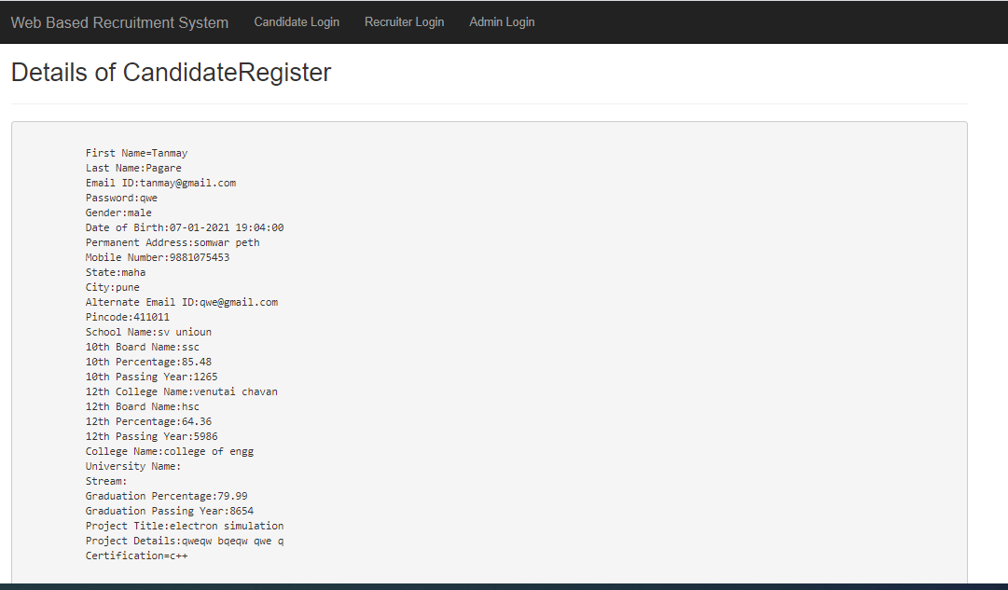
Admin Viewing Candidate Details

Slide 41
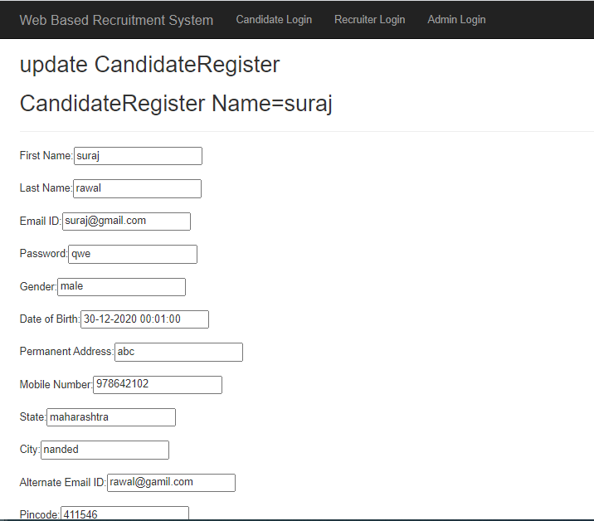
Admin Update Candidate Info

Slide 42
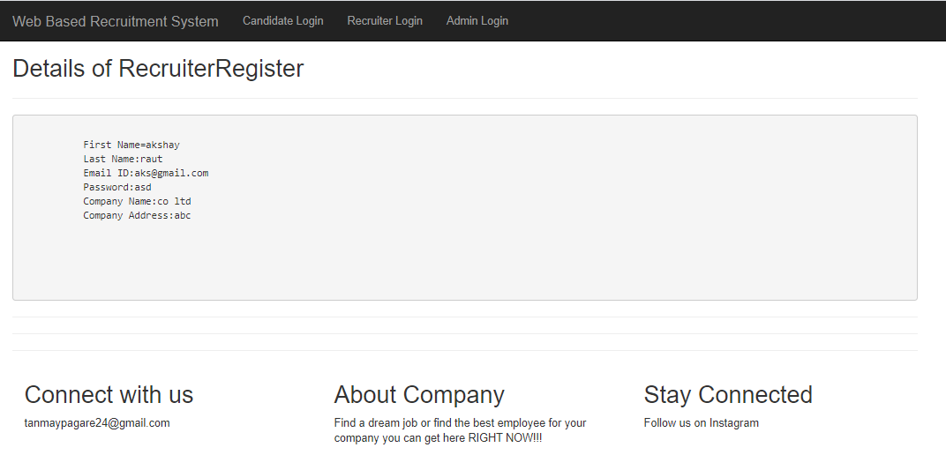
Admin Viewing Recruiter Details

Slide 43
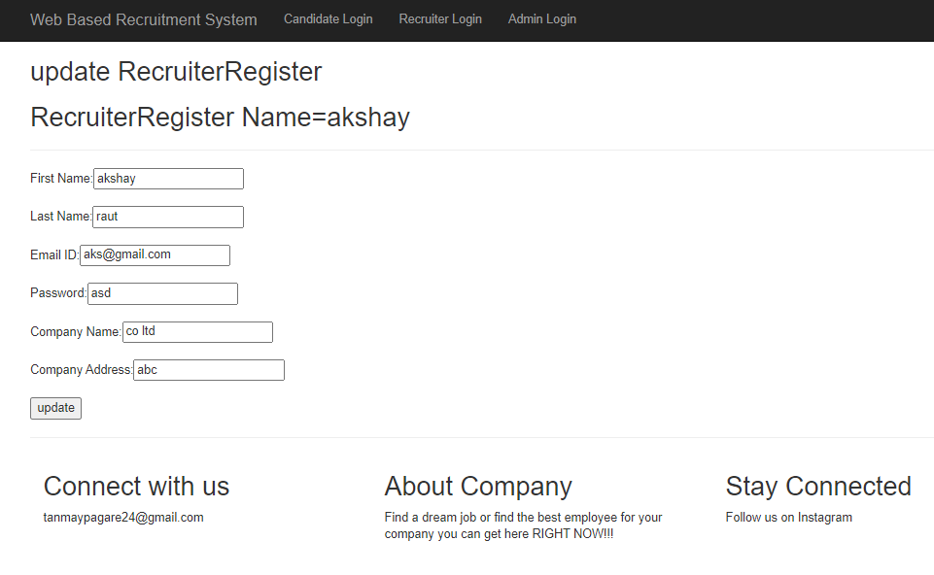
Admin Updating Recruiter Details

Slide 44
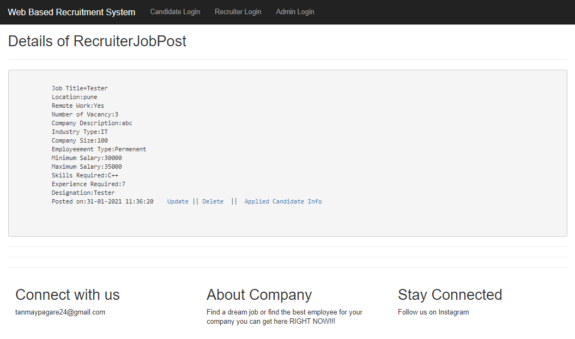
Admin Viewing Vacancy Details

Slide 45
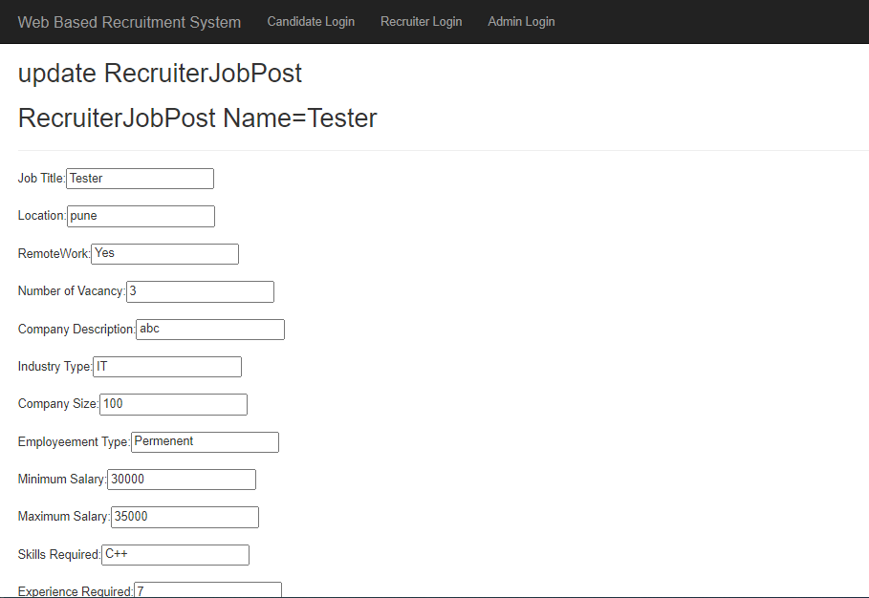
Admin Updating Vacancy Details

Slide 46
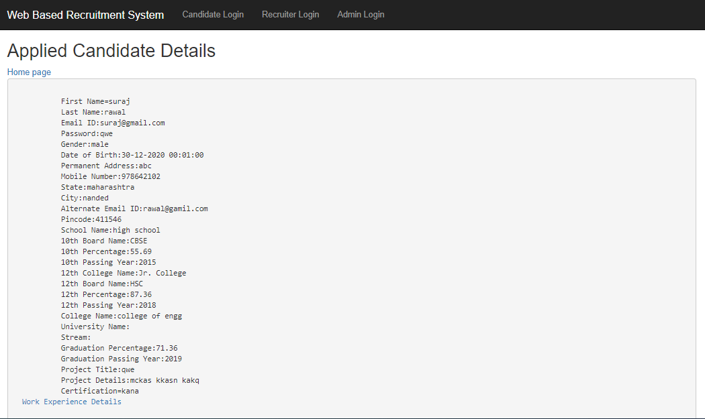
Admin Viewing Candidate Applied Job

Slide 47
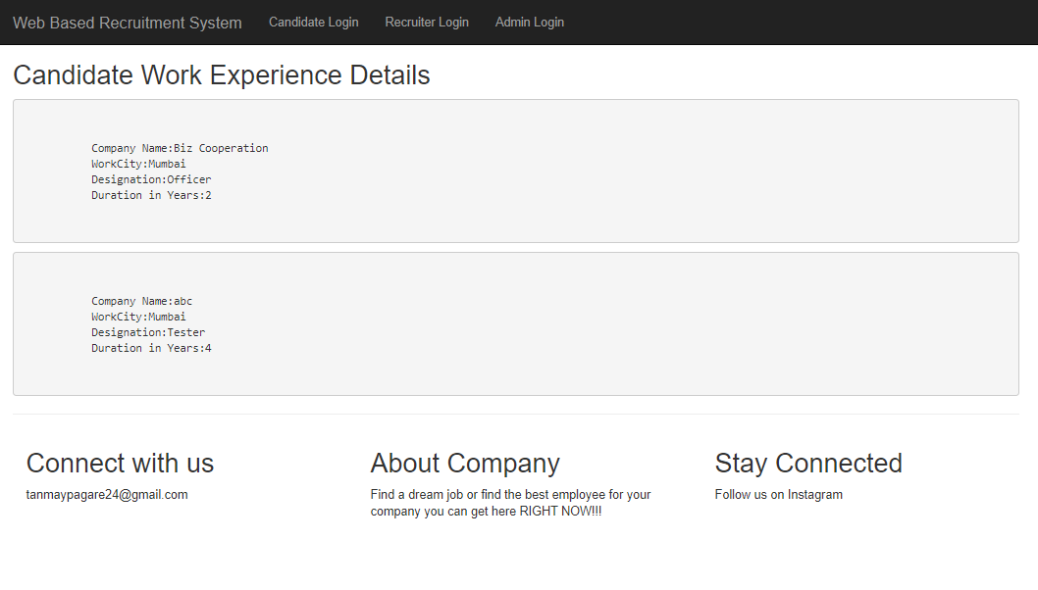
Admin Viewing Candidate Work Experience

Slide 48
Conclusion
Web Based Recruitment system manages Candidates resume as well as Recruiter Job Post and all Personal details. Candidate can make a Resume and Search job by title and City. Candidate can add one or more work experience. Recruiter can add one or more vacancy and can view Resume of the Candidate who had applied to his job. Both Candidate and Recruiter can manage all the functionality anywhere and anytime on go.

Slide 49
Future Scope
Project can enhance by following points:-
Candidate can Download his/her Resume.
Recruiter can make interview call to the applied candidate.
Recruiter can send a private message to applied candidate.
Additional Payment method for premium candidates.
Candidate can view Recruiter Company Review and also give your own reviews.

Slide 50
Thank You

