Slide 1



Quality Assurance Process at Caresmartz360: A Practical Approach
Jaypee University of Information Technology, Waknaghat - 173234 (India)
Major Project - II (18B19CI891) | AY 2024-25
Mid-Term Evaluation | March 17-22, 2025.
Group No.: 60C
Student Details
Tanmay Parashar (211396)
Designation: Junior Software Engineer QA (intern)
Organization: Netsmartz (Caresmartz360)
Location: Chandigarh
Supervisor
Name: Yashika Dahiya
Designation: QC Engineer (Operations)
Organization: Netsmartz (Caresmartz360)
Location: Chandigarh

Slide 2
Outline
Introduction
Problem Statement
Objectives
Work Done (after Major Project - I)
Project Design
Implementation
Experimental Results and Evaluation
Key Learnings
Work Plan (till End-Term Evaluation)
Work Contribution and Other Details
References

Slide 3
Introduction
Software Quality Assurance (QA) plays a crucial role in ensuring the reliability and functionality of software products.
This project focuses on implementing QA techniques such as test case creation, bug replication, and reporting in a live project environment.
The primary objective is to gain hands-on experience in manual testing, defect tracking, and evaluating software performance.
Tools Used: Jira , Qase, Figma, MS-Office
QA Ensures defect free software by identifying and fixing issues before deployment
Improves user experience by ensuring software functionality aligns with requirements.

Slide 4
Problem Statement
Software testing challenges:
Late-stage defect detection leading to high fixing costs.
Inefficient test case management results in missed bugs.
Lack of structured bug reporting causing delays in resolution.
Project Focus:
Enhancing the bug detection and reporting process.
Improving test case execution for better defect tracking.
Integrating structured methodologies to ensure software quality.

Slide 5
Objectives
Learn and apply fundamental concepts of software testing.
Develop and execute test cases for a live project.
Replicate and report bugs effectively.
Understand defect lifecycle and track issues using Jira.
Work towards improving software reliability by identifying critical defects.
Analyze defects based on severity and priority to ensure efficient bug resolution.
Collaborate with developers and QA team members to enhance software reliability and user experience.

Slide 6
Work Done (after Major Project - I)
Fundamentals of Software Testing:
Types of testing: Unit, Functional, Regression, Smoke, Sanity, etc.
Test Case Writing:
Created structured test cases covering different scenarios.
Bug Replication & Reporting:
Identified, reproduced, and logged defects in the system.
Contribution to Live Project:
Validated new features and performed end-to-end testing.
Challenges Faced:
Understanding complex test scenarios.
Handling defect prioritization.

Slide 7
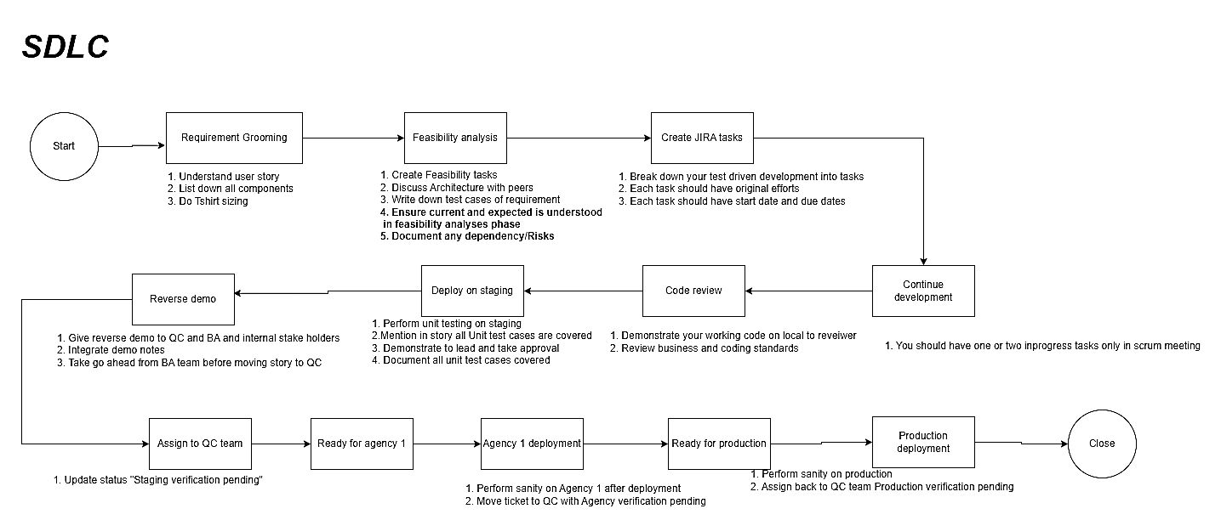
Project Design

Slide 8
Project Design
Test Case Flow:
Test case creation
Execution
Verification
Defect logging

Slide 9
Project Design (cont…)
Bug Tracking Process:
Bug identification
Replication
Fixing & Retesting
Severity assessment

Slide 10
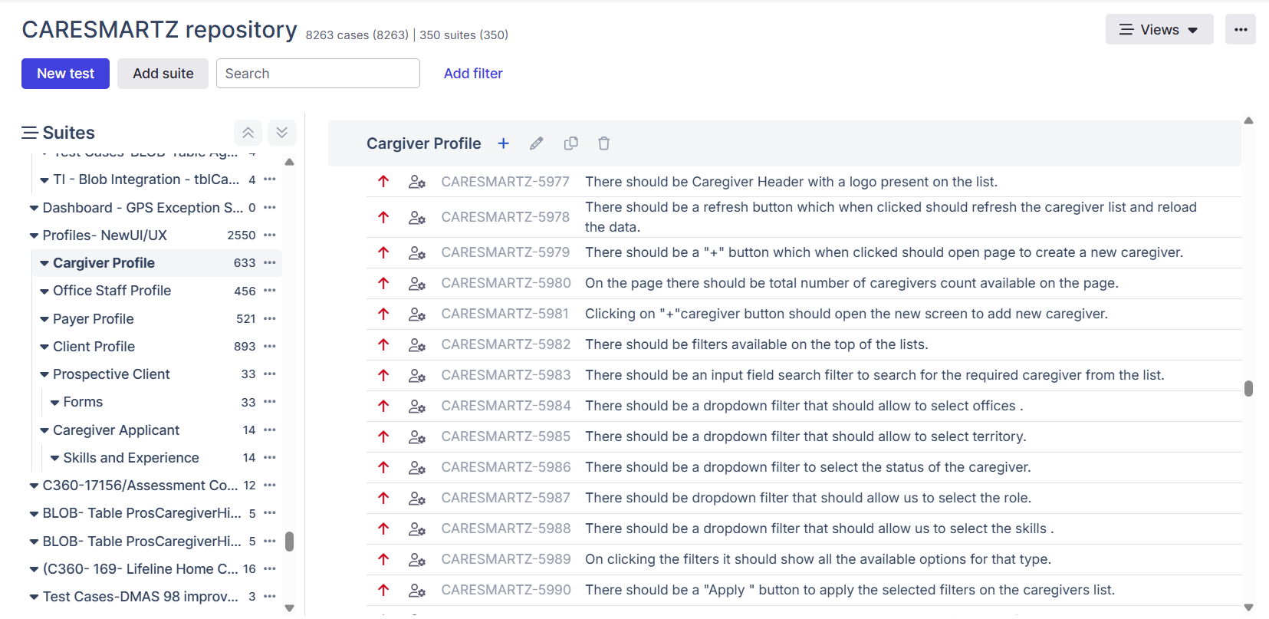
Implementation

Slide 11
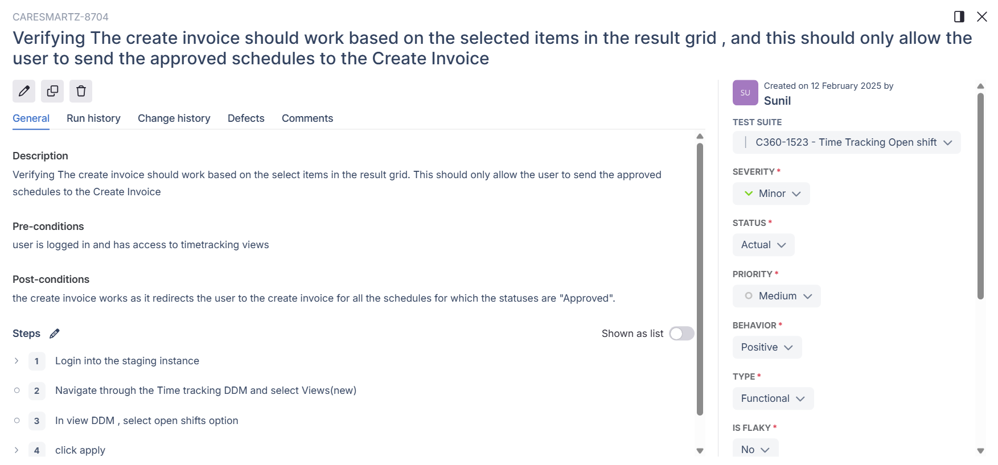
Implementation (cont…)

Slide 12
Implementation (cont…)
Use max. three slides for project implementation.
Include dataset description, important code snippets demonstrating core logic, algorithms, tools and techniques, etc.
Demonstrate how different code components interact, focusing on key functions, modules, and workflow.

Slide 13
Experimental Results and Evaluation
Use max. three slides to show your experimental results.
Include detailed findings, interpretation of results, comparison with existing solutions to provide context and significance.
Use tables, graphs, and charts to highlight trends, patterns, while aligning findings with the project’s objectives.

Slide 14
Experimental Results and Evaluation (cont…)
Use max. three slides to show your experimental results.
Include detailed findings, interpretation of results, comparison with existing solutions to provide context and significance.
Use tables, graphs, and charts to highlight trends, patterns, while aligning findings with the project’s objectives.

Slide 15
Experimental Results and Evaluation (cont…)
Use max. three slides to show your experimental results.
Include detailed findings, interpretation of results, comparison with existing solutions to provide context and significance.
Use tables, graphs, and charts to highlight trends, patterns, while aligning findings with the project’s objectives.

Slide 16
Key Learnings
Skills Gained:
Writing effective test cases.
Understanding defect lifecycle.
Bug tracking using Jira.
Firsthand experience to Corporate work culture
Handling real-time test execution
Communicating with developers , mentors , and top management to cultivate the necessary public speaking , management ettiquettes.

Slide 17
Work Plan (till End-Term Evaluation)
Expanding test case coverage.
Exploring test automation (if applicable).
Enhancing bug reporting efficiency.
Improve defect tracking analysis by categorizing bugs based on modules and severity levels.
Optimize test execution strategy by prioritizing critical test cases.
Ensure seamless integration of new features into the existing system.
Maintain a QA knowledge base for test cases, defect reports, and testing strategies.

Slide 18
Work Contribution and Other Details
Roll No. |  | Start Date (dd/mm/2025) |  | Organization & Location | Work Mode (Online/Offline) | Work Nature (Tech./Non-Tech.) | Work Domain
211396 |  | 08/01/2025 |  | Netsmartz House Chandigarh | Offline | Tech | Software Testing Manual Testing
GitHub Repository URL: https://github.com/Tanmay-Parashar/Major-Project.git
Work Contribution (provide week-wise work details)
Week 1 | 08/01/2025 to 15/01/2025 |  | Fundamentals of Software Testing Software Development Life Cycle Software Testing Life Cycle
Week 2 | 16/01/2025 to 23/01/2025 |  | Started the product Training videos
Week 3 | 24/01/2025 to 31/01/2025 |  | Continued with Product Videos Received dummy login and started exploring the features and functionalities
Week 4 | 01/02/2025 to 08/02/2025 |  | Started writing generalized test cases for the product

Slide 19
Work Contribution and Other Details (cont…)
Work Contribution (provide week-wise work details)
Week 5 | 10/02/2025 to 17/02/2025 | Continued writing test cases.
Week 6 | 18/02/2025 to 25/02/2025 | Given a specific module on product to review , write and log test cases on Qase software
Week 7 | 26/02/2025 to 05/03/2025 | Given the next module to review , write and log test cases.
Week 8 | 06/03/2025 to 13/03/2025 | Got Assigned a module that had client bugs reported and started reviewing the module in detail
Week 9 | 17/03/2025 to 22/03/2025 | Got Assigned another module that had client bugs reported and started reviewing the module in detail
Week 10 | dd/mm/2025 to dd/mm/2025 | Describe your work

Slide 20
References
Use max. three slides to provide a comprehensive list of at least 10 references in IEEE format, including journal articles, conference papers, book chapters, websites, blogs, etc.
Ensure the references are accurate and properly formatted.
Please see slide no. 21 for guidance on formatting references in IEEE style.

Slide 21
References (cont…)
Use max. three slides to provide a comprehensive list of at least 10 references in IEEE format, including journal articles, conference papers, book chapters, websites, blogs, etc.
Ensure the references are accurate and properly formatted.
Please see slide no. 21 for guidance on formatting references in IEEE style.

Slide 22
References (cont…)

Slide 23
Thanks.

