Slide 1
ContribMatch
Find an issue you can actually finish.
A name, an issue, a first pull request.
Powered by open-weight Gemma · MIT licensed · Built for Hacktoberfest HackDays
Built by Tanmay Tiwari
contribmatch · pitch deck
01

Slide 2
Open source does not have an issue shortage.
It has a first-step shortage.
Is this issue still open?
Is it still unclaimed?
Is the project still alive?
Is it a first contribution for me, in a language I use?
What is the first pull request supposed to look like?
None of these are code questions — and all of them stop people.
the bottleneck
the bottleneck
02
02

Slide 3
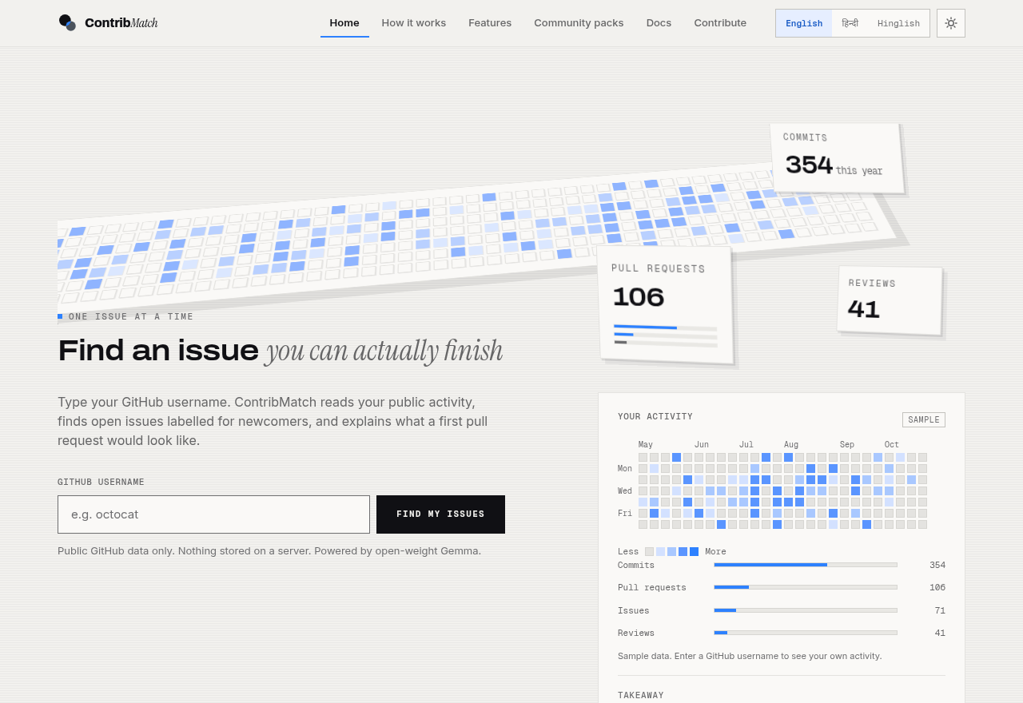
One screen. Four answers.
Match
Score
the issues a beginner can actually finish
0–100, every point traceable to a rule
Plan
Guard
the files, the steps, the checklist
the quality checks a maintainer would run
The home page: the 3D contribution wall and the activity panel, in one view.
Type a GitHub username and the matcher runs the whole pipeline live.
the product
the product
03
03

Slide 4
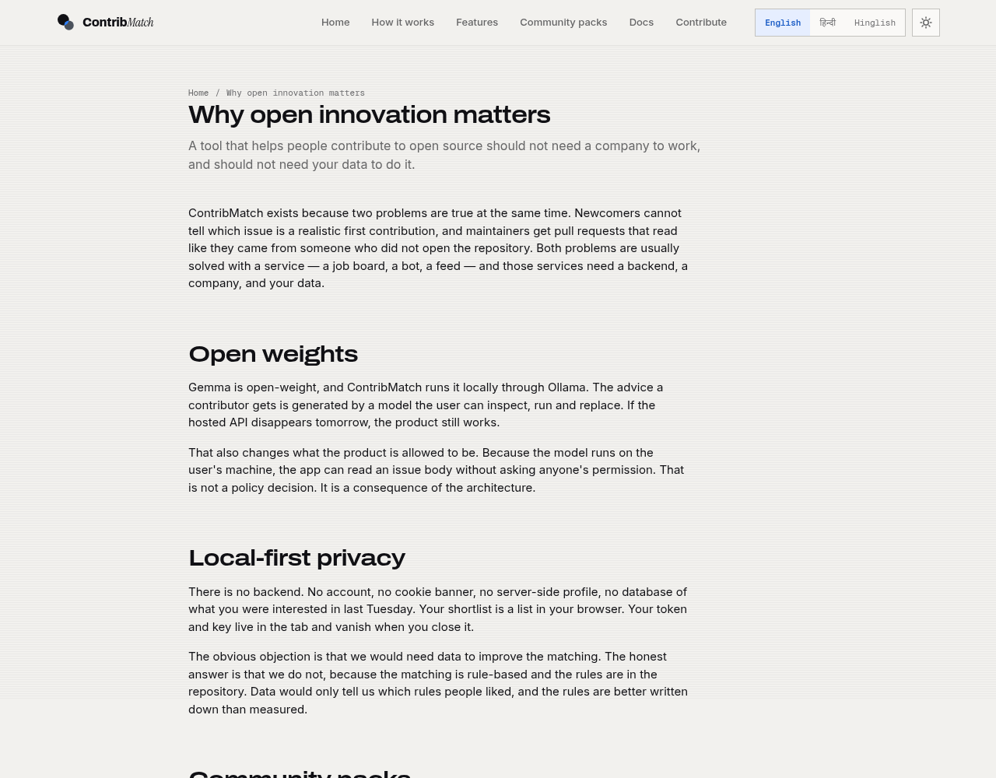
Why open innovation matters
• The contribution pipeline is the product, and the product should be owned by the people building it.
• The friction is not technical. It is informational. Information is something a tool can carry.
• No backend, no account, no data collection: the trust argument is the architecture, not a promise.
• MIT licensed and forkable in an afternoon, so a community can run their own version.
why open innovation
why open innovation matters
04
04

Slide 5
Architecture
• Static site, vanilla ES modules, no build step, no framework
• Business logic is DOM-free; only js/ui touches the document
• One provider interface, two implementations, one mock
• Rules first: the model only ever sees the top eight
Profile Agent
public activity → skills, level
Scout Agent
GitHub search → candidate issues
Ranker
rules → top 8 → Gemma → 0–100 + reasons
Coach Agent
issue → plan, comment, checklist
Quality Guard
the flags
shortlisting → localStorage (exports as Markdown)
architecture
architecture
05
05

Slide 6
The agents
AGENT
READS
WRITES
Profile
public repos, languages, topics, activity
skills, level
Scout
GitHub search
a candidate list
Ranker
rules, then the model on the top 8
0–100 and the reasons
Coach
one issue
the plan, the comment, the checklist
Quality Guard
the plan and the draft
the flags
Every agent is async run(input, ctx) and returns schema-validated JSON.
the agents
the agents
06
06

Slide 7
Open-weight Gemma
• Ollama runs Gemma locally — the model that is on your machine
• Google AI Studio hosts Gemma, for a shared key
• OLLAMA_ORIGINS is the setting people get wrong; it is in the docs
• The model is never the only path. Rules carry the ranking; the model carries the wording.
• The model rating is blended at 35% into the final score — never 100%
• A key is never committed and never sent anywhere but the API it belongs to
RANKING SOURCES
65%
transparent rules: language match, repo health, labels, freshness, activity, body hygiene
35%
Gemma's rating of the top 8: ease, clarity, fit
open-weight gemma
open-weight gemma
07
07

Slide 8
Exact versus approximate data
Exact
a token is set
the full calendar from GraphQL
Approximate
no token
about 90 days of public events, mapped
Sample
no name yet
clearly labelled sample data
The 3D wall always covers the same window as the panel. An approximation is never drawn as a full year.
honesty
honesty as a feature
08
08

Slide 9
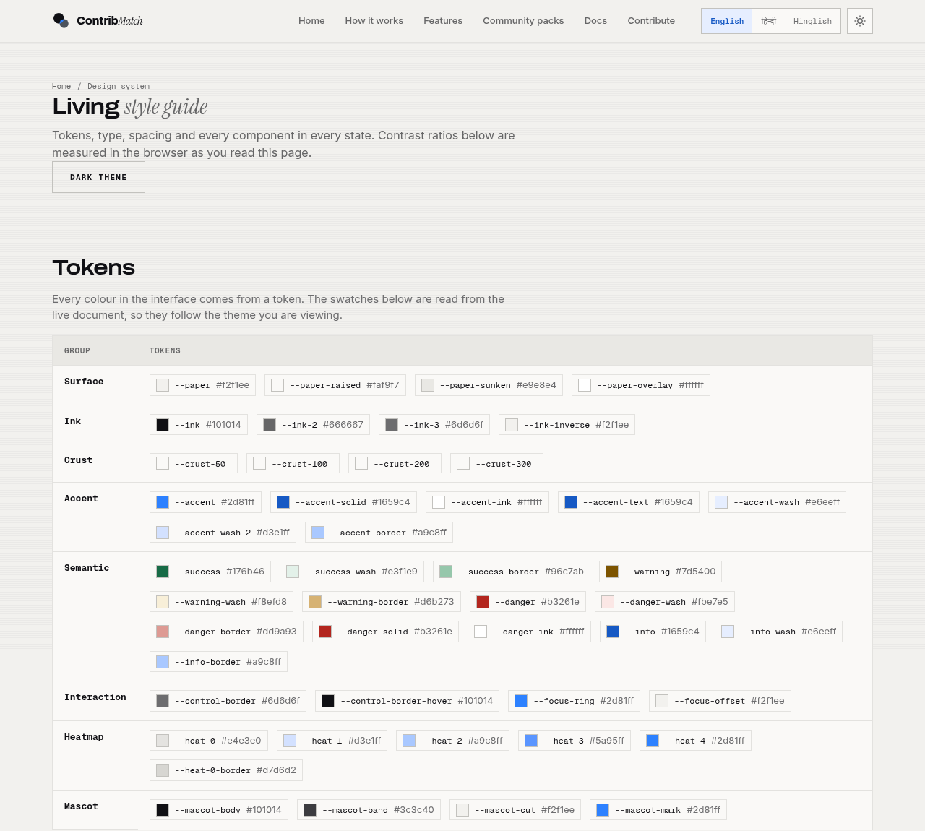
The interface
• Neutral, square, hairlines, one accent
• Depth from perspective and flat offset shadows, never from glow
• English, Hindi and Hinglish — including the generated notes
• Every control has six states and a 24px minimum target
• WCAG AA throughout; the audit runs on every page, in both themes
the interface
the interface
09
09

Slide 10
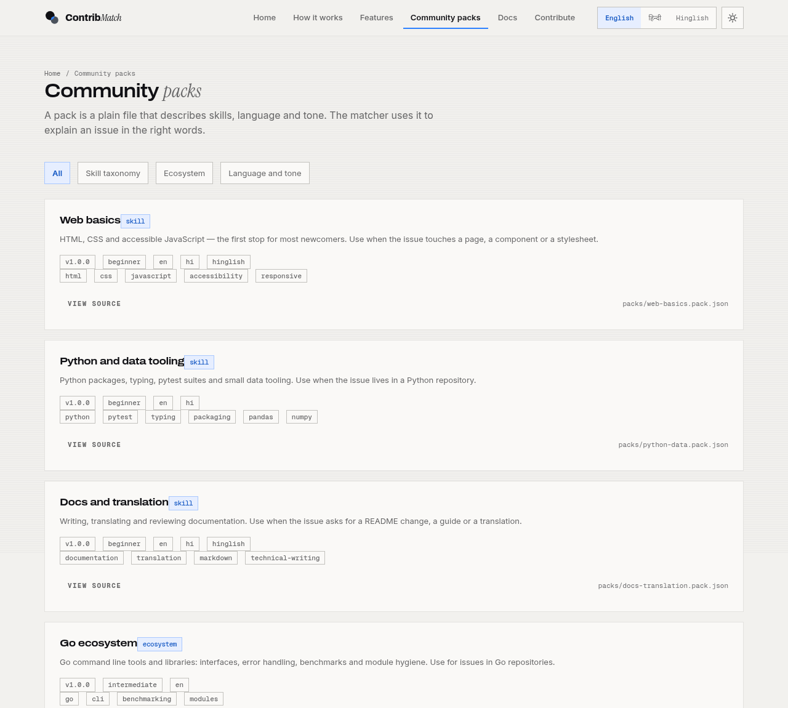
Community packs
{ "id": "web-basics", "type": "skill",
"skills": ["html", "css"] }
• A pack is a plain JSON or YAML file describing skills, tone and vocabulary for an ecosystem
• Five ship with the project
• npm run validate:packs checks them
• Adding one is a pull request, not a ticket — this is the collaboration model, not a feature list
community packs
community packs
10
10

Slide 11
Try it
git clone https://github.com/Tanmay-Tiwaricyber/contribmatch
cd contribmatch && npm install && npm run serve
LINKS
Live app
https://tanmay-tiwaricyber.github.io/contribmatch/
Repository
https://github.com/Tanmay-Tiwaricyber/contribmatch
Demo video
link to be added on submission
• npm test runs everything: the packs, the rules, the providers, the orchestrator, and the copy rules
• No key needed. Mock mode runs the whole flow offline.
• Gemma locally: ollama pull gemma3:4b
try it
try it
11
11

Slide 12
By design, not by accident
Five decisions that shape the product. Ask us about any of them.
01
The ranking is a rubric — every score traces to rules you can read, not a black-box guess.
02
Gemma refines and writes; the rules decide. Turn the model off and you still get a shortlist and a plan.
03
The graph always says what it covers — a token unlocks the exact year; without one you get 90 days of public events, clearly labelled.
04
Results are bounded by GitHub's own search index. Nothing is invented, and the static catalogue keeps good data flowing.
05
No backend and no write path: nothing is ever posted on your behalf. Every action stays yours.
design decisions
12

Slide 13
Find an issue you can actually finish.
Live: https://tanmay-tiwaricyber.github.io/contribmatch/ · Code: https://github.com/Tanmay-Tiwaricyber/contribmatch · Demo: [video link]
MIT licensed. Open-source because the contribution pipeline is the product, and the product should belong to the people building it.
Built by Tanmay Tiwari · Built for Hacktoberfest HackDays · Powered by open-weight Gemma
contribmatch · thank you
13

